Slide 1
GSICS Agency Report 2025
Eun-Jeong Cha, Euidong Hwang, Hanbyul Lee, Daehyeon Oh
Korea Meteorological Administration

Slide 2
Presentation Overview
GSICS Activities, Actions, and Achievements
Support to GDWG Activities
Support to GRWG Activities
Instruments Updates & Planned launches that are relevant to GSICS (stress new programs and significant accomplishments)
Calibration Major Updates

Slide 3
Summary of KMA’s GSICS Activities, Actions, and Achievements
Achievements Summary
Uncertainty Evaluation for AMI – IASI RAC product
Activities summary
GK2A AMI IR channels
Review the AMI IR products (NRTC, RAC) for MetOp-B/-C, NOAA-20/-21
Updated the recalibration coefficients of COMS/MI – GK2A/AMI
GK2A AMI VIS/NIR channels
Updated Ray-matching (SNPP, NOAA-20 and -21 VIIRS)
GSICS DCC (SNPP, NOAA-20 and -21 VIIRS)
Lunar calibration (GIRO)
=> IR session
=> VIS/NIR + Lunar
session

Slide 4
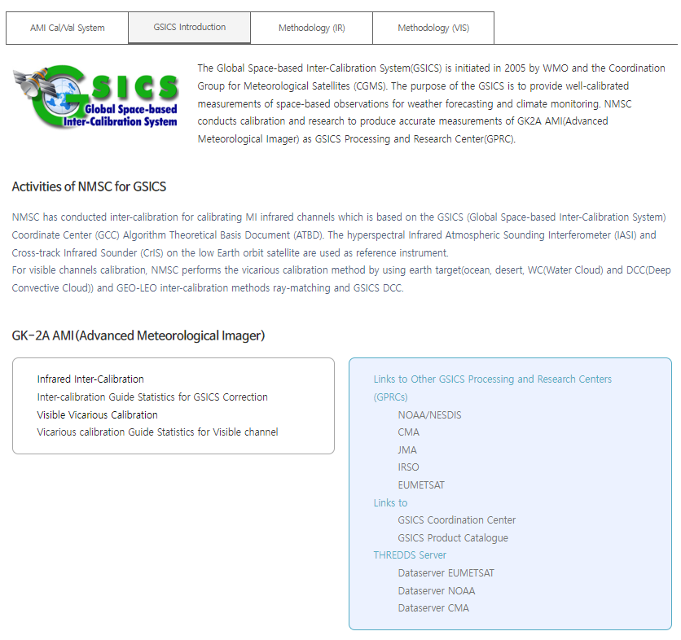
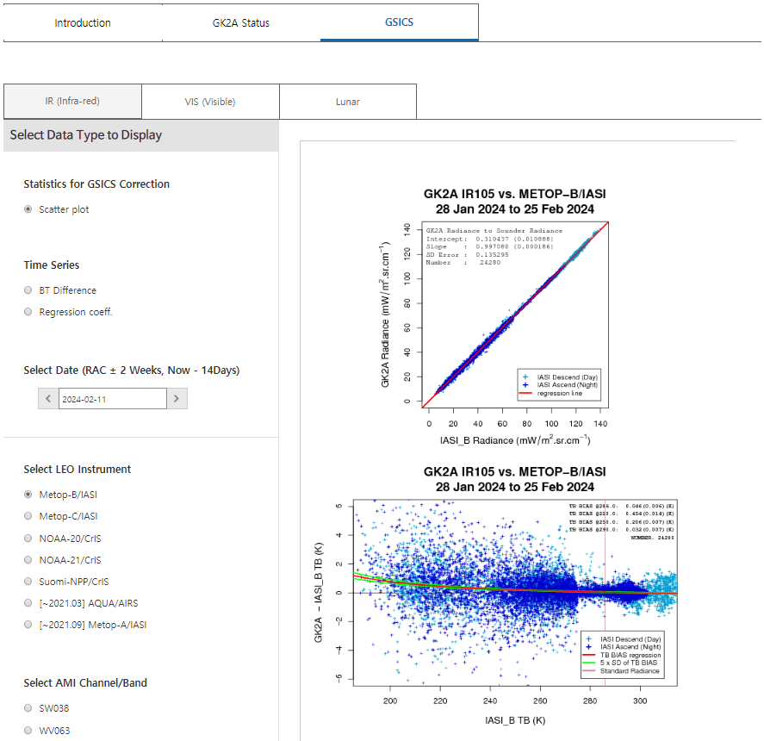
KMA’s Support to GDWG Activities
KMA GPRC Webpage
Landing page
https://nmsc.kma.go.kr/homepage/html/gsics/gsicsIntro.do (Korean, now open)
http://nmsc.kma.go.kr/enhome/html/main/main.do (English, will be updated soon)
Event logging: http
http://nmsc.kma.go.kr/enhome/html/bbs/listNotice.do?bbsCd=00026
GSICS monitoring pages
IR (Metop-a/b/c IASI, NOAA-20/21, S-NPP CrIS)
VIS Ray Matching(Terra MODIS, S-NPP, NOAA-20/21 VIIRS)
Lunar(GIRO)

Slide 5
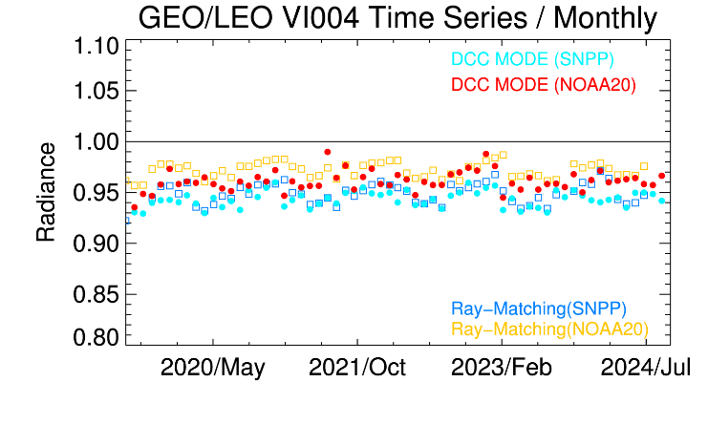
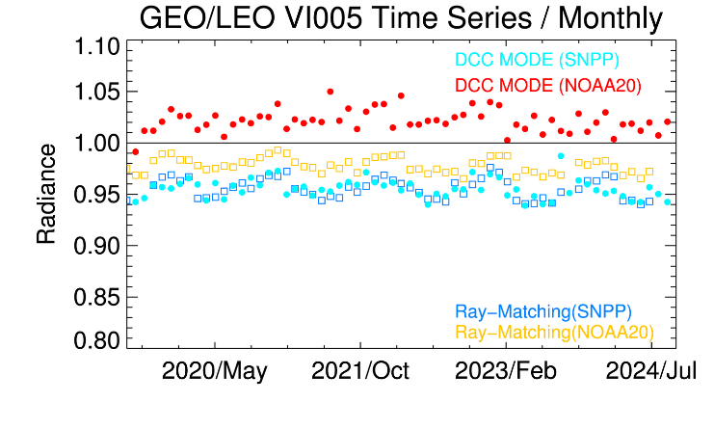
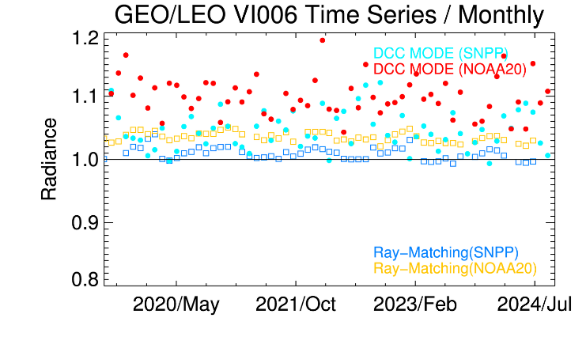
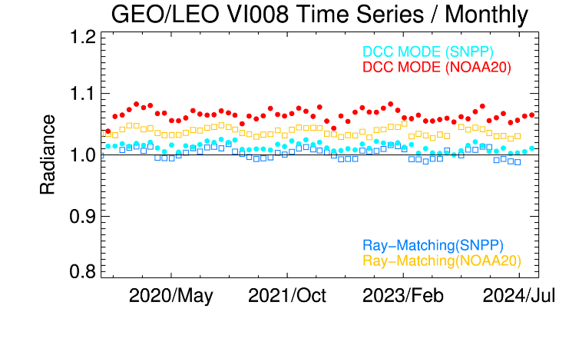
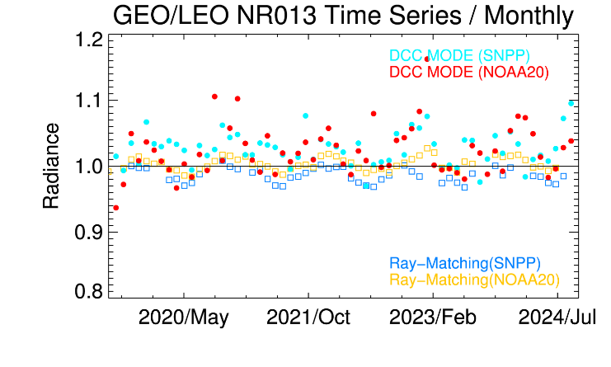
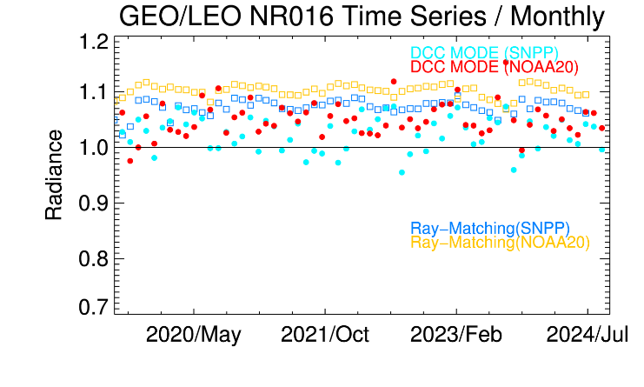
KMA’s Support to GRWG Activities (1)
VIS/NIR
Monitoring of GEO-LEO using Terra MODIS, S-NPP and NOAA-20/21 VIIRS
Analyze Ray-Matching and GSICS DCC for long-term variation from September in 2019
※ Ray-Matching calibration data selected for DCC target
-> AMI and VIIRS Reflectance : < 0.8 for VIS band, < 0.6 and < 0.1 for NIR band

Slide 6
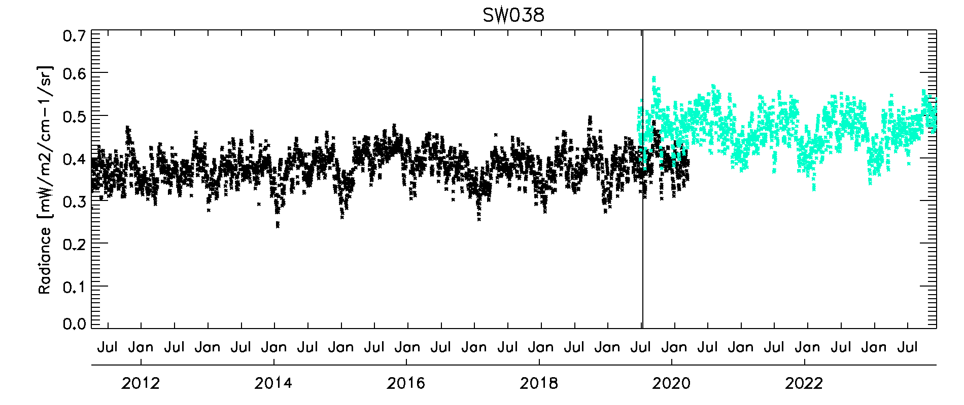
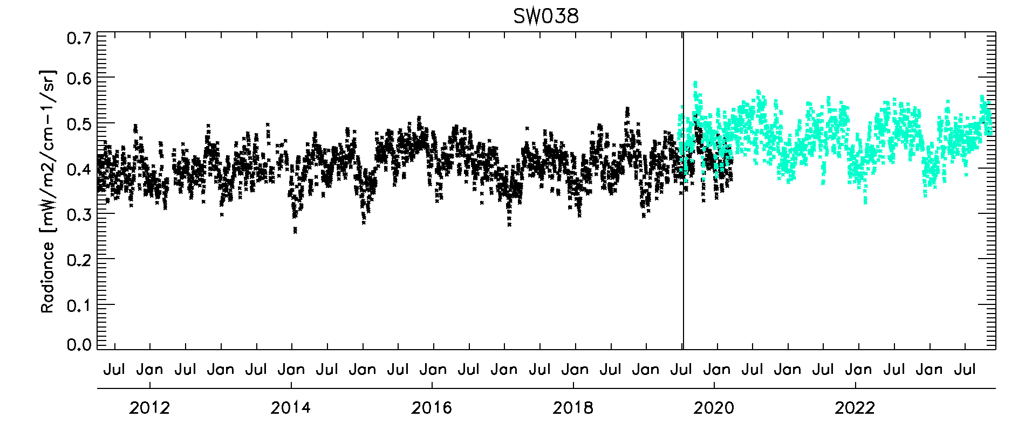
KMA’s Support to GRWG Activities (2)
IR
Monitoring of GEO-LEO using MetOp-B, -C/IASI, NOAA-20, -21/CrIS
Application of gap-filling method to inter-calibrate with CrIS
Demo phase for NRTC and RAC data (MetOp-B, -C/IASI, NOAA-20, -21/CrIS)
Reprocessing the long-term data from COMS/MI – GK2A/AMI
Update the recalibration coefficients for 3.8µm channel
Reduced sensor to sensor jump
Original rad.
SW038
Re-cal. rad.
SW038
COMS
GK2A
Reduced
sensor to sensor jump

Slide 7
GEO satellite program updates
GK5 Imager
Wavelength(㎛) | Resolustion(km)
0.47 | 0.5
0.64 | 0.25
0.86 | 0.5
0.91 | 1
1.38 | 2
1.61 | 1
2.25 | 1
3.9 | 1
5.1 | 1
6.2 | 2
6.9 | 1
7.3 | 2
8.5 | 2
9.6 | 2
10.4 | 1
11.2 | 2
12.3 | 2
13.3 | 2
GEO-KOMPSAT-2A (GK2A)
AMI started meteorological observations in July 2019 and is scheduled to continue until 2031
Payloads
AMI is a meteorological imager that has 16 channels spread over the VIS/IR wavelength
KSEM is a space weather monitor (Electron/Proton detectors and Magnetometer)
GEO-KOMPSAT-5 (GK5)
GK5 development started in 2025 and is scheduled for launch in 2031
Payloads
GK5 imager has 18 channels spread over VIS/IR wavelength (some channels improved on spatial resolution)
GK5`s space weather monitor consists of 4 sensors*
* Electron/Proton detectors, Magnetometer and Satellite Charging Monitor
excluded 0.51µm in GK2A
 | 2024 | 2025 | 2026 | 2027 | 2028 | 2029 | 2030 | 2031 | 2032 | 2033 | 2034 | 2035 | 2036
GK2A
GK5
Operation
Extended Op.
Main Development Phases
Operation for 10 years
Launch

Slide 8
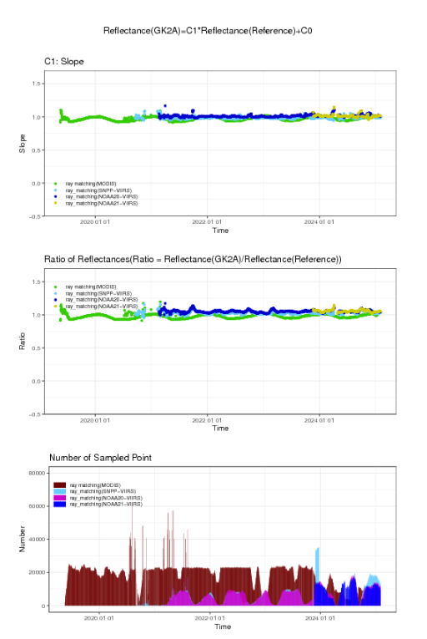
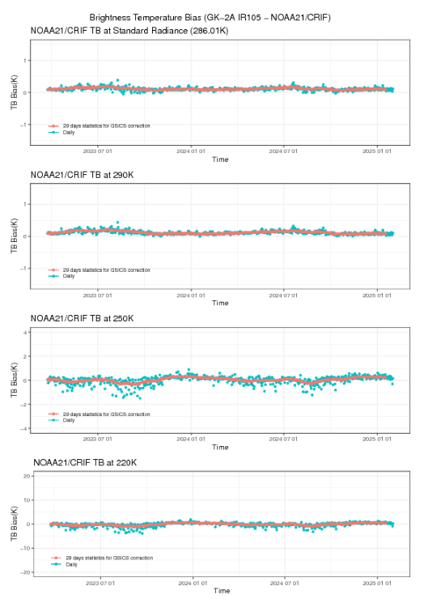
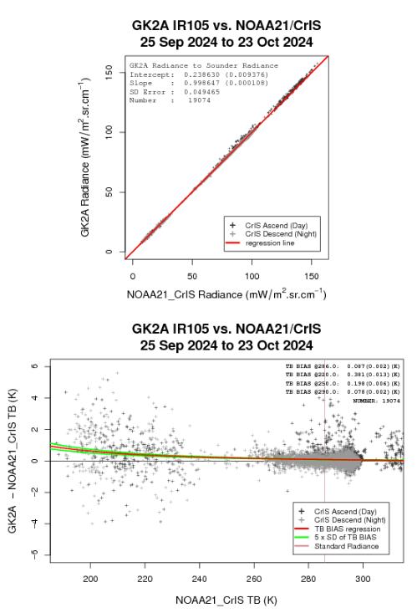
KMA’s Calibration Major Updates
NOAA21-VIIRS/CrIS as reference has been added
ray_matching(MODIS)
ray_matching(SNPP_VIIRS)
ray_matching(NOAA20_VIIRS)
ray_matching(NOAA21_VIRRS)
ray_matching(MODIS)
ray_matching(SNPP_VIIRS)
ray_matching(NOAA20_VIIRS)
ray_matching(NOAA21_VIRRS)

Slide 9
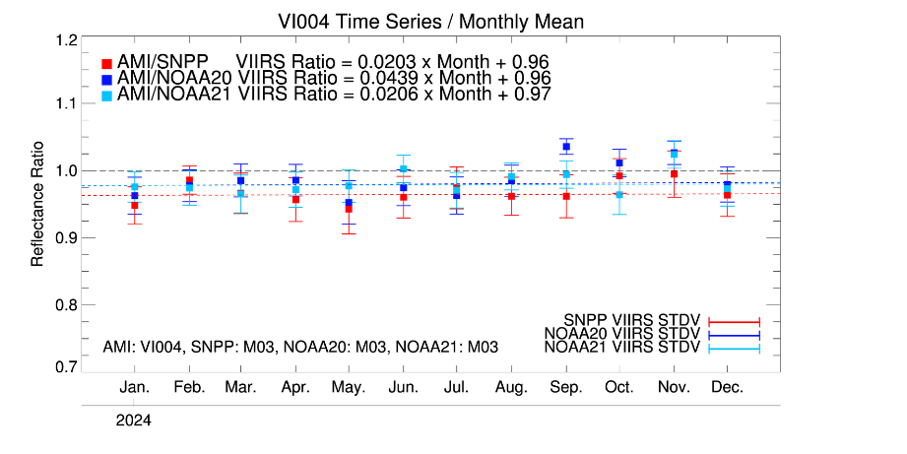
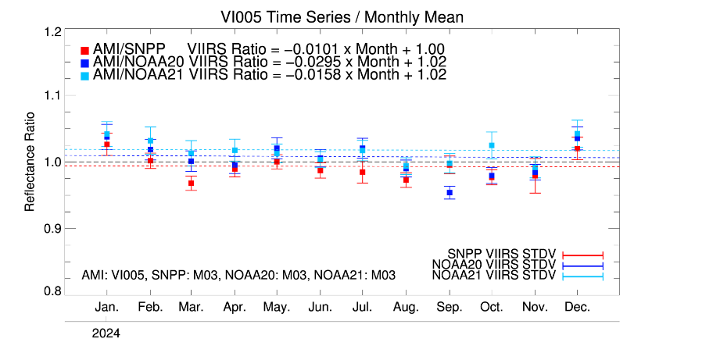
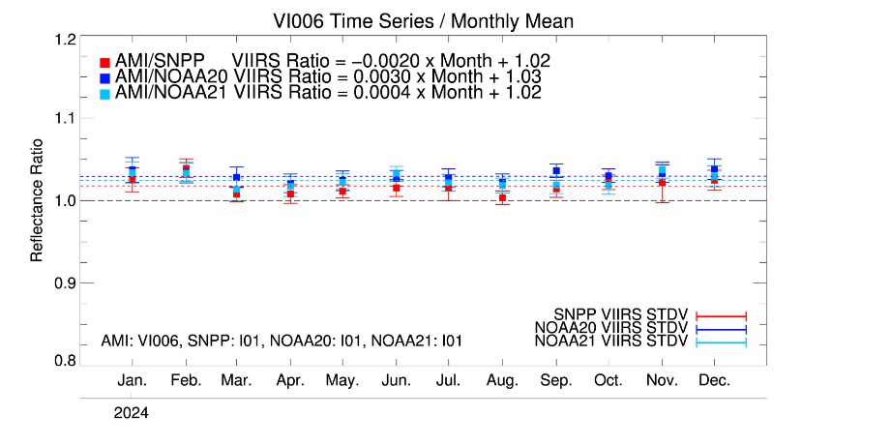
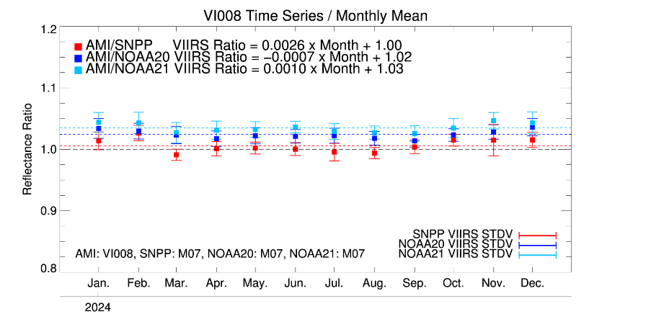
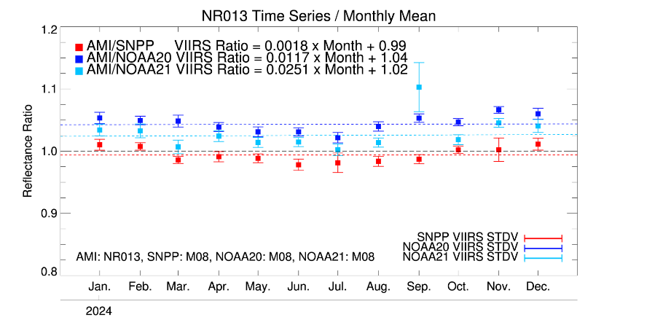
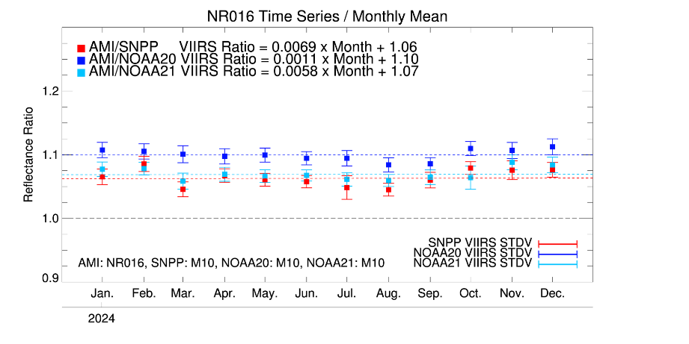
KMA’s Calibration Results (VIS/NIR) (1)
January to December 2024
Reference Satellite | Mean Bias (Uncertainty)
 | VI004_0.47 μm | VI005_0.51 μm | VI006_0.64 μm | VI008_0.86 μm | NR013_1.37 μm | NR016_1.61 μm
S-NPP/VIIRS | -4.20 (±2.21) | -0.71 (±1.15) | 1.07 (±1.07) | 0.04 (±1.14) | -2.11 (±0.74) | 5.20 (±0.98)
NOAA-20/VIIRS | -2.49 (±1.87) | 1.15 (±1.19) | 2.67 (±1.02) | 1.88 (±1.19) | 2.82 (±0.65) | 8.61 (±1.04)
NOAA-21/VIIRS | -2.19 (±1.75) | 1.59 (±1.23) | 2.13 (±1.00) | 2.60 (±1.20) | 0.55 (±0.71) | 6.00 (±0.97)

Slide 10
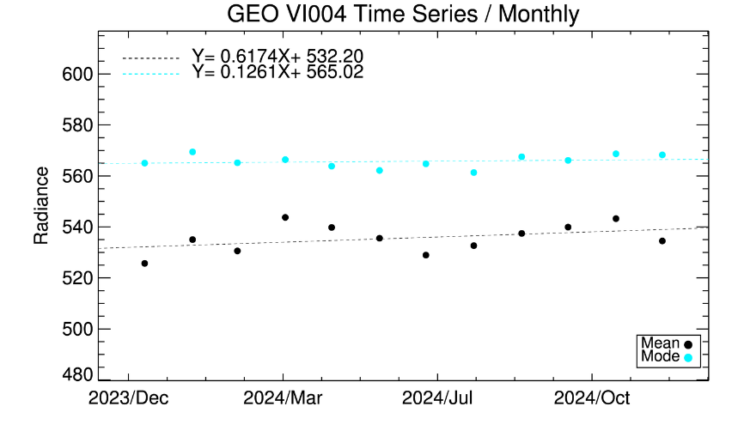
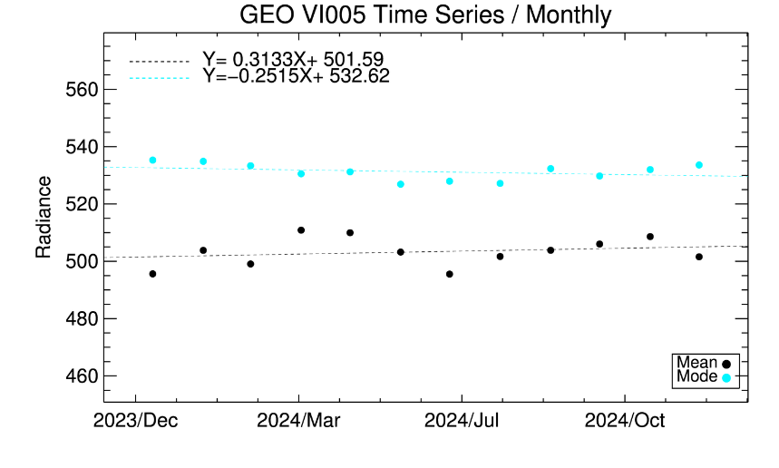
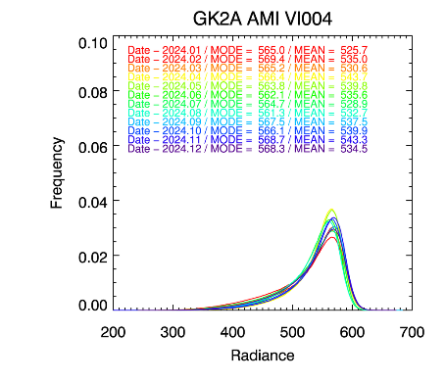
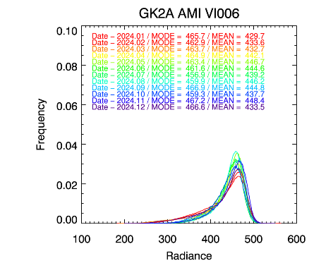
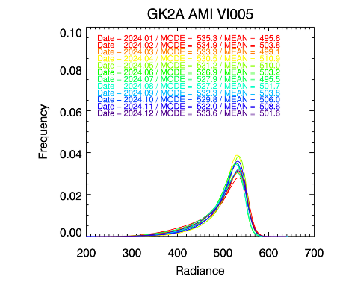
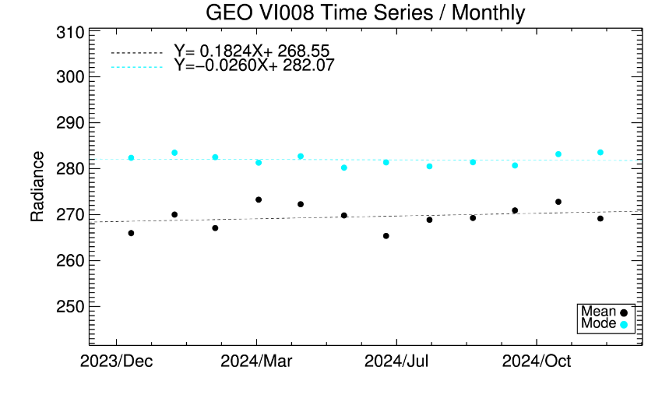
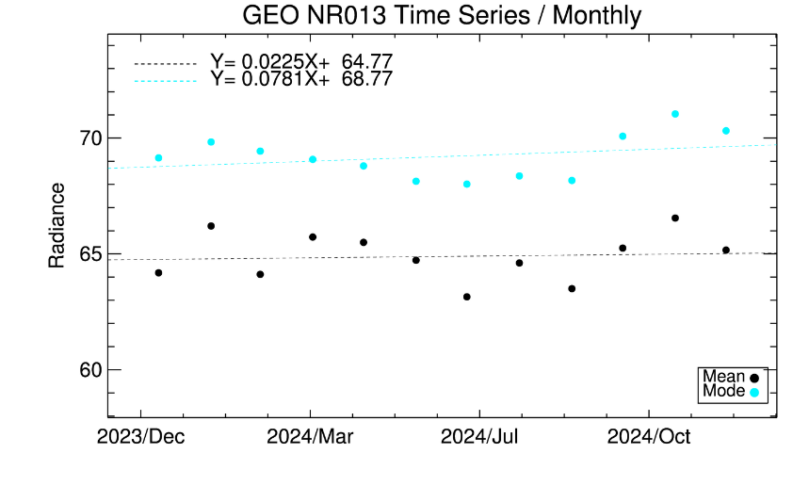
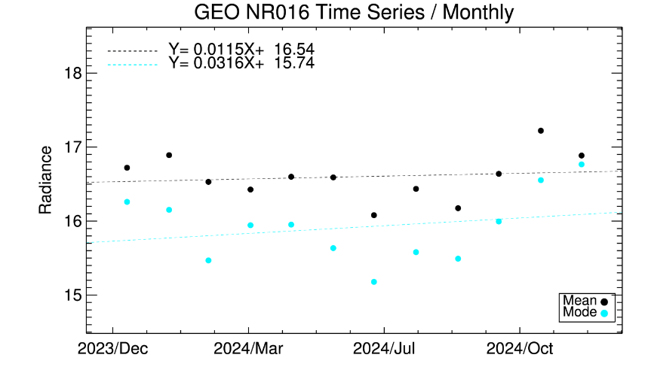
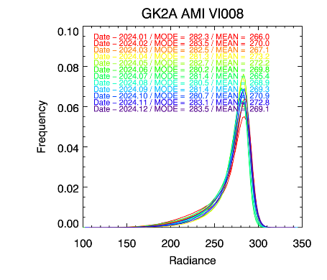
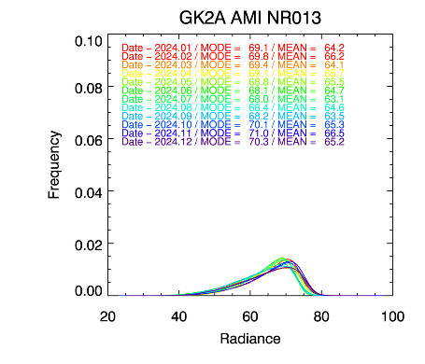
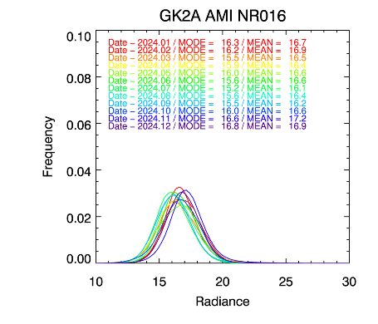
KMA’s Calibration Results (VIS/NIR) (2)
GSICS DCC radiance mode and mean time series and histogram in 2024

Slide 11
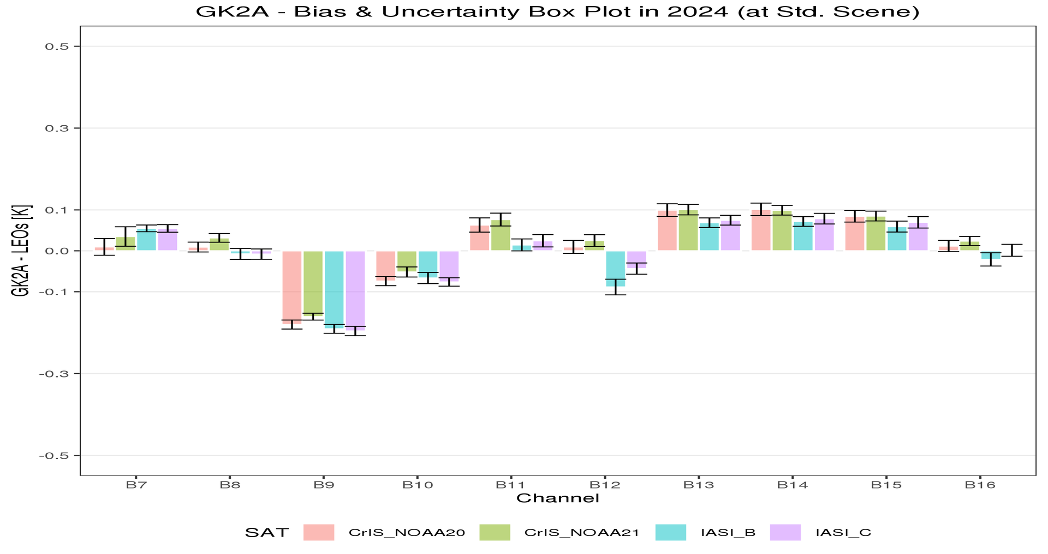
KMA’s Calibration Results (IR)
Statistical Summary of GK2A/AMI IR Calibration Performance in Jan. 1 ~ Dec. 31, 2024
GK2A AMI IR channels are stable
GK2A AMI has relatively large negative bias around -0.2K for 6.9µm, while the other channels are blow ±0.1K
Reference Satellite |  | Bias (Uncertainty)
 |  | SW038 (3.8㎛) | WV063 (6.3㎛) | WV069 (6.9㎛) | WV073 (7.3㎛) | IR087 (8.7㎛) | IR096 (9.6㎛) | IR105 (10.5㎛) | IR112 (11.2㎛) | IR123 (12.3㎛) | IR133 (13.3㎛)
CrIS | NOAA-20 | 0.01 (±0.02) | 0.01 (±0.01) | -0.18 (±0.01) | -0.07 (±0.01) | 0.06 (±0.02) | 0.01 (±0.02) | 0.10 (±0.02) | 0.10 (±0.02) | 0.08 (±0.01) | 0.01 (±0.01)
 | NOAA-21 | 0.03 (±0.02) | 0.03 (±0.01) | -0.16 (±0.01) | -0.05 (±0.01) | 0.08 (±0.02) | 0.03 (±0.01) | 0.10 (±0.01) | 0.10 (±0.01) | 0.08 (±0.01) | 0.02 (±0.01)
IASI | Metop-B | 0.05 (±0.01) | -0.01 (±0.01) | -0.19 (±0.01) | -0.07 (±0.01) | 0.01 (±0.01) | -0.09 (±0.02) | 0.07 (±0.01) | 0.07 (±0.01) | 0.06 (±0.01) | -0.02 (±0.02)
 | Metop-C | 0.05 (±0.01) | -0.01 (±0.01) | -0.20 (±0.01) | -0.08 (±0.01) | 0.02 (±0.02) | -0.04 (±0.01) | 0.07 (±0.01) | 0.08 (±0.01) | 0.07 (±0.01) | 0.00 (±0.01)
Standard Temp.(K) |  | 285.9 | 234.9 | 244.1 | 254.5 | 283.7 | 259.1 | 286.1 | 286.0 | 283.8 | 269.4

Slide 12
Q & A

Slide 13
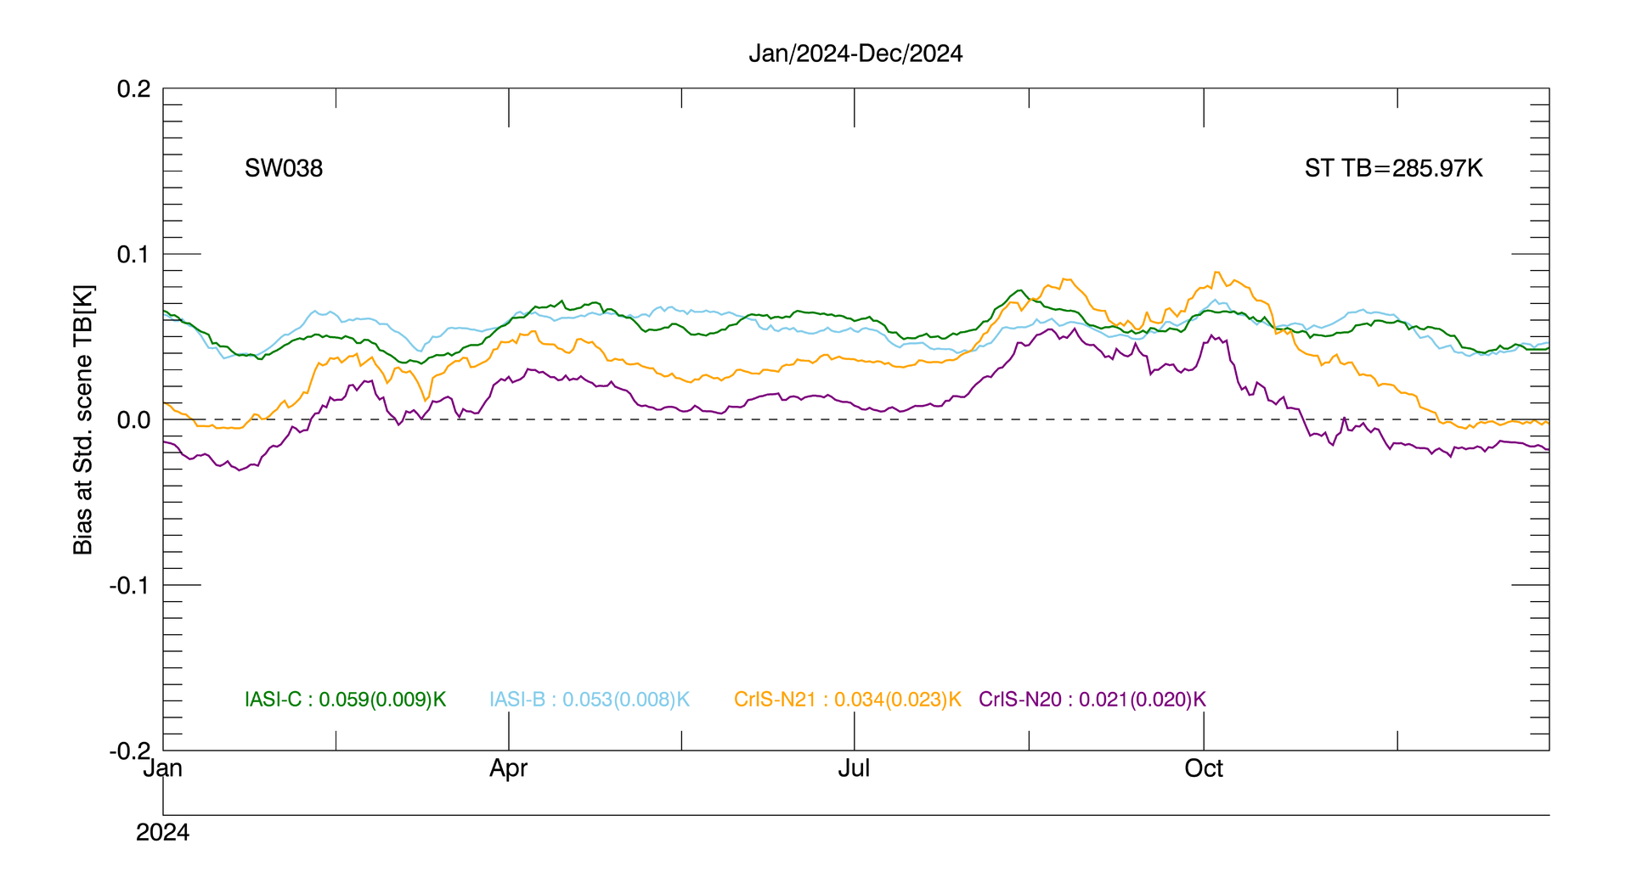
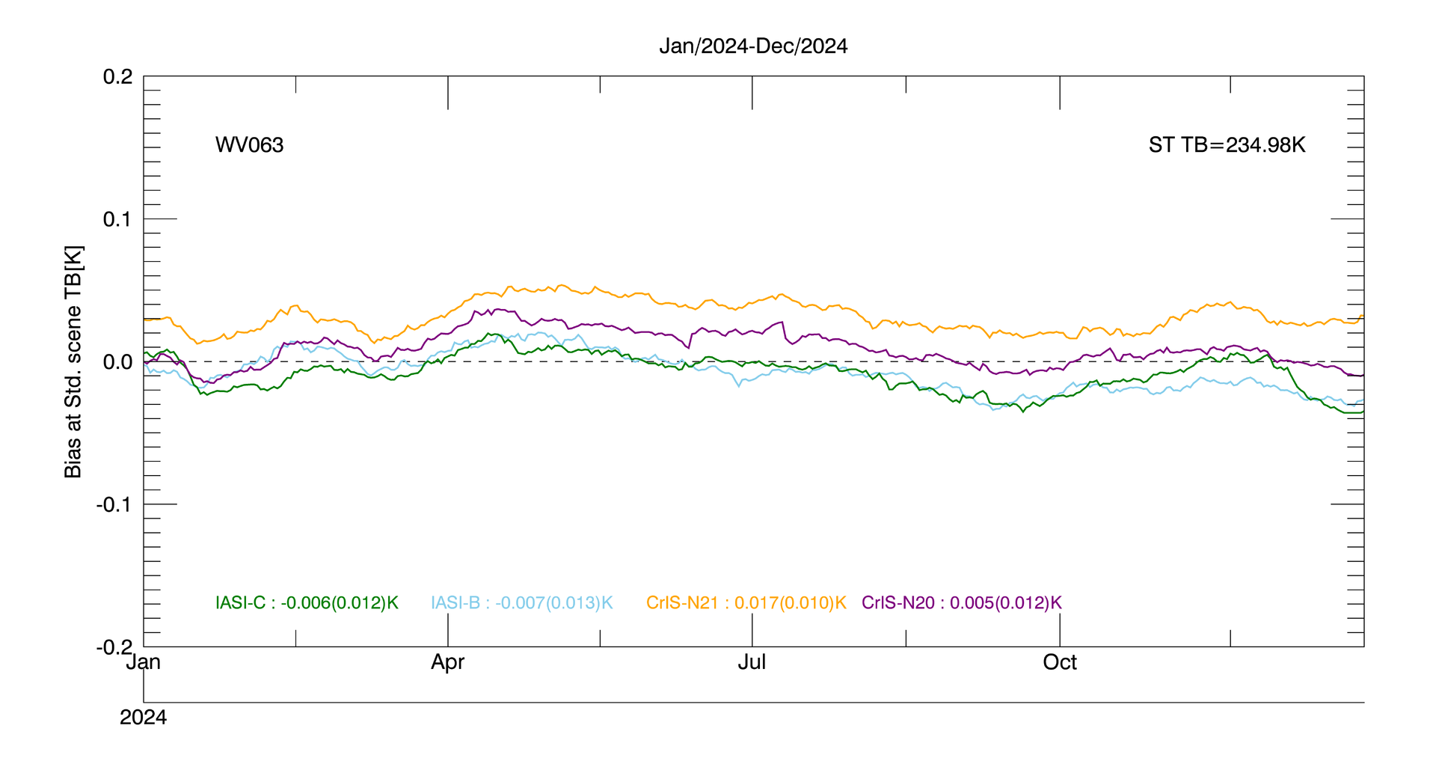
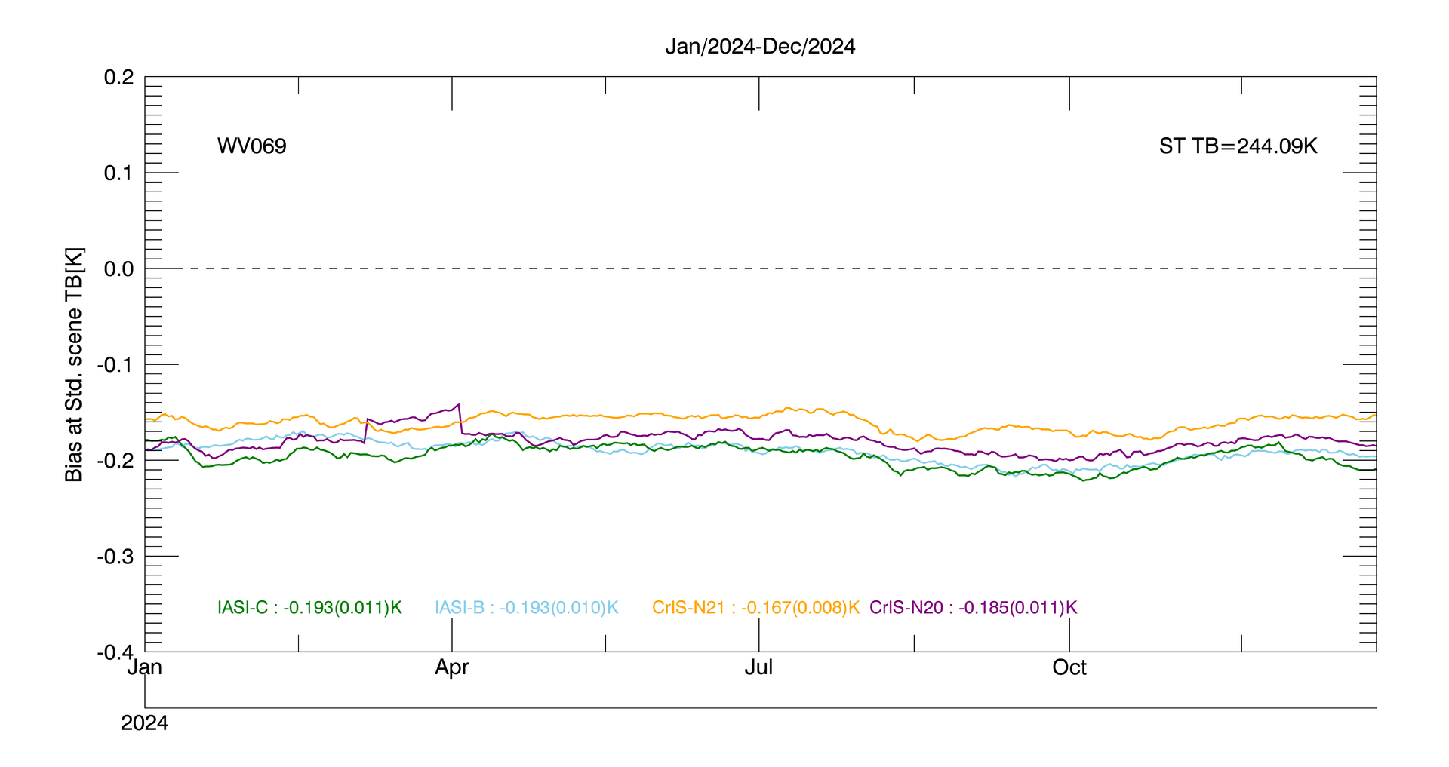
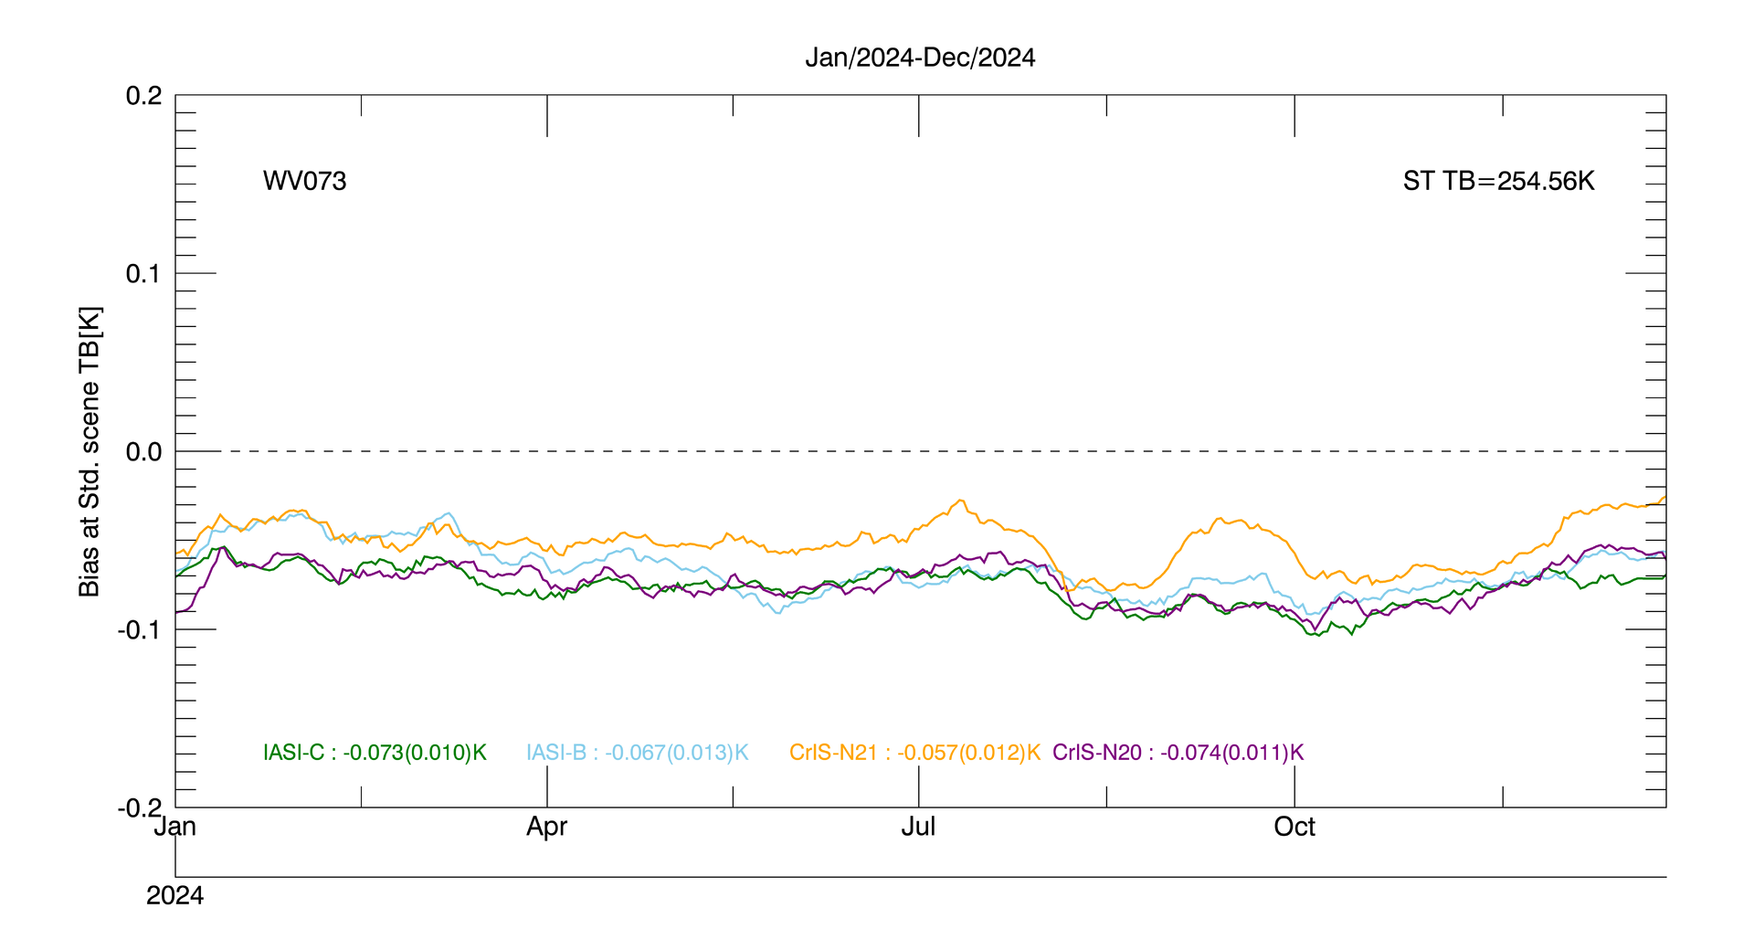
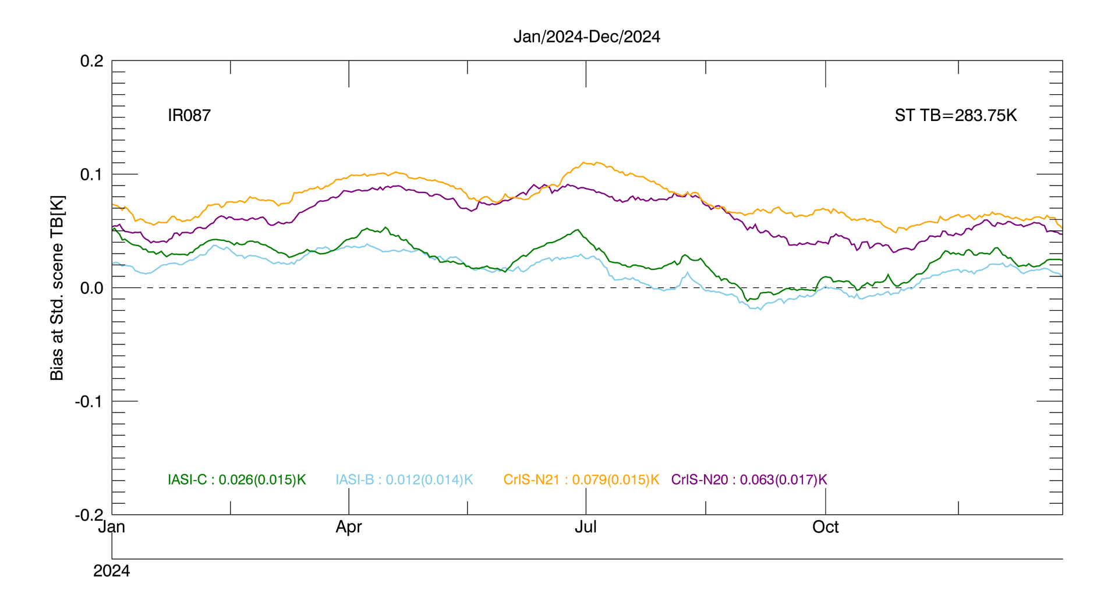
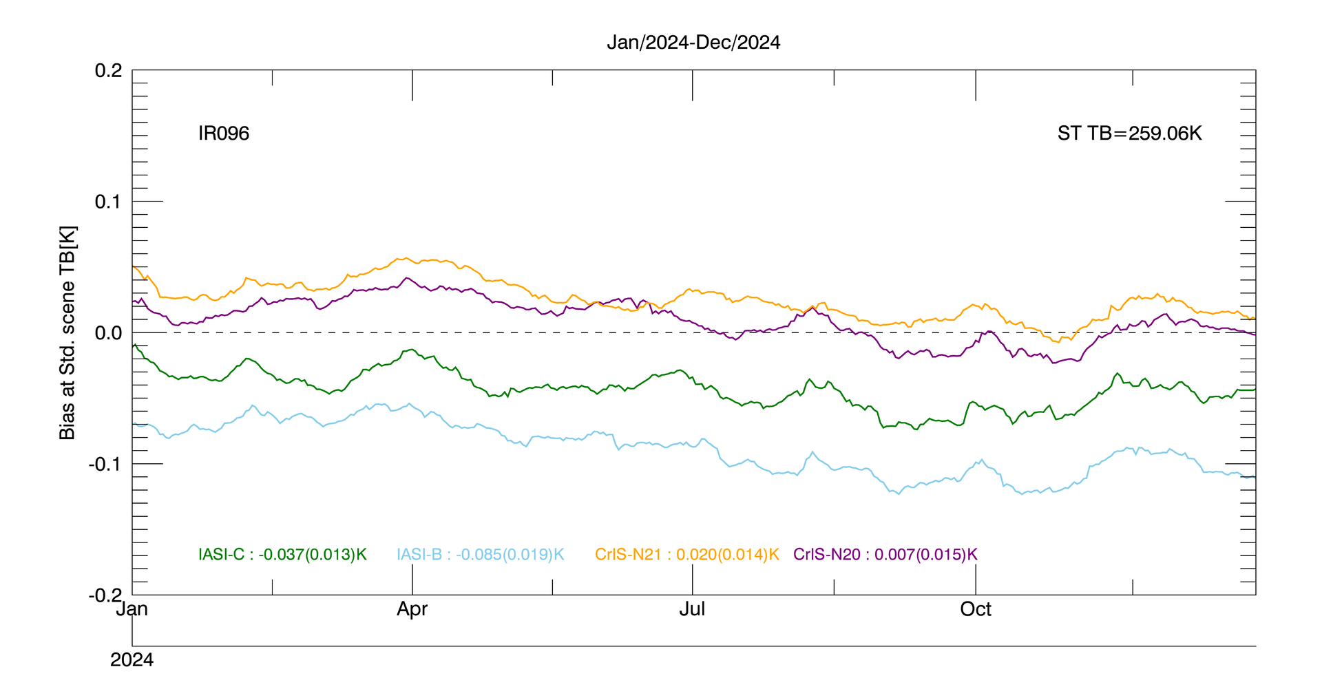
KMA’s Calibration Results (IR)

Slide 14
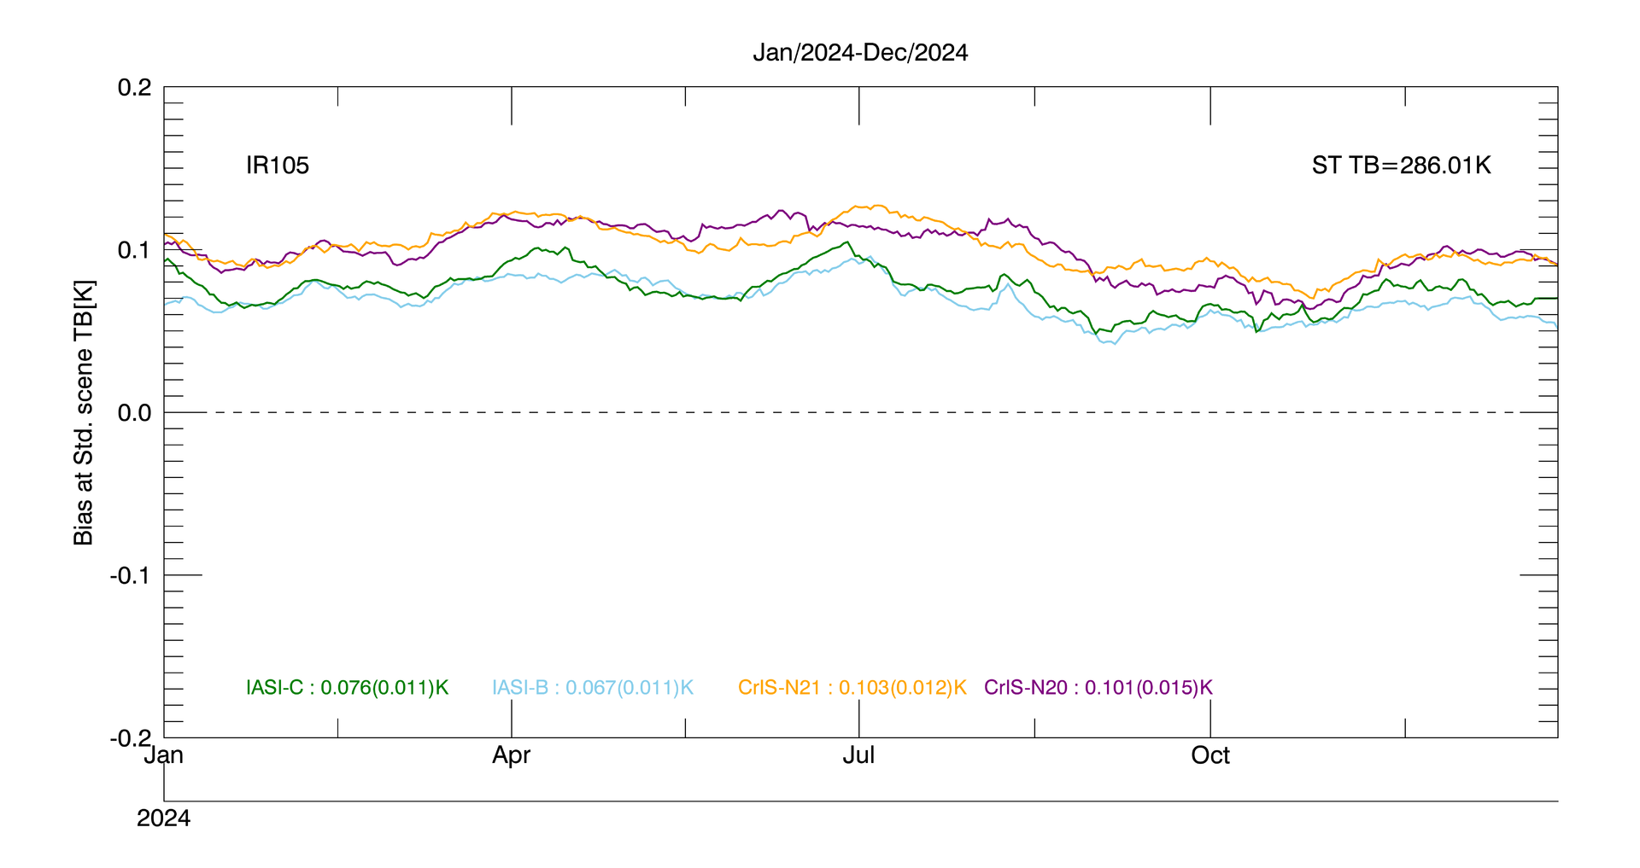
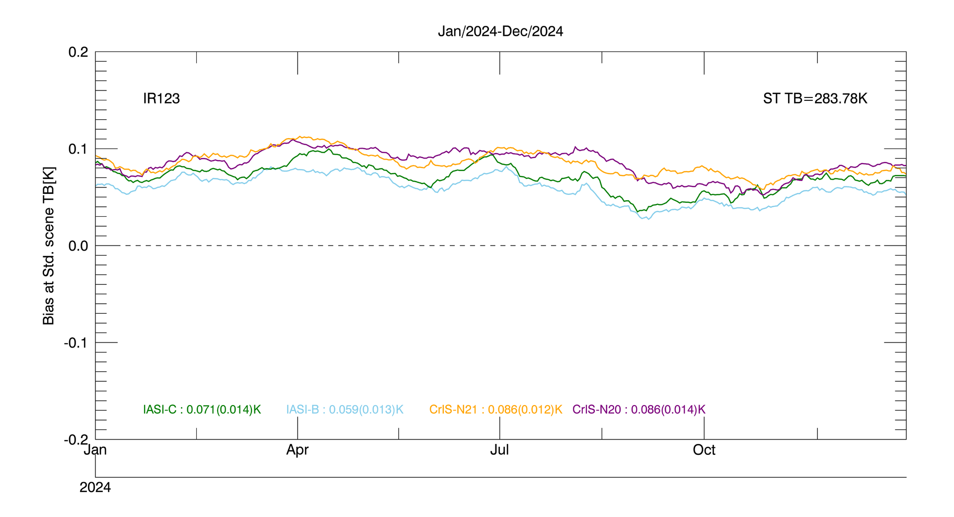
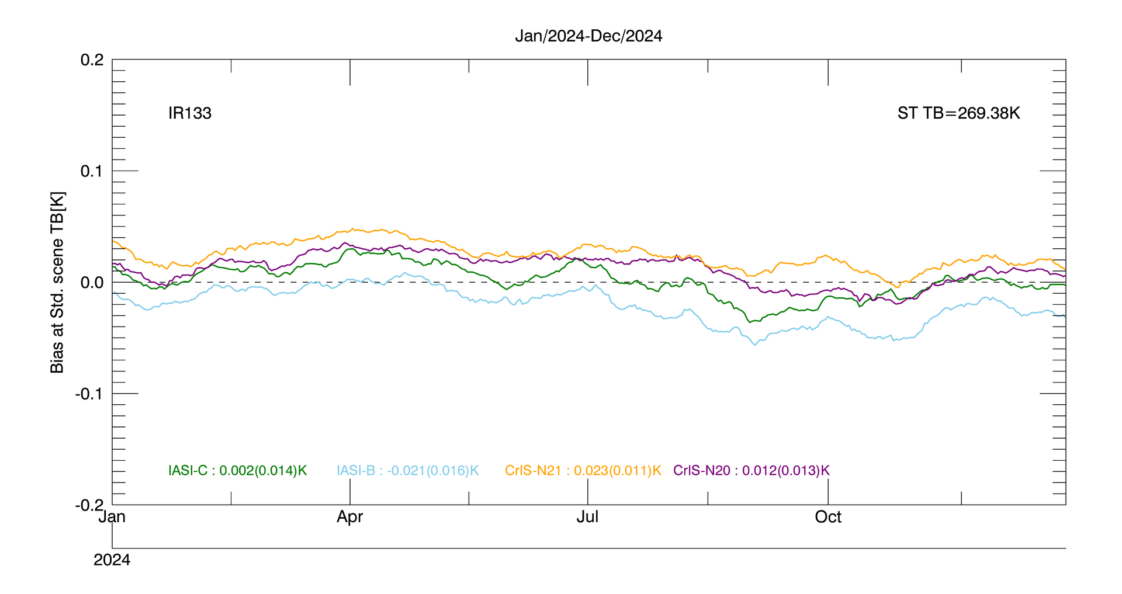
KMA’s Calibration Results (IR)

