Slide 1

GSICS Agency Report
2025
Lei DING
Contributor: Shijie XIN, Yang WANG, Chunyuan SHAO, etc.
Shanghai Institute of Technical Physics, CAS
（SITP）

Slide 2
Presentation Overview
Summary of Agency’s GSICS Activities, Actions, and Achievements
Agency’s Support to EP Activities
Agency’s Support to GDWG Activities
Agency’s Support to GRWG Activities
Agency’s Instruments Updates & Planned launches that are relevant to GSICS (stress new programs and significant accomplishments)
Agency’s Calibration Major Updates

Slide 3
Activities and Achievements
Reprocessing FY-3G HAOC calibration data
Inter-Sensor Comparison using HAOC data
Pre-launch calibration for FY-3H MERSI, FY-3H HIRAS, FY-3H GAS, DQ-2/HIACS
Developing Infrared Benchmark instrument

Slide 4
Participation in EP, GDWG, GRWG
Points of contacts/meeting participants:
  EP: Lei Ding
  GDWG:
  GRWG:
Main contribution to GDWG actions
  …
Main contribution to GRWG actions
  Calibration for instrumens, FY-3H, FY-4C, DQ-2
Comments, feedback
  …..

Slide 5
Summary of SITP’s GSICS Activities
Payloads under construction
  Enhanced AGRI, GIIRS onboard FY-4C, planned to be launched in 2025.
  MERSI-III, HIRAS-II, GAS-2(Greenhouse-Gas Absorption Spectrometer) onboard FY-3H , planned to be launched in 2025
  Enhanced AGRI, GIIRS onboard FY-4D, scheduled to be launched in 2026.
  MERSI-LL, HIRAS-II onboard FengYun 3J, scheduled to be launched in 2026.
  Enhanced AGRI, GIIRS onboard FY-4E, scheduled to be launched in 2027.
  MERSI-RM, HAOC(High Accuracy On-board Calibrator) onboard FY-3I (Rainfall) mission, scheduled to be launched in 2027;
  Infrared Benchmark Payload, scheduled to be launched around 2027;

Slide 6
Summary of SITP’s GSICS Activities
Operational service
  AGRI, GIIRS,GHI onboard FengYun 4B, launched in June 2021.
  MERSI-LL, HIRAS-II onboard FengYun 3E, launched in July 2021.
  AHSI (Advanced Hyperspectral Imager) onboard GaoFen 5-02, launched in Sept. 2021.
  Thermal Infrared sensor onboard SDGSAT-1(CASEarth), launched in Nov. 2021.
  AHSI onboard ZY-1 02E (Ziyuan-1 02E) launched in Dec. 2021;
  WSI(Wide-field-of-view Spectral Imager) onboard DaQi-1 launched in April 2022;
  AHSI (Advanced Hyperspectral Imager) onboard GF-5 01A mission, launched in Dec. 2022;
  MERSI-RM, HAOC(High Accuracy On-board Calibrator), PMAI onboard FY-3G(Rainfall) mission, launched in April 2023;
  MERSI-III, HIRAS-II, ERM onboard FY-3F(AM), launched in July 2023;
  PMRIS(Programmable Medium Resolution Imaging Spectrometer) onboard HY-3A(HaiYang 3A) mission, launched in Noverber 2023;

Slide 7
HIRAS-II onboard FY-3
Compared with the FY-3D/HIRAS HIRAS-II focuses on improving the detection sensitivity, spectral and radiative accuracy.
The observation time of each scan line of HIRAS-II is changed from 10 to 8 seconds, the view angle is changed from 1.1 to 1 degree and the nadir spatial resolution improved from 16 to 14 km.
In addition, the detector array is changed from 2×2 to 3×3.
The observed spectra of the instrument are divided into three infrared bands: long wave (LW), medium wave 1 (MW1) and medium wave 2(MW2).
The maximum optical path difference of the interferometer is 0.8cm, which will produce a basic resolution of 0.625cm⁻¹.
Parameters | Specification
Scan Period | 8s
FOV size | 1°
Pixels per scan line | 252 (9 FOVs x 28 FORs)
Maximum scan angle | ± 48.6°
Nadir spatial resolution | 14km
detectors define | 3*3
Direction pointing bias | ＜0.06°
Band | Spectral Range (cm⁻¹) | Spectral Resolution (cm⁻¹) | Sensitivity NEΔT@280K | Radiometric accuracy | Spectral accuracy
LW | 650～1136 （15.38μm～8.8 μm） | 0.625 | 0.2～0.8K | 0.4～1K | 7ppm/ 5ppm
MW1 | 1210～1750 （8.26μm～5.71 μm） | 1.25(0.625) | 0.2～0.3K | 0.4～0.5K
MW2 | 2155～2550 （4.64μm～3.92 μm） | 2.5(0.625) | 0.3～0.5K | 0.5～0.6K

Slide 8
Calibration of HIRAS-II
FY-3H/HIRAS-II Spectral calibration
FOV | FOV1 | FOV2 | FOV3 | FOV4 | FOV5 | FOV6 | FOV7 | FOV8 | FOV9
LW pre-launch/ppm | 0.84 | -3.58 | 1.26 | -2.63 | 0.84 | 1.05 | 2.42 | 0.21 | 2.63
MW1 pre-launch/ppm | 1.85 | 1.31 | -0.85 | 3.17 | 0.93 | 3.01 | -1.00 | 3.17 | -2.86
MW2 pre-launch/ppm | 2.97 | -3.34 | -1.10 | 2.42 | -2.42 | -0.18 | 3.93 | 3.84 | -0.73
Spectral calibration biases are within 4 ppm after off-axis parameters adjustment in LW, MW1 and MW2 bands.
DQ-2/HIACS Spectral calibration
FOV | FOV1 | FOV2 | FOV3 | FOV4 | FOV5 | FOV6 | FOV7 | FOV8 | FOV9
LW pre-launch/ppm | -0.84 | -2.73 | 1.684 | -1.68 | 0.421 | 0.842 | 0.526 | -1.89 | 1.68
MW1 pre-launch/ppm | 0.15 | 0.07 | 2.62 | -2.47 | -0.30 | -0.30 | -0.23 | 0.38 | 0.07
MW2 pre-launch/ppm | -0.86 | -1.73 | -0.22 | 1.14 | -0.77 | 0.59 | -1.73 | 1.60 | 0.32
Spectral calibration biases are within 3 ppm after off-axis parameters adjustment in LW, MW and SW bands.

Slide 9
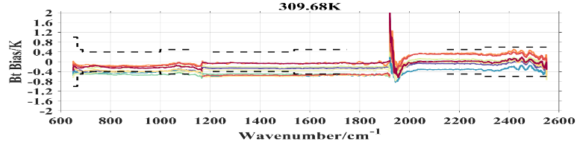
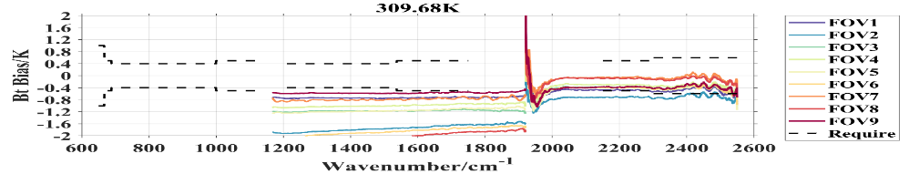
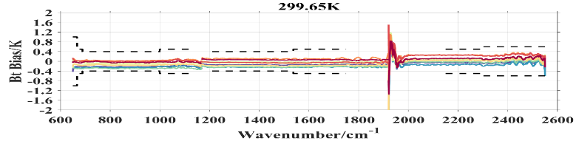
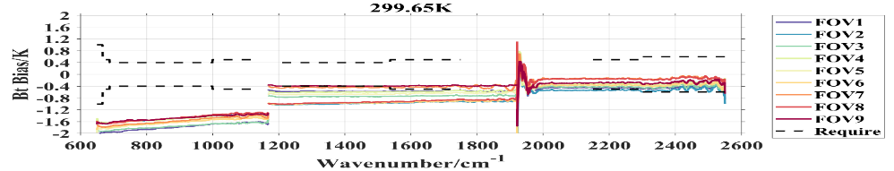
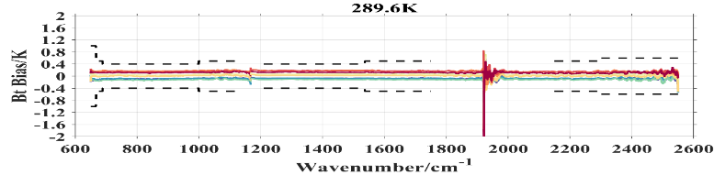
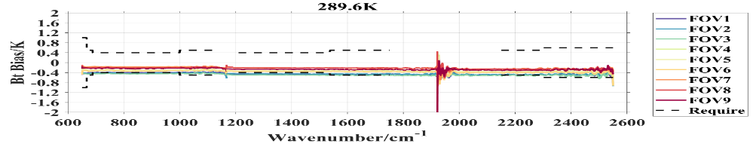
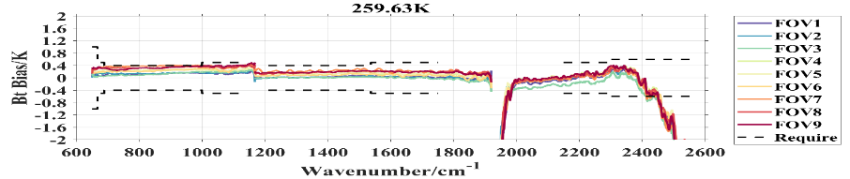
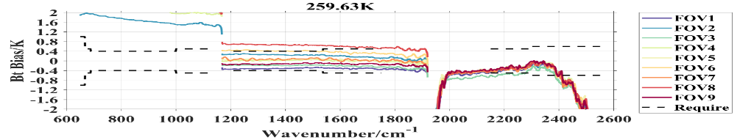
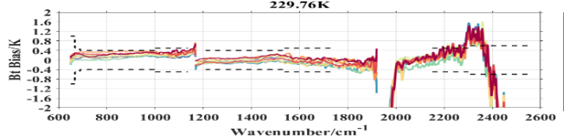
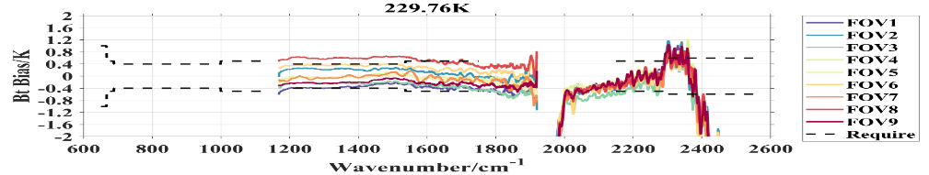
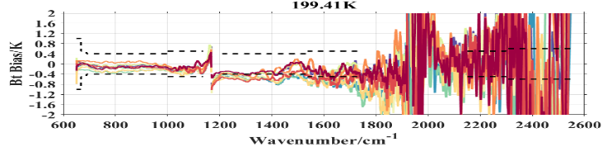
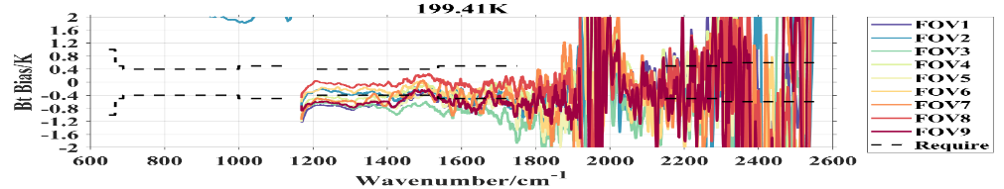
Calibration of HIRAS-II
FY-3H/HIRAS-II Radiometric calibration
pre-launch test
Before Non-Linearity Correction
After Non-Linearity Correction
LW and MW1 exhibit obvious Non-Linearity characteristics.
• After NL correction, LW and MW1 channels calibration biases are within 0.5 K.
• MW2 without NL correction, but displays abnormal large bias structure due to weak sigal and large noise for low temperature

Slide 10
DQ-2/HIACS Radiometric calibration
pre-launch test
Before Non-Linearity Correction
After Non-Linearity Correction
LW exhibit obvious Non-Linearity characteristics.
After NL correction, LW MW and SW channels calibration biases are within 0.2~0.5 K.

Slide 11
Infrared Benchmark Payload
Progress & Achievements
Uncertainty evaluation of space infrared radiation benchmark payload
Uncertainty System Analysis
Type | Items | Uncertainty Sources
Radiometric Calibration Uncertainty | u(T_{R,ICT}) | System temperature stability and non-uniformity
 | u(T_{R,ST})
 | u(a₂) | FTS uncertainty relation
 | u(C_{ICT}) | Interferometric efficiency uncertainty, detector temperature stability, measured complex spectral noise
 | u(C_{ECT})
 | u(C_{ST})
 | u(V_{ICT})
 | u(V_{ECT})
 | u(V_{ST})
 | SCR*R_{ECT} | Stray light
Uncertainty of infrared radiation reference source | Temperature u1 | Thermometer calibration, phase change reproducibility, temperature control stability, temperature uniformity, measurement noise
 | Emissivity u2 | Blackbody temperature, heated halo temperature & emissivity, ambient temperature, radiation measurement noise, radiation angle coefficient
 | Ambient temperature u3 | measurement noise
The uncertainty u_{a2} of the nonlinearity of the system response is recorded as the uncertainty of the nonlinear contribution a2.
The combined uncertainty of the DC quantities V_{ECT},V_{ICT},V_{ST} is u_{v}.
The combined uncertainty of the radiation spectra C_{ECT},C_{ICT},C_{ST} is u_{C}.
There are uncertainties u_{εICT}, u_{εST} , u_{TICT}, u_{TST} of the high-temperature & the low-temperature calibration radiation source.
Temperature changes of the temperature field inside the instrument will also introduce uncertainty u_{TR}.

Slide 12
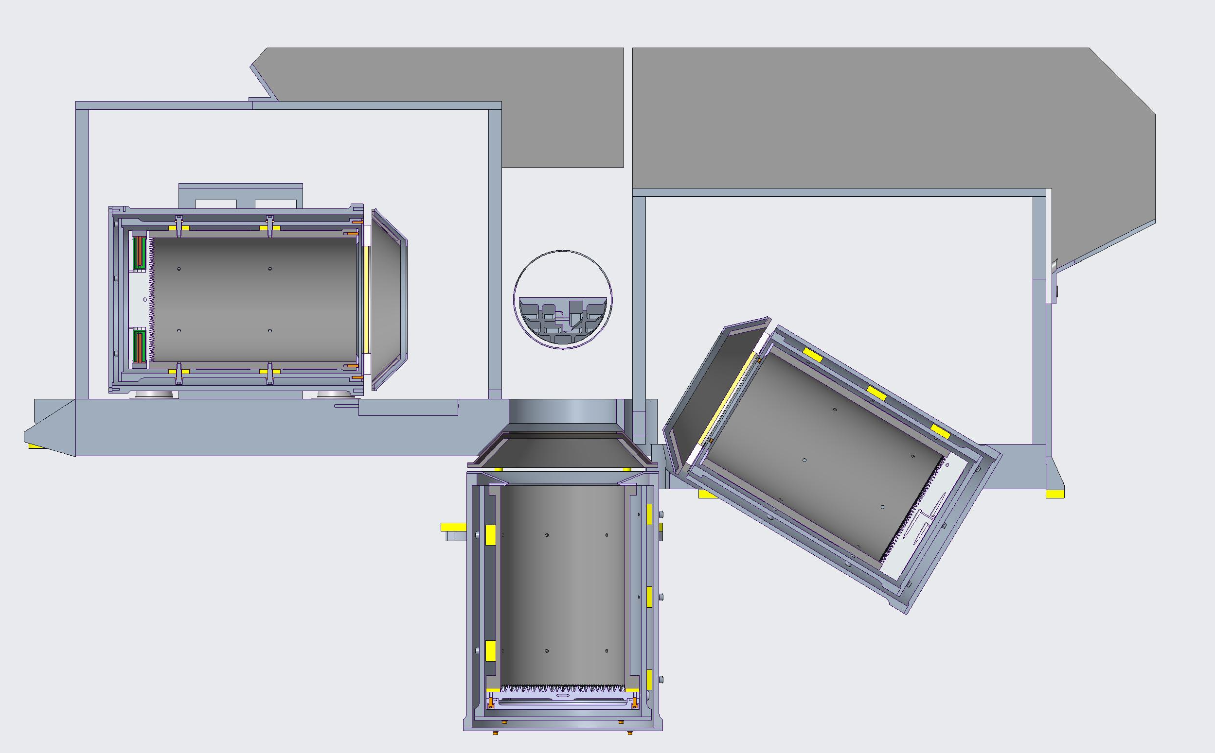

Infrared Benchmark Payload
Overview of infrared radiation reference SI-traceable subsystem
Low temperature BB(with 3 micro phase change fixed point)
Heated Halo
Variable temperature BB
Temperature range：220K~330K
Caliber：130mm
Emissivity：0.999
Temperature uniformity @bottom：20mK
Reproducibility of phase transition temperature ：20mK
Scanning mirror
Variable temperature BB(with 3 micro phase change fixed point)
Low temperature BB
Temperature range：220K~330K
Caliber：130mm
Emissivity：0.999
Temperature uniformity @bottom：20mK
Reproducibility of phase transition temperature ：20mK
Gallium fixed point BB
Temperature range ：270K~320K
Caliber ：130mm
Emissivity ：0.999
Reproducibility of phase transition temperature ：20 mK
Gallium fixed point BB

Slide 13
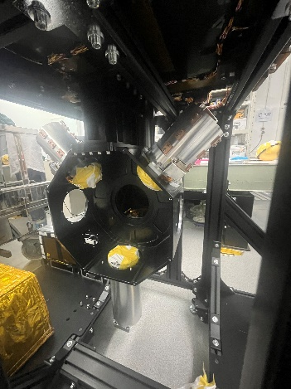
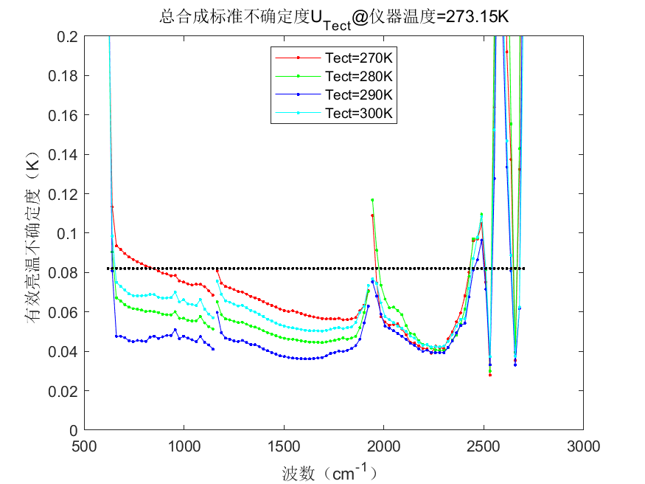
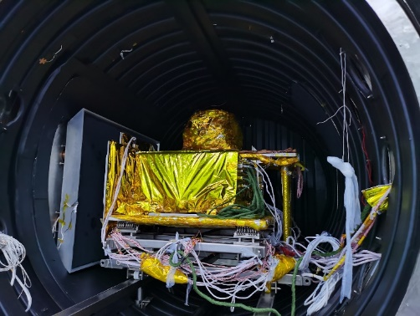
Infrared Benchmark Payload
Designed for GSICS Inter-Calibration Products
Uncertainty of Prototype
0.085K（k=1）
Notes:
根据红外辐射基准载荷辐射测量合成标准不确定度公式，可以得到载荷的各谱段不确定度结果，如图所示

Slide 14
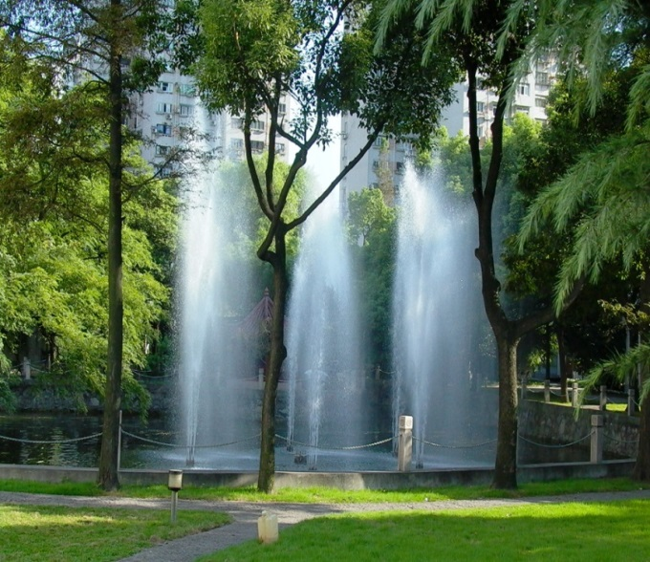

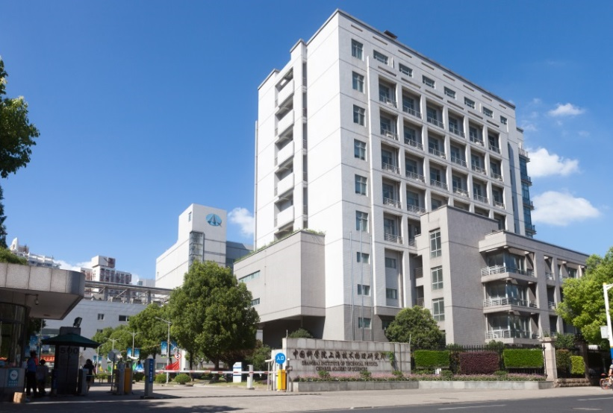
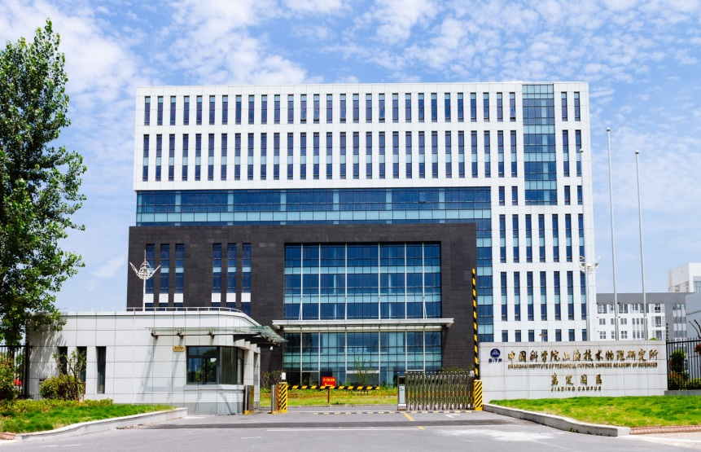



THANK YOU!
Welcome to SITP

Slide 15
Thank you!

