Slide 1
GRWG IR Report
Chengli Qi & Likun Wang
NSMC/CMA qicl@cma.gov.cn
ESSIC/Univ. of Maryland wlikun@umd.edu
2025 GSICS Annual Meeting, Changchun, China
March 21 2025

Slide 2
Outline
Scope of IR Subgroup
IR Group Activities in 2024
Agenda and Discussion
Future Direction and Plans

Slide 3
Review Scope of the IR Sub-Group
Counterpart of VIS/NIR, Microwave and UV Sub-Groups
For satellite instrument channels in thermal infrared
For Hyperspectral instruments
To establish user requirements for inter-calibration
Cooperate with instrument calibration groups(pre-launch and on-orbit)
To communicate relevant information to the users
To help them understand the root cause of observed biases and develop fixes
Review existing, or develop new inter-calibration
Algorithms, procedures, corrections, collocation, spectral-gap filling etc.
Using NWP+RTM, ground-based, near-space measurements, etc.
To define and promote calibration standards, tools and datasets, and best practices
Including selection of inter-calibration reference
Threshold values of time/spatial/spectral/angle difference.
Chair: Chengli Qi (CMA affiliation, Since 2024) with many helps from Likun Wang, also from Tim Hewison, Mounir Lekouara, Larry Flynn, Manik Bali...

Slide 4
Four Web Meetings in 2024
The IR group is active as usual. Four web meetings have been organized.
2024/07/18: Inter-calibration of GEO-LEO IR Hyperspectral instruments, and FY-3G/MERSI-RM Result of On-orbit Calibration.
2024/10/24: FCI Commissioning update and Merging SSU with AIRS
2024/12/19: IR lunar calibration
2025/02/13: Uncertainy analysis of cross-calibration
The topics includes inter-calibration algorithms improvements, development of climate data records, and using the moon for IR inter-calibration.
These web meetings are very important to keep the team members communicate and exchange information. We should continue it.

Slide 5
IR Session in 2025 GSICS Annual Meeting
8 talks in first half-day session----- (PM 18 Mar)
Improved calibration method and technology: FY-3/MERSI
Improved cross calibration method, collocation method, SRF retrieval method et.al, and factor influence analysis.
IR channel calibration monitoring and gsics products : MTG-I1/FCI, GK-2A/ AMI, FY-3/MERSI .
13:30 | Welcome Remarks and Review for IR Groups | Chengli Qi (CMA)
13:40 | Monitoring the MTG-I1 FCI IR Calibration Using GSICS Inter-Calibration Algorithms | Ali Mousivand (EUMETSAT)
14:00 | Current status of AMI IR product | Euidong (KMA)
14:20 | The Calibration and Validation System of the Infrared Channels of the FY-3/MERSI | Hanlie Xu (CMA)
14:40 | On-board Calibration Technology for the Infrared Emission Spectral Bands of Medium-Resolution Spectral Imager | Yang WANG (SITP)
15:00 | Break | Break
15:20 | Improvements on Inter-calibration of CrIS and VIIRS | Likun Wang (NOAA/UMD)
15:40 | Application of new collocation method based on LOS vector to AHI and LEO instruments | Shin Koyamatsu (JMA)
16:00 | Relative SRF retrieval -Application to Metop IASI | Pierre Dussarat (EUMETSAT)
16:20 | Discussion of IR topics | All
15 minutes for talk and 5 minutes for questions

Slide 6
IR Session in 2025 GSICS Annual Meeting
8 talks in second half-day session----- (AM 20 Mar)
IR Lunar calibration: Lunar geometry computing of CrIS & AGRI, IR lunar calibraiton practice for CrIS.
Airborne validation experiment of HIRAS.
New instruments: FY-4C GIIRS introduction and pre-launch calibration, Space infrared radiation benchmark of SI-traceability subsystem.
8:30 | Future of the EUMETSAT GSICS IR products | Mounir Lekouara (Eumetsat)
8:50 | FY-4C GIIRS instrument and Level-1 processing introduction | Lu Lee (CMA)
9:10 | Prelaunch calibration of the FY-4 Geostationary Interferometric Infrared Sounder(GIIRS） | Libing LI (SITP)
9:30 | Computing Lunar Geometry for CrIS Observations | Likun Wang (NOAA/UMD)
9:50 | Innovative Ideas in Lunar Calibration for IR | Martin Burgdorf (University of Hamburg)
10:10 | Break
10:30 | Navigation Registration and Radiometric Calibration for Lunar Observation of Geostationary Meteorological Satellites | Peiwen Chen (SDUST)
10:50 | Comprehensive Analysis of the Airborne HIRAS Validation Experiment | Yiqi Zhu (SITP)
11:10 | Research progress of space infrared radiation reference SI-traceability subsystem | Shijie Xin (SITP)
11:30 | Plan for next year | All

Slide 7
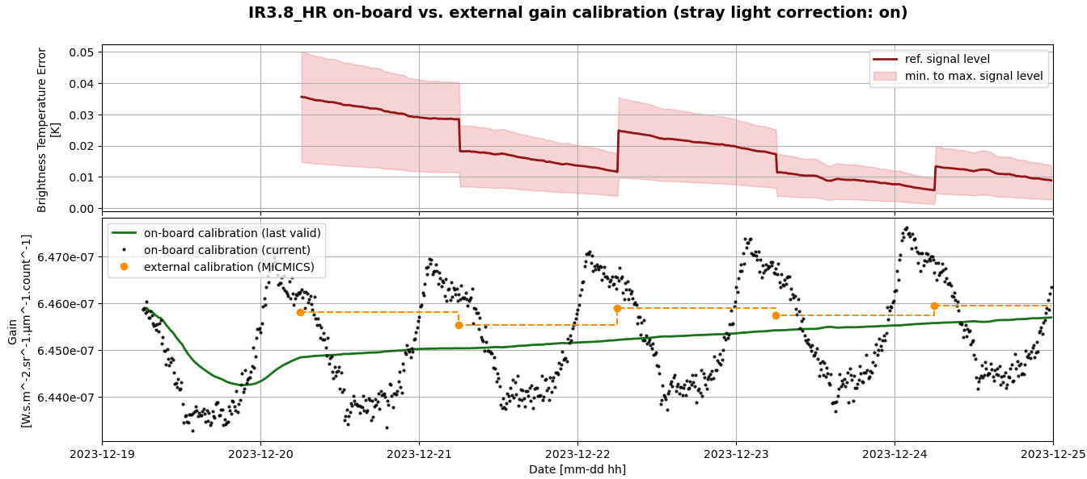
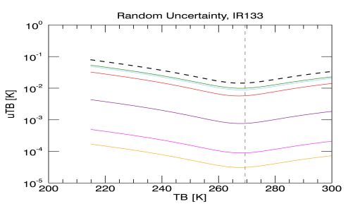
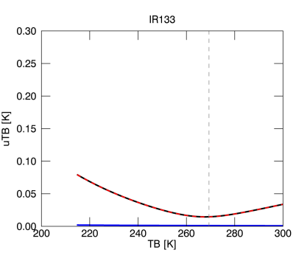
Highlights:
Improved calibration method and technology: FY-3/MERSI
Improved cross calibration method, collocation method, SRF retrieval method et.al, and factor influence analysis.
IR channel calibration monitoring and gsics products : MTG-I1/FCI, GK-2A/ AMI, FY-3/MERSI .
From Ali Mousivand
From Euidong

Slide 8
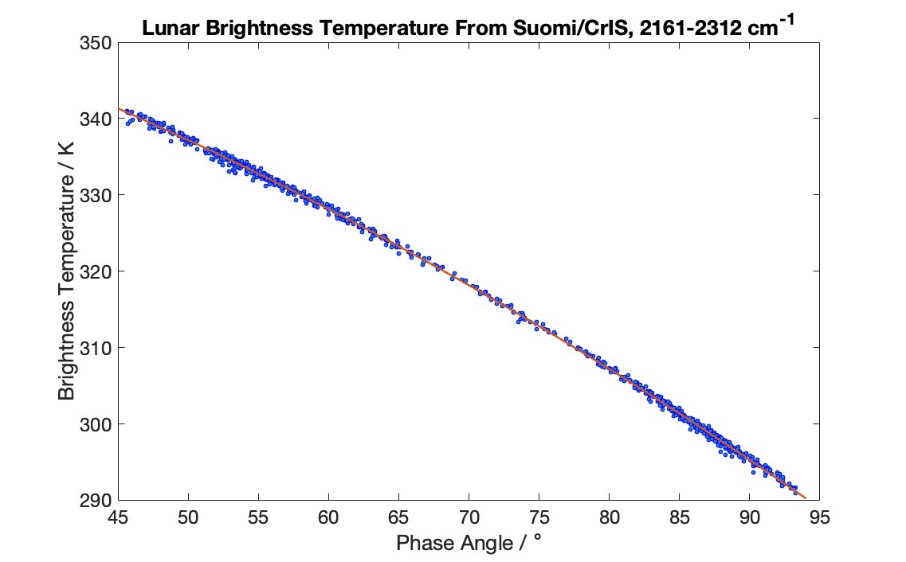
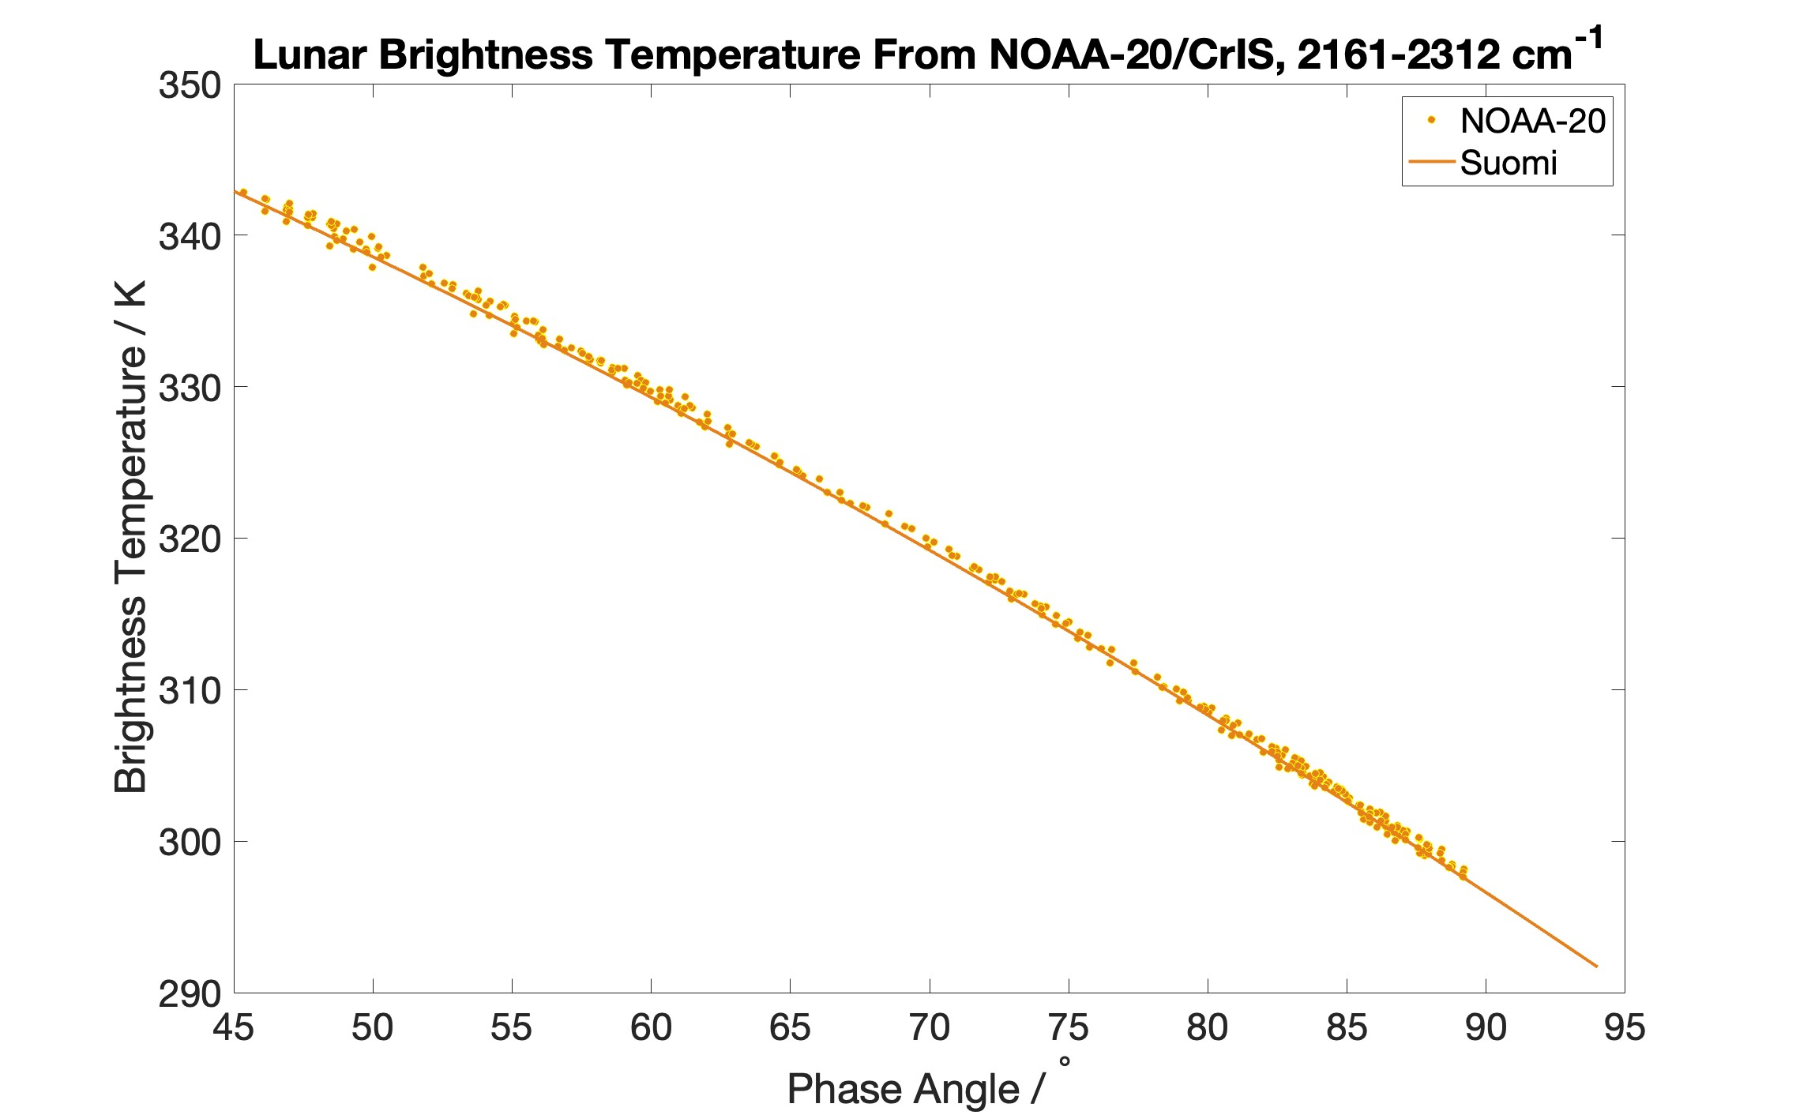
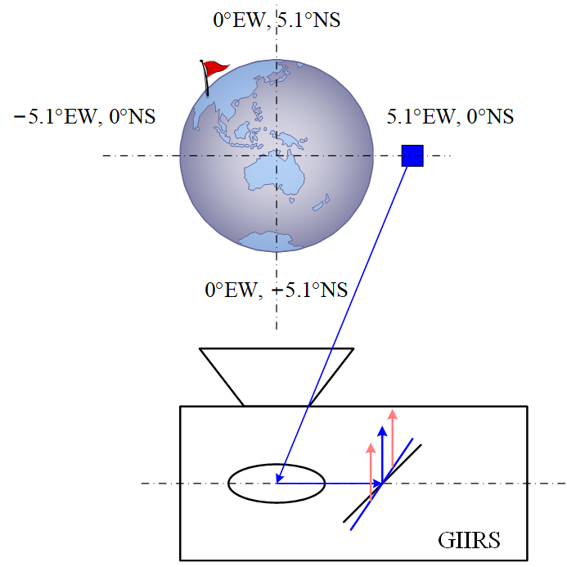
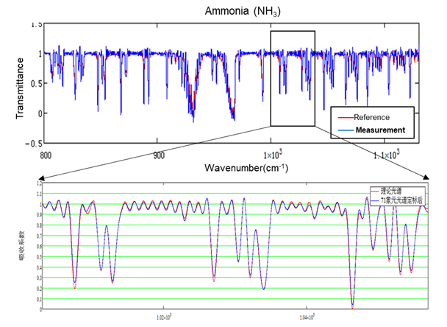
Highlights:
From Martin Burgdorf
IR Lunar calibration: Lunar geometry computing of CrIS & AGRI, IR lunar calibraiton practice for CrIS.
Airborne validation experiment of HIRAS.
New instruments: FY-4C GIIRS introduction and pre-launch calibration, Space infrared radiation benchmark of SI-traceability subsystem.
less self-emission into FOV
From LEE Lu & LI Libing

Slide 9
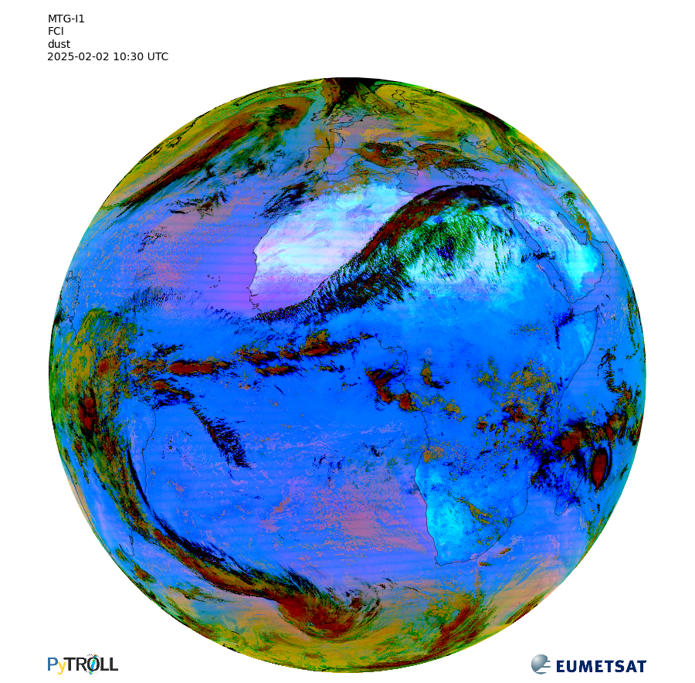
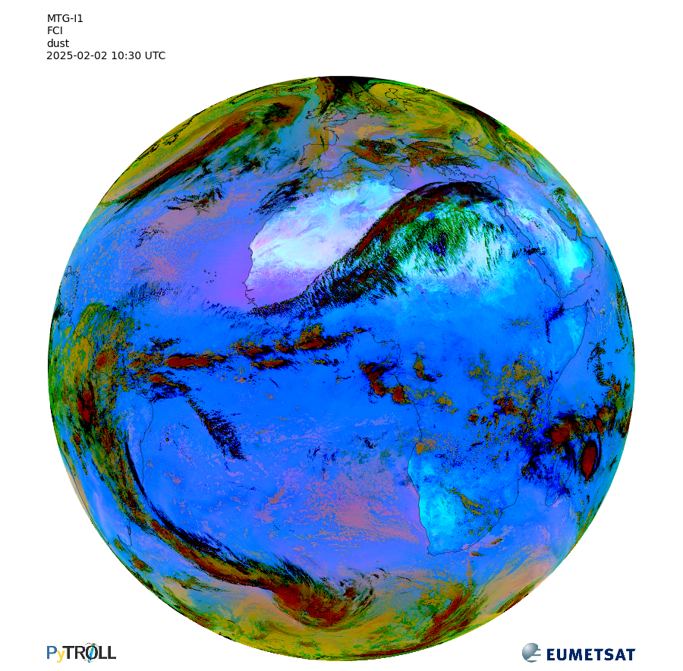
Relative SRF retrieval - Application to Metop IASI (and MTG-I FCI)
derived a novel solution to compute relative SRF between similar hyperspectral detectors by analysis of colocations
Characterize in-flight discrepancies of responses between detectors within a single instruments or between instruments
Application to Metop-IASI , revealing extremely small discrepancies between FOV
Application to the infrared channels of MTG-I FCI (mono-channel) to derive relative gain corrections (de-striping / calibration artefact removal)
From Pierre Dussarat

Slide 10
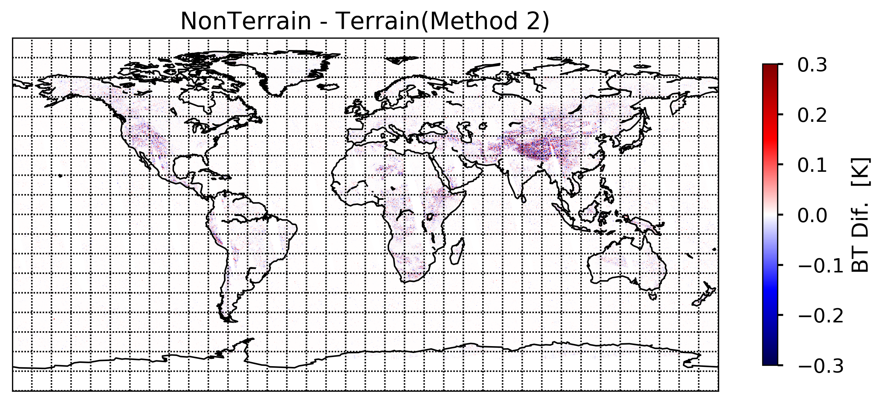
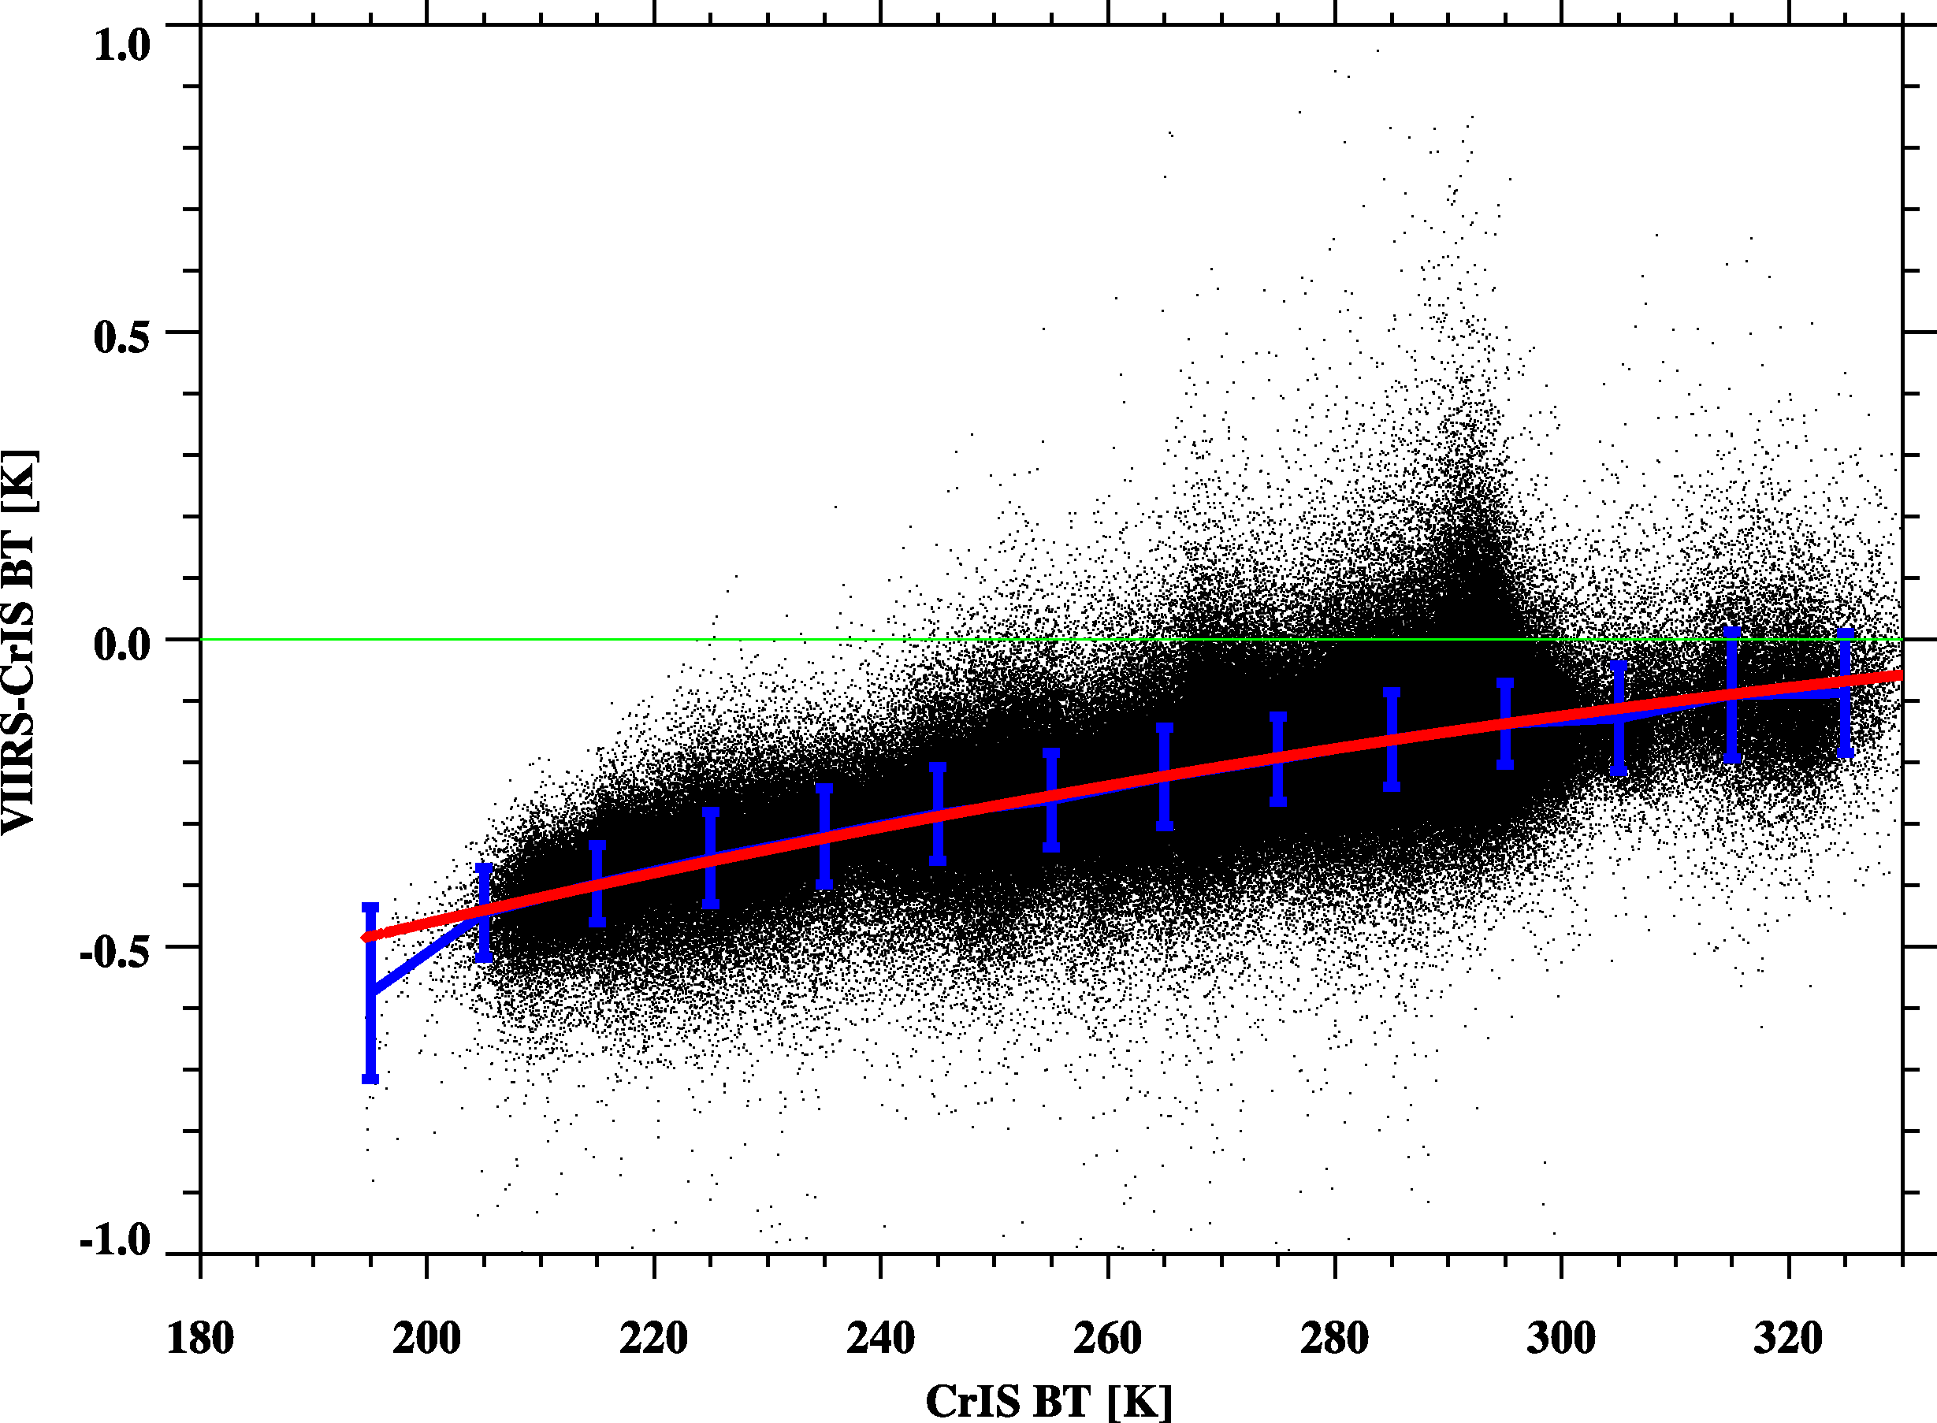
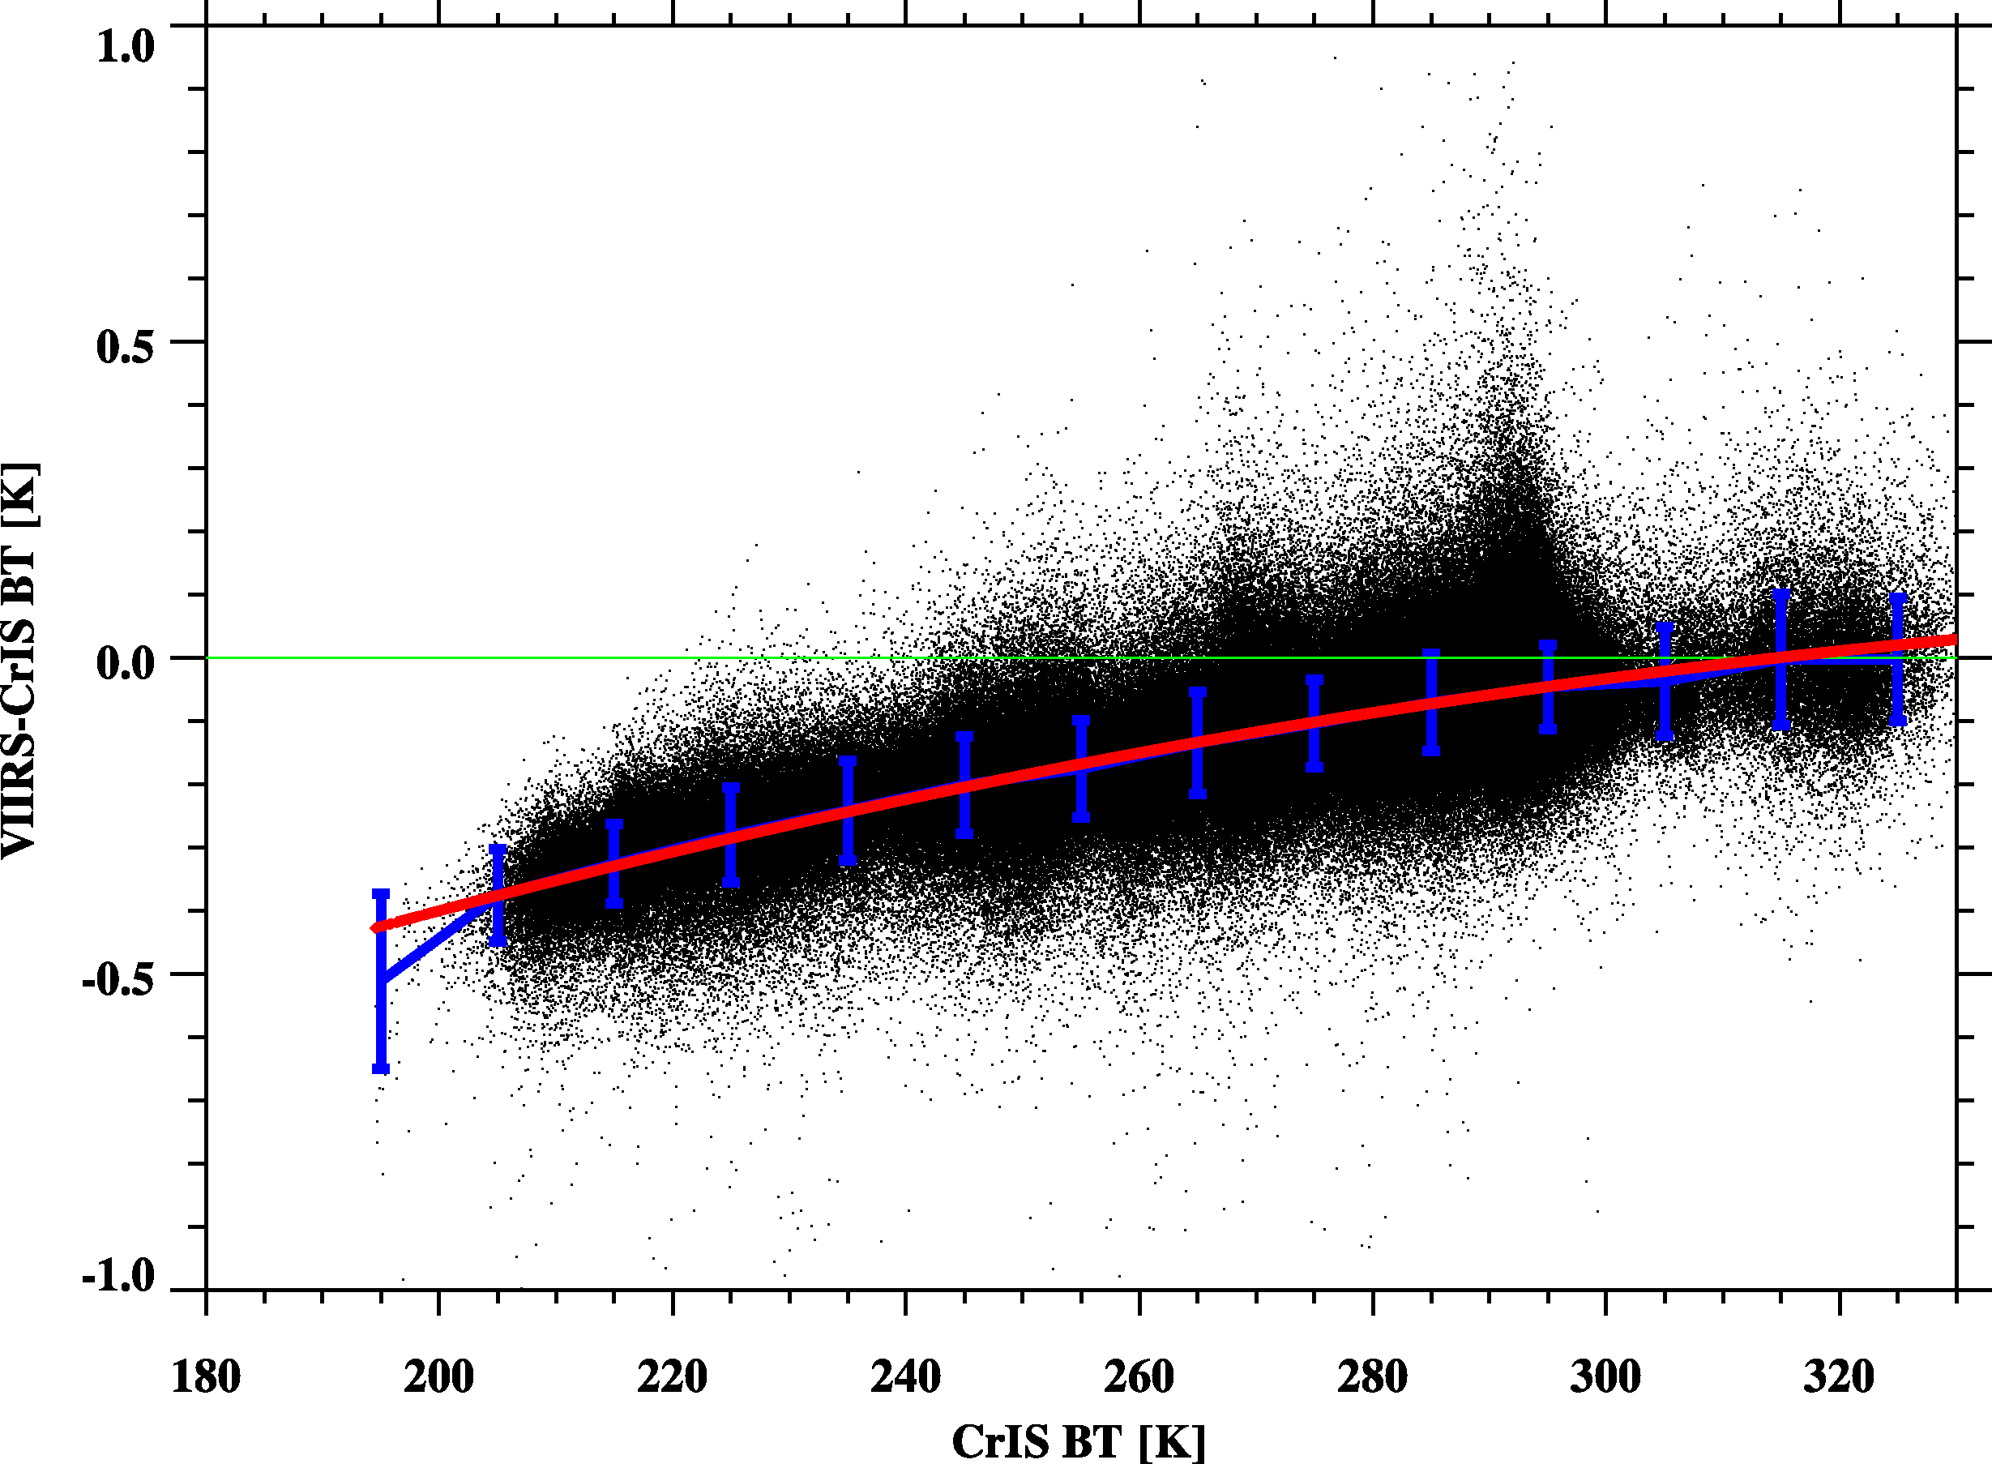
Improvements of CrIS and VIIRS Inter-Calibration
Collocate sounder and imager in space instead of on the Earth Surface
Incorporating the geoid height (from the static dataset) and terrain height (already stored in the VIIRS geolocation data), the collocation method can be modified to achieve results comparable to those obtained with non-TC data.
Without OOB correction
With OOB correction
The out-of-band effects of VIIRS should be accounted for by using CrIS gap filling method to reduce the inter-comparison bias between CrIS and VIIRS .
From Likun Wang

Slide 11
Two Discussion
Discussion 1: CAL/VAL Algorithms Improvements and the way forward ( PM 18 Mar)
16:20-17:00
Hosted by Chengli Qi
Hot discussion point: Los vector for collocation, sample reduce percent evaluation, Relative SRF retrieval -Application to reduce striping and FOV difference.
Discussion 2: Lunar base data collection, plan, ( AM 20 Mar)
11:30-12:00
Hosted by Likun Wang
Hot discussion point: Formulate a common Lunar information dataset format to Lunar model as inputs, Agency generate Lunar information dataset files according to it.

Slide 12
Actions and Recommendations from Discussion
Topic One: Algorithms Improvements
Action: Group members are encouraged to apply collocation method based on the LOS vectors for GEO and LEO collocation algorithms. The potential effects, including dynamic ranges and collocation samples, should be further evaluated..
Topic Two: Software on FOV (pixel) Difference Characterization
Action: Group members are encouraged to test the software from EUMETSAT to evaluate pixel or FOV differences. EUMETSAT has agreed to share the software. A web meeting will be scheduled to report on the progress.
Topic Three: Lunar Dataset
Action: The IR working group encourages the provision of lunar datasets to support the development of the IR lunar model. This includes data from sounders and IR channels of imagers on both LEO and GEO platforms. The group will define the data content and format by working with Martin and the Lunar group.

Slide 13
New Actions
Action Id | Summary | Lead
A.GIR.2025.5g.1 | Evaluate how many samples reduced after used LOS collocation method | Shin Koyamatsu (JMA)
A.GIR.2025.5h.1 | Agency applied the SRF retrieval method for detecting and eliminating striping and FOV difference. EUMETSAT Share the SRF retrieval code ? | Agency Pierre Dussarat (EUMETSAT)
A.GIR.2025.10d.1 | Generate a common dataset file format including inputs for Lunar model development and inter-comparison | EUMETSAT(IASI), CMA(HIRAS&GIIRS)
A.GIR.2025.10d.2 | Generate Lunar information dataset files according to common dataset format to Lunar model as inputs | Likun Wang
A.GIR.2025.10e.1 | Martin Burgdorf give a requirement of inputs for Lunar model development and inter-comparison | Martin Burgdorf

Slide 14
2025 Plan
Bi-monthly web meeting
On Thursday for the first week of each odd Month
Comunication topics
- Algorithms improvements for inter-calibration, instrument calibration,
- Development of FCDR,
- Using the moon for IR inter-calibration, Common dataset files for Lunar model
- AI tenique application in calibration
- New IR instruments concept and applicaion potential...
Inter-calibration algorithms improvements
- Avoid parallax effects, Gap-filling application
- Strategy for treat time difference bias over hot land
- Regression, Uncertainty analysis
- GEO-LEO Hyper-spectral comparison

Slide 15
Cooperation
Cooperate with instrument calibration groups
To communicate relevant timely information to the users
To help them understand the root cause of observed biases and develop fixes
To promote reprocessing of instruments
VIS/NIR, Microwave and UV Sub-Groups
Support more cross-community efforts,
Dialogue with Pre-flight workshop, NWP community, CEOS WGCV/IVOS subgroup
Support climate application
Support radiance reference transfering model
Encourage more experts involved in the IR group
Updates on new instrument, methods, and datasets and application for the IR group
Instrument observation simulation to characterise error
Share the tools and codes, knowledge Exchange memo
GitHub or GSICS wiki may be the best host place

