Slide 1
GRWG Microwave (MW) Subgroup Annual Report 2025
Flavio Iturbide-Sanchez and Shengli Wu, Co-Chairs
Tim Hewison, DaZhen Gu, and Hu Yang, Focus Group Leads
Kun Zhang and Juyang Hu, GSICS MW Coordinator
03/21/2025

Slide 2
GRWG Subgroup Report - MW
Activities
Organized 3 MW General Meetings and 9 MW Focus Group Meetings.
Generated SRF Data Using New GSICS netCDF Convention
Distributed the Initial Version of MW Lunar Radiative Transfer Software Package to the GSICS Community
Provided Validated Lunar Observation Datasets from MHS and ATMS instruments
Reviewed SNO Methods, Collocation Mismatch Uncertainty and Vicarious Inter-calibration Algorithms
Issues, challenges and/or recommendations
Consolidated Terminology
Precise Definitions (e.g., random noise, striping, etc.)
Best Practices (e.g., antenna pattern correction, characterization, etc.)
Opportunities
Partnership with International Precipitation Working Group (IPWG)
by Flavio Iturbide and Shengli Wu

Slide 3
Meetings Organized/Supported in 2024
Organized the Quarterly Microwave Subgroup General Meetings to Communicate Status and Path Forward Plans for the Focus Groups.
22 May 2024, Virtual Meeting
28 August 2024, Virtual Meeting
24 February 2025, Virtual Meeting
SNO/Vicarious Inter-calibration Focus Group Meetings:
2024-05-02 - Introducing SNO Focus Group
2024-08-08 - Review of SNO methods, Collocation mismatch Uncertainty
2025-01-16 – SNO for FY-3F, RSS Vicarious Inter-calibration for GPM
Microwave Lunar Focus Group Meetings:
2024-07-25 – Kick off meeting to discuss the working scope
2024-11-25 – Discuss the different lunar intrusion correction strategy adopt by different satellite agency
2025-02-22 - Lunar RTM model discussion
Technology & Testing Focus Group Meetings:
2024-07-31 – Kick off meeting for refining focus group topics
2024-11-12 – Pre-launch characterisation at NASA
2025-02-17 – SRFs, Antenna effects, NEDT definition

Slide 4
New Products and Product Promotions
New GSICS SRF netCDF convention:
Frequency unit in GHz instead of wavelength for improved familiarity in microwave community
Spectral Response (SR) unit in decibel scale with respect to peak to replace linear scale
Uncertainty addition to both frequency and SR
Plans:
Consolidate proposal for a baseline SNO algorithm
Uncertainty framework
Independent evaluation by different groups – with different sensors
Extend SNO points to low latitude
Continue review of other vicarious (inter-)calibration algorithms
Inviting experts to present at web meetings
by Dazhen Gu and Tim Hewison

Slide 5
Challenges and Opportunities
Partnership with IPWG (International Precip. Working Group)
Key customer for MW inter-calibration
Establish requirements for inter-calibration:
Target instruments, channels, dynamic range
Inter-calibration uncertainty, traceability
Timeliness – lead time and update frequency
Form of inter-calibration product: Algorithm, Corrections, Re-calibration, …
Consolidate terminology!
Compare requirements with capability of current algorithms
Propose way forward

Slide 6
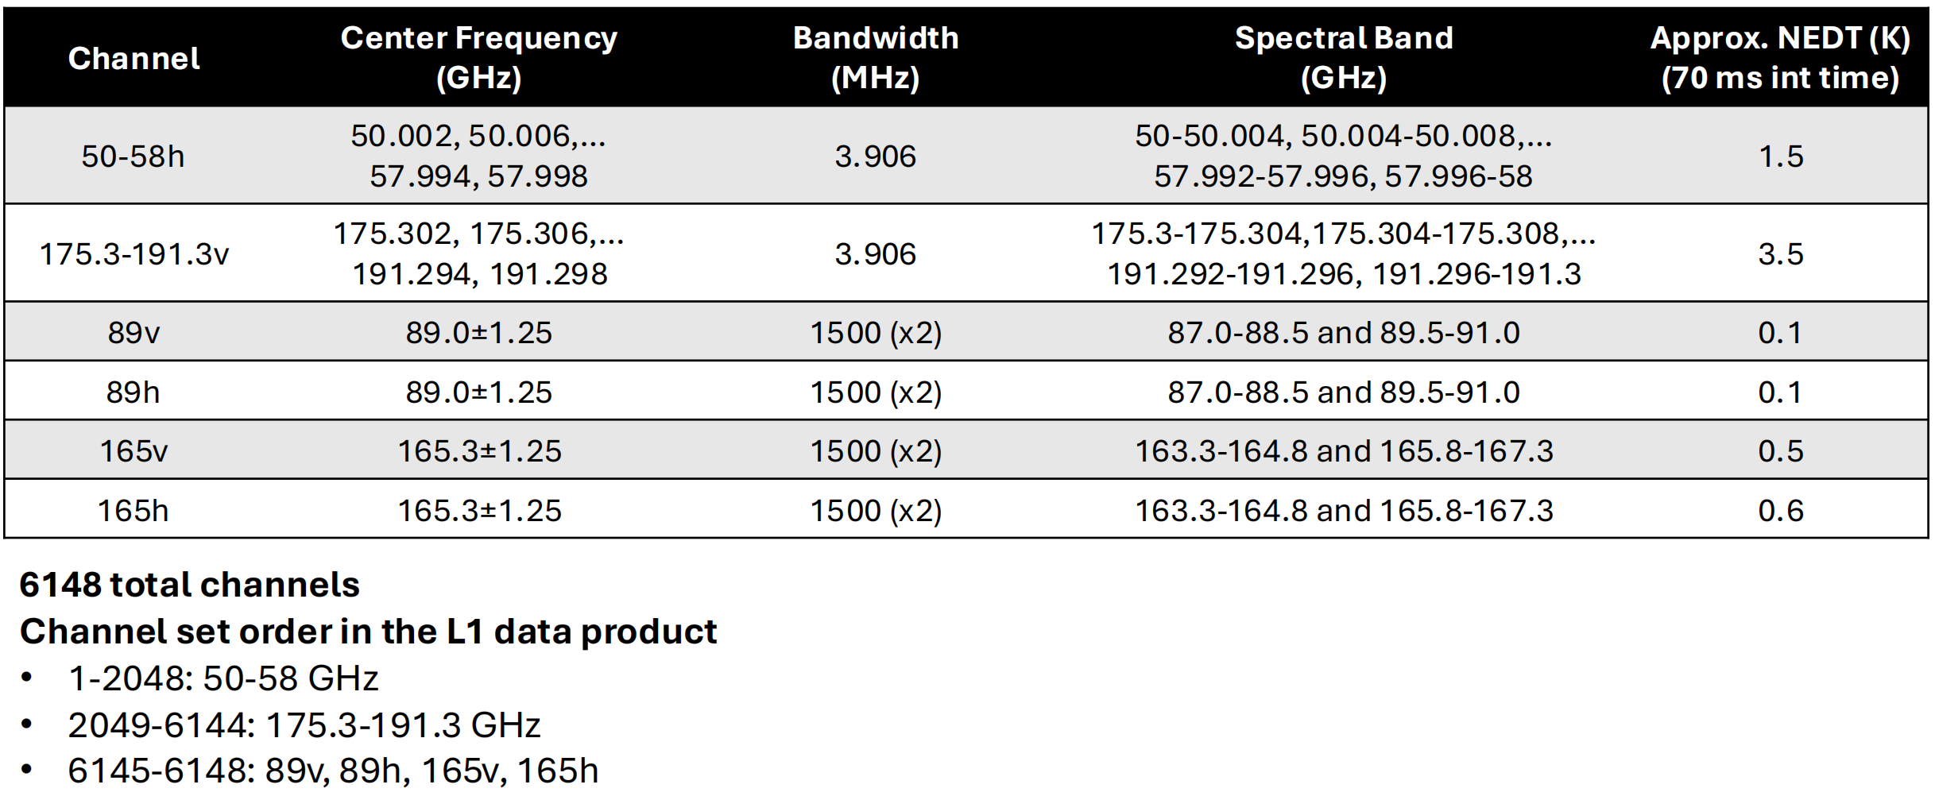
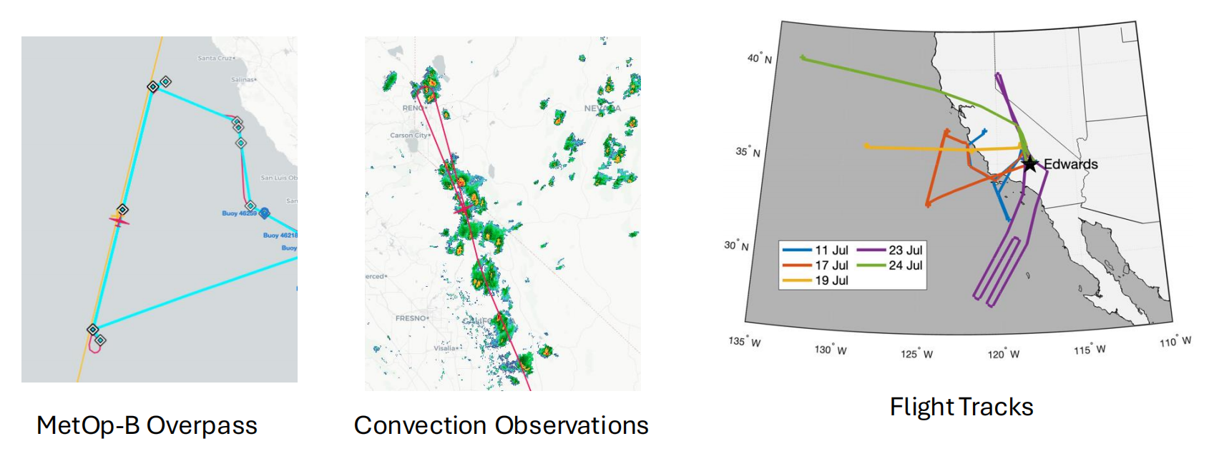
Highlight: Hyperspectral Microwave By Rachael Kroodsma
by Rachael Kroodsma

Slide 7
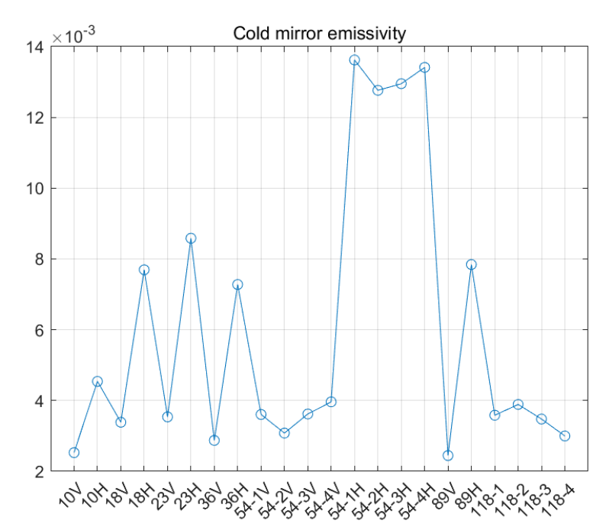
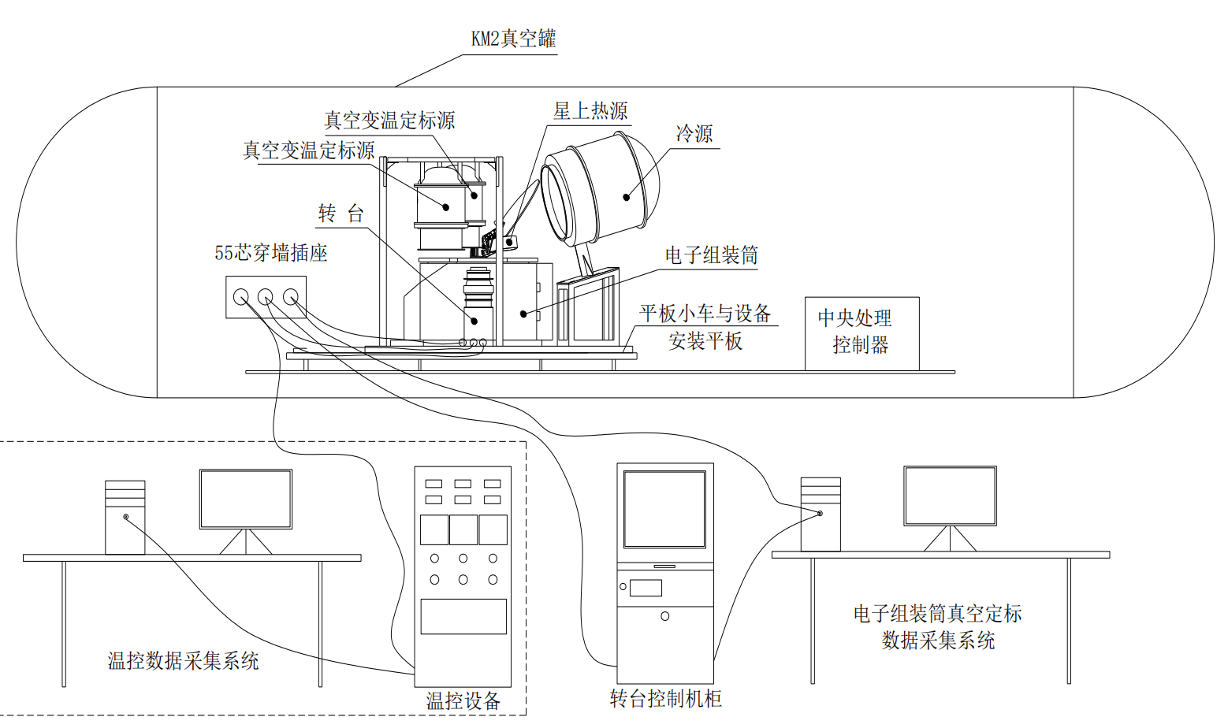
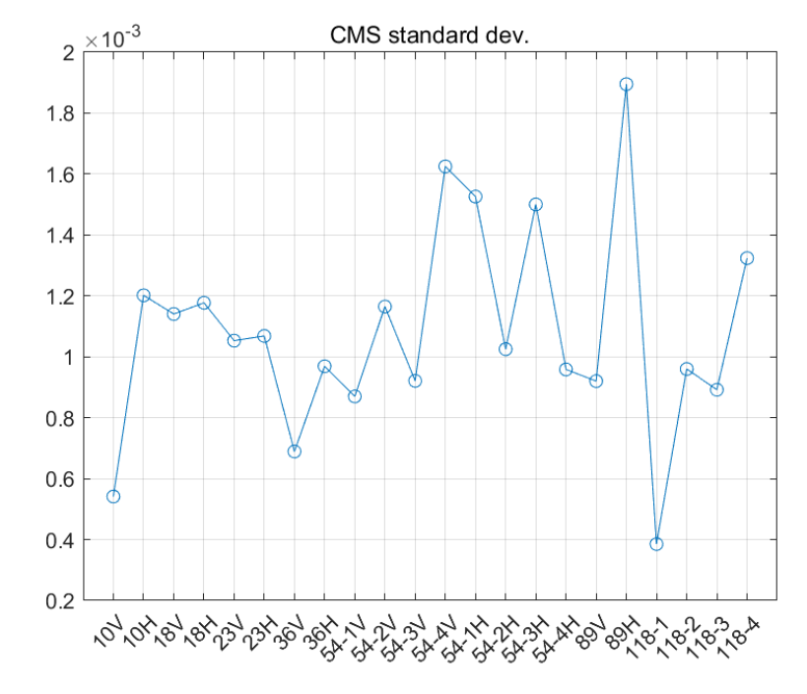
Highlight:Antenna Emissivity Measurement By PengjuanYao
by Presenter??

Slide 8
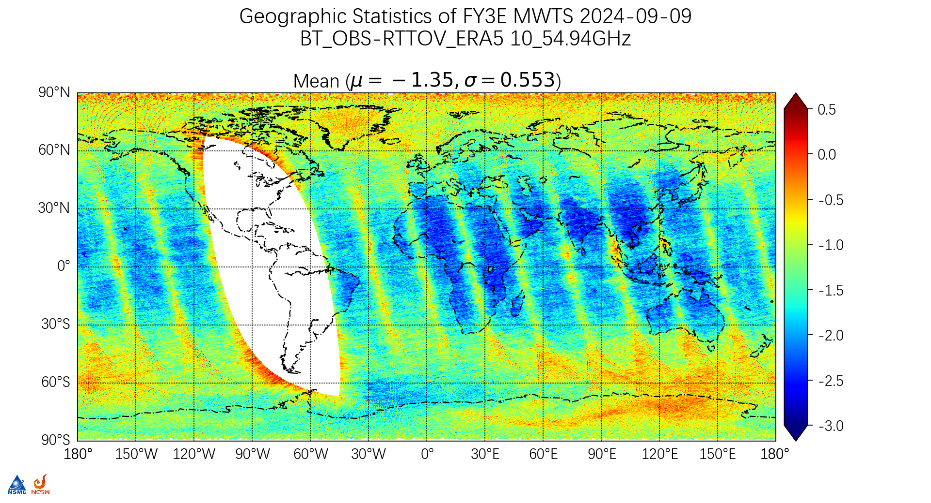
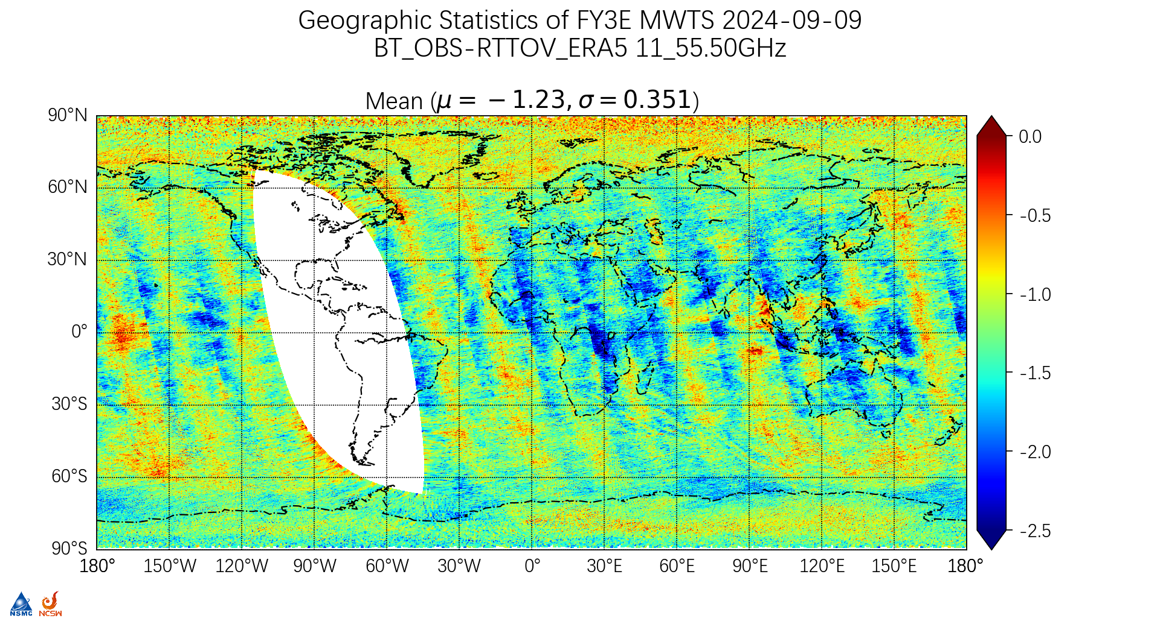
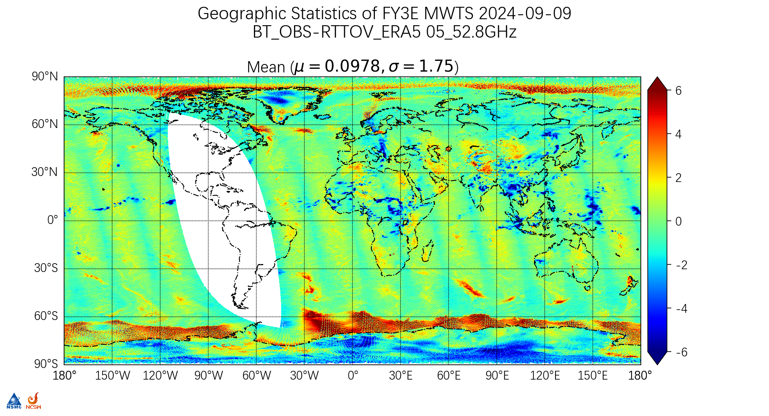
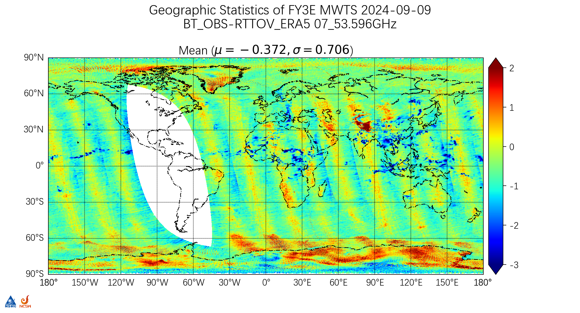
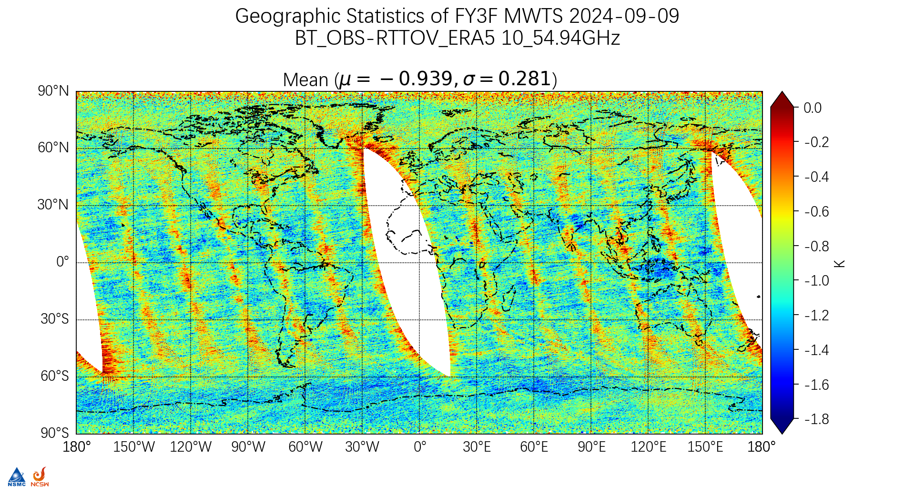
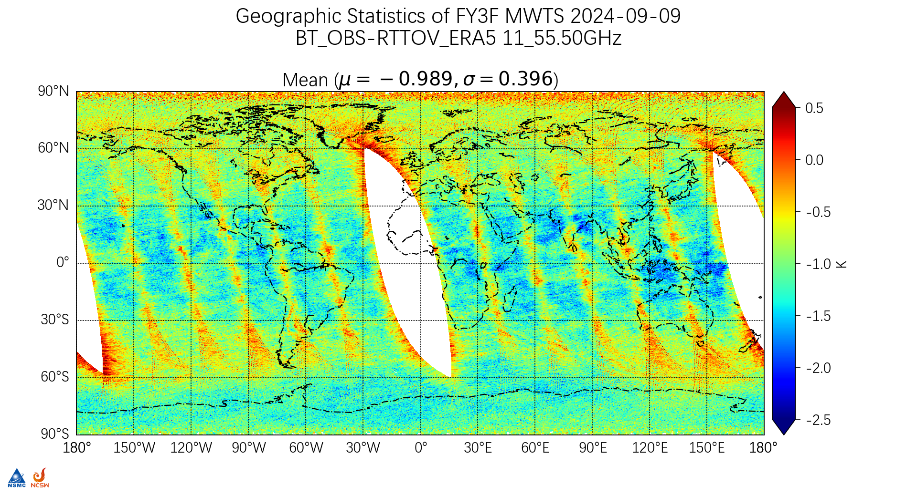
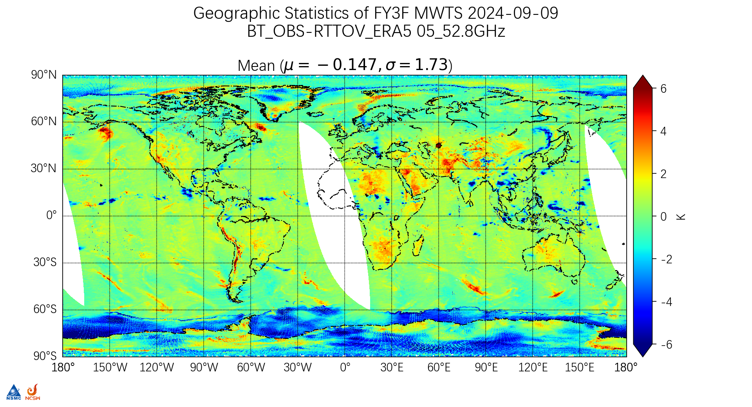
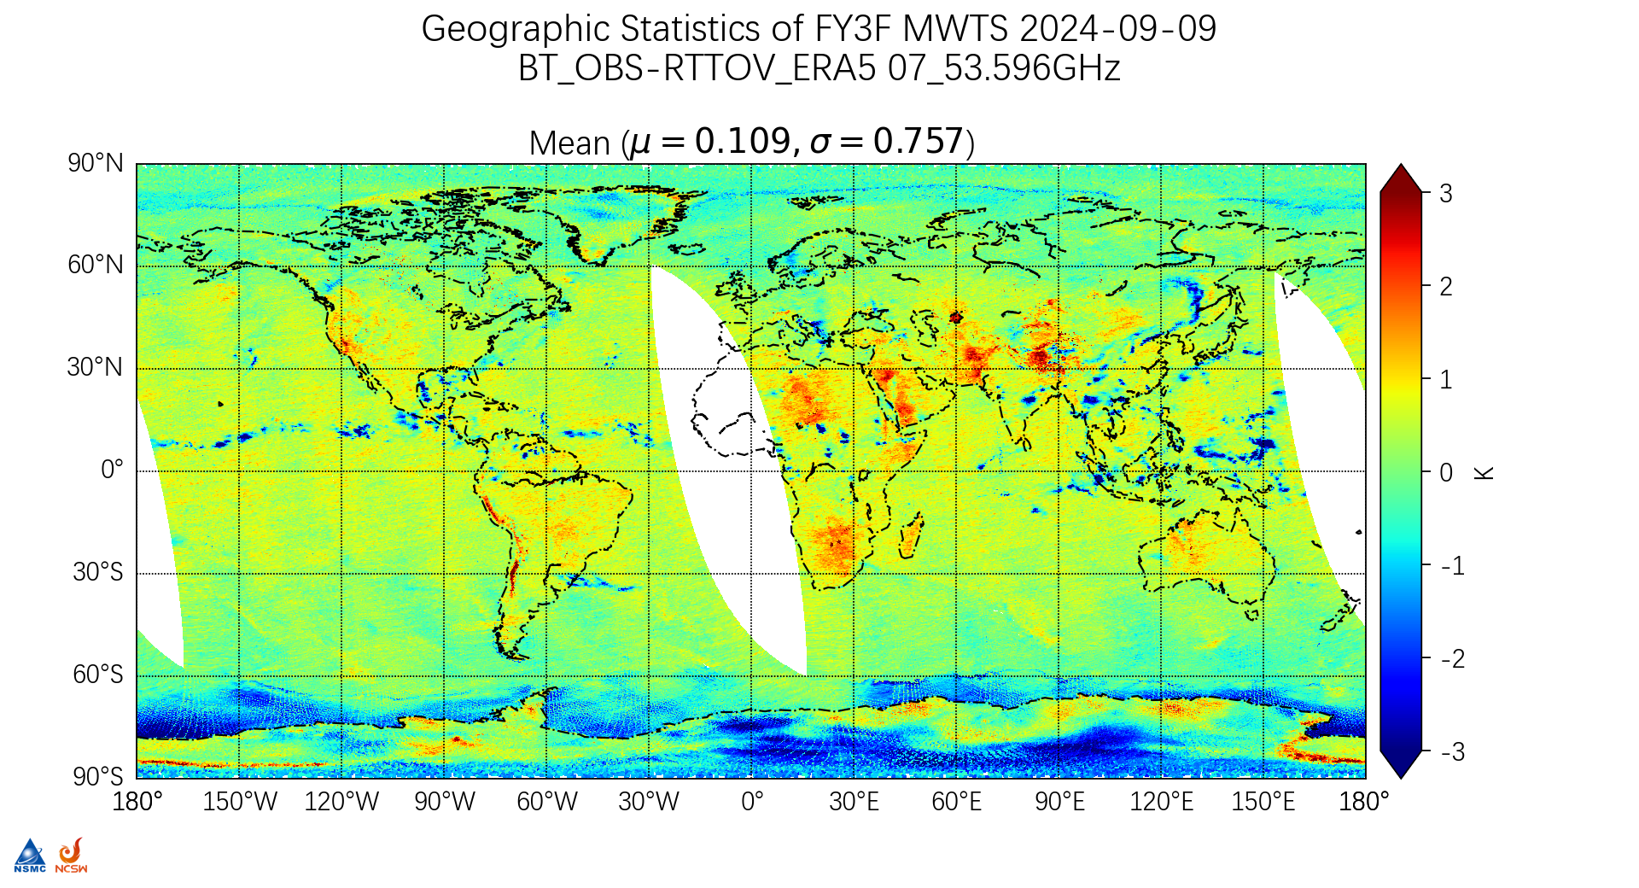
Highlight:Improvement of MWTS By Juyang Hu
Land-sea contrast bias
Scan-dependent bias
by Presenter??

Slide 9
Highlight: Sterna inter-calibration study By Tim Hewison
Microwave lunar RTM model development
Satellite Moon observations
Ground based Moon observation
Lunar observation applications
Lunar PICS

Slide 10
Achievements and way forward of Lunar Calibration WG
Microwave lunar RTM model development
Satellite Moon observations
Ground based Moon observation
Lunar observation applications
Lunar based PICS
by Hu Yang

Slide 11
Achievements and way forward of Technology and Instrument Pre-Launch Testing and Post-Launch Characterization (TT)WG
SRF netCDF Convention
Antenna effects in space radiometer measurements
Started a collaborative document development on Overleaf
Main lob, side lob and back lob illumination
Polarization
Array effects
Antenna Emission
System NEP and NEΔT Definition
RFI Issues
by Dazhen Gu

Slide 12
Achievements and way forward of Direct MW Radiometer Inter-comparison Method and Vicarious Calibration WG
SNO algorithm development
effects of inhomogeneities within satellite footprint and aims to enhance accuracy of data assimilation by understanding and characterizing observation error
absolute calibration by SNO and DD
Proposal for a baseline SNO algorithm and uncertainty framework
by Tim Hewison

Slide 13
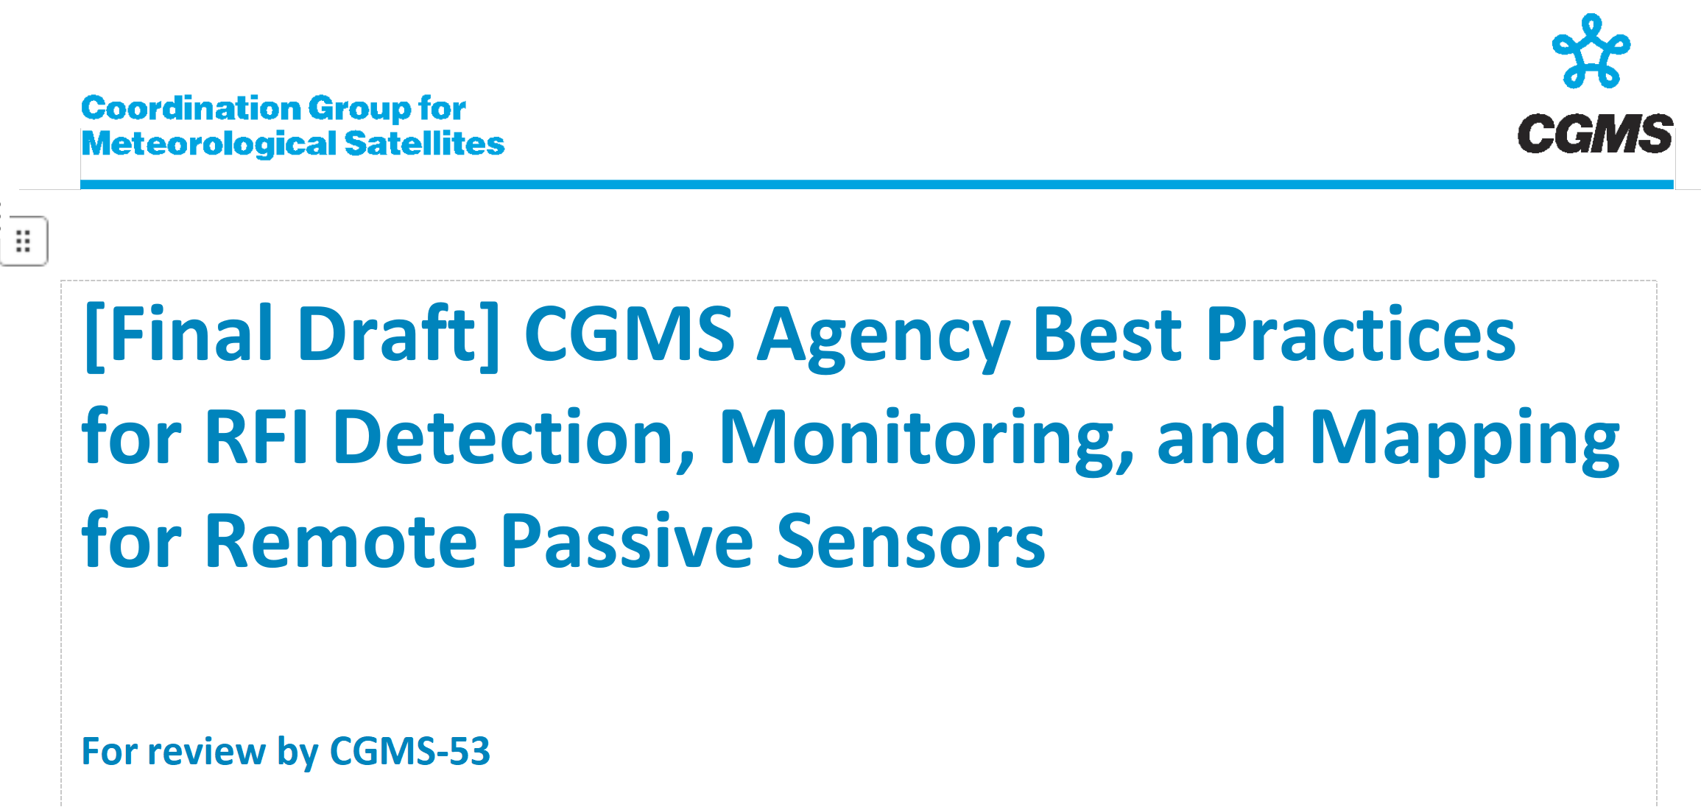
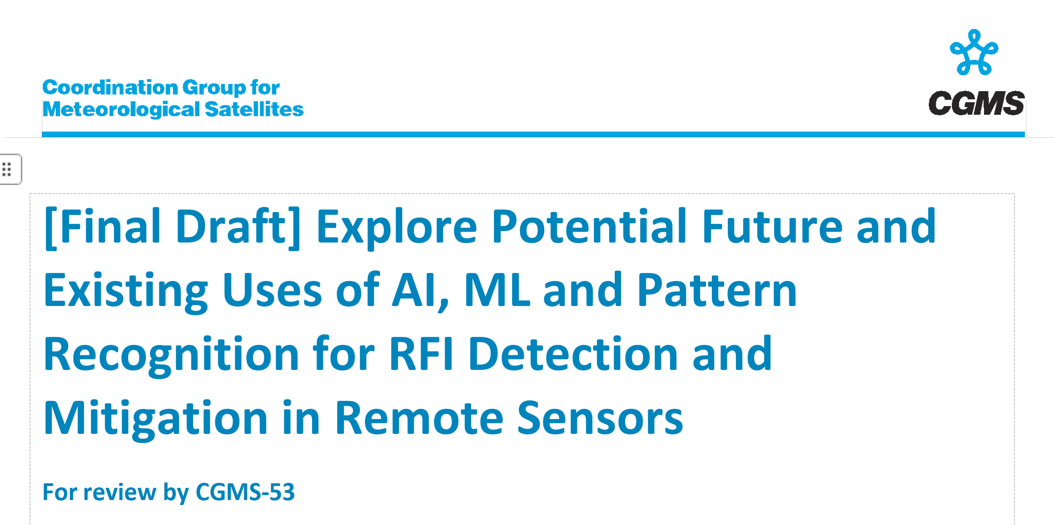
Cross-Cutting
RFI Issue
RFI Conference triggered initiative for WMO-OSCAR-Space to set up a feature to report RFI experienced for specific channels (Heikki).
CGMS agency best practices (BP) for RFI Detection, Monitoring, and Mapping/AI, ML and Pattern Recognition (Beau Backus)
Discuss in TT Focus Group, or a NEW RFI Focus Group.
IPWG：Discuss in EP

Slide 14
Thank you

