Slide 1
Report on UVN-S Session and Plans for the Coming Year
L. Flynn (NOAA), R. Lindstrot (EUMETSAT) and Yuan Li (CMA)
21 March 2025

Slide 2
Disclaimer
"The contents of this presentation are those of the authors and do not necessarily reflect any position of the US Government or the National Oceanic and Atmospheric Administration."

Slide 3
UVN-S Session Agenda Part II
19-Mar-25 | UVN-S Breakout Session I |  | UVNS Drive
Time | Topic | Presenter
UTC+8 | Session Chair: Rasmus Lindstrot | Minutes: Larry Flynn | UVNS Drive
8:00 | TEMPO instrument calibration status | Heesung Chong | 6a
8:20 | Recent OMPS Calibration efforts for NOAA 20 & 21 | Sriharsha Madhavan | 6b
8:40 | NPP & NOAA-20 OMPS Time-Dependent Calibration; update on ACX | Larry Flynn | 6c
9:00 | OCO-2 and OCO-3 Radiometric Trends | Rob Rosenberg | 6d
9:20 | GOSAT serious calibration and intercomparison with multiple GHG sensors | Kei Shiomi | 6e
9:40 | The Calibration results of the OMS-Nadir onboard FY-3F | Jinghua Mao | 6f
10:00 | In orbit Calibration and Evaluation of FY-3F OMS Limb. | Yuan Li | 6g
10:20 | An Overview to Pre-launch Calibration of FY-3F OMS-Limb | Haochen Li | 6h
10:40 | Discussion of UVN-S Topics for the Year | All | 6i

Slide 4
UVN-S Session Agenda Part II
19-Mar-25 UVN-S Breakout Session
Time | Topic | Presenter | eMail
UTC+8 | Chair: Yuan Li | Minutes: Rasmus Lindstrot |  | #
14:40 | Study on EMI decay monitoring and correction in orbit | Fuqi Si | sifuqi@aiofm.ac.cn | 8a
15:00 | Current status of calibration and validation for GEMS Level 1 Products | Yeeun Lee | yeenylee@gmail.com | 8b
15:20 | Calibration and validation concept of the CO2I/NO2I instrument on-board the CO2M mission | Bernd Sierk | Bernd.Sierk@eumetsat.int | 8c
15:40 | Current status of GOME-2 calibration & outlook for Sentinel-4 & Sentinel-5 | Rasmus Lindstrot | Rasmus.Lindstrot@eumetsat.int | 8d
16:00 | OMI/TropoMI Status Overview | Deborah Stein Zweers | deborah.steinzweers@knmi.nl | 8e
16:20 | DLER database (surface reflectivity.) | Erwin Loots | Erwin.loots@knmi.nl | 8f
16:40 | L1 UVN status update | Erwin Loots | Erwin.loots@knmi.nl | 8g
17:00 | ESA FDR4ATMOS Project: Status Update and Roadmap | Günter Lichtenberg | guenter.lichtenberg@dlr.de | 8h
17:20 | On-orbit degradation of FY-3E SSIM UV band | Jin Qi | qijin@cma.gov.cn | 8i
17:40 | The Inflight Calibration of the FY-3E SSIM VIS Band | Xiaohu Yang | yangxiaohu@ciomp.ac.cn | 8j

Slide 5
Planned Activities following 6i. Discussions
GHG Missions next quarterly meeting:
  OCO-TROPOMI-GOSAT Calibration Team Meeting #13, organized by JAXA, on May 9 at 12:00 UTC
Potential UVN-S Topical Meetings (fifth Thursday of the month)
  Matchup Inter-comparisons for LEO/GEO, LEO/GEO/Lagrange-1, LEO/LEO
    Geostationary – GEMS, TEMPO and Sentinel 4 UVN
    Do we have stable instruments to use as long-term transfer standards?
  Discussion of Radiative Transfer Model strengths and weaknesses
  Use of Targets and Statistical approaches for reflectivity channels
    Ice Radiances, Open Ocean, Land (PICS, etc.), Deep Convective Clouds
    Comparisons of surface reflectivity databases
  UV Ozone Profiler homogenization methods

Slide 6
Overview of presentations
18 talks with over 30 attendees (20 virtual) covering most of the operational UV/Vis/NIR spectrometers.
Presentations will be linked to the agenda at
  https://gsics.atmos.umd.edu/bin/view/Development/AnnualEP2025
Minutes are in revision but can be accessed at
  https://umd0-my.sharepoint.com/:w:/g/personal/mbali_umd_edu/Eb5j7P0xqWZHthAWMTMvgZYBMX_CMBF4JaZHYeo10fXSXg?e=Rm3Ld2

Slide 7
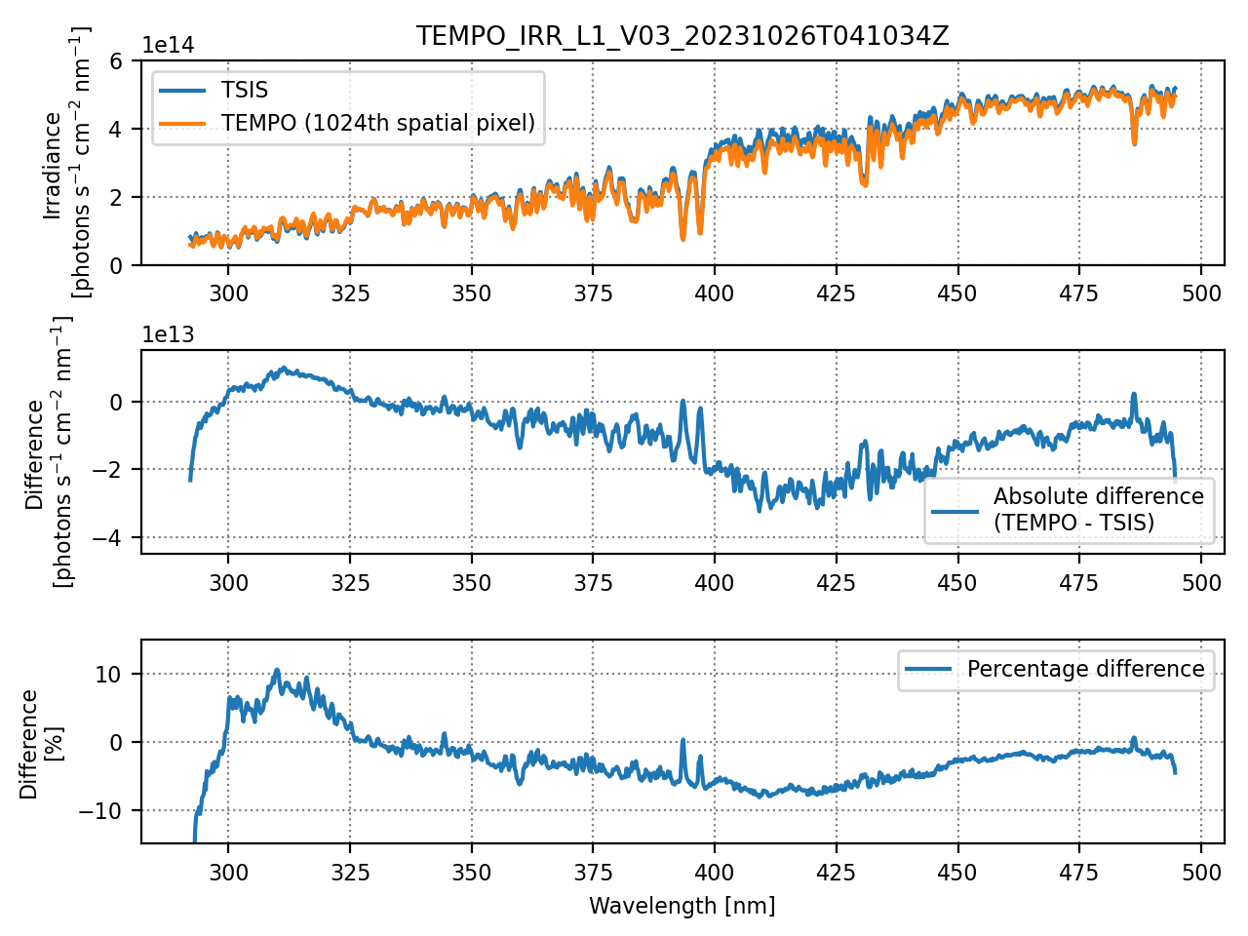
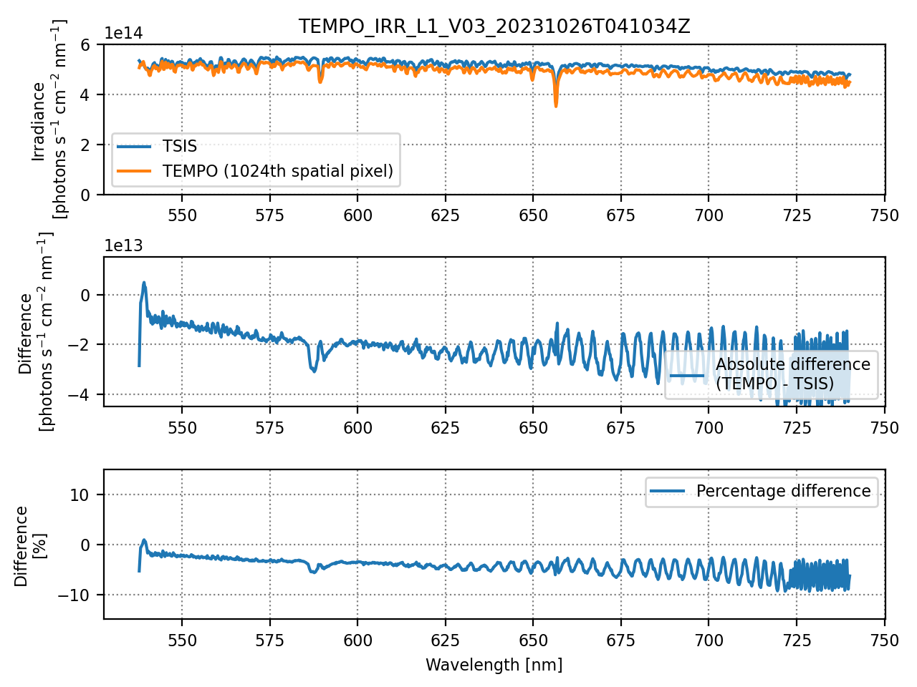
6a. TEMPO Calibration Status, Heesung Chong et al.
Sun-normalized radiances from TEMPO V03 Level 1 products are generally overestimated by on the order of 10%.
Solar irradiance and Earth radiance have been validated separately, and the results align with the ~10% bias in Sun-normalized radiance.
Ongoing work
Absolute calibration
- We are considering adjustments to the radiometric calibration coefficients and BTDF to address (a) the Sun-normalized radiance biases and (b) the etaloning residuals.
Stray light
- We have been working on updating the point spread function and implementing background stray light correction.
Polarization correction (early stage)
- The correction algorithm has already been integrated into the TEMPO Level 0-1 processor.
- We have begun assessing its performance using in-flight measurements.
Solar irradiance comparisons
UV CCD
TEMPO – TSIS [%] (October 26, 2023)
470 nm
VIS CCD
TEMPO – TSIS [%] (October 26, 2023)
640 nm
7

Slide 8
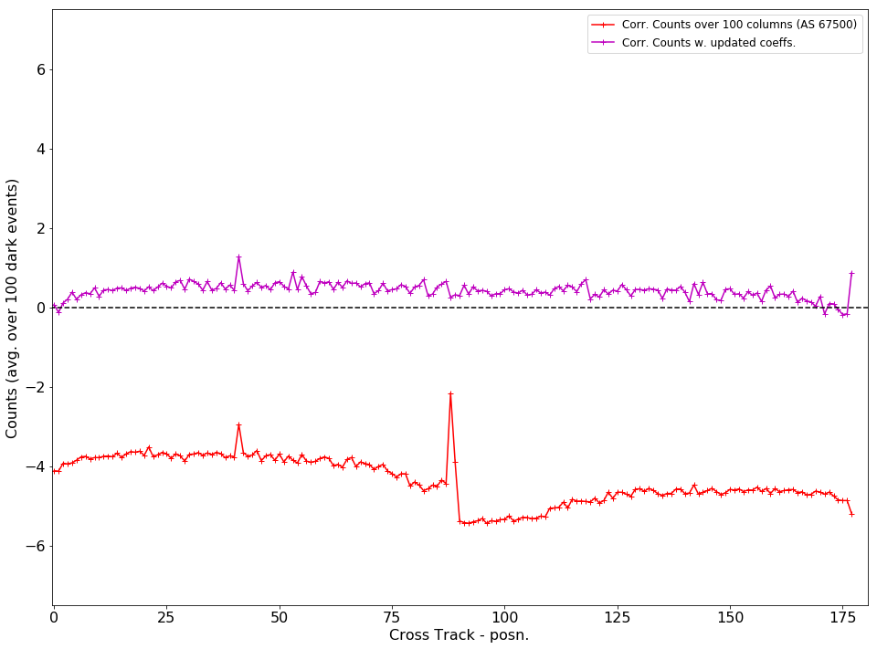
6b. NOAA-20 & NOAA-21 OMPS Calibration, Sri Madhavan et al.
Earth-view Night Data, 2023/12/03
NASA is beginning it’s first reprocessing of the NOAA-20 and NOAA-21 OMPS Nadir Level 1 products. This involves a re-calibration and the addition of several new corrections.
Problem areas (work in progress) include Day 1 radiometry on N21 and Stray Light levels on both N20 and N21.
We anticipate new product releases in May (N20) and July (N21). Data will be available through the GSFC DISC.
EV Night data from 2023/12/03
Counts = Raw-Smear-Dark
New Implementation using 1.25-S integration time
Current dark correction is based on 30-S Integration time which induces an over correction

Slide 9

6c. OMPS Time-dependent calibration, Larry Flynn et al.
Analysis of biweekly working and annual reference solar measurements for NOAA-20 and S-NPP OMPS NP allow accurate characterization of the instrument throughput changes at the 0.1% level.
Soft calibration adjustments to force agreement for all OMPS can be calculated by using the V8Pro and V8TOz ozone, reflectivity and aerosol index estimates and their sensitivity to radiance / irradiance ratio changes.
The stable orbits of the JPSS polar satellites allows the creation of accurate long-term records.
(a)
(b)
Newest
Average Differences
Wavelength Shifts
(c)
(d)
Soar Activity
Differences after subtracting the shift and activity patterns
Oldest

Slide 10
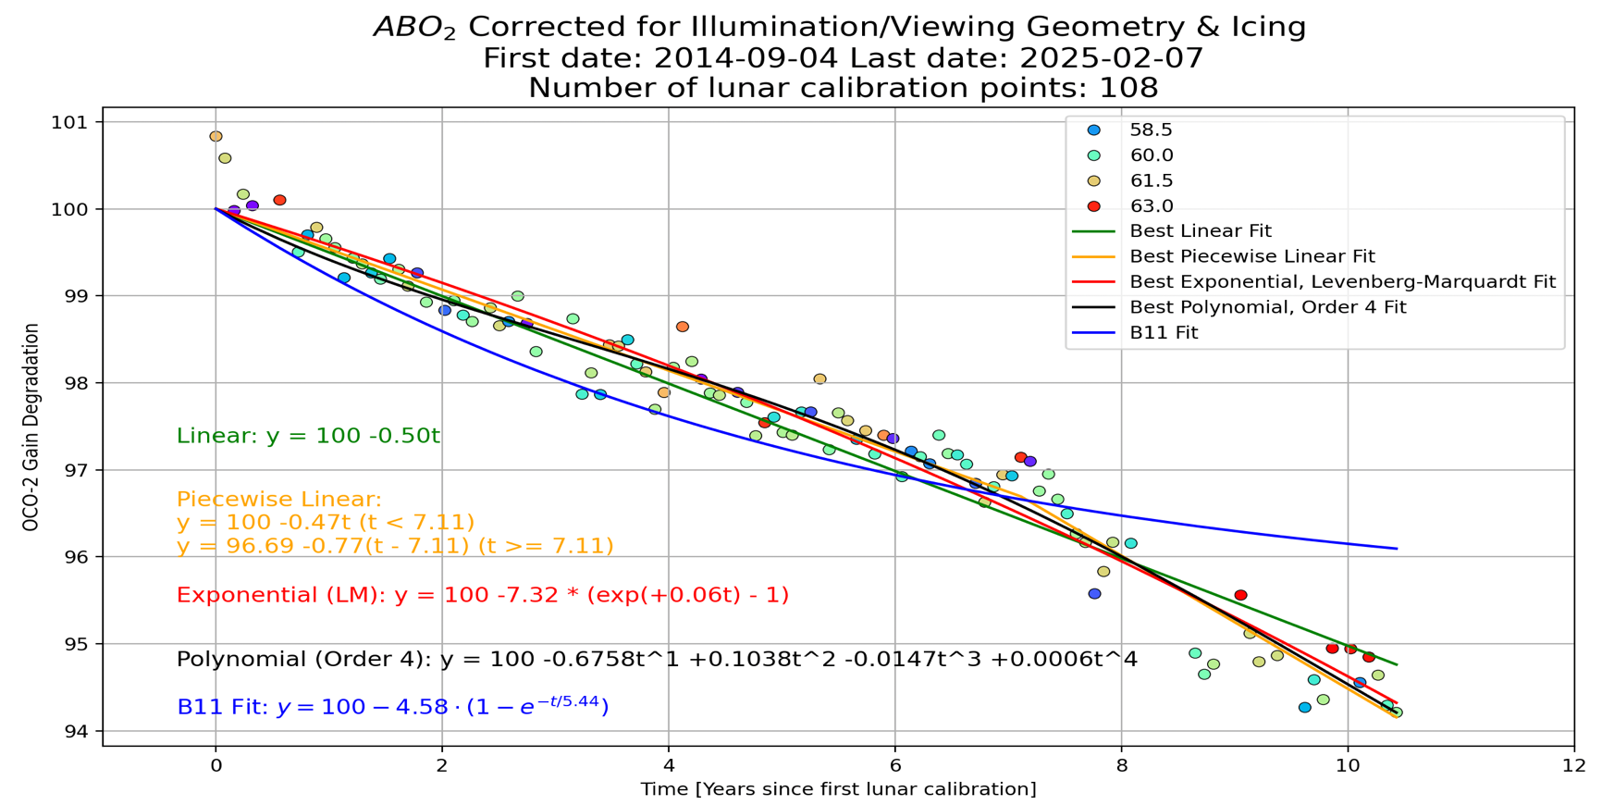
6d. OCO-2 & OCO-3 Radiometric Trends, Rob Rosenberg et al.
Consistently accurate calibration is vital for carbon cycle science.
As record lengthens, reprocessing campaigns cost more, take longer, and are less frequent.
Continuing to monitor detector health using daily dark & lamp measurements, very stable .
Maturing analysis techniques & extending time series for vicarious calibration, simultaneous nadir overpasses, and lunar calibration
Data accessible to the public:
https://disc.gsfc.nasa.gov/
L1B ATBD updated Feb 6. 2024
OCO-2 Waxing Gibbous Lunar Trending
Not fully independent from solar because of icing correction

Slide 11
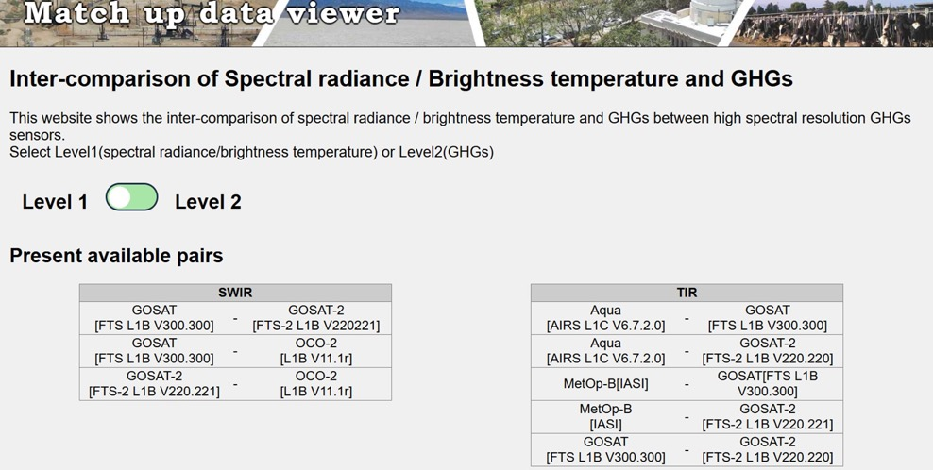
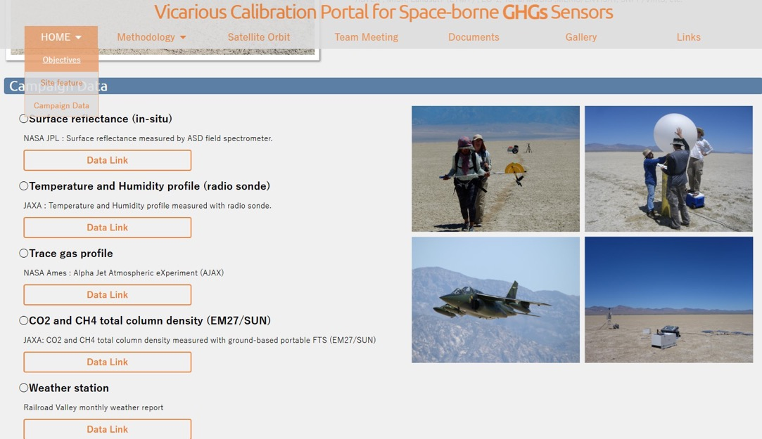
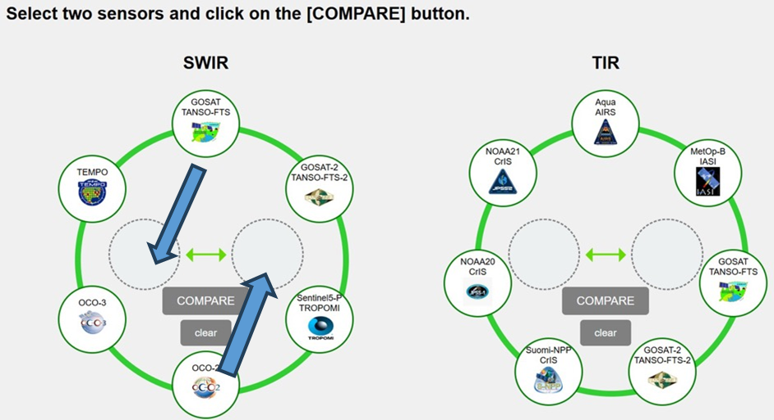
Summary
6e. GOSAT serious calibration and intercomparisons, Kei Shiomi
VCAL portal site update
Match-up data viewer newly release!
Coincident match-ups
For SWIR
(1) Calibrated radiance
XCO2, XCH4, SIF, AOT
For TIR
(1) Calibrated radiance
(2) Brightness temperature
Updated
New
https://www.eorc.jaxa.jp/GOSAT/GHGs_Vical/index.html
https://www.eorc.jaxa.jp/GOSAT/Matchup_forCal/top_matchup_viewer.html
The Railroad Valley field data are available from VCAL portal site.
VCAL team meeting is held every 3-4 months. Next meeting: 12-13UTC, Friday, May 9, 2025.
RRV2025 summer (May30-Jun05): Good for OCO-3 target, TEMPO and hopefully MethaneSAT
RRV2025 fall plan: Good for OCO-3 target, hopefully GOSAT-GW in the initial phase
11

Slide 12
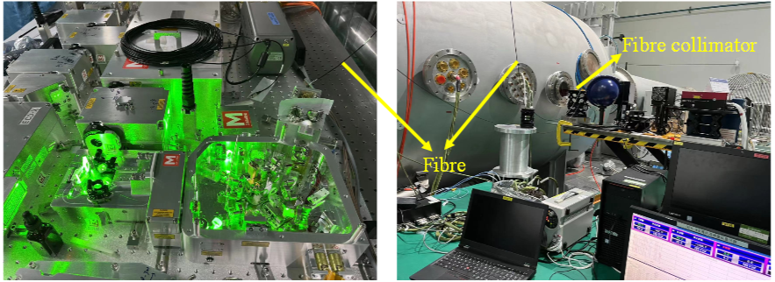
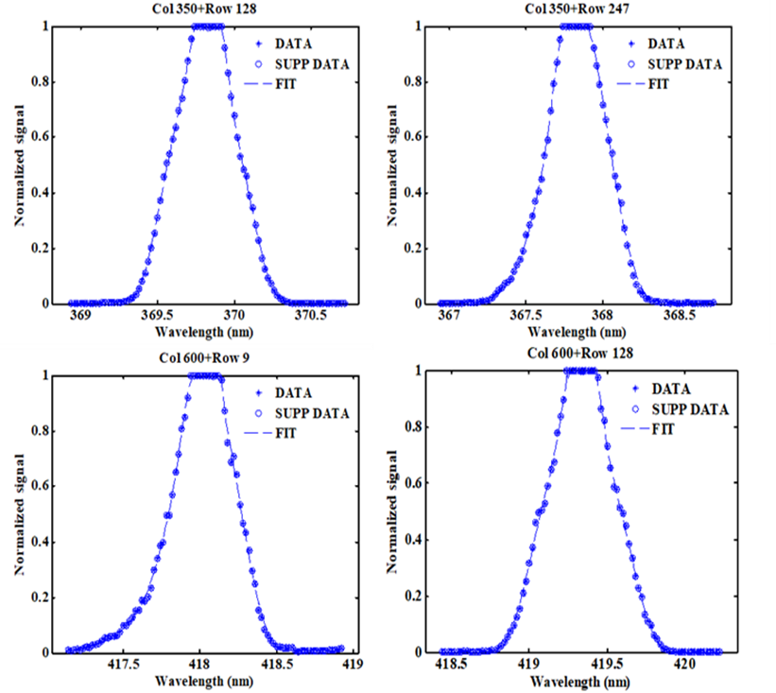
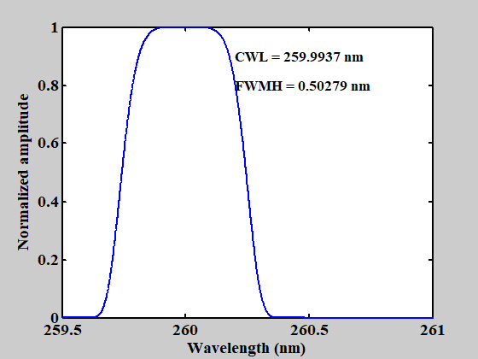
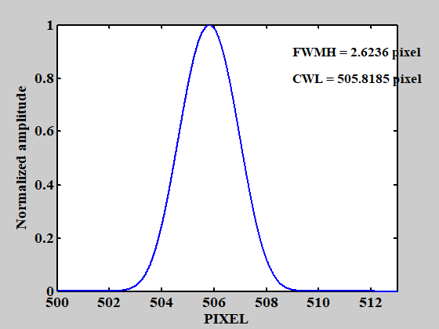
Calibration results for Spectral Response
6f. Calibration results of the FY-3F OMS-Nadir, Jinghua Mao
Method
A narrow spectral line is tuned in small steps.
During tuning, the signal of each individual pixel is followed as the laser scans over this pixel. This is the Instrument Spectral Response Function (ISRF) for each pixel.
ISRF is function fitted iteratively
ISRF for one pixel
Notes:
The method for obtaining the spectral response function is as follows.
We tune a narrow spectral line in small steps. As the laser scans over each pixel, we monitor the signal of that individual pixel.
This data is used to obtain the Instrument Spectral Response Function (ISRF) for each pixel by fitting through a function. This approach allows us to precisely measure the spectral response characteristics of each pixel of the instrument.
This graph shows the ISRF for one pixel. For example, at a central wavelength (CWL) of 259.9937 nm, the full (FWMH) is 0.50279 nm.
These spectral response data help us accurately understand the instrument's spectral info..

Slide 13
6g. In-orbit Calibration & Performance Analysis for OMS-Limb, Yuan Li et al.
In-Orbit Temperature Stability
The temperatures of the detectors in Bands 1 and 2 are stable within the range of-10.2°C to-9.8°C, showing no obvious upward or downward trends.
Calibration and Positioning Stability
OMS-L shows stable in-orbit radiation performance. Its change in radiation responsivity is within 2%.
The temperature of the grating base, which is related to spectral registration, varies minimally and is basically stable between 15.8°C and 16°C. Only some discrete points are generated during tungsten lamp calibration.
The spectral performance of OMS-L is stable with a wavelength drift of less than 0.01nm.
The positioning difference of the knee-point tangent height is about 0.5km.
Four plans in this year will be of great significance for the normal operation and scientific data accuracy of our in-orbit mission. They are:
Optimization of Integration Time for Different Tangent Heights.
In-orbit Tracking and Correction of
Radiation Responsivity
Polarization Degradation
Spectral Shift

Slide 14
6h. Pre-launch Calibration of FY-3F OMS-Limb, Haochen Li, et al.
OMS-Limb is a UV/Vis limb-scatter spectrometer instrument with a scan mirror with a nominal vertical range of 15-60 km (extended to 9-84 km in-orbit). and two bands covering at 290-400 nm and 390-500 nm at 0.4-nm (?0.6) resolution. Ground-based characterization has been performed for of spectral response and wavelength scales with a tunable laser providing extensive characterization at 0.05 nm intervals. The bandpasses are modelled with Gaussian functions. Further radiance / irradiance calibration was obtained by using an Integrating sphere with three different radiance standards. The tungsten lamp response shows nonlinearity, and a jump point at integration time of 32 – a 1% effect. Similar results were seen with the Xenon Lamps. The RSS Uncertainty matrix for radiometric calibration provides a total uncertainty of ~3%.
  Specifications
SN | Parameter Name | Specification Requirements
1 | Spectral Range | 290-500nm
2 | Spectral Resolution | 0.6nm@290-500nm
3 | Spectral Sampling Rate | Continuous sampling pixel by pixel
4 | Wavelength Calibration Accuracy | 0.01nm
5 | Scanning Mode | Along the vertical height direction of the Earth's limb
6 | Scanning Field of View Angle | Better than ±1.8° (vertical, direction of the Earth's limb)
7 | The Pointing Accuracy of The Scanning Mirror | Better than ±0.01°
8 | Spatial Resolution | Better than 3km(vertical, direction of the Earth's limb)
9 | Instantaneous Field of View | 2.3° (horizontal)×0.045 ° (vertical)
10 | Dynamic Range | 10⁵
11 | Relative Radiometric Calibration Accuracy | Better than 2%
12 | Calibration Accuracy of Diffuse Reflector | Better than 3%
13 | Absolute Radiometric Calibration Accuracy | Better than 3%
14 | Signal to Noise Ratio | >300@0.1μw/cm²⋅sr⋅nm(radiance)
15 | Spectral Stray Light | 10⁻⁵
OMS-L can achieve continuous spectral limb detection in the range of 290nm-500nm, at an altitude of 0-100km, with a spectral resolution of 0.6-nm.

Slide 15
8a: Study on EMI decay monitoring and correction in orbit, Fuqi Si, et al.
The EMI instrument and its on-ground calibration were presented, covering the diffuser and radiometric calibration (accuracy of 4.3%). In terms of in orbit monitoring, the spectral stability and radiance trends were presented, the latter based on the analysis of scenes of Greenland and the Antarctic. Comparison against TROPOMI (similar orbit & equator crossing time) shows a relative error of 6% across the spectrum.

Slide 16
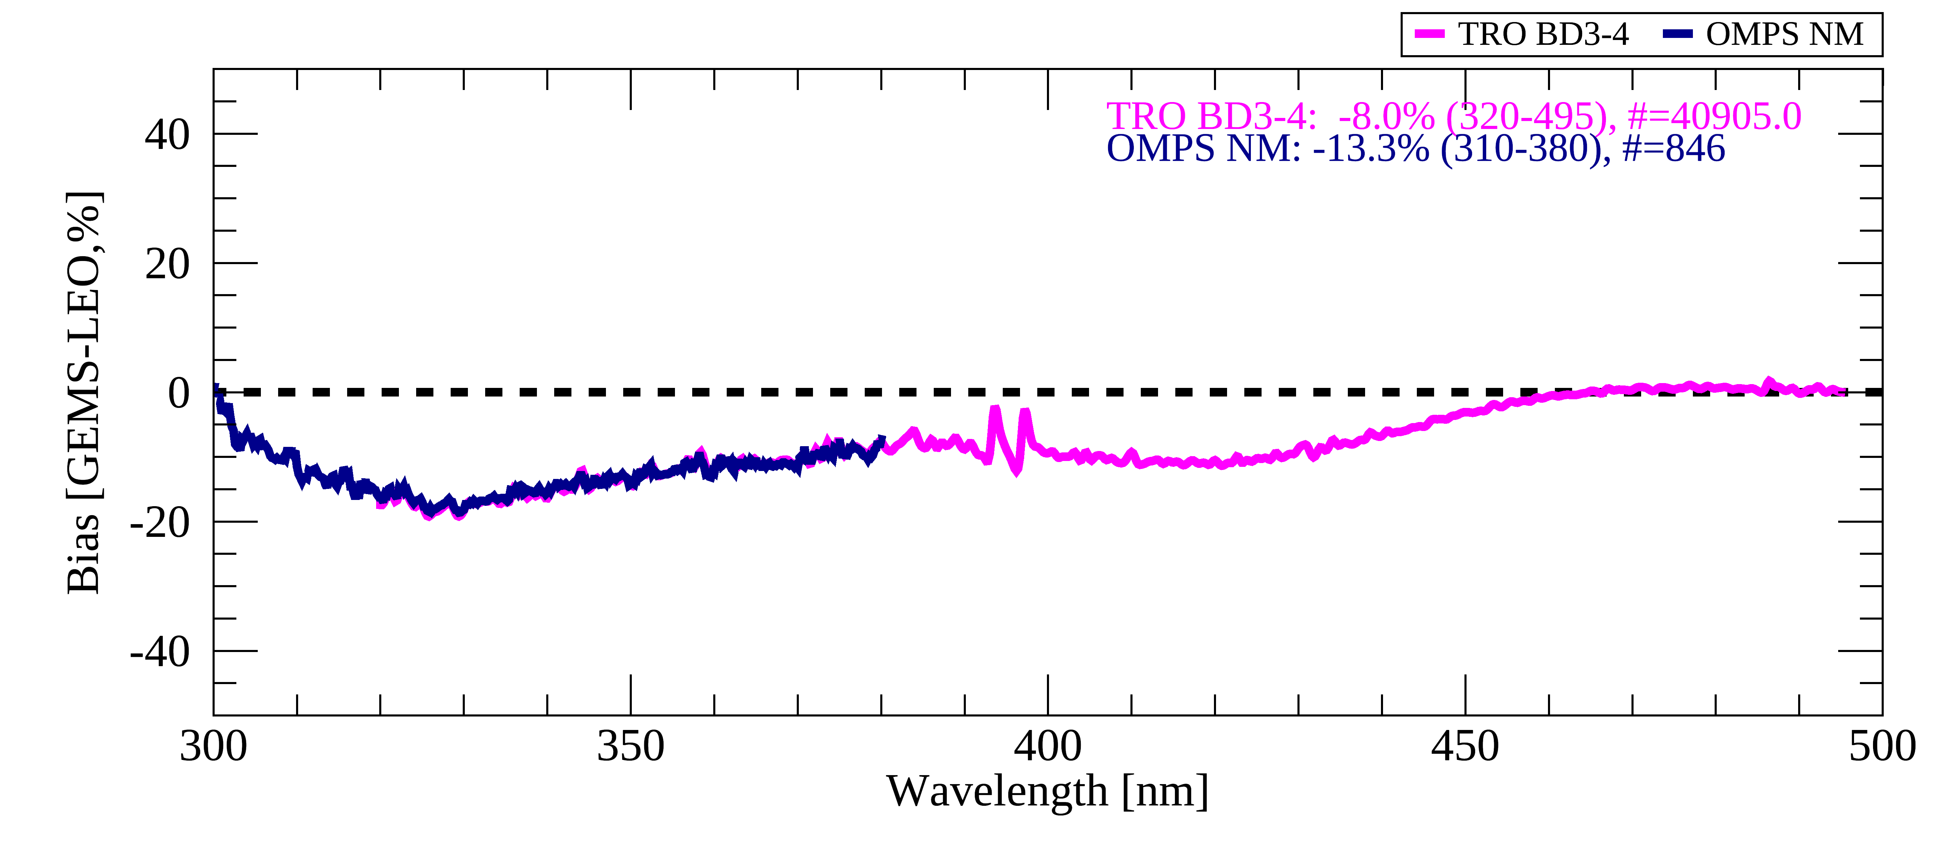
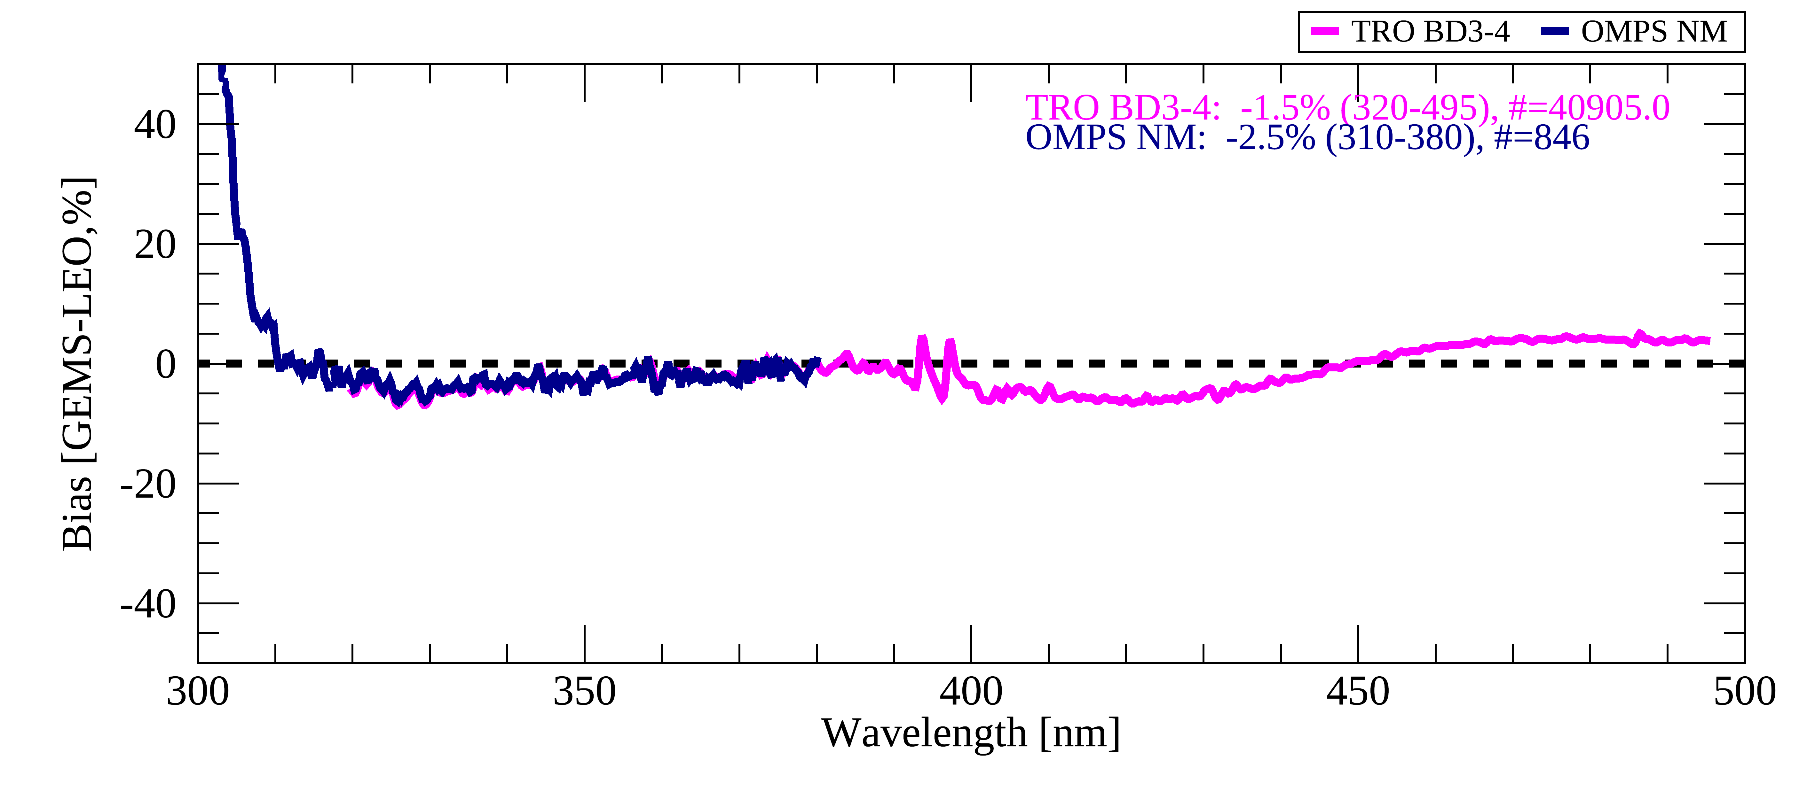
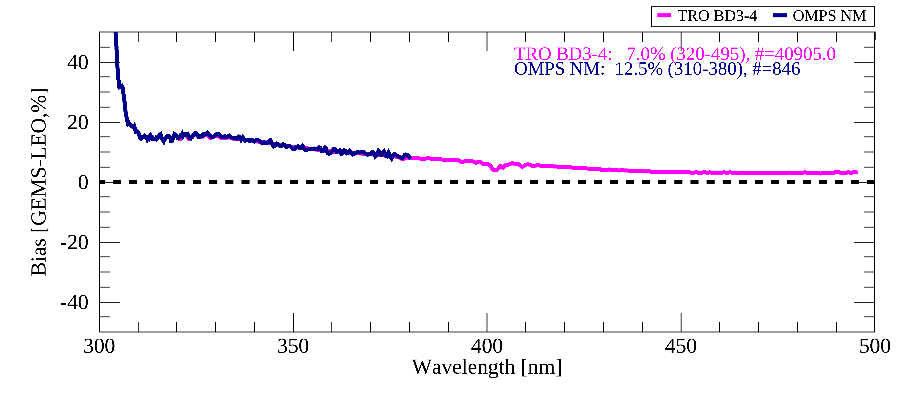
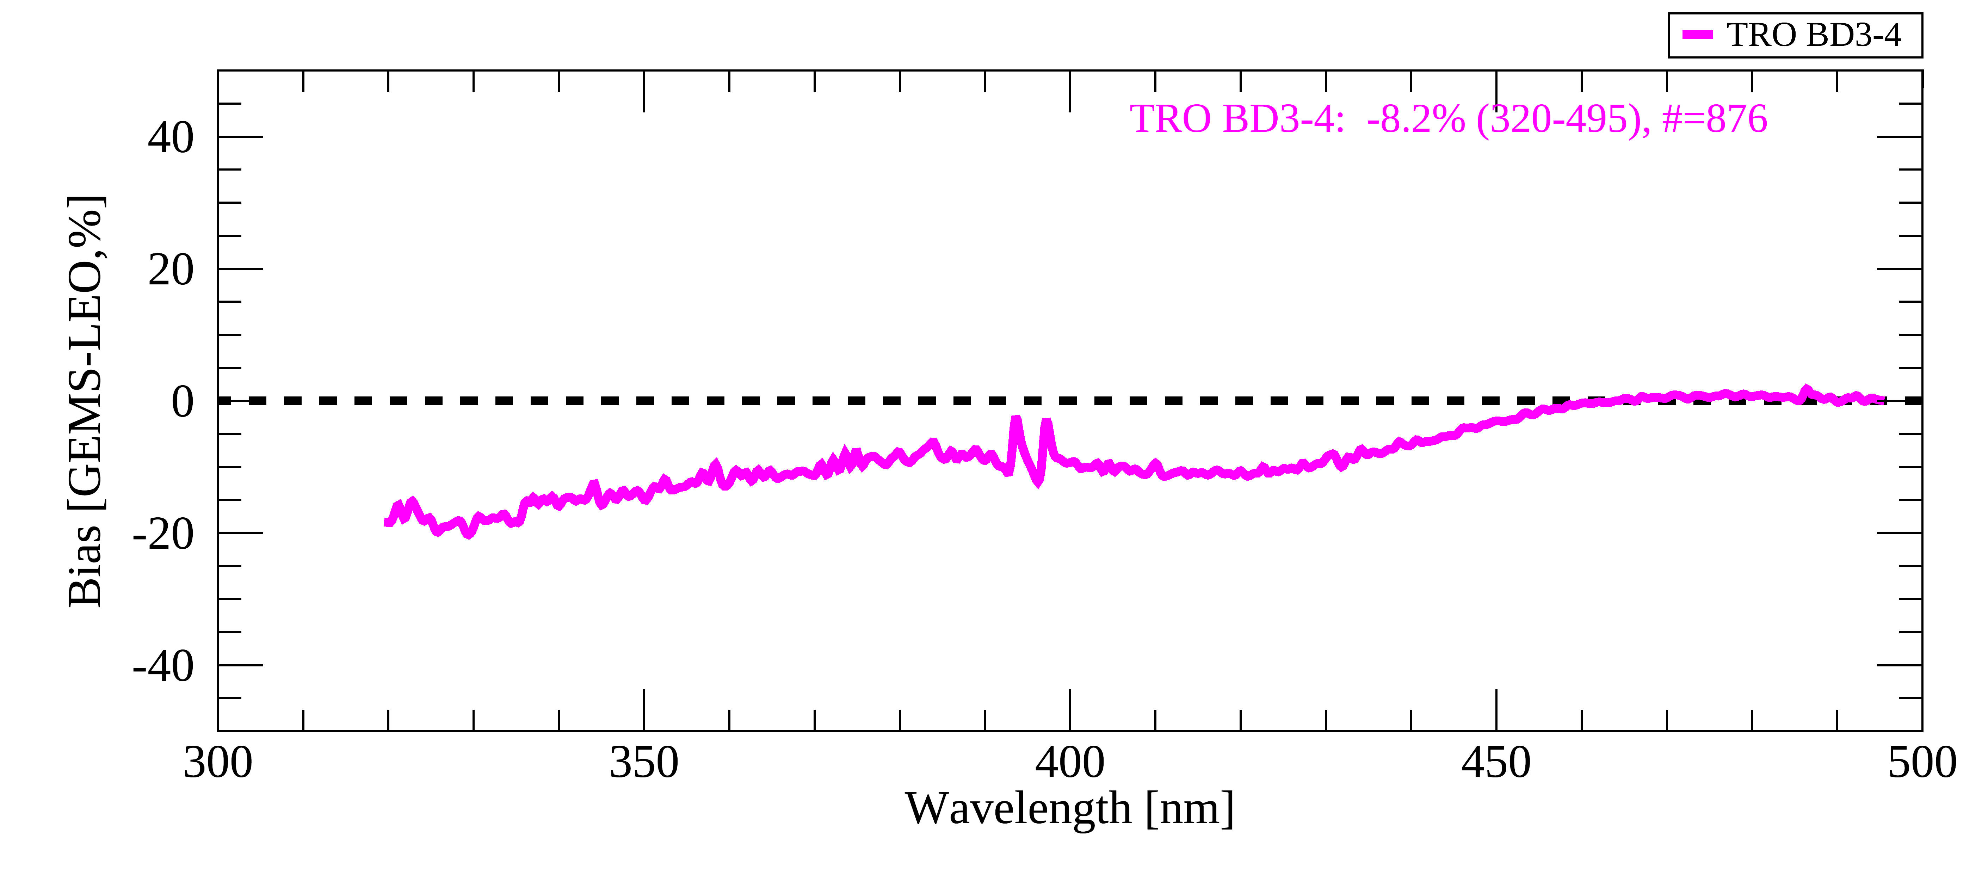
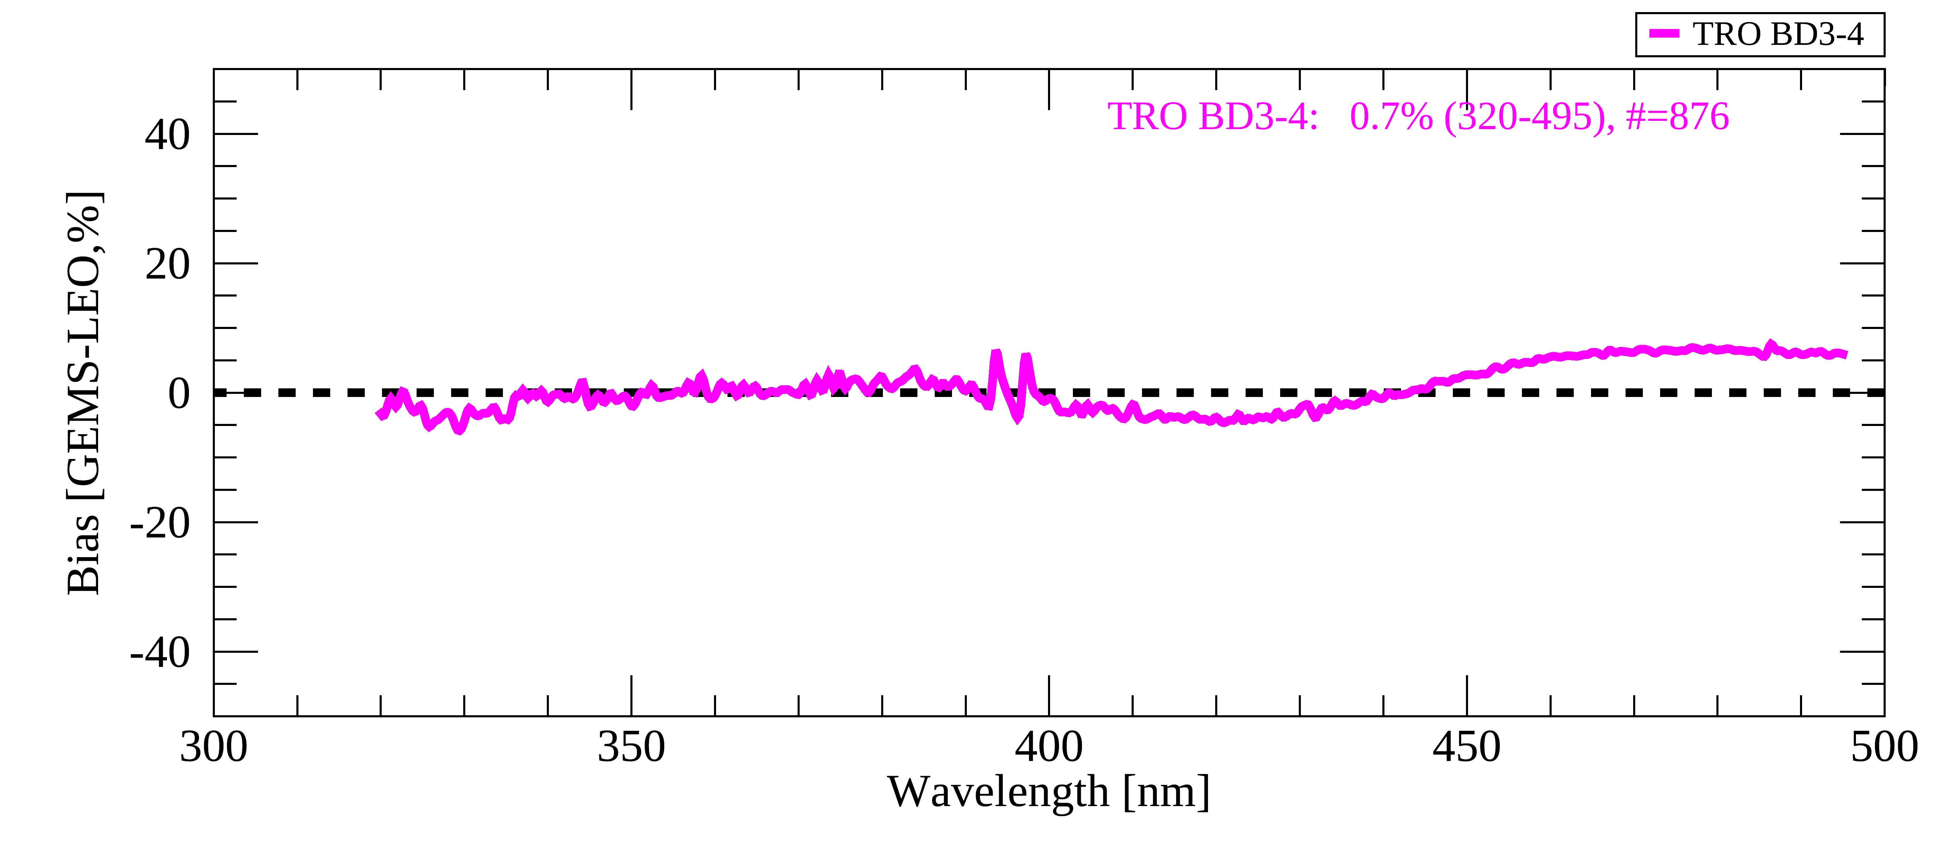
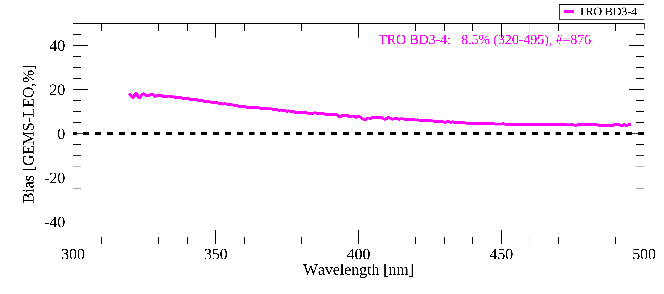
Validation Results – after BTDF update
8b: Calibration & validation for GEMS Level 1 Products, Yeeun Lee et al.
Collocation w/ TROPOMI BD3-4 and OMPS/SNPP NM
  January 2021 – February 2025, five-days interval
DCCs
Irradiance Radiance Reflectance
SSP
Irradiance Radiance Reflectance

Slide 17
8c. Calibration and validation concept of the CO2I/NO2I instrument on-board the CO2M mission, Bernd Sierk,, et al.
CO2M mission for monitoring of anthropogenic greenhouse gas emissions
  Multi-instrument payload (“hyper instrument”) with combined retrieval of CO2 (and CH4)
    CO2I/NO2! Push-broom imaging spectrometer for measurement of XCO2 and XCH4
    Multi-Angle Polarimeter (MAP for Aerosol measurement
    Cloud Imager (CLIM) for sub-sample cloud flagging/characterisation
CO2I/NO2I “special features”
  Fibre-based slit homogenizer with implications on (un-)binning strategy
  Detector lag/persistence/memory effects require detailed models and corrections
    Development of correction algorithms are on-going, to be implemented in operational L1b processor
    Will require vicarious (re-)calibration at Level-1 (contrast scenes)
Product Cal/Val system under development
  Four–pillar approach,
    Cross-calibration with other missions (OCO-2/3, GOSAT-1/2/GW, MicroCarb, Sentinel-5/4)
    Product validation with ground networks (YTCCON, COCCON, PanIR, Aeronet, …)
  Development of system for continuous quality monitoring
    GBP requirements established
    Implementation phase kicked off

Slide 18
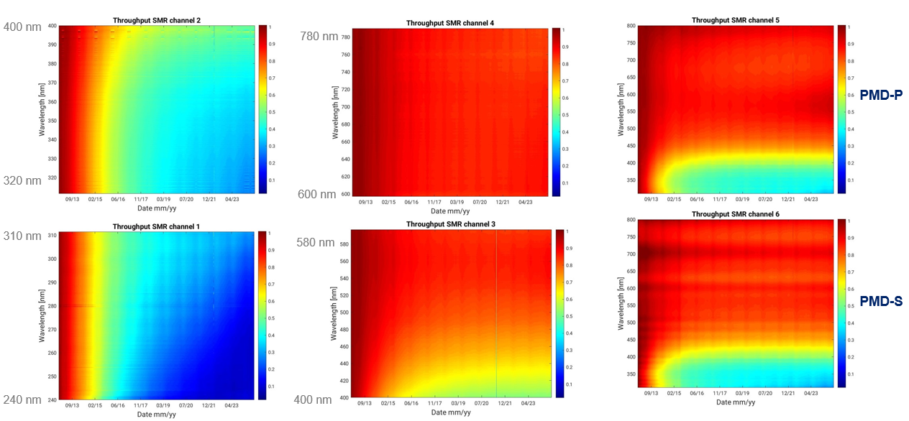
8d. Status of GOME-2 calibration and outlook for Sentinel-4 & Sentinel-5,
Rasmus Lindstrot, et al.
Metop-B GOME-2: Radiometric degradation

Slide 19
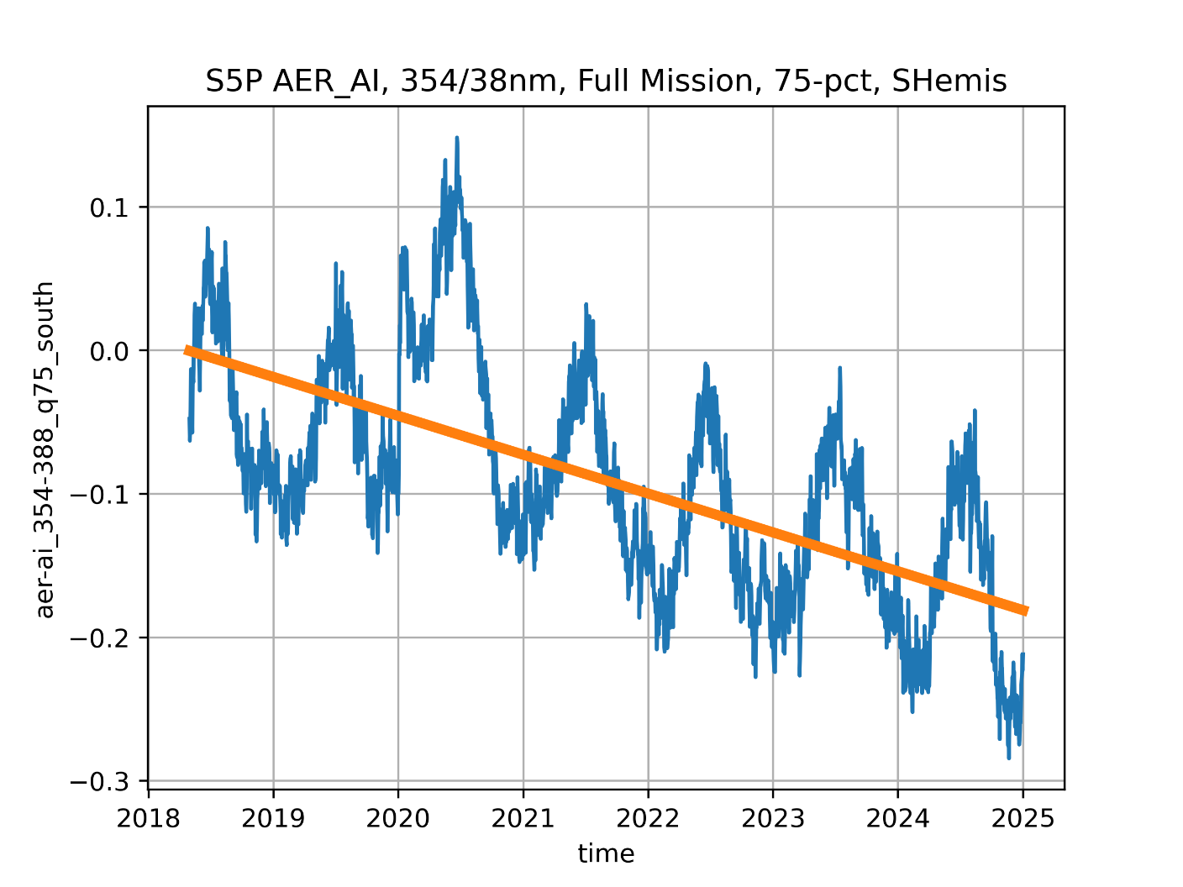
8e. OMI-TROPOMI Overview, Deborah C Stein Zweers
OMI and TROPOMI missions are operating well
  Both OMI and TROPOMI are beyond mission lifetimes
    OMI remains stable and functioning despite advanced mission “age”
    TROPOMI is stable and providing high quality science data for Level 1 and more than 12 Level 2 operational data products, plus additional research products
      Erwin Loots will give more details about the instrument & calibration, next presentation
  Level 1 processing for OMI & TROPOMI harmonized to facilitate combined datasets
    OMI: Nov 2004 to present – More than 20 years of data!
    TROPOMI: May 2018 to present – Nearly 7 years, overlap with OMI
    Time resolution OMI combined with improved spatial resolution TROPOMI allows for much deeper understanding seasonal and interannual effects for emissions etc.
  Data are free and open
  https://www.tropomi.eu &
  https://dataspace.copernicus.eu/
  https://maps.s5p-pal.com/

Slide 20
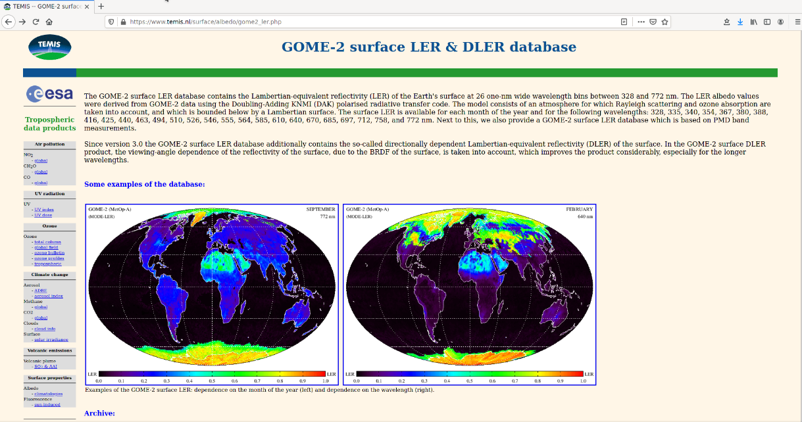
8f. GOME-2 & TROPOMI directional surface reflectivity, Erwin Loots, et al.
Databases are available for download: www.temis.nl/surface/albedo.html

Slide 21
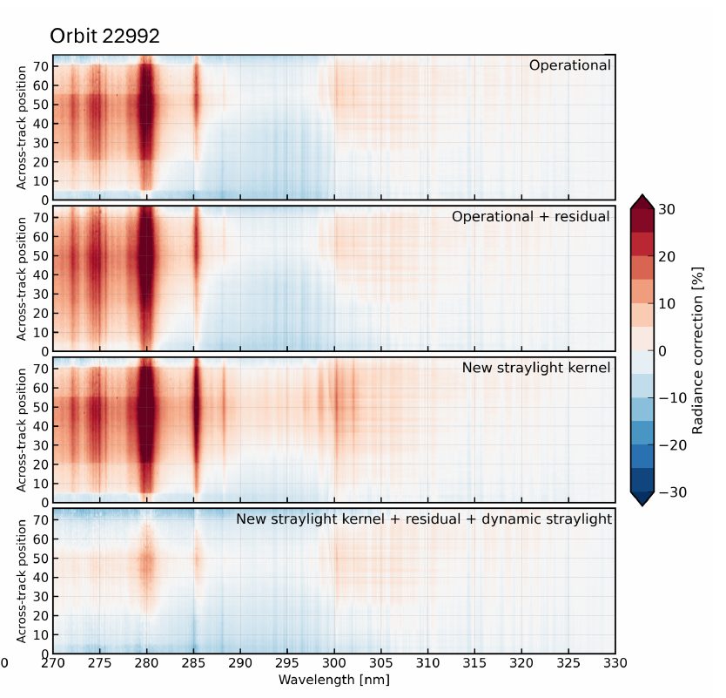
8g. TROPOMI L1 UV, Vis, & NIR status update , Erwin Loots, et al.
Analysis of instrument degradation lead to suspicion of uncorrected-for additive signals (offsets)
Especially in UV, since the absolute signal there is low
Three offset candidates, three corresponding adjustments to th1 L1b Processor:
  Straylight convolution kernel (static). → Re-assessment of on-ground calibration: alternative convolution kernel that partly closes the ‘in-flight straylight gap’.
  (Temporally increasing) Difference between calculated and observed straylight. → Use LSLR/USLR measurements to impose a dynamic (delta) straylight correction
  Residual out-of-model signal. → Use aggregate background measurements, converted to residual CKD for a residual correction
These improvements work well in the case of the UV detector, see ozone profile retrieval algorithm
Continuing research, together with L2 scientists, on feasibility of these potential improvements for UVIS and NIR detectors
Results: Soft calibration ozone profile retrieval algorithm
“Characterization of the TROPOMI UV radiometric calibration for the operational Ozone Profile retrieval algorithm”, Di Pede et al, in prep.

Slide 22
8h. FDR4ATMOS: Current Status and First Results of Phase 2, Güner Lichtenberg
The added value of the FDR is:
GOME-1 SMR is harmonised to independently validated SCIAMACHY SMR
SCIAMACHY data scaled to minimum integration time in band
Reflectances are directly provided
GOME-1 UV viewing angle dependency mitigated
L1 errors decomposed into systematic and random components
Phase 1: Harmonization of GOME-1 and SCIA
Phase 2: Inclusion of GOME-2 and publication of GOME-2 lunar data record
For v1, a limited L2 impact study was conducted, showing that the harmonization does not affect the L2 DOAS retrievals for ozone. EUMETSAT has provided calibrated lunar data and this will be released this year.
GOME-1 Degradation Correction

Slide 23
8i. On-orbit status of FY-3E SSIM UV band, Jin Qi, et al.
The Solar particle events in the South Atlantic Anomaly region have an influence on data quality, especially on UV band;
UV band spectral calibration show a stable pattern, since the spectral accuracy matched the requirement, no correction is applied;
Based on the calibration ratio results, wavelength drift correction is needed;
The UV band degradation is significant, mostly from the detector, and we need to consider it from instrument design;
We will have another SSIM on-board FY-3I. Some optimization ideas have already been implemented.
UV1 compare to UV2 with backup quartz

Slide 24
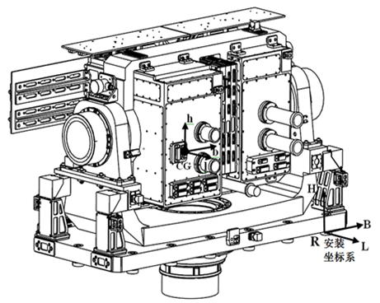
8j. Inflight Calibration of the FY-3E SSIM VIS Band, Xiaohu Yang, et al.
Electric Box
For the SSIM VIS band’ 3.5-year inflight time, The wavelengths show yearly periodicities in the range of Calibration Accuracy 0.05nm, which needs to be corrected in order to obtain more accurate data; Attenuations of the commonly used variable part1 are monotonically increasing with time, and also larger as the wavelength becomes shorter, with 8.7% at 300nm and 0.4% at 700nm until now; Attenuations of the stable parts are same law but bigger than the commonly used variable part1 at the same time, with 16.2% at 390nm and 0.5% at 700nm until now.
VIS Band
UV1 Band
UV2 Band
Sun Guide Telescope
2-D Turntable
NIR Band
Wavelength Variation of SSIM VIS Band

