Slide 1
GSICS - 2025
Radiometric Calibration using Artificial Intelligence (AIRC)
Boyang Chen*, Na Xu, Shengli Wu, Peng Rao, Changpei Han
（陈博洋，徐娜，武胜利，饶鹏，韩昌佩）
National Satellite Meteorological Center, Chinese Meteorological Administration, et al
2025.3

Slide 2
01
Definition of Radiometric Calibration and Performance
02
Our idea about Radiometric Calibration using AI
CONTENT
目录
03
Performance and analysis to AIRC
04
Discussion

Slide 3
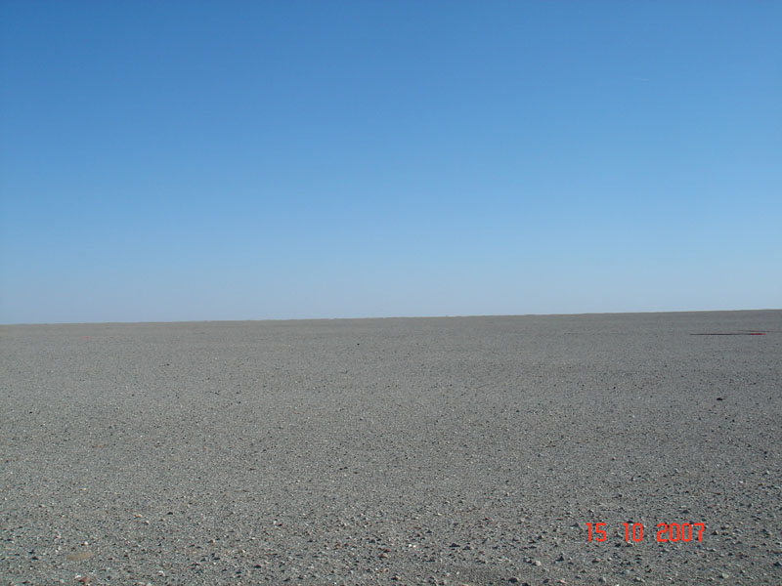
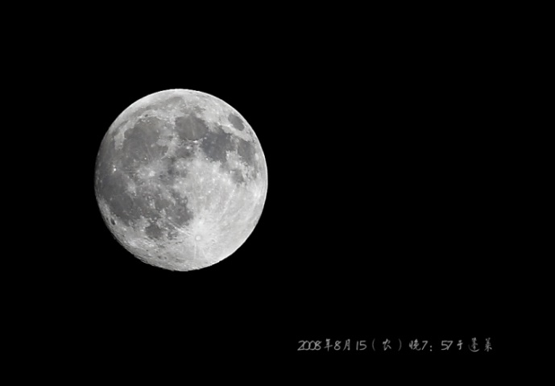
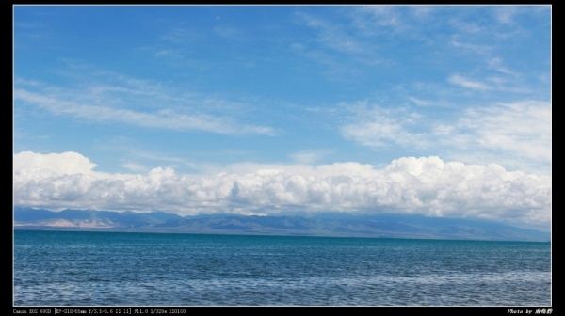
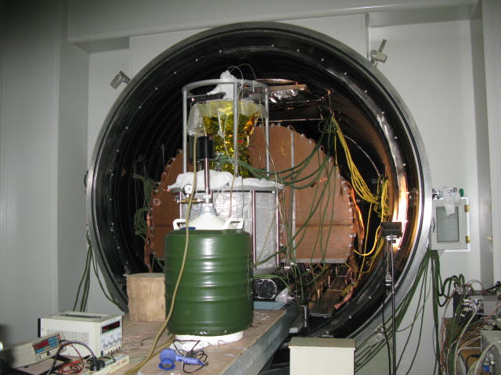
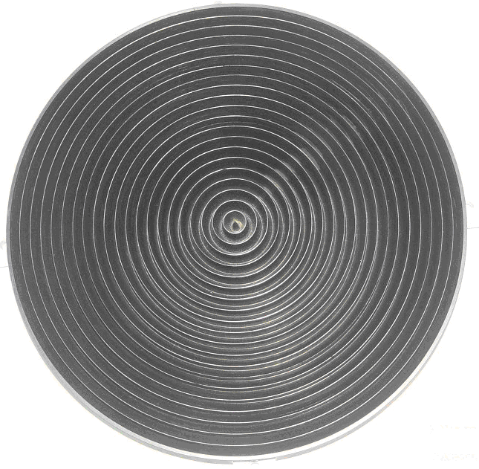
Radiometric Calibration
The Working Group on Calibration and Validation (WGCV) of the Committee on Earth Observation Satellites（CEOS) define “Calibration”:
The process of quantitatively defining the system response to known, controlled signal inputs.
——Belward, A. S. International co-operation in satellite sensor calibration; the role of the CEOS Working Group on Calibration and Validation. Adv. Space Res. 23, 1443–1448 (1999).
The
kth
Calibarion Coefficient
The
Pair of known, controlled radiometric source and its response
ith
fitting
To calculate
while

Slide 4
01
Definition of Radiometric Calibration and Performance
02
Our idea about Radiometric Calibration using AI
CONTENT
目录
03
Performance and analysis to AIRC
04
Discussion

Slide 5
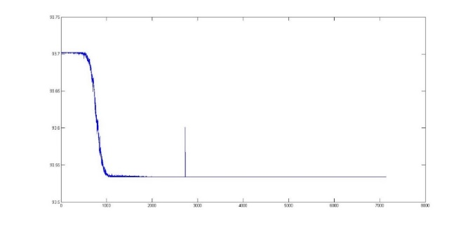
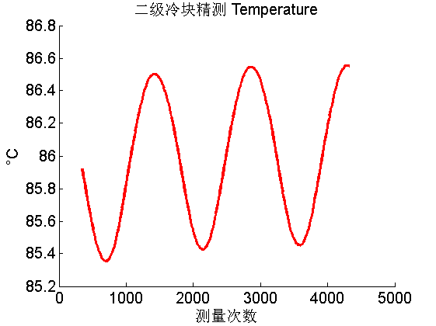
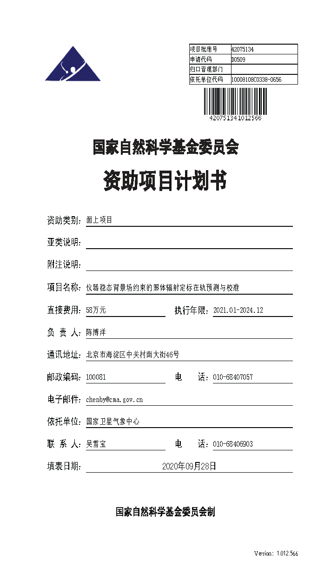
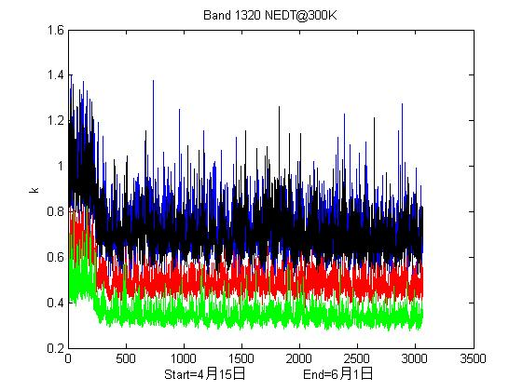
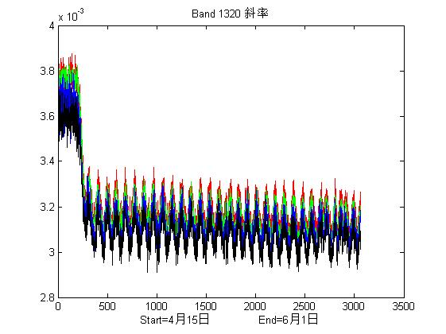
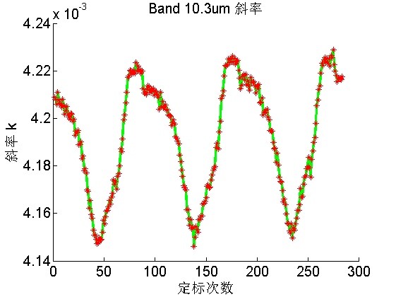
2.1 Unstable temperatures of Radiant Cooler of AGRI on FY-4A
Analyse the unstable temperatures
——supported by National Natural Science Foundation of China
The temperatures of Radiant Cooler of FY-2（Stable）
Similar！
But Not
The Same
The temperatures of Radiant Cooler of FY-4A/AGRI（Unstable）
Sensitivity of FY-4A/AGRI
The slope of FY-4A/AGRI
The slope of Channel 10.3 um of FY-4A/AGRI

Slide 6
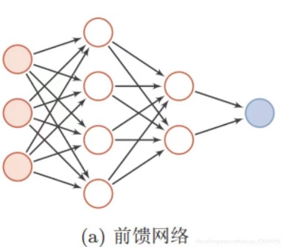
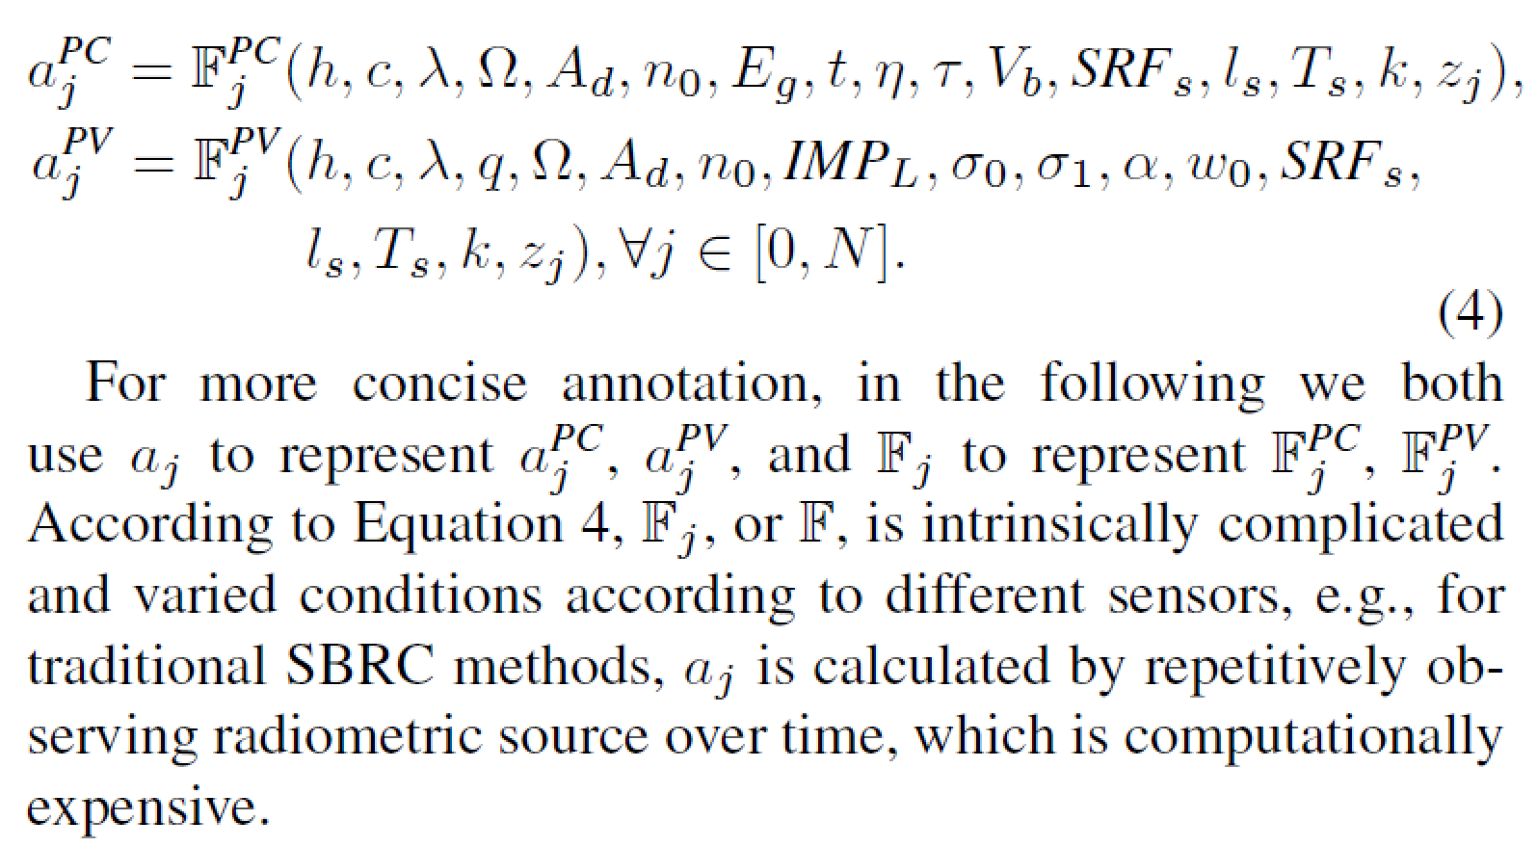
2.2 Find the relation between RC coefficients and the states of sensor
We have derived that:
the RC coefficients are the function of sensor states
Inputs:
Temperatures from all the components in the optical paht of the sensor
Outputs:
Radiometric Calibration Coefficients
pc: photoconductance
pv: photovoltaic
Radiometric Calibration Neural Network
(RCNN)
More details ： （Boyang Chen, et al）IEEE TGRS, vol. 63, pp. 1-16, 2025
Radiometric Calibration using Artificial Intelligence: Constituting Uniform Observing System for Infrared Satellites
DOI: 10.1109/TGRS.2025.3534794
Download : https://ieeexplore.ieee.org/document/10855605

Slide 7
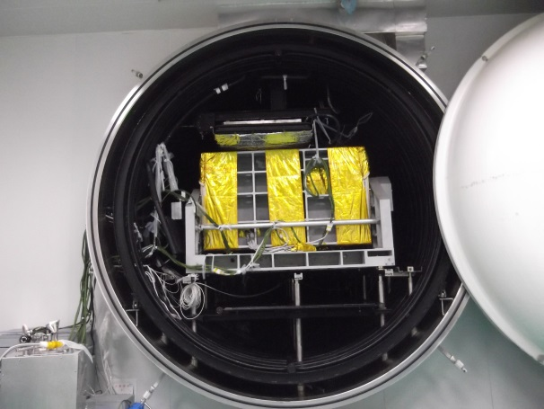
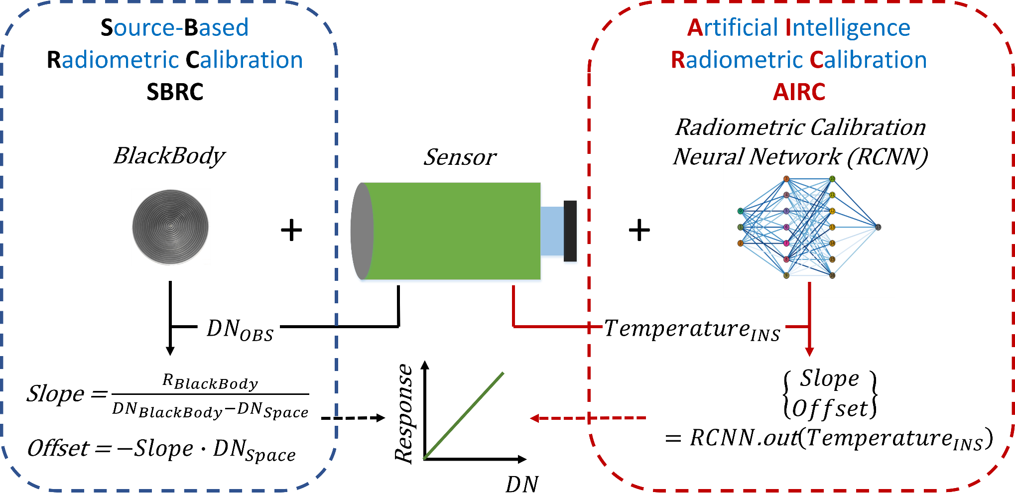
2.31 Work Models of AIRC
外壳 温度 (℃) | 太阳屏 温度 (℃) | 辐射板 温度 (℃) | 一级 温度 (K) | 二级 温度 (K) | 二级制冷余量 (mW) | 辐冷筒温度(℃)
-107.04 | -109.93 | -112.55 | 109.25 | 80.17 | 20 探测器通电 | -18.56
-107.14 | -109.93 | -112.67 | 108.98 | 78.22 | 0 探测器通电 | -18.93
-100.89 | -104.11 | -108.45 | 112.19 | 83.45 | 40 探测器通电 | -10.07
-99.60 | -102.84 | -107.53 | 113.17 | 88.30 | 92 探测器通电 | -4.74
-99.68 | -102.92 | -107.53 | 113.22 | 88.29 | 100 探测器未通电 | -4.08
Typical work mode:
Using pre-launch Calibration Result To
train the RCNN
RCNN：The relation between RC coefficients and work station

Slide 8
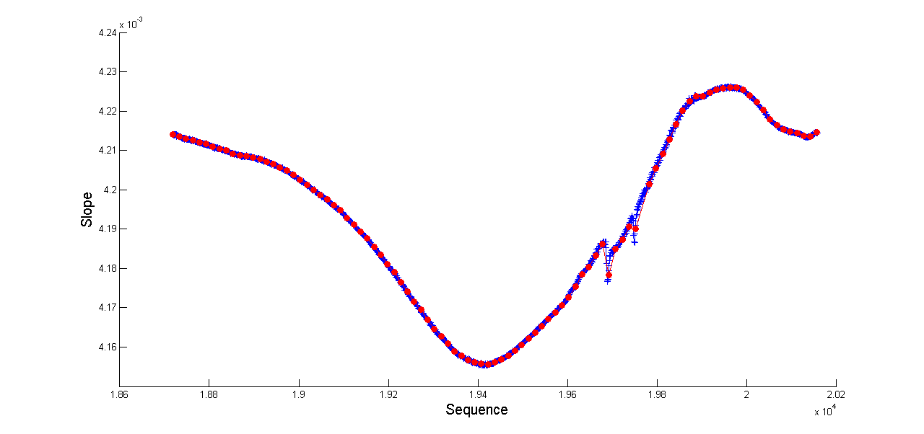
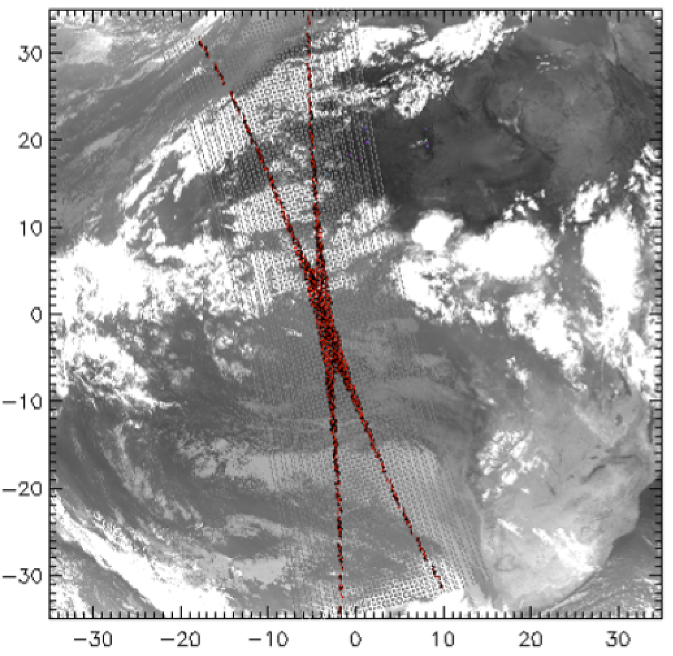
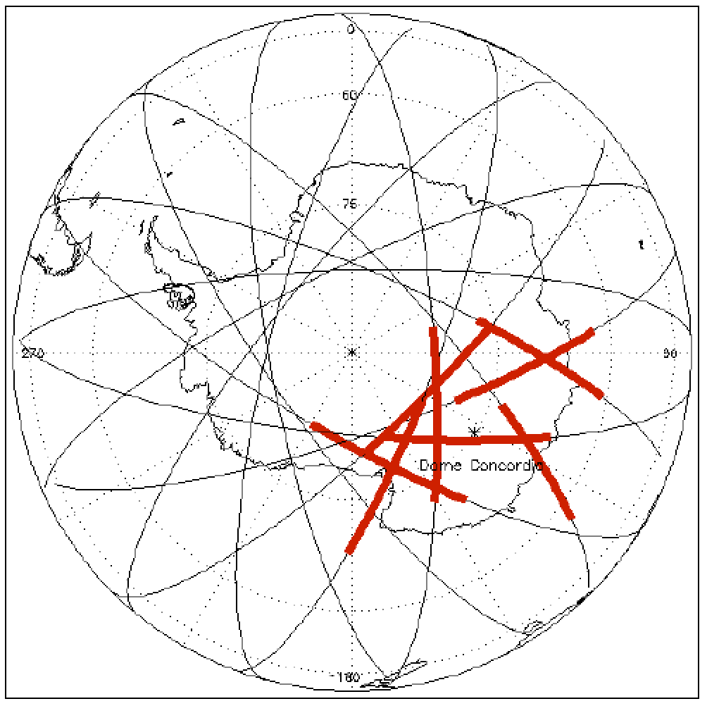
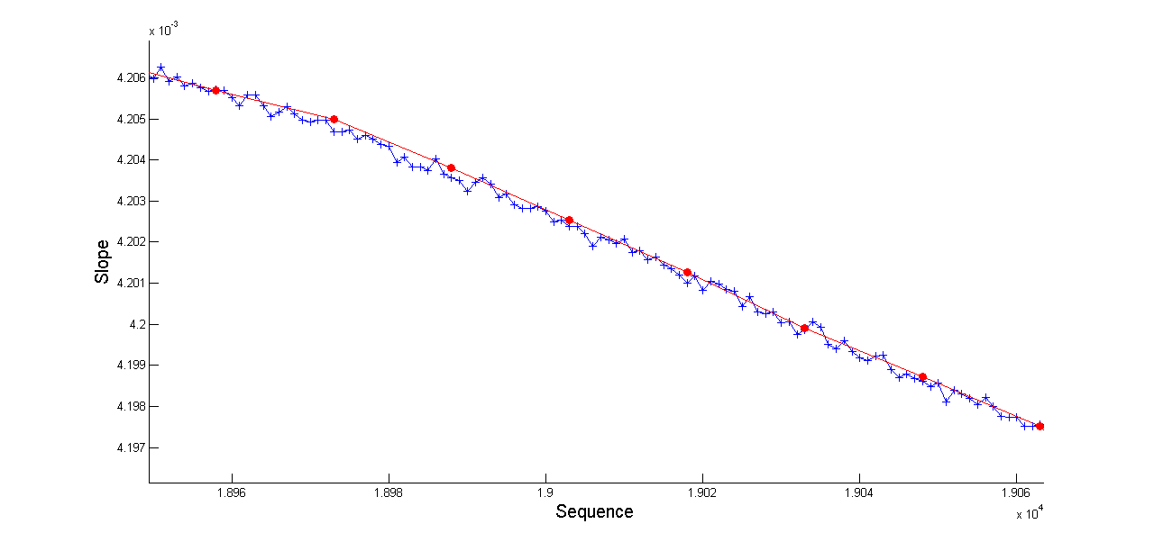
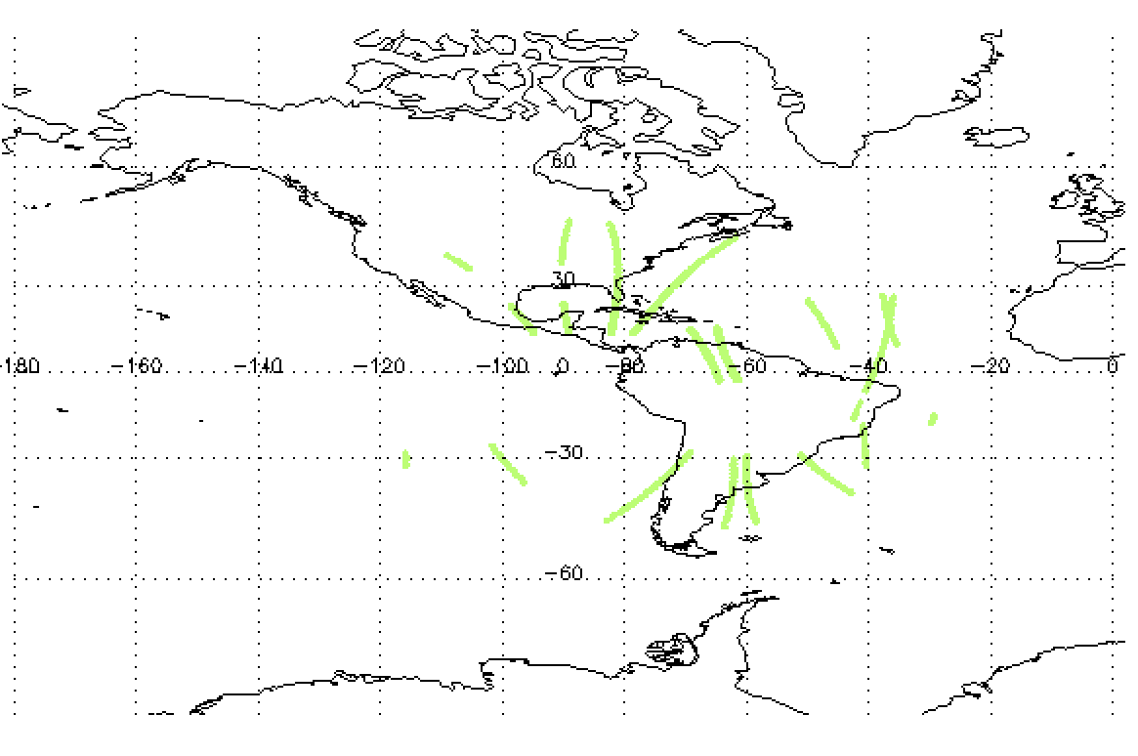
2.32 Work Models: On-orbit RC && AIRC, GSICS && AIRC, et al…
encrypting
On-Orbit RC-15 mins
AIRC- 1 mins
On-Orbit RC && AIRC
GSICS && AIRC
Magnified view of up fig

Slide 9
01
Definition of Radiometric Calibration and Performance
02
Our idea about Radiometric Calibration using AI
CONTENT
目录
03
Performance and analysis to AIRC
04
Discussion

Slide 10
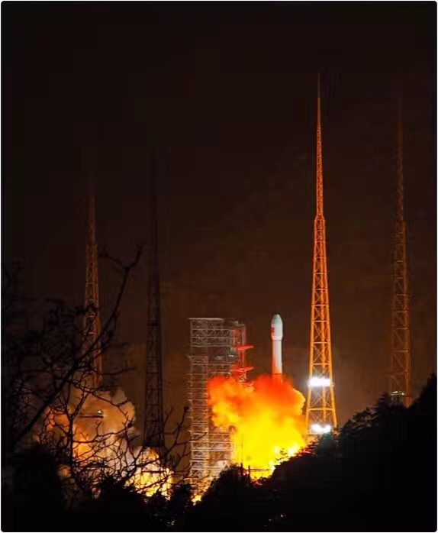
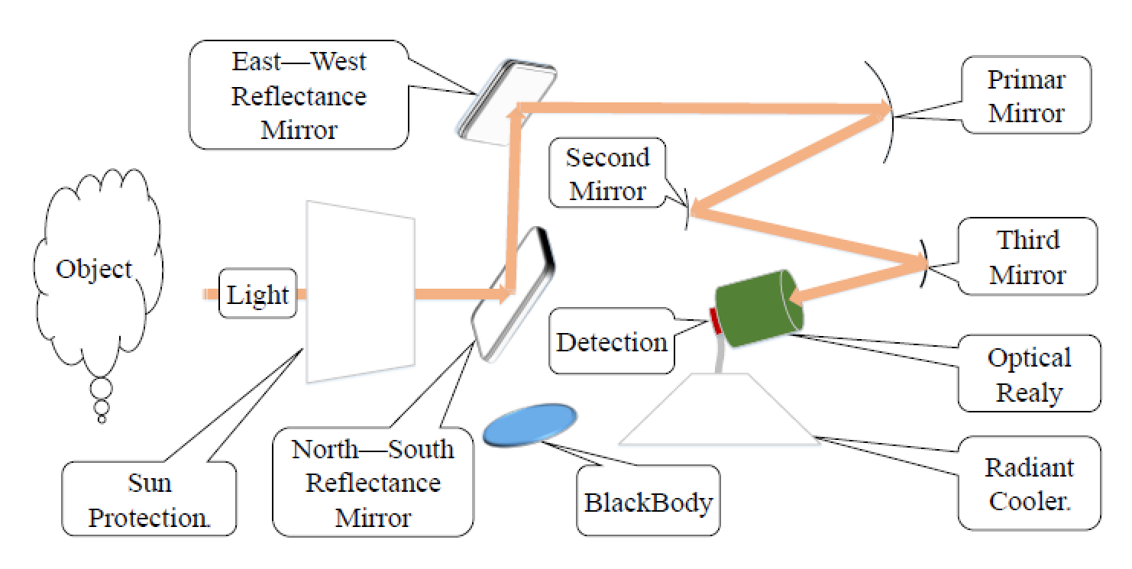
3.1 Introduction to FY-4A AGRI ---- Experiments data for AIRC
Optical Path of AGRI
With an on-orbit blackbody
On-orbit Radiometric Calibration performance per 15 minutes
The temperatures measurement to 8 components
Total 18 temperatures, some of components are more than 1 temperature measurement
AGRI on FY-4A was launched on 11 Dec, 2016

Slide 11
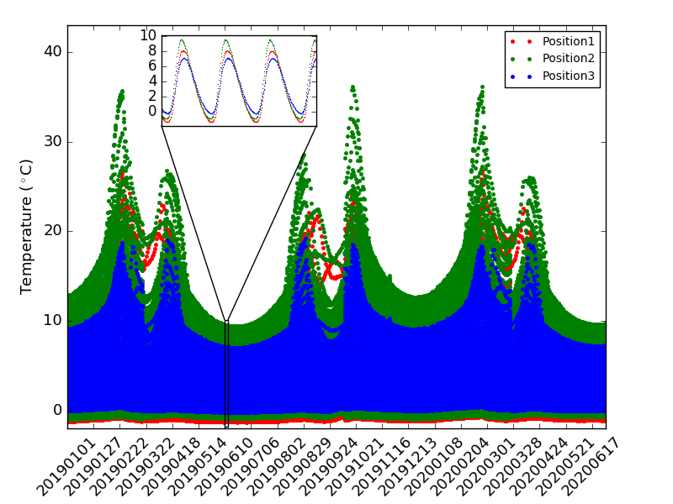
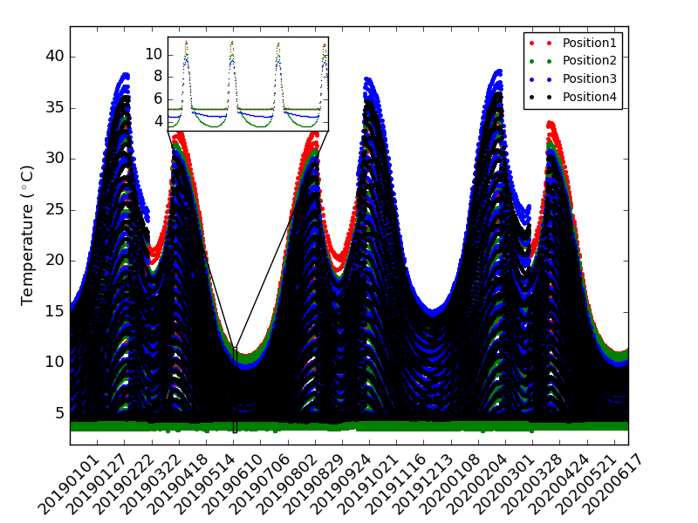
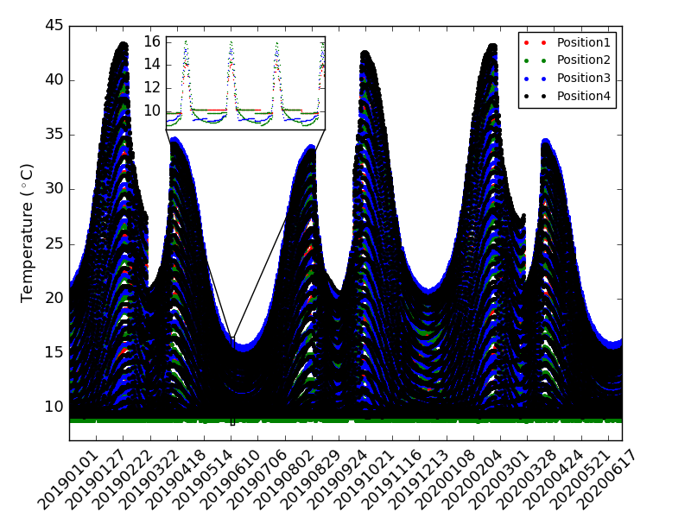
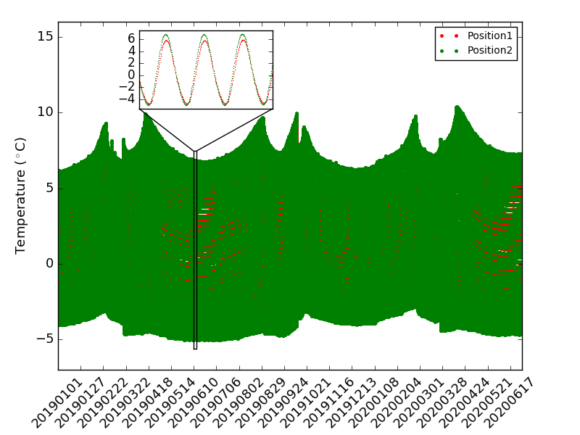
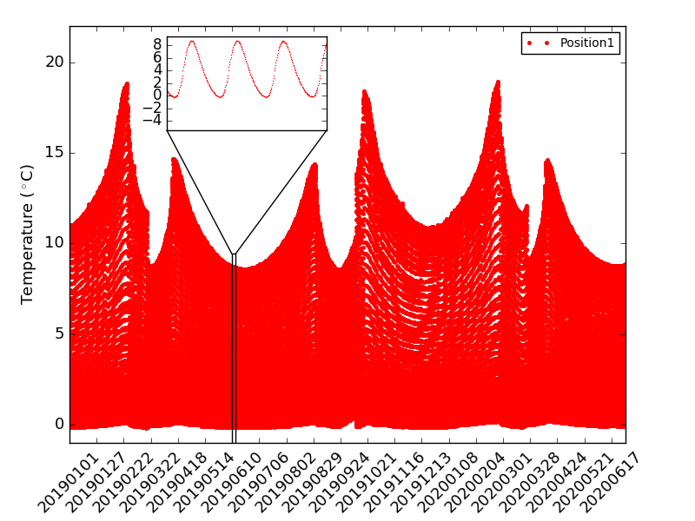
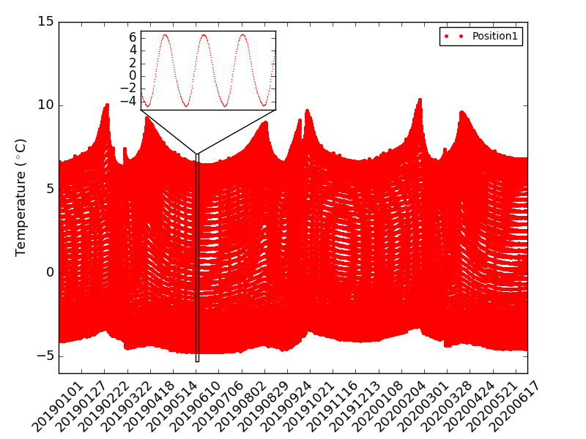
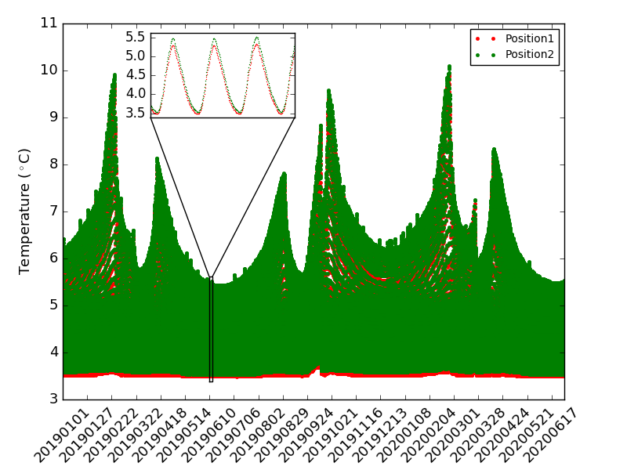
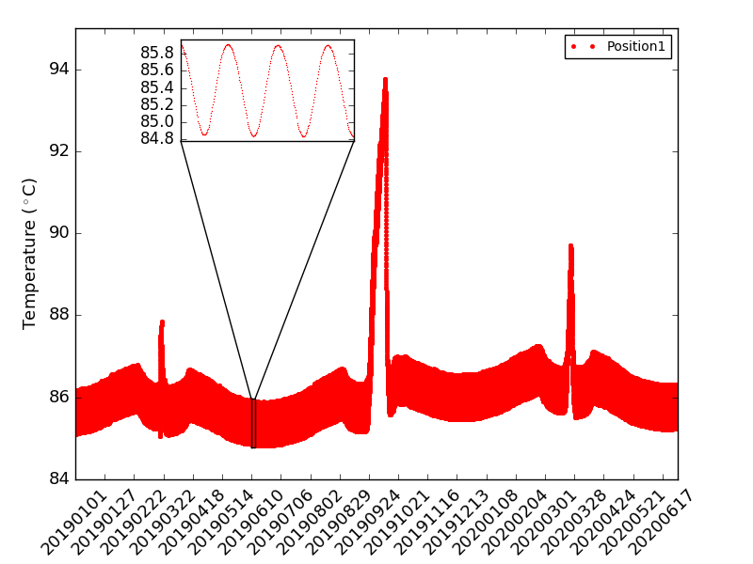
3.2 The temperatures of 8 components ---- Inputs of RCNN
Sun Protection
North-South
Reflectance Mirror
East-West
Reflectance Mirror
Primary Mirror
Second Mirror
Third Mirror
Optical Ralay
Radiant Cooler

Slide 12
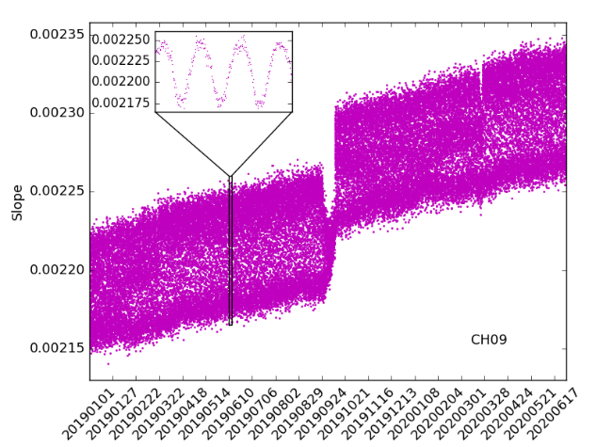
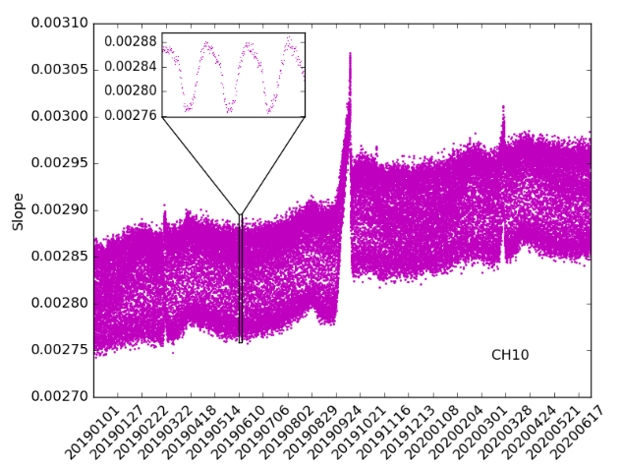
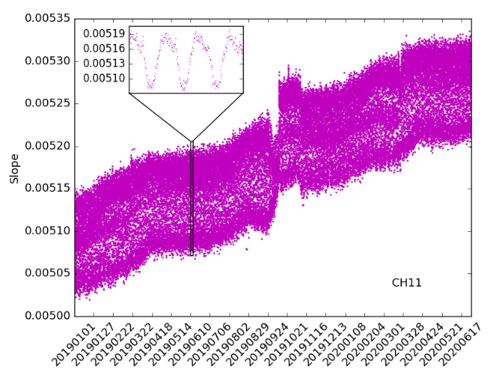
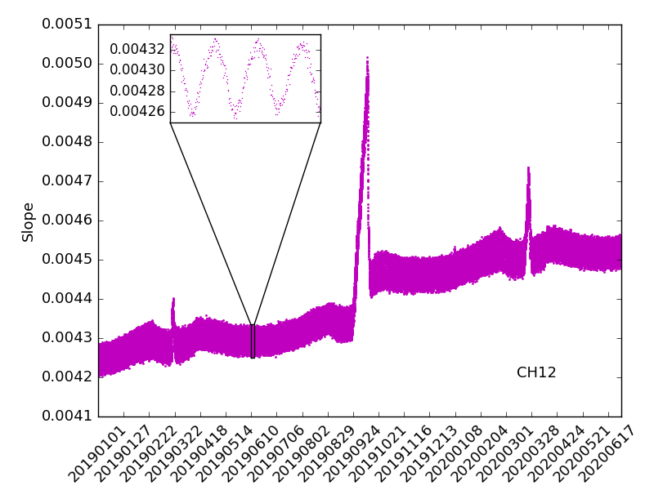
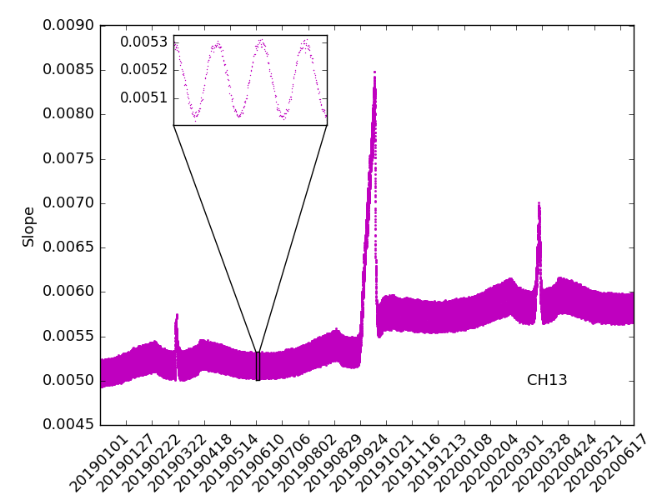
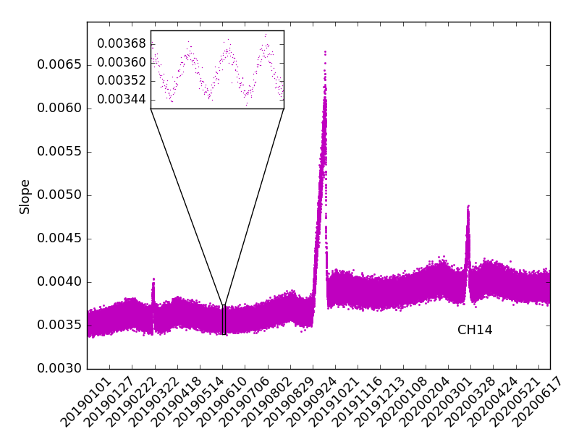
3.3 Radiometric Coefficients: Slope ---- Labels of RCNN
5.8-6.7μm
6.9-7.3μm
8.0-9.0μm
10.3-11.3μm
11.5-12.5μm
13.2-13.8μm

Slide 13
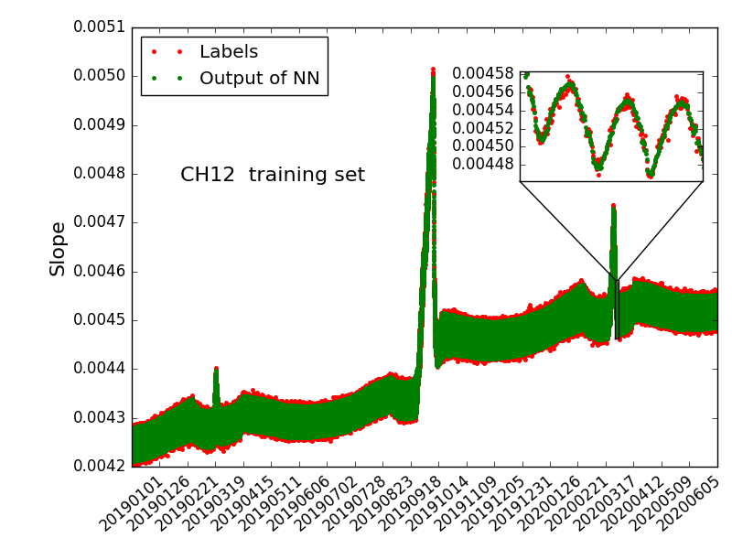
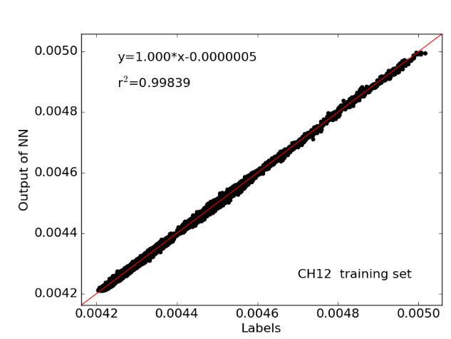
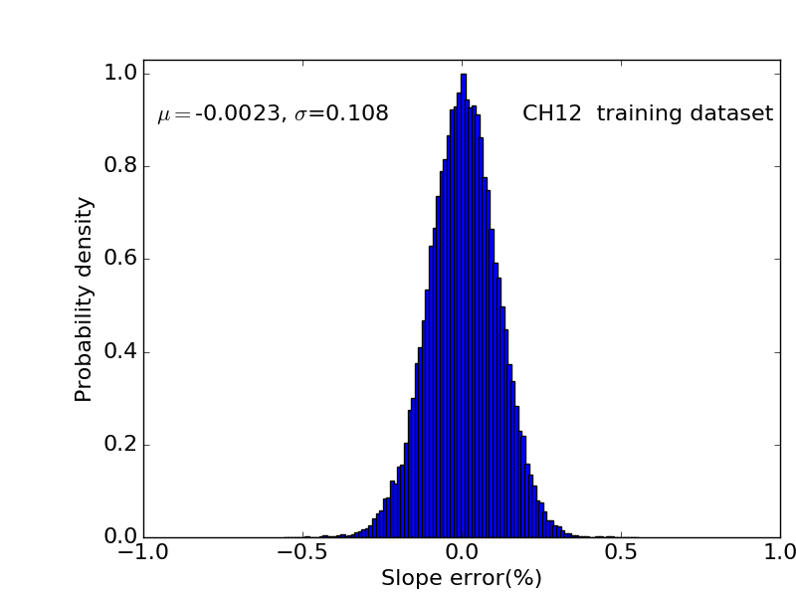
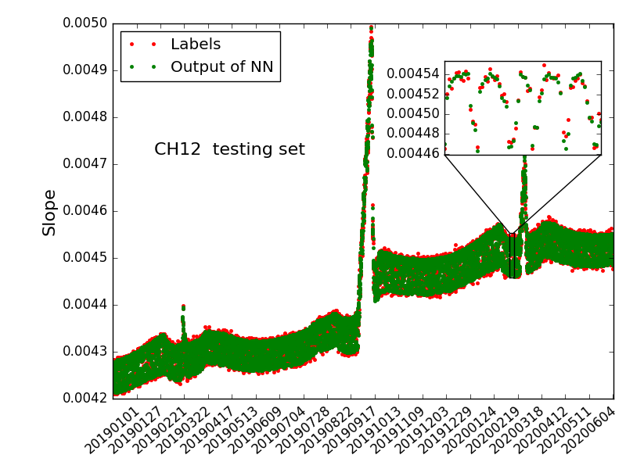
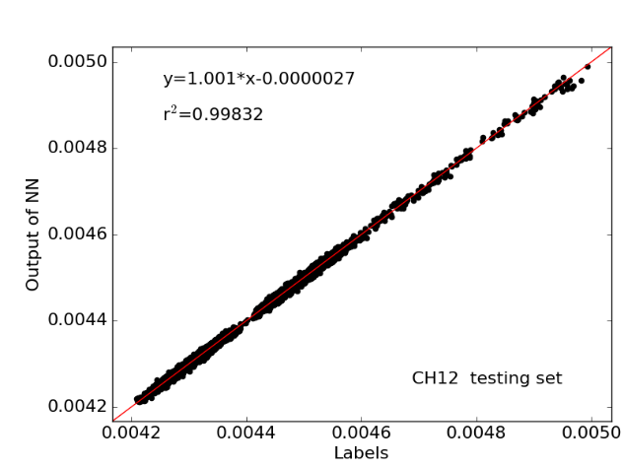
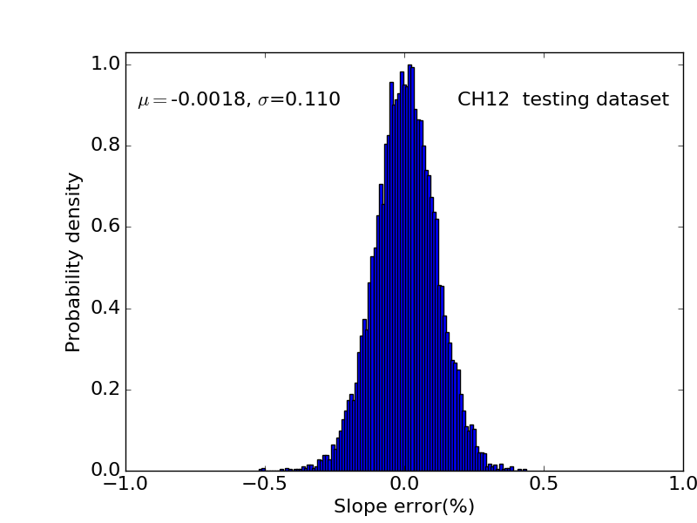
3.4 The results of AIRC----Comparisons between the outputs of RCNN and labels
Data sequence-training dataset
Scatter-training dataset
Statistics Analysis-training dataset
Data sequence-testing dataset
Scatt-testing dataset
Statistics Analysis-testing dataset

Slide 14
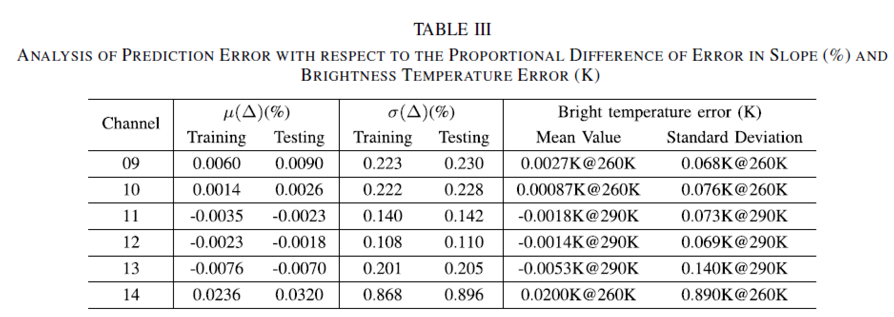
3.5 The evaluation of AIRC ---- for all the channels: slope error and BT erros.

Slide 15
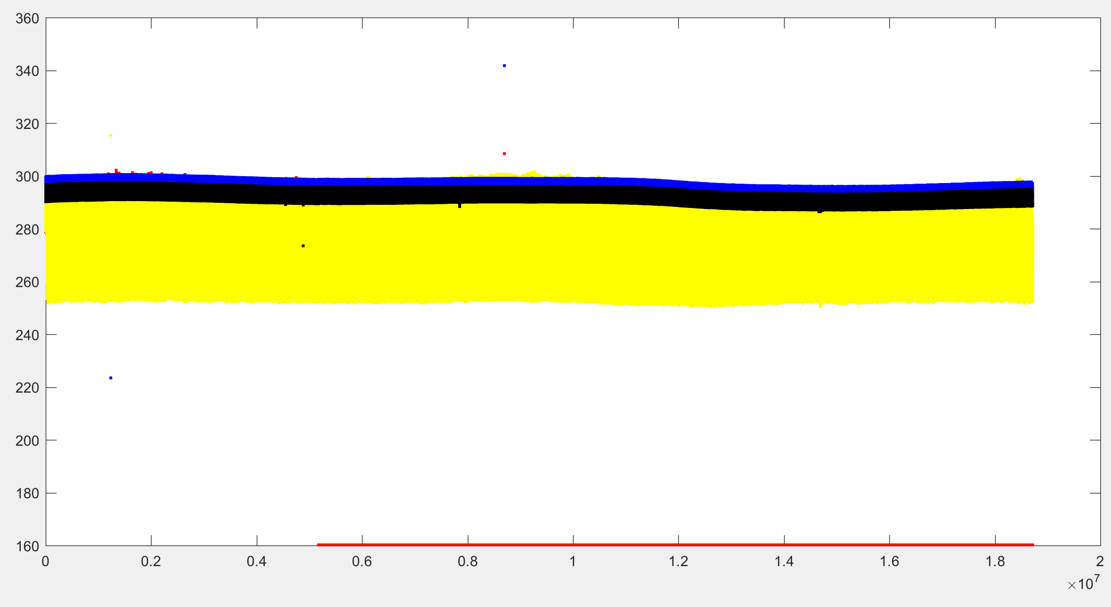
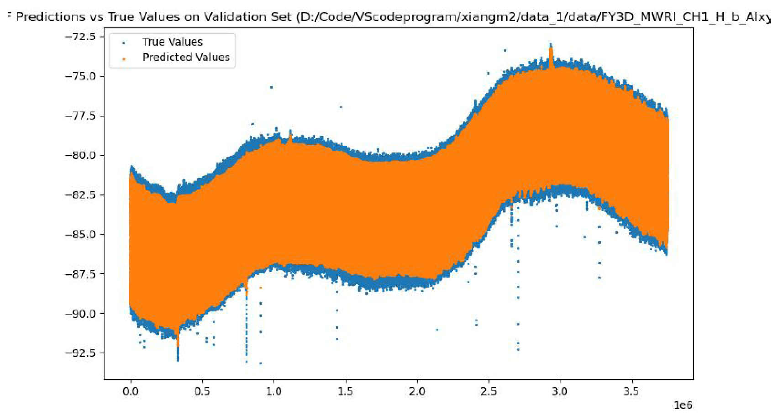
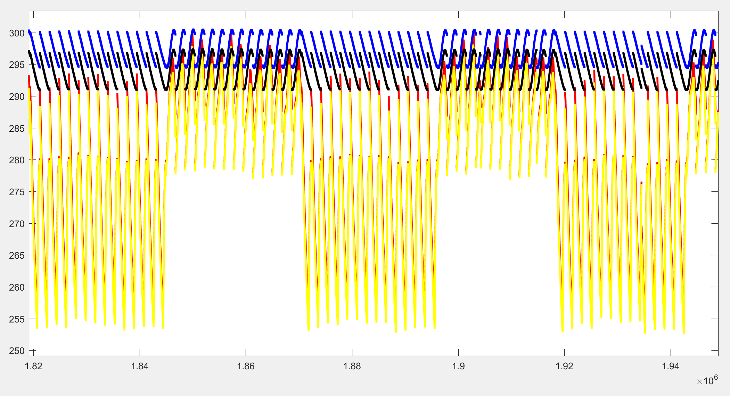
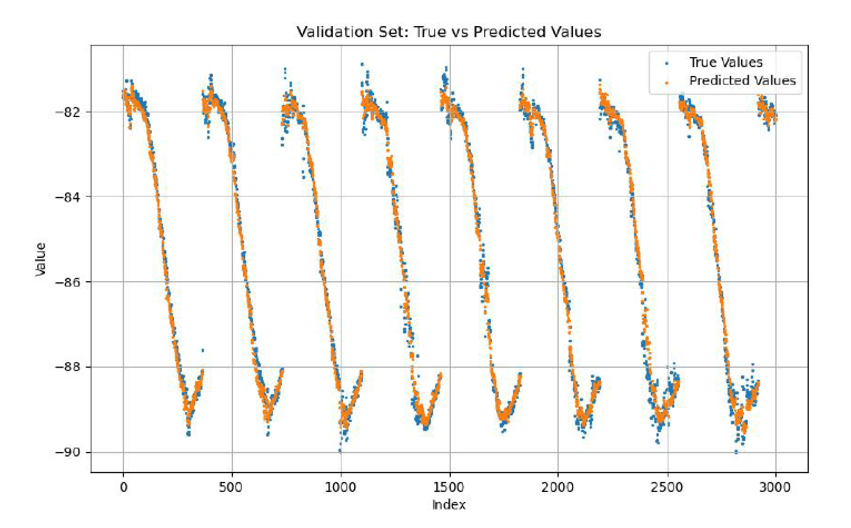
3.6 The AIRC results of FY-3D MWRI---- MicroWave Band
Temperatures of antenna and receiver
Outputs of RCNN vs labels
Magnified view of up fig
Magnified view of up fig

Slide 16
01
Definition of Radiometric Calibration and Performance
02
Our idea of Radiometric Calibration using AI
CONTENT
目录
03
Performance and analysis to AIRC
04
Discussion

Slide 17
4.1 Advantage of AIRC
The accuracy of AIRC is linked to high-accuracy training data(i.e. pre-launch calibration coefficients) and the on-orbit temperatures measurement, they are both easy to achieve high accuracy.
The training data of different infrared sensors can be linked to the same radiance reference(i.e. using the same blackbody), that is benefit for enhancing the radiation consistency.
AIRC saves the weight and space because on-orbit blackbody is not needed, that saves the cost of launch.
AIRC improves efficiency of observations to the object without observing on-orbit blakcbody.

Slide 18
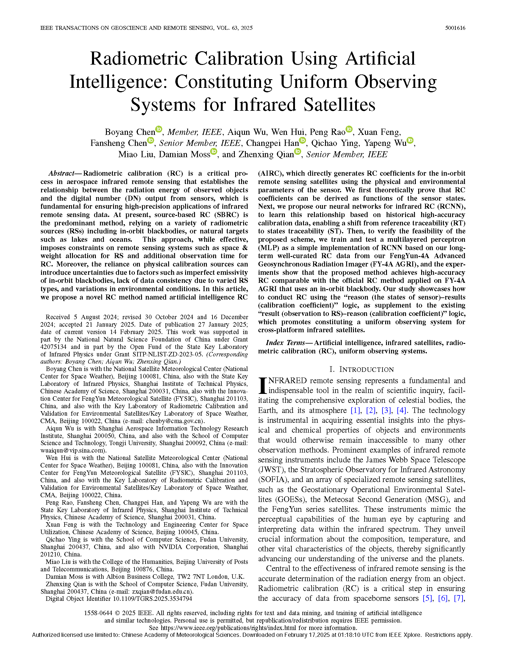
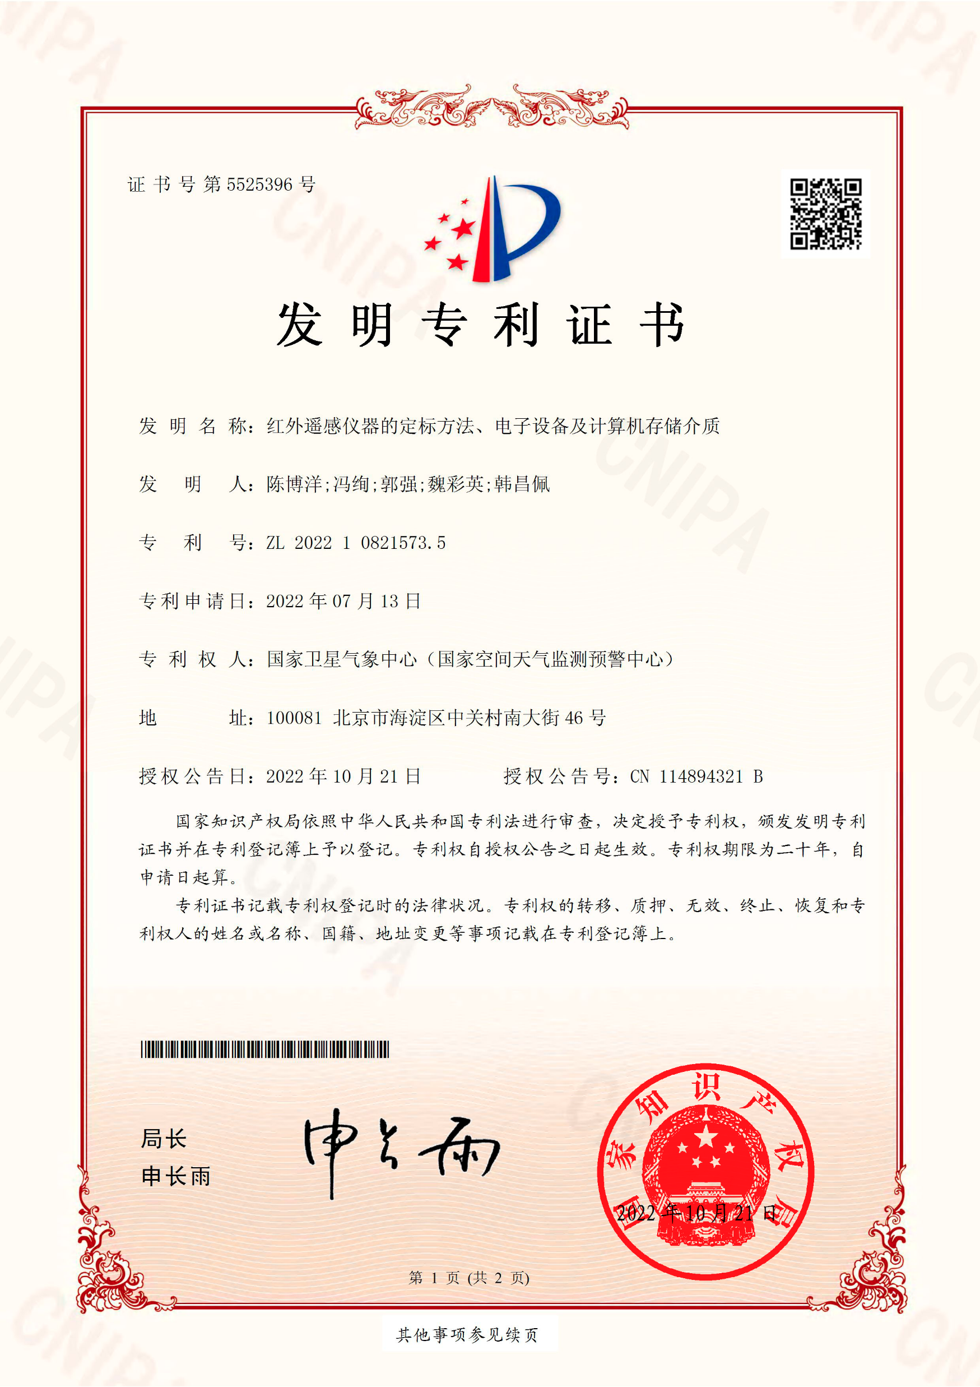
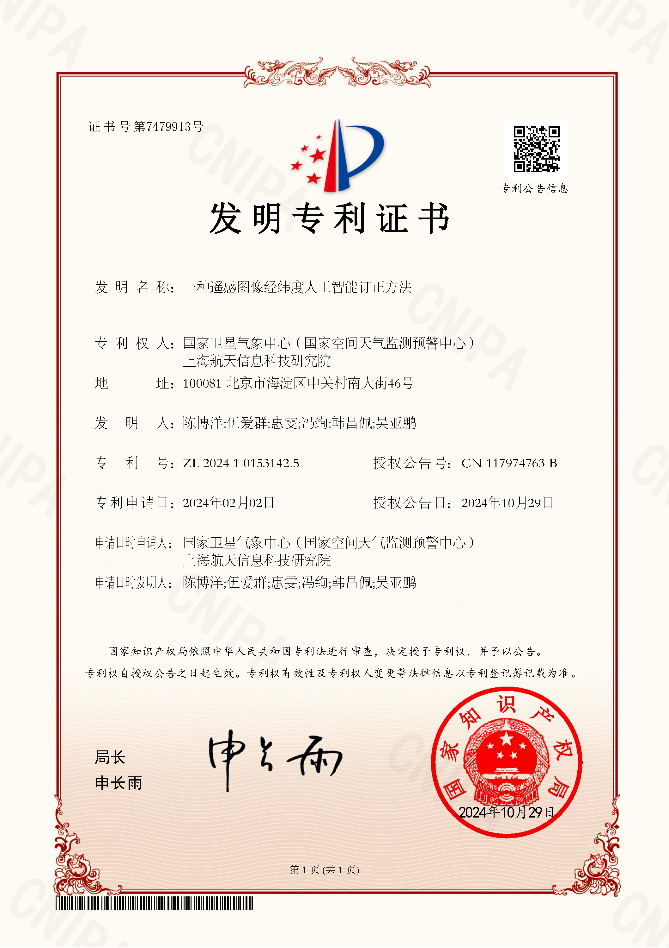
4.2 Plan for AI Pre-processing and progress until now
Article && patents:
1.AI Radiometric Calibration
2.AI Geometric Calibration
3.Fast Simulation for Observation based AI
4. Improve the quantity of remote sensing image

Slide 19
Boyang Chen 18611627835
chenby@cma.gov.cn
For more Exactly details of AIRC.
Any Questions or Discussion, please be at tea-break！
谢谢！
THANK YOU FOR WATCHING
THANK YOU FOR WATCHING

