Slide 1
GDWG Report
Paolo Castracane (Starion for ESA)
Manik Bali (NOAA/UMD)

Slide 2
Table of Contents
GDWG Overview: Membership, Actions, the breakout Session
Topics
Outcomes
New Actions

Slide 3
GDWG Overview
The Global Space-based Inter-Calibration System (GSICS) aims to enhance the accuracy and consistency of satellite observations by providing reliable inter-calibration among satellite instruments. This is crucial for ensuring that data from different satellites can be compared meaningfully, which is essential for climate monitoring, weather forecasting, and various scientific applications. By establishing standards and methodologies for calibration, GSICS aims to improve the overall quality of satellite data used across different platforms and missions. The GSICS Data Working Group (GDWG) plays a crucial role in achieving these objectives. Typical activities of the GDWG include:
Data working group is actively working on GSICS products and deliverables, dissemination/standardization and acceptance.
It continues to support the GSICS Cal/Val activities by building tools and best practices for the community.
Tools are being developed to connect with users of GSICS products and deliverables.
New actions have been picked up to support collaborative ecosystem of development.
All agencies shared development efforts, significant data management efforts, infrastructure, test data sets, and the availability of calibration references.

Slide 4
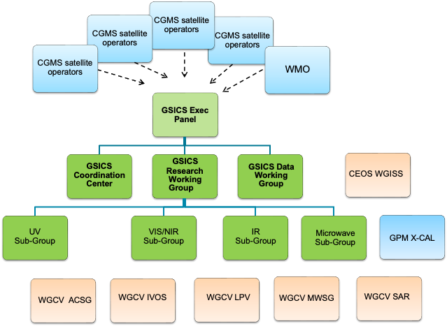
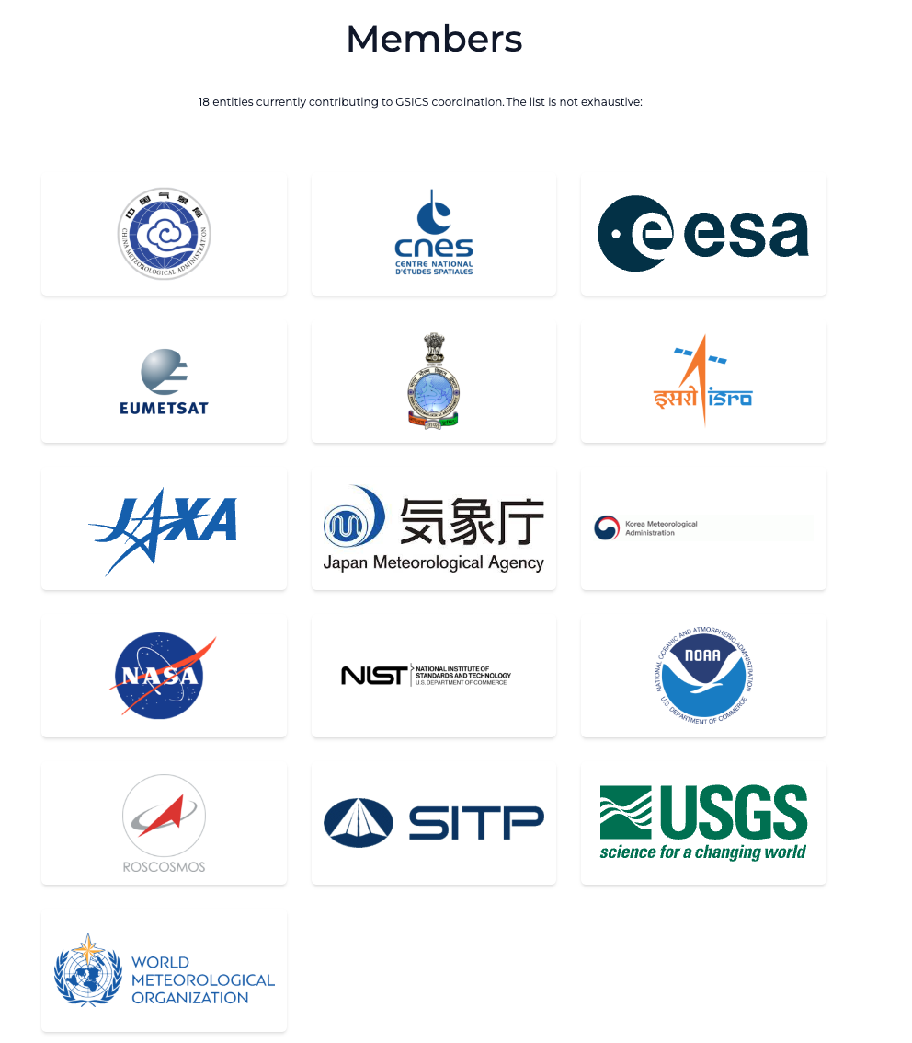
GDWG in the GSICS Framework
GDWG actively supports all aspects of GSICS activities
e.g . systems/metadata/products/wiki/GPPA
Detailed TOR here
Oversee and coordinate the data management activities of GSICS and advise the EP on questions related to GSICS data management including information delivery services

Slide 5
GDWG Membership
Affiliation | First Name | Last Name
CMA | Lin | Tian
ESA | Paolo | Castracane
EUMETSAT | Simon | Elliott
IMD | R.K. | Giri
IMD/Ministry of Earth Sciences | Kamaljit | Ray
ISRO | Nitant | Dube
JMA | Masaya | Takahashi
KMA | Hanbyul | Lee
NOAA | Manik | Bali
ROSHYDROMET | Sergey | Uspensky
WMO | Heikki | Pohjola
https://gsics.wmo.int/en/focal-points

Slide 6
Action 2024 Status [ 2024 ]
Action Id | Summary | Lead | Actual Completion | Deliverable Usage | Status
A.GDWG.20240311.2 | Paolo and Manik to coordinate with the SITsat group (CLARREO, LIBRA, TRUTHS) to define product format, also addressing the way uncertainties shall be reported in the products (with a special care on data volume). | Paolo/Manik | NASA would provide a sample data file |  | Closed
A.GDWD.20240312.1 | Manik Bali to define a format in which the agencies shall provide input for the SOS report. | Manik | Suggested |  | Closed
A.GDWD.20240312.2 | GRWG and GDWG to define a way forward for the generation of the SOS report. | Manik Bali | Script Developed |  | Closed
A.GDWG.20240312.4 | Paolo Castracane (ESA) to lead discussion with GCC and WMO on possible enhancement of GSICS websites following WGCV Cal/Val Portal as example. | Paolo Castracane | Ongoing |  | Open
A.GDWG.20240313.1 | CMA to post daily instrument bias on GPRC website in machine readable form. |  |  |  | Open
A.GDWG.20240313.2 | EUMETSAT (Simon Elliot) to provide IASI L1C reader to ISRO (Pradeep Thapliyal ) : | Simon/Pradeep |  | Code provided | Closed
A.GDWG.20240313.4 | Paolo to coordinate with Manik on reducing overlap of webpage on solar radiance at ESA, NOAA/wiki and LASP. | Paolo |  |  | Open
A.GDWG.20240313.5 | Masaya to collect new codes of GSICS deliverable filenaming to be added in Common code table C-13 of WMO Manual on Codes. | Masaya |  |  | Open
A.GDWG.20240313.6 | Masaya to work on update of GSICS SRF Convention if GRWG requires any updates. | Masaya |  |  | Open
A.GDWG.20240313.7 | Take steps to integrate GSICS products into WIS | Manik | Exploring integration to EUMETSAT Data Server which is already WIS 2.0 active |  | Closed
A.GDWG.20240313.8 | Suggest format for storing daily bias following CF 1.5 CCC conventions | Manik | A.GDWD.20240312.1 |  | Closed
A.GDWG.20240313.9 | GDWG (NOAA) to find a method for digitally marking LSICS outputs that have been generated by the official GSICS code version and copies thereof and making them distinguishable from outputs that have been generated by LSICS code that has been modified. | Manik | Suggested API |  | Closed
R.GDWG.20240313.1 | CMA to link quality of reprocessed data related document on reprocessing website | Scott |  |  | Open

Slide 7
GDWG Breakout Session
GDWG Breakout Session (Day 4 Thu 20 March)
Chair: Paolo Castracane /Co-Chair Manik Bali Minutes: Manik Bali
Time | Title | Presenter
9:00 | Welcome remarks from GDWG Chair | Paolo Castracane (in person) | 11a
9:15 | WMO – status of GSICS WMO website | Heikki Pohjola (in person) | 11b
9:30 | KMA GDWG Report | Hanbyul Lee (Remote) | 11c
9:45 | JMA GDWG Report | Masaya Takahashi (in person) | 11d
10:00 | CMA GDWG Report - extended talk including CMA Server status | Lin Tian (Remote) | 11e
10:30 | IMD GDWG Report | Asim Mitra (he replace Kamaljit). (in person) | 11f
10:45 | NOAA GDWG Report | Manik Bali. (in person) | 11g
11:00 | EUMETSAT GDWG Report | Simon Elliott (in person) | 11h
11:15 | ESA GDWG Report | Paolo Castracane | 11i
11:30 | Topics Discussion: GSICS Data and Product server (current status); Data Conventions and Versioning; SOS Report; Jupiter Notebook in GSICS. | All | 11j

Slide 8
GDWG Additionl Session
18 March 2025 GDWG Additional Session
Time UTC+8 | Topic | Presenter | Agenda item
16:00 | GSICS Data and Product Server | Luca Garegnani (remotly) | 11k
16:45 | Discussion | All

Slide 9
Outcomes from Breakout Session (summary)

Slide 10
Topics
GSICS Data and product Server (Day 2 – 16:00-17:00)
SOS Report (including GRWG - Mounir’s input)
Data Convention and versioning
Jupiter Notebook in GSICS (alternative to Google Colab)

Slide 11
GSICS Data and product Service outcomes from telco 23 Sept. 2024
Current System: Uses THREDDS Data Server (NCAR) with EUMETSAT as the key collaborative server.
Challenges:
THREDDS is becoming outdated and difficult to maintain.
EUMETSAT faces increasing difficulty in supporting it.
Some agencies (CMA) struggle with maintaining their THREDDS servers.
Alternative Proposal: EUMETSAT’s Data Access Services (Data Store).
It provides online access via web interface & APIs.
It requires user registration but no licensing.

Slide 12
GSICS Data and product Service outcomes from telco 23 Sept. 2024
Transition Considerations & Next Steps
Concerns with Migration:
THREDDS currently supports 82 product types.
Harmonized file structure supports external scripts.
Transition requires adaptations and adequate testing.
Key Actions:
Access Request: MB requested API access for testing.
Use Cases Development: EUMETSAT team to prepare demos
User Notifications: System will align with WIS 2.0, notifying users of new datasets.
Backup Plan: Agreement on maintaining a backup in a separate center.
User Focus: Need to rethink expected users & product definitions.

Slide 13
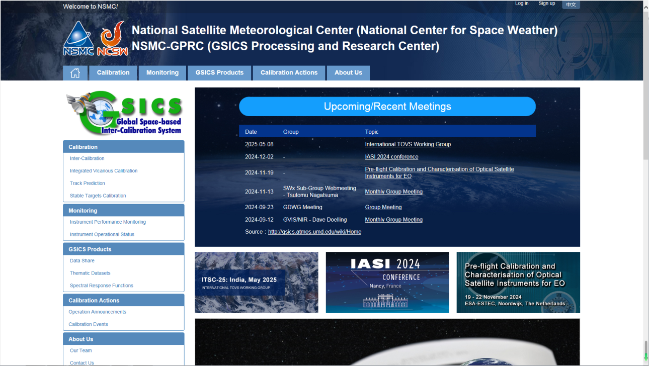
CMA support to GDWG Activites - Lin Tian
Keep CMA GPRC Website Content updating:
GPRC Information
CMA GSICS product sharing (Thredds)
FengYun Satellites Instrument Operation Status (Landing Pages）
CMA GDWG:
Website construction and maintain
New satellite data sharing
NSMC-GPRC Website Upgrade

Slide 14
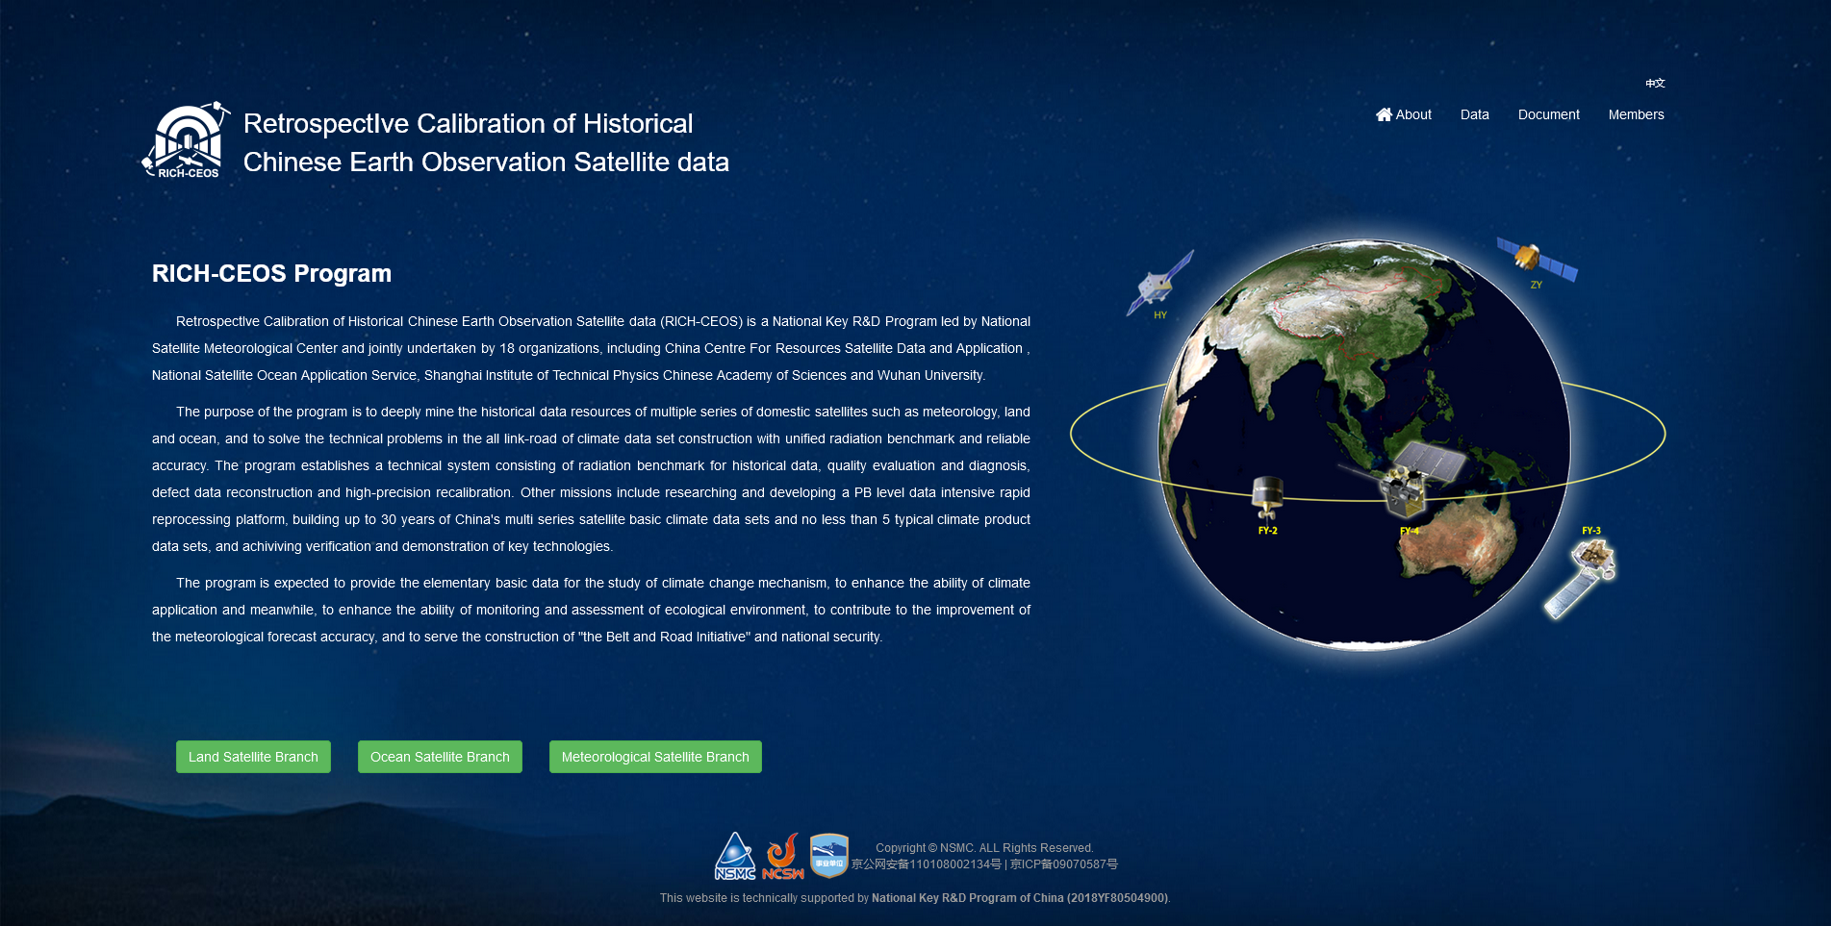
RICH-CEOS Data Website
Up to 30 years of basic climate data of China's multi series satellite such as meteorology, land and ocean.
Climate data sets constructed with unified radiation benchmark and reliable accuracy.
Approximately 300TB data available:
13 primary climate data sets,
9 thematic product data sets,
4 radiation reference data sets.
www.richceos.cn/record/en/index.html

Slide 15
KMA’s GSICS Corrections - Hanbyul Lee
Current Status
Near-Real Time Correction (NRTC)
GK2A / AMI / IR with reference to IASI(Metop-B/-C) and CrIS(S-NPP and NOAA-20/21) : Demo. phase
COMS / MI / IR with reference to AIRS(Aqua), IASI(Metop-A/-B): Demo. phase
Re-analysis Correction (RAC)
GK2A / AMI / IR with reference to IASI-B/-C and CrIS(S-NPP and NOAA-20/21) : Demo. phase
COMS / MI / IR with reference to IASI-A : Demo. phase
NRTC and RAC Correction Data is available in the EUMETSAT GSICS Server from Jan. 15, 2018

Slide 16
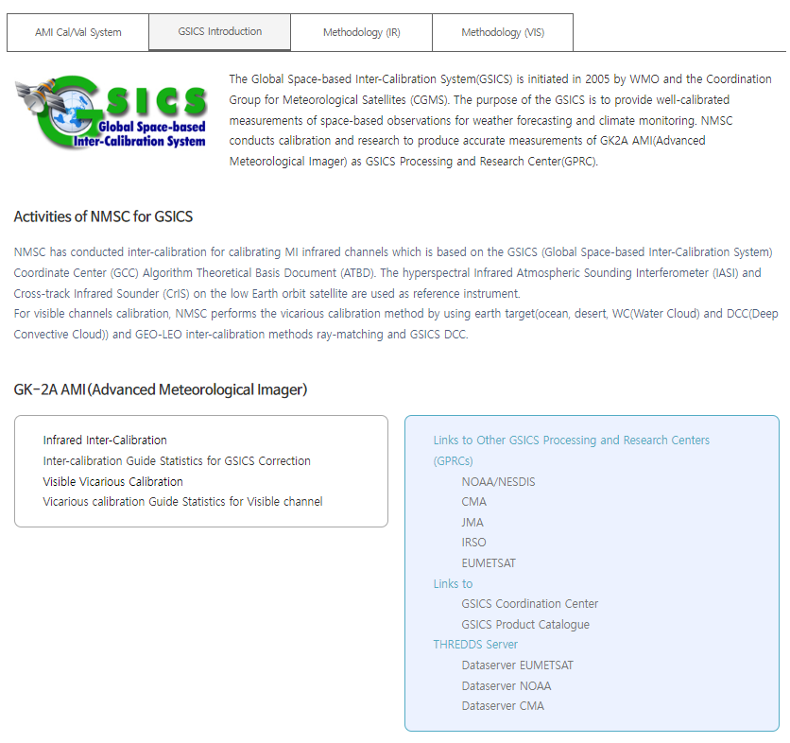
KMA GPRC web pages
Landing page (ACVs)
https://nmsc.kma.go.kr/homepage/html/gsics/gsicsIntro.do (Korean, open)
http://nmsc.kma.go.kr/enhome/html/main/main.do (English, will be updated soon)
Monitoring page
IR (Metop-a/b/c IASI, NOAA-20/21, S-NPP CrIS)
VIS Ray Matching(Terra MODIS, S-NPP, NOAA-20/21 VIIRS)
VIS Lunar(GIRO)

Slide 17
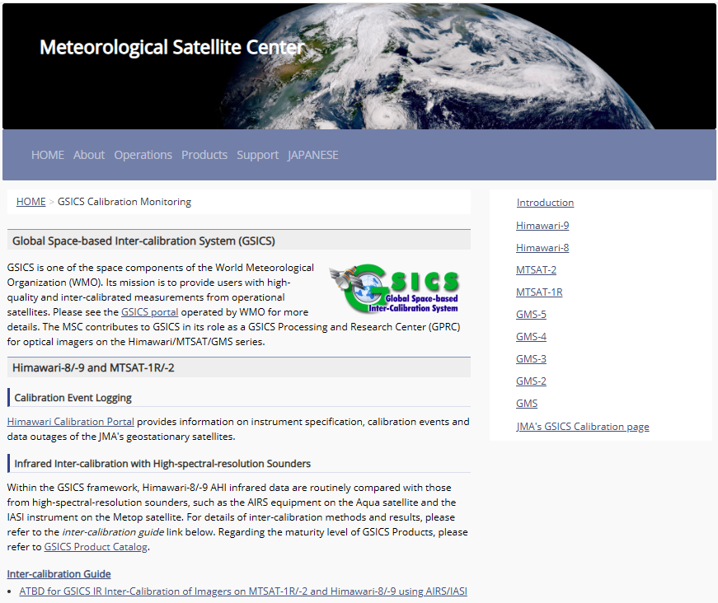
JMA GDWG Activities - Masaya Takahashi
Lunar calibration
Development of I/O data Convention for new lunar calibration framework (LSICS)
GSICS SRF Convention
Support to MW instruments
Maintaining JMA GPRC webpage
Calibration landing page
Instrument info (e.g., SRF)
Event logging
IR re-calibration info (GMS to MTSAT-2)
AHI monitoring pages
VNIR Ray-matching
VNIR Vicarious calibration
GEO-LEO-IR
https://www.data.jma.go.jp/mscweb/data/monitoring/calibration.html

Slide 18
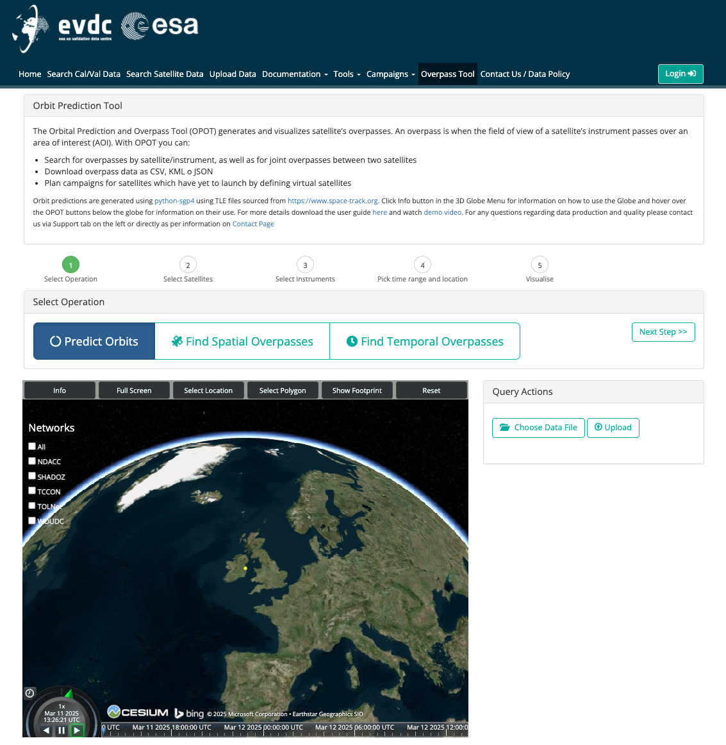
ESA GDWG Activities – Paolo Castracane
Status and updates of the main webportals supporting cal/val activities in different domains:
ESA Atmospheric Validation Data Centre (EVDC) (https://evdc.esa.int/)
with focus on EarthCARE
Pilot-Mission Exploitation Platform (Pi-MEP) salinity (https://www.salinity-pimep.org/)
CEOS Cal/Val portal (https://calvalportal.ceos.org/)
with focus in:
CEOS FRMs Assessment Framework
SITSat Task Team webpage
Area of collaboration GSICS – CEOS WGCV
(see P. Castracane presentation GDWG
breakout Session 20th March AM)

Slide 19
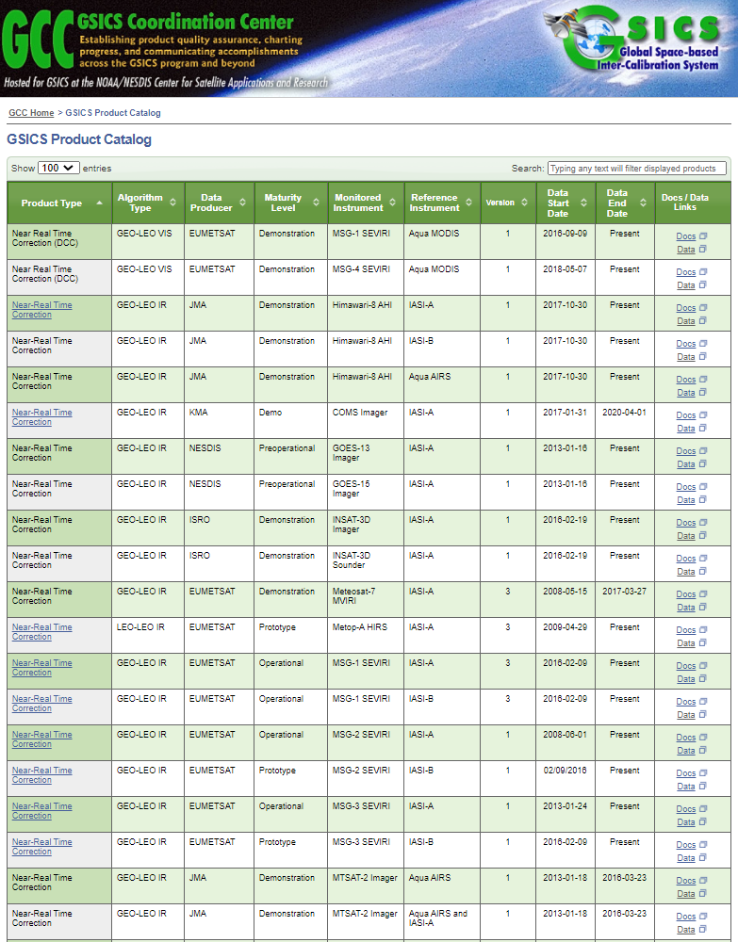
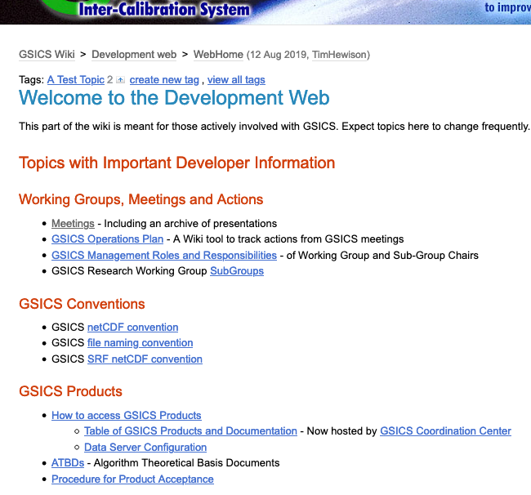
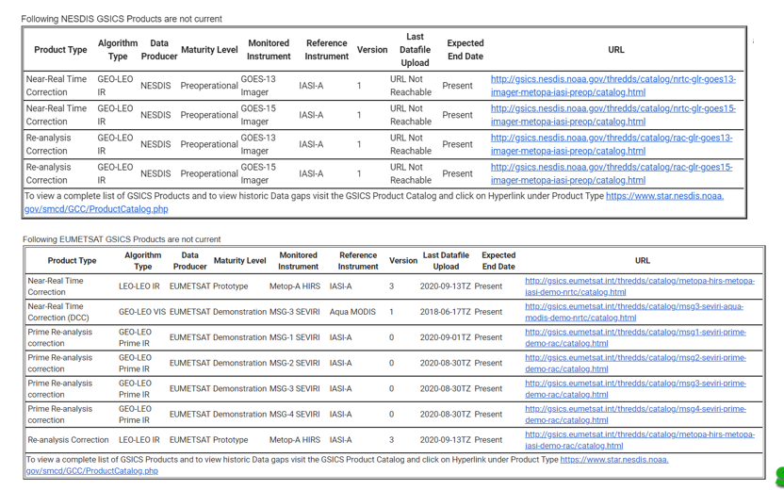
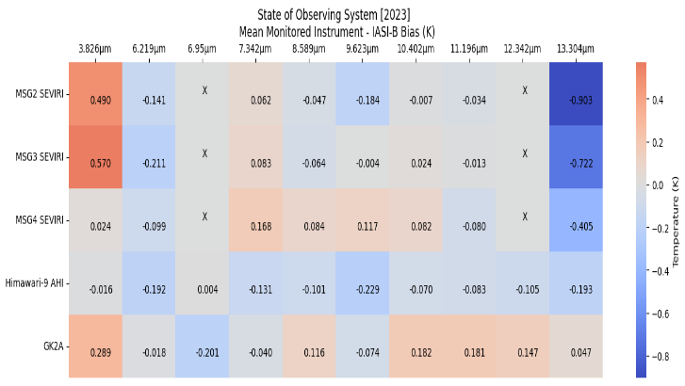
NOAA GDWG Activities – Manik Bali
GSICS Product Catalog
GSICS Wiki
GSICS Notebooks
THREDDS Server
Track GSICS products
State of Observing System Heatmap

Slide 20
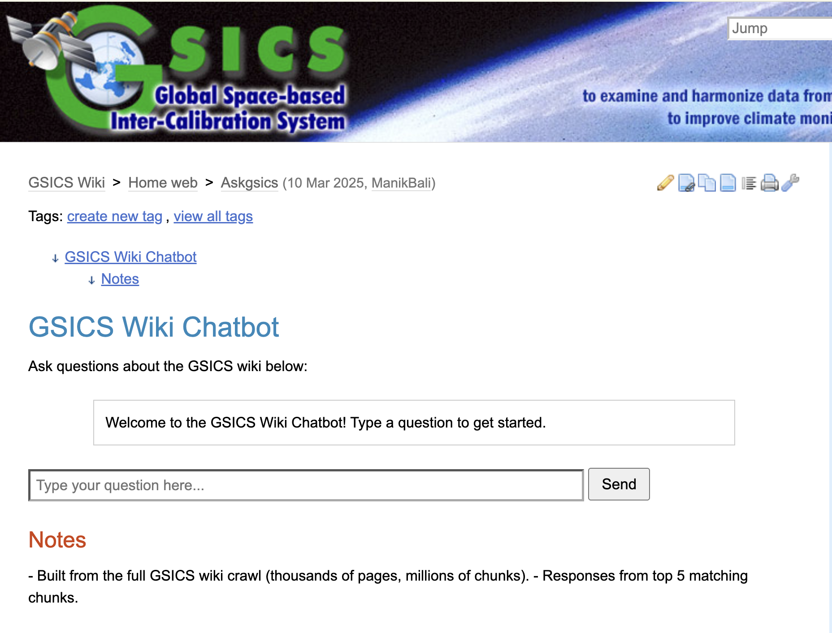
GSICS Wiki Chatbot
Action on GSICS website updates:
Testing of different chatbot approach
We need your partecipation to build trusthable database

Slide 21
Summary GSICS tools
Bash script to download GSICS Data http://gsics.atmos.umd.edu/bin/view/Development/DownloadGSICSProducts
Series of notebooks to read, view and process GSICS Data and Deliverables from the browser in a collaborative ecosystem
DCC Product notebook
This notebook reads DCC products and plots and lists them
GIRO SRF notebook
GSICS Product RAC notebook and NRT notebook
3. Plotting Tool http://gsics.tools.eumetsat.int/plotter
4. GSICS Product Catalog: https://www.star.nesdis.noaa.gov/smcd/GCC/ProductCatalog.php
5. GSICS Product Status registration: Register here

Slide 22
New Actions 2025 for GDWG

