Slide 1
GSICS Coordination Centre (GCC)
Report for 2024-2025
Larry Flynn & Manik Bali
March 17, 2025
2025 GSICS Annual Meeting/GSICS Executive Panel Meeting

Slide 2
Disclaimer
"The contents of this presentation are those of the authors and do not necessarily reflect any position of the US Government or the National Oceanic and Atmospheric Administration."

Slide 3
Outline
Introduction
GCC Activities
  Global participation in GSICS activities
  GSICS Quarterly Newsletter
  Meeting Support
GSICS Product Status
  New products accepted in past year
GSICS Action Tracker
GSICS Notebooks
GSICS Product Status System
Guidance from Executive Panel
Near Term Goals
Summary

Slide 4
GCC Activities – Participation in GSICS Activities
Interest in GSICS activities continues to grow

Slide 5
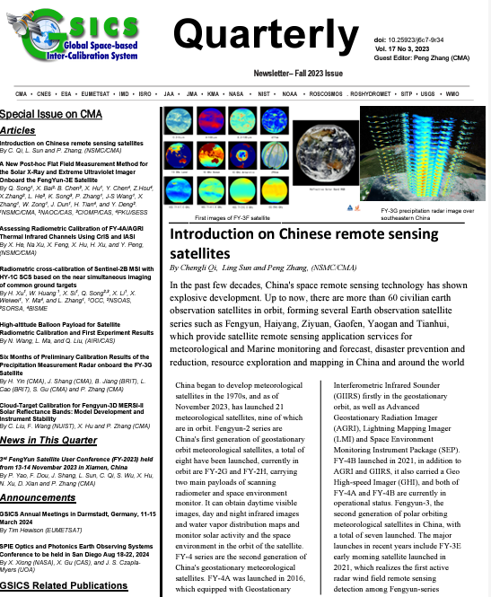
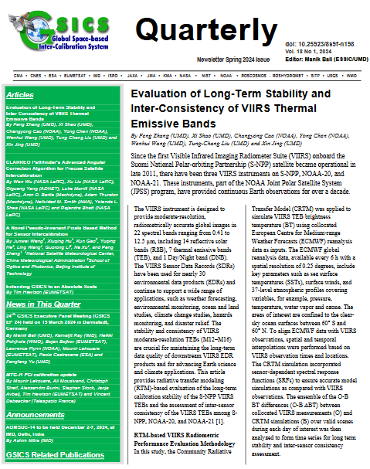
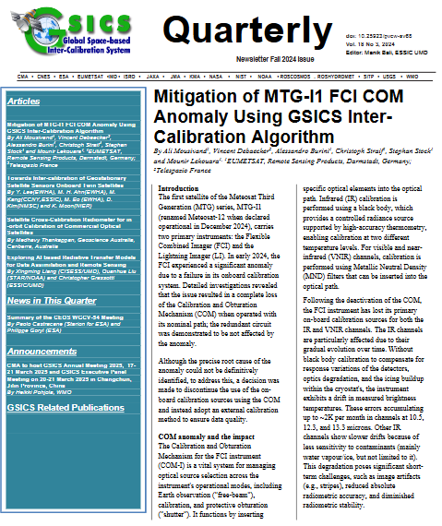
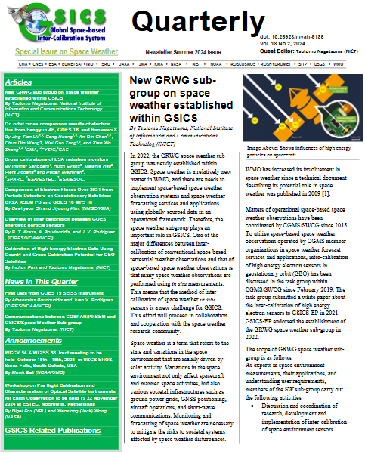
GSICS Activities-GSICS Newsletter
Each year we publish four Issues of the GSICS Newsletter. For the last year, the issues contained:
  21 Research Articles and Eight Topics of News to which
  Approximately 120 Scientists contributed as Authors & Co-Authors.
  Special Issue on Chinese remote sensing satellites
  Upcoming issues: Ideas welcome [ Special issues, Lunar, SW, UV]
https://www.star.nesdis.noaa.gov/smcd/GCC/newsletters.php
GSICS Newsletter Editorial Board
Manik Bali, Editor
Lawrence E. Flynn, Reviewer
Lori K. Brown, Tech Support
Fangfang Yu, US Correspondent.
Tim Hewison, European Correspondent
Yuan Li, Asian Correspondent
Reviewers in the past year
Lawrence E. Flynn, NOAA
Tim Hewison, EUMETSAT
Sri Harshara Madhavan, SSAI/NASA
Cheng-Zi Zou, NOAA

Slide 6
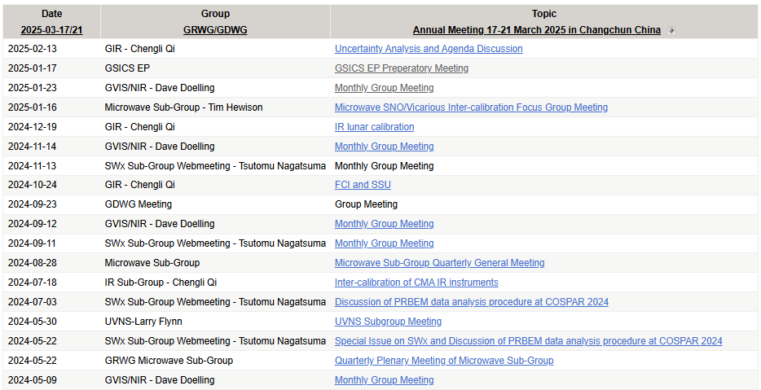
Meeting Support 2025
GSICS Coordination Center supported the GSICS Annual and GSICS EP Meetings for 2024. The meetings were hosted by EUMETSAT.
Meeting Minutes /Agenda can be accessed from GSICS Wiki
https://gsics.atmos.umd.edu/bin/view/Development/AnnualMeeting2024
Meeting Actions can be viewed at https://www.star.nesdis.noaa.gov/smcd/GCC/MeetingActions.php
Supported over 20 meetings
In the past 12 months.
New Space Weather Subgroup
New Lunar Subgroup
Member of SITSAT Team
Collaboration with CALCON and New Space

Slide 7
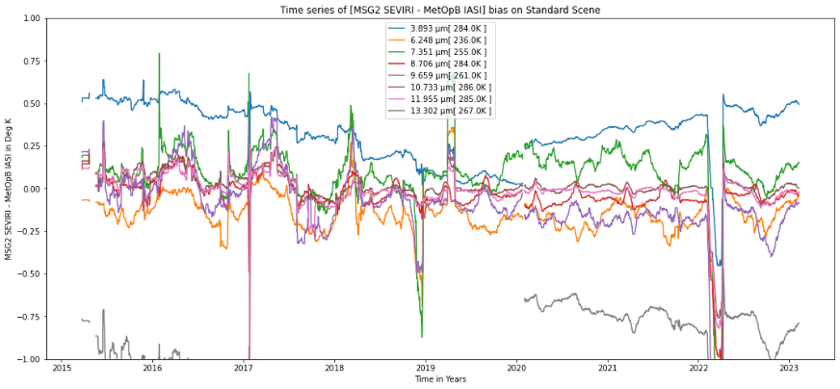
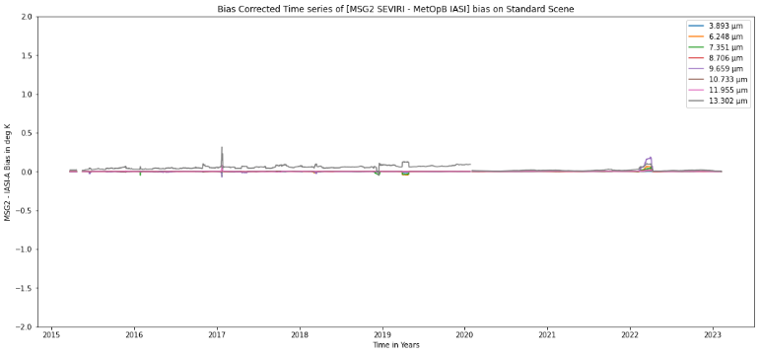
GSICS Products Status
A total of 85 (+5 from last year) Products presently delivered via the GSICS Product Catalog
Operational 16 products [16 EUMETSAT]
Preoperational 10 products [10 NOAA]
Demonstration 57 products [12 EUMETSAT, 17 NOAA, 16 JMA, 10 (+5) KMA, 2 ISRO]
Prototype 2 products [2 EUMETSAT]
Five new GK-2A Monitoring products from KMA included in the product catalog in the past year
Example of GSICS Correction
Notes:
Four demonstration products (NOAA) have ended production.
There are two prototype products.

Slide 8
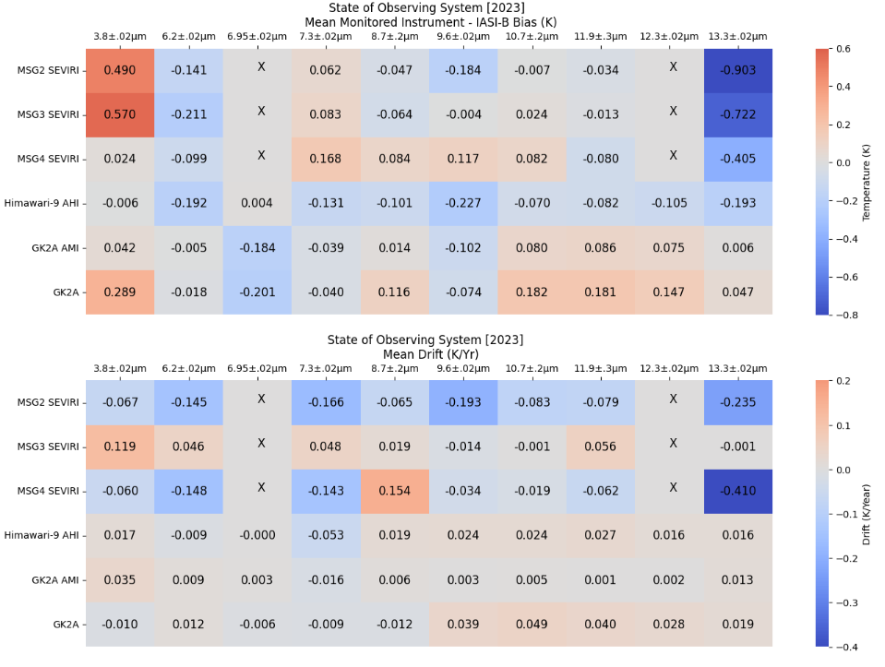
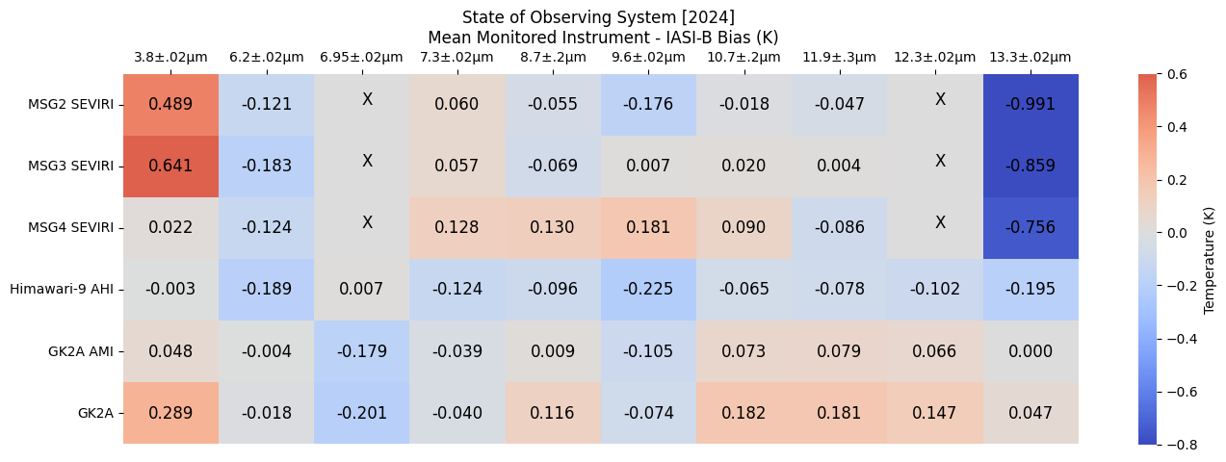
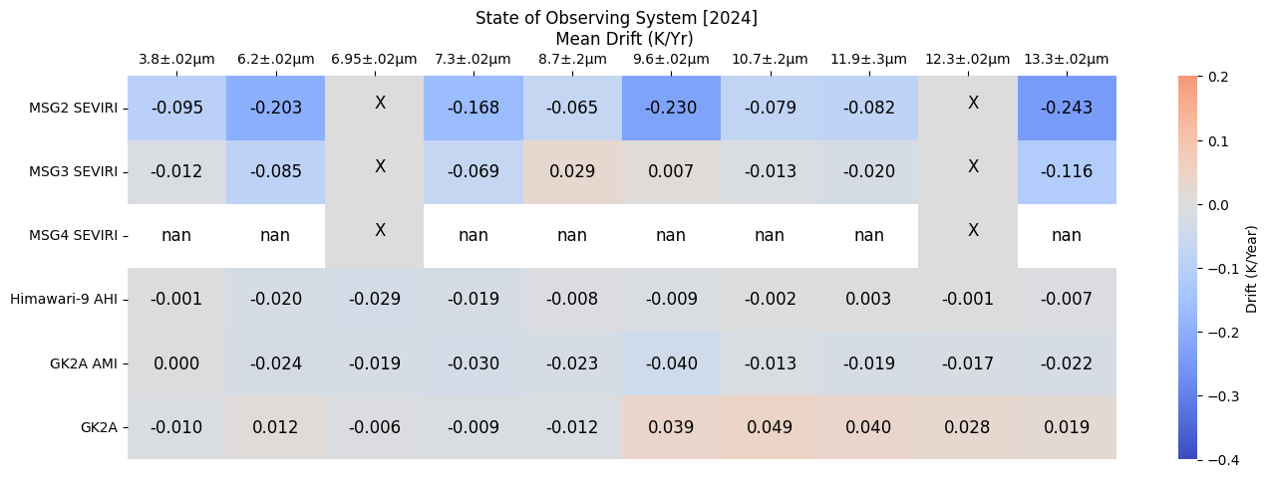
GSICS State of Observing System over the Past two years
Monitored instruments have remained stable for the past two years
Sample Heat Chart tables for Biases (Top) and Drifts (Bottom) for SEVERI, AHI and GK2A versus IASI-B for 2023 (Left) and 2024 (Right).
The biases of the instruments have been consistent and the instruments have maintained stability in 2024.

Slide 9
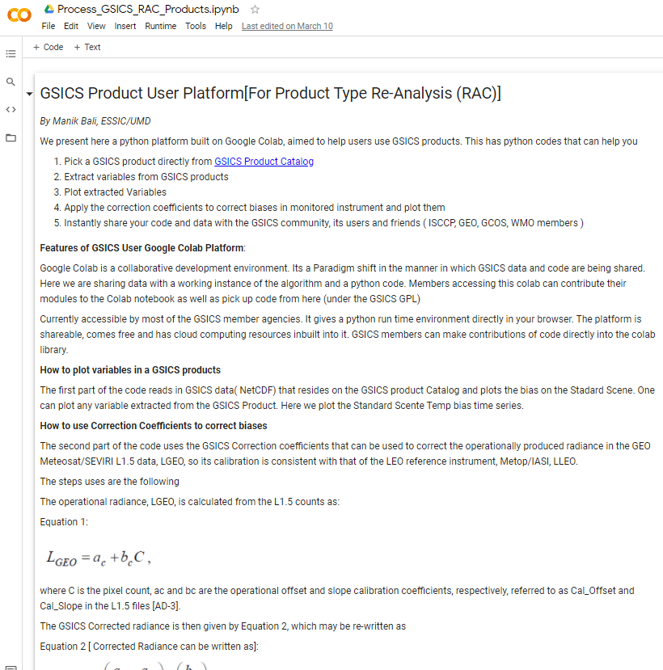
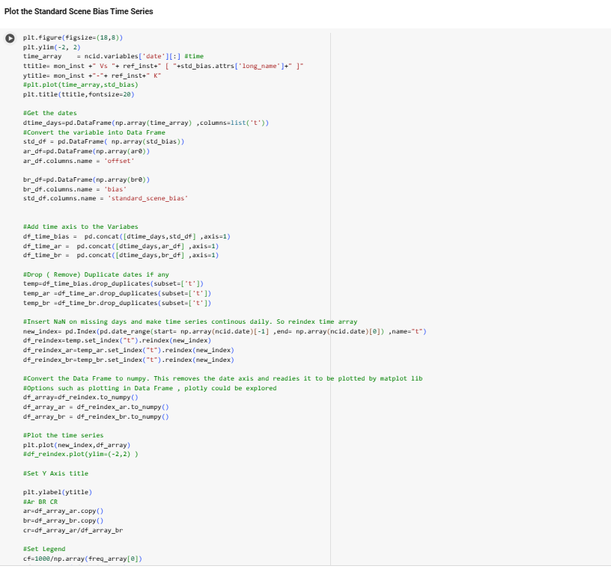
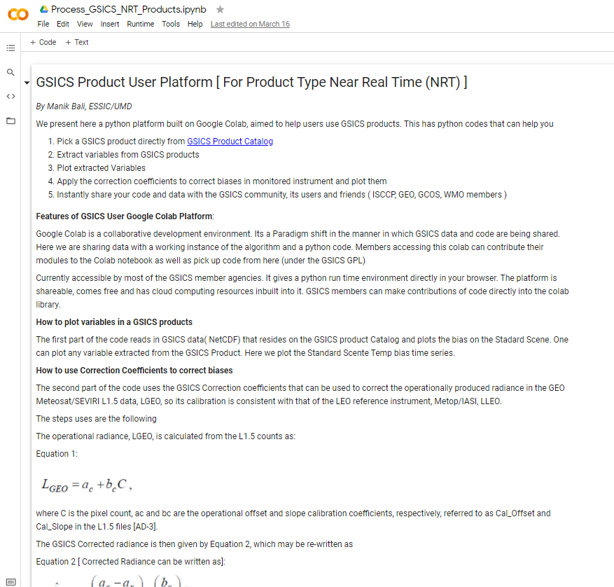
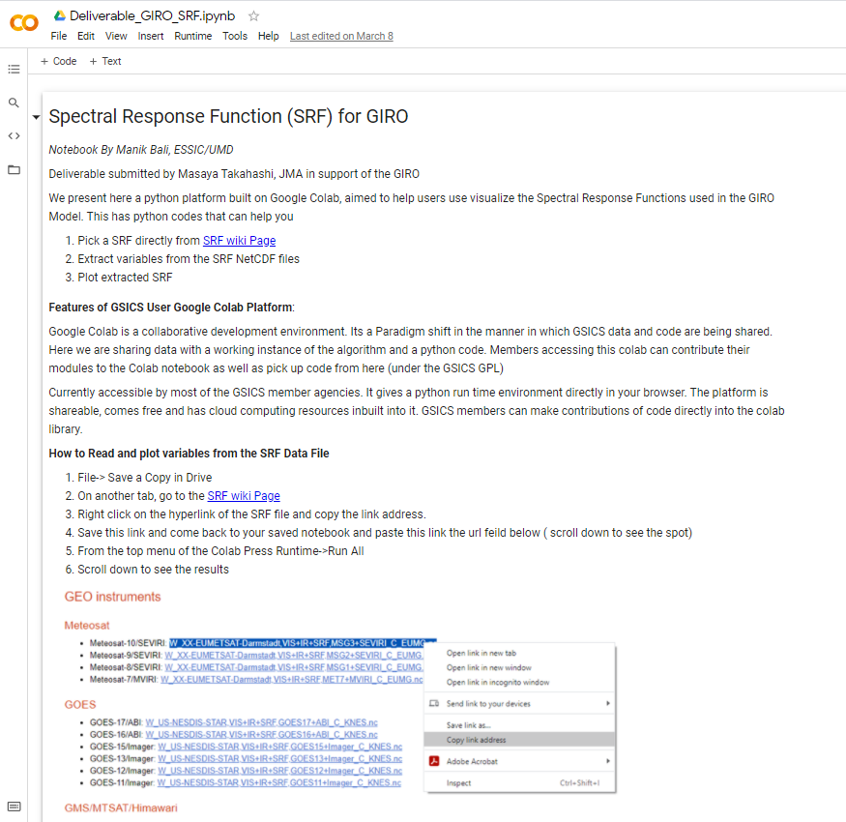
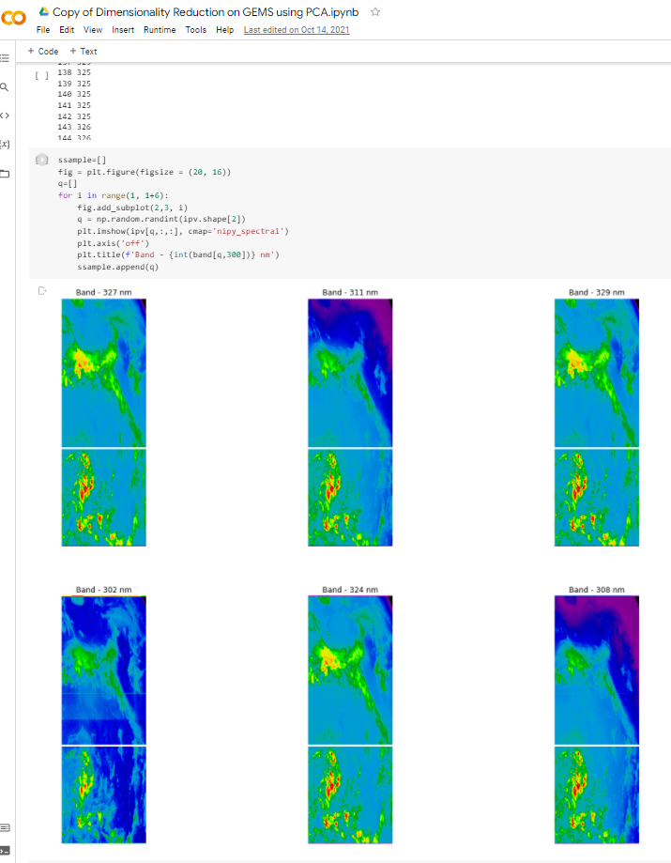
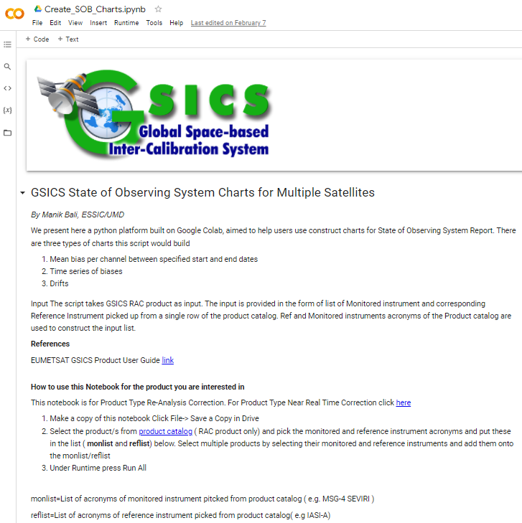
GSICS Google Colab Notebook
New Colab files were created and previous ones maintained and supported.
The Python Script can read and use GSICS Products/Deliverables. It can be run directly from the browser.
Connects Users directly with product producers which helps in collaborative development.
Can be shared instantly. Click on hyperlinks below and start using GSICS Products/Deliverables
Data Processing KMA and JMA biases
GSICS RAC Product
GSICS NRT Product
GSICS Deliverables SRF/Cal Tables
Generate State of Observing System Charts

Slide 10
GSICS Notebooks
Google Notebooks for Deliverables
Spectral Response Function (SRF) netCDF: SRFs used in GIRO in NetCDF format (Author: Masaya Takahashi, JMA) Note
GEO-LEO-IR Collocation netCDF: Intermediate Collocation data Himaware, METSAT 1R/2 Vs AIRS/IASI/MODIS (Author: Masaya Takahashi, JMA) [ Above Notebook can be tuned ]
LEO L1 netCDF: IASI Reference Radiances (Author: Masaya Takahashi, JMA) [Above Notebook can be tuned]
Level 1C inter calibration tables: Inter-Cal tables for Microwave Radiometers, e.g., SSMI series TRMM Constellation and GPM Radiometers (Author: Wes Berg, CSU)

Slide 11
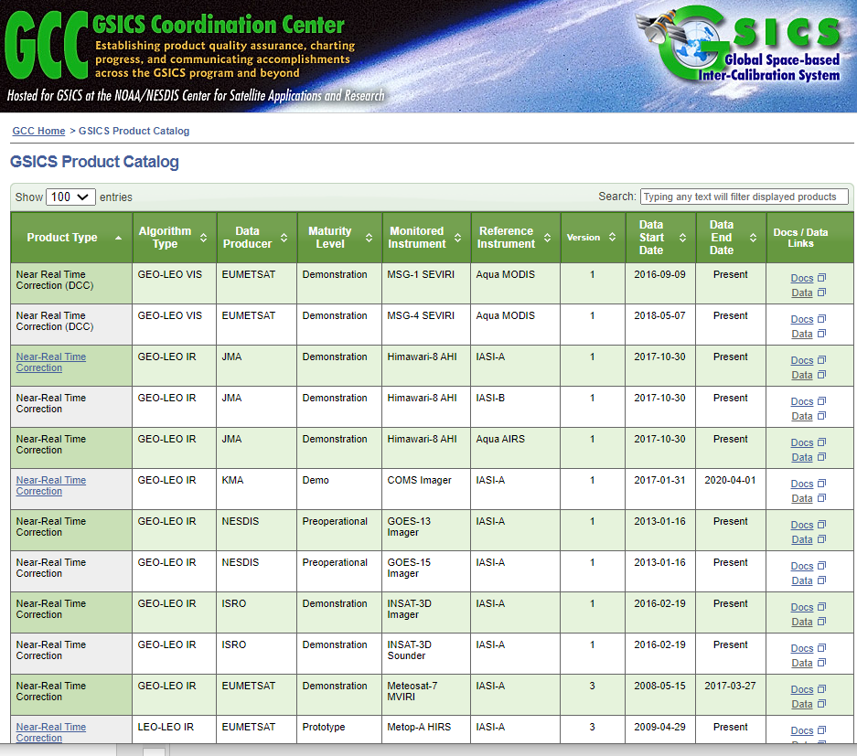
GSICS Product Status System: Background
The Global Space Based Inter-Calibration System ( GSICS ) maintains 85 inter-calibration products. These products are produced each day and disseminated via the THREDDS server or via the ftp servers on the
https://www.star.nesdis.noaa.gov/smcd/GCC/ProductCatalog.php
The Product Status System continues to provide status of GSICS product generation to subscribers.
Relays the following information to the subscriber:
When was the last time the product upload took place on the THREDDS server?
Whether or not the URL is active?
**System was updated to allow multiple users to access emails.

Slide 12
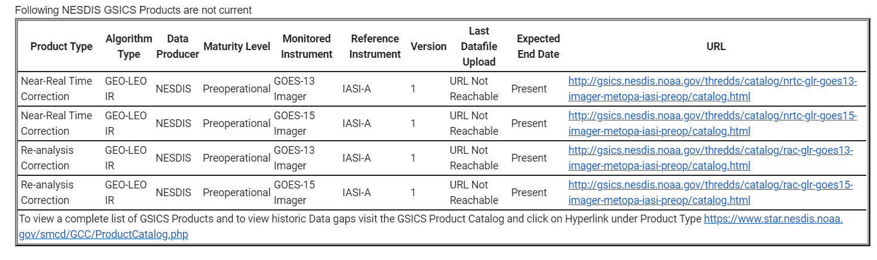
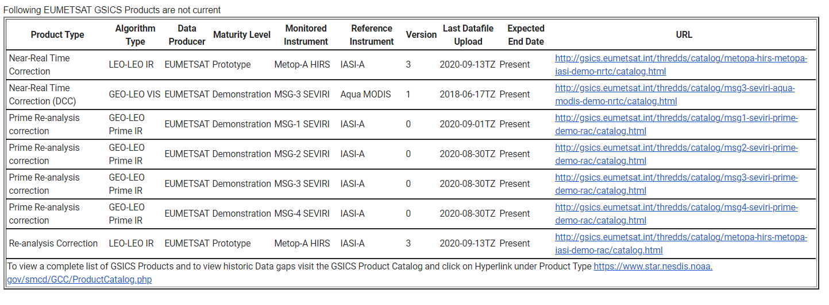
Sample Status Emails

Slide 13
GCC Action Status
how 204060All entries
Search:
Action Id | Summary | Lead | Actual Completion | Status
A.GCC.20240315.1 | Manik Bali (UMD) to prepare proposal to update GSICS Product Catalog and set up web meeting to discuss. | Manik |  | Ongoing
R.GEP.20240315.1 | GCC to give a GSICS overview talk at the JACIE workshop. | Larry/Manik | Would expand the action to reach out to a wider new space audience | Closed
R.GEP.20240315.4 | GCC to display SOS heatmap on GCC website with mean Mean Bias and Standard Deviation. | Manik |  | Open
R.GWG.20240311.1 | GCC to consider adding tool/guide to minutes template for provide correct format for Actions. | Manik Bali |  | Closed

Slide 14
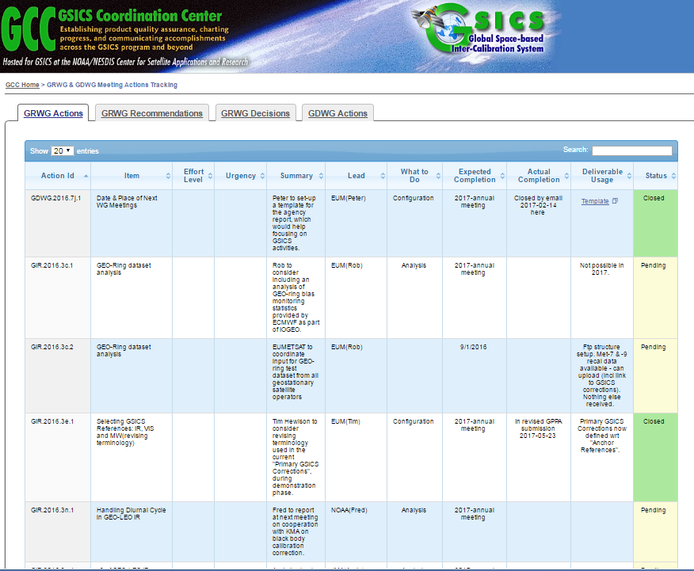
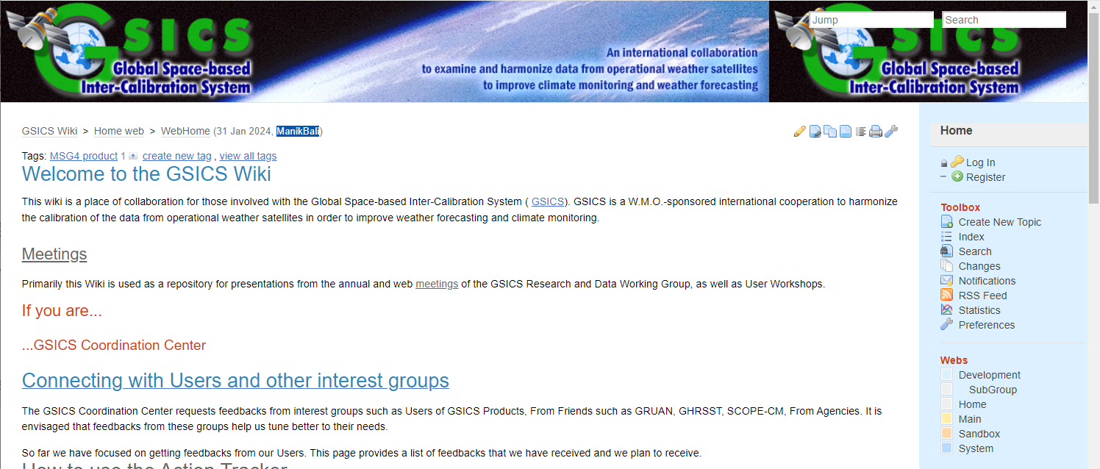
Actions Webpage and GSICS Wiki
The Action Tracker was maintained.
The GSICS Wiki Server was maintained and refined.
http://gsics.atmos.umd.edu/wiki/Home
http://gsics.atmos.umd.edu/wiki/Home
Server software was updated
https://www.star.nesdis.noaa.gov/smcd/GCC/MeetingActions.php

Slide 15
Near-term 2025-2026 Goals
Coordination
  Continue to work with the GPRCs, GRWG and GDWG to expand and formalize the content in the Annual Instrument Reports,
  Continue to coordinate efforts to establish the GSICS baseline algorithms, especially those for the GEO solar reflective channels, and increase the number of GSICS products for visible sensor measurements,
  Continue to provide communication between the research group and users.
GSICS Quarterly
  Continue to compile, edit and distribute this important communication to the GSICS community.
Continue to engage with News Space
Support the inclusion of new products in the GPPA, and conduct reviews of GSICS Products, Deliverables and Resources
Continue to support meetings (including this one)
Continue collaborative development of the Action Tracker.
[added sharepoint for updating actions]
Develop tools to help users
  Develop User Guide and Google Notebook
  Develop Product Status system
  Improve outreach to potential Users of GSICS Products
Notes:
2020-01GDWGProgress Meeting
2019-??GVNIR - D.DoellingSolar Spectra
2019-??GVNIR - S.WagnerPICS data extraction and sharing
2019-??GVNIR - D.DoellingExtension of DCC method to NIR
2019-??GVNIR - D.DoellingSolicit inputs from all GPRCs on preferred sites to be characterized by CLARREO Pathfinder
2019-??GVNIR - D.DoellingPlan journal paper on DCC method
2019-??GVNIR - B.FougnieRayleigh scattering calibration
2019-??GUV - R.MunroUltraviolet Sub-Group web meeting
2019-??GIR - T.HewisonReview different GEO-LEO IR inter-calibration algorithm evolutions
2019-??GRWG - R.Roebeling/T.HewisonReprocessing/recalibration Workshop planning
2019-??GRWG - X.WuMTF characterization on the moon2019-??GDWGTHREDDS + Plotting Tool
2020-06-18GRWGECMWF Workshop on Error treatment

Slide 16
Seeking Guidance from the Executive Panel
It is a constant endeavor of GCC to meet the expectations of the members
To this end we seek guidance on the following:
Should we have another GSICS Users Workshop?
Where will the GSICS Annual Meeting 2026 be held? (Ottawa Ontario Canada?)
Should the GPRCs have machine-readable content?
How should we expand collaboration with CALCON, 3G (GRUAN –GSICS-GNSS), etc. (discussion topic)?

Slide 17
Summary
The GSICS Coordination Center continues to support and coordinate exchanges of ideas within GSICS.
GCC continues to play its role in reaching out to potential future members.
GCC continues to publish the Newsletter.
GCC continues to support the collaboration and planning of GSICS research and other activities with complementary groups such as GRUAN, GNSS and WIGOS.
Established capability to generate SOS reports at NOAA.
Suggestions, Feedback are welcome

Slide 18
Thank You

Slide 19
Backup

Slide 20
GCC Action Status [2023]
Status of Actions in Past Year
A.GCC.20220318.1 | GCC to edit an article on Notebooks, wiki and pages GSICS Tools |  | Closed
A.GDWG.20220316.3 | GDWG members to inform GCC about the latest membership |  | Concurrent
A.GVNIR.20220318.6 | GRWG (Dave) to work with GCC lead a recommendation to EP of recommending TSIS-1 HSRS as a reference Solar spectrum | TSIS-1 recommended as reference solar spectrum | Closed
New Actions in 2023
A.GDWG.20230301.1 | Manik Bali (NOAA) to add option in tracking tool to label actions as no longer relevant, and ensure a lead is clearly identified for each action | Closed
A.GSW.20230615.1 | Larry Flynn/Manik Bali will assemble background documentation on the GSICS processes and products (Wiki, introductory presentation, GSICS products catalogue etc.) | Closed [documents shared by Larry]
A.GWG.20230227.2 | Manik Bali (NOAA) to consider the development of tool to interface GSICS Correction coefficients from GSICS Server with Satpy as external calibration coefficients. | Ongoing[ Implemented at UMD, converting to container]
A.GWG.20230228.1 | Manik Bali to engage with Copernicus climate archive experts (via Betsy Weatherhead) and NIST data librarians on strategies to provide users with guidance to access best GSICS products for their application | Ongoing [Met with Betsy, Lunar shared algorithm]
R.GDWG.20230301.5 | Manik Work closely to develop to utilize OSCAR API for retrieving information of interest | Ongoing[Met with Heikki Shared experience]

