Slide 1



Harmonization of SPOT-VGT1, SPOT-VGT2, and PROBA-V Time Series, Including Per-Pixel Uncertainty: Status of the FDR4VGT Project
Sindy Sterckx, Iskander Benhadj, Tom Van Roey, Joram Agten (VITO)
Marta Luffarelli, Yves Govaerts, Nicolas Misk (Rayference)
Fabrizio Niro, Roberto Biasutti (ESA)
GSICS Annual Conference, 2025

Slide 2
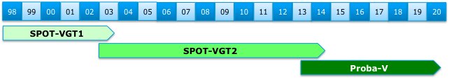
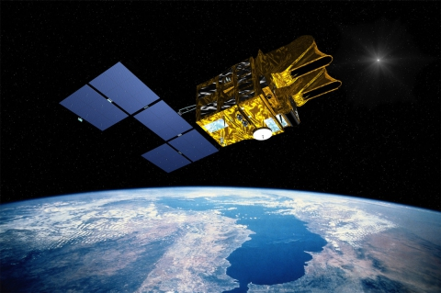
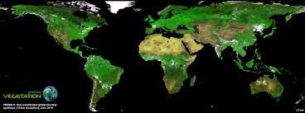
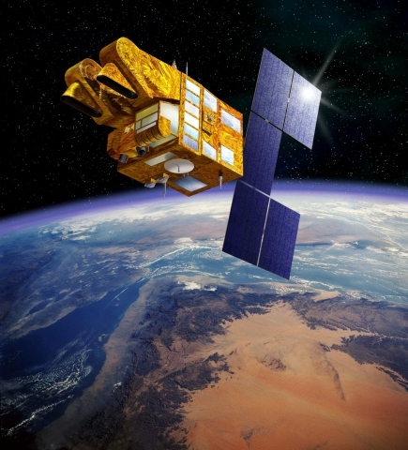
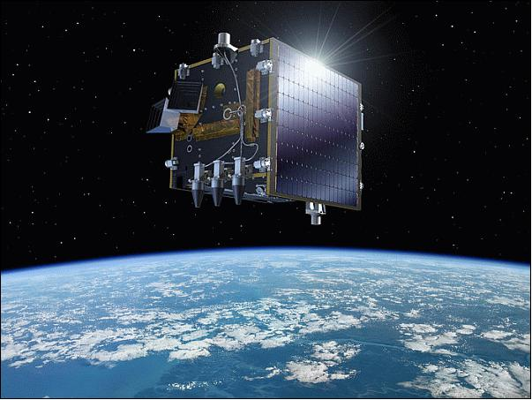
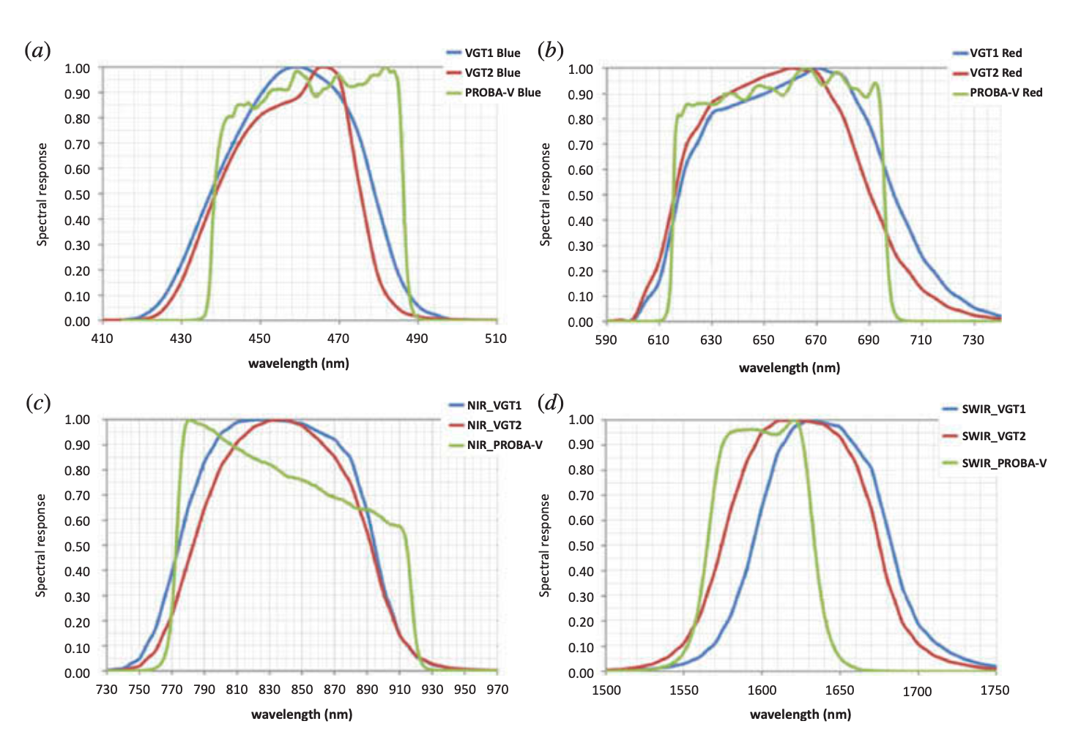


SPOT-VGT1, VGT-2, PROBA-V time series
Bridging the gap to S-3 for Land applications
Sentinel-3B
Sentinel-3A
Global near-daily coverage
Blue, Red, NIR, SWIR bands

Slide 3
FDR4VGT Objectives
Ensuring long-term data preservation and valorisation of SPOT-VGT1, SPOT-VGT-2 and PROBA-V data archives;
Improving consistency, by fully characterising the radiometric, geometric and spectral differences across sensors;
Enhancing harmonisation and temporal stability by quantifying and correcting inter-sensors biases and sensor-induced spurious drifts;
Providing uncertainty estimates at pixel level, ensuring traceability along the full processing chain, starting from raw data;
Generating a temporally stable and harmonised data record of reflectances at TOA and TOC level to be used as input for climate studies.

Slide 4

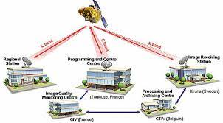
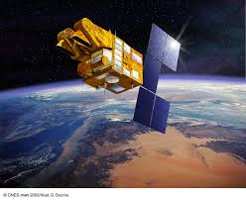

SPOT-VGT Calibration
Image Quality Centre (QIV) at CNES
Processing, Archiving & Distribution at VITO

Slide 5
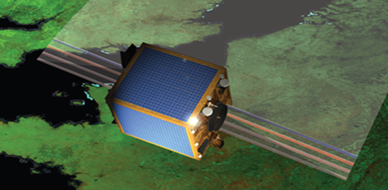
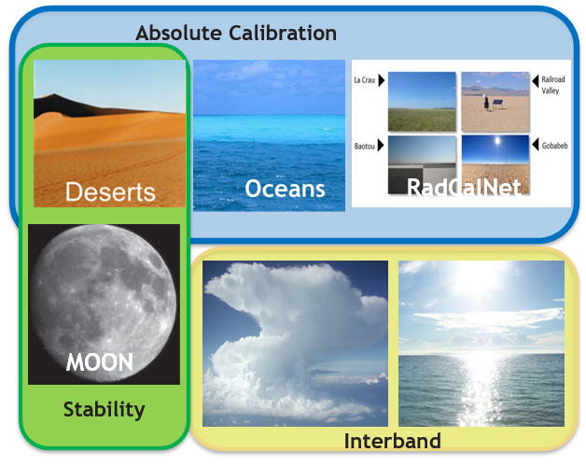
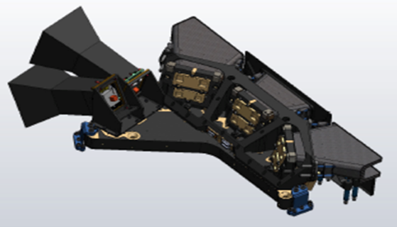
PROBA-V Calibration
Imaging Quality Center (IQC) at VITO
IQC is in charge of the assessment of the PROBA-V performance, the analysis of the image quality, and calibration after launch.
Radriometric Calibration
OSCAR* (Optical Sensor Calibration with simulated Radiances)
*Sterckx et al. IJRS, 2014; Sterckx et al. , TGARS, 2013; Govaerts et al., RSL, 2013; Sterckx et al., RS, 2016

Slide 6
FDR4VGT : Radiometric harmonisation
Objective: Secure radiometric consistency between VGT-1, VGT-2 and PROBA-V for the generation of higher level thematic data record.
Harmonisation: All the calibrations of the sensors have been made consistent with (a) reference dataset(s) which can be traced back to known (SI-traceable) reference sources.
Each sensor is calibrated to the reference, maintaining its features such that the calibration radiances represent the unique nature of each sensor. Following FIDUCEO, we apply Harmonisation.

Slide 7
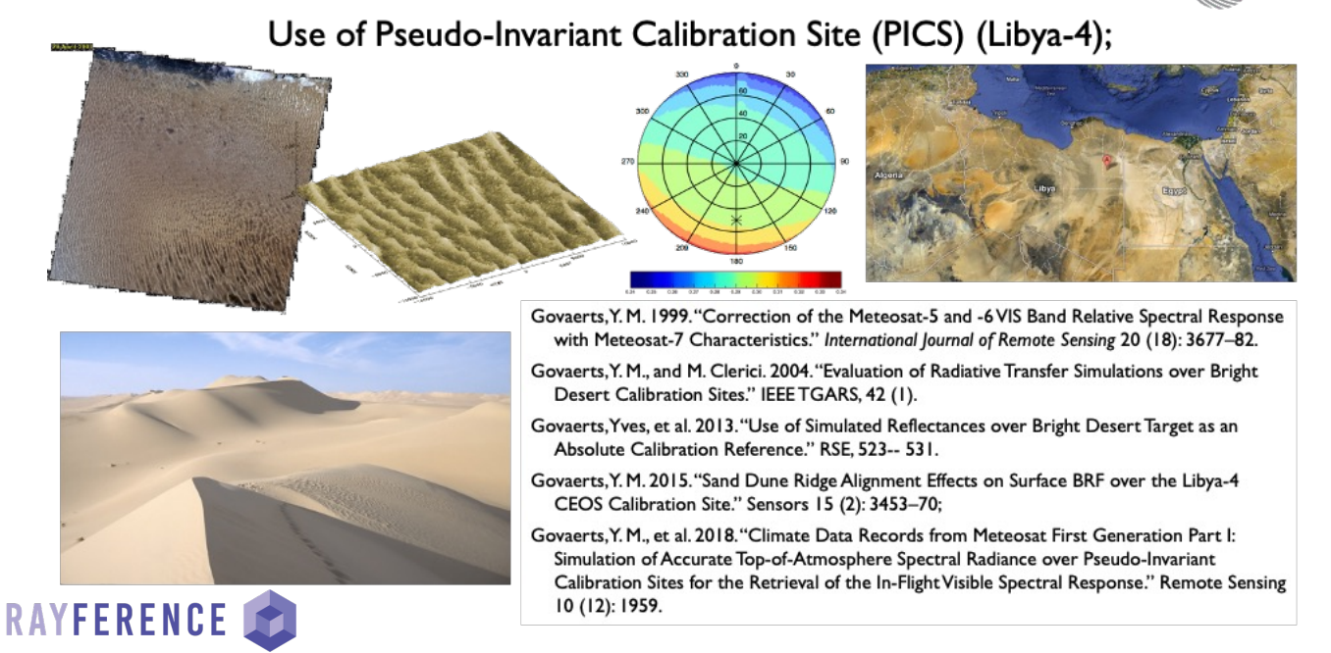
Rayference Radiometric Calibration Reference (RRCR)

Slide 8
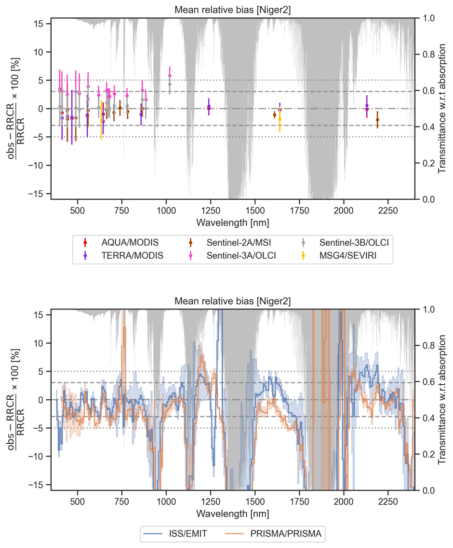
Rayference Radiometric Calibration Reference (RRCR)
RPV model for surface BRF at 1 nm spectral resolution;
CAMS data for the atmospheric profile;
CAMS data for aerosol optical thickness;
Aerosol model based on various sources of information;
Aerosol exponential profile;
Spherical Earth;
TOA simulation performed with Eradiate at 1 nm spectral resolution;
Illumination and viewing geometries from the simulated observation.

Slide 9
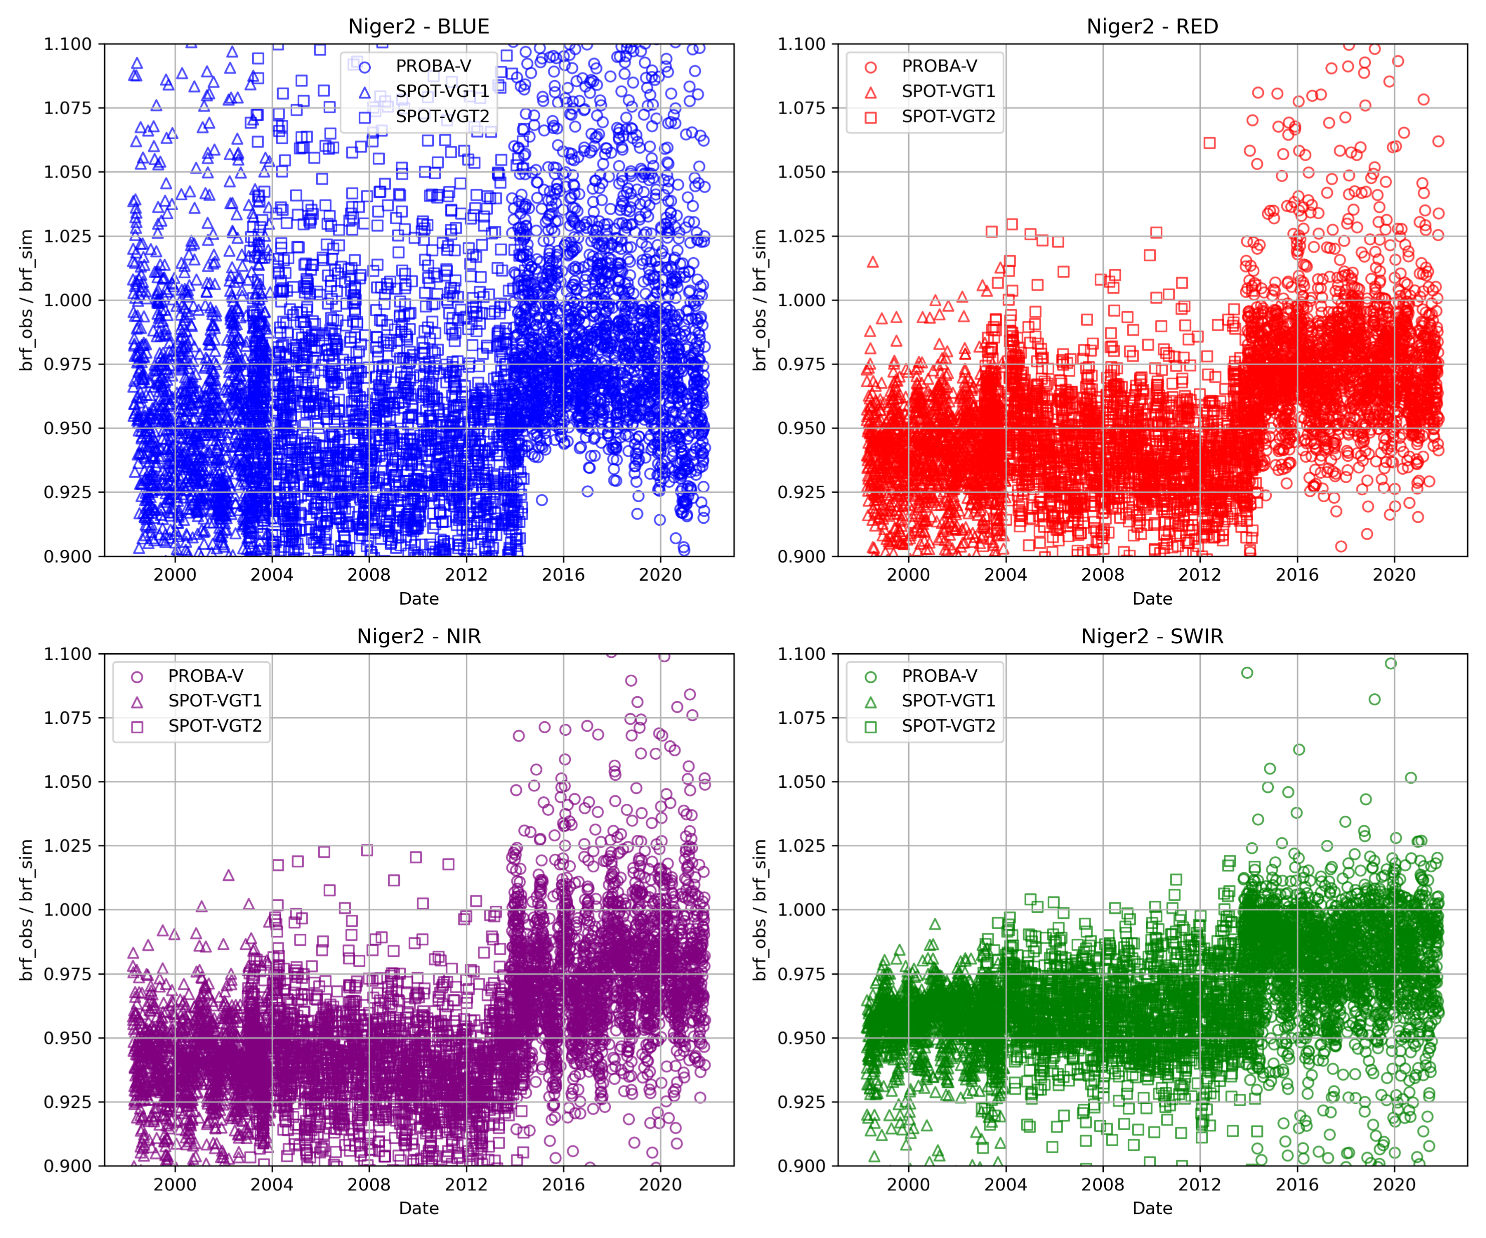
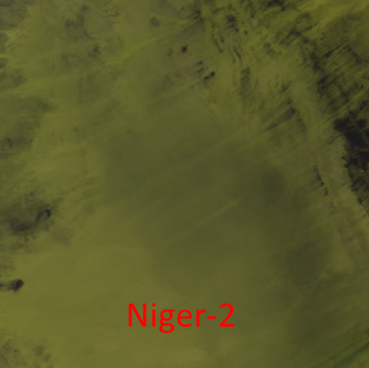

Slide 10
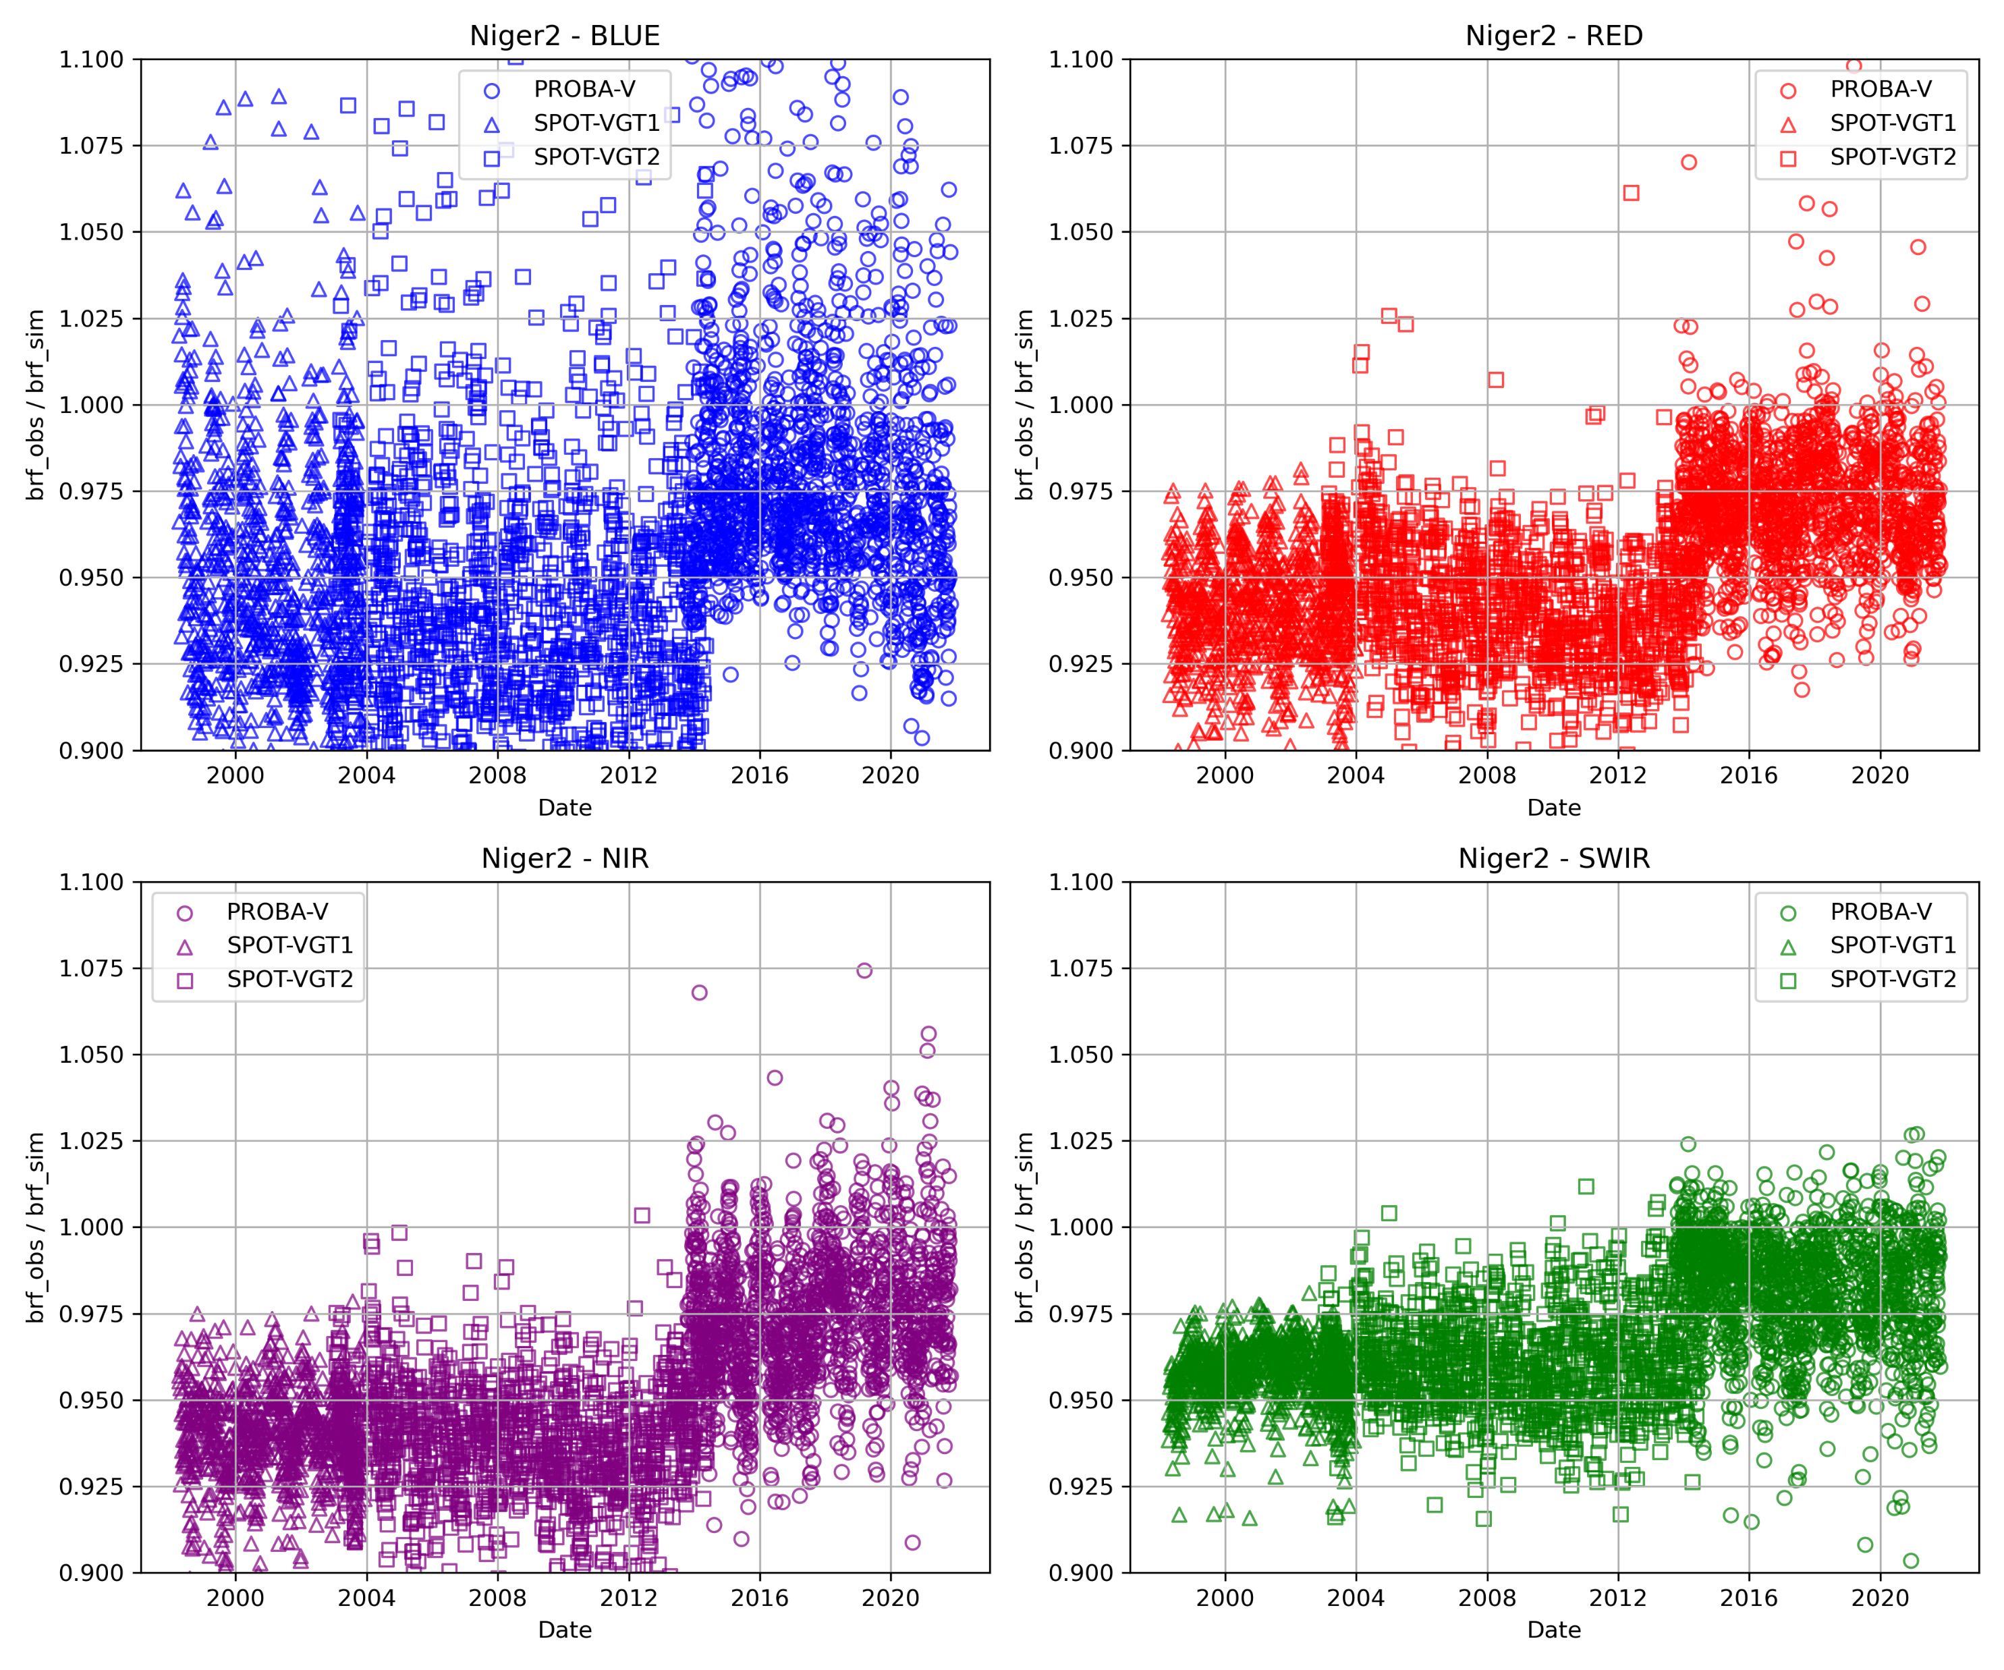
VISUAL CLOUD SCREENING

Slide 11
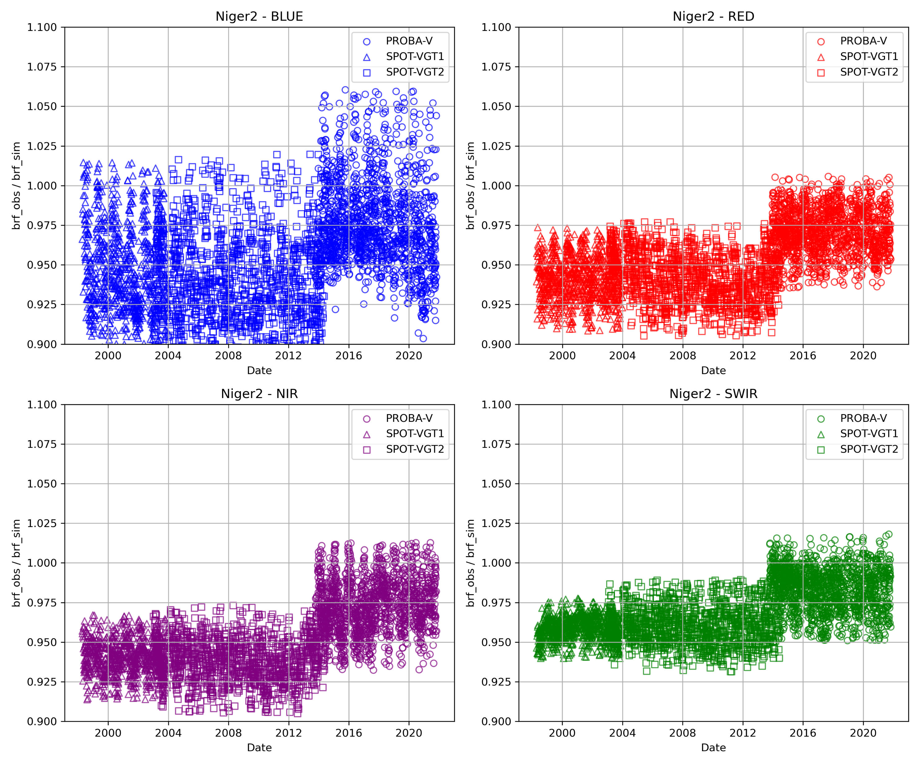
VISUAL CLOUD SCREENING+
OUTLIER

Slide 12
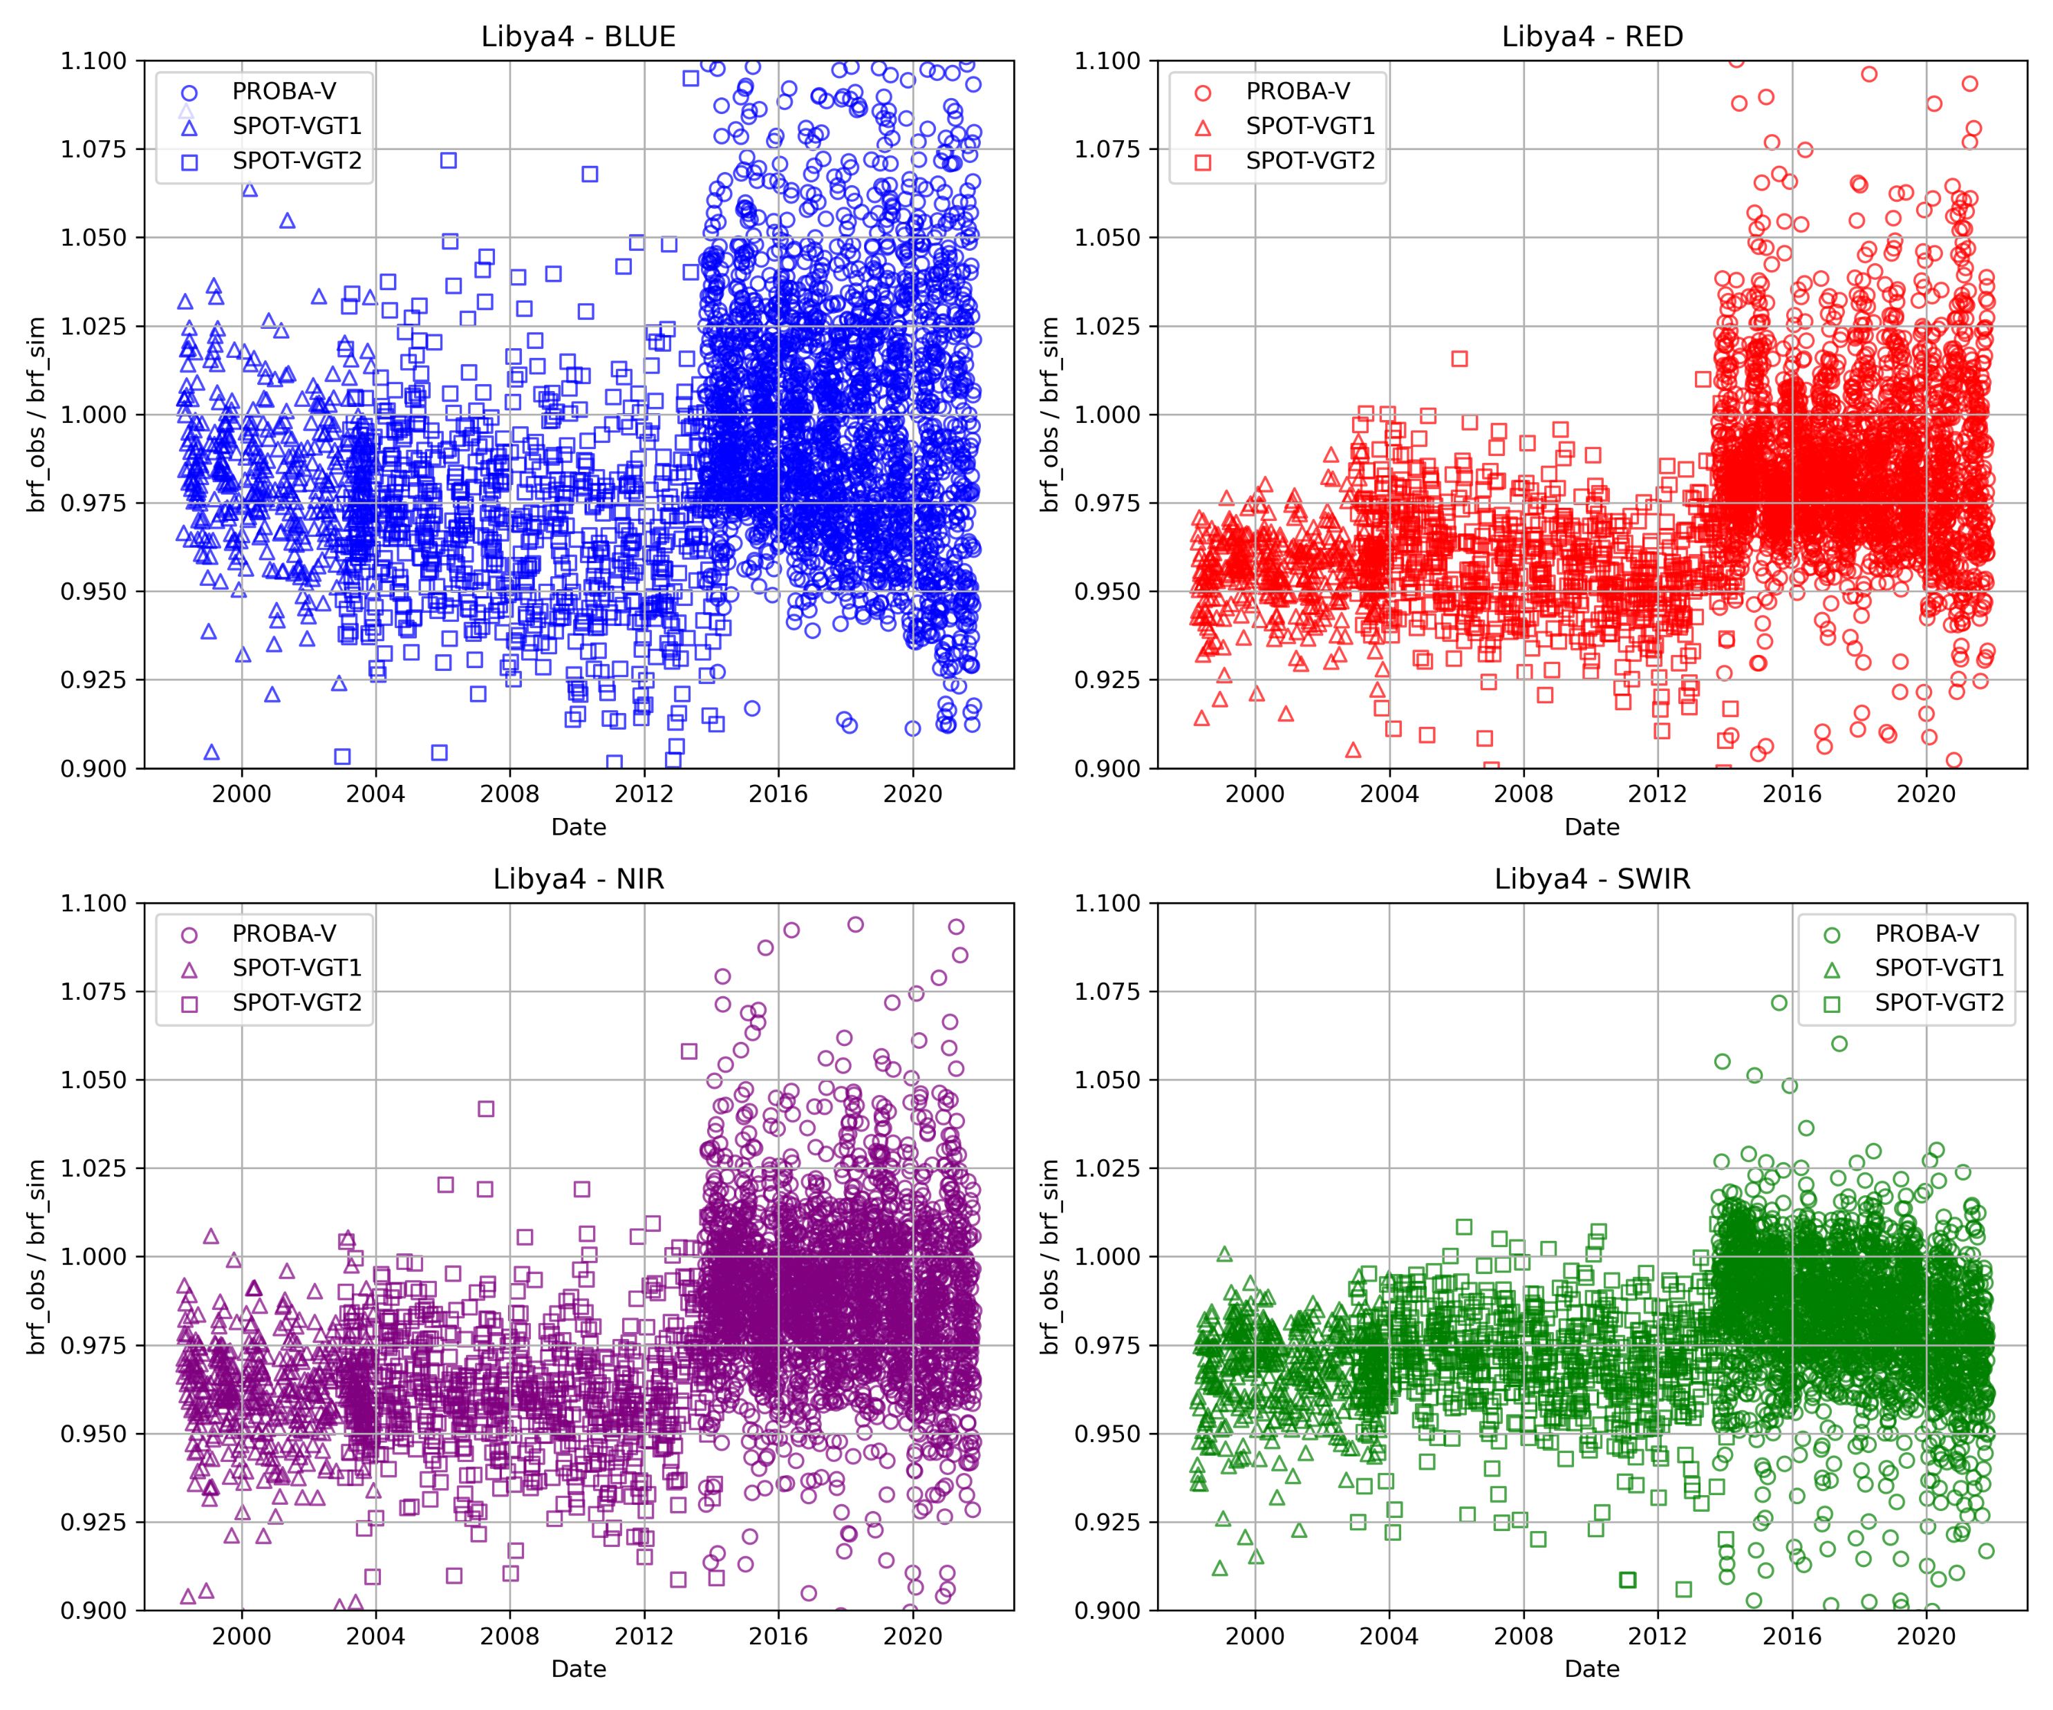
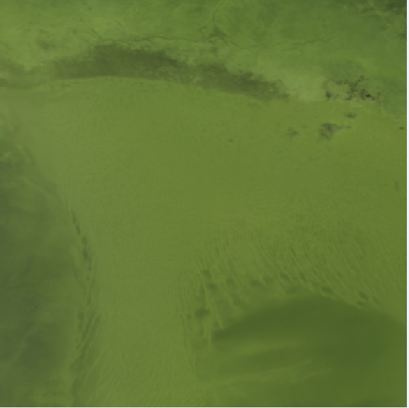
Libya-4

Slide 13
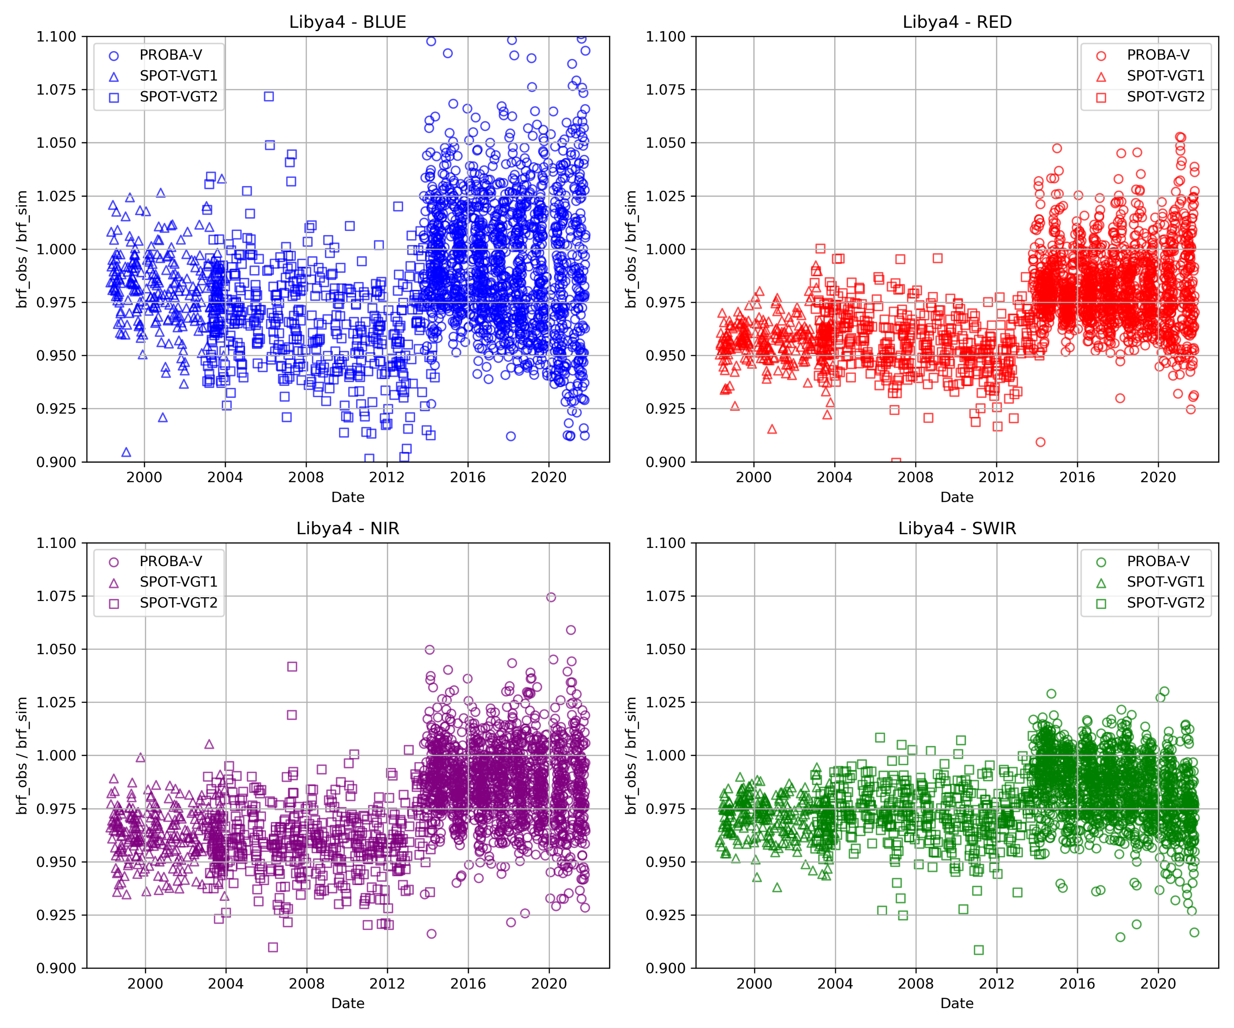
Libya-4
VISUAL CLOUD SCREENING

Slide 14
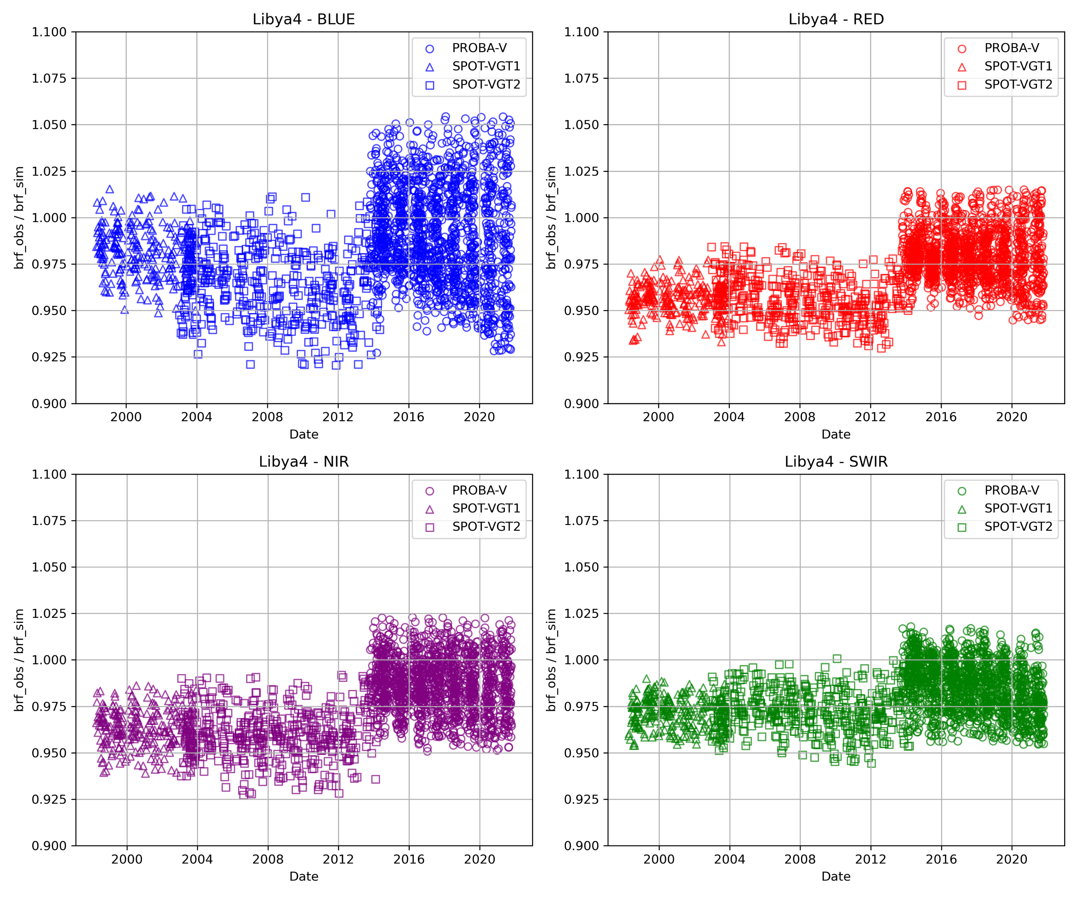
Libya-4
VISUAL CLOUD SCREENING+
OUTLIER

Slide 15
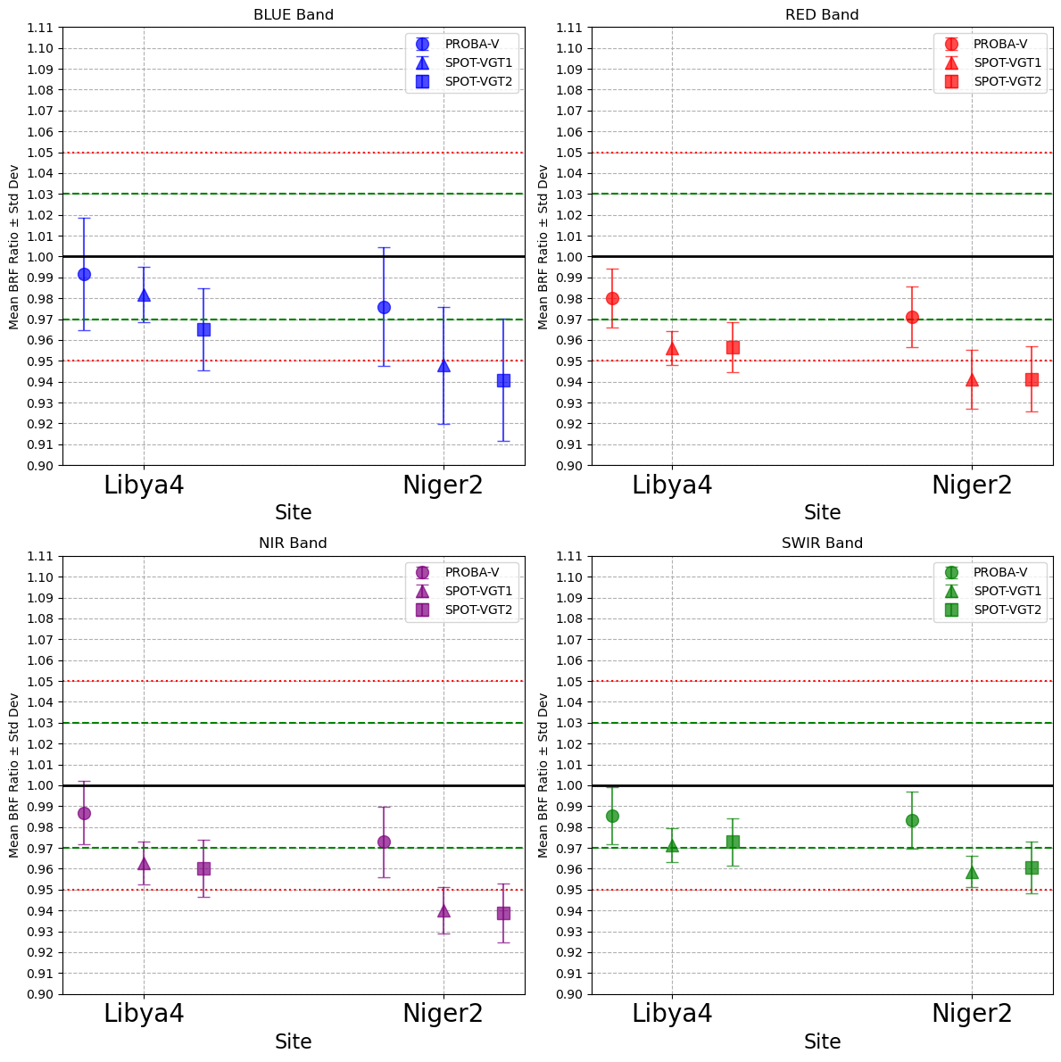

Slide 16
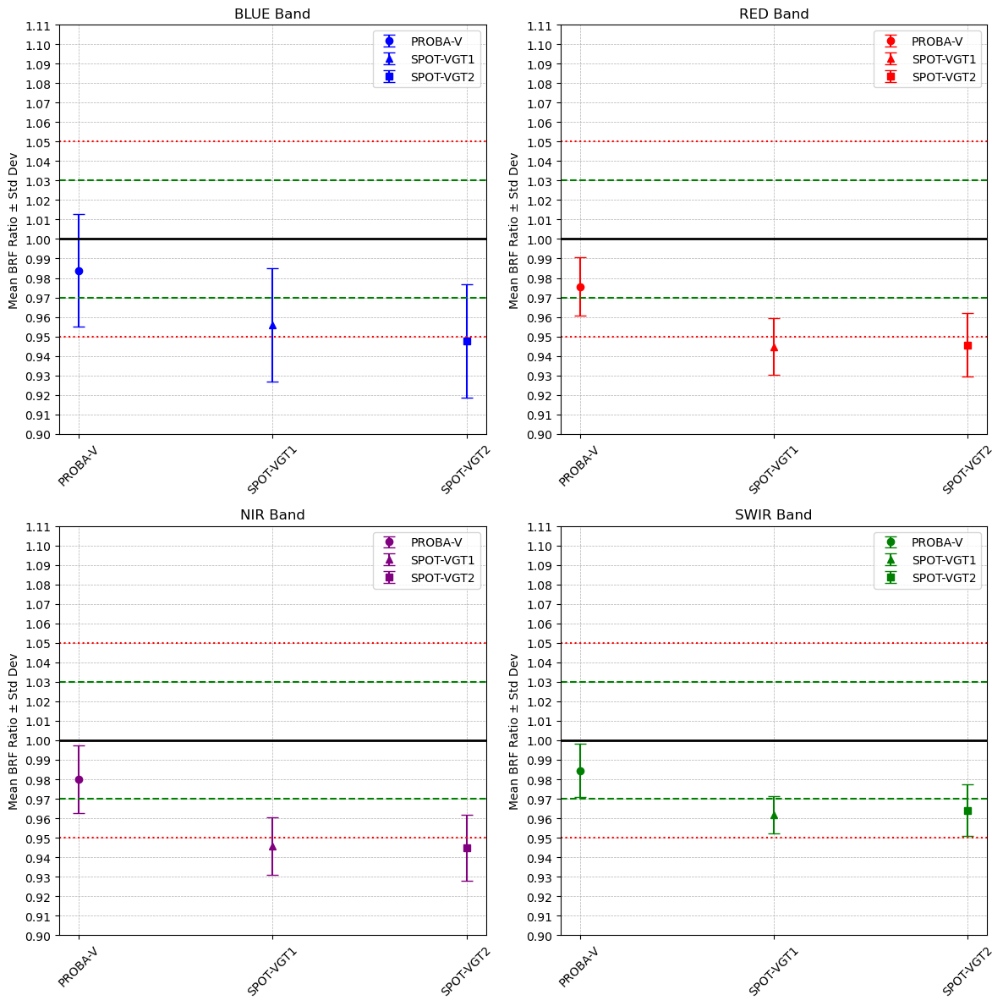

Slide 17
 | PROBA-V | SPOT-VGT1 | SPOT-VGT2
BLUE | 0.984 | 0.965 | 0.953
RED | 0.976 | 0.949 | 0.949
NIR | 0.980 | 0.951 | 0.949
SWIR | 0.985 | 0.965 | 0.967

Slide 18
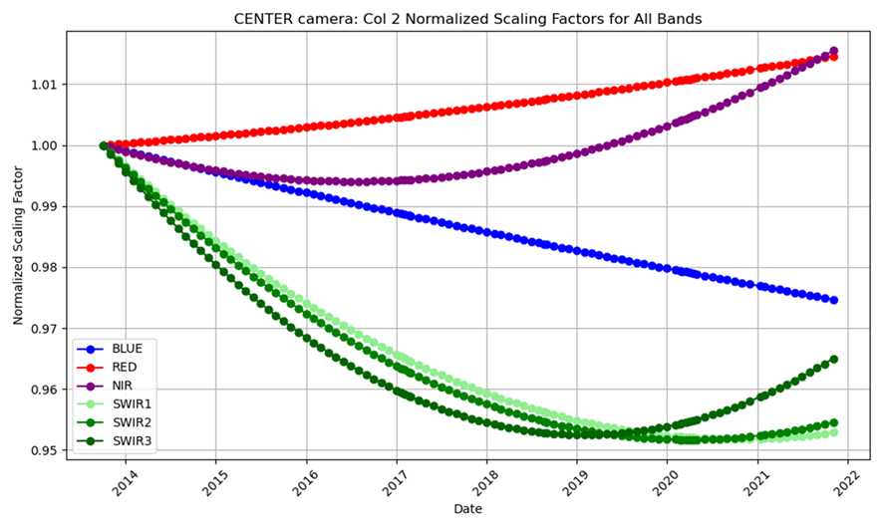
Any “remaining” trend ?
Absolute Calibration Parameter
Trending Model
L=~DN/A

Slide 19
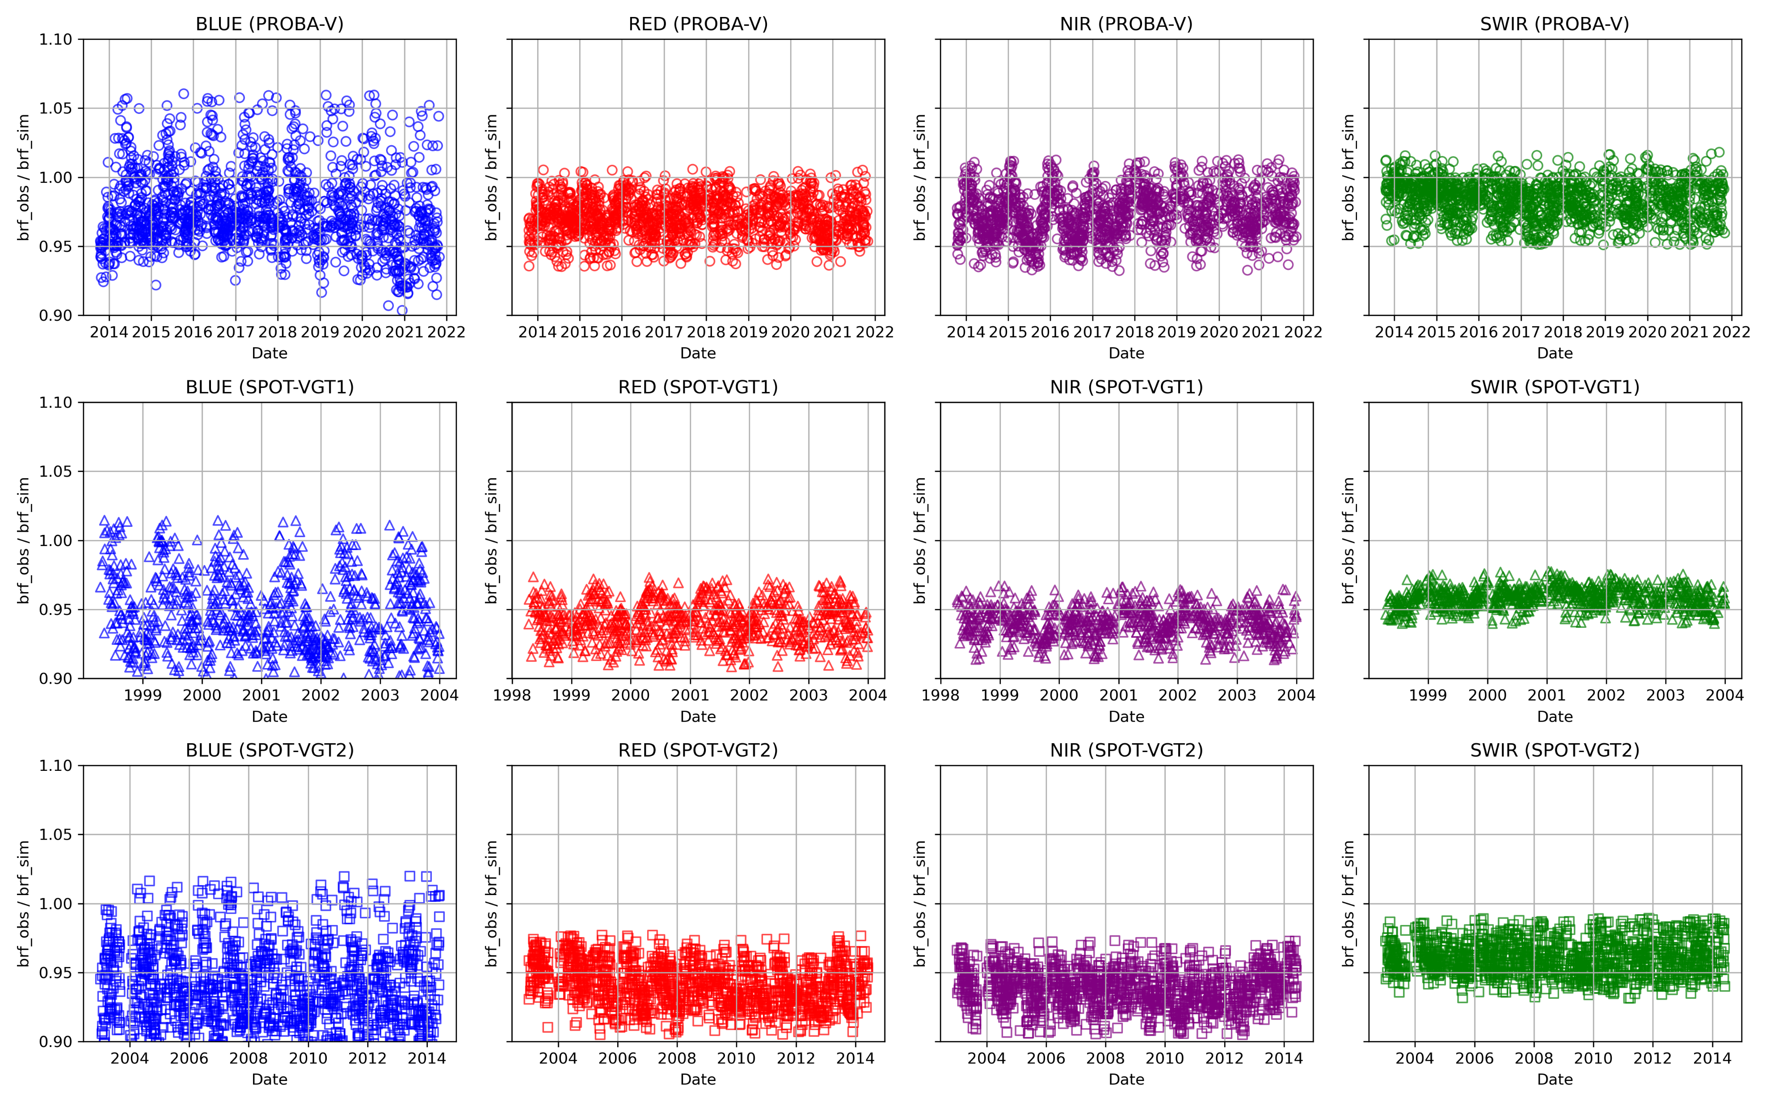
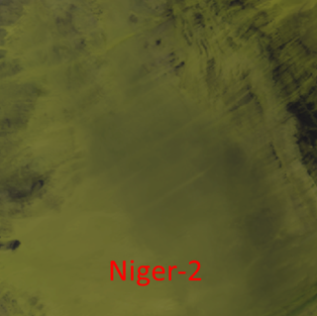

Slide 20
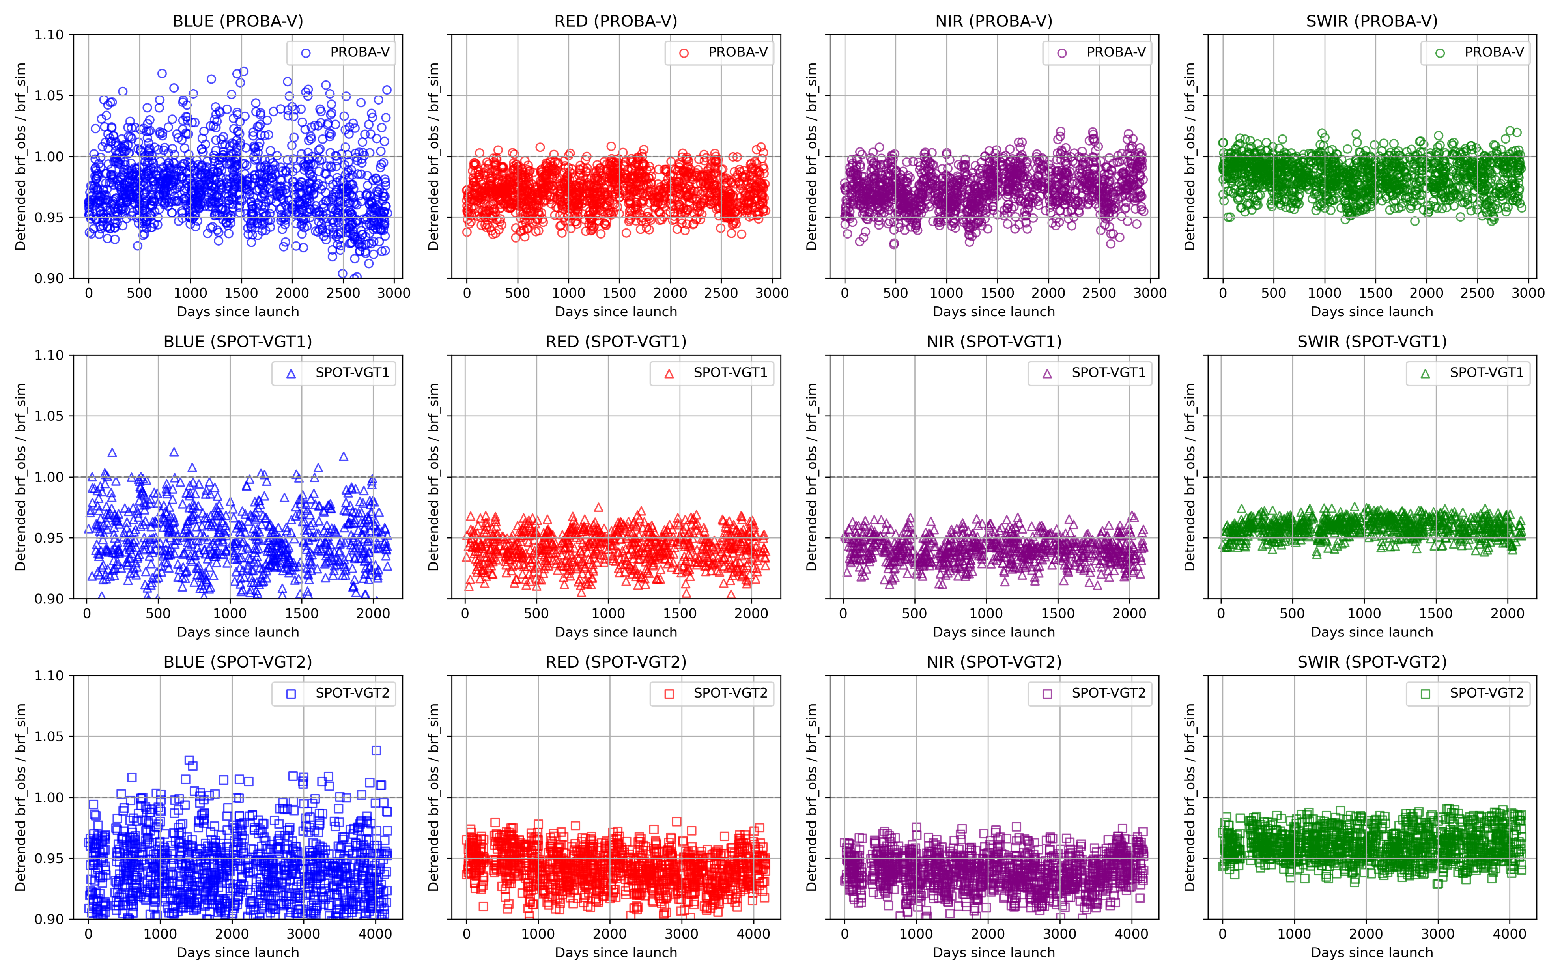

Slide 21
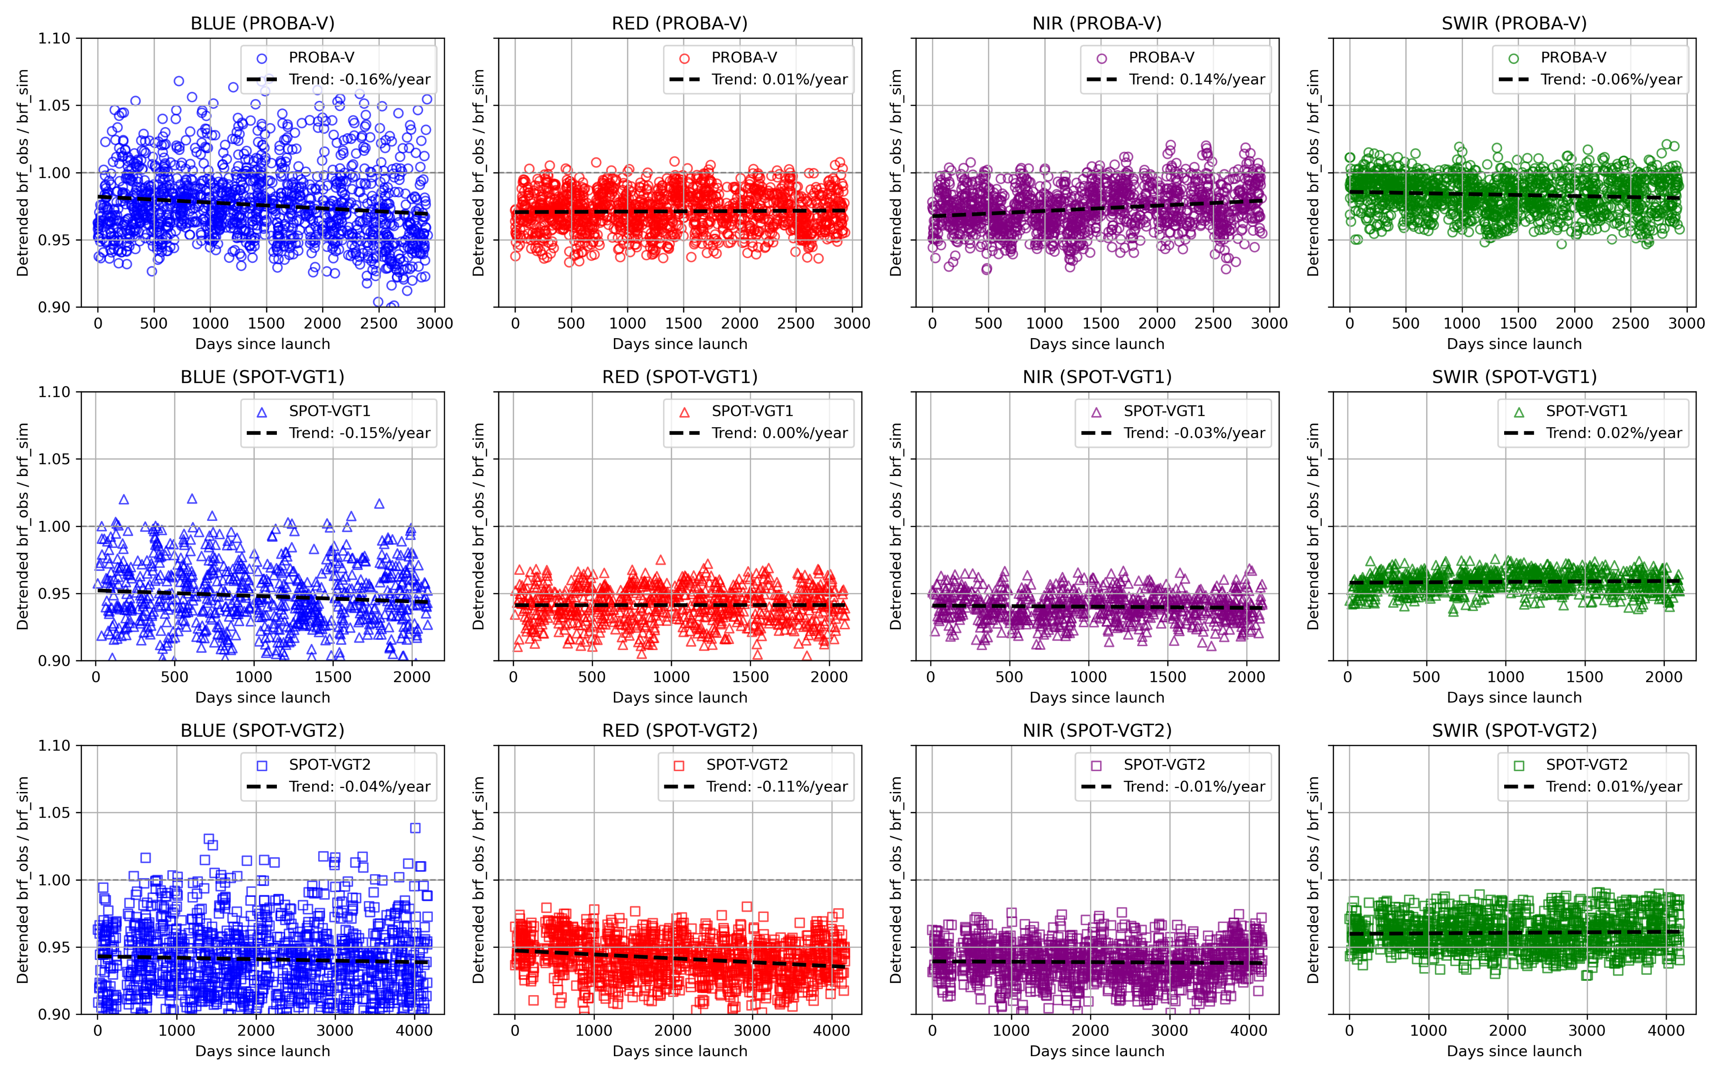

Slide 22
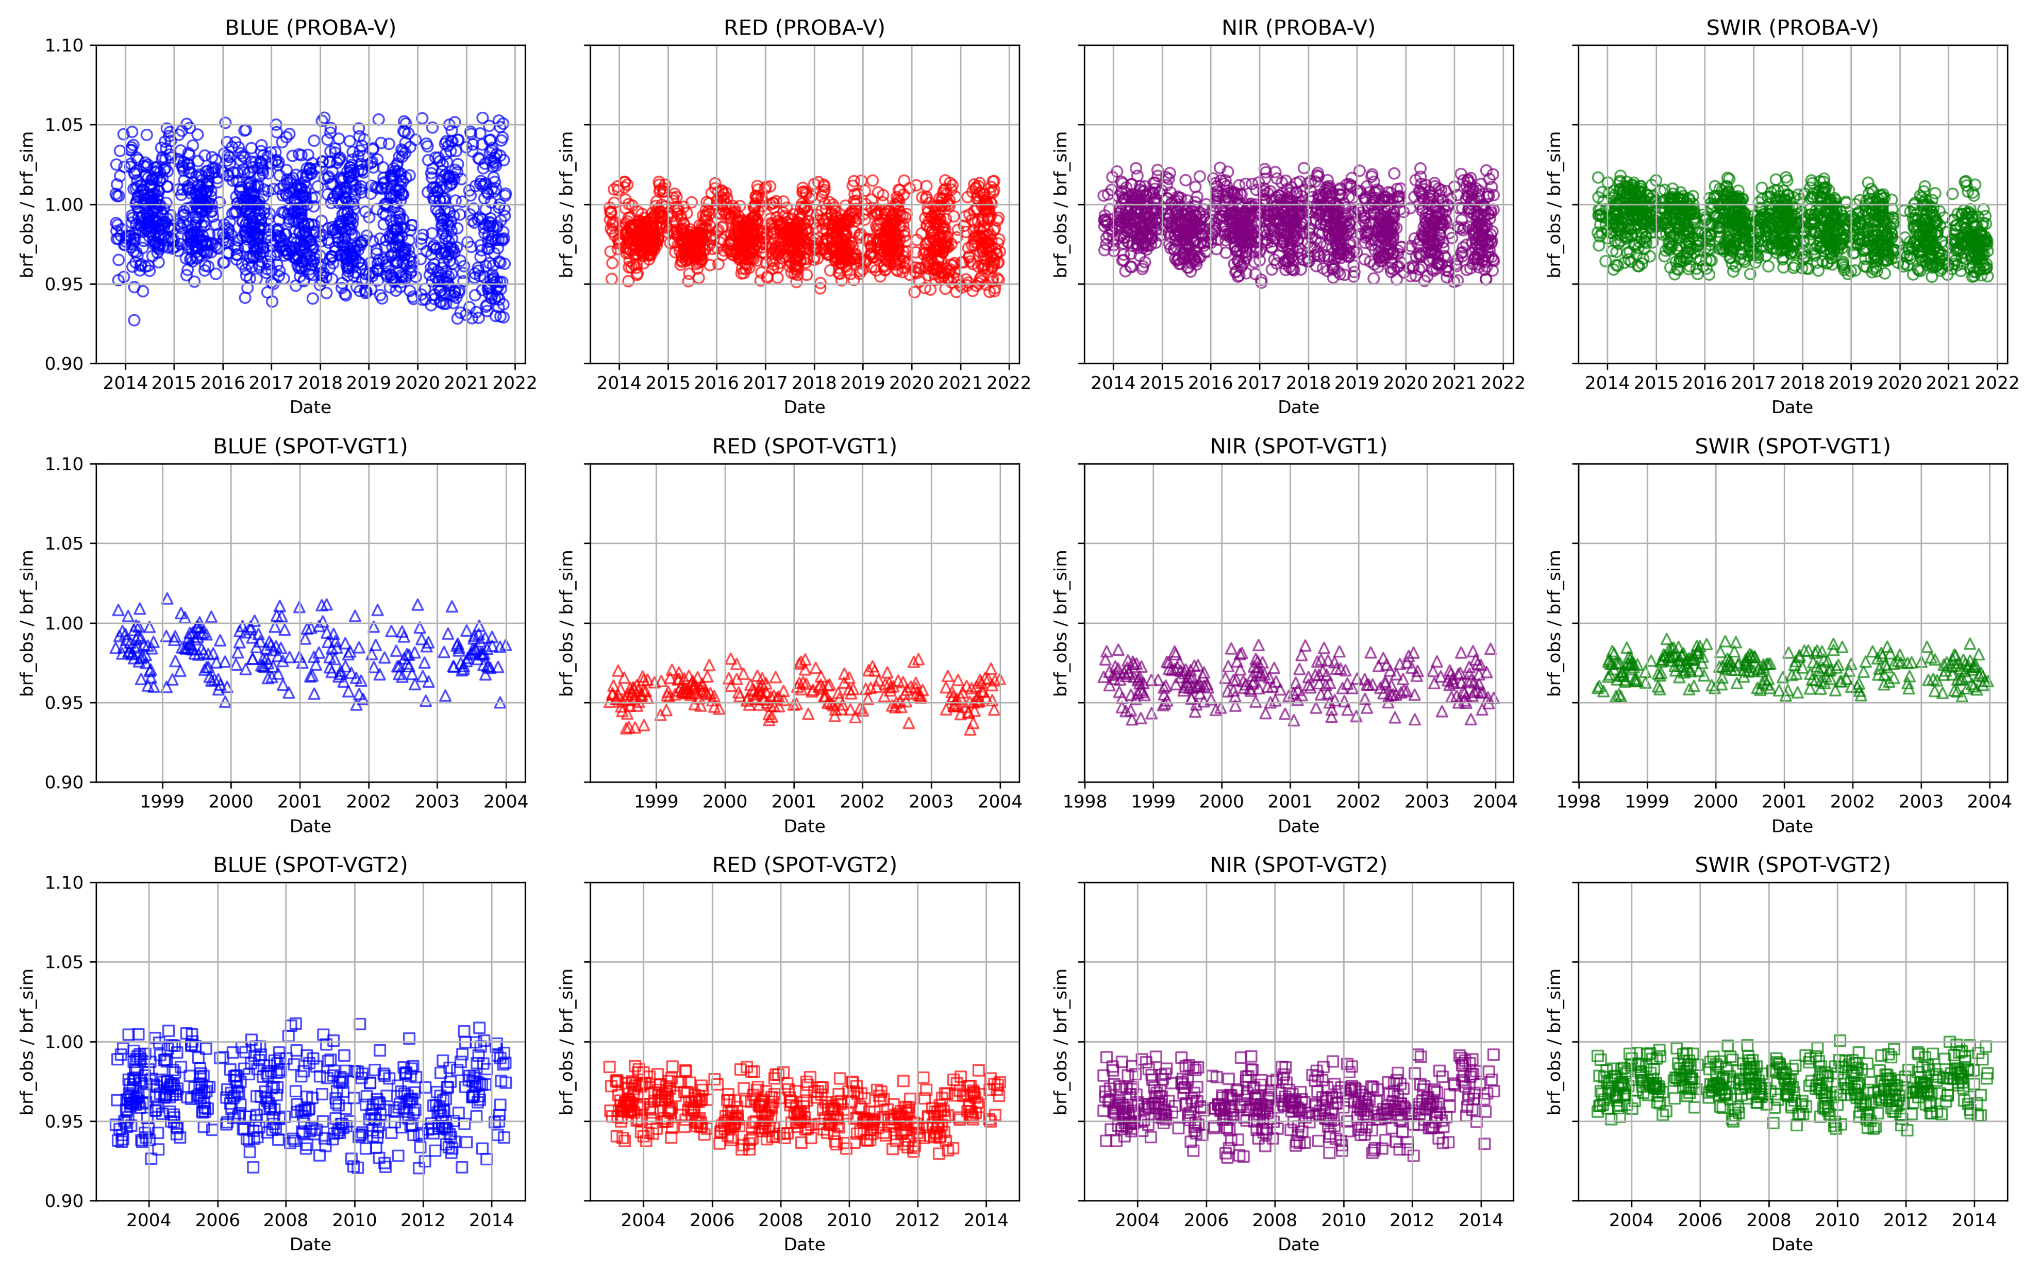
Libya-4

Slide 23
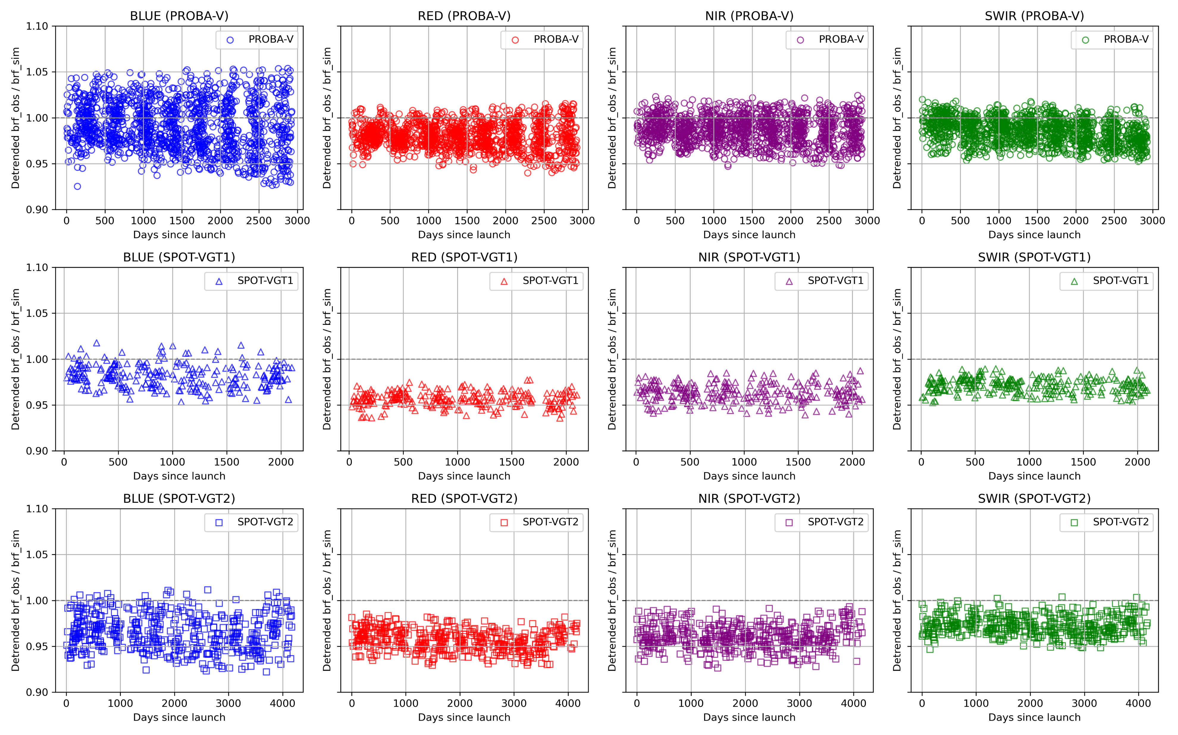

Slide 24



Slide 25
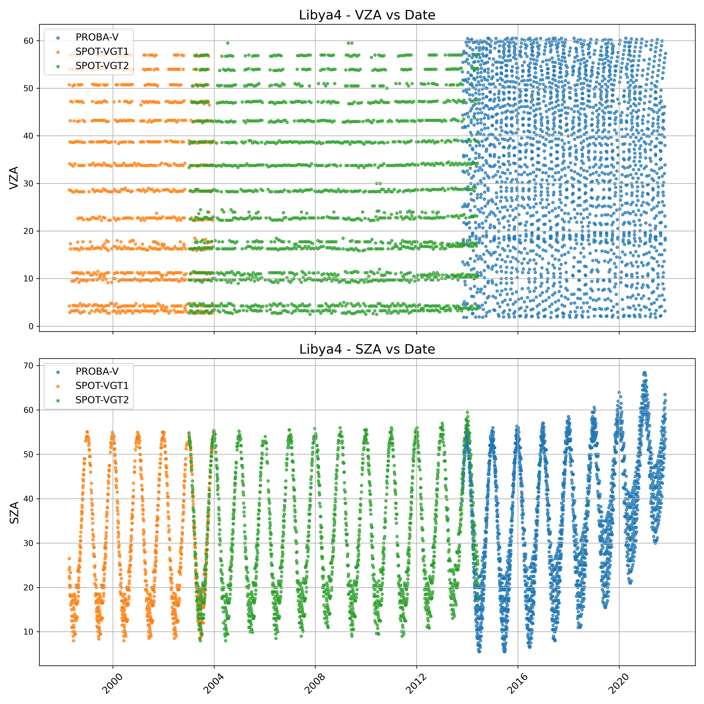

Slide 26
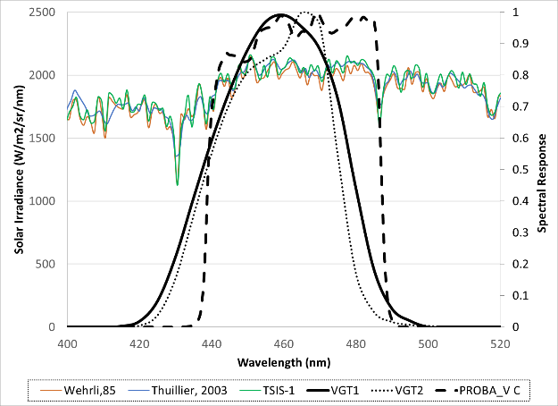
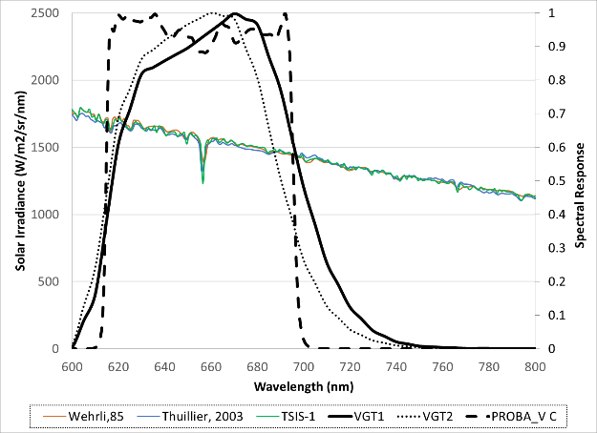
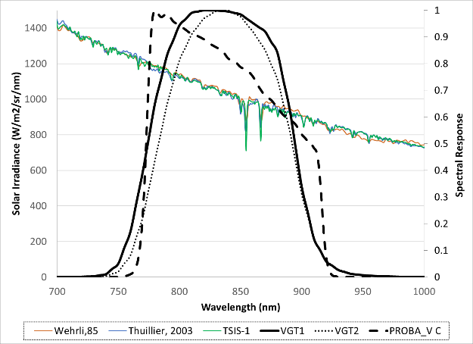
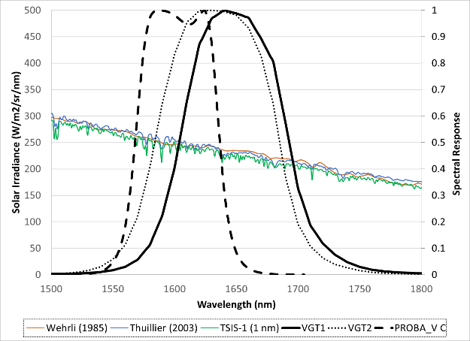
Harmonization Solar irradiance
Thuillier, et al, 2003
Wehrli , 1985
TSIS-1

Slide 27
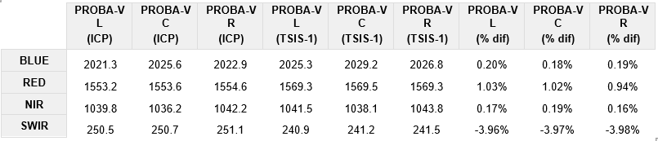
Harmonization Solar irradiance
Integrated solar irradiance for VGT-1 & VGT-2
Integrated solar irradiance for PROBA-V

Slide 28
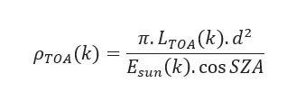

Harmonization Solar irradiance
Only TOA reflectance $(ρ_{TOA}\left(k\right))$ data are delivered to the user community.
Given this equation, with all other values remaining the same, a change in the solar irradiance will result in a corresponding change in the TOA reflectance.
Therefore, any change in the solar irradiance should be matched by a similar change in the absolute calibration.
By updating the solar irradiance, the absolute calibration coefficient and the TOA radiance is affected, but the final TOA reflectance remains unchanged.

Slide 29
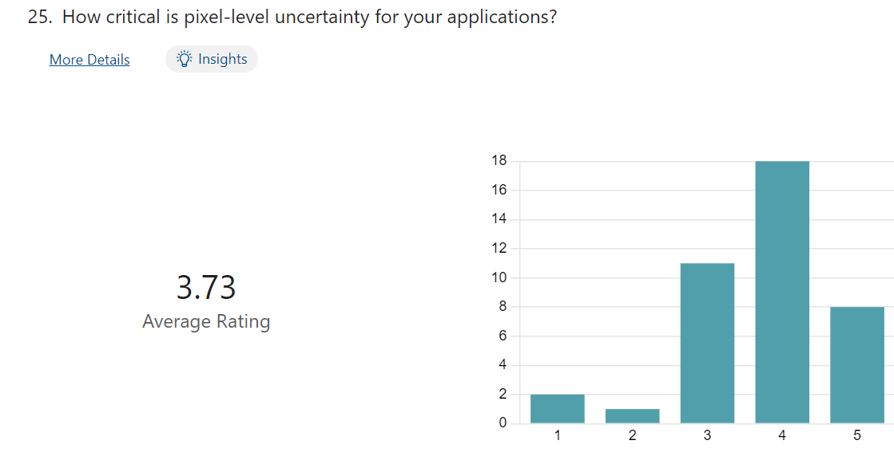
FDR4VGT: Pixel level -uncertainty
Not at all important
Absolutely required

Slide 30
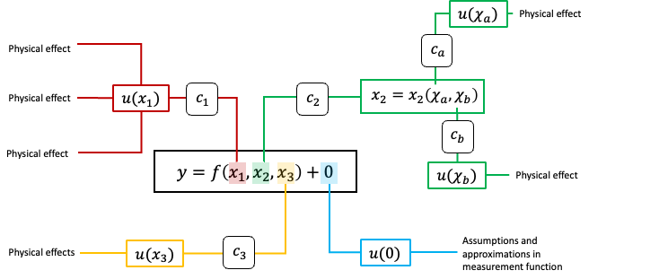
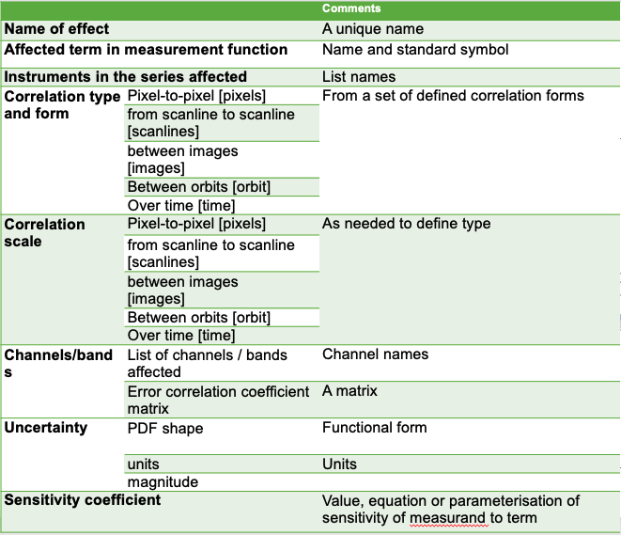



FDR4VGT: Pixel level -uncertainty
FDR4VGT Requirement : Providing uncertainty estimates at pixel level, ensuring traceability along the full processing chain, starting from raw data
Mittaz et al. 2019

Slide 31
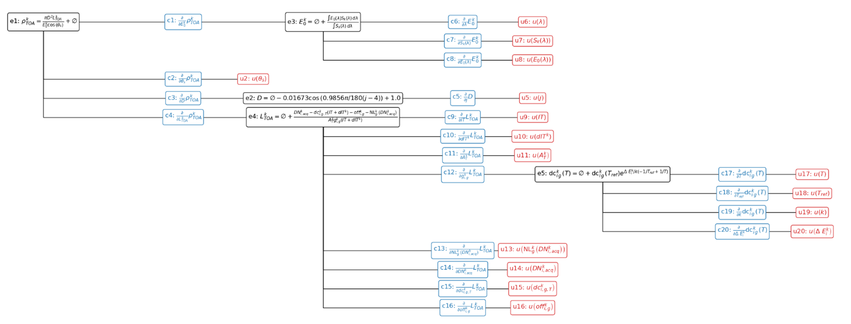

Uncertainty Model
PROBA-V uncertainty diagram

Slide 32
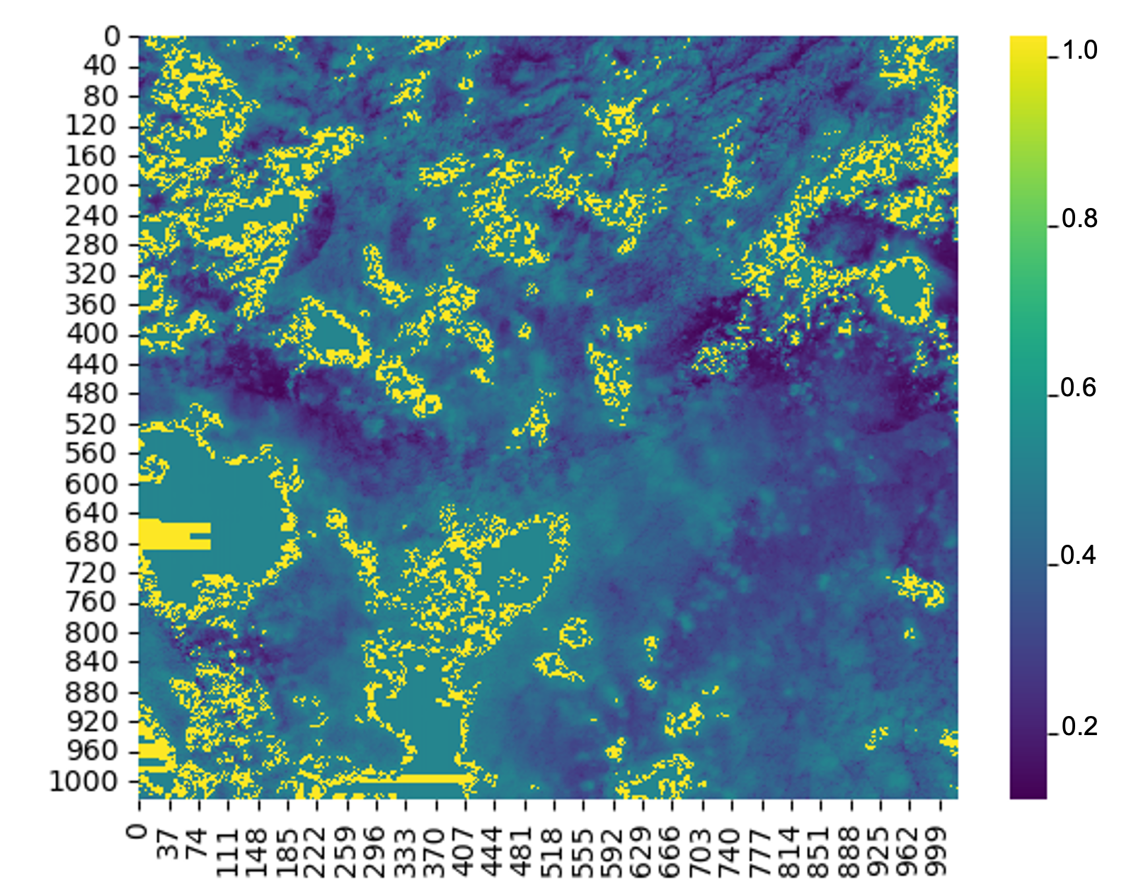
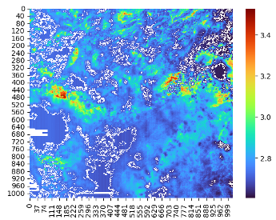
FDR4VGT: Pixel level-uncertainty
TOA reflectance
TOA reflectance relative uncertainty (%)

Slide 33
FDR4VGT: Pixel level -uncertainty
  The resulting uncertainty products benefit from the recent standardization efforts of the data format of these 3 sensors.
  Alongside the uncertainty products, Digital Effect Tables (DETs) are provided, describing the magnitude different sources of uncertainty.
  Uncertainty information is provided in 3 distinct components: random, structured and systematic.

Slide 34
Geometric harmonization
DEM Harmonisation
  Use of Copernicus DEM for both missions
Common Database of Ground Control Points (GCPs)
  Use of Sentinel 2 Global Cloud free Imagery
Harmonisation of the geometric Calibration parameters (ICPs) files
  Use the same format and correction parameters
Geometric Calibration harmonisation
  Use of common geometric calibration approach based on bundle adjustment
Notes:
GCPs for checking, DEM used in projection , to be checked if geometric harmonization

Slide 35
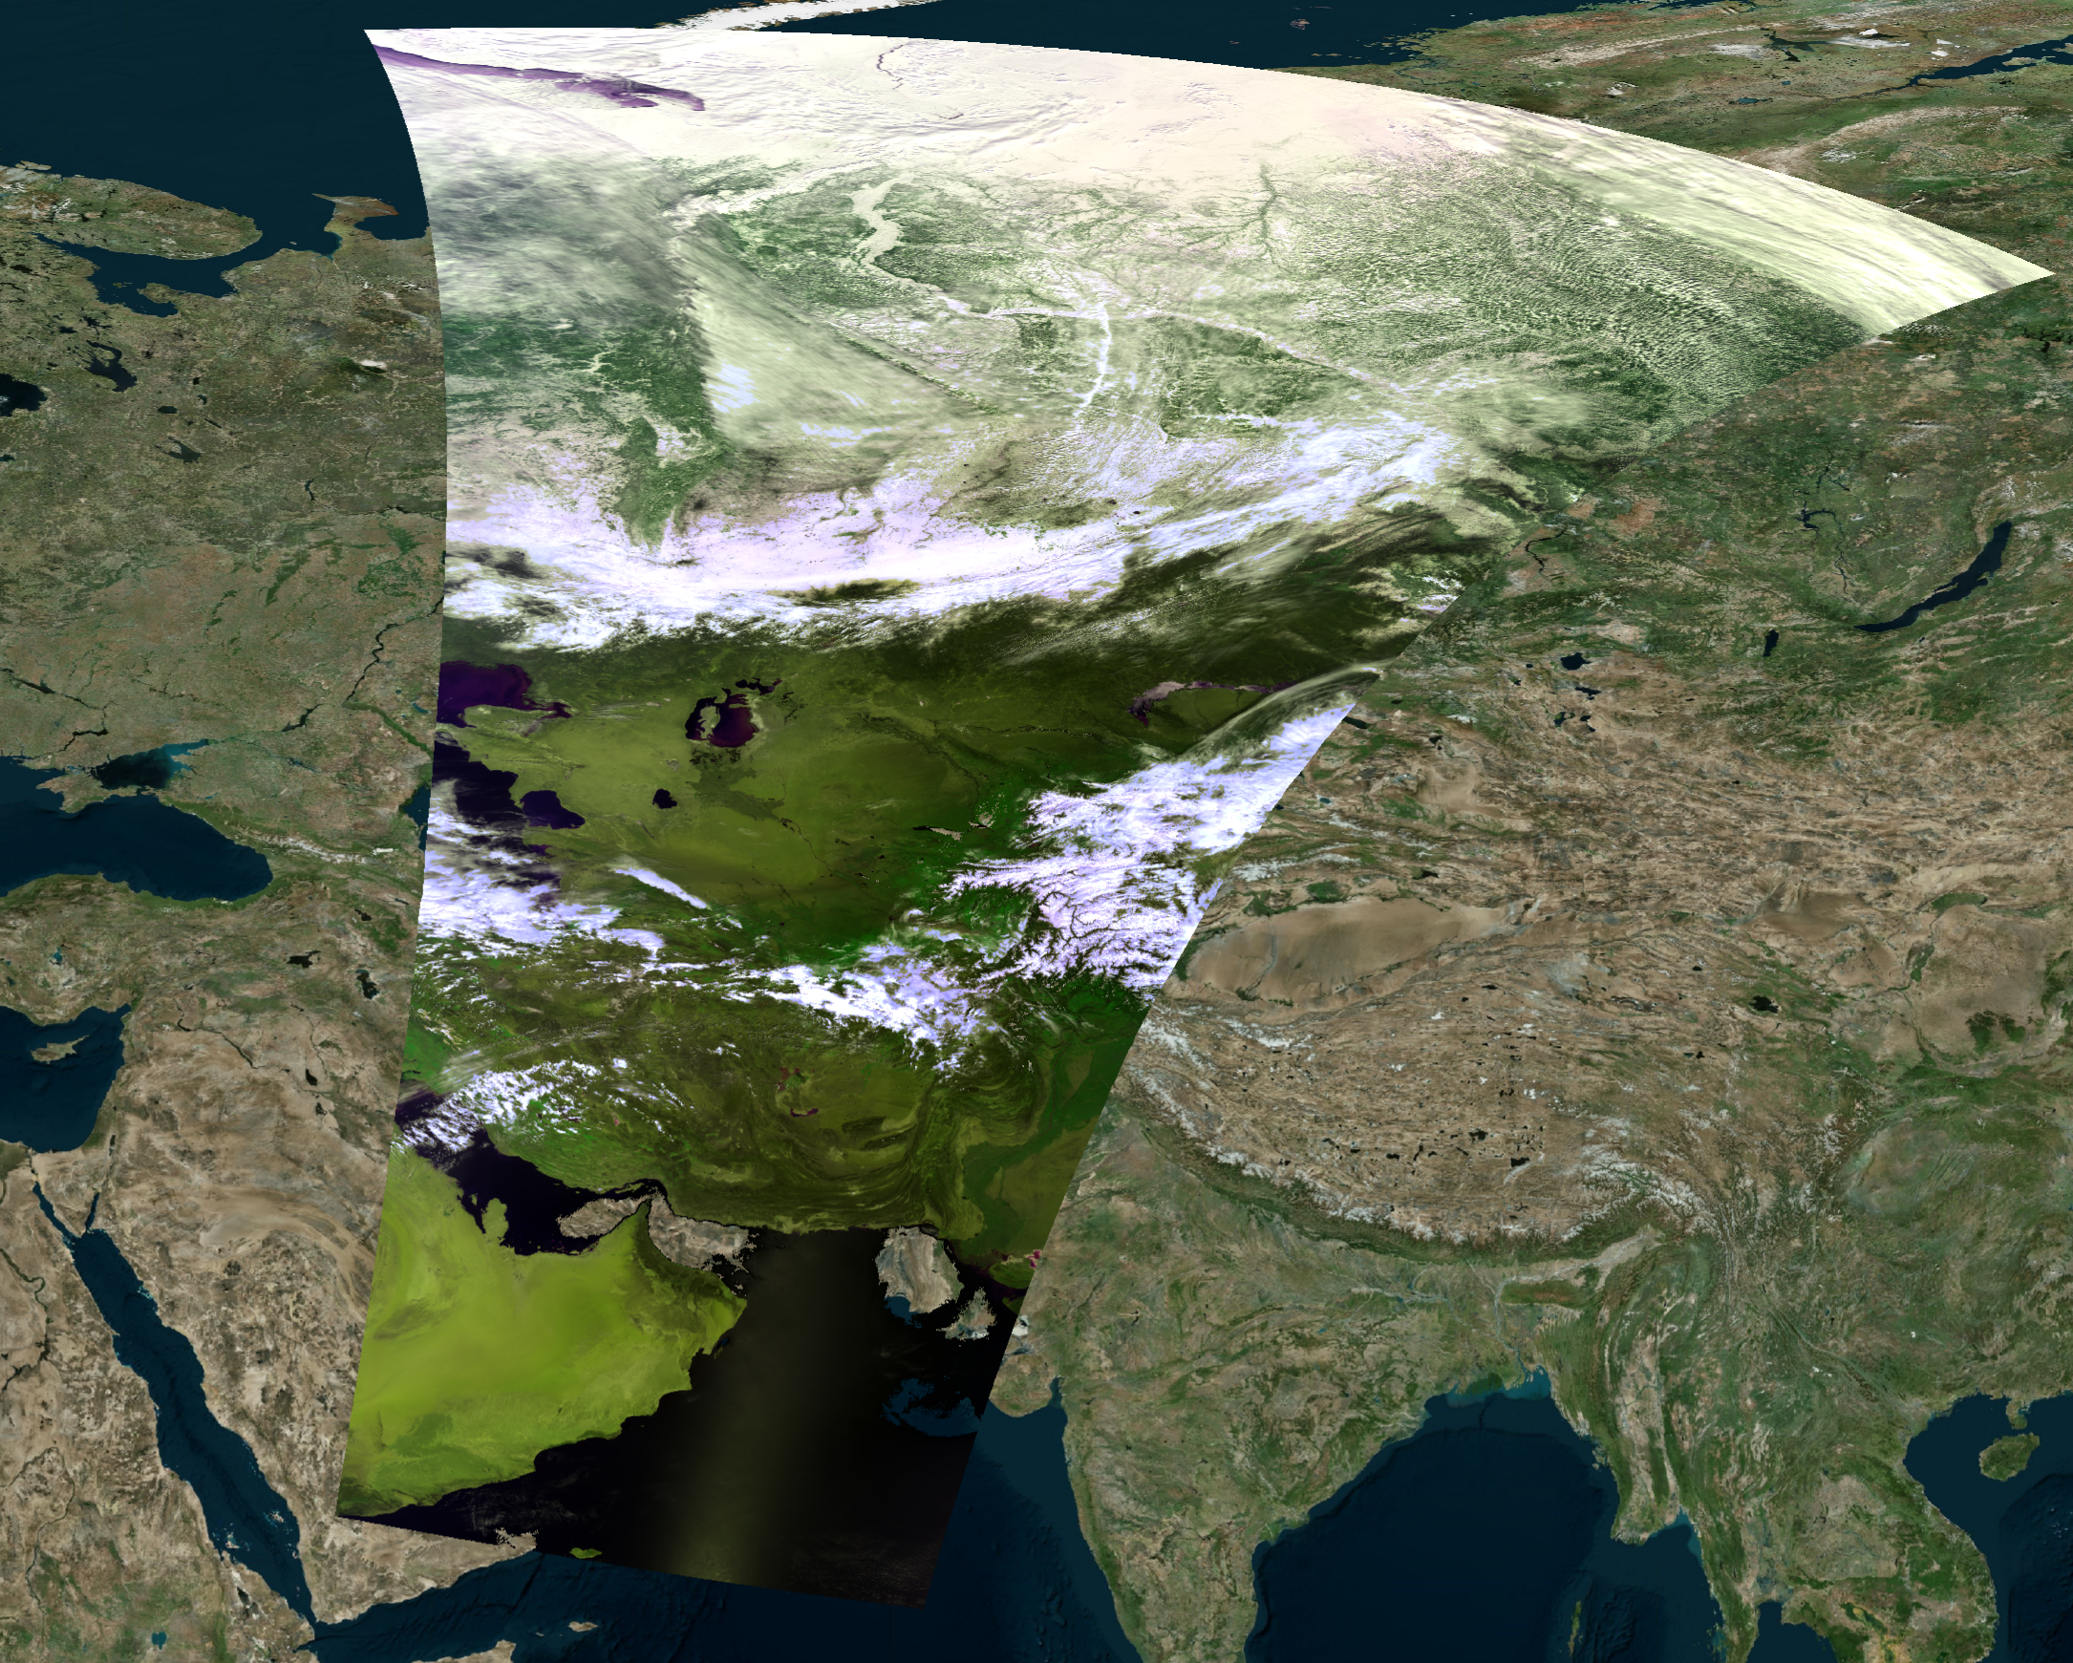
Segment V119990408196
Geometric shift in the C3 SPOT-VGT
Notes:
Error in timing , bad line period, satellite shrinked in along track (C3S)

Slide 36
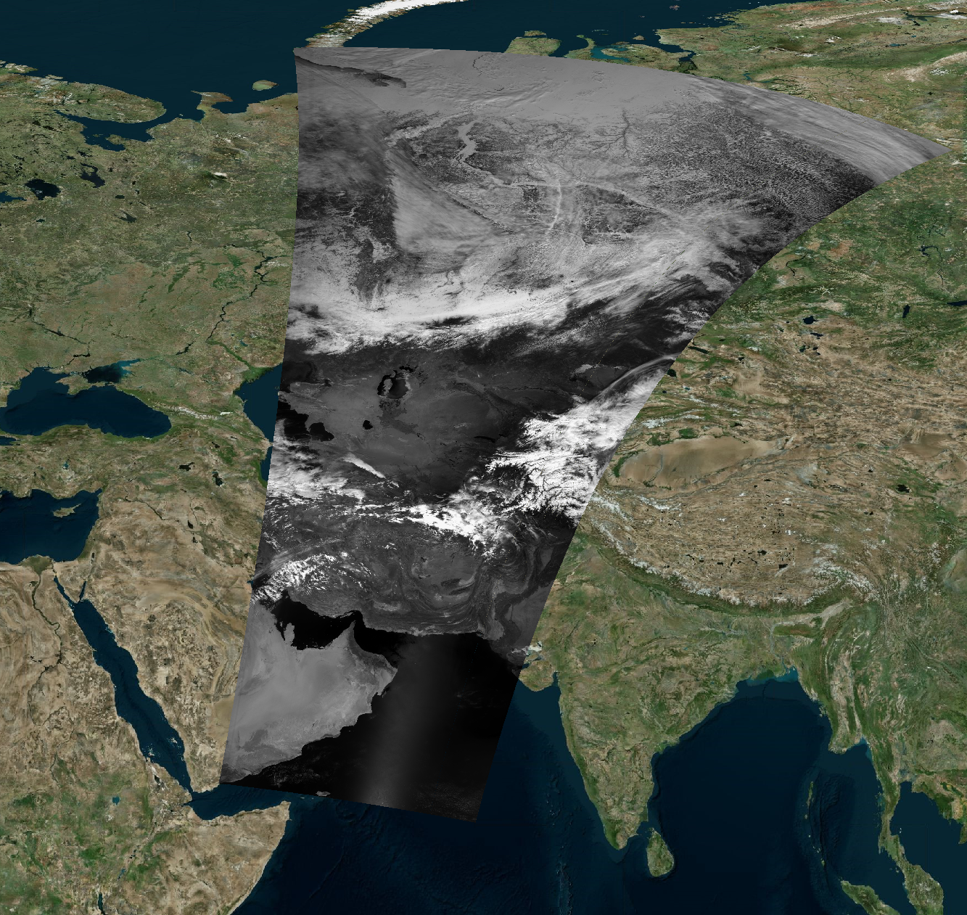
Segment V119990408196
Geometric shift removed using the new geoemtric calibration
Notes:
Correct tilme period, recover the segments

Slide 37
Conclusion and next steps
Phase 1 (2024-26) : Algorithm development
  ✅ Radiometric Harmonization: Inter-sensor biases quantified
  ✅ Geometric Harmonization
  ✅ L1 pixel-level Uncertainty
  🔄 Consistent Cloud Masking (University of Valencia)
  🔄 Consistence A/C and Uncertainty Propagation to L2 (Hygeos)
Phase 2 (2026-28): Integration and reprocessing 20+ years archive.

