Slide 1
Monitoring the FCI VIS-NIR and LI Radiometric Performance Using Vicarious Calibration and Inter-Calibration
Ali Mousivand, Sebastian Wagner, Vincent Debaecker, Rakshith Shanbhag, Romain Degoul, Alessandro Burini, Bartolomeo Viticchie and Mounir Lekouara
EUMETSAT/ RSP/INRC
GSICS Annual Meeting,
17 – 21 March 2025, Changchun, China

Slide 2
Agenda
MTG-I1 FCI and LI – Overview
MICMICS
Vicarious calibration and Inter-Calibration
  Desert calibration
  Desert inter-calibration
  Raymatching inter-calibration
  DCC inter-calibration
  GEO-GEO inter-comparison
  Lunar calibration
Insights and Conclusions

Slide 3
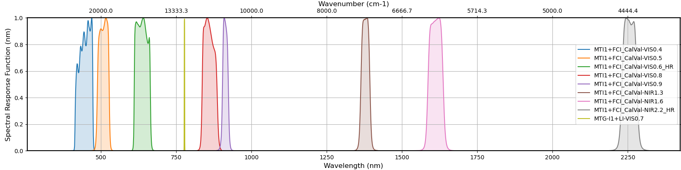
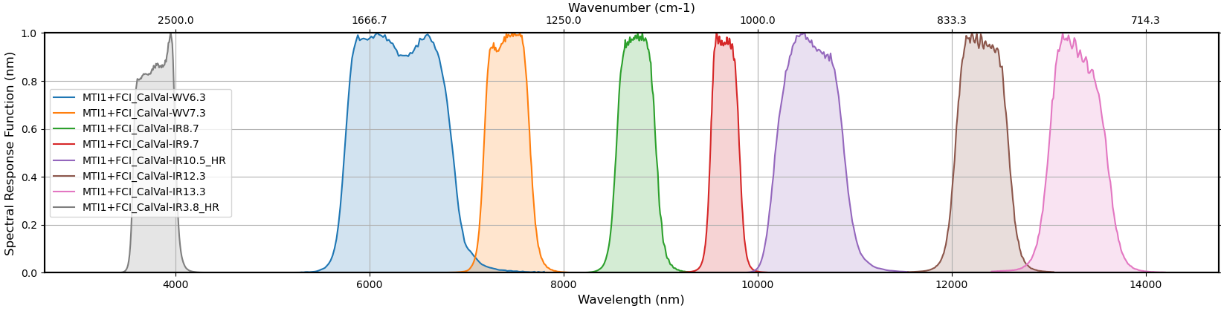
MTG-I1 FCI and LI – Overview
FCI and LI VNIR channels
FCI IR channels

Slide 4
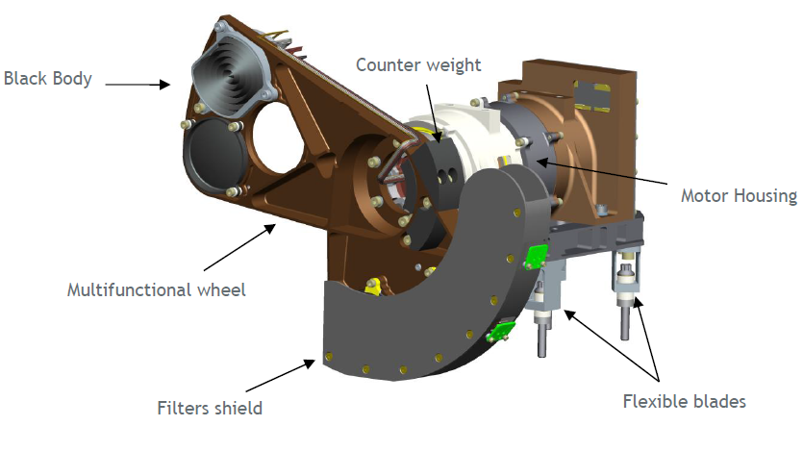
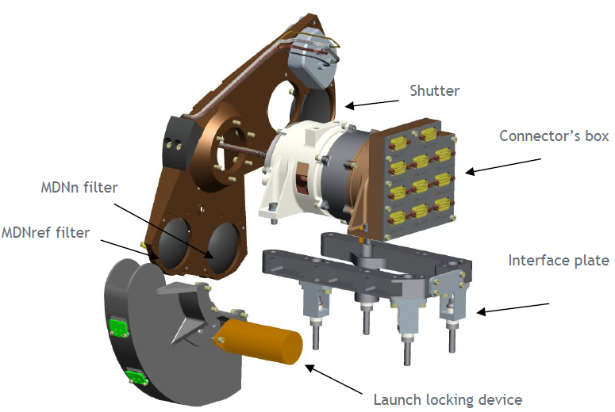
MTG-I1 FCI and LI – Overview
LI Background Radiance Image:
  A single-channel image centered at 777.4 nm, with no onboard calibration device.
  Absolute user requirement accuracy of 10%
FCI VNIR Onboard Calibration:
  Uses two MND filters mounted on the COM, operated twice a year.
  Absolute user requirement accuracy of 5% (10% for High Resolution VIS0.6 & NIR2.2)
On DOY 013 2024, FCI suffered a major anomaly and automatically switched to SURVIVAL mode. The initial investigations identified the root cause in an electrical failure in the COM mechanism.
The Calibration and Obturation Mechanism for the FCI instrument (COM-I):
  Provides optical source selection for observation, calibration (IR by a black-body and VNIR by MND filters) and obturation tasks by inserting the appropriate optical elements in the light path;
  IR calibration uses a black-body in the light path, providing controlled radiance and precise temperature control for accurate calibration;
  The VNIR calibration function is provided by MND filters.
By not operating the COM anymore:
  FCI is losing its main on-board calibration sources for the VNIR and IR channels;
  IR Channels are more at risk of degradation (stripes in the images, loss of absolute radiometric accuracy, loss of radiometric stability) due to the sensor technology. (SHORT TERM PROBLEM);
  VNIR on-board characterisation is still considered to be valid and thanks to the slow degradation of VIS channels, it can be considered still valid for the next short/medium term. (LONG TERM PROBLEM).
Radiometric calibration for VIS-NIR channels is based on Autumn 2023 in-flight calibration

Slide 5
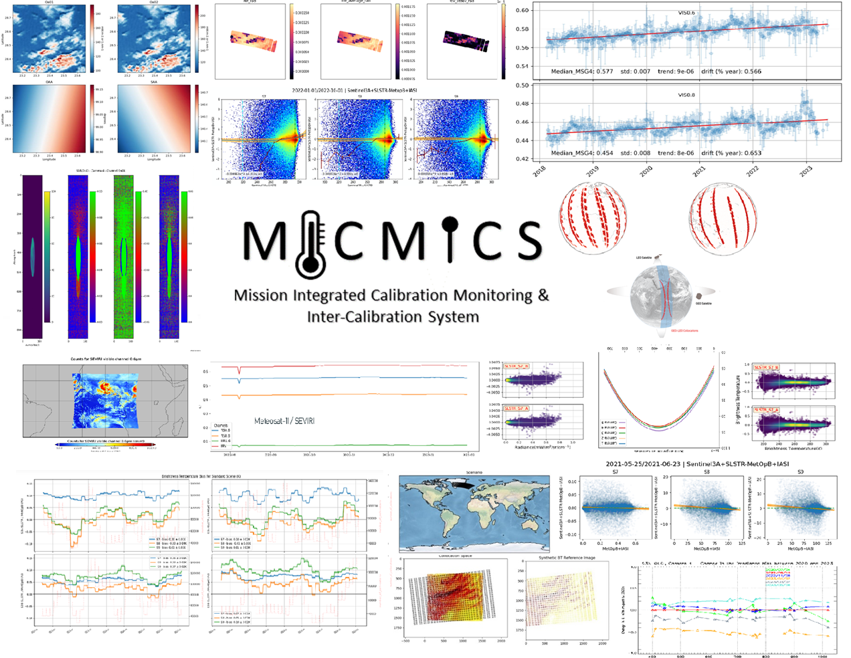
MICMICS (Mission Integrated Calibration Monitoring and Inter-Calibration System)
EUMETSAT’s MICMICS is an agile system dedicated to the near-real time monitoring of radiometric performances and inter-calibration
Main assets:
  Easy integration of new missions
  Easy integration of updated/new calibration methods and interoperability of the processing modules
  Rationalisation of resources and efforts (including for the maintenance)
  Support the operational generation of GSICS products (and intermediate products such as collocations) and the generation of Climate Data Records
Status:
  The prototype has been extensively tested and validated
  Already supporting the EUMETSAT diagnostics on SEVIRI, AVHRR, OLCI & SLSTR, FCI & LI
  Developments are on-going for EPS-SG and CO2M

Slide 6








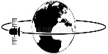


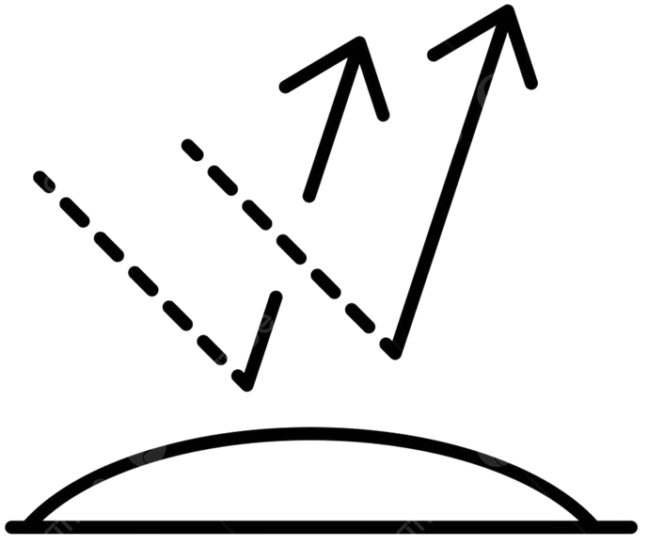
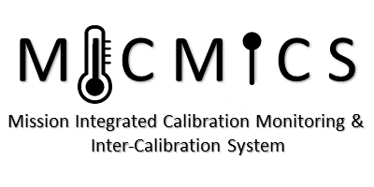


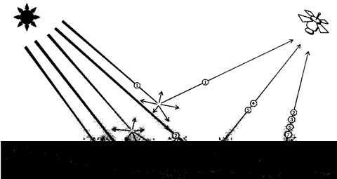
MICMICS workflows
Desert Calibration
Desert Inter-Calibration
DCC Inter-Calibration
Lunar Calibration
DCC Calibration
Lunar Inter-Calibration
Imager-Hyperspectral
Inter-Calibration
Rayleigh Calibration
Imager-Imager
Inter-Calibration
FCI
LI
SLSTR
SEVIRI
OLCI
Rayleigh Inter-Calibration
SLSTR
METimage
Ray-Matching
Inter-Calibration
NWP Calibration
FCI
SEVIRI
AVHRR
NWP Inter-Calibration
Inter-Calibration Blender
3MI
METimage
DCC Extraction Module
CLIM
MAP
Sun Glint Inter-Calibration
CO2-I
UVNS
UVN
Lunar Extraction Module
Snow and Ice Inter-Calibration
Subsetter Tool
Radiative Transfer Module
Data-Fusion Tool
#9ba9ea
Collocation Tool
Pre-Collocation Tool

Slide 7
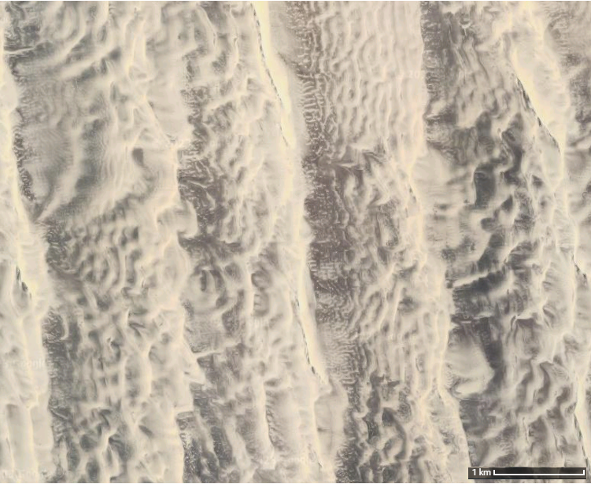
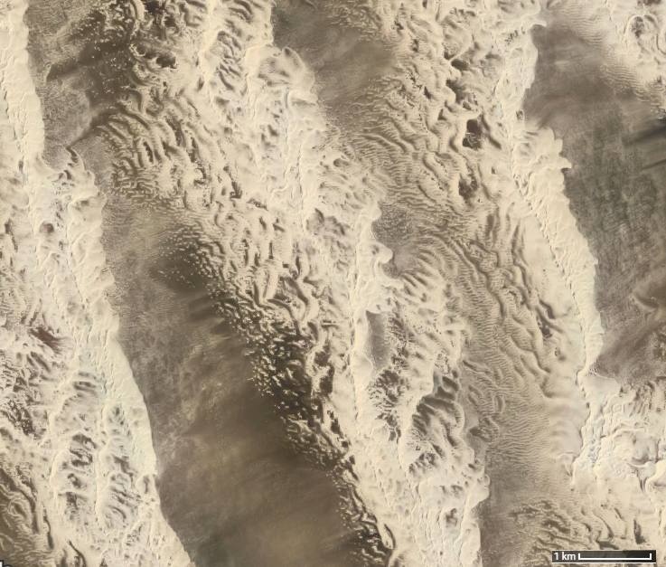
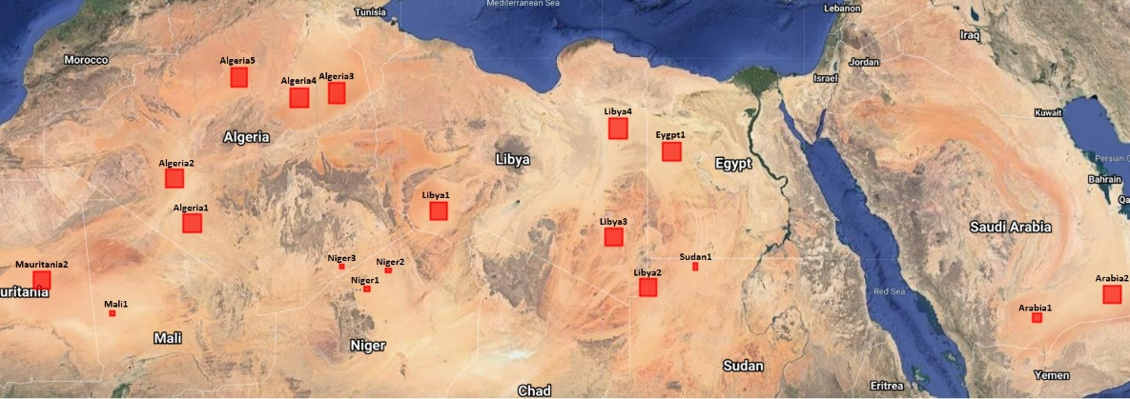
DESert Calibration System (DESCS)
Uses desert Pseudo Invariant Calibration Sites (PICS) to transfer the calibration from a reference Radiative Transfer Model (RTM) to the monitored instrument.
TOA radiance simulation
  RTM: a customised version of the polarized 6SV2.1, DISORT, Monte-Carlo;
  Surface: 4-parameter BRDF RPV model using spectrally resolved BRDF parameters;
  Atmosphere:
    Customized Desert Aerosol model over the Sahara and Arabian Peninsula;
    US standard atmosphere, scaled with H2O and O3 column;
    O3, WV, surface pressure from ECMWF, and AOT550 from CAMS;
Evaluate & Monitor bias:
  Estimate the absolute calibrations by comparing simulated radiance against actual measurements
  Desert vicarious calibration offers an accuracy of approximately 2-3%.
Six priority one targets: Libya4, Egypt1, Algeria5, Niger2, Sudan1 and Arabia2

Slide 8
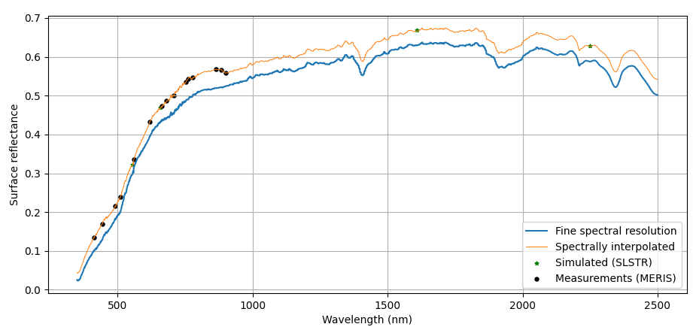
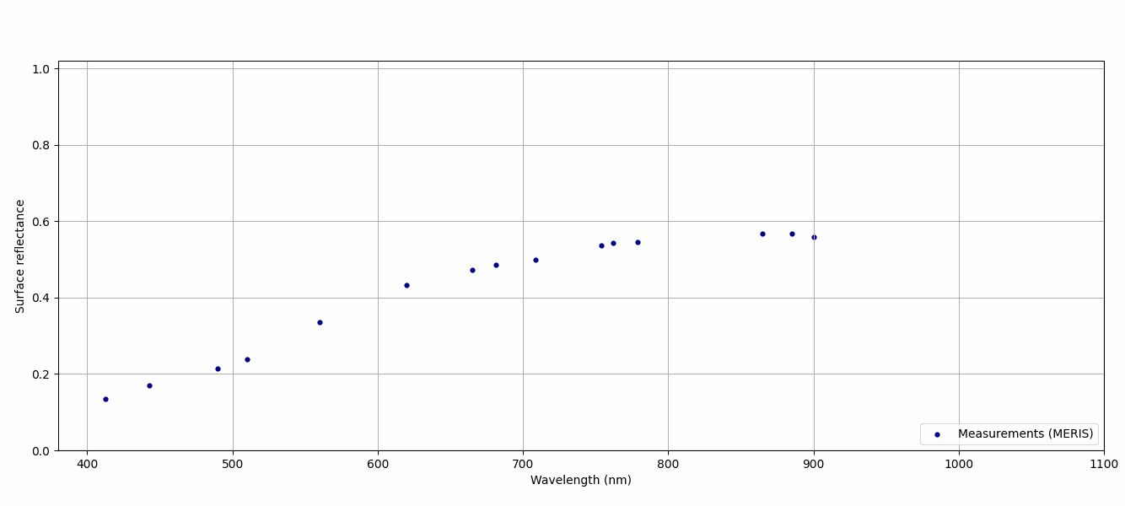
DESert Inter-Calibration System (DESICS)
Uses desert Pseudo Invariant Calibration Sites (PICS) to transfer the calibration from a reference instrument to the monitored instrument.
BOA reflectance retrieval
  Atmospheric correction: Customised version of the polarized 6SV2.1,
  Atmosphere:
    same as those of Desert Calibration system;
TOA reflectance simulation
  RTM: customised version of the polarized 6SV2.1
  Surface: simulated spectral surface reflectance for monitored instrument
  Atmosphere: same as those of BOA reflectance retrieval
Filtering: Apply geometry criteria
Evaluate & Monitor bias:
  Estimate the relative calibrations by comparing TOA simulated reflectance against actual measurements

Slide 9
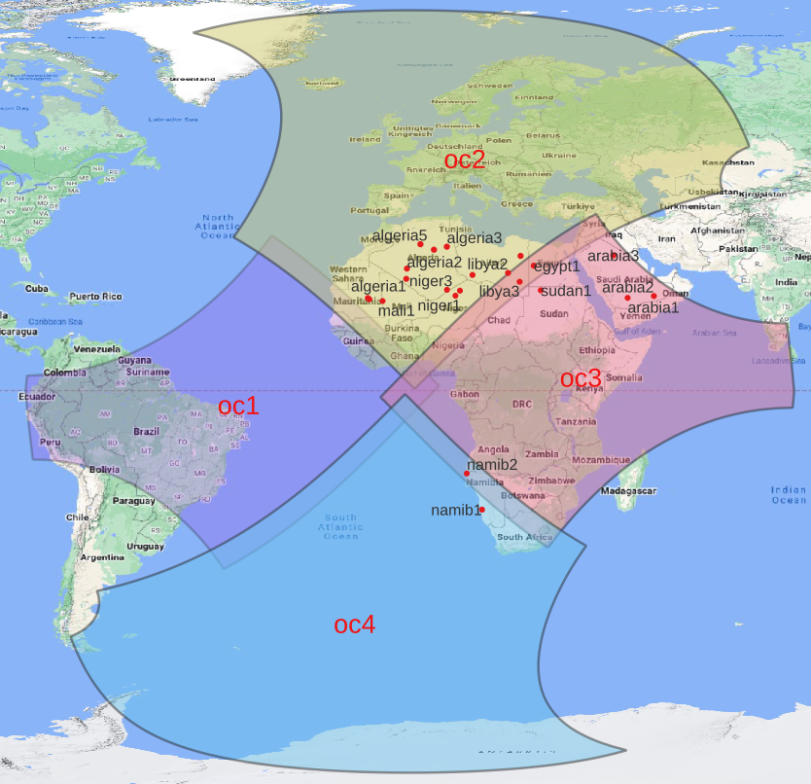
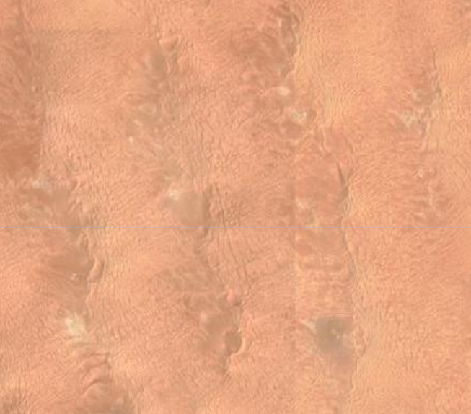


Pseudo Invariant Calibration Sites (PICS)
All FCI VIS-NIR channels but NIR1.3 are processed.
Results are daily and 7-day average over desert targets
Algeria5
FCI observations: 10,277
Libya4
FCI observations: 11,045
Egypt1
FCI observations: 11,001
FCI observations over desert
Sudan1
FCI observations: 10,446
Niger2
FCI observations: 11,303
MTG-I1 LI four cameras coverage, with a flip maneuver along the horizontal axis every six months.
Six priority one targets: Libya4, Egypt1, Algeria5, Niger2, Sudan1 and Arabia2 (skipped for this analysis)

Slide 10
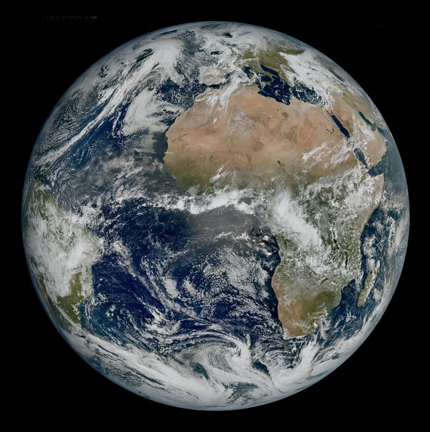
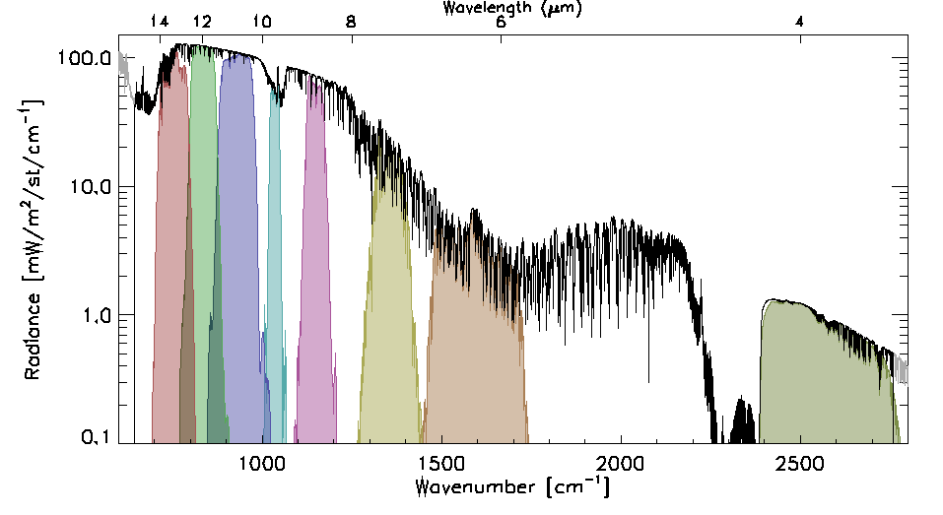
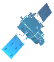
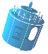
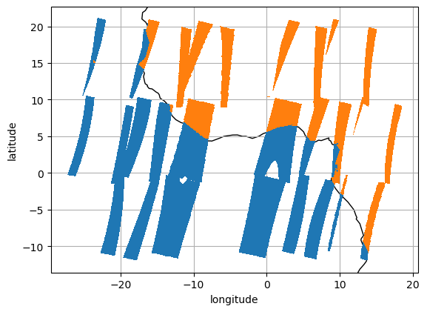
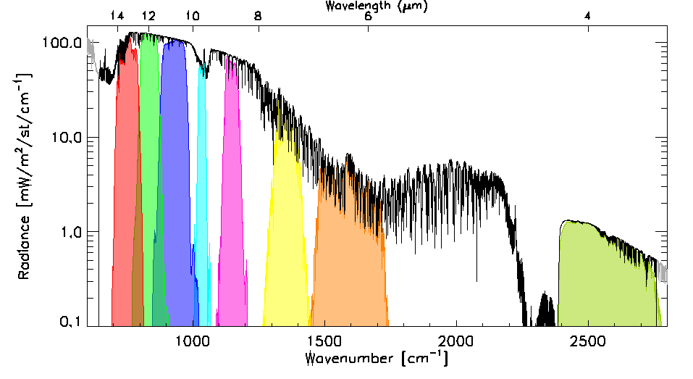
Raymatching algorithm: FCI-OLCI
Pre-collocation:
ROI -15/15° longitude -10/10° latitude
Time difference: |dt|< 900s
Collocate in Space, Time, Angle:
  Pre-downsampling of ref image to 900m
  Re-grid mon and ref images to 8x8 km
  Maximum VZA < 30°
  Maximum difference in |dsec(VZA)| < 0.03
  Pixels’ max time difference |dt| < 900s
  Calculate Mean & Variance
Account for Spectral differences:
  Apply Spectral Band Adjustment Factors
Filter:
  Apply Sun-Glint mask to solar channels
Combine:
  Collocations within a predefined windows
  Tag land/sea/day/night for analysis
Compare:
  Weighted regression of radiances
  Evaluate uncertainties
Time (1 hour)
SEVIRI SRFs
(µ, σ)
|
(µ, σ)
Spectral Band Adjustment Factors
FCI SRFs

Slide 11
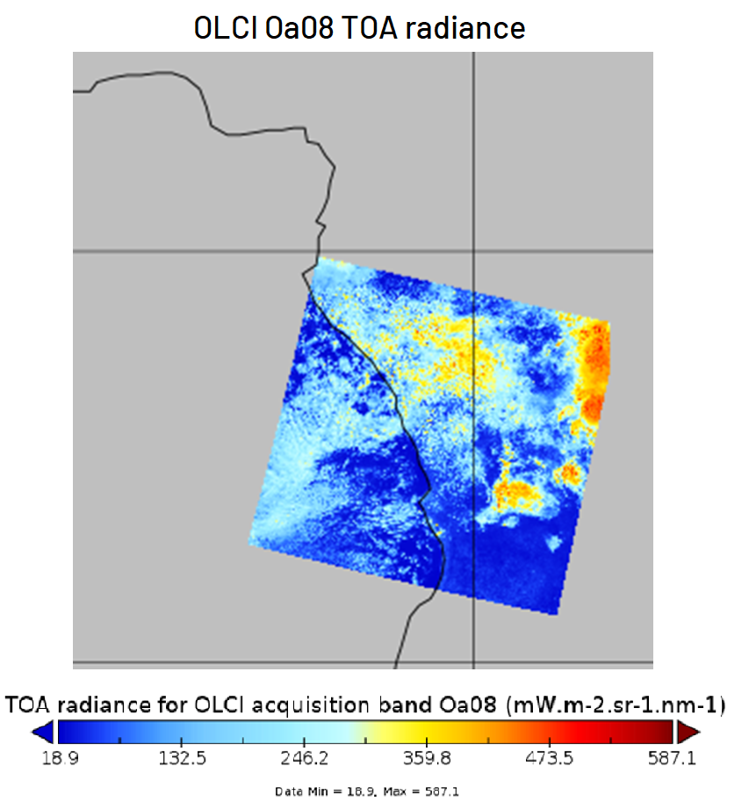
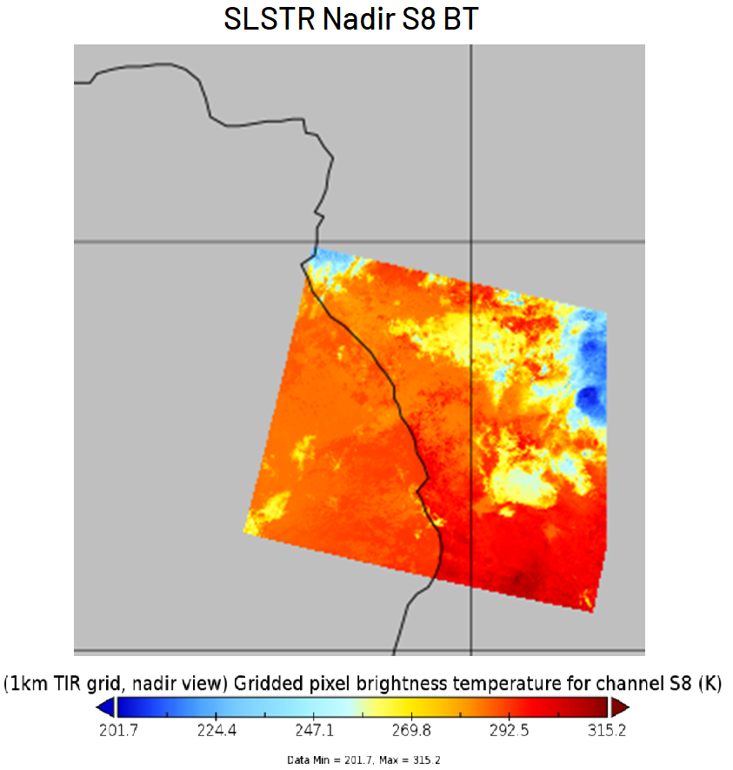
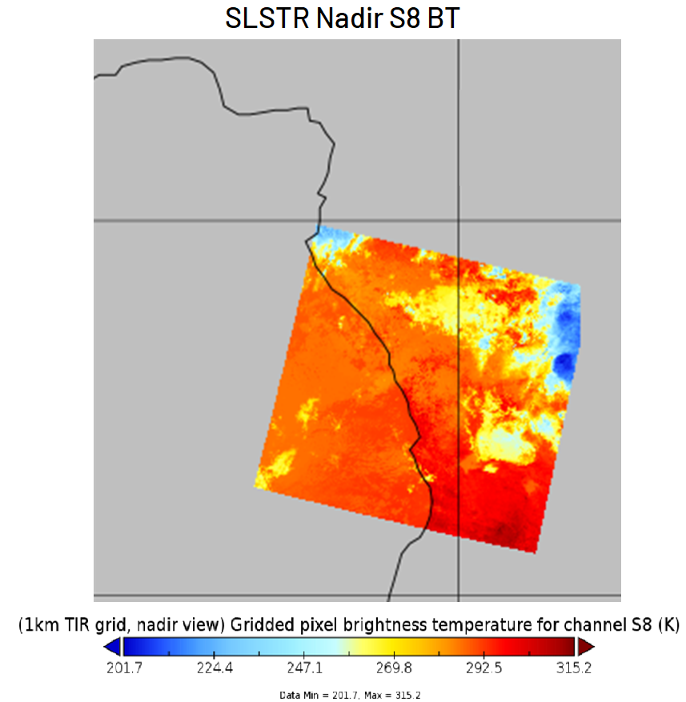
Deep Convective Clouds Inter-Calibration System (DCCICS)
Uses Deep Convective Clouds (DCC) to transfer the calibration from a reference instrument (NOAA-20 VIIRS as provided by NASA) to the monitored instrument;
DCC extraction:
  Subsets of L1C products over ROI;
  Use FCI 10.5μm band to extract DCC
Statistical approach:
  DCC observations accumulated over about 30 days (sliding windows), extract PDFs;
  PDF parameter defining the typical observed DCC signal = MODE (Mean + Median also tested);
  The metric to define the measurements to be taken from the target instrument is still under evaluation;
Spectral band adjustment factors provided by NASA (SBAF)
  To account for the SRF difference between the reference and target instruments;
  If no corresponding channel available on the reference instrument, we make assumptions and use the closest channel.

Slide 12
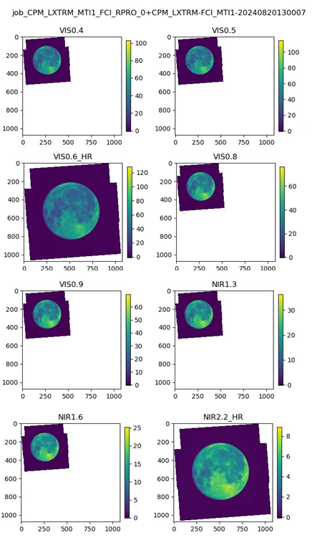
Lunar calibration system (LCS)
Use the Moon to transfer the calibration from a reference Lunar irradiance model to the monitored instrument;
MICMICS Lunar Calibration: 2 components
  LXTRM: Extraction of the lunar imagery from L1 data and input preparation for LCS
    Extraction process specific to each mission
    Standardisation of the output to ingest into the Lunar Calibration System
  LCS (two models)
      GSICS Implementation of the ROLO model (GIRO)
        current reference but will be replaced soon
        Lunar phase angles = [-92, +92]
        Uncertainties between 5 and 10% in absolute but less than 1% for drift monitoring after characterisation of the phase dependence
      Lunar Extended Satellite Reflectance Model (LESSR)
        based on SCIAMACHY + RELAB data
        Lunar phase angles = [-80, +20]
        Uncertainties less 2-3% in absolute in that range. Increases for phases > 20 degrees

Slide 13
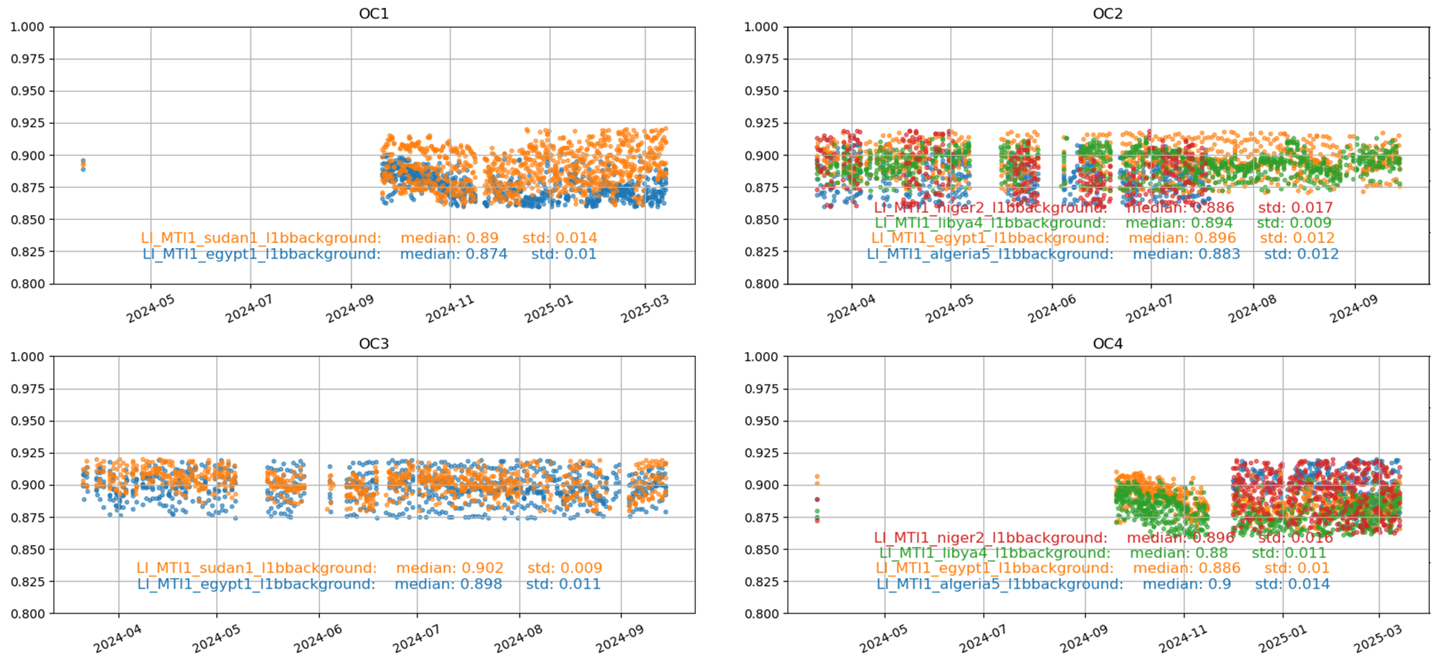
DESert Calibration System (DESCS) LI results
Hourly average desert results over PICS for all cameras (absolute calibration)
DESCS

Slide 14
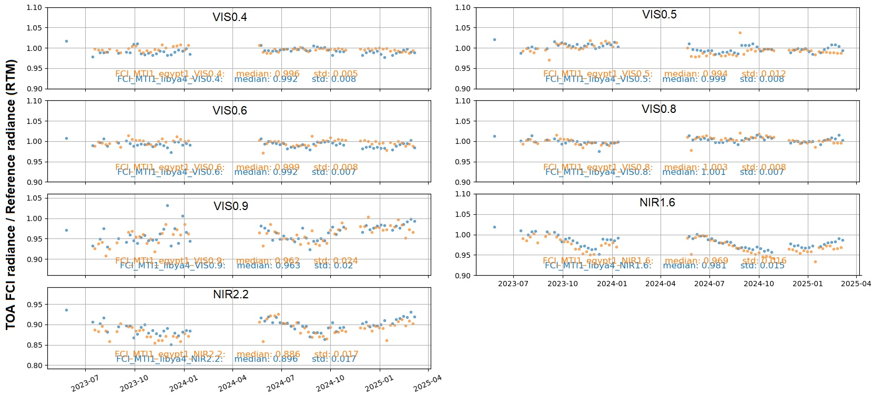
DESert Calibration System (DESCS)
7-day average over Egypt1 and Libya4 PICS (absolute calibration)
DESCS

Slide 15
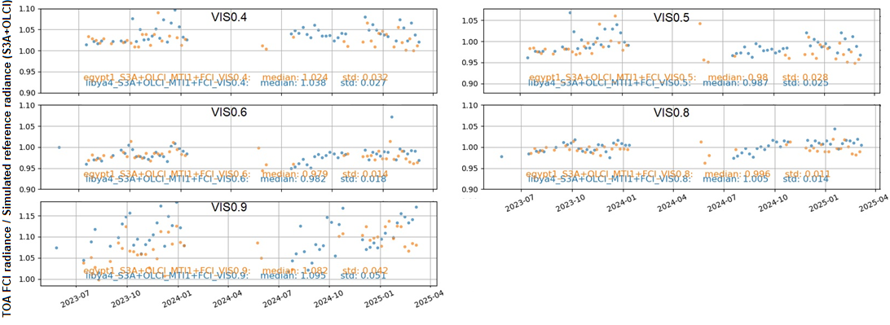
DESert Inter-Calibration System (DESICS) (ref: S3A+OLCI)
Like DESCS, VIS0.4, VIS0.5, VIS0.6, and VIS0.8 show stable performance.
VIS0.9 also appears stable, but desert inter-calibration may be unsuitable due to water vapor absorption.
When using OLCI as a reference, only VIS channels are considered valid.
DESICS
Notes:
NIR1.3

Slide 16
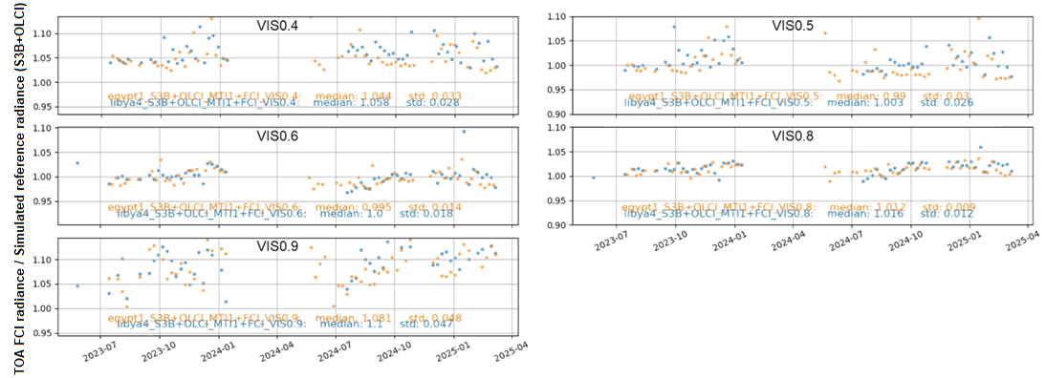
DESert Inter-Calibration System (DESICS) (ref: S3B+OLCI)
Like DESCS, VIS0.4, VIS0.5, VIS0.6, and VIS0.8 show stable performance.
VIS0.9 also appears stable, but desert inter-calibration may be unsuitable due to water vapor absorption.
The ~ 2% bias between OLCI-A and OLCI-B is seen in the results
DESICS
Notes:
NIR1.3

Slide 17
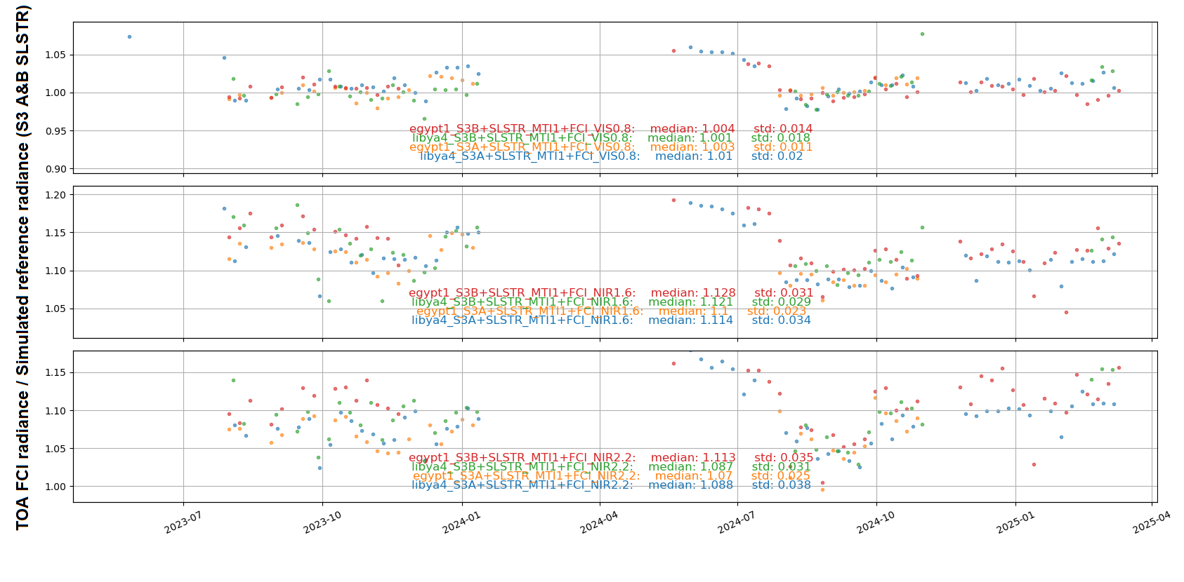
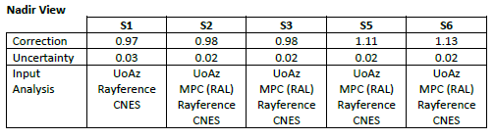
DESert Inter-Calibration System (DESICS) (ref: S3A/B+SLSTR)
7-day average over Egypt1 and Libya4 PICS (SLSTR-A and SLSTR-B)
From the Sentinel-3 MPC report
Not suitable for Absolute calibration, need to apply the corrections before processing)
DESICS

Slide 18
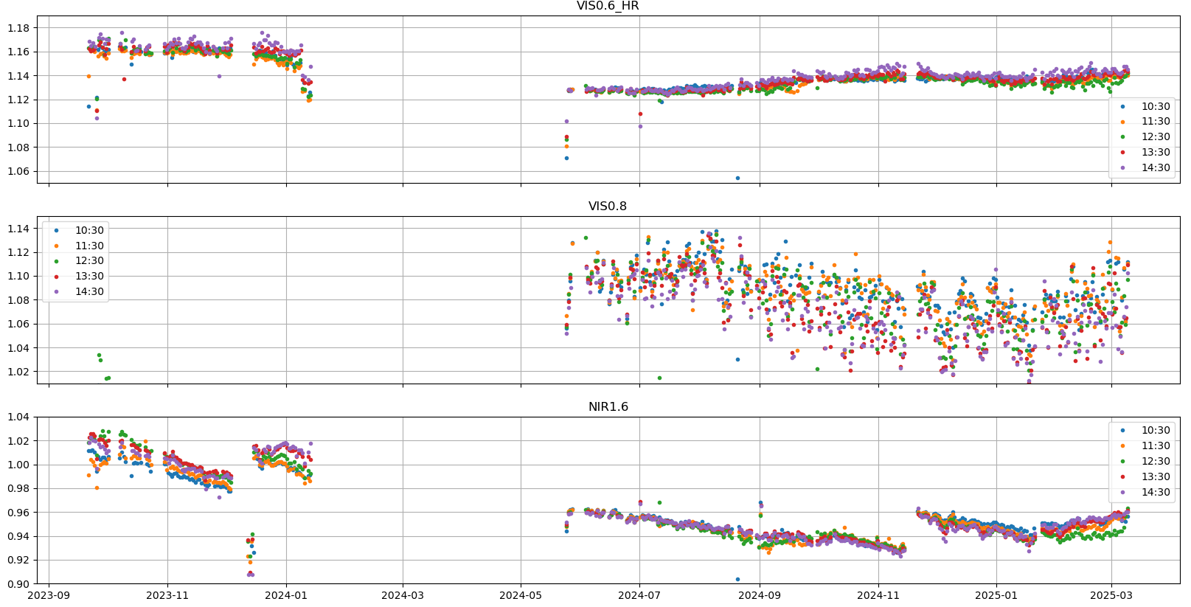
GEO-GEO analysis, MSG3-SEVIRI vs MTGI1-FCI
Inter-comparison with SEVIRI performed for five time slots (hours) during the day.
First part is impacted by conversion inaccuracies

Slide 19
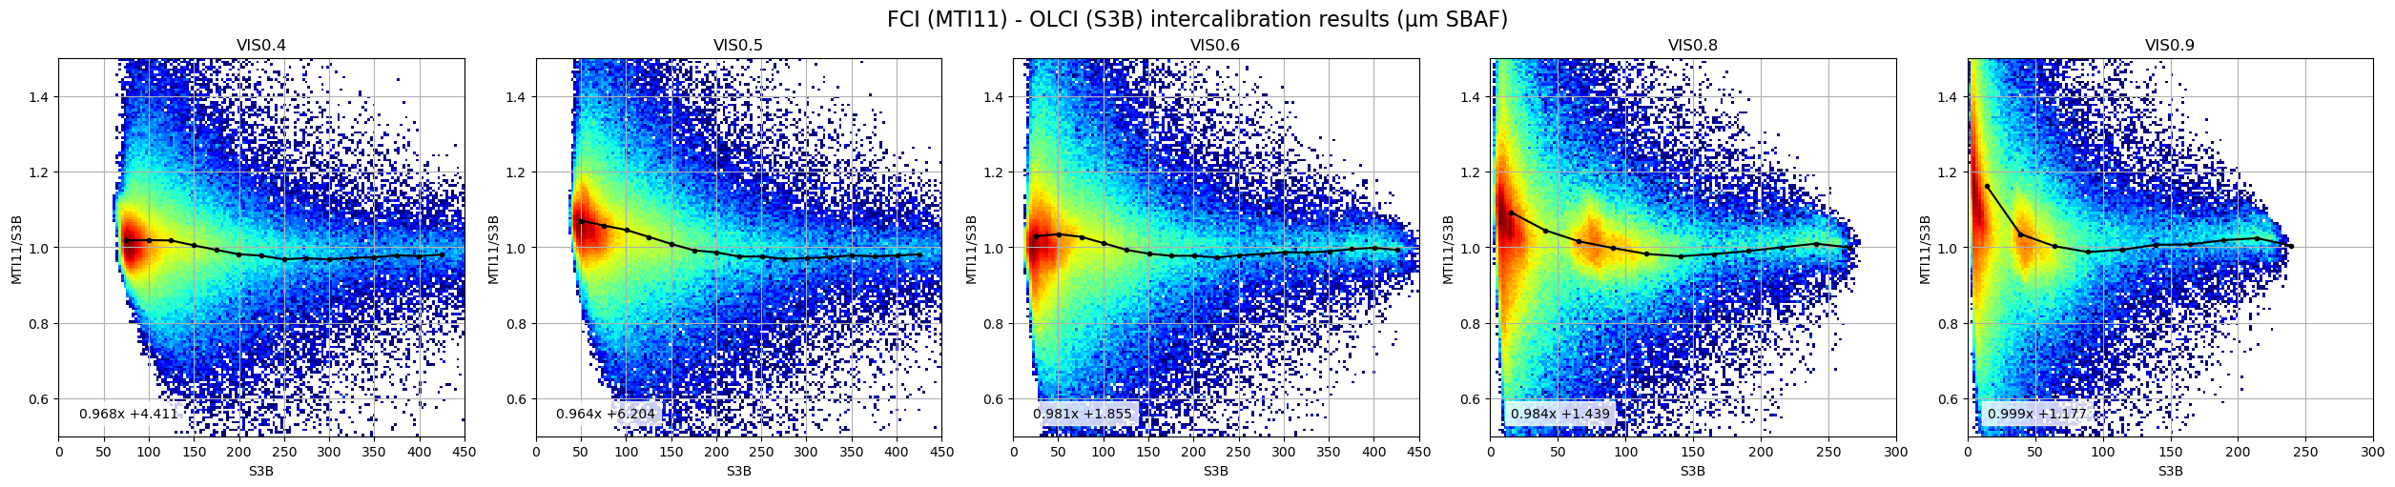
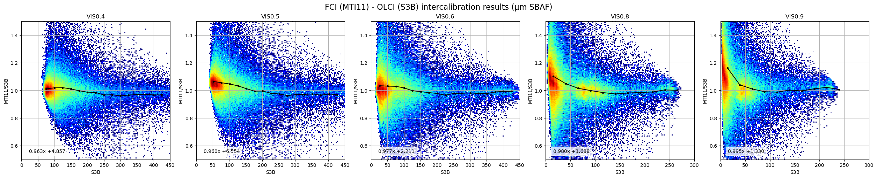
Raymatching MTG-I1- FCI vs Sentinel-3A OLCI
15-day collocations, sea mask + incidence_angle < 15, zen_diff_sec < 0.03
15-day collocations, sea mask + incidence_angle < 15, zen_diff_sec < 0.01
.
Preliminary results
Notes:
15-day in feb 2025

Slide 20
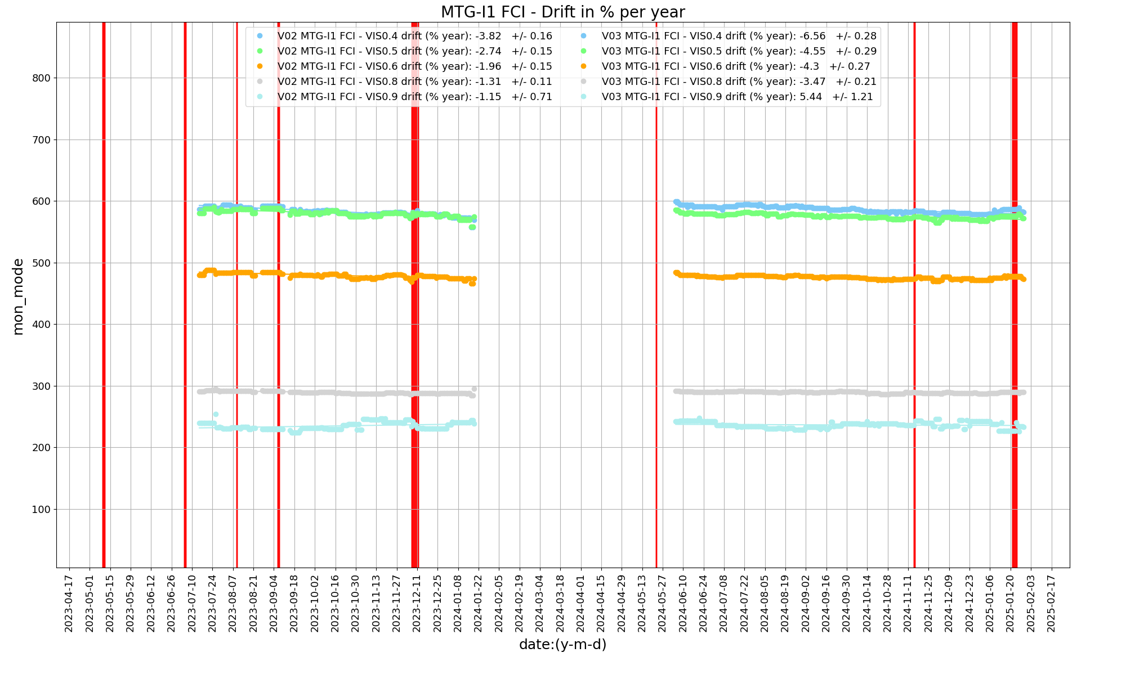
Deep Convective Clouds Inter-Calibration (DCCICS)
V03
V02
Period 1
Period 2
DCCICS
Mode = more stable than mean for VIS channels

Slide 21
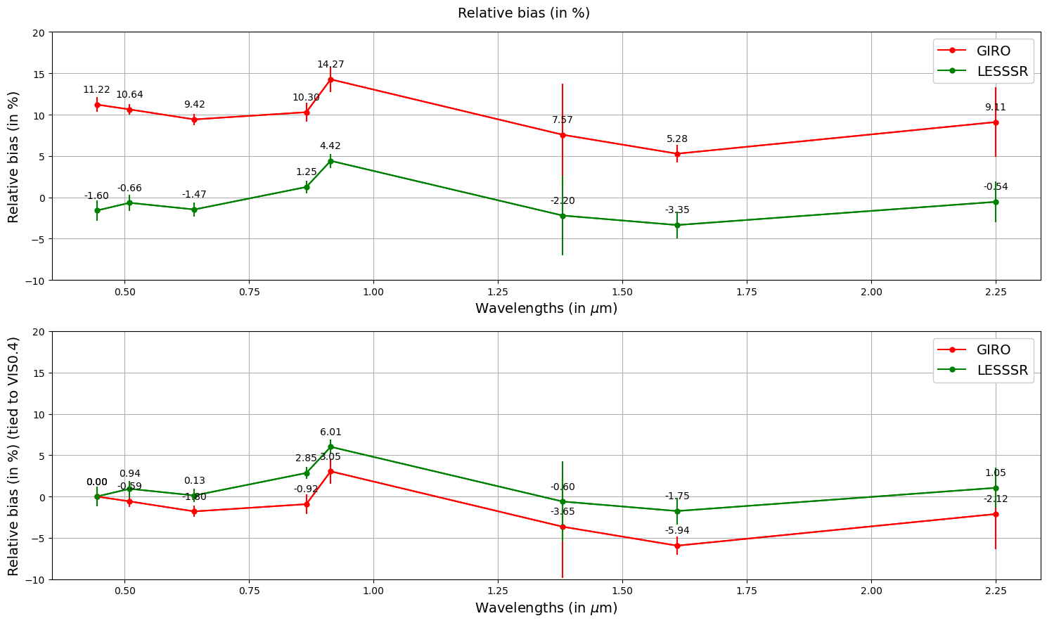
Spectral behaviour of the relative bias for MTI1/FCI VIS/NIR channels
LCS

Slide 22
Conclusions
LI: VIS0.7 radiometric calibration shows a bias of 8-10%, within user requirement.
FCI:
  Stable VIS-NIR gains mitigates the impact of missing on-board calibration for FCI in the short-term.
  Current VIS-NIR radiometric calibration is based on Autumn 2023 in-flight data.
  VIS0.4, VIS0.5, VIS0.6, and VIS0.8 remain stable with no or minimal degradation.
  VIS0.9 appears to be stable but exhibiting a bias (up to 4%), under investigation.
  FCI NIR 1.6 shows significant degradation (up to 4%), while NIR 2.2 degrades more slowly.
  NIR2.2 exhibits significant bias (5-10%), under investigation.
  Seasonality must be considered for drift estimation, requiring a full annual cycle.
  MICMICS will eventually serves as the calibration source for both the FCI IR and VIS-NIR channels.
  Continuous feedback collection and system improvements are ongoing.
Notes:
VIS0.4, VIS0.5, VIS0.6, and VIS0.8 demonstrate relatively stable performance, with little to no degradation.
VIS0.9 appears to be stable, although using desert results may not be suitable approach for monitoring this channel due to water vapor absorption.
NIR1.3 is excluded due to strong absorption.
NIR1.6 shows significant degradation (under investigation).
NIR2.2 exhibits similar behavior to NIR1.6, though less pronounced. However, it is observed to have a bias of 7–10%.
Note: PICS often show strong seasonality that has to be taken into account after one full cycle.

Slide 23
Thank you!
Questions are welcome.

Slide 24
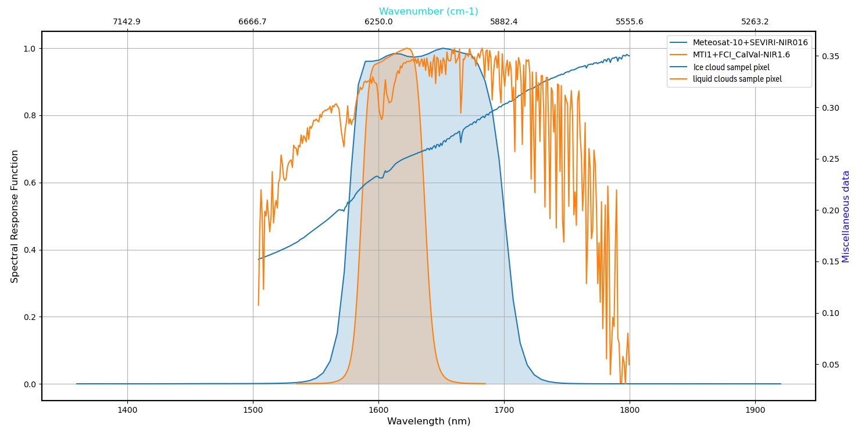
Level-2 cloud micro-physical properties

Slide 25
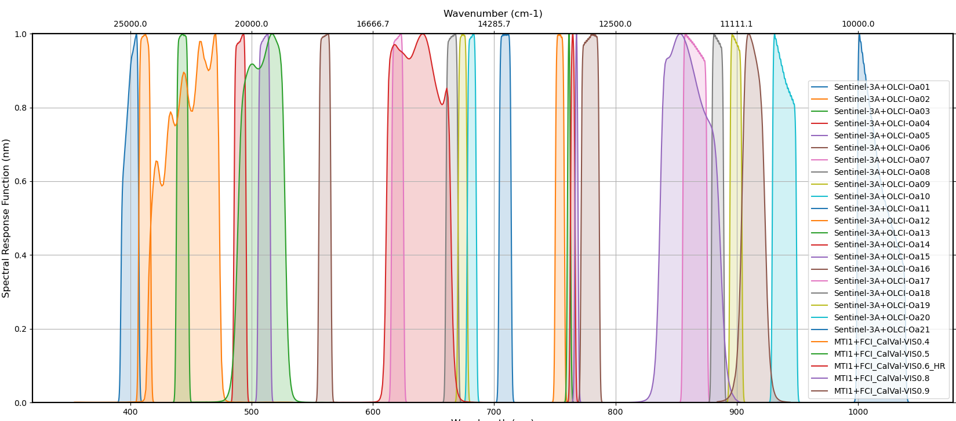

Slide 26
