Slide 1
Relative SRF retrieval -
Application to Metop IASI (and MTG-I FCI)
Pierre Dussarrat
Remote Sensing Scientist
GSICS – 18/03/2025

Slide 2
Agenda
Introduction to relative SRF retrieval
Solution
Applications
- Metop IASI
- MTG-I FCI
Discussion and Conclusion

Slide 3
Agenda
Introduction to relative SRF retrieval
Solution
Applications
- Metop IASI
- MTG-I FCI
Discussion and Conclusion

Slide 4
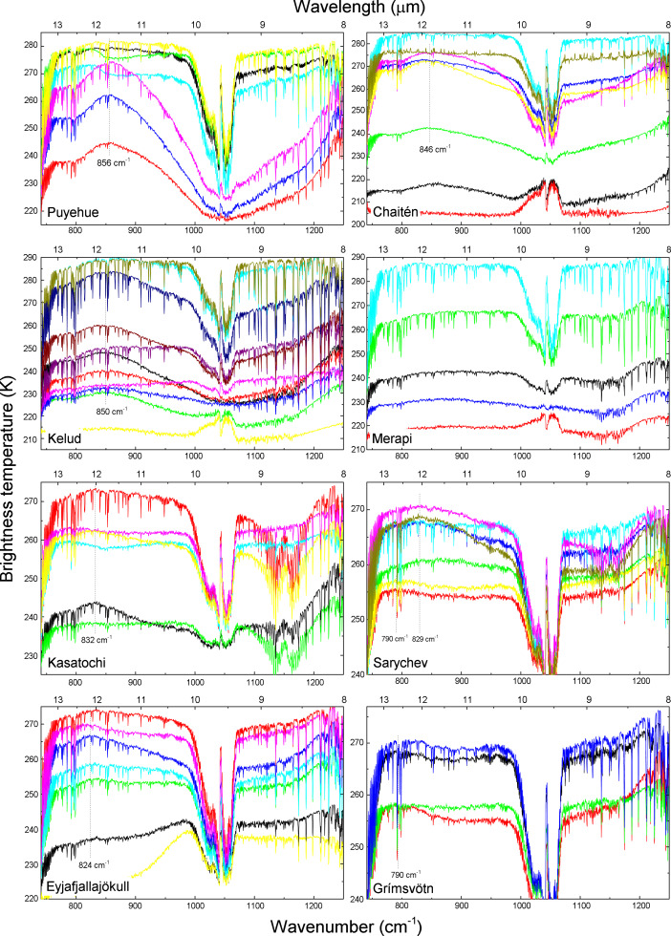
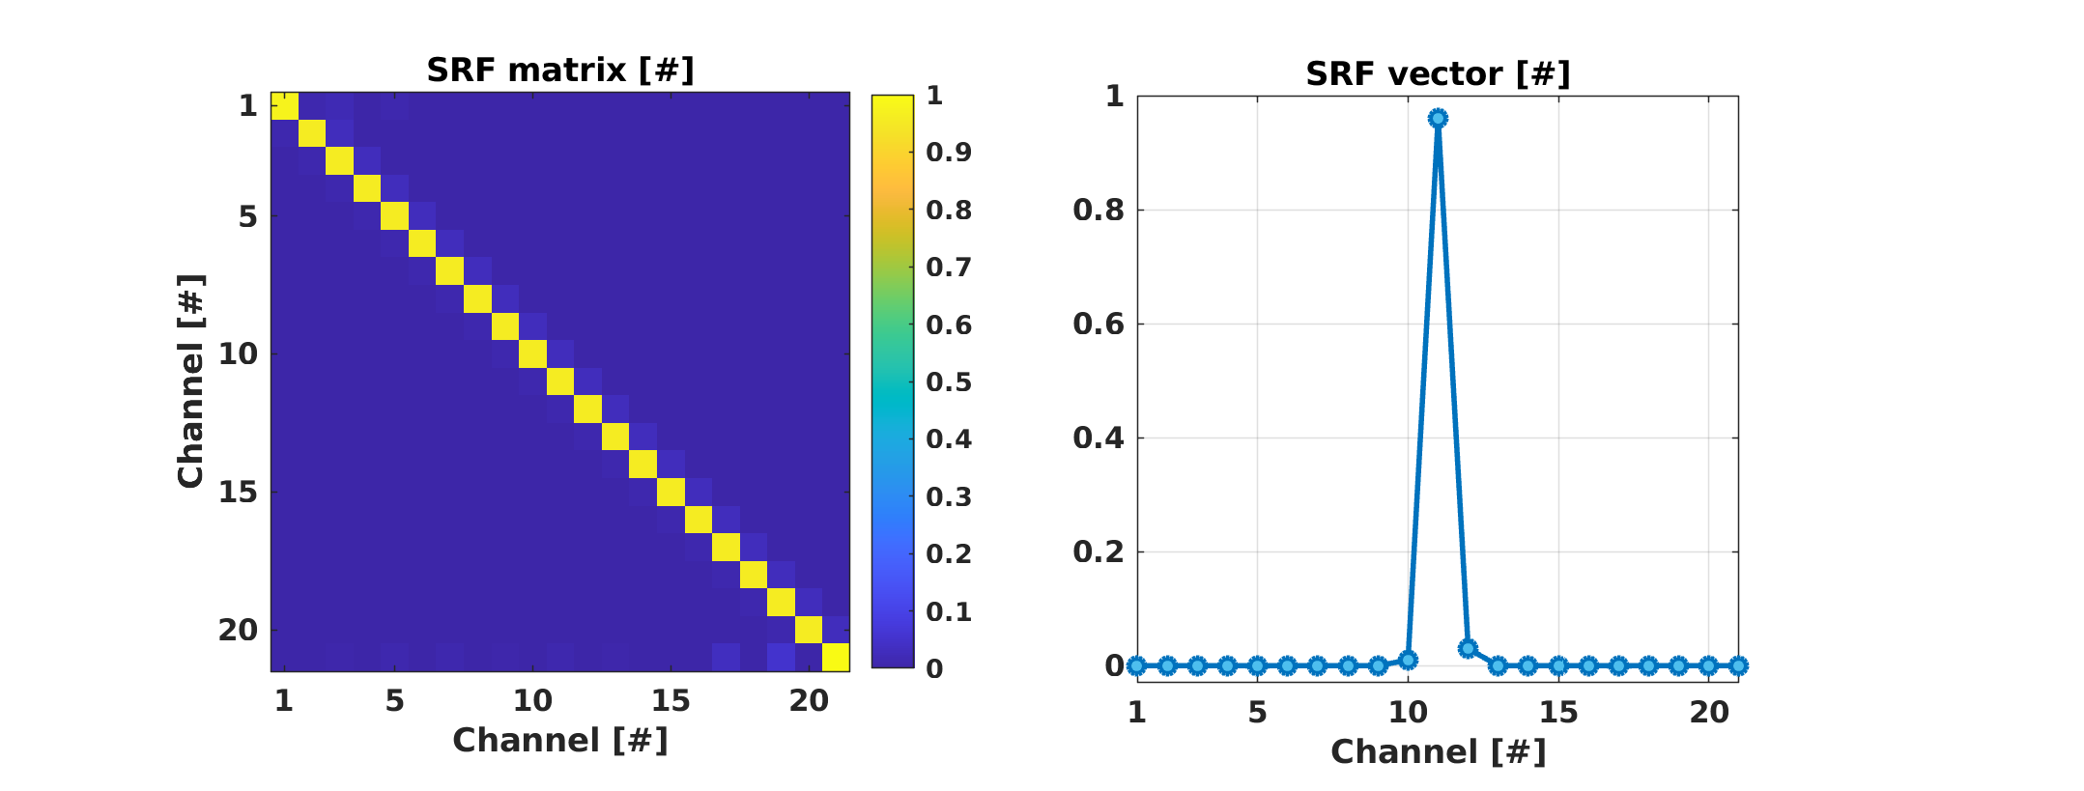
Introduction
Hypothesis:
  2 similar hyperspectral detectors acquiring continuous spectra
  Dataset of collocated acquisitions of the 2 detectors over a large diversity of scenes
Problem: Find the best relative Spectral Response Function (SRF) between the two detectors
Applications:
  Characterize in-flight discrepancies of responses between detectors within a single instruments or between instruments
  Track launch-induced and/or long-term evolutions of the instruments’ responses in-flight
  Harmonize the responses of the detectors using the relative SRF in post-processing
  Application to any spectrometers: grating, FTS…
Detector #1
Detector #2
Collocations
SRF = ?

Slide 5


Introduction
Problem description (Linear algebra):
  $\left(y_{1},y_{2}\right)$ = 2 sets of $N_{s}$ acquisitions (spectra) with $N_{c}$ channels $\left(N_{s}≫N_{c}\right)$.
  We look for a matrixial solution, $SRF≅I$, of size $\left(N_{c},N_{c}\right)$ that best realizes:
  $$\boxed{y_{2}=SRF×y_{1}}$$
NB: Assumption that the differences in the measurements are uniquely caused by differences of spectral responses (ex: non-linearity or difference of footprint are neglected)
Detector #1
$$SRF= ?$$
Detector #2

Slide 6
Agenda
Introduction to relative SRF retrieval
Solution
Applications
- Metop IASI
- MTG-I FCI
Discussion and Conclusion

Slide 7
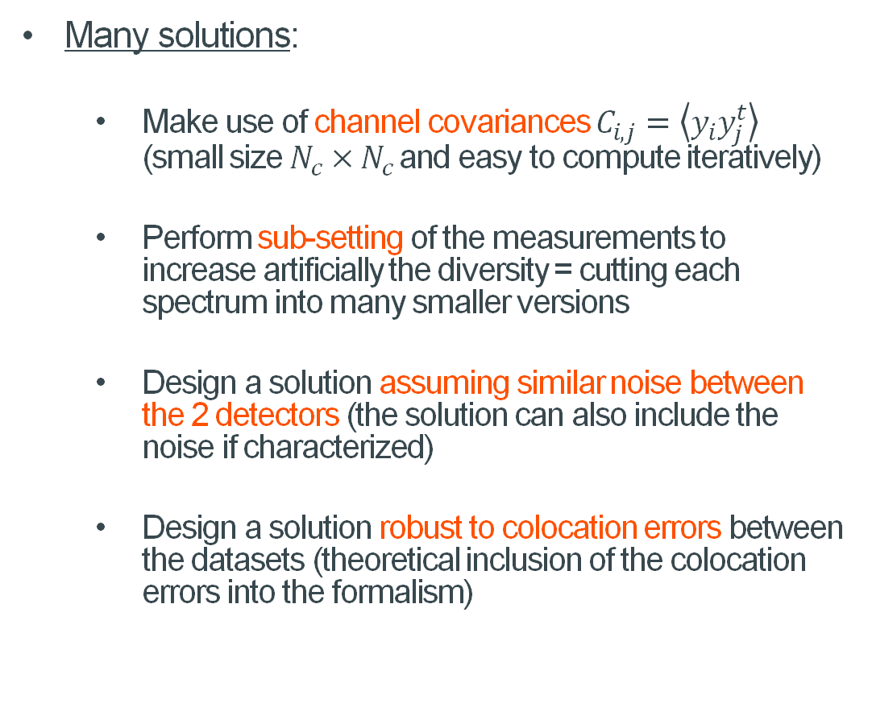
Solution
Many issues:
  Large datasets
  Diversity of acquisitions is limited by the possible ranges of atmospheric and surface states = unstable retrieval
  Radiometric noise
  Quality of colocations is limited (not
  perfect footprint overlapping, line of
  sight alignment, and time colocations)
Many solutions:
  Make use of channel covariances $C_{i,j}=\left\langle y_{i}y_{j}^{t}\right\rangle$ (small size $N_{c}×N_{c}$and easy to compute iteratively)
  Perform sub-setting of the measurements to increase artificially the diversity = cutting each spectrum into many smaller versions
  Design a solution assuming similar noise between the 2 detectors (the solution can also include the noise if characterized)
  Design a solution robust to colocation errors between the datasets (theoretical inclusion of the colocation errors into the formalism)
Dussarrat P, Deschamps G, Coppens D. Spectral Response Function Retrieval of Spaceborne Fourier Transform Spectrometers: Application to Metop-IASI. Remote Sensing. 2024; 16(23):4449. https://doi.org/10.3390/rs16234449

Slide 8
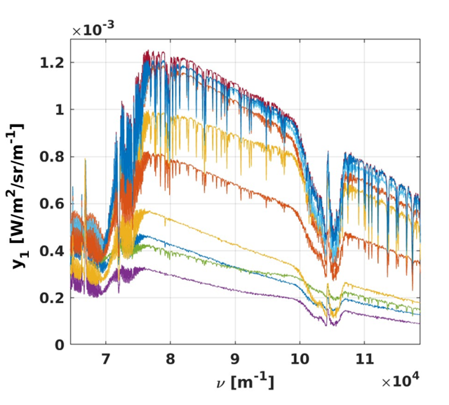
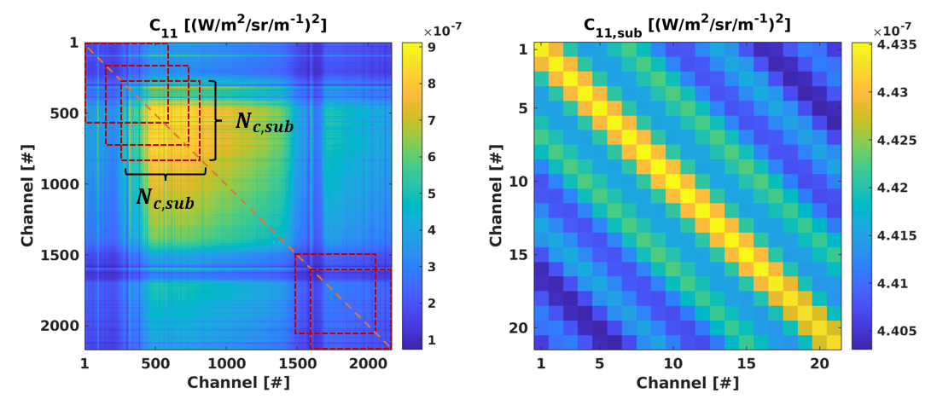

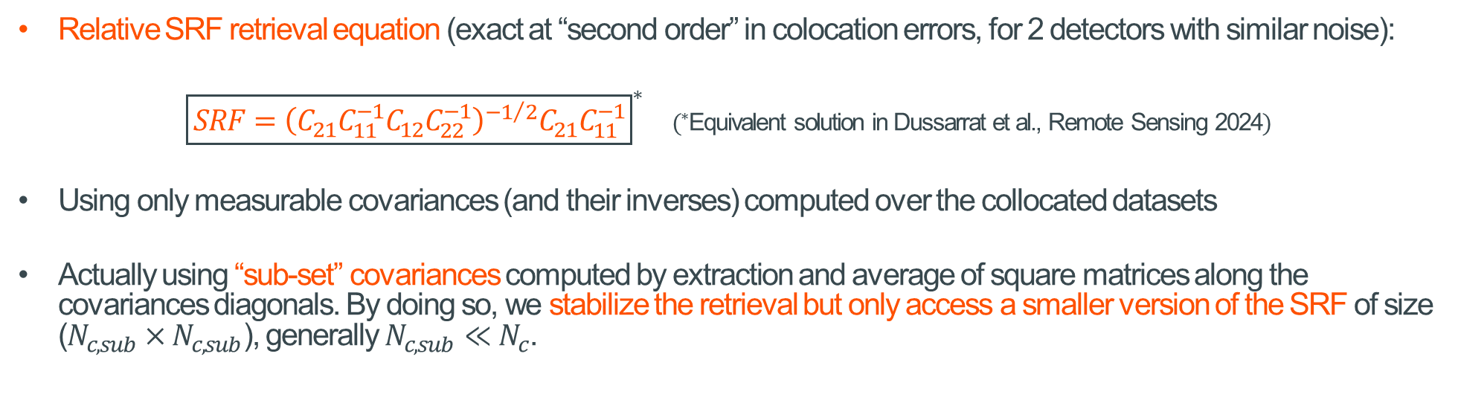



Solution
Relative SRF retrieval equation (exact at “second order” in colocation errors, for 2 detectors with similar noise):
${\boxed{SRF={\left(C_{21}C_{11}^{−1}C_{12}C_{22}^{−1}\right)}^{−1/2}C_{21}C_{11}^{−1}}}^{∗}$ $(^{∗}$Equivalent solution in Dussarrat et al., Remote Sensing 2024$)$
Using only measurable covariances (and their inverses) computed over the collocated datasets
Actually using “sub-set” covariances computed by extraction and average of square matrices along the covariances diagonals. By doing so, we stabilize the retrieval but only access a smaller version of the SRF of size ($N_{c,sub}×N_{c,sub}$), generally $N_{c,sub}≪N_{c}$.
Collocated acquisitions: $\left(y_{1},y_{2}\right)$
Covariances computation: $C_{i,j}$
Sub-set covariances computation: $C_{i,j,sub}$
SRF retrieval: $SRF$

Slide 9
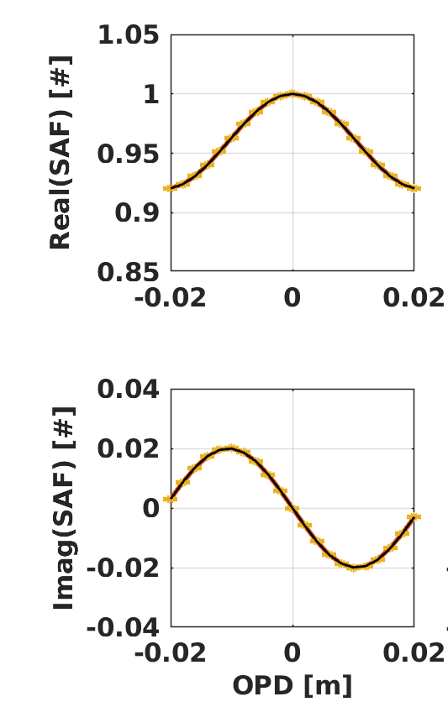
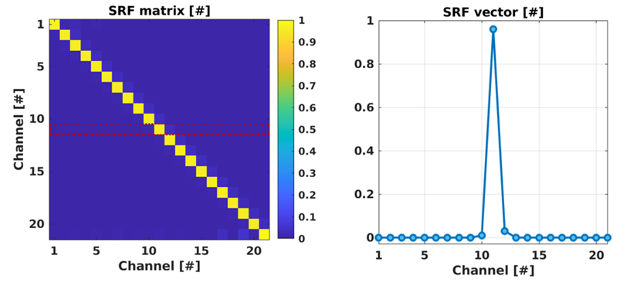

Solution
SAF retrieval:
From a relative SRF matrix to a SRF vector, extraction of the central row:
In Fourier transform spectrometry (FTS), the relative SRF vector can be further processed (Fourier transform) to provide a relative self-apodisation function (SAF):
$$\boxed{SAF\left(opd\right)=FT\left[SRF\left(ν\right)\right]\left(opd\right)}$$
NB: The SAF is a complex function, commonly used in FTS, informing visually about detrimental effects occurring at the level of the primary measurements that are the interferograms.

Slide 10
Agenda
Introduction to relative SRF retrieval
Solution
Applications
- Metop IASI
- MTG-I FCI
Discussion and Conclusion

Slide 11
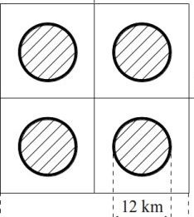
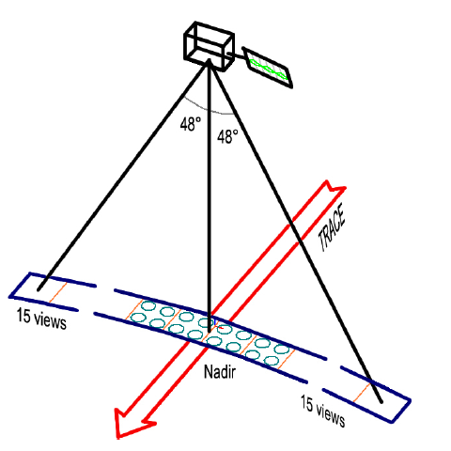
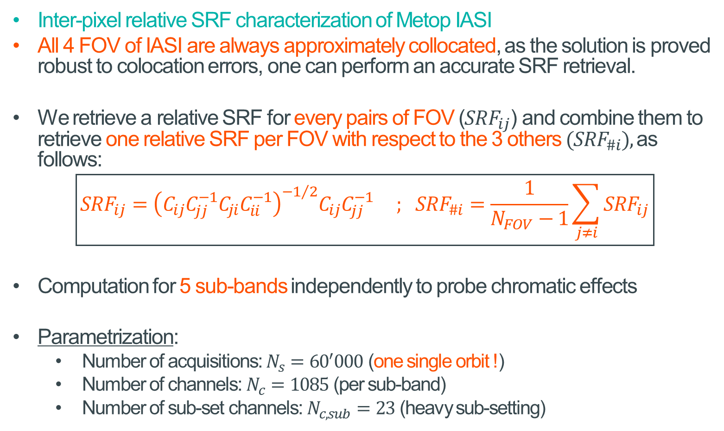
Application to IASI
Inter-pixel relative SRF characterization of Metop IASI
All 4 FOV of IASI are always approximately collocated, as the solution is proved robust to colocation errors, one can perform an accurate SRF retrieval.
We retrieve a relative SRF for every pairs of FOV ($SRF_{ij}$) and combine them to retrieve one relative SRF per FOV with respect to the 3 others ($SRF_{\#i}$), as follows:
$$\boxed{SRF_{ij}={\left(C_{ij}C_{jj}^{−1}C_{ji}C_{ii}^{−1}\right)}^{−1/2}C_{ij}C_{jj}^{−1} ; SRF_{\#i}=\frac{1}{N_{FOV}−1}\sum_{j≠i}{SRF_{ij}}}$$
Computation for 5 sub-bands independently to probe chromatic effects
Parametrization:
  Number of acquisitions: $N_{s}={60}^{′}000$ (one single orbit !)
  Number of channels: $N_{c}=1085$ (per sub-band)
  Number of sub-set channels: $N_{c,sub}=23$ (heavy sub-setting)
1
4
2
3

Slide 12
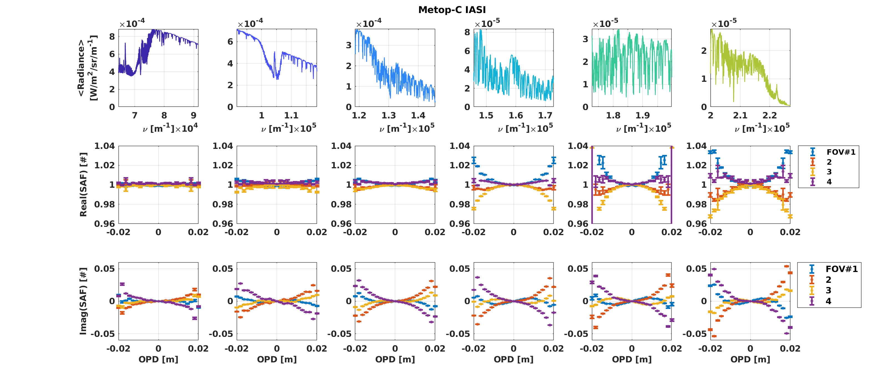
Application to IASI
First characterization of IASI relative SRF and SAF – for 5 sub-bands
Accurate characterisation with only one orbit of data
Revealing vey small discrepancies between FOV (mis-alignment residual, straylight ?)
~0.01K level but nonetheless quantifiable (to be used to harmonize further the IASI data ?)
Dussarrat P, Deschamps G, Coppens D. Spectral Response Function Retrieval of Spaceborne Fourier Transform Spectrometers: Application to Metop-IASI. Remote Sensing. 2024; 16(23):4449. https://doi.org/10.3390/rs16234449

Slide 13
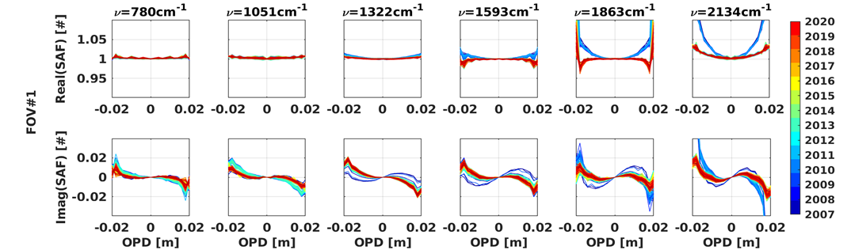
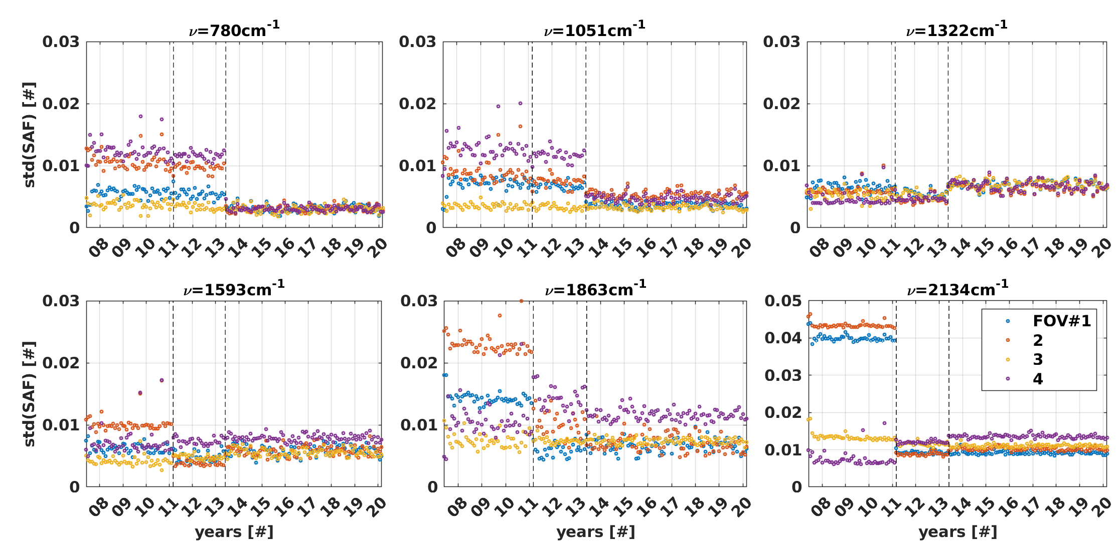
Application to IASI
Application to Metop-A, 13 years of operation, from 2007 to 2020.
Processing of the first orbit every months.
Detection of two sudden changes in February 2011 and June 2013, linked to on-ground processing updates aiming at improving discrepancies between FOV.
No long-term evolutions detected.
Our methodology is extremely sensitive and therefore well-suited to monitor instrument and processing status.
SAF standard deviation:
Dussarrat P, Deschamps G, Coppens D. Spectral Response Function Retrieval of Spaceborne Fourier Transform Spectrometers: Application to Metop-IASI. Remote Sensing. 2024; 16(23):4449. https://doi.org/10.3390/rs16234449

Slide 14
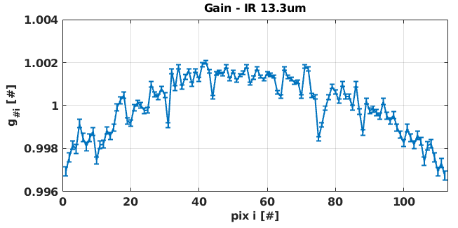
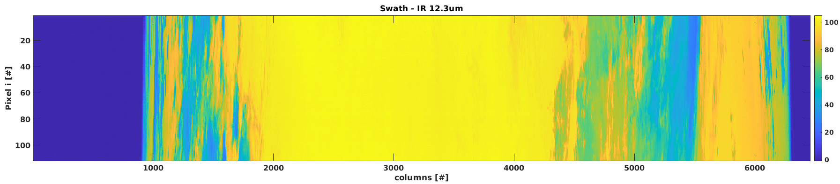
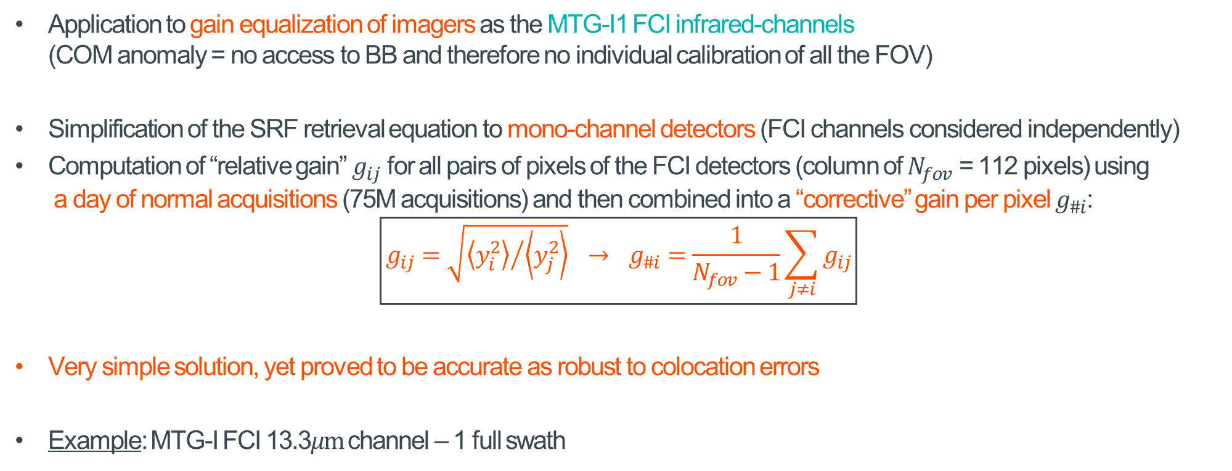
Application to MTG-I FCI
Application to gain equalization of imagers as the MTG-I1 FCI infrared-channels
(COM anomaly = no access to BB and therefore no individual calibration of all the FOV)
Simplification of the SRF retrieval equation to mono-channel detectors (FCI channels considered independently)
Computation of “relative gain” $g_{ij}$ for all pairs of pixels of the FCI detectors (column of $N_{fov}$ = 112 pixels) using
a day of normal acquisitions (75M acquisitions) and then combined into a “corrective” gain per pixel $g_{\#i}$:
$$\boxed{g_{ij}=\sqrt{{\left\langle y_{i}^{2}\right\rangle }/{\left\langle y_{j}^{2}\right\rangle }} → g_{\#i}=\frac{1}{N_{fov}−1}\sum_{j≠i}{g_{ij}}}$$
Very simple solution, yet proved to be accurate as robust to colocation errors
Example: MTG-I FCI 13.3$μm$channel – 1 full swath

Slide 15
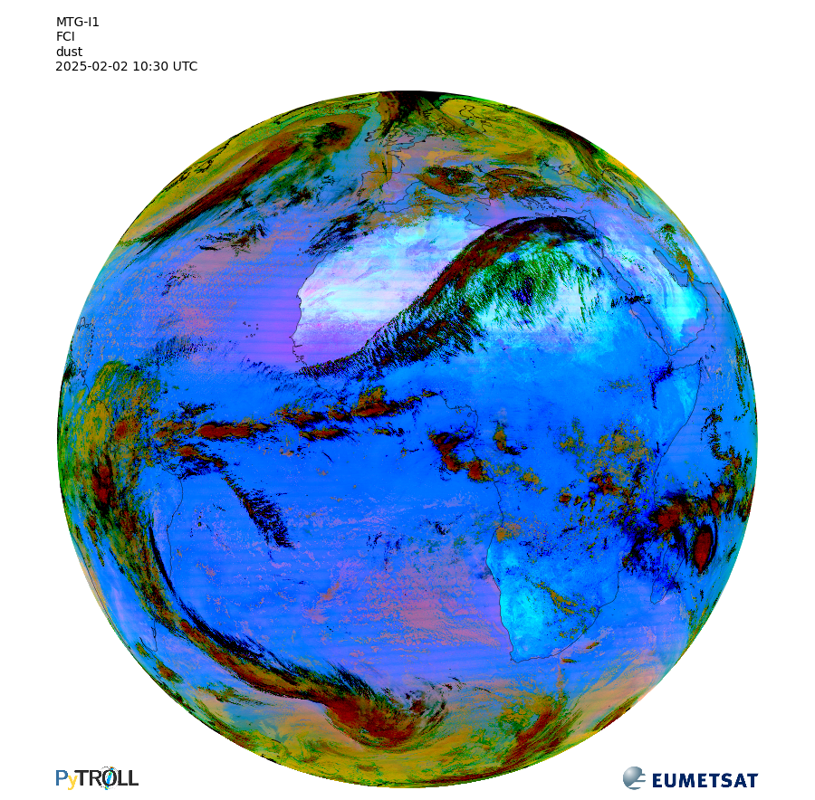
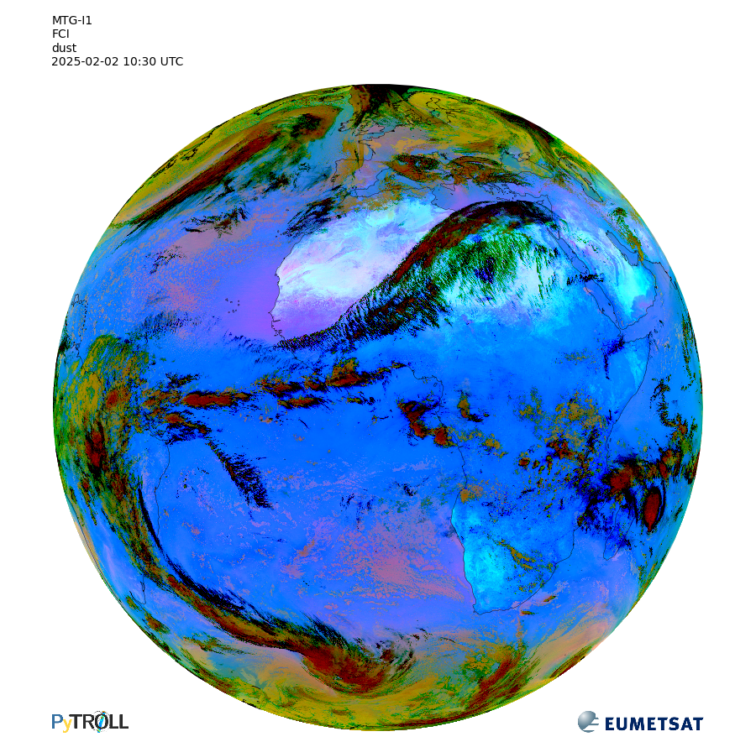

Application to MTG-I FCI
Gain equalization of the MTGI1 FCI infrared channels
Example on dust RGB $→$ Efficient removal of striping / calibration artefacts (see pink areas)
Correction operational since early March 2025

Slide 16
Agenda
Introduction to relative SRF retrieval
Solution
Applications
- Metop IASI
- MTG-I FCI
Discussion and Conclusion

Slide 17
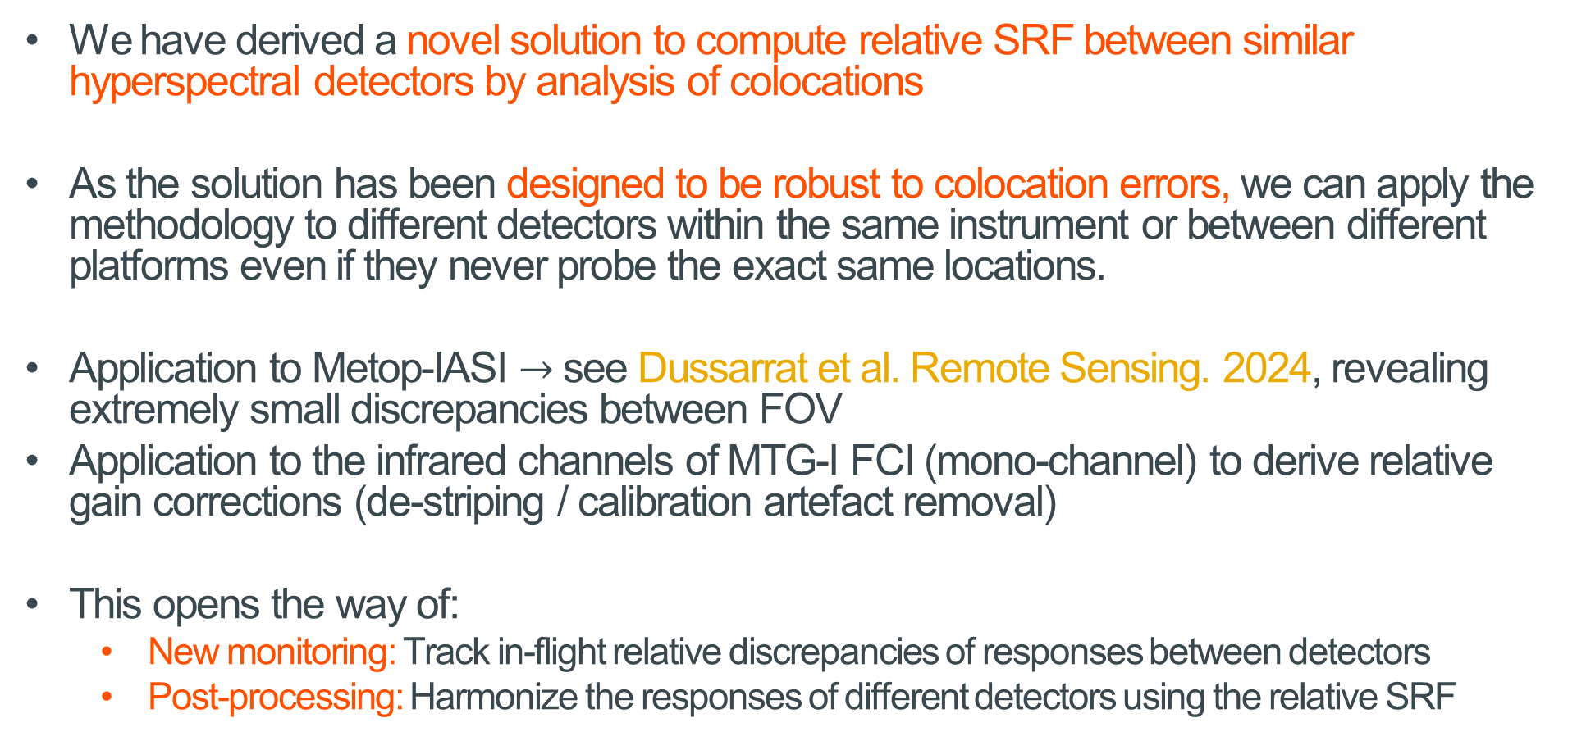
Conclusion
We have derived a novel solution to compute relative SRF between similar hyperspectral detectors by analysis of colocations
As the solution has been designed to be robust to colocation errors, we can apply the methodology to different detectors within the same instrument or between different platforms even if they never probe the exact same locations.
Application to Metop-IASI $→$ see Dussarrat et al. Remote Sensing. 2024, revealing extremely small discrepancies between FOV
Application to the infrared channels of MTG-I FCI (mono-channel) to derive relative gain corrections (de-striping / calibration artefact removal)
This opens the way of:
  New monitoring: Track in-flight relative discrepancies of responses between detectors
  Post-processing: Harmonize the responses of different detectors using the relative SRF
Dussarrat P, Deschamps G, Coppens D. Spectral Response Function Retrieval of Spaceborne Fourier Transform Spectrometers: Application to Metop-IASI. Remote Sensing. 2024; 16(23):4449. https://doi.org/10.3390/rs16234449

Slide 18
Thank you!
Questions are welcome.

