Slide 1




Tropospheric Emissions:
Monitoring of Pollution
TEMPO instrument calibration status
Heesung Chong¹, X. Liu¹, J. Houck¹, D.E. Flittner², J. Carr³,
W. Hou¹, J. E. Davis¹, R. M. Suleiman¹, K. Chance¹, N. Mishra²,
C. Chan Miller¹, G. González Abad¹, B. Baker⁴, J. Lasnik⁴,
D. Nicks⁴, J. Park¹, J. Bak¹, C.R. Nowlan¹, H. Wang¹,
E. O’Sullivan¹, J. Fitzmaurice¹, L. Carpenter¹, L. Flynn⁵,
S. Marchenko⁶, J. Joiner⁶, Colin Seftor⁶, and Glen Jaross⁶
¹SAO, CfA ²NASA LaRc ³Carr Astro.
⁴BAE ⁵NOAA/NESDIS ⁶NASA GSFC
GSICS Annual Meeting
March 19, 2025

Slide 2
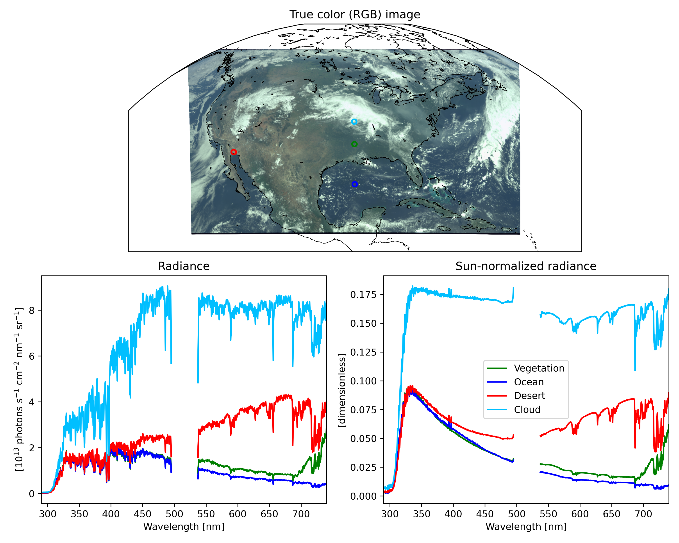
TEMPO V03 Level 1 products
Release: May 20, 2024
Products: (1) Dark, (2) Earth radiance, (3) Twilight Earth radiance, (4) working solar irradiance, and
(5) reference solar irradiance
Sun-normalized radiance = Earth radiance / working solar irradiance
Twilight Earth radiance
[Chong et al., to be submitted to ESS]
[Carr et al., in review (ESS)]
V03 Level 1 products led to quality improvements in Level 2 products and nighttime measurements.

Slide 3
TEMPO V03 Level 1 products
(PRNU: photo response non-uniformity; BTDF: bidirectional transmittance distribution function)
* : Parameters with major updates through V03
Major algorithm updates through V03
Parameter | Update | Impact
Electronic offset | Row-by-row correction implemented | Increased accuracy at low signal levels
Smear | Estimation method changed to one using the photoactive regions
Dark current | Arrhenius coefficients updated to improve temperature correction
Stray light | Stray light kernel (1-dimensional point spread function) implemented
Diffuser goniometry | Scattering-angle-based BTDF correction implemented | Spatial and temporal gradient in solar irradiance reduced greatly

Slide 4
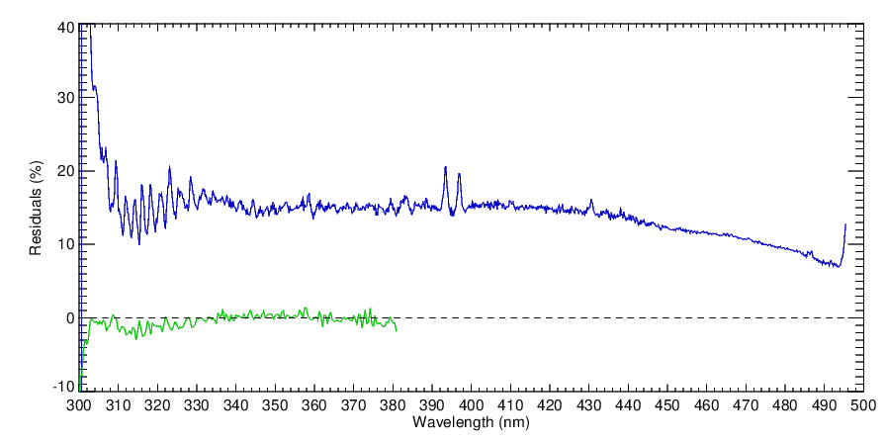
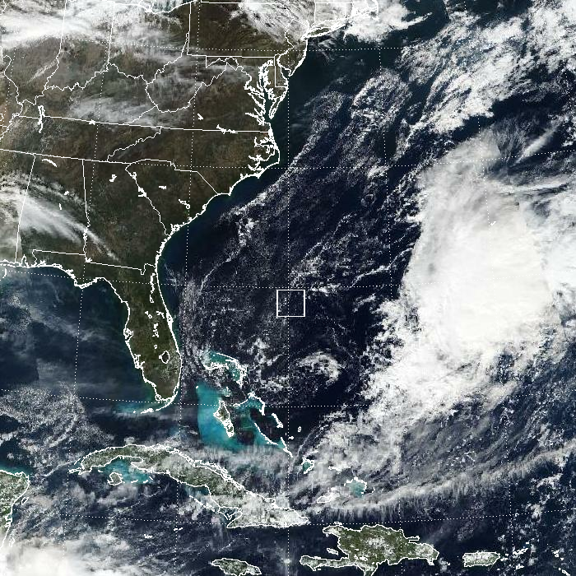
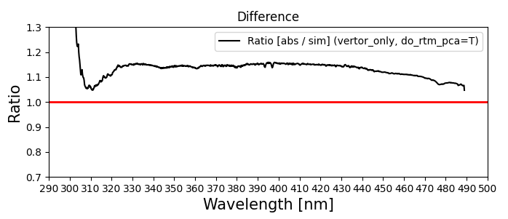
V03 Sun-normalized radiance assessment
Comparisons against two radiative transfer models
TOMRAD
(TEMPO – Simulation) / Simulation × 100
Radiance (11/06/2023, scan 009, granule 02)
/ Irradiance (10/26/2023)
TEMPO
OMPS
Selected
pixels
UV CCD
[Credit: Colin Seftor]
VLIDORT (TEMPO ozone profile algorithm)
TEMPO / Simulation
[VIIRS RGB, Credit: Colin Seftor]
UV CCD
[Credit: Junsung Park]
The overestimation of TEMPO UV (290–490 nm) and VIS (540–740 nm) Sun-normalized radiances is generally on the order of 10%.

Slide 5
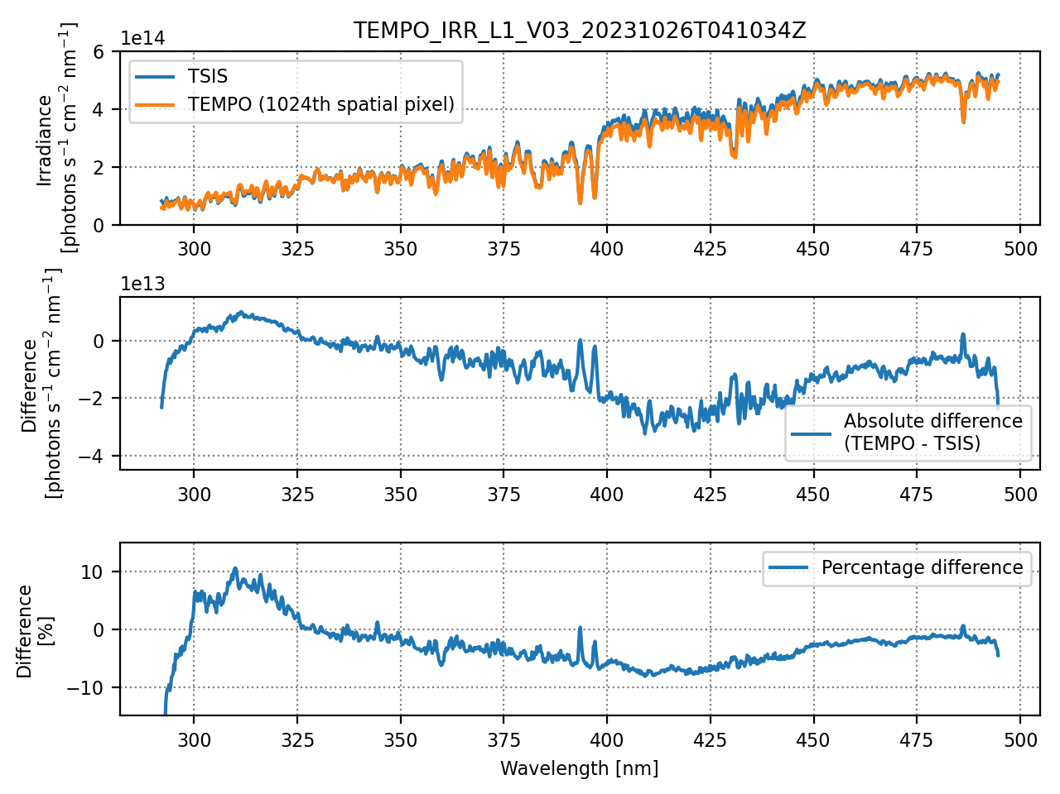
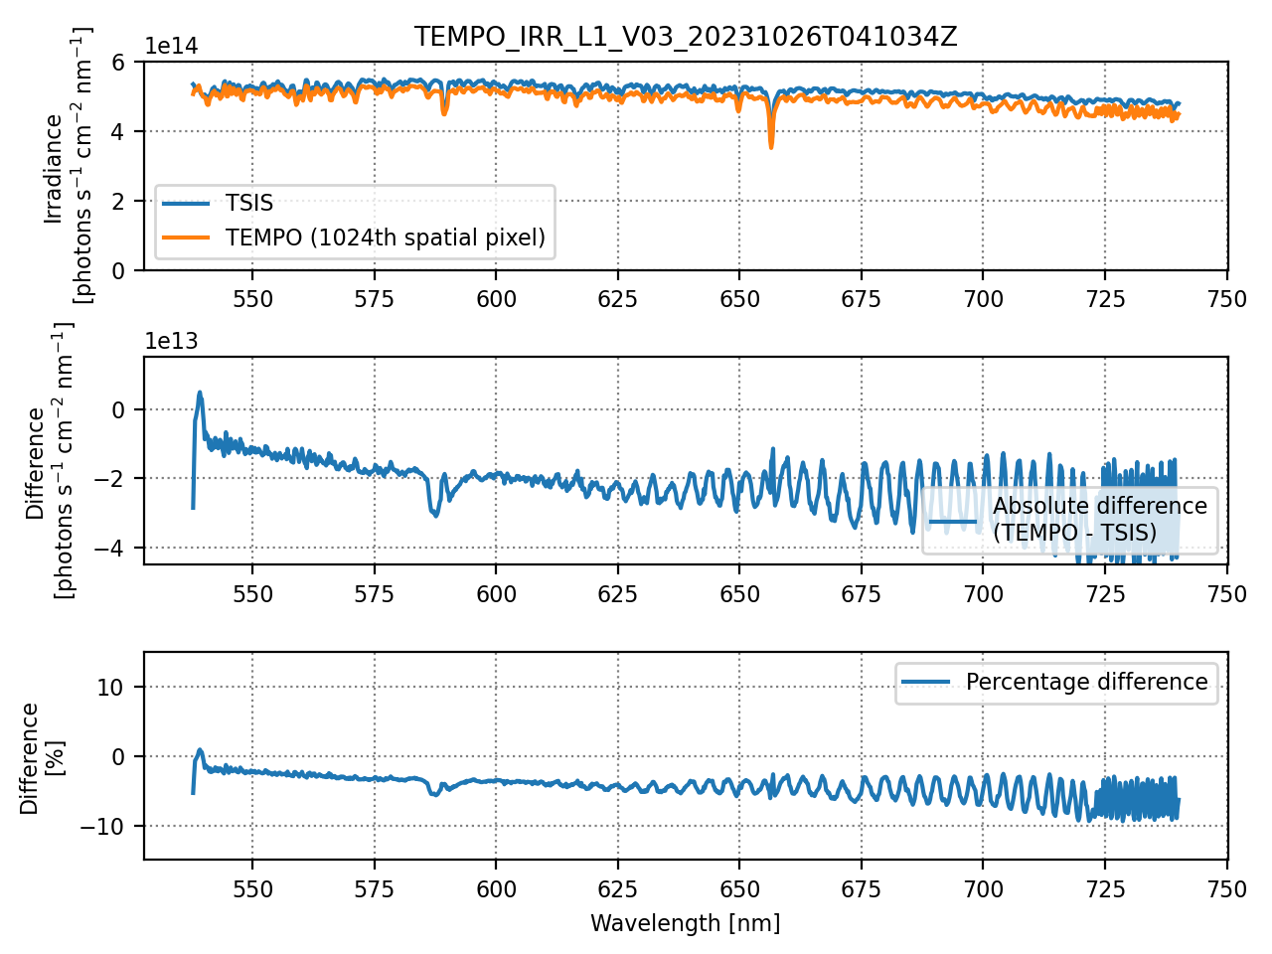
V03 solar irradiance assessment
UV CCD
VIS CCD
(October 26, 2023)
(October 26, 2023)
Underestimated, but not to the extent that it accounts for the overestimation of Sun-normalized radiance.
The fringe pattern results from uncorrected CCD etaloning.
Results indicate that Earth radiance measurements are overestimated.
The spectral registration of radiometric calibration coefficients should be updated to address the etaloning residuals.

Slide 6
V03 Earth radiance assessment
Goal: Estimate the biases in TEMPO earthshine radiances using VIIRS as the reference.
Indirect evaluation: Compare TEMPO and GOES ABIs, then combine the result with existing VIIRS-ABI comparison.
Instruments
* TEMPO: 91.0°W, GOES-16: in operation at 75.2°W, GOES-19: at 89.5°W checkout position to replace GOES-16 soon
* ABI Band 1: 470 nm (440–500 nm), ABI Band 2: 640 nm (580–700 nm)
Methods:
For each band of each ABI instrument,
(1) Convolve TEMPO radiances using the ABI spectral response function.
(2) Estimate biases in the convolved TEMPO radiances against ABI radiances under fully cloudy conditions.
(3) Examine VIIRS-ABI comparison results to understand biases in the ABI radiances.
(4) Estimate biases in the convolved TEMPO radiances against VIIRS radiances by combining the results of steps (2) and (3).

Slide 7
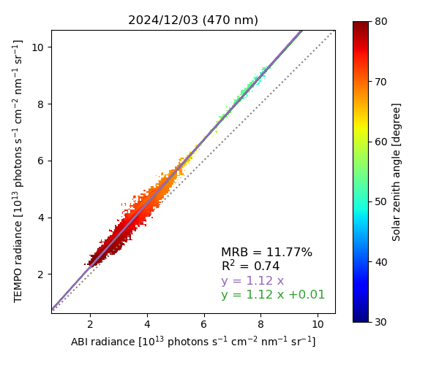
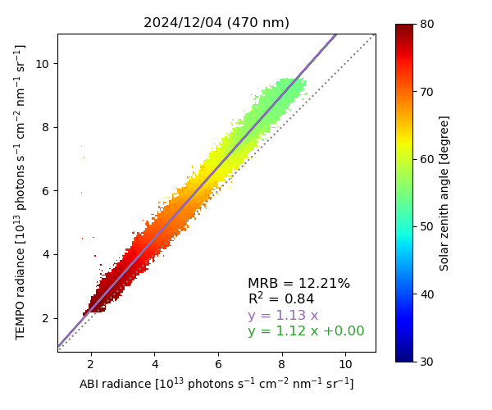
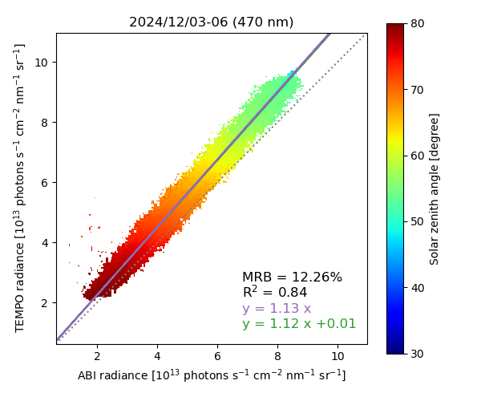

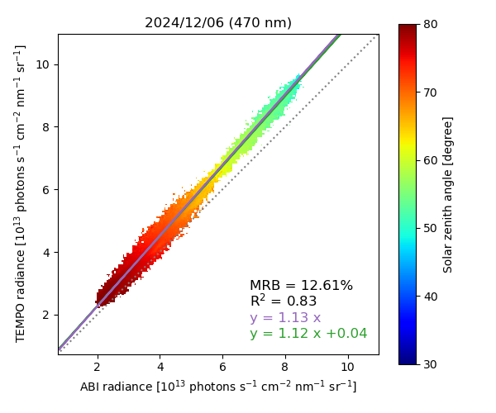
TEMPO vs. GOES-19 ABI: 470 nm
Daily scatter plot for fully cloudy conditions (Dec 3–6, 2024)
*MRB: median relative bias
*Two regression equations
- Purple: Standard regression with a fixed y-intercept of zero
- Green: Reduced major axis regression
4-day scatter plot for fully cloudy conditions
TEMPO radiances are higher than
G19 ABI Band 1 radiances by ~12%.

Slide 8
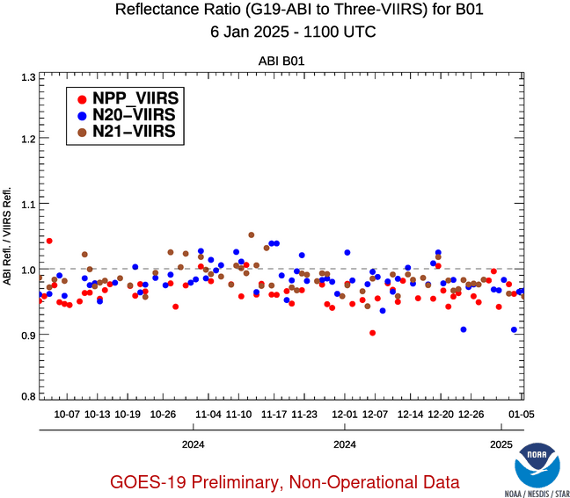
GOES-19 ABI vs. VIIRS: 470 nm
Based on a visual inspection, G19 ABI Band 1 radiances are lower than VIIRS radiances, typically by ~2%.
Therefore, TEMPO radiances are higher than VIIRS radiances by ~10% at 470 nm.
[Source: https://www.star.nesdis.noaa.gov/GOESCal/G19_ABI_RadVal_VNIR_static.php]

Slide 9
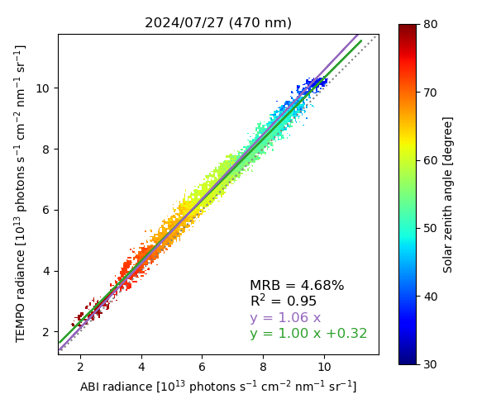
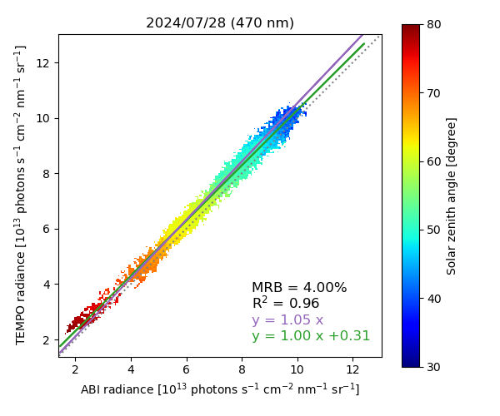
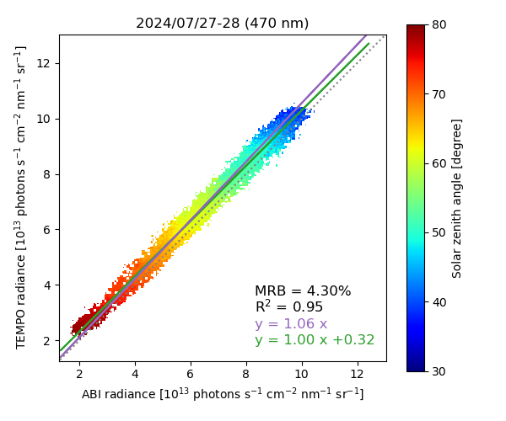
TEMPO vs. GOES-16 ABI: 470 nm
*MRB: median relative bias
*Two regression equations
- Purple: Standard regression with a fixed y-intercept of zero
- Green: Reduced major axis regression
Daily scatter plot for fully cloudy conditions (Jul 27–28, 2024)
2-day scatter plot for fully cloudy conditions
TEMPO radiances are higher than
G16 ABI Band 1 radiances by ~4%.

Slide 10
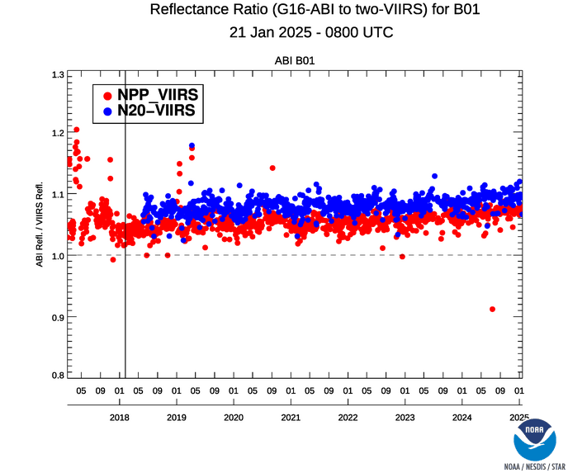
GOES-16 ABI vs. VIIRS: 470 nm
Based on a visual inspection, G16 ABI Band 1 radiances are higher than VIIRS radiances, typically by ~6%.
Therefore, TEMPO radiances are higher than VIIRS radiances by ~10% at 470 nm.
→ A conclusion consistent with that from the G19 Band 1 comparison
→ Note that the G16 and G19 data are from different dates (July and December, respectively).
[Source: https://www.star.nesdis.noaa.gov/GOESCal/G19_ABI_RadVal_VNIR_static.php]

Slide 11
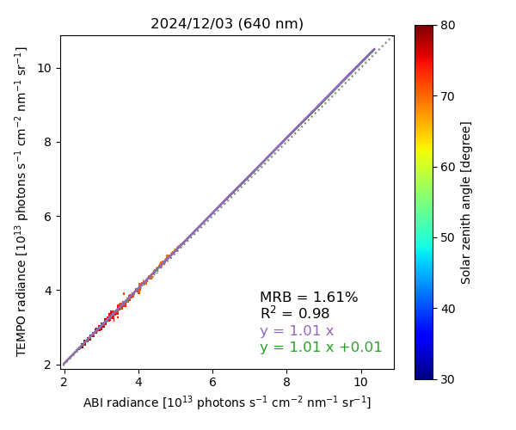
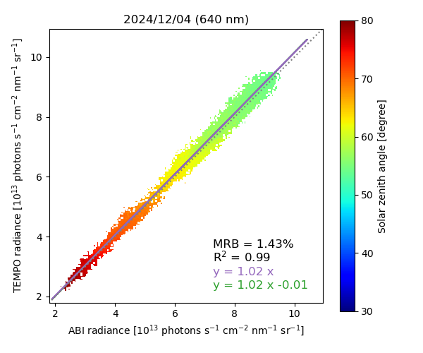
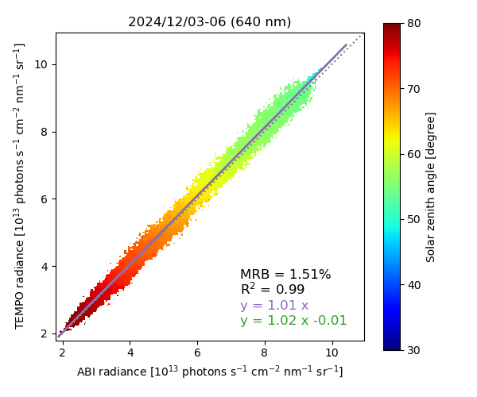
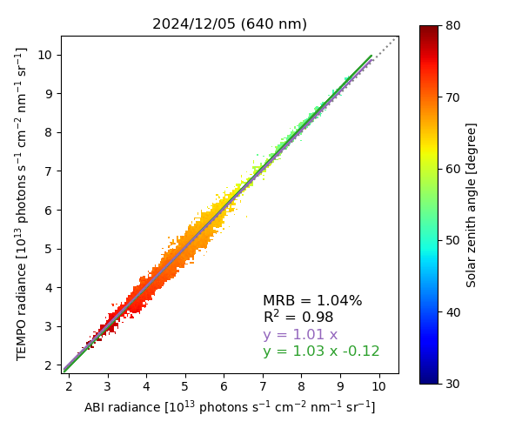
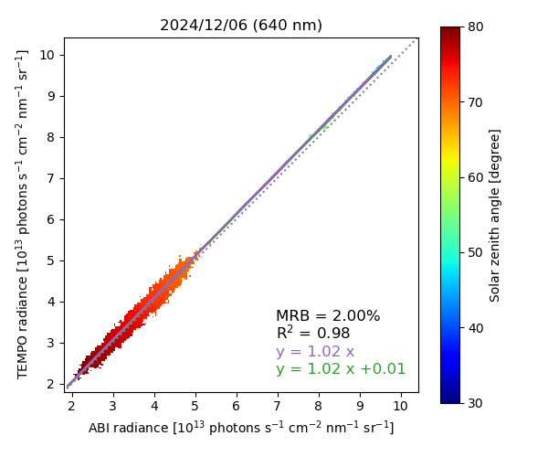
TEMPO vs. GOES-19 ABI: 640 nm
Daily scatter plot for fully cloudy conditions (Dec 3–6, 2024)
*MRB: median relative bias
*Two regression equations
- Purple: Standard regression with a fixed y-intercept of zero
- Green: Reduced major axis regression
4-day scatter plot for fully cloudy conditions
TEMPO radiances are higher than
G19 ABI Band 2 radiances by ~2%.

Slide 12
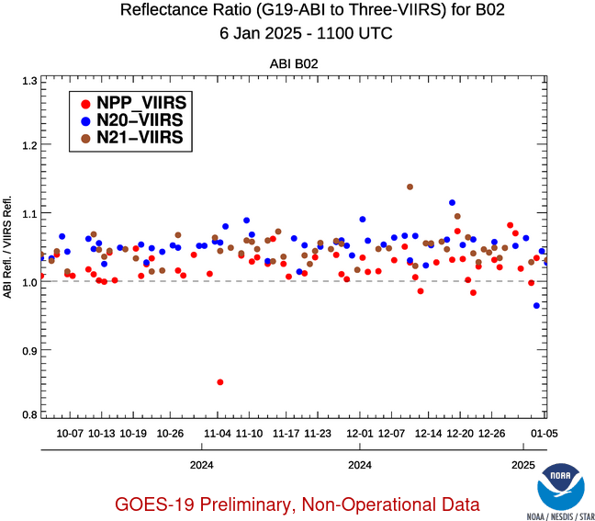
GOES-19 ABI vs. VIIRS: 640 nm
Based on a visual inspection, G19 ABI Band 2 radiances are higher than VIIRS radiances, typically by ~4%.
Therefore, TEMPO radiances are higher than VIIRS radiances by ~6% at 640 nm.
[Source: https://www.star.nesdis.noaa.gov/GOESCal/G19_ABI_RadVal_VNIR_static.php]

Slide 13
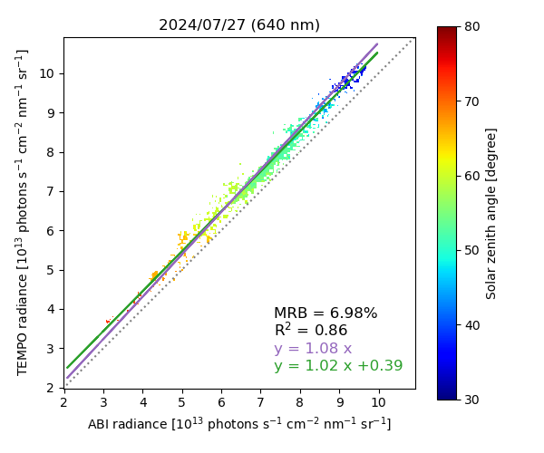
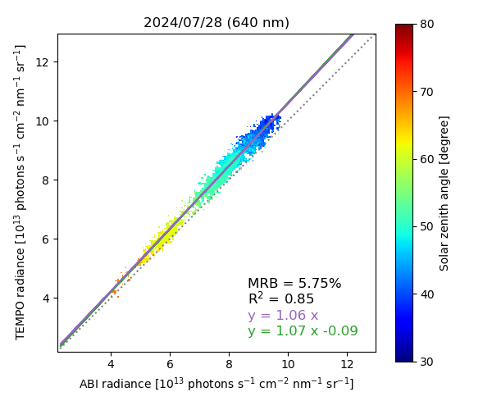
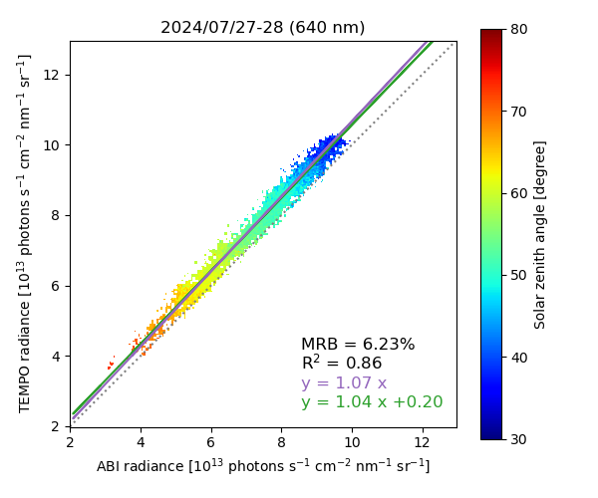
TEMPO vs. GOES-16 ABI: 640 nm
*MRB: median relative bias
*Two regression equations
- Purple: Standard regression with a fixed y-intercept of zero
- Green: Reduced major axis regression
Daily scatter plot for fully cloudy conditions (Jul 27–28, 2024)
2-day scatter plot for fully cloudy conditions
TEMPO radiances are higher than
G16 ABI Band 2 radiances by ~6%.

Slide 14
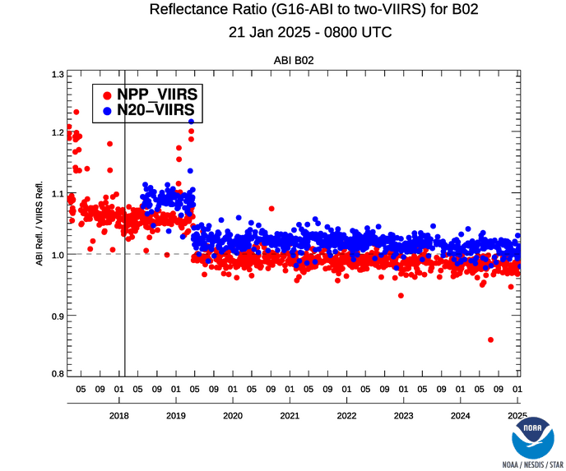
GOES-16 ABI vs. VIIRS: 640 nm
Based on a visual inspection, G16 ABI Band 2 radiances are comparable with VIIRS radiances.
Therefore, TEMPO radiances are higher than VIIRS radiances by ~6% at 640 nm.
→ A conclusion consistent with that from the G19 Band 2 comparison
→ Note that the G16 and G19 data are from different dates (July and December, respectively).
[Source: https://www.star.nesdis.noaa.gov/GOESCal/G19_ABI_RadVal_VNIR_static.php]
Minor refinements planned for TEMPO-ABI comparison (e.g., convolution)

Slide 15
Absolute calibration summary
Solar irradiance
UV CCD
VIS CCD
TEMPO – TSIS [%] (October 26, 2023)
TEMPO – TSIS [%] (October 26, 2023)
640 nm
470 nm
Earth radiance
The biases are estimated to be ~10% and ~6% at 470 nm and 640 nm, respectively. (Reference: VIIRS)
Sun-normalized radiance
Combining the biases in solar irradiance and Earth radiance, as expected, the Sun-normalized radiance biases are on the order of 10%.
(PRNU: photo response non-uniformity; BTDF: bidirectional transmittance distribution function)
Along with a careful investigation of each parameter, we are considering adjustments to the radiometric calibration coefficients and BTDF.

Slide 16
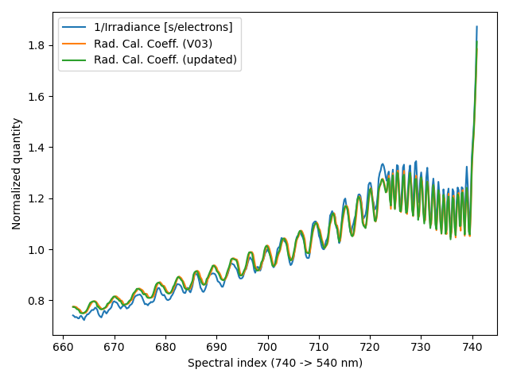
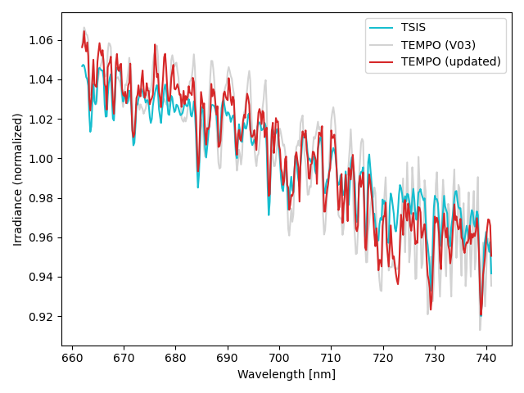
Fringe correction (work in progress)
August 1, 2023, spatial position 1020 (0-based)
Radiometric calibration coefficients [photons/s/cm²/nm/(electrons/s)]
TSIS and TEMPO irradiances
[photons/s/cm²/nm]
Spectral shifts applied to Rad. Cal. Coeff.
(V03 → updated)
Ideally, the radiometric calibration coefficients should compensate for the etaloning pattern in irradiance [electrons/s],
resulting in fringe-free Level 1 irradiance [photons/s/cm²/nm].

Slide 17
Summary
Sun-normalized radiances from TEMPO V03 Level 1 products are generally overestimated by on the order of 10%.
Solar irradiance and Earth radiance have been validated separately, and the results align with the ~10% bias in Sun-normalized radiance.
Ongoing work
– polarization
– polarization
(2)
(1)
(3)
Absolute calibration
- We are considering adjustments to the radiometric calibration coefficients and BTDF to address (a) the Sun-normalized radiance biases and (b) the etaloning residuals.
Stray light
- We have been working on updating the point spread function and implementing background stray light correction.
Polarization correction (early stage)
- The correction algorithm has already been integrated into the TEMPO Level 0-1 processor.
- We have begun assessing its performance using in-flight measurements.

Slide 18
Thank you for your attention!

Slide 19
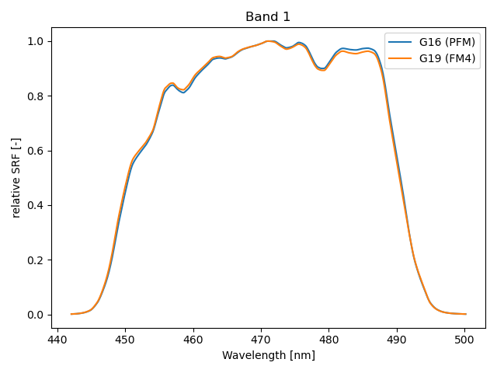
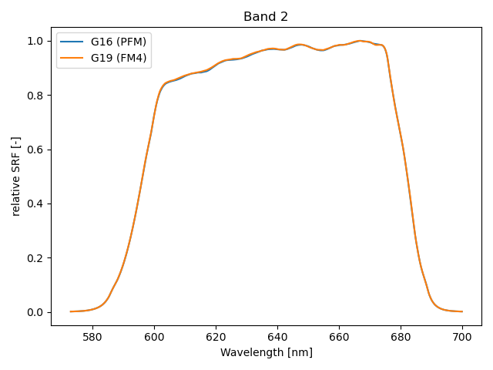
ABI bandwidths

Slide 20
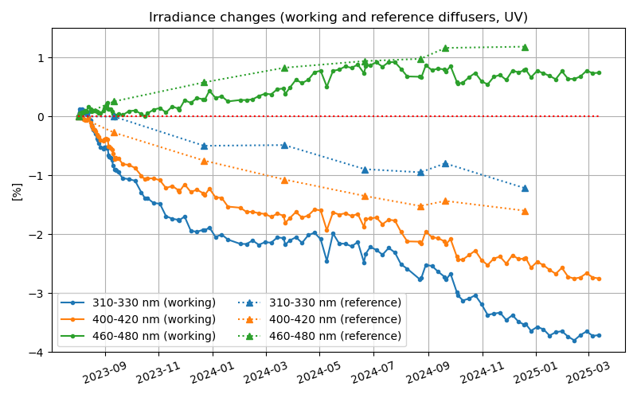
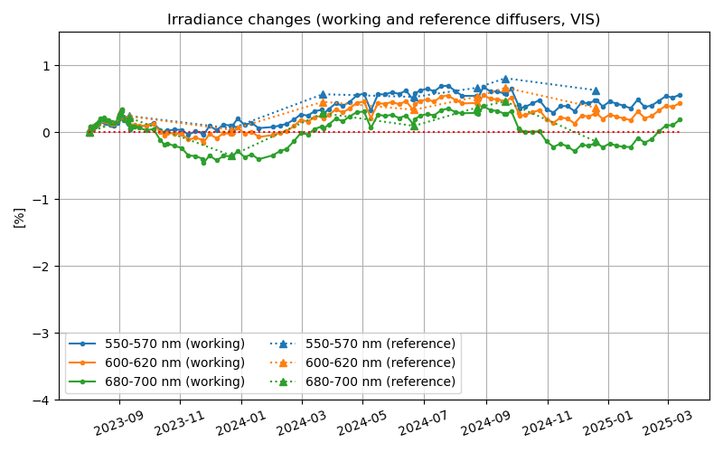
Degradation
Irradiance trend (after correcting for Earth-Sun distance)
UV CCD
VIS CCD

Slide 21
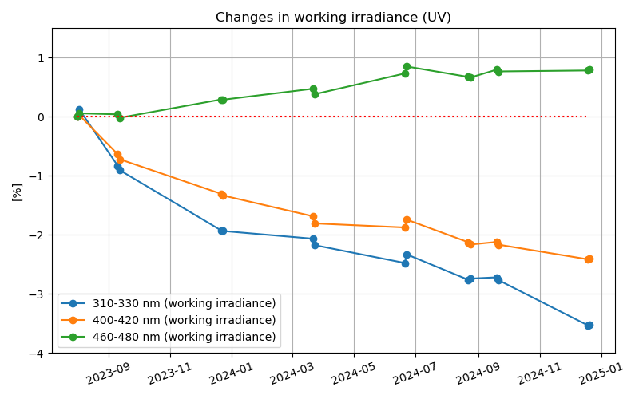
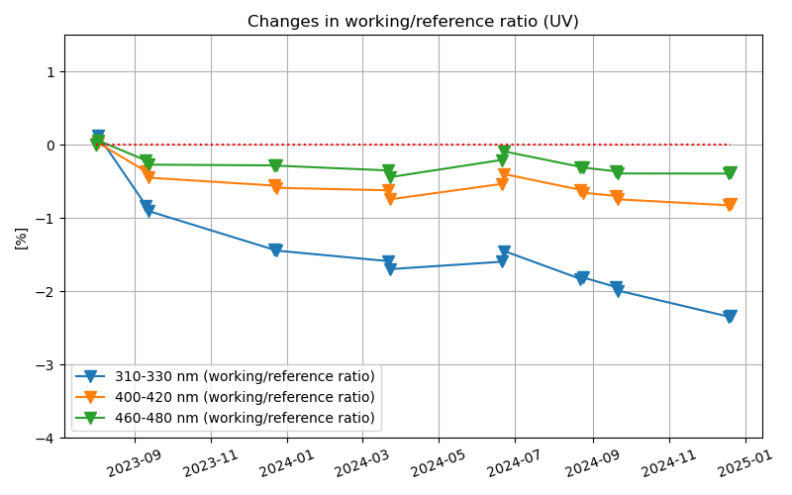
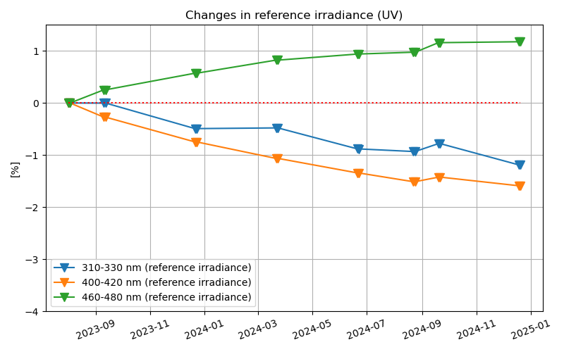
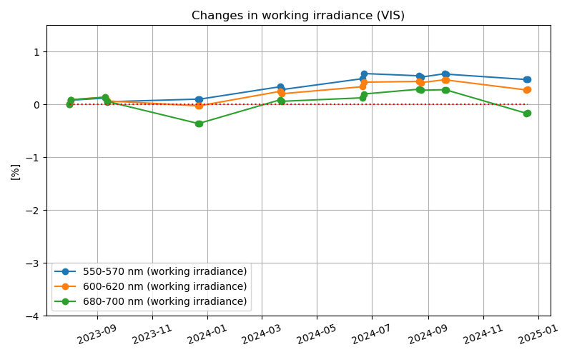
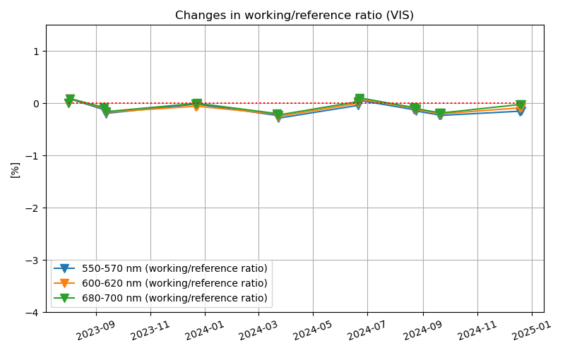
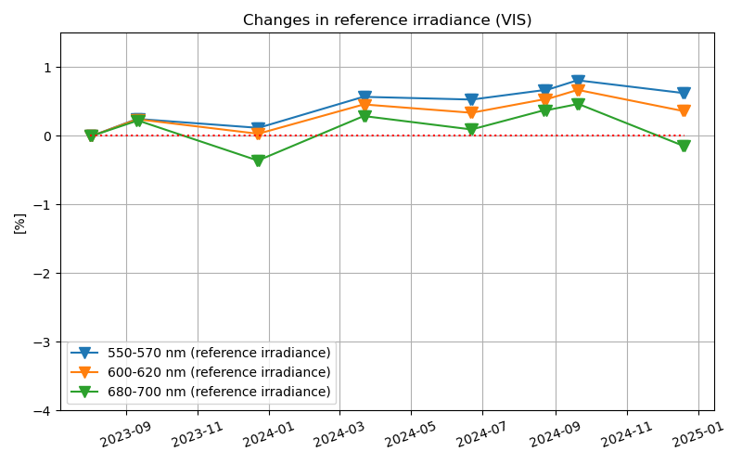
Degradation
UV
Working irradiance changes
Proxy for working diffuser changes
Proxy for optics + detector changes
=
+
VIS
Working irradiance changes
Proxy for working diffuser changes
Proxy for optics + detector changes
=
+

