Slide 1
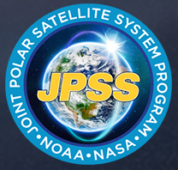

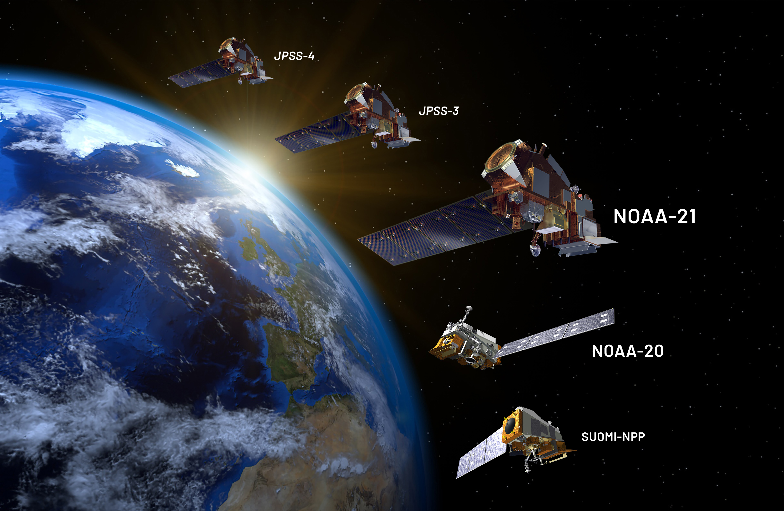

Recent OMPS Calibration efforts for NOAA 20 & 21
Sri Madhavan, Glen Jaross & NASA OMPS Team
03/19/2025
GSICS Annual and Executive Panel Meeting 2025

Slide 2
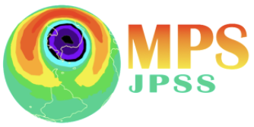
Background
NOAA 20 & 21 Calibration changes in the upcoming reprocessing
  Improved Day 1 BSDF cal
  Improved Day 1 BCW assignment (derived ground-to-orbit changes using Earth-View)
  Time-dependent wavelength registration and intra orbital wavelength monitoring
  Time-dependent radiometric calibration (incl. wave-shift sensitivity)
  Improved stray light in Nadir Profiler (TBD)
  Daily solar activity correction
  Improved dark current corrections using power law characterization
Assessing the calibration improvements using residuals
GSICS Annual and Executive Panel Meeting 2025

Slide 3
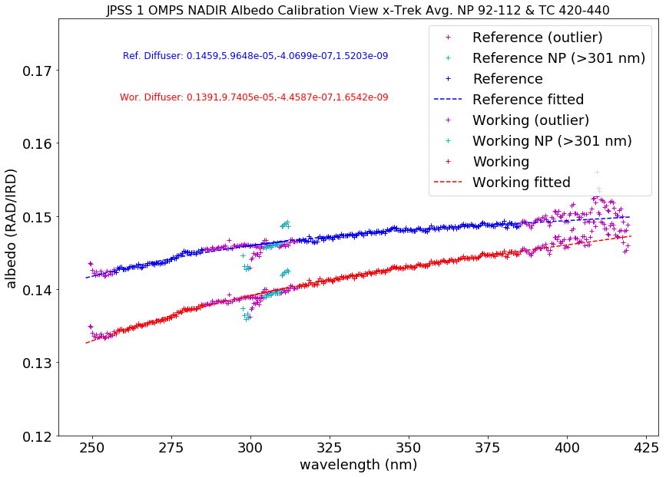
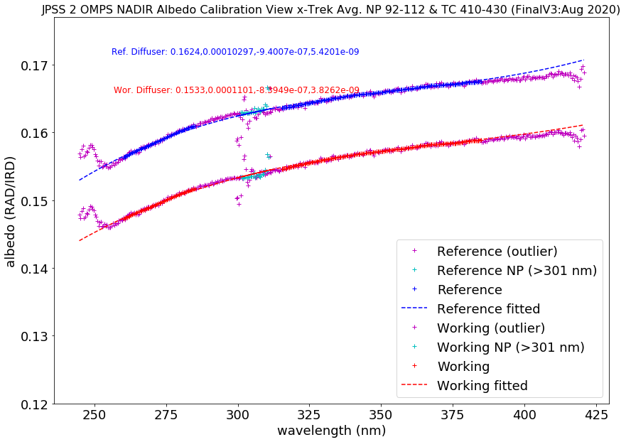
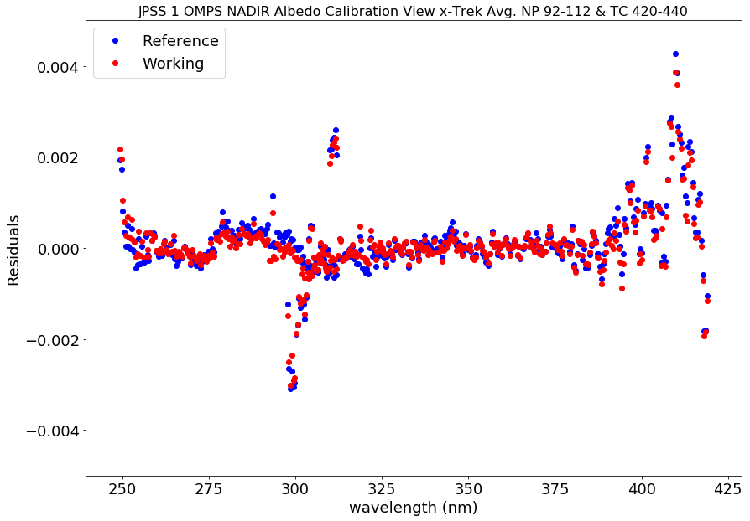
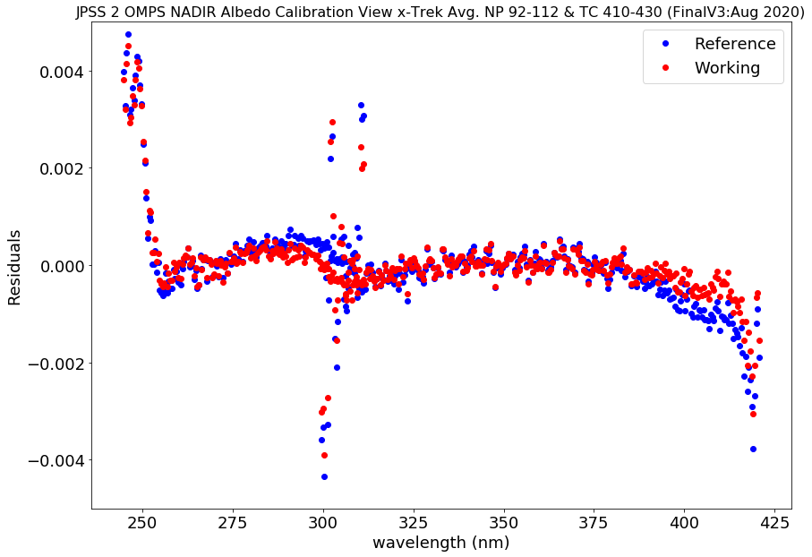
Day1 BSDF Calibration
N20
N21
Pixel Shifting (spectral) NP and NM
by approx. 0.03 pix
Reduction in test artifacts and fine
spectral structure by
fitting to a low order polynomial
GSICS Annual and Executive Panel Meeting 2025

Slide 4
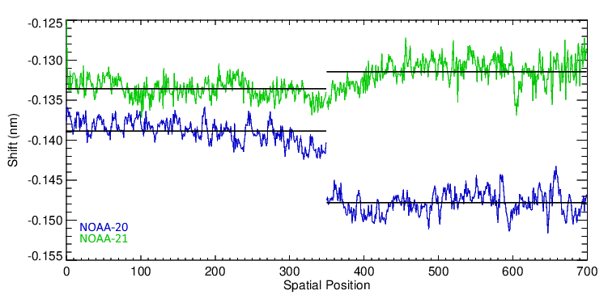
Day 1 BCW Assignment
Ground-to-Orbit Shifts in nm
The Ground- to-Orbit Shifts were determined using EV FullFrame data for Nadir Mapper and using the Reference Solar Flux for Nadir Profiler
Used the spatial averages shown as we cannot verify the validity of the fine structure
GSICS Annual and Executive Panel Meeting 2025

Slide 5
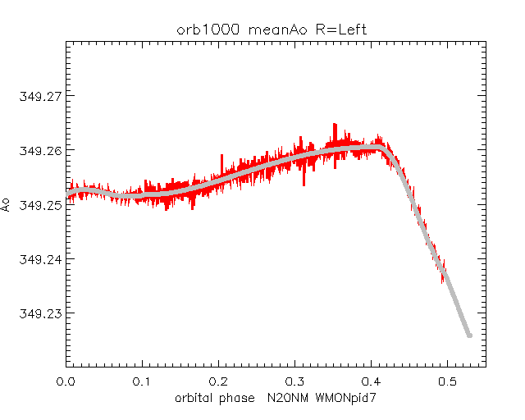
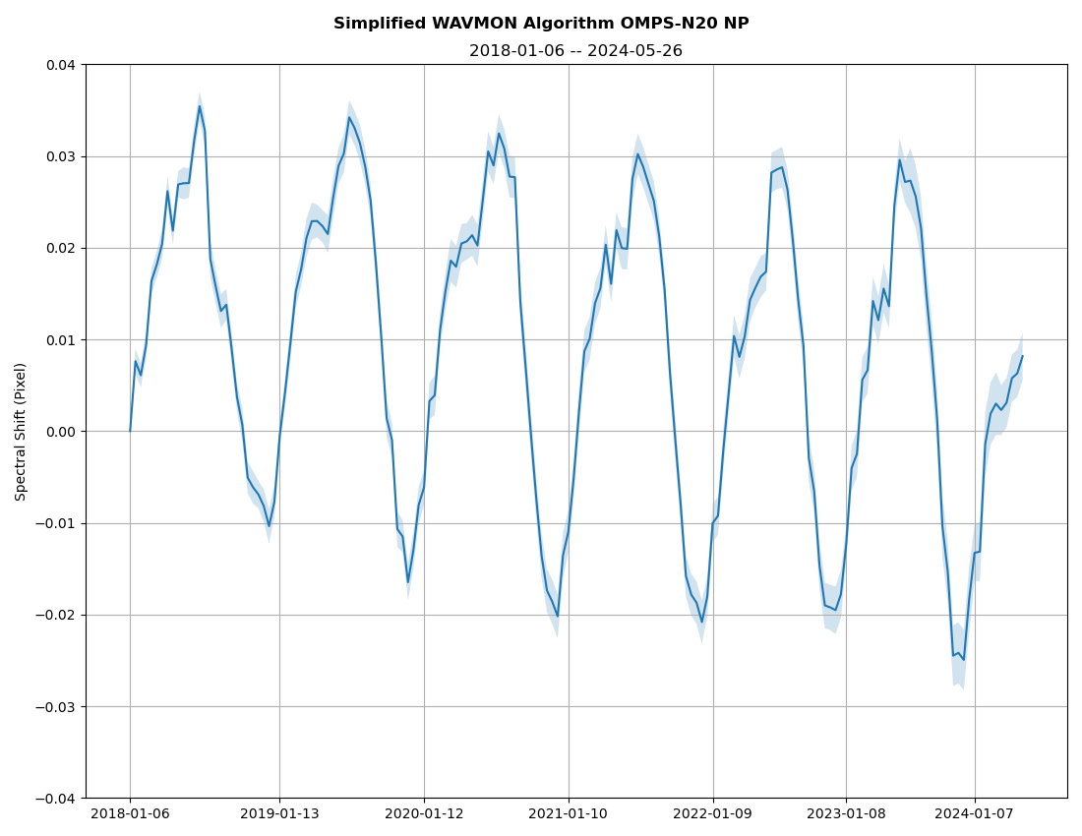
Time-Dependent wavelength registration & Intra-Orbital monitoring
Intra-orbital shift due to thermal change
during an orbit
NM
~0.006 pix shift over 6-years
Spectral Shift (pixel)
Band Center Wavelength
Intra-Orbital Monitoring
Year
Wavelength calibration is performed with the solar flux measurements by making use of the spectral structure of the solar Fraunhofer lines.
Wavelength registration differences monitored through ratio of Earth View radiances with Solar Flux, at wavelengths that have no ozone absorption (>340 nm).
GSICS Annual and Executive Panel Meeting 2025

Slide 6
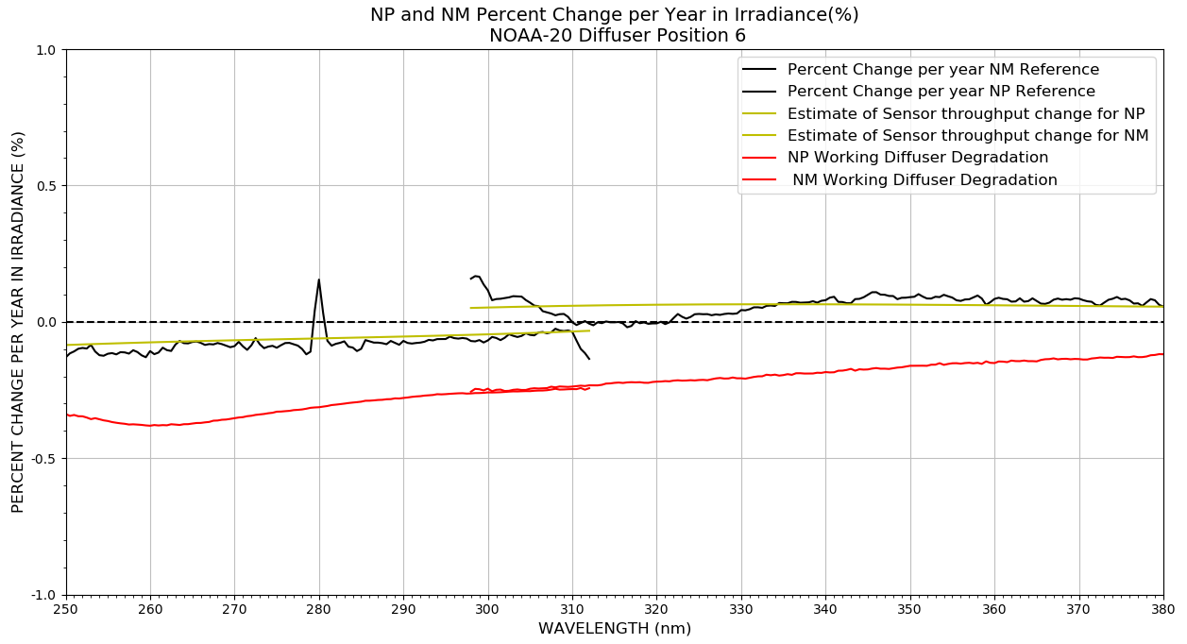
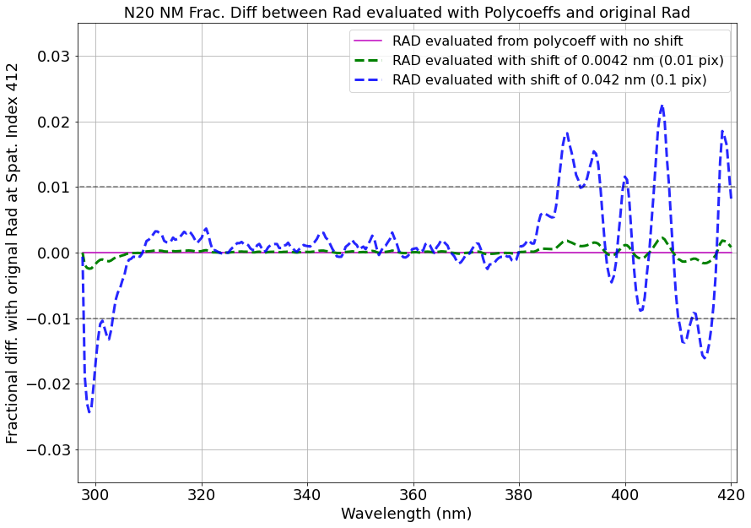
Time-dependent radiometric calibration
Reference Diffuser used to update the radiometric change
Radiometric sensitivity correction based on
intra-orbital pixel shift evaluated using (slide 5)
N20
N20
N20
Left Plot: Temporal change in radiometric calibration is incorporated using a Correction Factor (CF) and is derived
using the reference diffuser.
Right Plot: Intra-orbital radiometric change captured through poly-coefficients as a function of pixel,
pixel shifts evaluated by Intra-Orbital wavelength monitoring
GSICS Annual and Executive Panel Meeting 2025

Slide 7
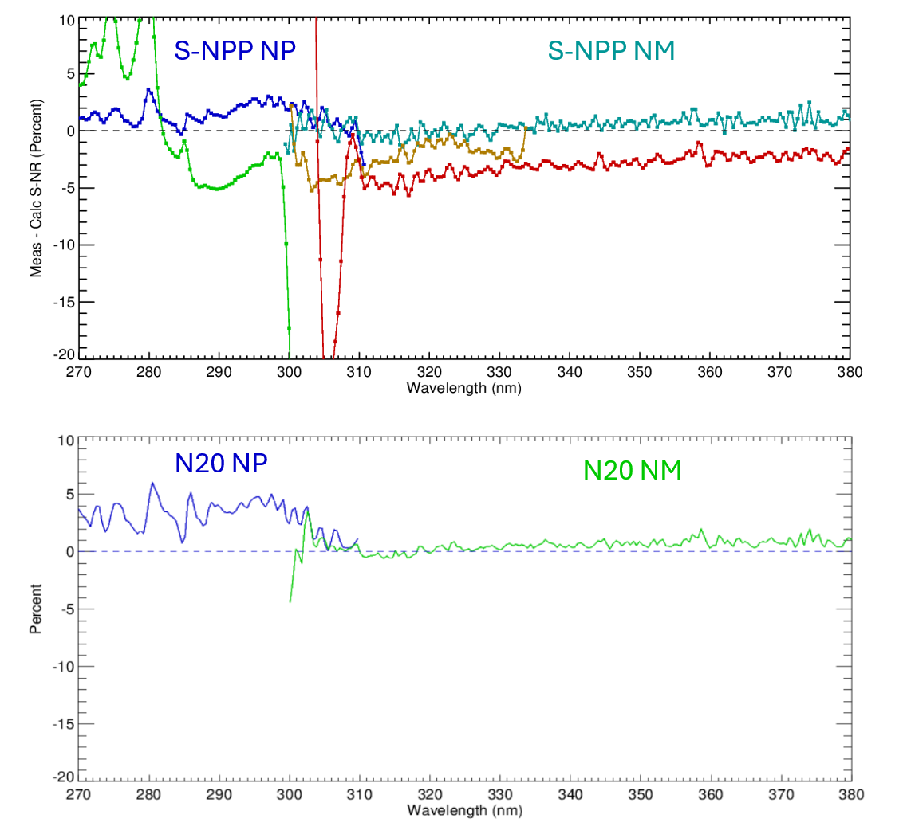
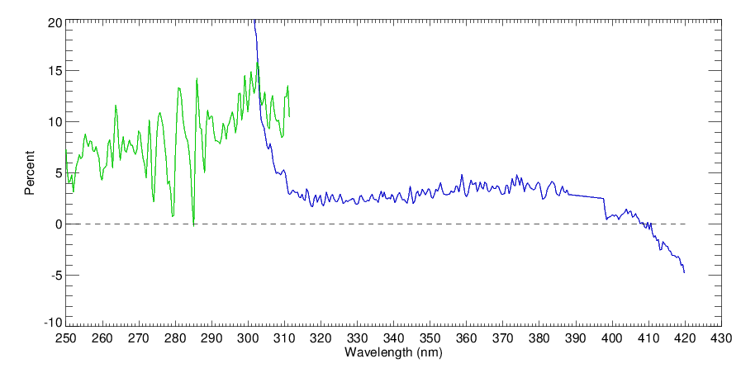
RTM Residual Evaluation (‘at’ nadir)
RTM is based on co-located NPP ozone measurements
Fine structure in NM is caused by Raman scattering (unmodeled)
N20 is finalized but we’re still investigating N21 problems
These results are only used to guide our investigations. Soft calibration in Level 2 should resolve uncorrected errors
N21 NP
N21 NM
GSICS Annual and Executive Panel Meeting 2025

Slide 8
Daily Solar Activity Correction
Longterm UV Solar Irradiance variability accounted using the MGII Index
Plots are derived from daily averages of Mg II indices from Earth View radiance. These will be used to introduce the solar activity correction into the L1B radiances.

Slide 9
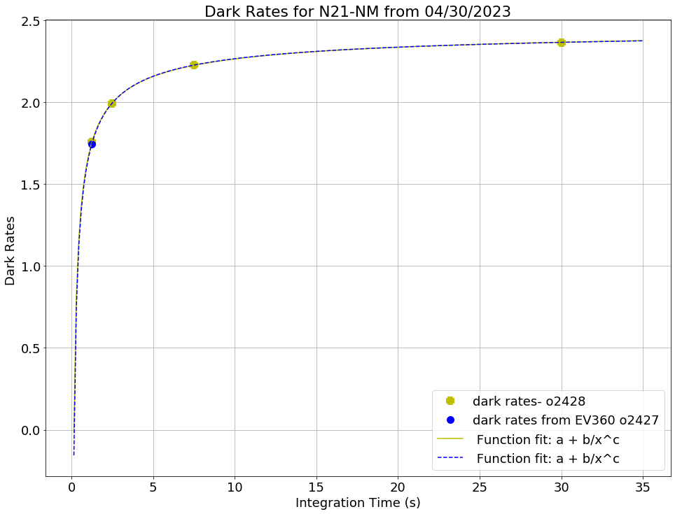
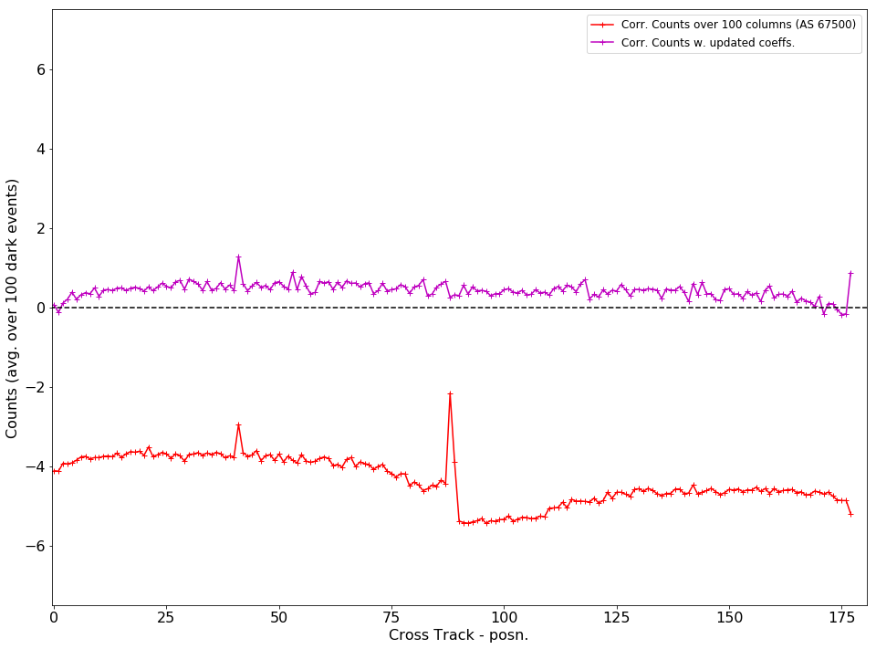
Improvements to Dark Current Correction
EV Night data from 2023/12/03
N21
Current dark correction is based on 30 S IT
which induces an over correction
Counts = Raw-Smear-Dark
EV Darks at 1.25 s IT
New Implementation
tc(x) = a + b/x^c where x = 1.25 s for NM
Currently the Dark Currents cause overcorrection in the EV responses for both N20 and N21
GSICS Annual and Executive Panel Meeting 2025

Slide 10
Summary
NASA is beginning it’s first reprocessing of the NOAA-20 and NOAA-21 OMPS Nadir Level 1 products. This involves a re-calibration and the addition of several new corrections.
Problem areas (work in progress) include Day 1 radiometry on N21 and Stray Light levels on both N20 and N21.
We anticipate new product releases in May (N20) and July (N21). Data will be available through the GSFC DISC.
GSICS Annual and Executive Panel Meeting 2025

Slide 11
BACK-UP
GSICS Annual and Executive Panel Meeting 2025

Slide 12
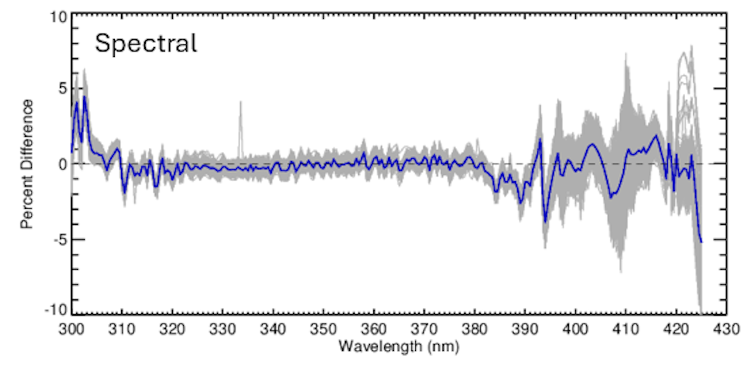
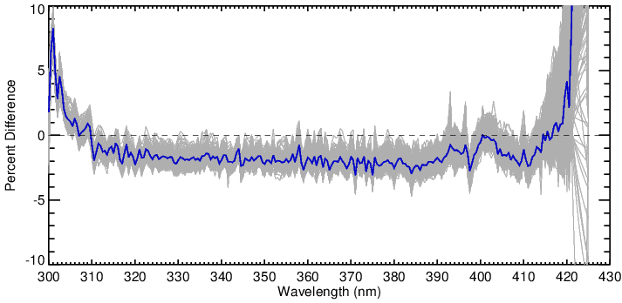
Comparison of New SolarFlux to Synthetic*
NOAA-20
NOAA-21
*Dobber, M., R. Voors, R. Dirksen, Q. Kleipool, and P. Levelt (2008), ”The high-resolution solar reference spectrum between 250 and 550 nm and its application to measurements with the Ozone Monitoring Instrument,” Sol. Phys., 249, 281-291, doi: 10.1007/s11207-008-9187-7.
GSICS Annual and Executive Panel Meeting 2025

Slide 13
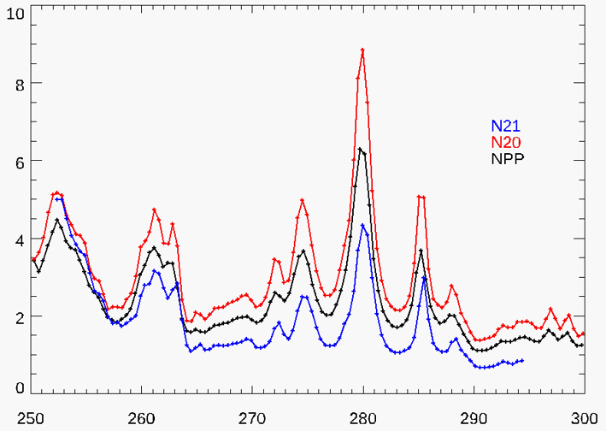
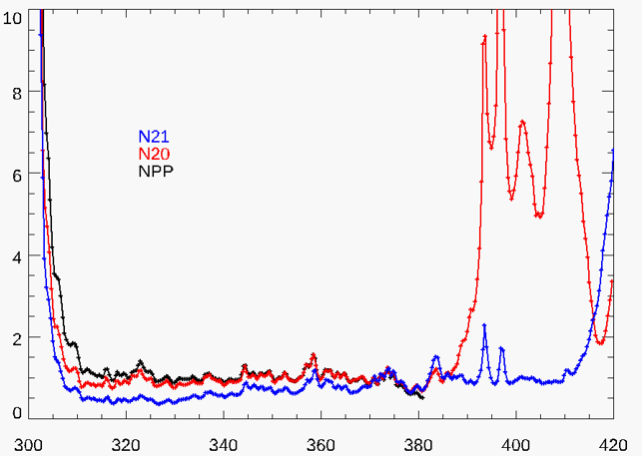
Straylight Analysis
NP stray light percentage mean calculated within latitude band [-20,20]. For each instrument, data is from one orbit of full-frame measurements.
NM stray light percentage mean calculated within latitude band [-20,20]. For each instrument, data is from one orbit of full-frame measurements.
NPP
NPP
N20
N20
N21
N21
N20
Percent
Percent
Wavelength (nm)
Wavelength (nm)
GSICS Annual and Executive Panel Meeting 2025

