Slide 1
The Calibration results of the OMS-Nadir onboard FY-3F
Jinghua Mao
National Space Science Center, Chinese Academy of Sciences
March 19, 2025
2025 GSICS Annual Meeting/GSICS Executive Panel Meeting
Notes:
Good morning, everyone! I'm Mao Jinghua from the National Space Science Center, Chinese Academy of Sciences.
It's my great honor to present the calibration results of the (OMS-Nadir) onboard the Fengyun-3F satellite

Slide 2
Outline
FY-3F misson
The OMS-Nadir instrument
OMS-Nadir instrument performance and calibration
  Calibration in progress
  A few selected calibration results
  Spectral response function
  Spatial calibration
  Radiometric calibration
Conclusion
Notes:
My presentation mainly includes the following aspects.
First, an overview of the FY-3F satellite mission;
the second part is introduction of the OMS-Nadir instrument;
The third part is some calibration results of the OMS-Nadir instrument, covering calibration progress, and the results such as spectral response function, spatial calibration, and radiometric calibration;
and finally, a conclusion.

Slide 3
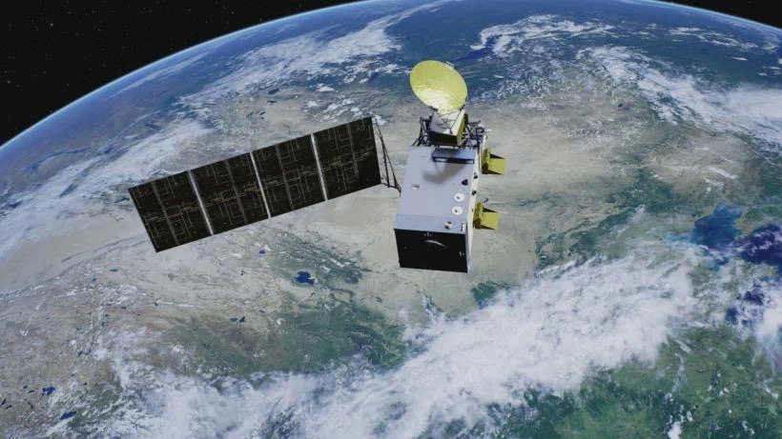
FY-3F misson
The launch date for FY-3F is end of 2023 with a 8 year design lifetime
The Earth system's observation capacity has been strengthened, enhancing detection of stratospheric and tropospheric components like ozone and sulfur dioxide.
The Ozone Monitoring Suite - Nadir (OMS-N) is the payload of the FY-3F mission
Notes:
The FY-3F satellite was successfully launched at the end of year 2023, with a designed lifespan of 8 years.
It has significantly enhanced the Earth system's observation capabilities, especially in detecting components in the stratosphere and troposphere, such as ozone and sulfur dioxide.
The OMS-Nadir, as the payload of the FY-3F satellite, plays a improtant role in these observation tasks.

Slide 4
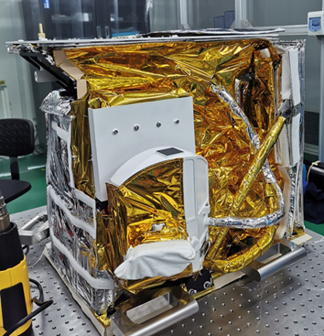
The OMS-Nadir instrument
The OMS-N
UV-VIS nadir viewing pushbroom grating spectrometer
Spectral range : 250-320nm,310-495nm
Spectral resolution :0.5-0.6nm
FOV :112°
Spatial resolution(nadir):7×7km²
The science products
Total column: O₃，NO₂，SO₂ ，HCHO,BrO,OCIO
O₃ profile
Aerosol：optical depth，absorbing index
Notes:
The OMS-Nadir is a nadir viewing pushbroom grating spectrometer.
Its spectral range covers 250 - 320 nm and 310 - 495 nm, with a spectral resolution of 0.5 - 0.6 nm
and FOV is 112 degrees with spatial resolution of 7 times 7 suqre km².
With this instrument, we can obtain various scientific products, including the total column content like ozone (O₃), nitrogen dioxide (NO₂), sulfur dioxide (SO₂), and so on,
Furthermore the vertical profile of ozone, and aerosol can also be detected

Slide 5
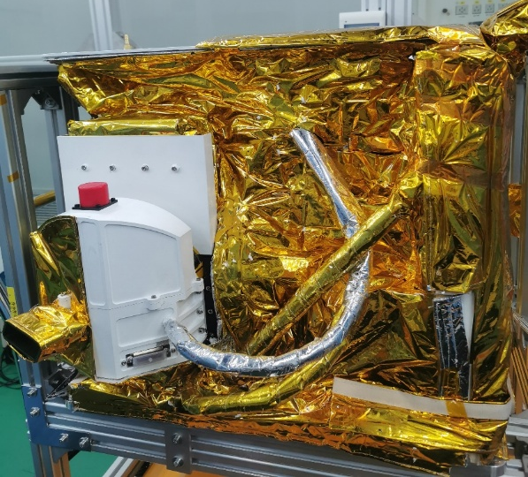
The OMS-Nadir instrument
The OMS-N performance parameters
Spectrometer | UV | UV | UVIS
Band | 1 | 2 | 3
Spectral range [nm] | 250-300nm | 300-320nm | 310-495nm
Spectral resolution [nm] | 0.5nm | 0.5nm | 0.6nm
Spectral sampling [nm] | 0.08nm | 0.08nm | 0.2nm
Spatial sampling [km2] | 21×28 | 7×7 | 7×7
Signal-to-noise(required) | 100 | 250 | 500-1500
Earth
Sun
Notes:
Here are the more detailed performance of the OMS-Nadir instrument.
It is divided into three spectral bands.
The bands have different spectral range, resolution, sampling , and SNR requirements.
These parameters provide a strong guarantee for the accurate observation of the instrument.
OMS-N have two port,one for earth with 112 degree，the other is for sun with the purpose of on-board calibration.

Slide 6
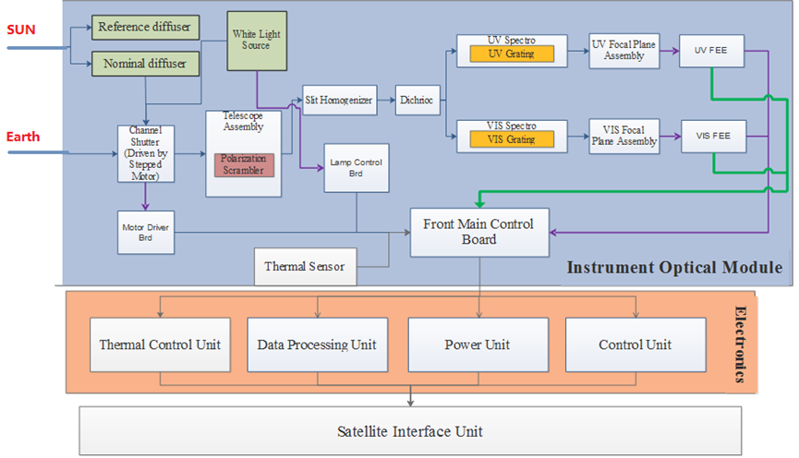
The OMS-Nadir instrument
Notes:
This figure shows the internal structure of the OMS-Nadir .
It consists of multiple parts, including the optical module, electronics system, thermal control unit, data processing unit, power unit, control unit, and satellite interface unit.
All these parts work in coordination, ensuring the stable and efficient operation of the instrument and enabling precise observations of target.

Slide 7
Calibration in progress
Efficiently organized performance
A fully automatic system for data acquisition
Only 112 days to get all Calibration Key Data
Notes:
The calibration work of the OMS-Nadir instrument has been carried out very efficiently.
We have established a fully automatic data acquisition system and obtained all the key calibration data within just 112 days.
This achievement is due to the organized workflow and advanced tech, providing a solid foundation for the upcoming calibration analysis.

Slide 8
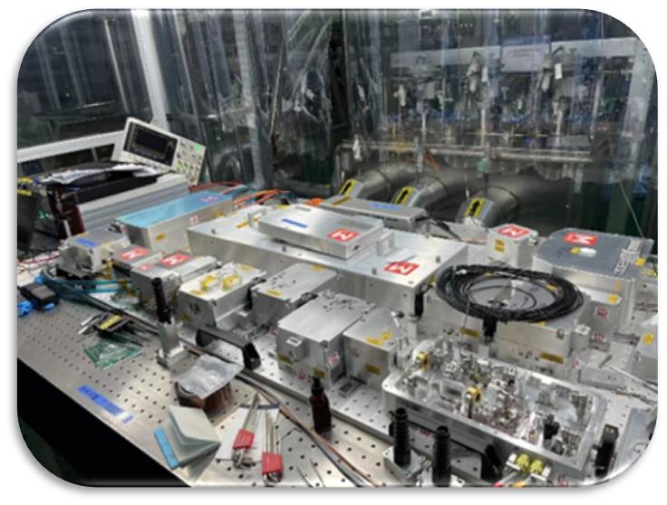
Calibration in progress
Cal name | Equipments
Spectral calibration | M square laser(250-300nm,350-500nm) OPO laser (300-350nm)
Geometric calibration | Collimator+Xenon lamp
Radiance calibration | Integrating sphere+Xenon lamp+Halogen lamp
Irradiance calibration | Solar simulator,diffuser
MTF test | Collimator+line pair
Non-linear and dynamic range | Integrating sphere+Xenon lamp+Halogen lamp
Tunable lasers
Notes:
During the entire calibration process, we used professional equipment.
For spectral calibration, we employed M square lasers and OPO lasers for different wavelength.
The geometric calibration used a Collimator
while the radiance calibration use of an integrating sphere
The irradiance calibration involved a solar simulator and a diffuser
the MTF test used a collimator and a line pair.
These specialized instruments ensure the accuracy and reliability of the calibration work.

Slide 9
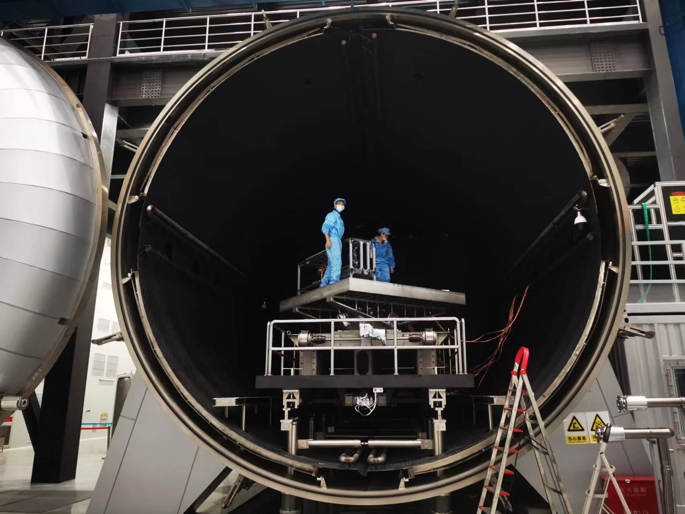
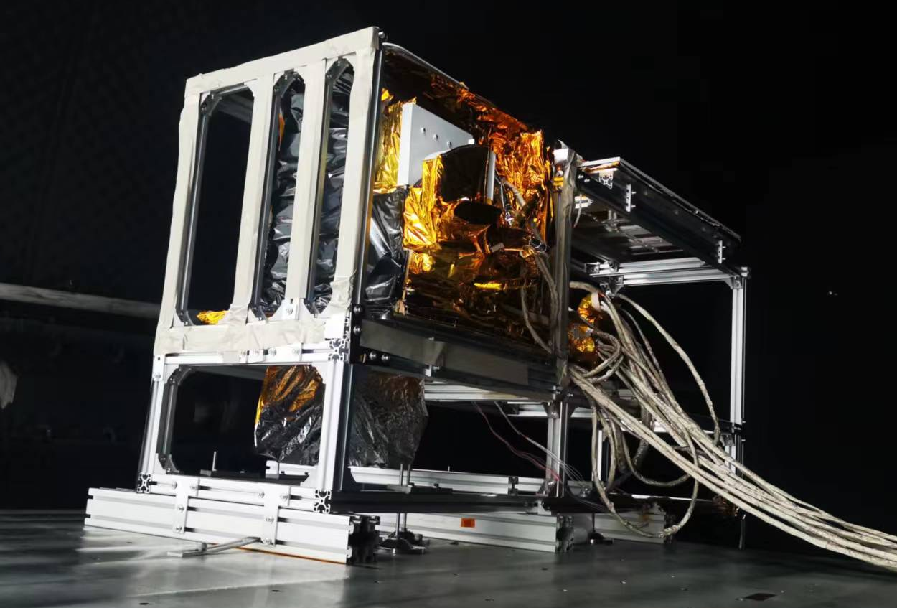
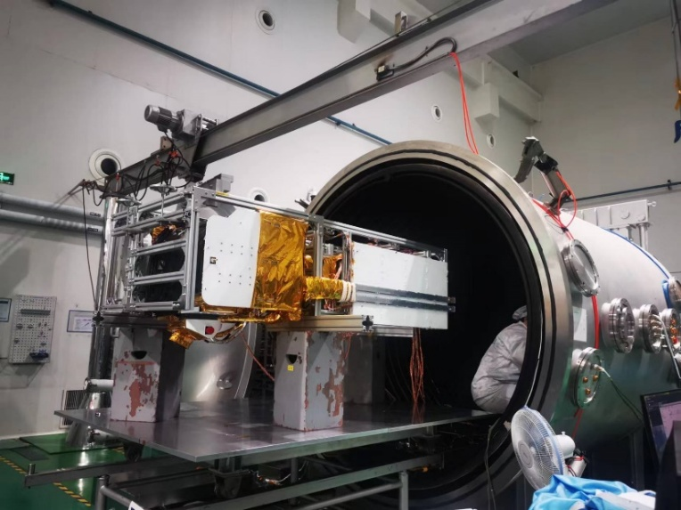
Calibration in progress
OMS-N is installed on the turntable
Radiometric Calibration within Vacuum Systems
Preparation of Vacuum Conditions for Spectral Calibration
Notes:
As shown in the pictures, the OMS-N is installed on the turntable, which is an important step for calibration. We also prepared vacuum conditions for all calibration
These experimental setups are made to simulate the real working environment of the instrument in space as closely as possible, so we can get more dependable calibration results.

Slide 10
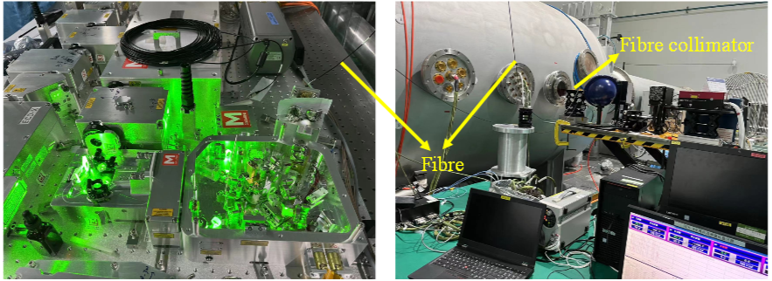
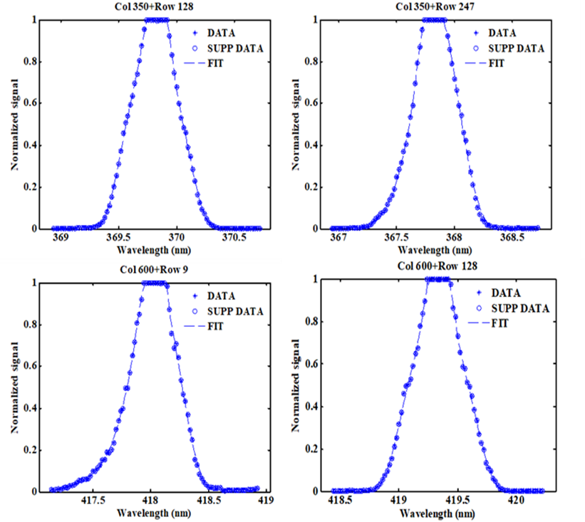
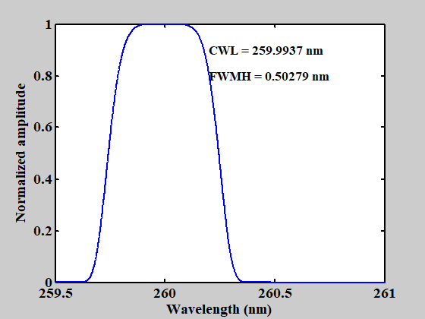
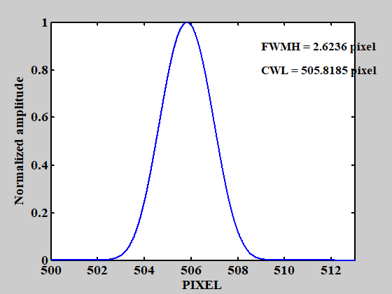
Calibration results
Method
A narrow spectral line is tuned in small steps.
During tuning, the signal of each individual pixel is followed as the laser scans over this pixel. This is the Instrument Spectral Response Function (ISRF) for each pixel.
ISRF is function fitted iteratively
ISRF for one pixel
Notes:
The method for obtaining the spectral response function is as follows.
We tune a narrow spectral line in small steps. As the laser scans over each pixel, we monitor the signal of that individual pixel.
This data is used to obtain the Instrument Spectral Response Function (ISRF) for each pixel by fitting through a function. This approach allows us to precisely measure the spectral response characteristics of each pixel of the instrument.
This graph shows the ISRF for one pixel. For example, at a central wavelength (CWL) of 259.9937 nm, the full (FWMH) is 0.50279 nm.
These spectral response data help us accurately understand the instrument's spectral info..

Slide 11
Calibration results
250nm
280nm
320nm
13pixel
13pixel
11pixel
310nm
400nm
495nm
SMILE
10pixel
8pixel
10pixel
Notes:
While doing the spectral calibration, we also noticed the SMILE effect.
This happens because OMS-N has a large optical FOV.
Each wavelength shows different characteristics in shape, which reflects the instrument's performance in different spectral ranges.
and different wavelength have different Bending value，the max value is 13 pixels

Slide 12
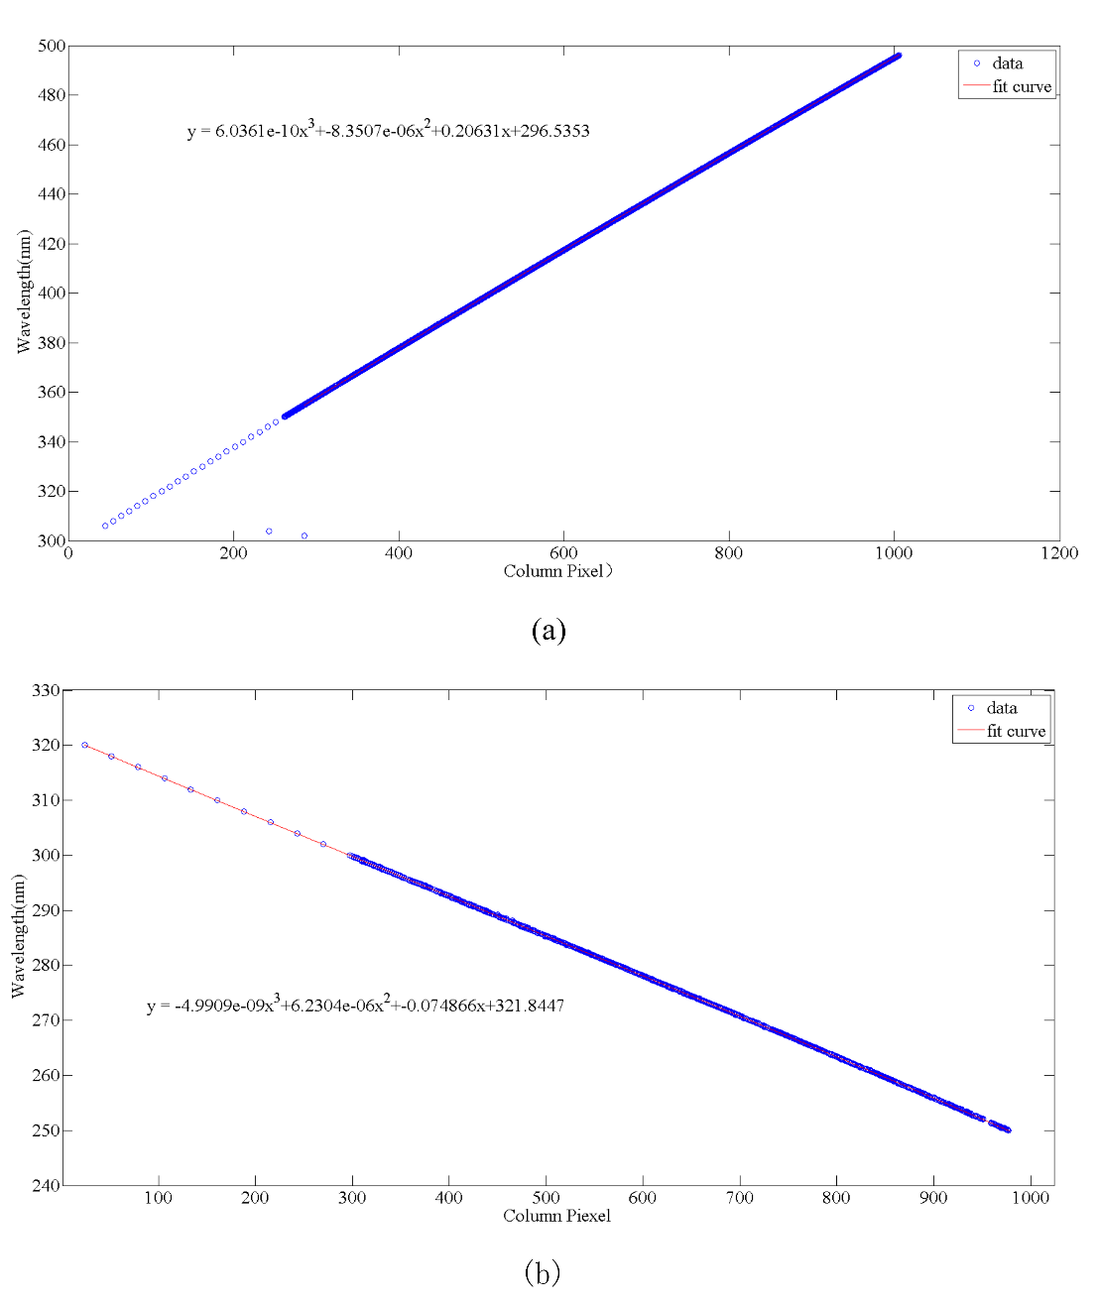
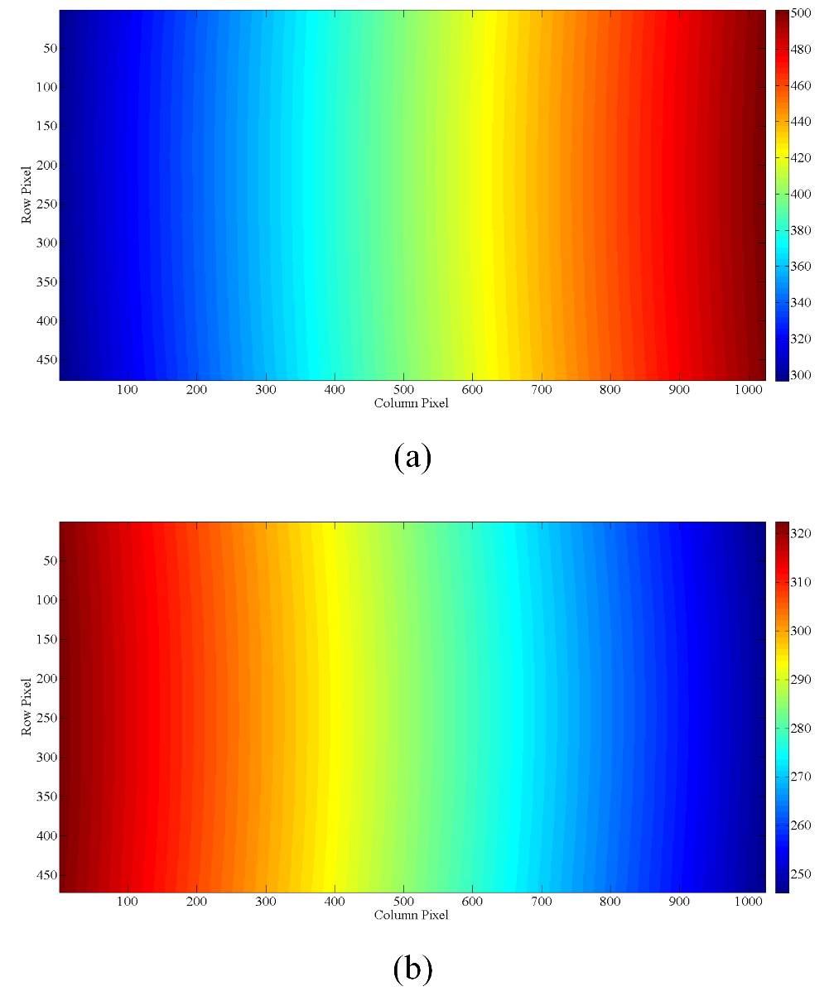
Calibration results
Wavelength map
OPO laser
Wavelength equation
Notes:
We have obtained the wavelength equation and wavelength map through calibration.
The points in the box area were tested by an OPO laser
The wavelength equation is used to calculate the relationship between the pixel position and the corresponding wavelength for one sptral row。
while the map shows Wavelength distribution for all sptral rows .

Slide 13
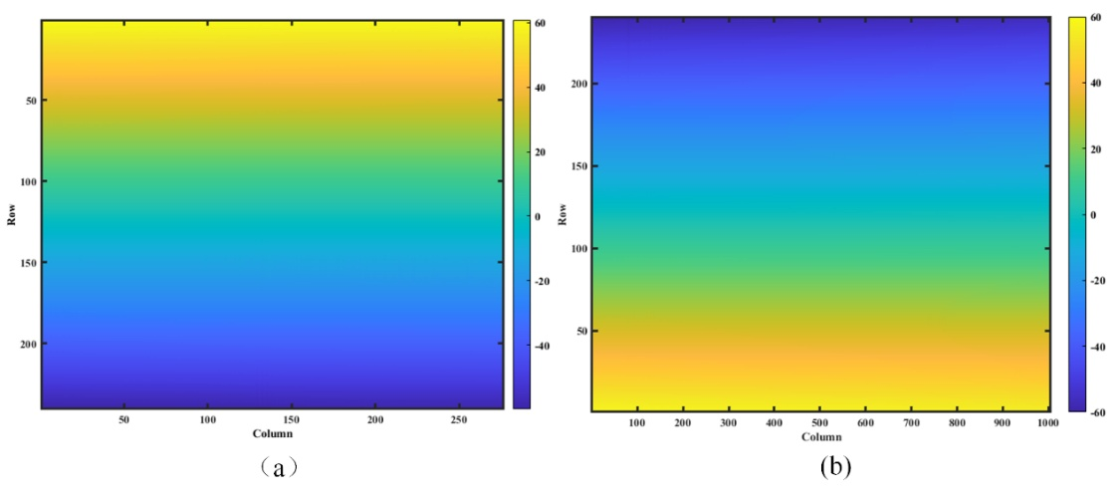
Calibration results
Method
The OMS-N is mounted on the two-dimensional angle adjustment table.
A large-aperture Ultraviolet Collimator Illuminate the OMS-N from multiple small angles.
For each across-track angle, have different pointing angles, we test the angles in along-track by small-angle scanning
Notes:
To measure the spatial function, the OMS-N is mounted on a turnable table.
A UV collimator illuminates the OMS-N from multiple small angles.
For each across-track angle, we set different pointing angles and do small-angle scanning along the track.
This method helps us understand the spatial response characteristics of the instrument
The graphs show the results of the spatial function test.
They show how the instrument reacts to different angles in space, which is key for figuring out the exact position and resolution of the targets.

Slide 14
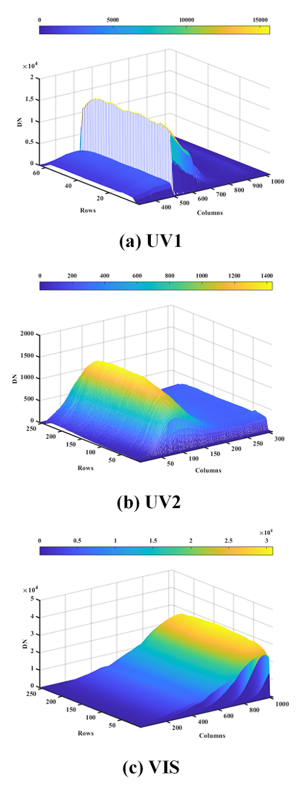
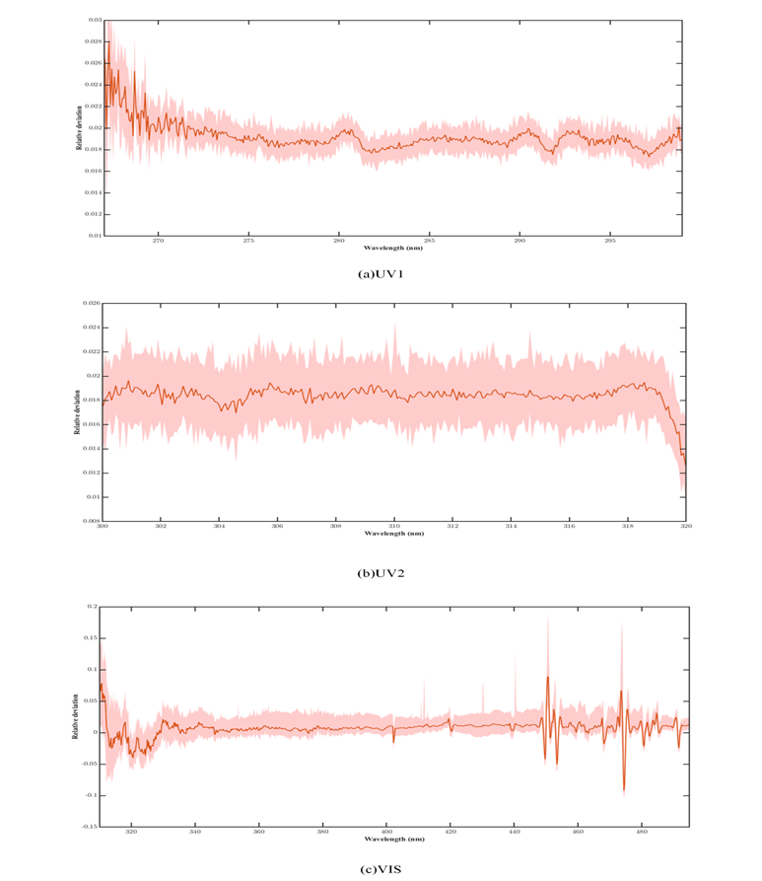
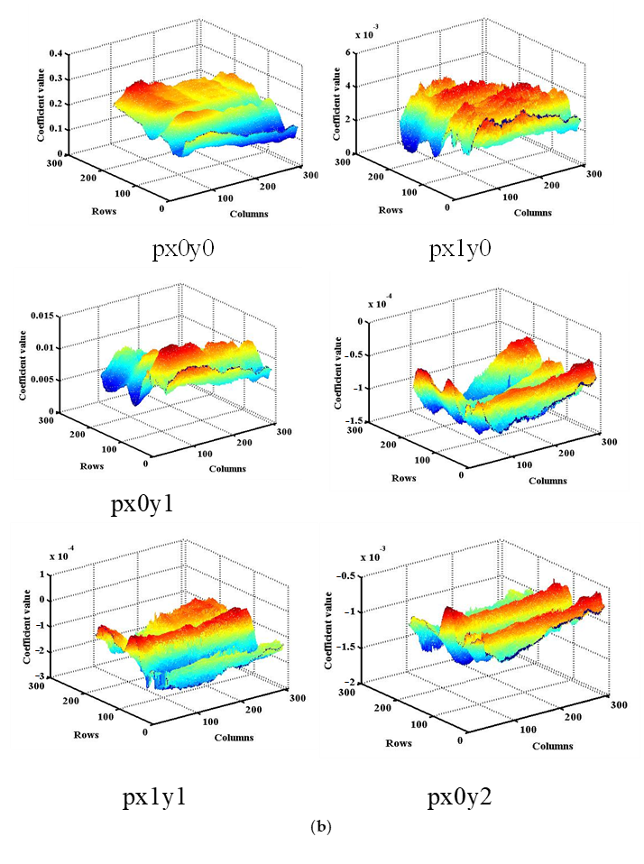
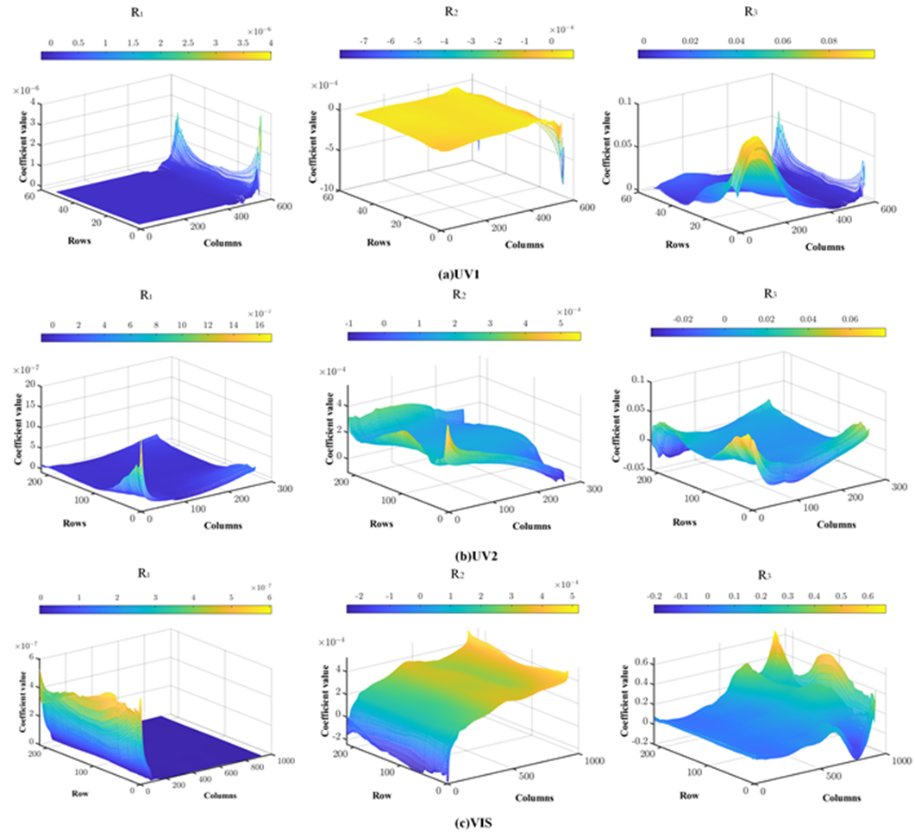
Calibration results
Method
A 400mm variable-intensity integrating sphere was used for radiance calibration of OMS-N.
The solar simulator used for irradiance calibration of OMS-N ,by illuminating solar port with different alpha and beta angles.
The fitted surface depicts the correlation between the irradiance and various α and β angles
Notes:
For radiance calibration of the OMS-N, a variable-intensity integrating sphere was used.
For irradiance calibration, a solar simulator was employed by illuminating the solar port with different alpha and beta angles.
The fitted surface shows how irradiance relates to these angles, which is crucial for accurately calibrating the instrument's radiometric performance.
These graphs present the radiometric calibration results for different bands (UV1, UV2, and VIS).
They show how DN relates to row and column positions, as well as its connection with wavelength and different angles.
These results help us accurately quantify the radiometric performance of the instrument.

Slide 15
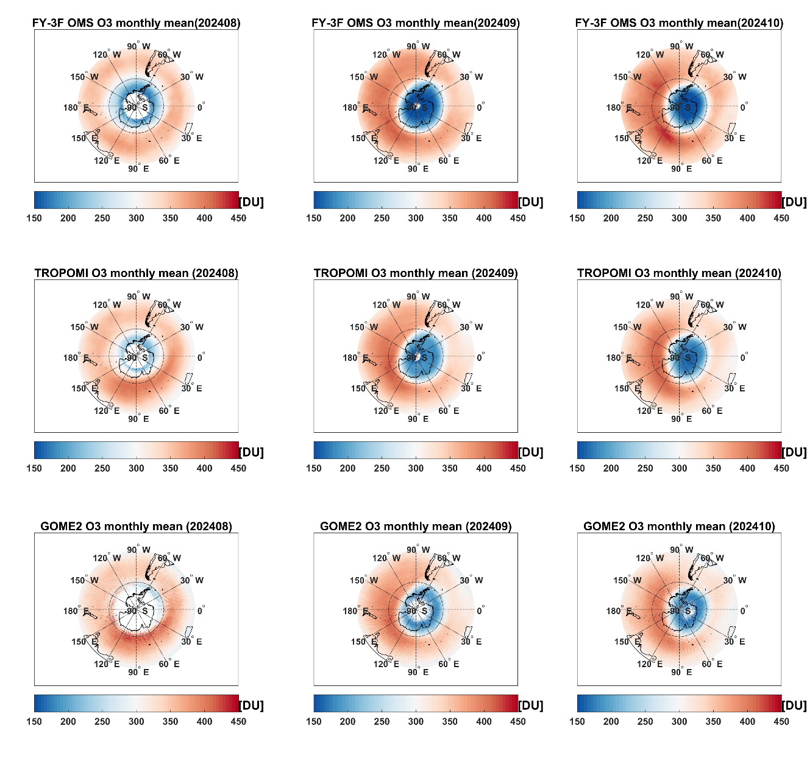
Calibration results
conclusion
The calibration data has been used in L1b and L2 data processing
Further correction in orbit need to do in future.
Total Ozone Column over the Antarctic pole observed by OMS-N, TROPOMI, and GOME-2B. The comparisons are plotted for August, September, and October of 2024, respectively.
（Xu, Wang, Chen, et al., Science China Earth Sciences, under review）NSSC and CMA
Notes:
The calibration data has been applied in the L1b and L2 data processing.
However, we also recognize that further in-orbit correction is needed in the future.
This means that while we've made some progress in calibration, there's still more to do to keep the instrument running accurately over the long term.
Here are some products examples of the OMS-N.
For instance, we can observe the total ozone column over the Antarctic pole using data from the OMS-N, TROPOMI, and GOME-2B last year.
These three aspects are pretty consistent when it comes to time and space.

Slide 16
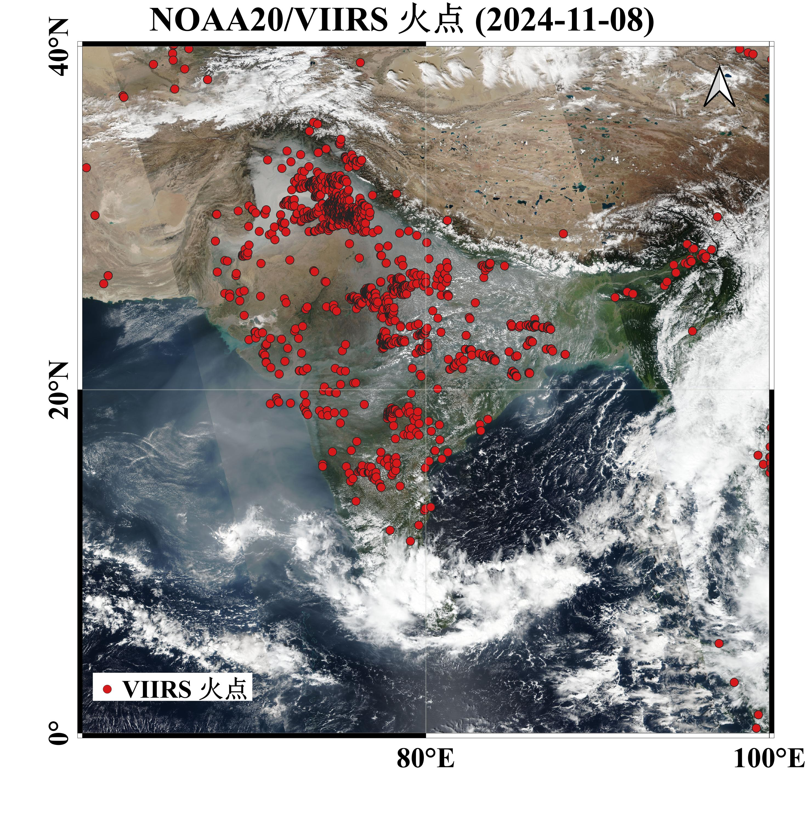
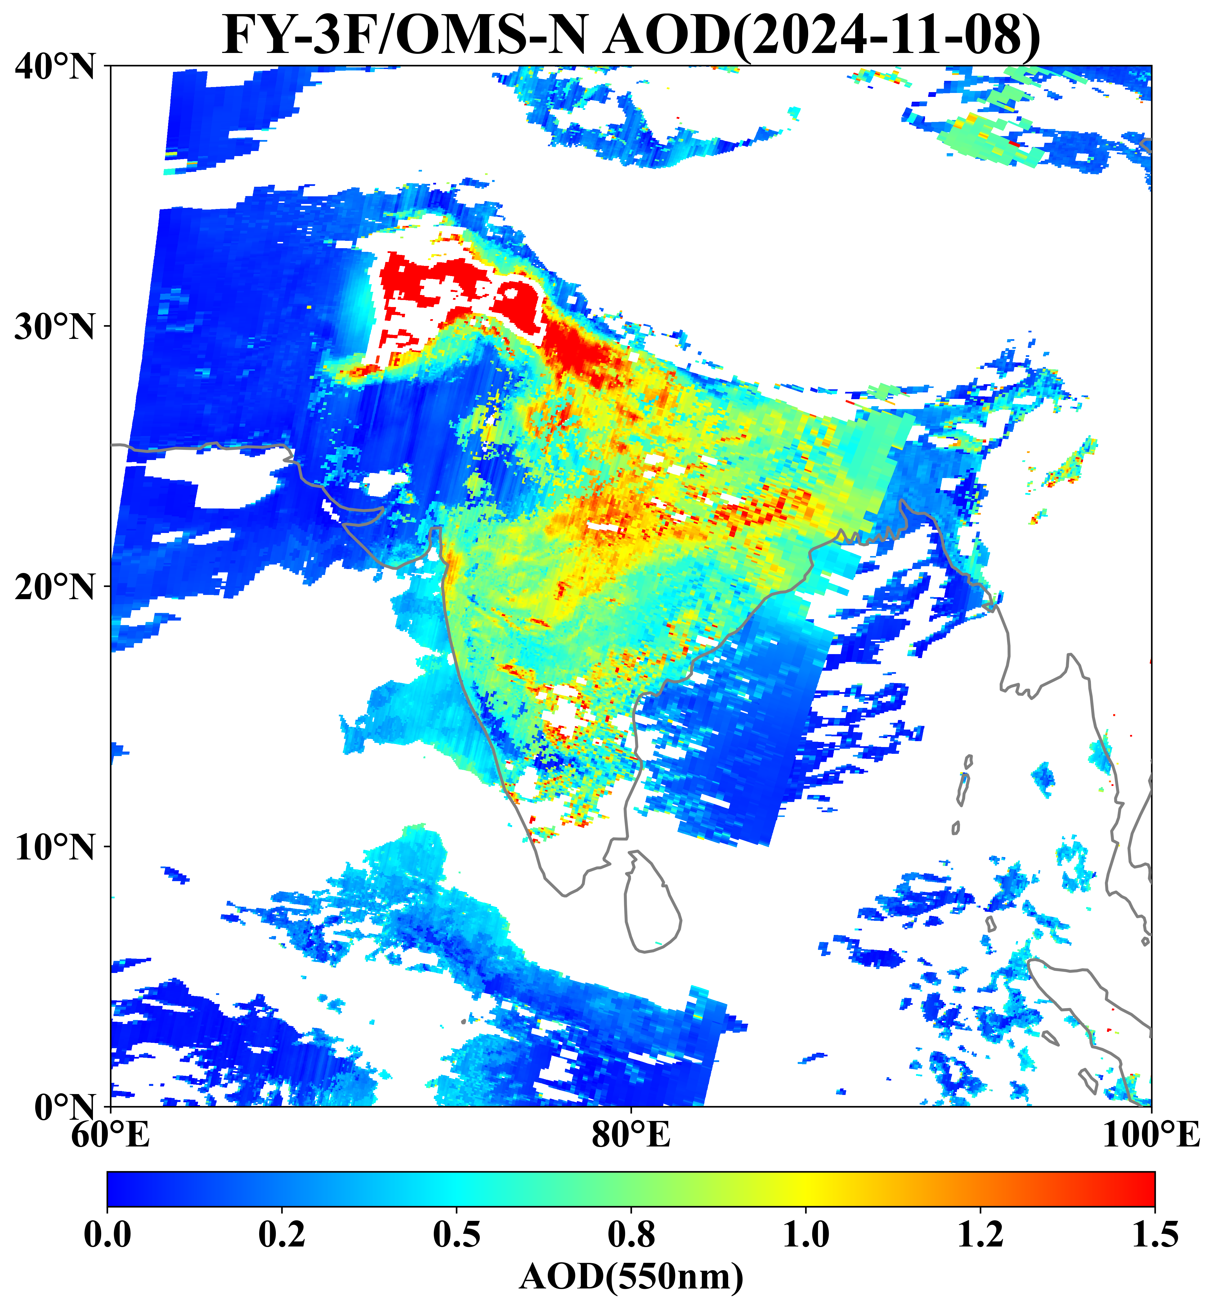
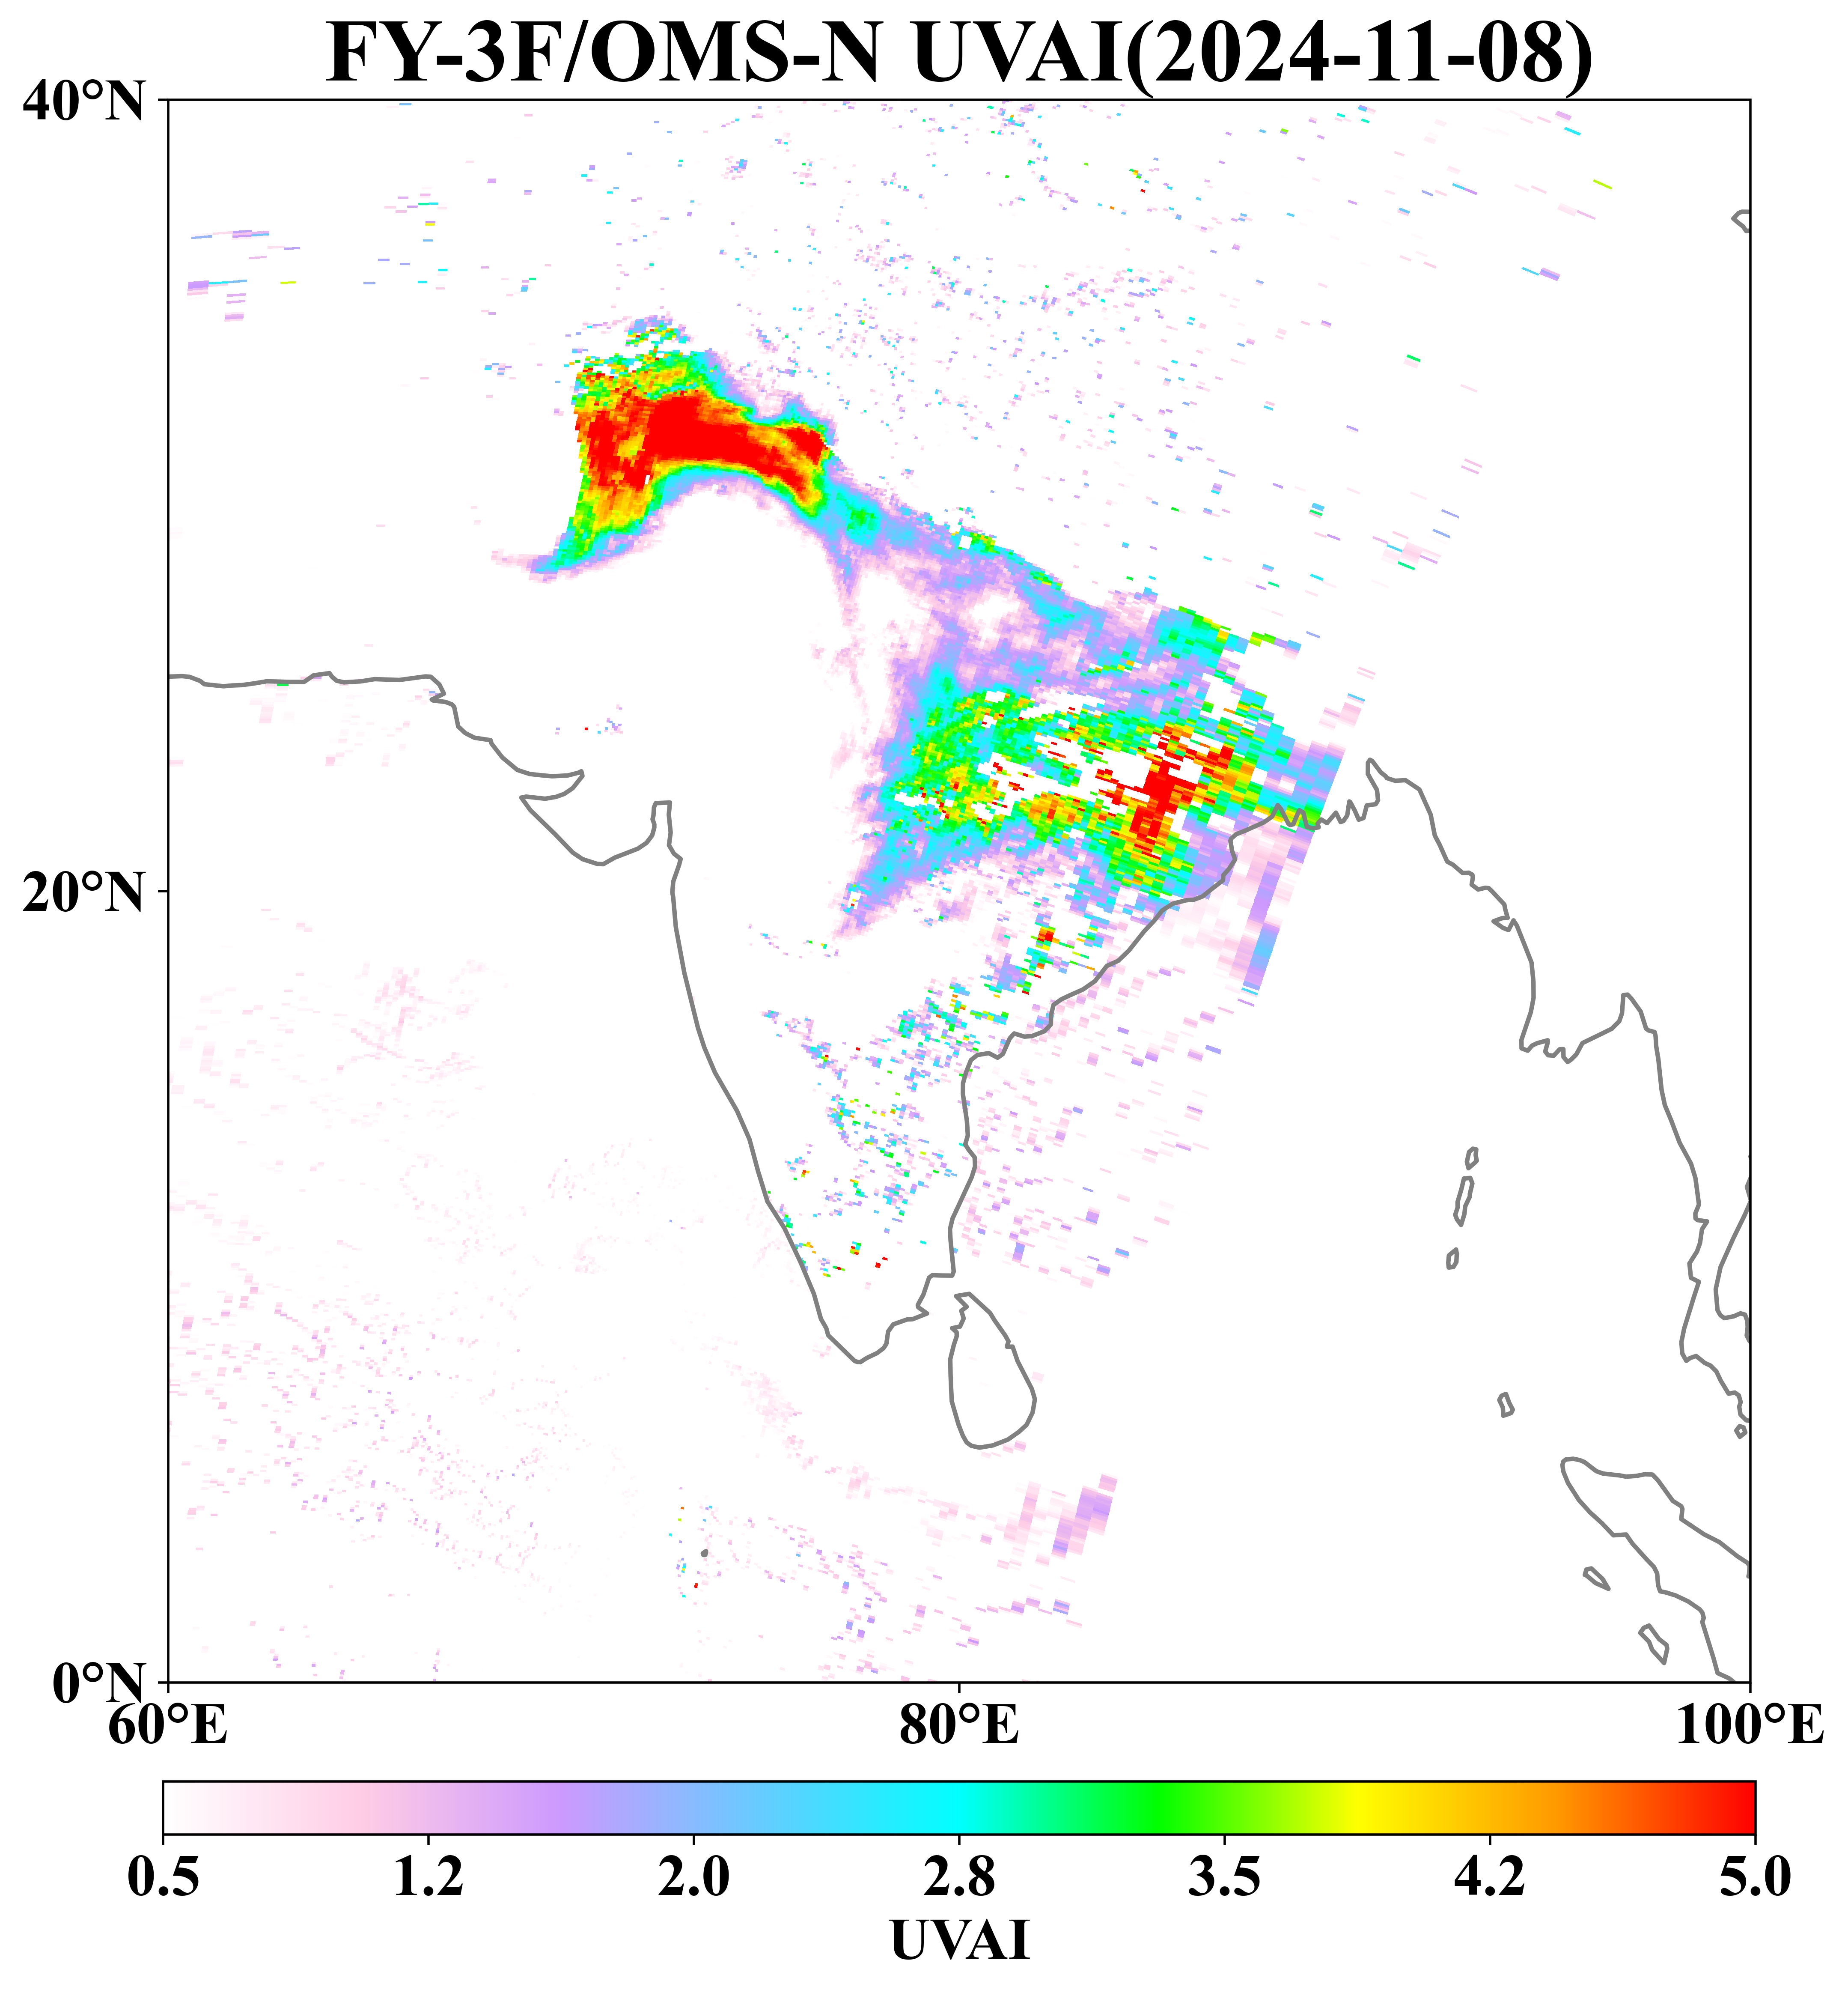
Calibration results
Systematic Surveillance and Analysis of Large-scale Crop Residue Burning in India on November 8, 2024
Meng Fan , et al. Aerospace Information Research Institute, Chinese Academy of Sciences(AIRCAS)
Notes:
In addition, We can also monitor and analyze large-scale crop residue burning in India.
The comparison with the true-color fire point image shows that OMS-N's aerosol product is highly consistent.

Slide 17
Thank You
Contaction
maojinghua@nssc.ac.cn
National Space Science Center, Chinese Academy of Sciences
Notes:
Thank you all for your attention. If you have any questions, please contact me with email.
Thank you again for your participation in this meeting.

