Slide 1
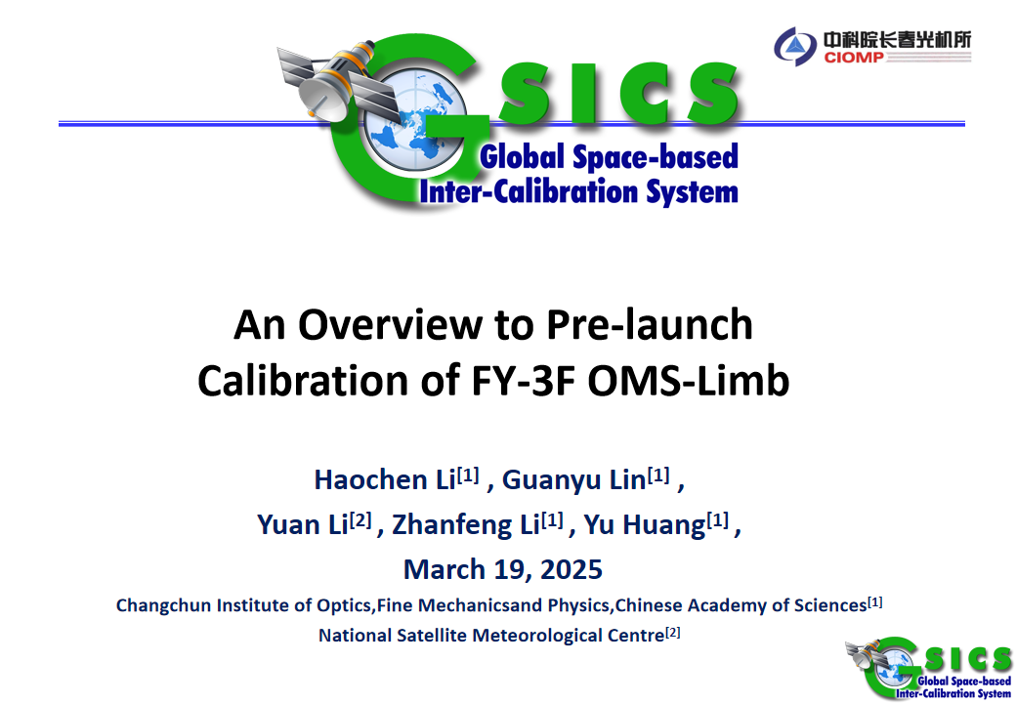
Notes:
Good morning,distinguished professors. I am Li Haochen from the CIOMP. The topic of my report today is An Overview to Pre-launch Calibration of FY-3F OMS-Limb.

Slide 2
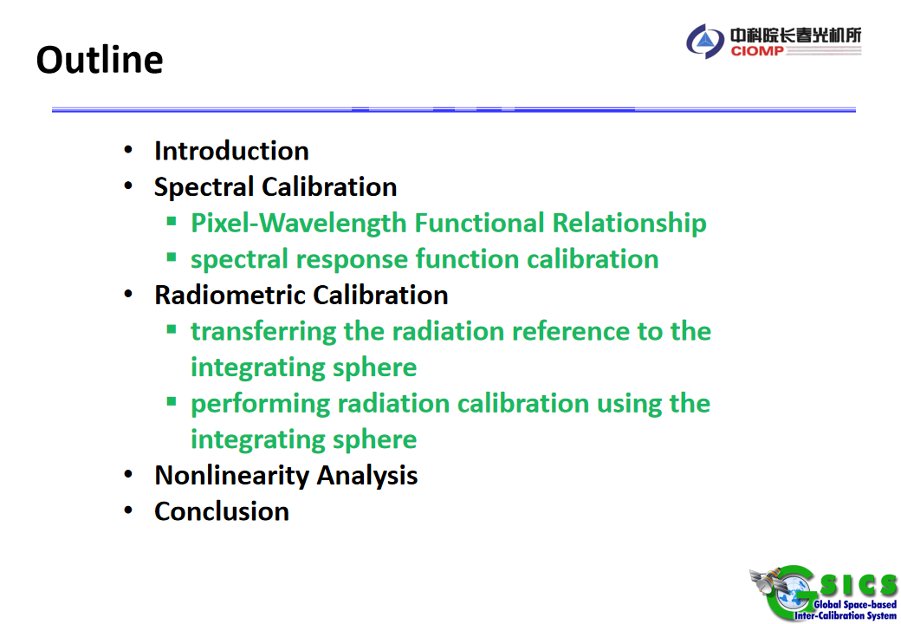
Notes:
This is the outline of my report today.

Slide 3
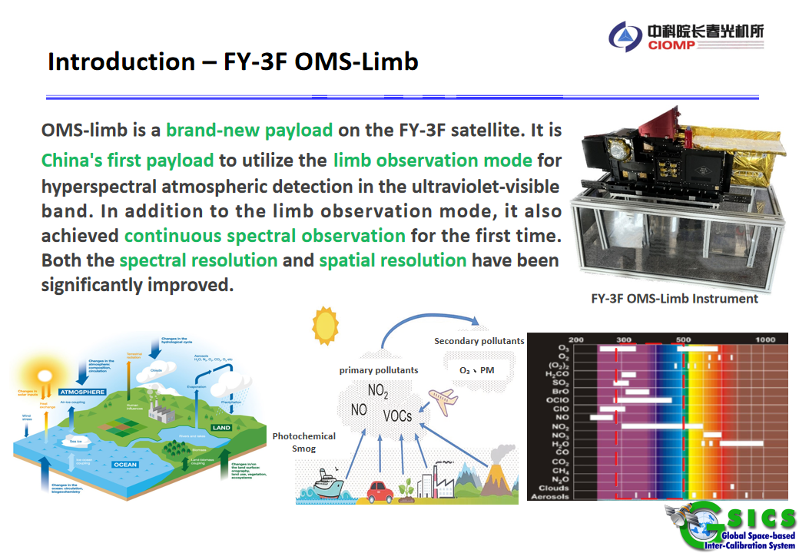
Notes:
It retrieves vertical profiles of Ozone、Nitrogen dioxide、Sulfur dioxide, and stratospheric aerosols.

Slide 4
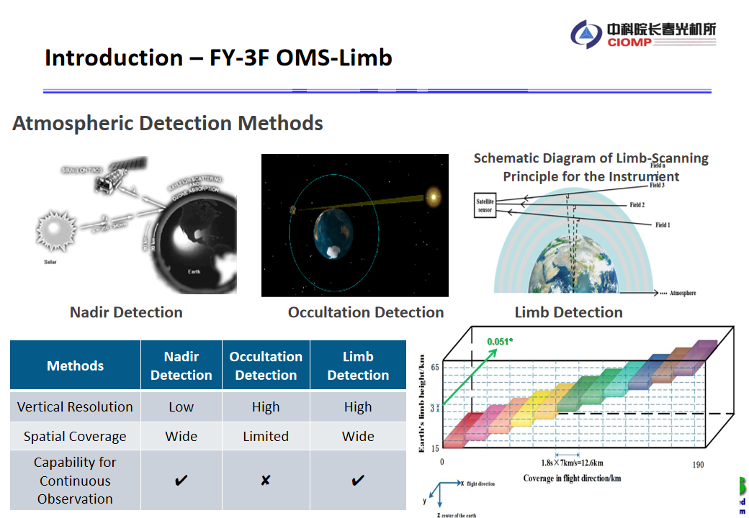
Notes:
Currently, there are three main detection methods used in space remote sensing instruments: nadir, occultation, and limb.
Limb detection has several advantages over the other two.
For example, it provides higher vertical resolution, broader spatial coverage, and continuous observation capability.
The figure in the bottom-right corner clearly shows the detection method of OMS-limb. The scanning mirror performs detections at intervals of 0.051 degrees (corresponding to 3km for spatial resolution). Fifteen detections cover the limb altitude range of 15-60 km.

Slide 5
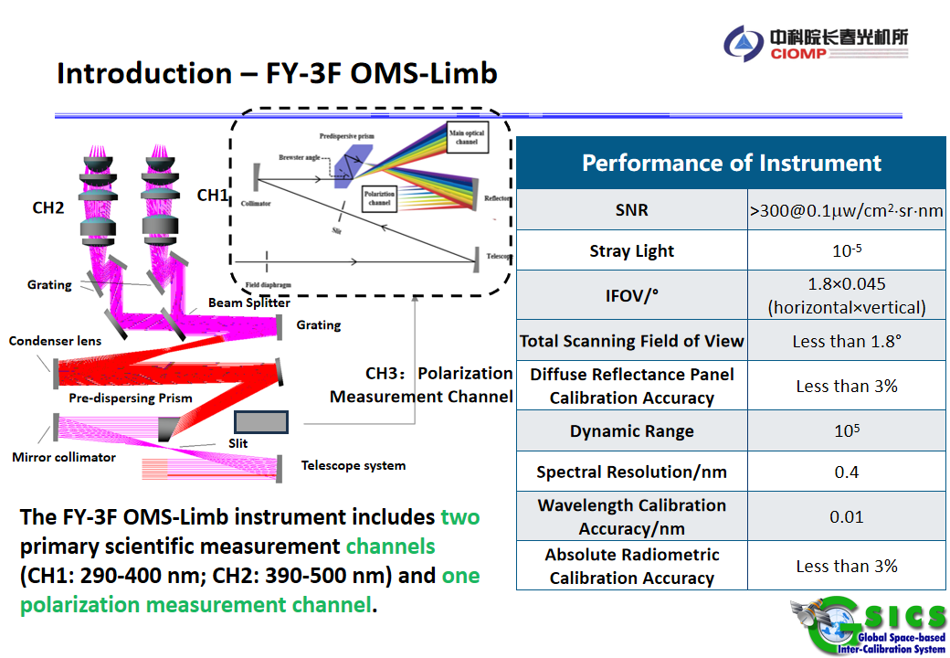
Notes:
And OMS-Limb has three channels in total.
Two of them are main science channels: one covers the wavelength range from 290 to 400 nm, and the other covers the range from 390 to 500 nm.
The last channel is the polarization measurement channel.
The table on the right shows the Performance of OMS-limb
.

Slide 6
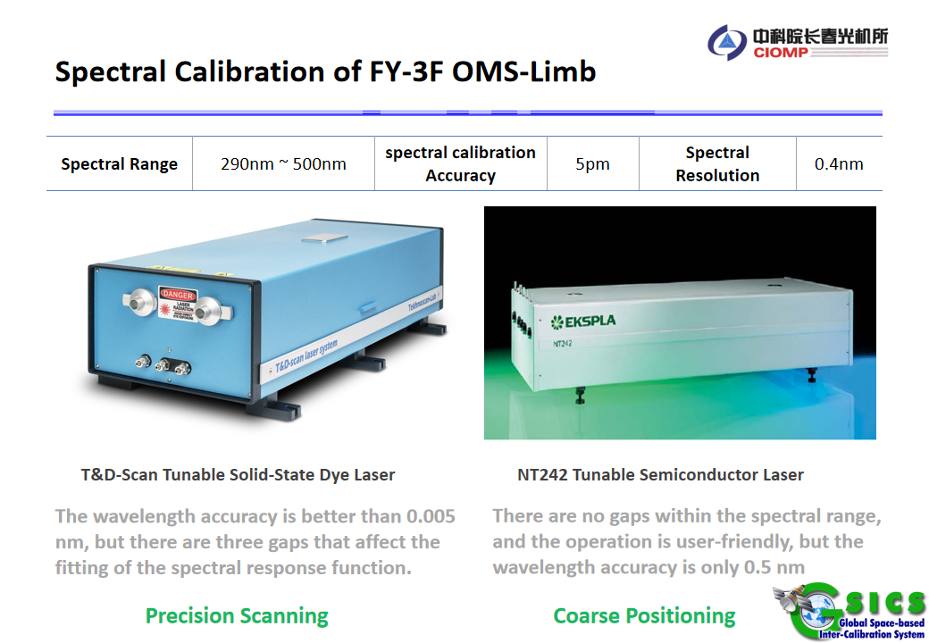
Notes:
OMS-Limb has a spectral calibration accuracy of 5 picometers. Its spectral resolution is 0.4 nm.
The pre-launch spectral calibration of OMS-limb mainly focused on two tasks. The first task was establishing the spectral calibration formula, which relates pixel numbers to wavelengths. The second task was calibrating the instrument's spectral response function.
We used two tunable lasers for spectral calibration . The first one is the T&D-Scan laser which provided precision scanning . The second one is the NT242 tunable semiconductor laser which provided coarse positioning.

Slide 7
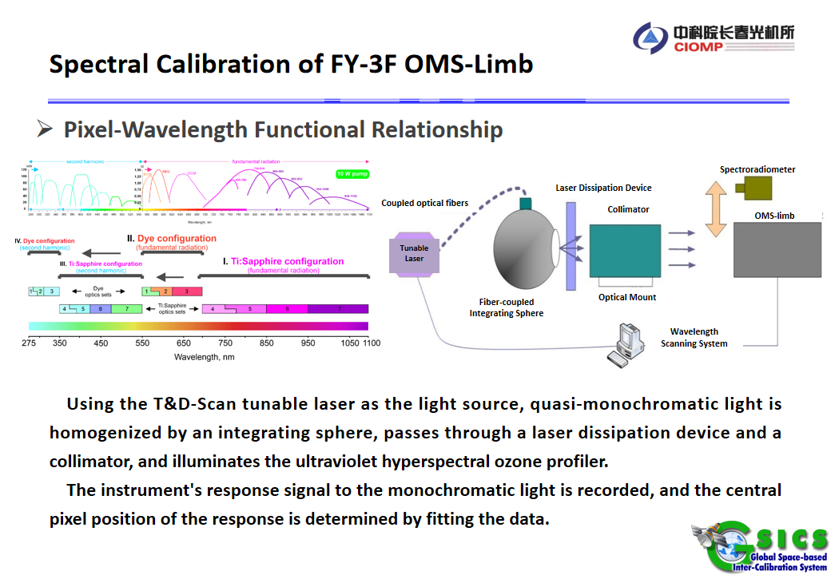
Notes:
To establish the Pixel-Wavelength Functional Relationship, first, we used the T&D laser as the light source.
It outputs quasi-monochromatic light, which is homogenized by an integrating sphere.
Then, the light passes through a laser dissipation device and a collimator to illuminate the instrument .
We recorded the instrument's response signal to the monochromatic light.
By fitting the data, we determined the central pixel position of the instrument's response to the light.

Slide 8
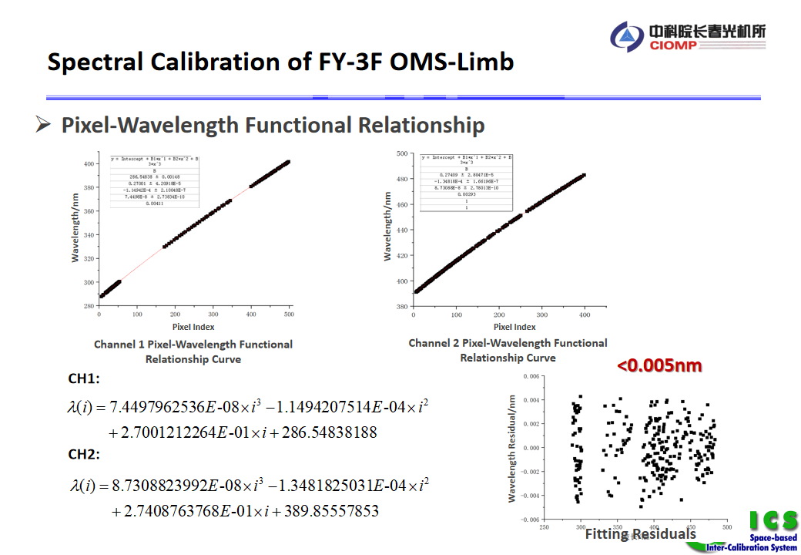
Notes:
We performed fitting on all wavelengths output by the tunable laser, obtaining a series of data points that correlate wavelength with the response center pixel. As shown in the top figures, the spectral calibration formula was derived through polynomial fitting.
Analysis shows that using a third-order polynomial ensures a fitting residual of less than 0.01 nm， achieving high precision.
Due to the operational complexity of T&D laser and the lack of technical support from the manufacturer, the 290-500 nm wavelength range was not fully covered. The missing spectral bands are as illustrated in the figure.
Specifically:
Channel 1 has gaps in the 300-330 nm and 370-380 nm ranges.
Channel 2 has gaps in the 480-500 nm range.
Particularly in the 480-500 nm range, which is at the edge of the spectrum, the lack of data may introduce some errors when extrapolating using the third-order polynomial.）

Slide 9
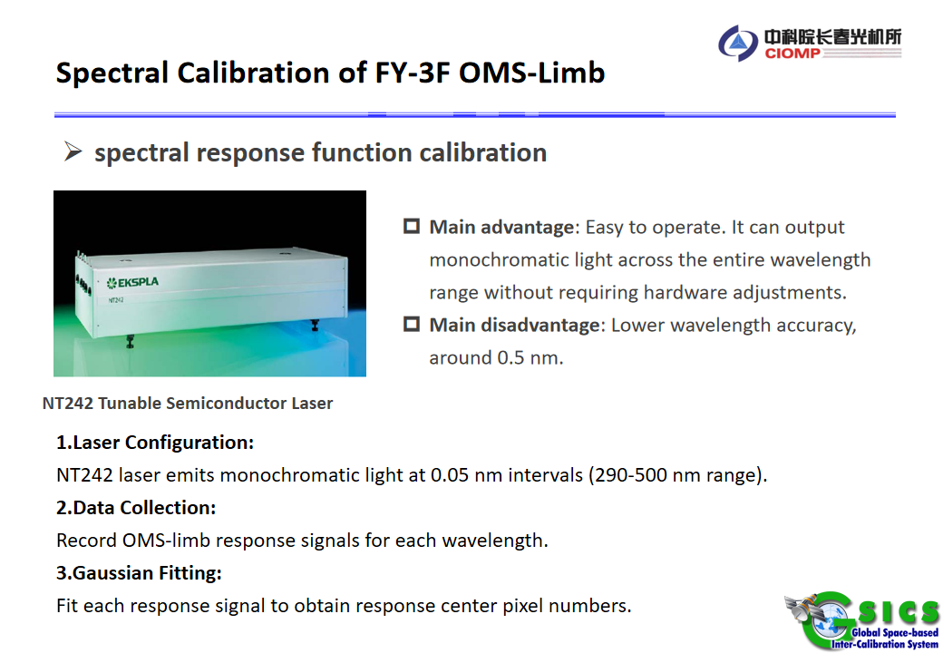
Notes:
Alright, let’s move on to the second part of pre-launch spectral calibration: spectral response function calibration.
Due to control issues with the T&D tunable laser, continuous scanning cannot be achieved. Therefore, the OMS limb spectral response function calibration uses the NT242 tunable semiconductor laser.
The main advantage of this laser system is easy to operate . It can output monochromatic light across the entire wavelength range without hardware adjustments.
However, this laser is deficient in wavelength accuracy, which is only about 0.5 nm.
To address the NT242 laser's wavelength inaccuracy , we optimized the spectral response function calibration data processing.
First, we controlled the NT242 laser to output monochromatic light at 0.05 nm intervals, covering the 290-500 nm range.
For each monochromatic light, we collected the OMS-limb response signal.
We performed Gaussian fitting on each response signal , to obtain a series of response center pixel numbers corresponding to the nominal wavelengths of the NT242 laser.

Slide 10
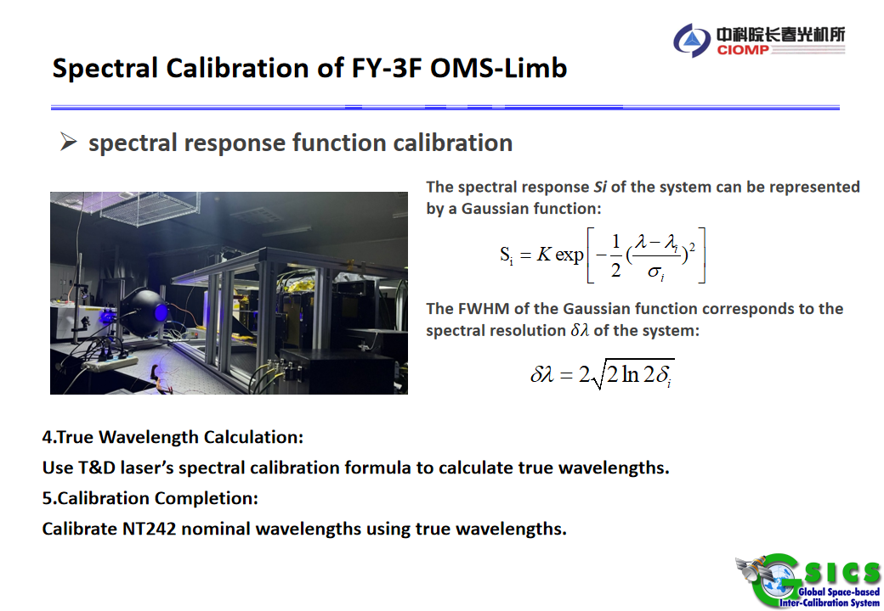
Notes:
Then, by using the spectral calibration formula obtained from the T&D laser, the true wavelength corresponding to the response center pixel number is calculated. The nominal wavelength of the NT242 laser is then replaced with the true wavelength, thereby completing the calibration of the spectral response function

Slide 11
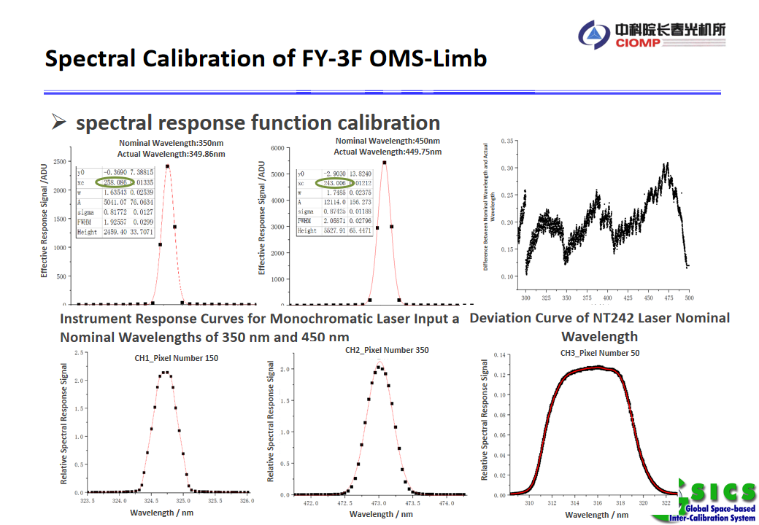
Notes:
Then, by using the spectral calibration formula obtained from the T&D laser, the true wavelength corresponding to the response center pixel number is calculated. The nominal wavelength of the NT242 laser is then replaced with the true wavelength, thereby completing the calibration of the spectral response function

Slide 12
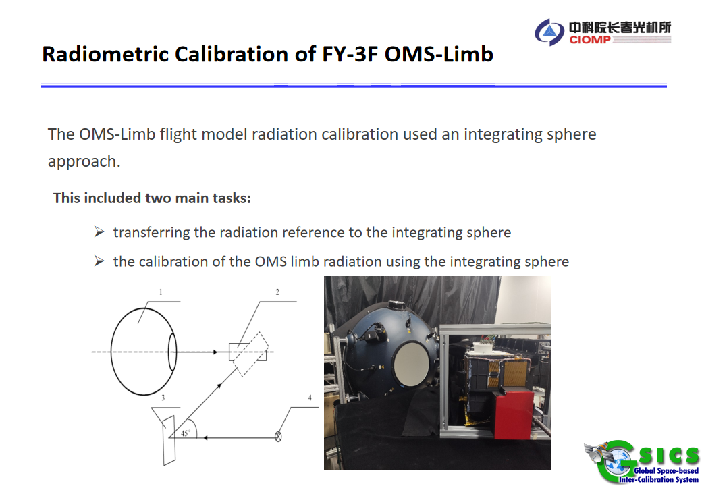
Notes:
The next part is pre-launch radiometric calibration of OMS-limb which used an integrating sphere approach. Since the integrating sphere system itself doesn’t have a standard, the calibration process involves two tasks:First, transferring the radiation reference to the integrating sphere.Second, completing the radiometric calibration of the OMS limb using the integrating sphere.

Slide 13
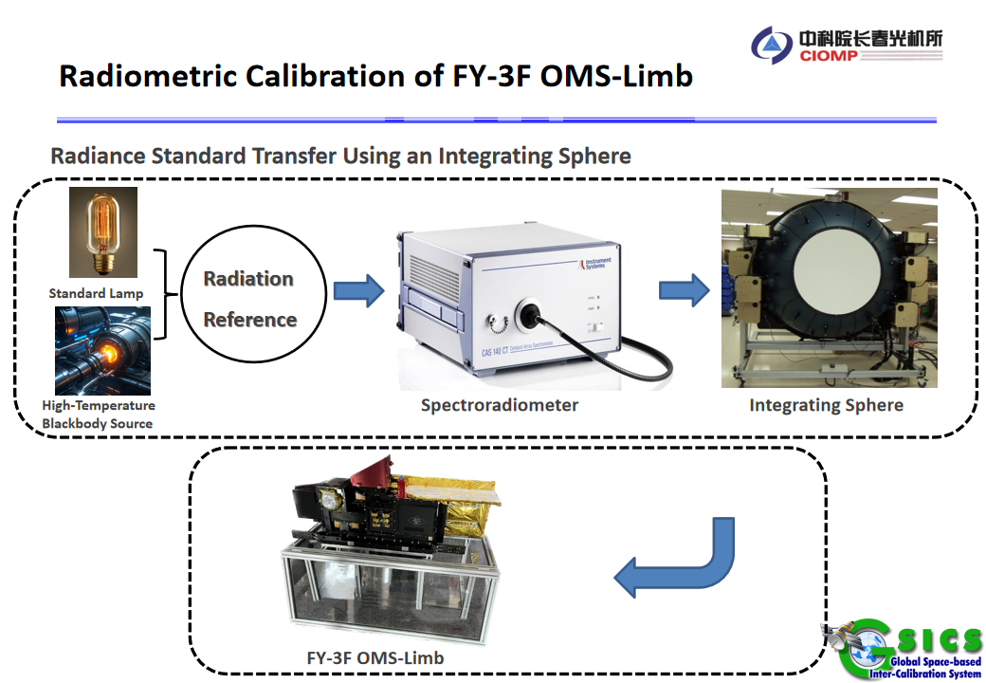
Notes:
The radiation reference is transferred to the integrating sphere in following two steps.
First, the radiation reference is transferred to the Spectroradiometer and then to the integrating sphere system.
We used three types of radiation sources—the NIST standard lamp, the NIM standard lamp, and the NIM high-temperature blackbody—to transfer the radiation reference.

Slide 14
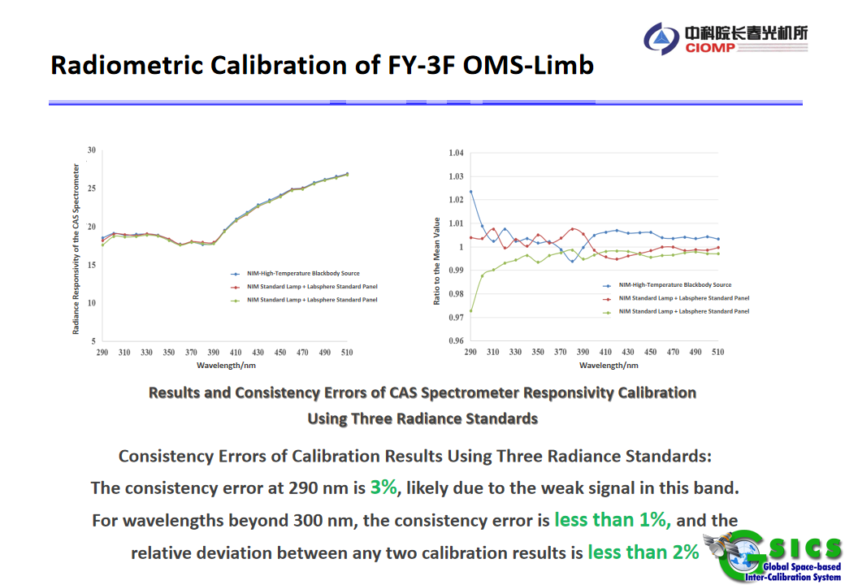
Notes:
The radiance responsivity of the transfer radiometer (CAS spectrometer) calibrated using the three radiation sources is shown in the left figure.The consistency curve is obtained by dividing each result by the average of the three, as shown in the right figure.At 290 nm, the signal is weak, and the error reaches Three percent. Beyond 300 nm, the consistency error is less than one percent, and the relative deviation between any two sources is less than Two percent.
Since the blackbody calibration results from NIM were provided late, our report and data are based on the NIST standard lamp.

Slide 15
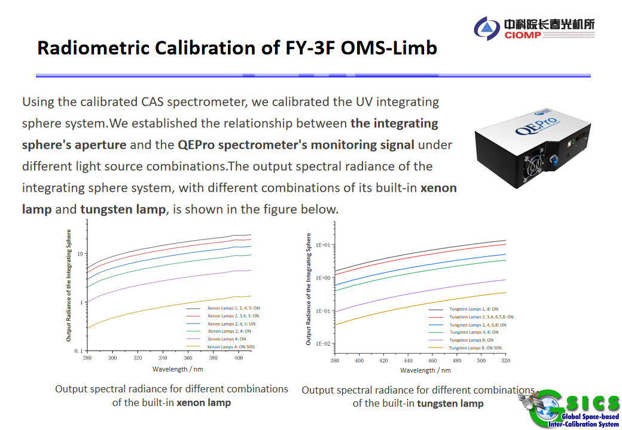
Notes:
The second step is to calibrate the integrating sphere system using the calibrated transfer radiometer.Using the calibrated CAS spectrometer, we calibrated the UV integrating sphere system.We established the relationship between the aperture radiance of the integrating sphere and the monitoring signals of the QEPro spectrometer under different combinations of light sources.The output spectral radiance of the integrating sphere system, with different combinations of its built-in xenon lamps and tungsten lamps, is shown in the figure below. We calibrated the integrating sphere's output radiance under six different light source combinations.Until now, we completed the radiation reference transfer to the integrating sphere.

Slide 16
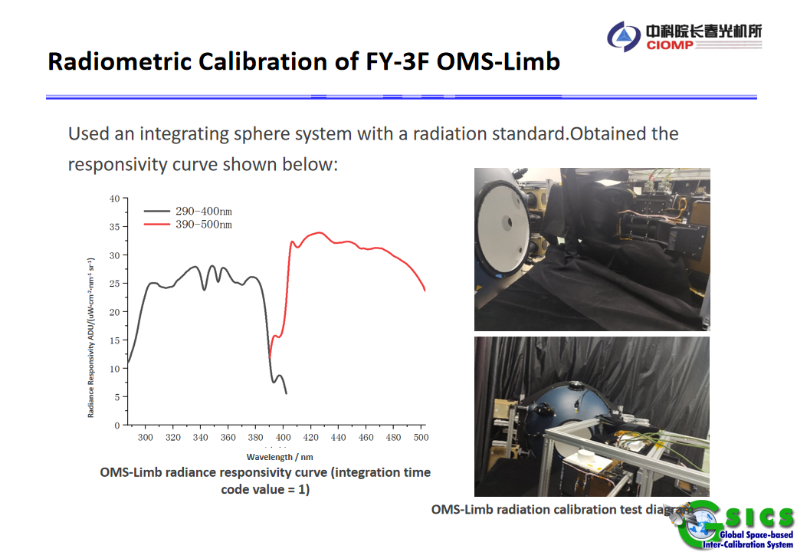
Notes:
We performed radiometric calibration on OMS-limb using the integrating sphere system with radiation reference.Based on the output signal of OMS-limb, we selected the radiance of the integrating sphere's built-in xenon lamp number 4 for Channel 1, and the radiance of the tungsten lamp number 8 for Channel 2. After preprocessing the OMS limb signals as described above, we divided them by the integrating sphere's radiance to obtain the responsivity of the detection channels, as shown in the figure.

Slide 17
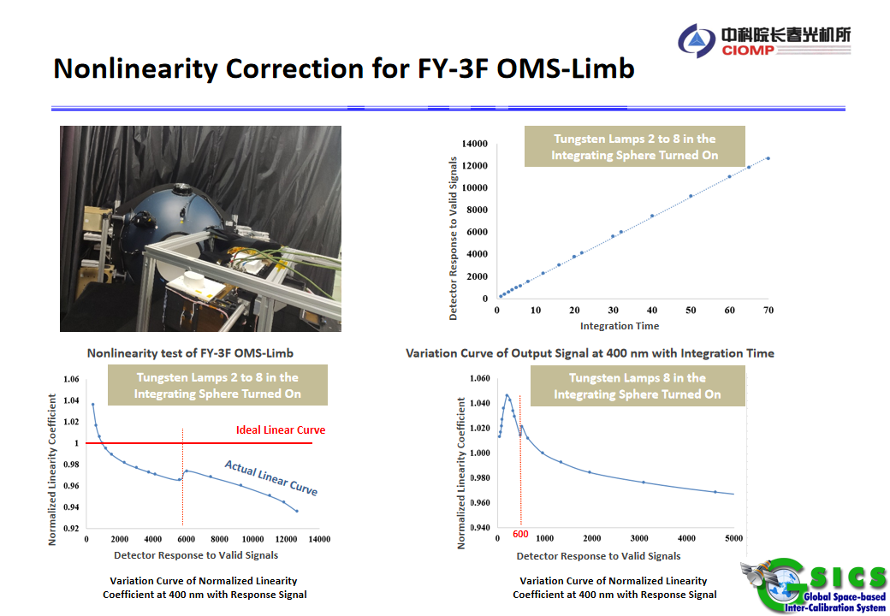
Notes:
Next, I will introduce the nonlinear correction for the OMS-limb.
First, we used an integrating sphere to output a stable light signal. By changing the detector's integration time, we generated signals of different luminance, as shown in the upper right figure.
To check if the response is linear, we normalized the response signals by integration time.
Ideally, a linear response curve would be a straight line with a value of 1, shown as the red line in the bottom-left figure.
However, the actual response curve of the detector is the blue line, which shows nonlinearity across the entire signal range.
Although this is unusual, it doesn't prevent us from building a nonlinear correction function.
One issue is that there is a jump point on the left side of the signal value 6000. To check if the jump point is related to the signal, we calculated the linear response curves for other tungsten lamp brightness settings.
We found that the jump point occurs at inconsistent signal values. For tungsten lamp eight , the jump point appears around a signal value of 600, as shown in the bottom-right figure.
Since the jump point is not related to the signal, we wondered if it's related to the integration time. Therefore, we changed the x-axis from signal value to integration time.

Slide 18
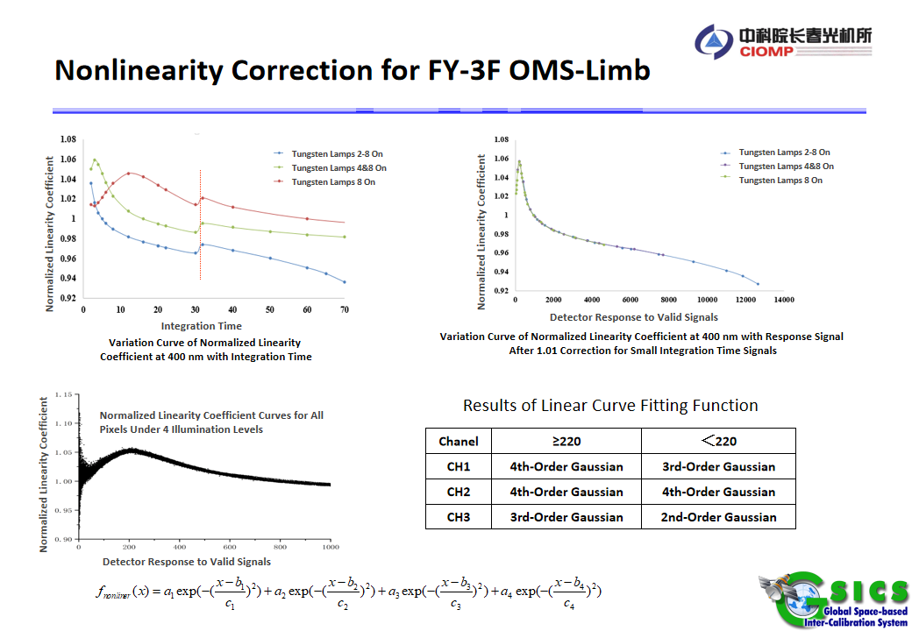
The frame period time
Notes:
The results are shown in the top-left figure. The jump points all appear between integration time from 30 to 32.
After analysis, we found that the jump points are likely caused by differences in control timing for integration time greater than or equal to 32 and less than 32.
We confirmed that the jump points are related to integration time. To accurately fit the response linearity curve, we must correct for these jump points.
The correction method involves multiplying signals with integration time less than 32 by a constant. Through testing, we found that using 1.01 works best, as shown in the figure on the right.
After correction, there are no obvious jump points, and the linearity curves for different brightness levels almost overlap.
After correcting the jump points, the next step is fitting the normalized linearity curve.
The fitting uses data from all pixels under four brightness levels, as shown in the bottom-left figure. We used a piecewise Gaussian function for fitting, with a maximum of 4th-order Gaussian functions.
The functional form is shown in the equation below.

Slide 19
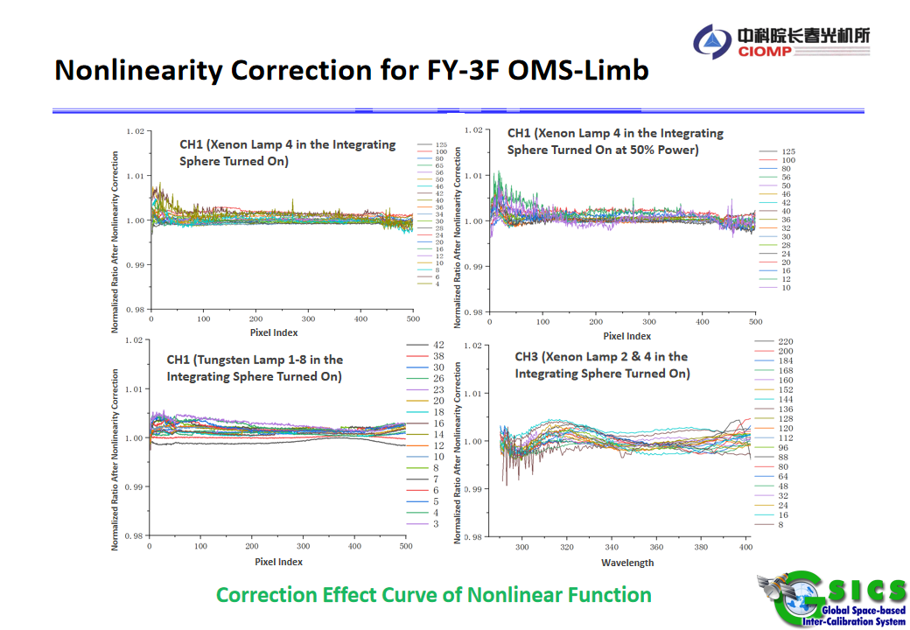
Notes:
We used the fitted nonlinear correction function to verify its effectiveness on data not included in the fitting process.
The results are shown in the figure. Most of the nonlinear residuals are less than 0.5 percent.
At the edges of the band, where the signal is weaker, the nonlinear residual error is less than 1 percent.
Overall, The results are quite good.

Slide 20
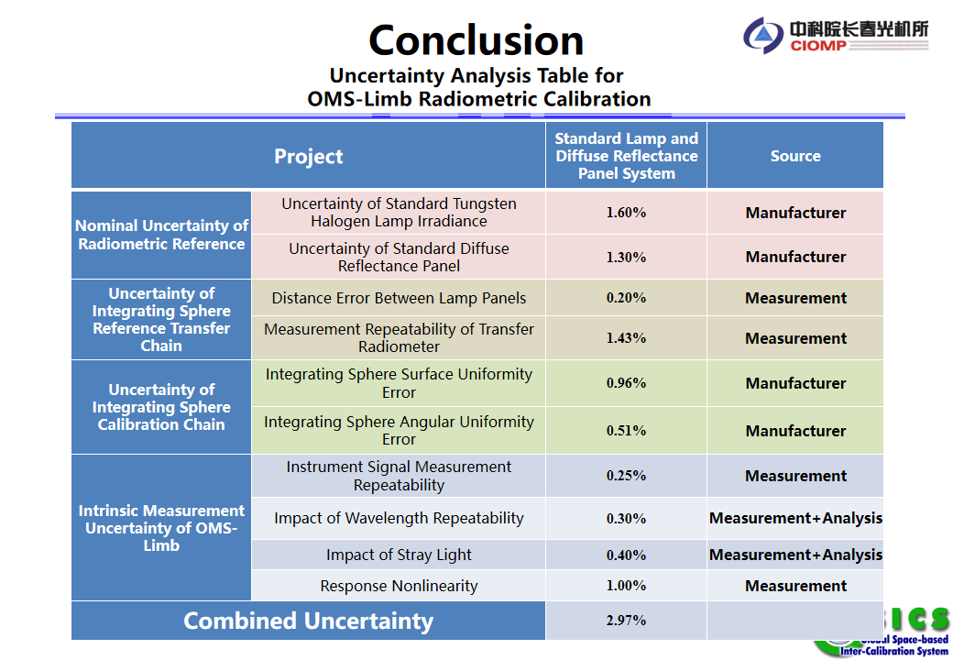
Notes:
We have individually analyzed the Nominal Uncertainty of Radiometric Reference, the Uncertainty of Integrating Sphere Reference Transfer Chain, the Uncertainty of Integrating Sphere Calibration Chain, and the Intrinsic Measurement Uncertainty of OMS-Limb. Through these calculations, we have derived the combined uncertainty.The combined uncertainty of OMS-Limb radiometric calibration is calculated to be approximately 3%

Slide 21


