Slide 1
Microwave Radiometer Technology and Instrument Pre-Launch Testing and Post-Launch Characterization (TT) Focus Group Report 2025
Dazhen Gu (NIST) and Juyang Hu (CMA), Co-Chair
03/19/2025

Slide 2
Focus Group Assembly
Solicitated and recruited members in June 2024
Eight members including two co-chairs:
  Jon Mittaz (University of Reading)
  Fennig Karsten (German Weather Service DWD)
  Tiger Yang (University of Maryland)
  Raffaele Crapolicchio (ESA)
  Shengli We (China Meteorological Administration)
  Tim Hewison (EUMETSAT)
  Juyang Hu (China Meteorological Administration)
  Dazhen Gu (National Institute of Standards and Technology)

Slide 3
Focus Group Meetings
Held three meetings on 7/31/2024, 11/12/2024 and 2/17/2025
Meeting 1 on 7/31/2024
  Four group members attended and discussed potential topics
Meeting 2 on 11/12/2024
  Seven group members and two guests attended
  Refined the focus group topics
  NASA guest Alexandra Bringer presented talks on RFI
Meeting 3 on 2/17/2024
  Seven group members attended and discussed progress on group topics
  Tiger Yang presented a talk on mitigation of 1/f noise and thermal noise

Slide 4
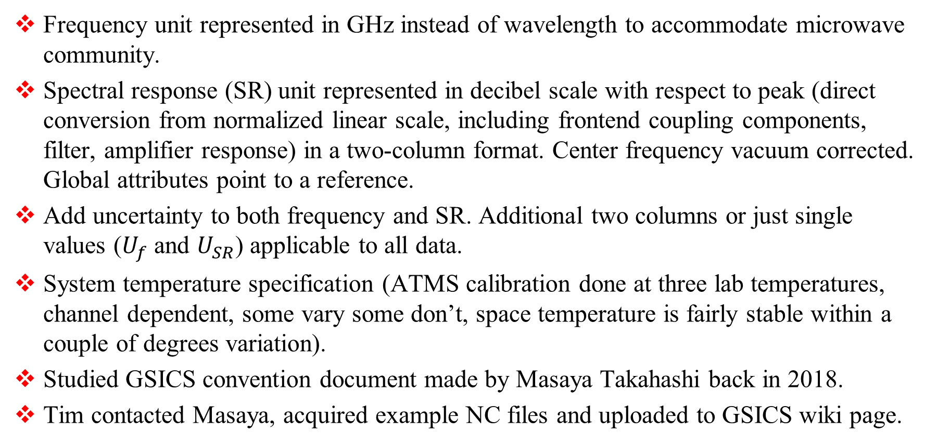
Focus Group Topic 1 – SRF netCDF Convention
Frequency unit represented in GHz instead of wavelength to accommodate microwave community.
Spectral response (SR) unit represented in decibel scale with respect to peak (direct conversion from normalized linear scale, including frontend coupling components, filter, amplifier response) in a two-column format. Center frequency vacuum corrected. Global attributes point to a reference.
Add uncertainty to both frequency and SR. Additional two columns or just single values ($U_{f}$ and $U_{SR}$) applicable to all data.
System temperature specification (ATMS calibration done at three lab temperatures, channel dependent, some vary some don’t, space temperature is fairly stable within a couple of degrees variation).
Studied GSICS convention document made by Masaya Takahashi back in 2018.
Tim contacted Masaya, acquired example NC files and uploaded to GSICS wiki page.

Slide 5
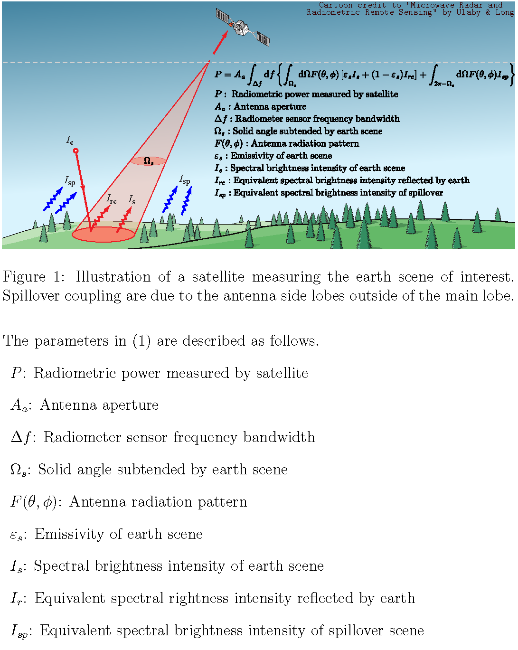
Focus Group Topic 2 – Antenna Effects in netCDF
Antenna effects in space radiometer measurements (recommendation of best practice).
  Main lob, side lob and back lob illumination
  Polarization
  Array effects??
Started a collaborative document development on Overleaf.
Welcome other GSICS members to contribute.

Slide 6
Focus Group Topic 3 – System NEP and NEΔT (Re)Definition
Originated from optics community for photon detectors.
Clear confusions.
Address the lack of mathematical precision and generality.
Establish link to fundamental physical quantities.

