Slide 1
Monitoring of FY-3 Microwave instruments' performances using radiative transfer models and NWP data
Fangli DOU, JuYang HU, Yang GUO, Shengli WU, Jian SHANG
National Satellite Meteorological Centor / CMA

Slide 2
Overview
Background and Motivation
O-B Monitoring of FY-3 MW Instruments
Microwave Sounders
Microwave Imagers
Active Radars
Conclusion and Prospect

Slide 3
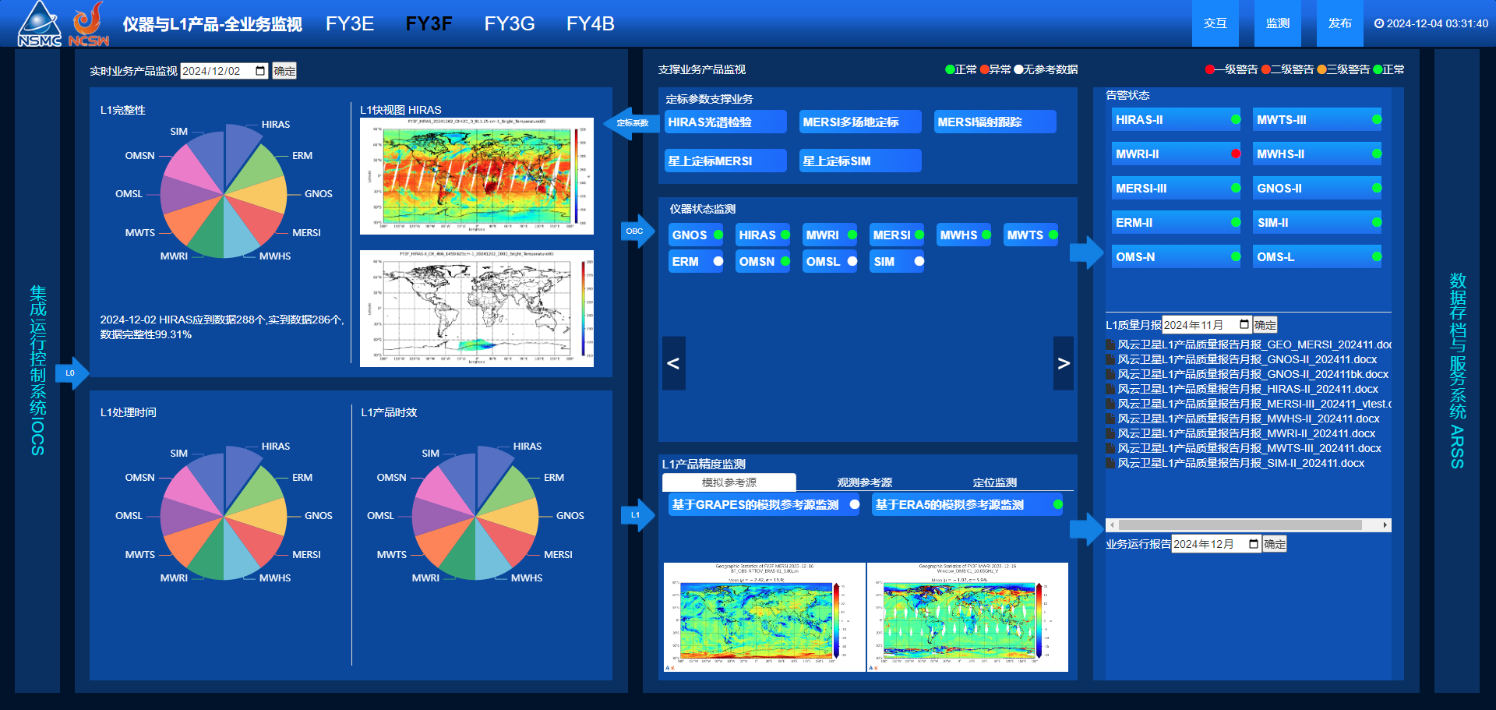
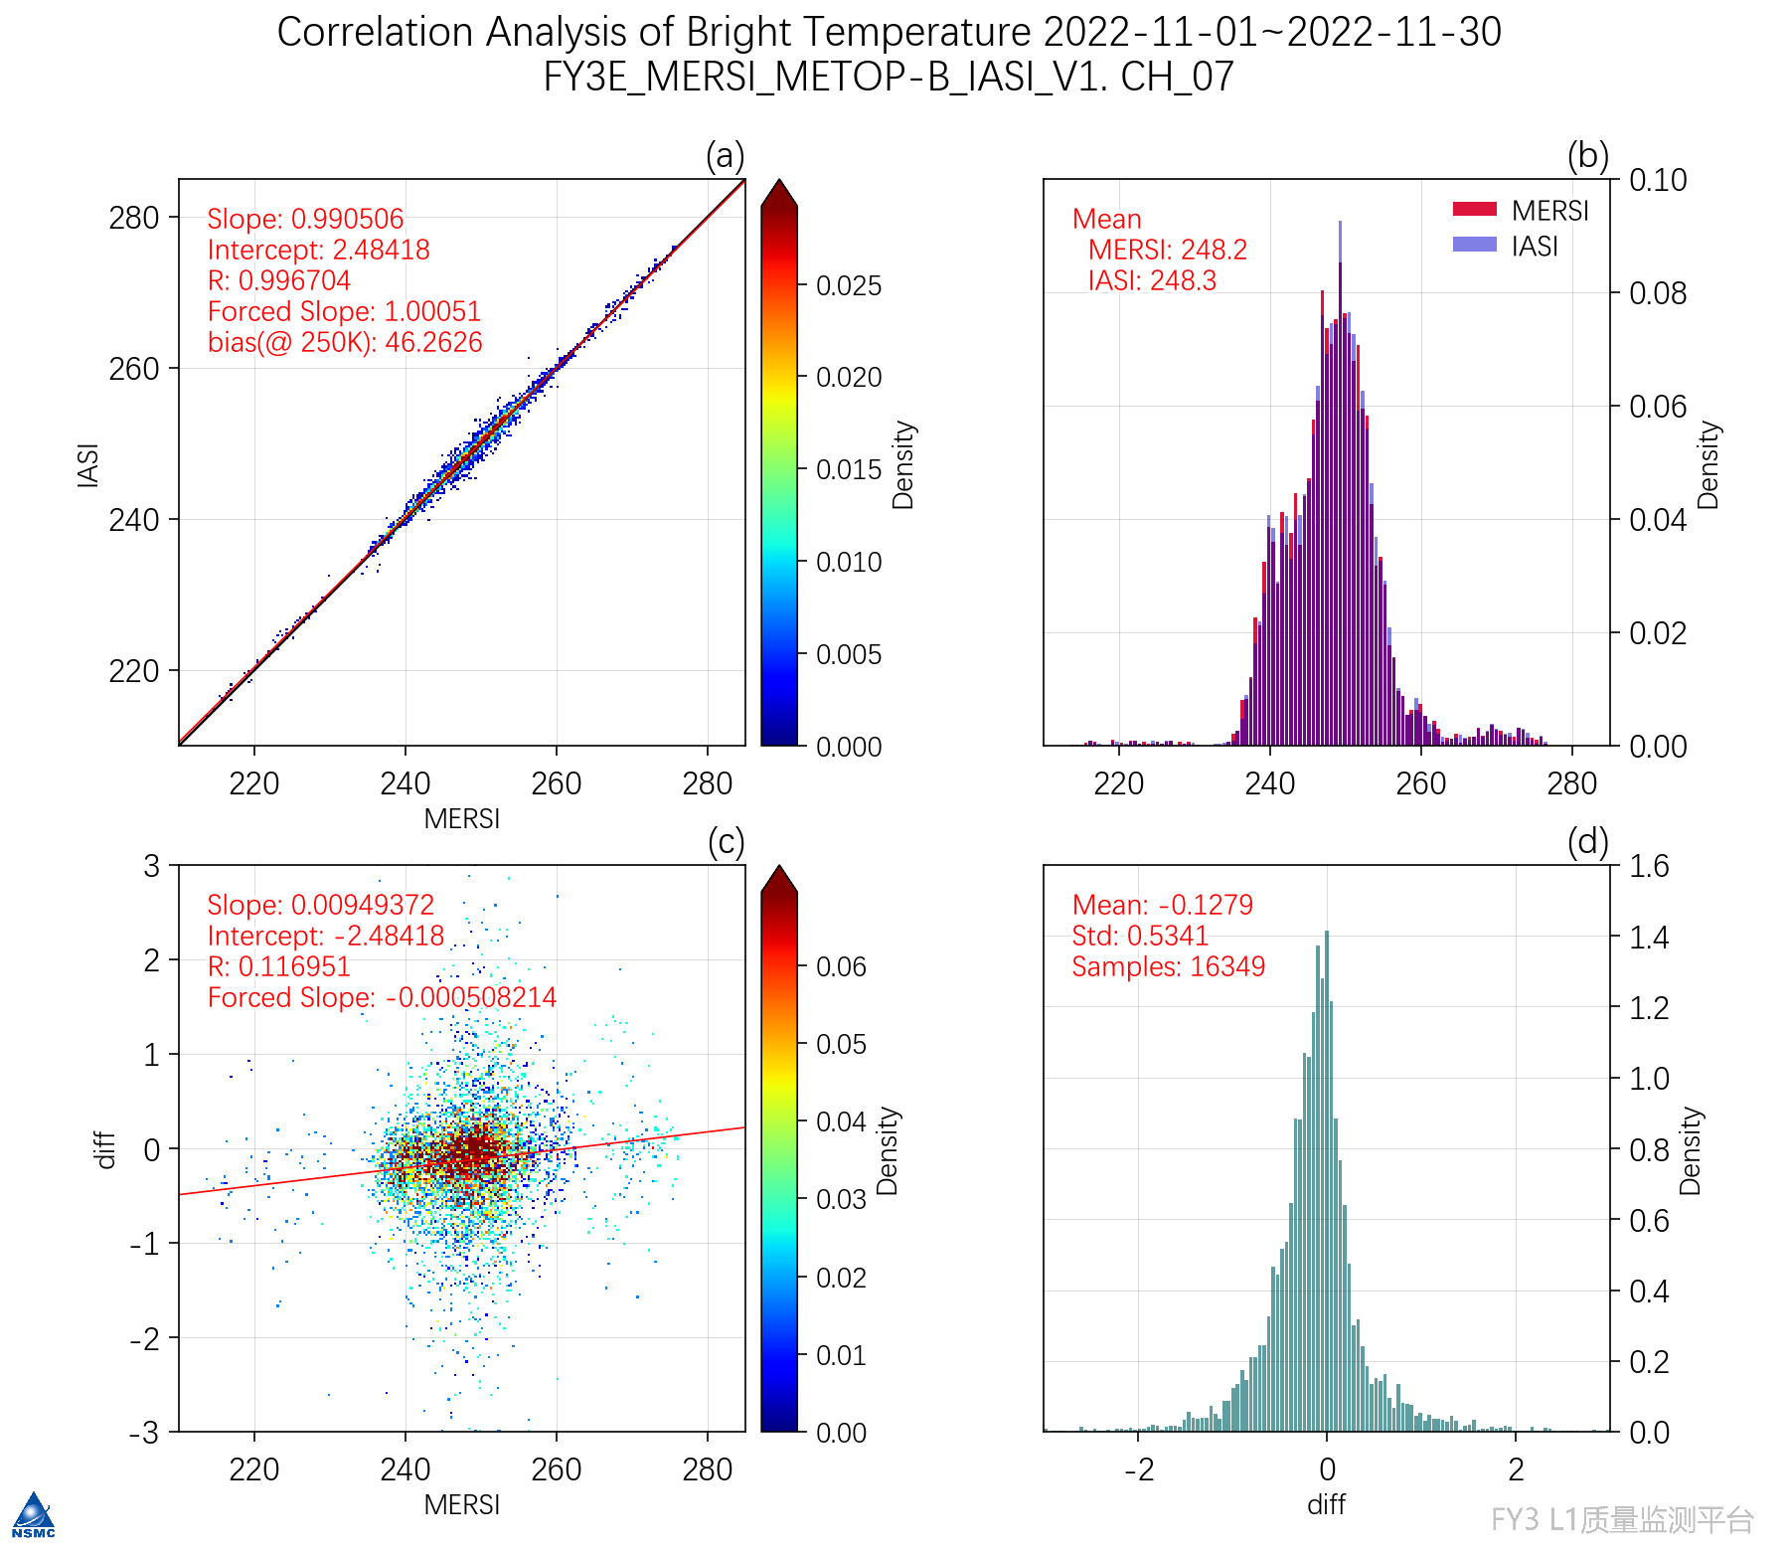
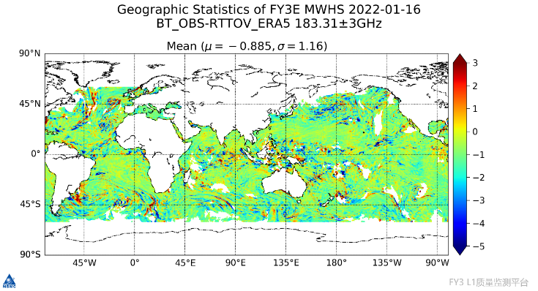
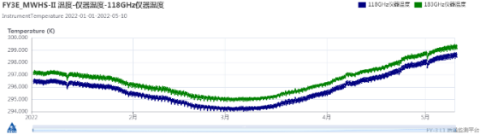
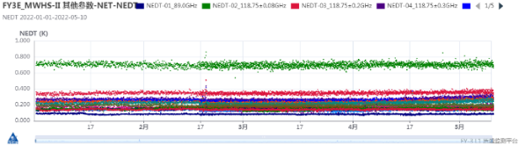
Background and Motivation
Fengyun Satellite Instrument Performances and L1 Data Quality Monitoring System
Monitoring based on SNO
Monitoring based on NWP and RT models
Monitoring of Telemetry Parameters
(The Instrument temperature and Blackbody temperature for MWHS-2 )
（https://gsics.nsmc.org.cn/portal/cn/fycv/ipm.html）

Slide 4
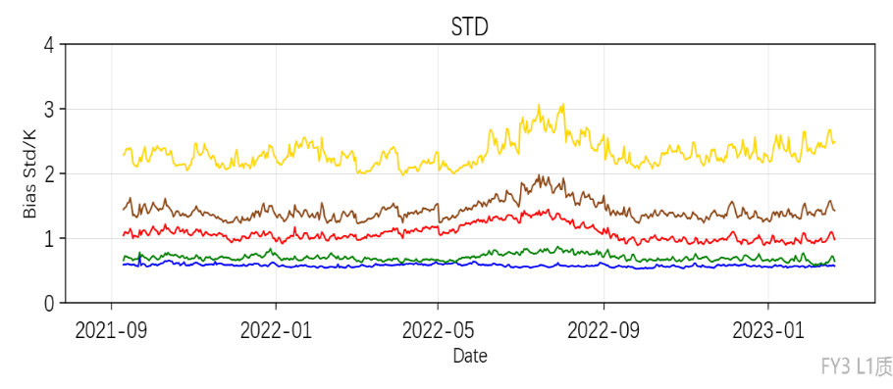
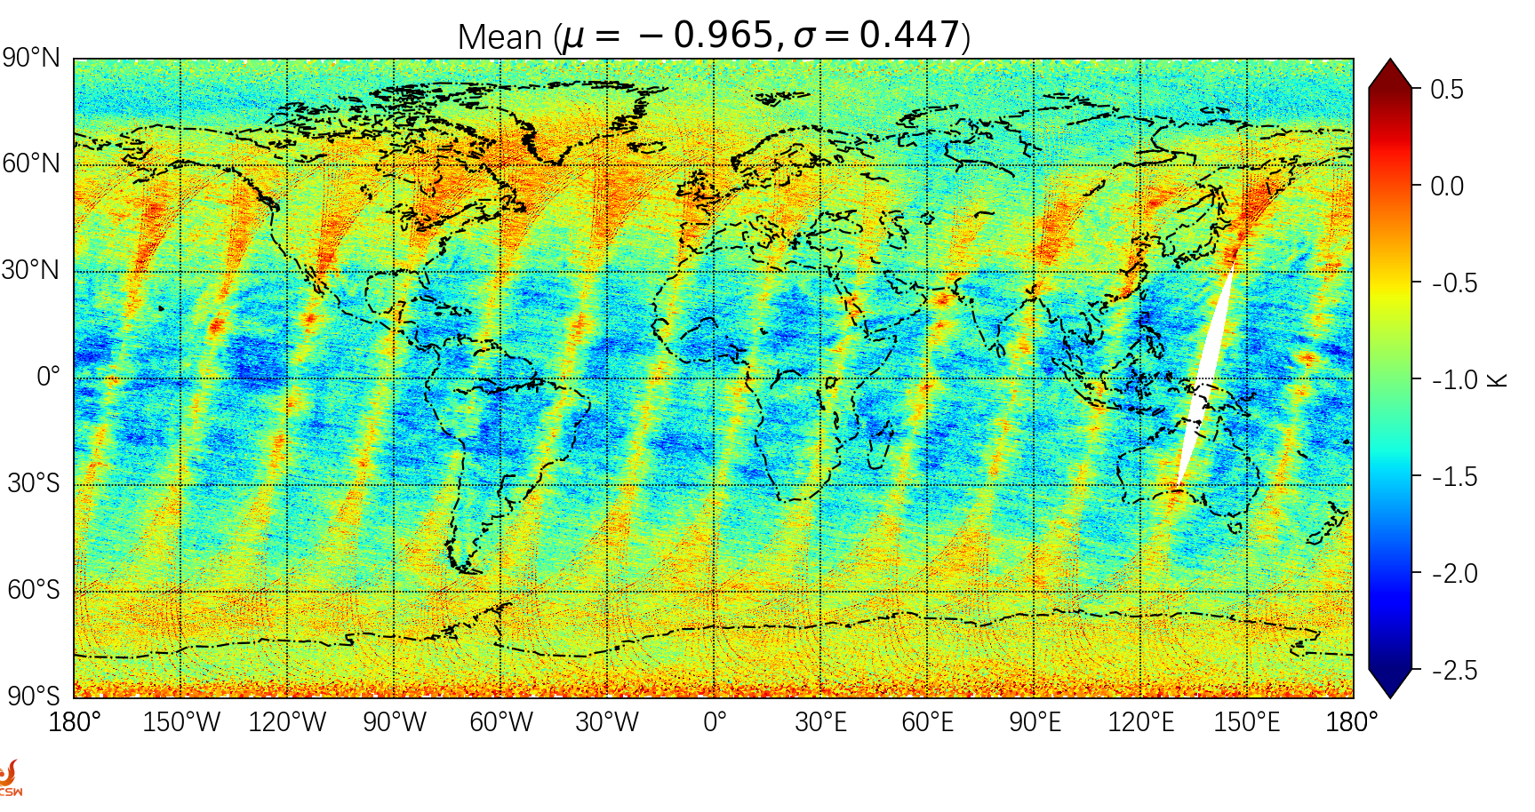
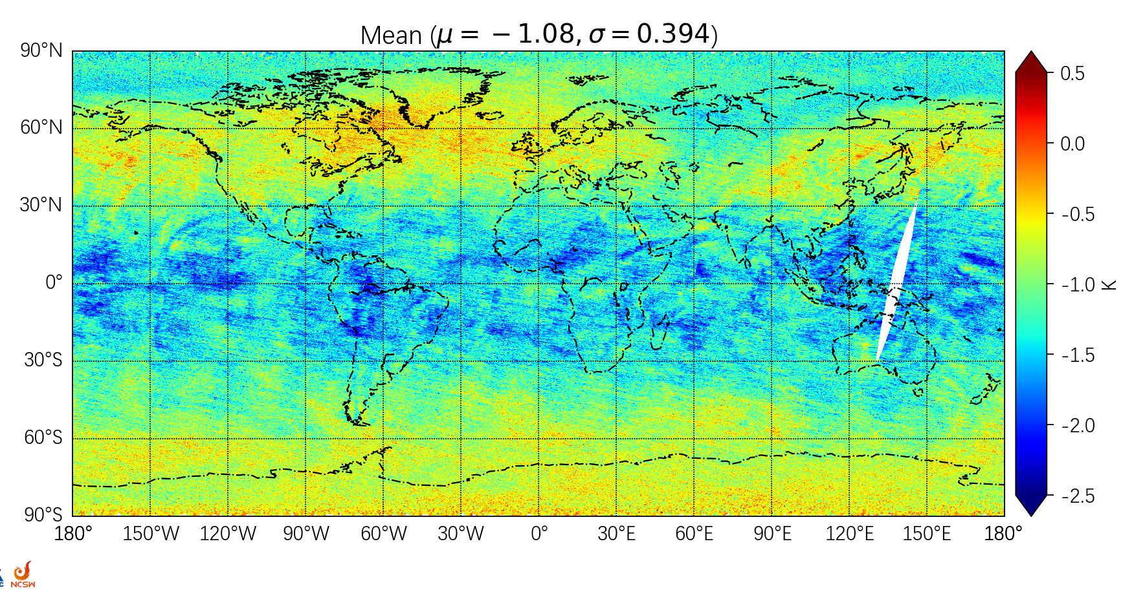
Background and Motivation
In support of GSICS project :The FY-3E/F/G microwave instruments are monitored routinely based on SNO and O-B (observation and background simulation).
O-B could provide an adequate sampling of the instrument biases for a full range of atmospheric conditions compared to SNO, suport understanding the nature of the biases seen in observation
Ultraviolet
VIS,NIR
Thermal Infrared
Microwave
CRA
Grapes
ERA-5,EC…
Input Data
Stability of L1 data quality based on O-B
ARMS,RTTOV,
CRTM,
LBLRTM,。。。
Abnormal
Normal
O-B global bias analysis

Slide 5
Background and Motivation
Data and Method
Multi-sources NWP Data Insput
CMA-GRAPES
CMA-CRA
ECMWF-ERA5
ECMWF-HRES
NCEP-GFS
Coupled with SRF
ARMS
Observation Geometrics
RTTOV
Radiances Simulator based on RTMs
GNOS-ROPP
Microwave Sounder
Simulation
Microwave Imager
Simulation
Active Radar
Simulation
GNSS Occultation Simulation
O-B Analysis
Notes:
Meet the objectives of the Global Space-based InterCalibration System (GSICS)
O-B monitoring provides NRT and continuous records of the difference between the observation and the equivalent simulated values computed from NWP model fields coupled with a RT model.

Slide 6
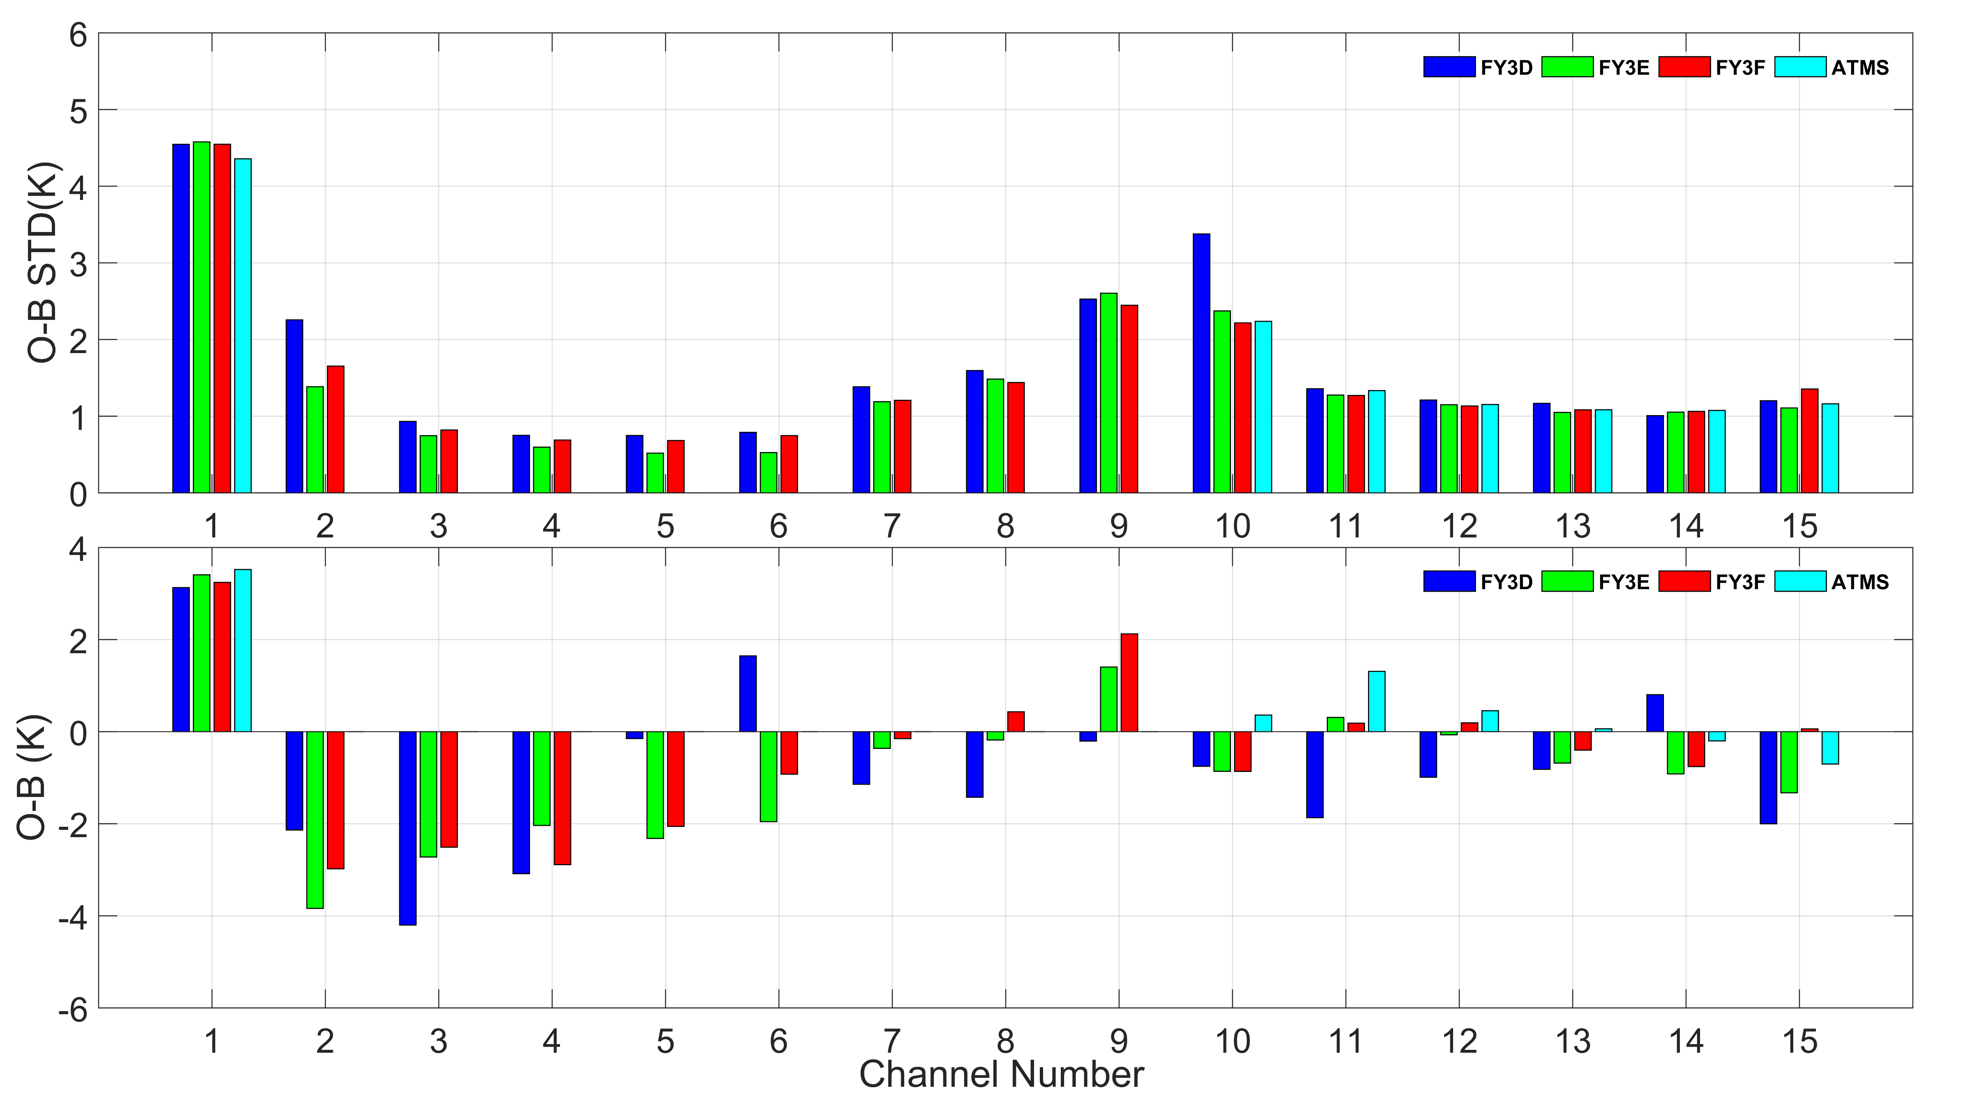
O-B Monitoring of MW Sounder
Applied to instrument problem exploration (sea-land deviation, scanning position deviation, etc.), problem localization, L1 absolute quality evaluation, and long-term stability monitoring
RTM: RTTOV,ARMS
NWP data: GRAPES, CRA,ERA5
Satellite Data: FY-3 MWTS, MWHS, ATMS
Data filter: clear-sky(scattering index); open ocean; tropical(45°S-45°N)
The quality estimation of FY-3 MWHS, compared with ATMS
O-B distribution of FY-3F MWTS before and after the antenna correction factor update
Notes:
MWHS-2 data has been assimilated in ECMWF oper-system since 2023 Feb 22.

Slide 7
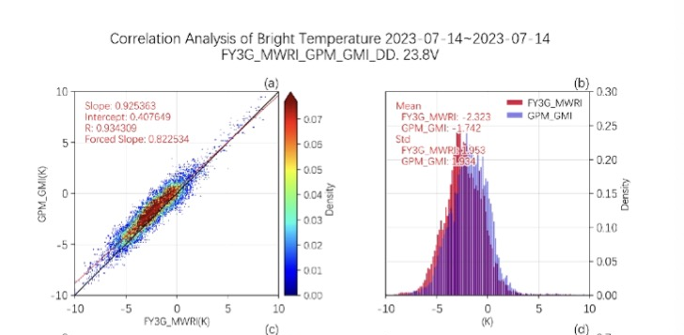
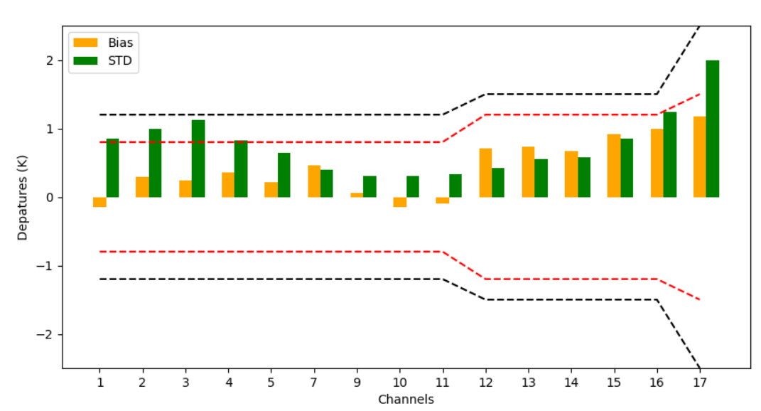
O-B Monitoring of MW Sounder
The cross-matching process of SNO involves differences in center frequency, channel response, and observation geometry.
Double difference analysis method combined with simulated brightness temperature to reduce these instrument configuration differences.
Double Difference Analysis for FY-3G MWRI-GMI
Double Difference Departure of FY-3F MWTS-ATMS

Slide 8
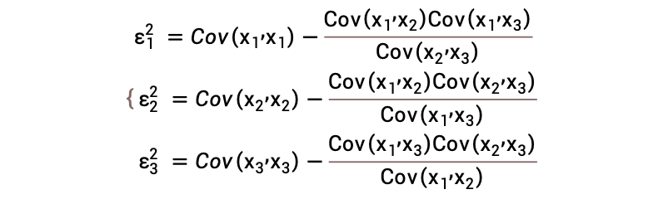

O-B Monitoring of MW Sounder
A triple collocation (TC) method relating satellite obs - similar satellite obs - model simulated Tb , is proposed to quantitatively estimate the random error term of mutually independent measurement systems
Truth
Random Error
Ch11 | Modeling Tb | ATMS Obs | MWHS Obs
calibration biases | 0.00 | 0.76 | -1.35
error variances | 5.06 | 1.84 | 1.53
error stand deviations | 2.25 | 1.35 | 1.23
$R_{i}$=$α_{i}+β_{i}T+ε_{i}$
model simulated Tb
Estimated Value
加性误差
乘性误差
satellite obs
similar satellite obs
Triple collocation analysis for
FY-3F/MWHS Ch11 Tb

Slide 9
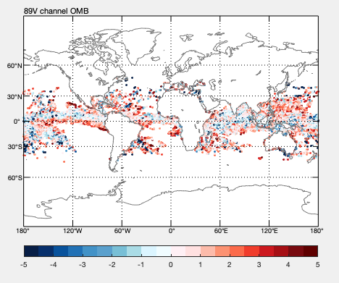
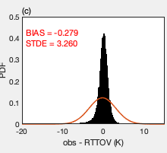
O-B Monitoring of MW Imager
Traditional approach:
RTM: RTTOV,ARMS
NWP data: GRAPES, CRA,ERA5
Satellite Data: FY-3 MWRI,GMI
Data filter: clear-sky(clw<0.2); open ocean; tropical
Method: Using the magnitude of brightness temperature variations within the region to constrain the target homogeneity
Main issues: The simulation bias varies significantly because of the inhomogeneous field of view
OMB shows a high degree of bias dispersion, with the maximum standard deviation of bias reaching 3.26 K.
Using the new scheme, the standard deviation of OMB is below 1K, with an average improvement of 32%.

Slide 10
O-B Monitoring of MW Imager
Quality Control Scheme for stable target
Quality Control for Window Channel |  |  | Quality Control for Temperature Channel |  |  | Quality Control for Moisture Channel
 | Constraint Strategy | Algorithm |  | Constraint Strategy | Algorithm |  | Constraint Strategy | Algorithm
Data Quality Control | 1. Abnormal Value | 70K＜T_{b}＜320K | Data Quality Control | 1. Abnormal Value | 120K＜T_{b}＜350K | Data Quality Control | 1. Abnormal Value | 150K＜T_{b}＜350K
 | 2. Data Integrity | QA_Ch_Flag≠0 |  | 2. Data Integrity | QA_Ch_Flag≠0 |  | 2. Data Integrity | QA_Ch_Flag≠0
 | 3. Calibration Quality | QA_Scan_Flag≠0 |  | 3. Calibration Quality | QA_Scan_Flag≠0 |  | 3. Calibration Quality | QA_Scan_Flag≠0
 | 4. RFI | RFI_Flag≠0 |  | 4. RFI | RFI_Flag≠0 |  | 4. RFI | RFI_Flag≠0
 | 5. Outlier | OMB>3σ_0 |  | 5. Outlier | OMB>3σ_0 |  | 5. Outlier | OMB>3σ_0。
Landmark Detection | 1. land-sea mask | landseamask=3 | Landmark Detection | 1. land-sea mask | landseamask=3 | Landmark Detection | 1. land-sea mask | landseamask=3
 | 2. Sea ice | 50S～50N |  | 2. Sea ice | 50S～50N |  | 2. Sea ice | 50S～50N
Impactful Weather Detection | 1. Strong Wind | SWS>8m/s | Impactful Weather Detection | 1. Strong Wind | SWS>8m/s | Impactful Weather Detection | 1. Strong Wind | SWS>8m/s
 | 2. Cloud | CLW(mm)<0.2 |  | 2. Cloud | CLW(mm)<0.2 |  | 2. Cloud | CLW(mm)<0.2
Homogeneity | 1. 60km X 60km buffer | obs_std <obs_std(60000) | Homogeneity | 1. 60km X 60km buffer | obs_std <obs_std(60000) | Homogeneity | 1. 60km X 60km buffer | obs_std <obs_std(60000)

Slide 11
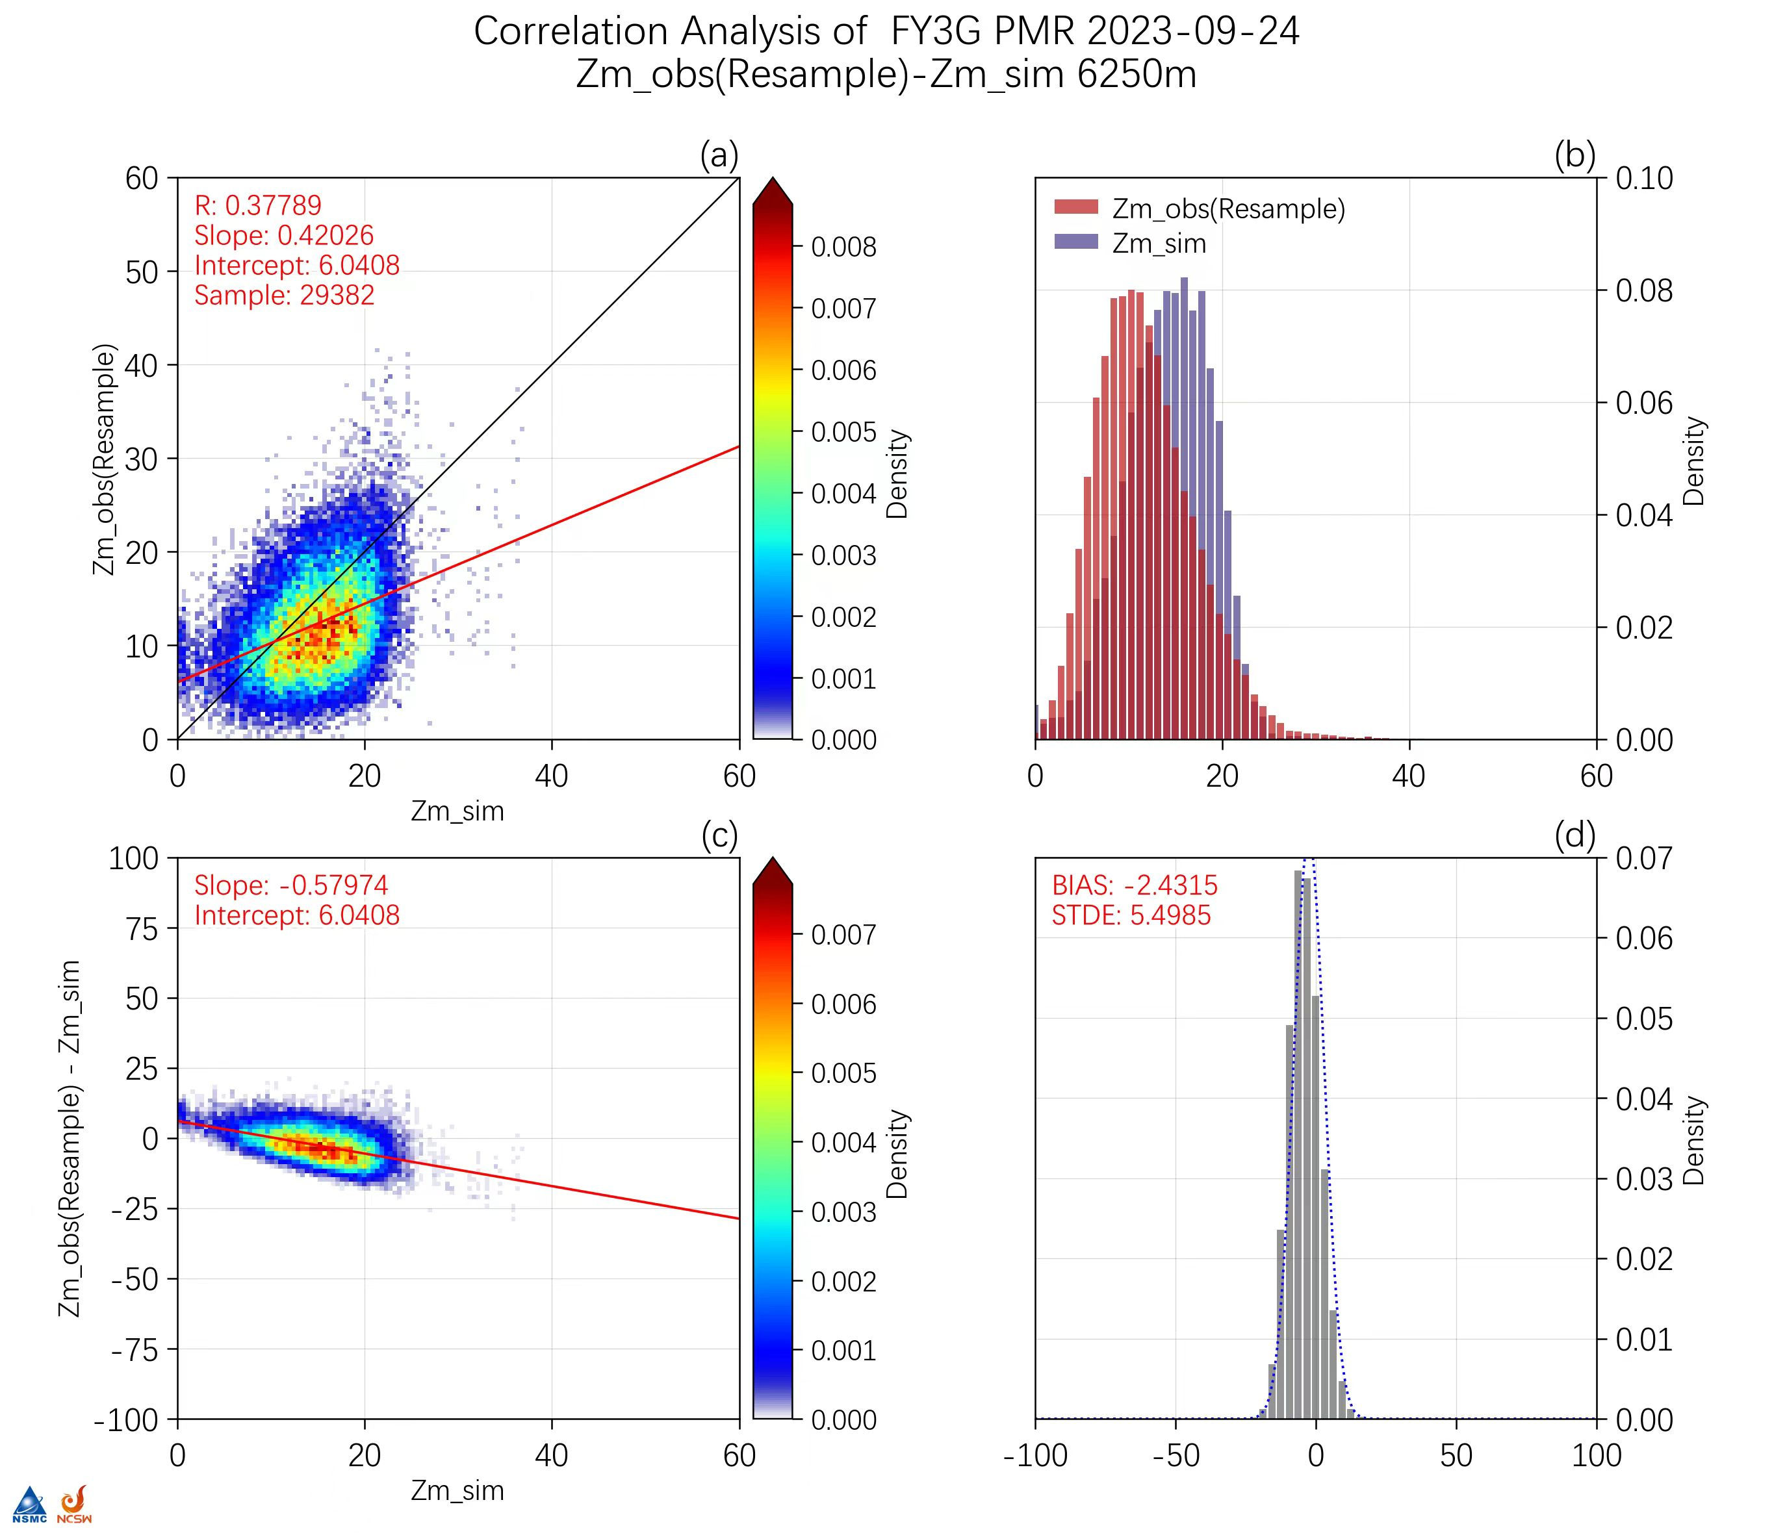
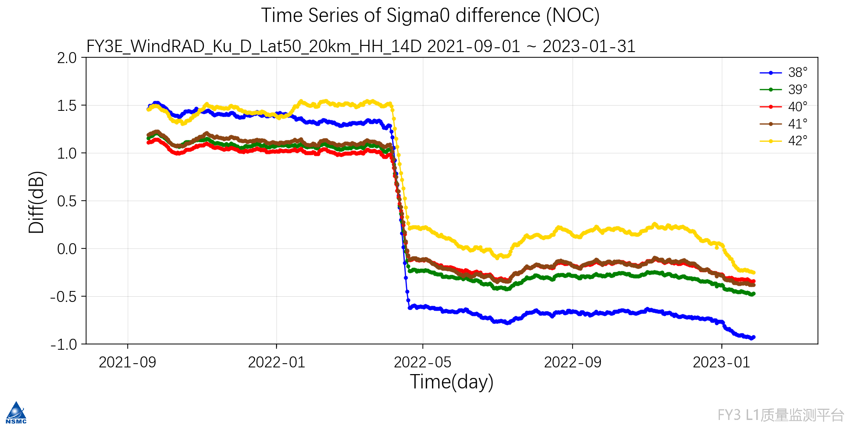
O-B Monitoring of Active Radar
Applied to radar instrument such as FY-3E WindRad FY-3G PMR, monitoring problem exploration (scanning position deviation, etc.), problem localization, L1 absolute quality evaluation, and long-term stability monitoring
RTM: GMF、RTTOV-SCATT
NWP data: ECMWF-HRES、GPROF
Data filter: open ocean; tropical(45°S-45°N), no sea-ice
Analysis method: NOC for WindRad
Calibration
Adjustment
Stability monitoring based on O-B for FY-3E/WindRad
O-B departure analysis for PMR

Slide 12
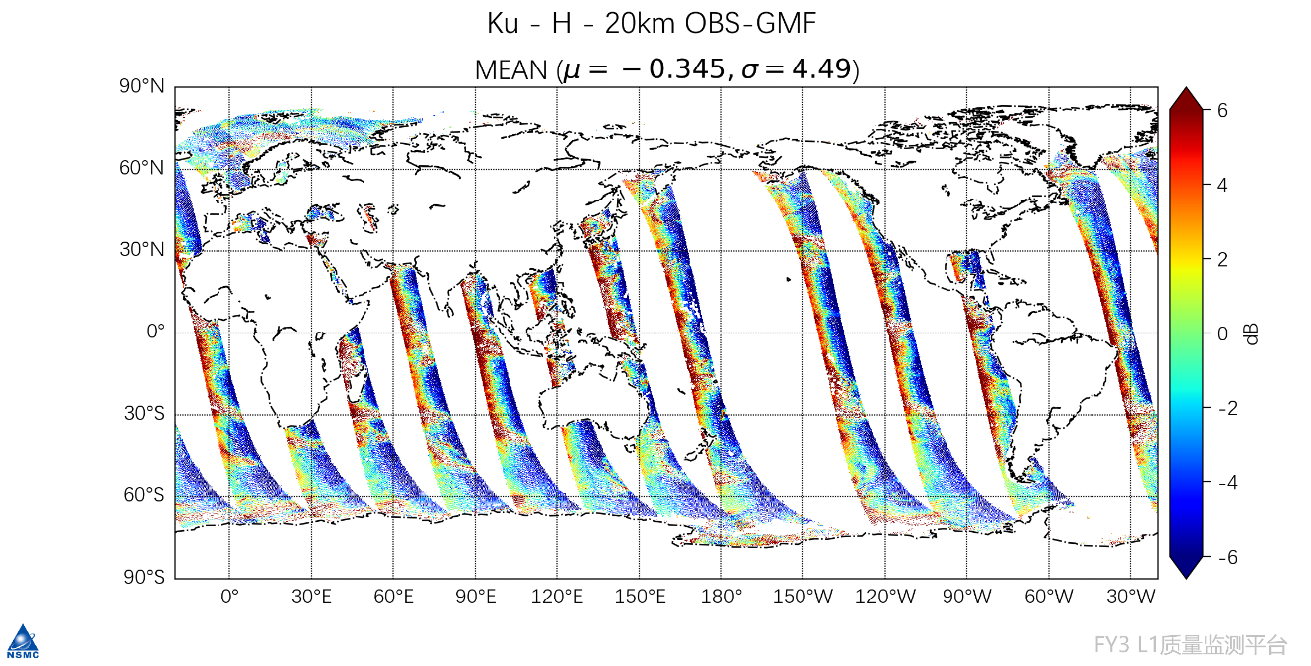
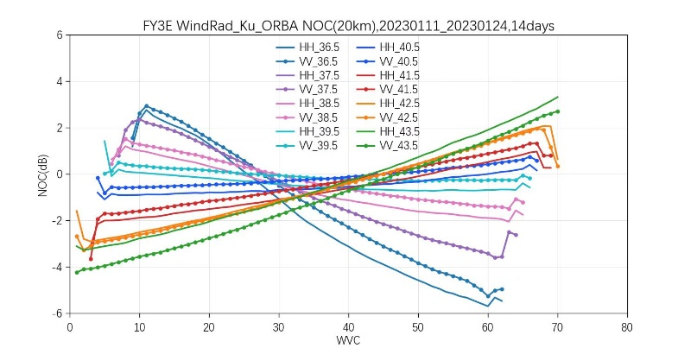
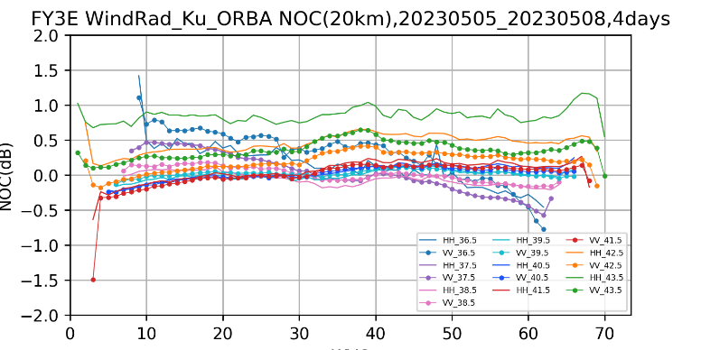
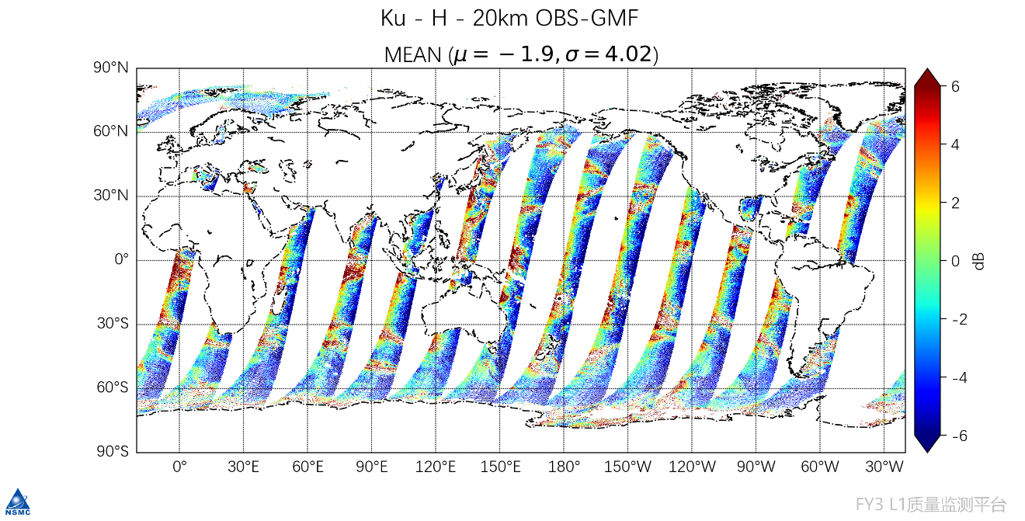
O-B Monitoring of Active Radar
Traditional 2-D O-B method for WindRad cannot characterize instrument specific problems
The 3-D O-B method including the incident angle dimension can analyze the WindRad scanning position deviation related to the scanning angle, which was related to a pre-processing problem
Distribution of O-B daily statistical values of WindRad with scanning position after the pre-processing problem correction
The WindRad scanning position deviation

Slide 13
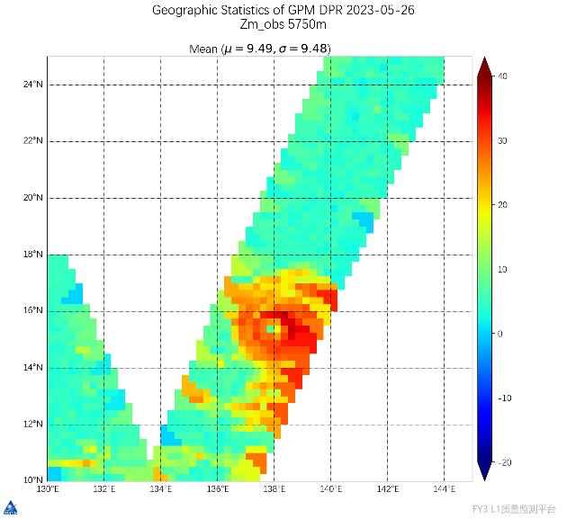
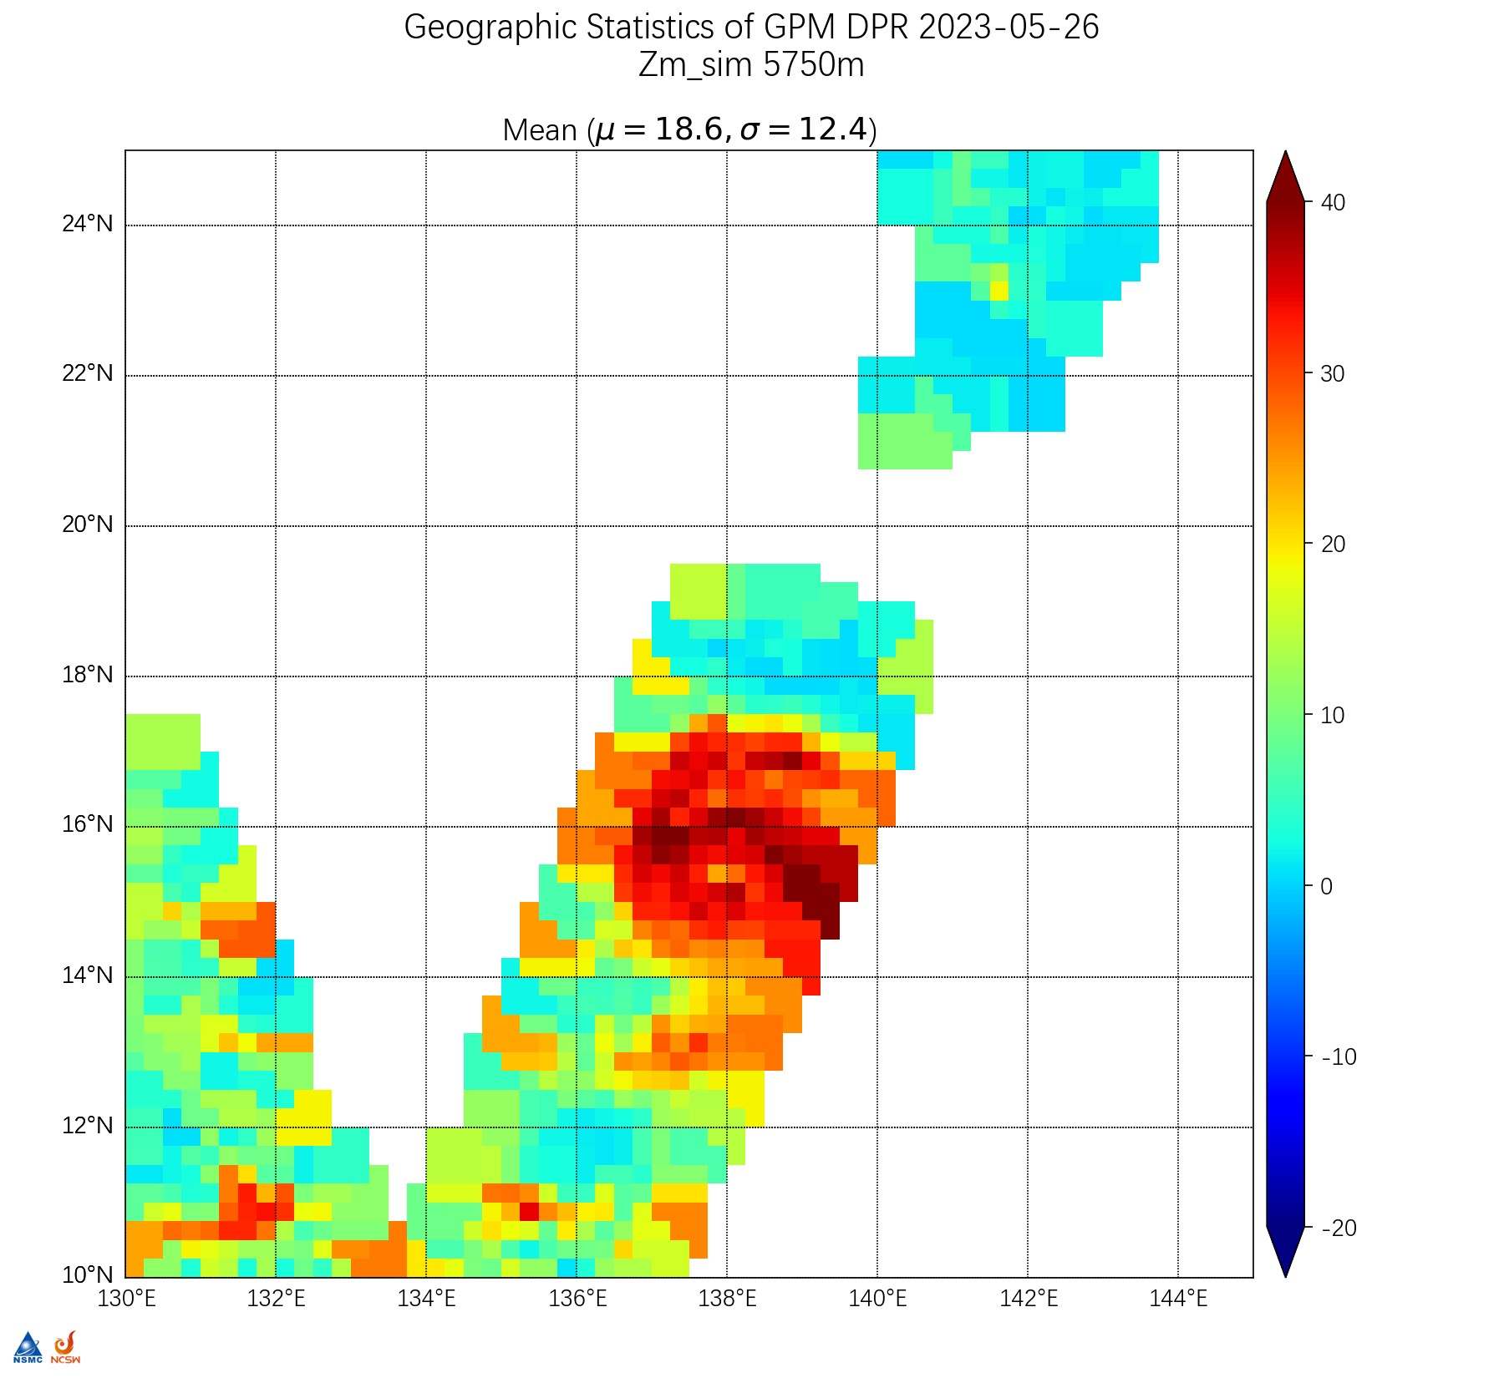
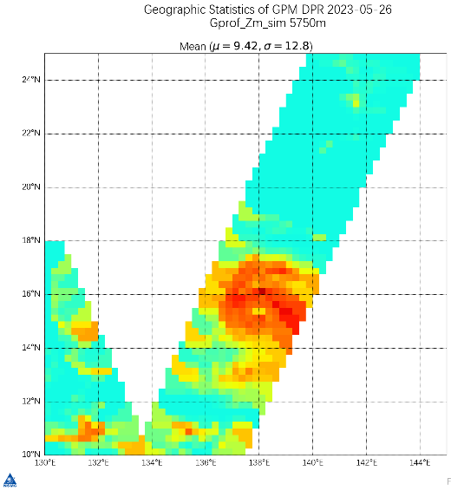
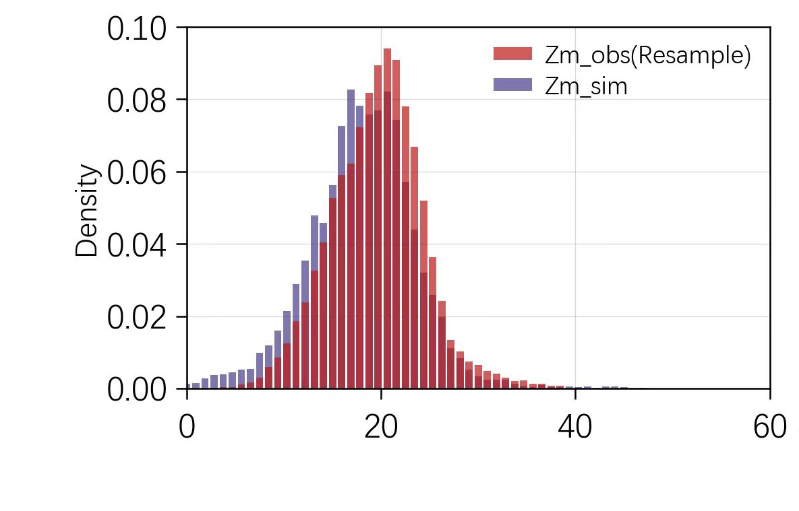
O-B Monitoring of Active Radar
Simulating precipitation radar echoes using RTMs and NWP data may result in mis-location problem and inaccurate magnitude
Towards improving the accuracy of PMR radar echo simulation, the multi-satellite Goddard profile products are used as the input instead, and the solid hydrometer scattering scheme is optimized.
Obs
Large plate
aggregate(default)
Evans Snow
aggregate
The single-layer radar echo distribution for a TC case
The PDF distribution for the observing and simulating single-layer radar echoes

Slide 14
Conclusion and Prospect
Continuous records of the O-B departure could help understand the nature of the biases seen in observations, evaluate the instrument and L1 data stability, and explore the instrument problems.
Some approaches have been attempted that combine SNO with simulated radiance, to mitigate the uncertainty in the data quality assessment and error estimation.
The O-B method has been extended to the active radar L1 data monitoring. Although progress has been made in precipitation radar simulation. this method remains more reliable in clear sky regions,
It is planned to continue this work within NSMC, incorporating longer time series and big data analysis to understand better theunderstand bias characteristics of each instrument.

