Slide 1


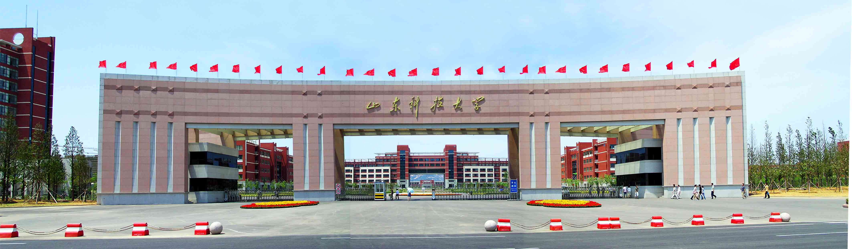
Spatio-Temporal Fusion and Selection of pseudo-invariant calibration sites (PICS) Based on Multi-Source Remote Sensing of Lunar Observations
Lide Zhu¹, Hongchun Zhu^{1*}, Huazhao Suo¹, Yong Zhang^{2*}
1 College of Geodesy and Geomatics, Shandong University of Science and Technology, Qingdao, China
2 National Satellite Meteorological, China Meteorological Administration, Beijing, China
Part 1 submitted to ICARUS, in review
Part 3 submitted to Acta Optica Sinica, in review
惟真求新
Notes:
Good afternoon, everyone. It's a pleasure to be here today. My name is Li-De Zhu, and I am a graduate student from Shandong University of Science and Technology. I’m honored to have the opportunity to present my research named " Spatio-Temporal Fusion and Selection of pseudo-invariant calibration sites (PICS) Based on Multi-Source Remote Sensing of Lunar Observations"

Slide 2
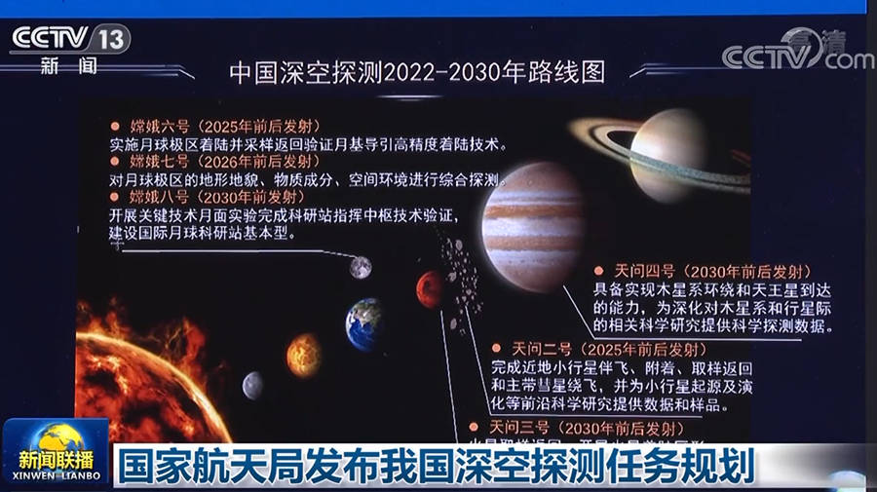
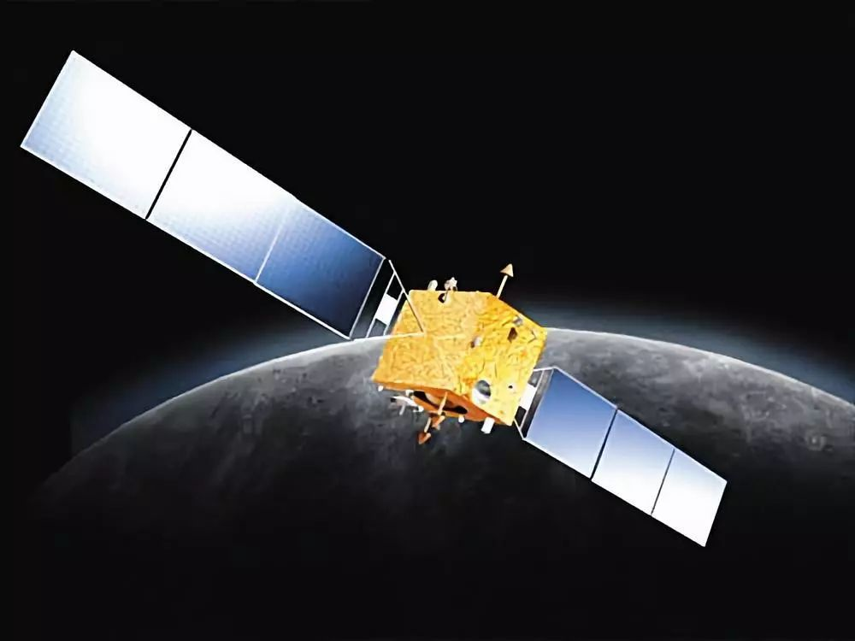
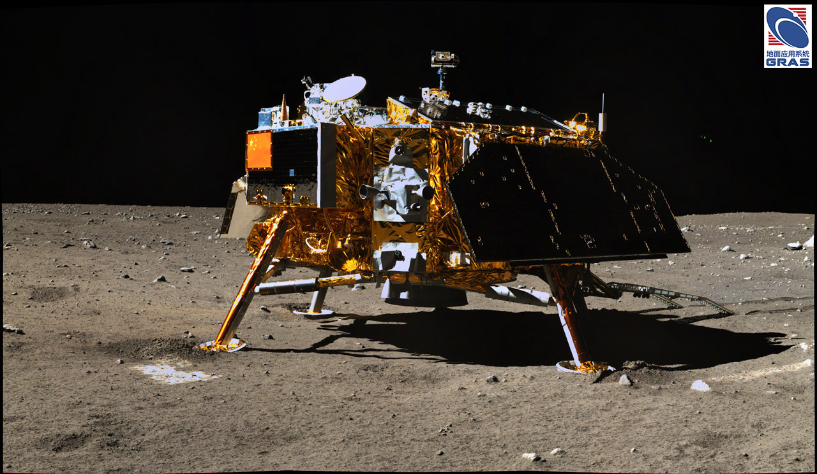
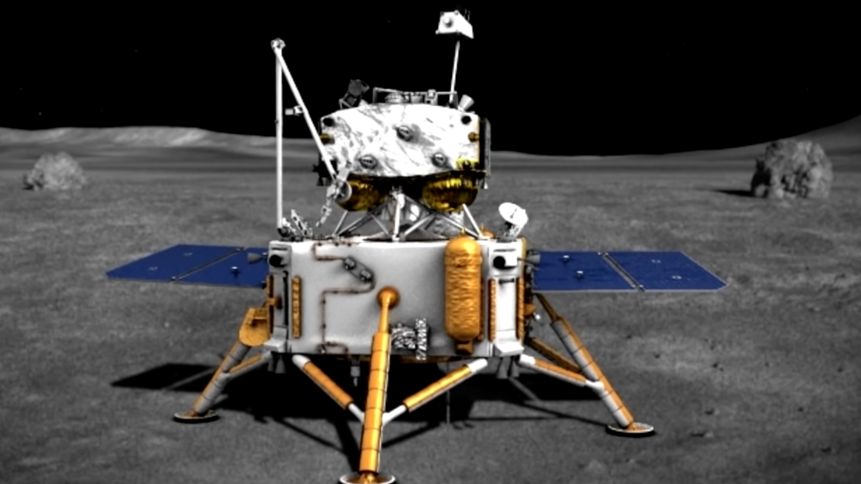
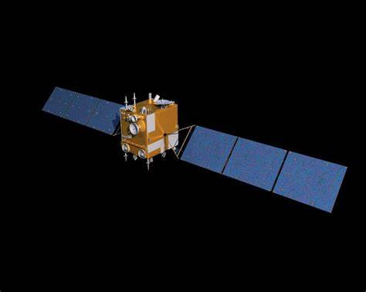
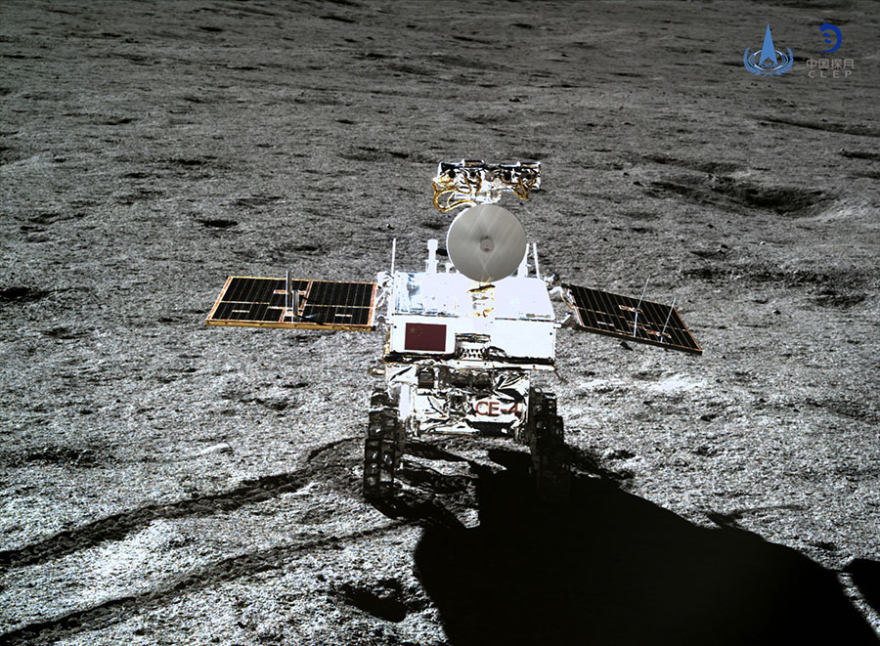
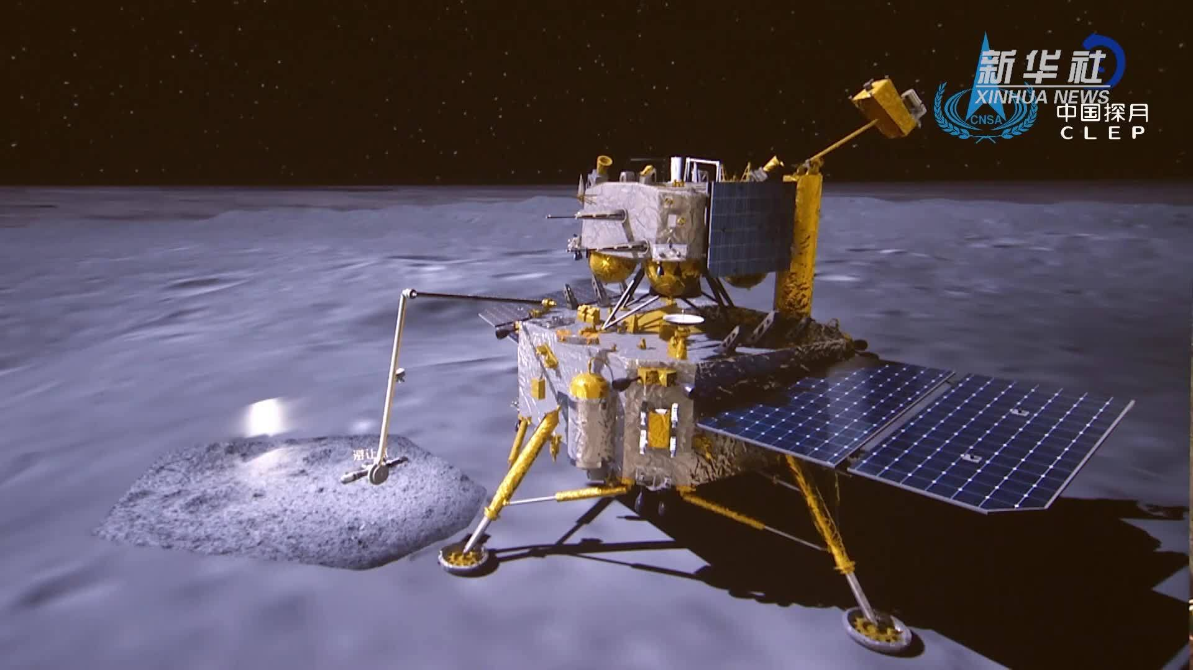
Research Background
In 2004, China officially launched the lunar exploration project and named it the "Chang'e Project". In October 2007, the "Chang’e-1" was successfully launched into space. The realization of lunar exploration will be a breakthrough in China's deep space exploration. On May 29, 2023, the lunar landing phase of China's manned lunar exploration project has been launched, and it is planned to realize the first landing of Chinese people on the moon before 2030.
CE-1 2007.10.24
CE-3 2013.12.2
CE-5 2020.11.24
……
CE-2 2010.10.01
CE-4 2018.12.8
CE-6 2024.5.3
Notes:
China places great importance on lunar resource exploration, In 2004, China officially launched the lunar exploration project and named it the "Chang'e Project". After more than 20 years of development, a variety of lunar data has been obtained.

Slide 3
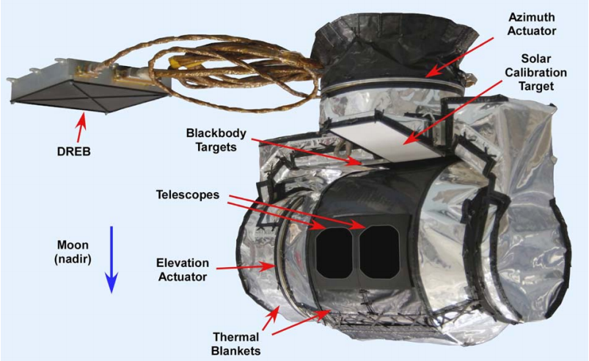
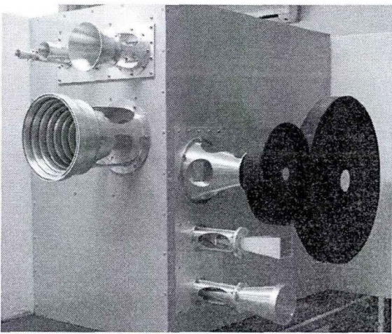
lunar soil thickness
LRO Diviner
Lunar soil composition
Fe & Ti content
Brightness Temperature
(BT)
Rock abundance
water ice detection
lunar surface roughness
Chang'e-2 (CE-2) microwave BT data boasts a better temporal resolution, enabling deep detection of lunar regolith, yet its spatial and temporal distribution is discontinuous. Conversely, Diviner infrared BT data exhibits higher spatial resolution and broader coverage.
CE-2 Microwave Radiometer
Notes:
Including the microwave brightness temperature (BT) data brought by Chang'e-2, the lunar BT data hide a lot of information about geology and minerals, Based on the microwave BT data from the Chang'e-2 microwave radiometer and the infrared BT data from Diviner on the LRO in the US, we combined the multi-source lunar data and get a higher quality of the lunar microwave BT distribution. Provided higher quality data for microwave radiation calibration on the moon.

Slide 4
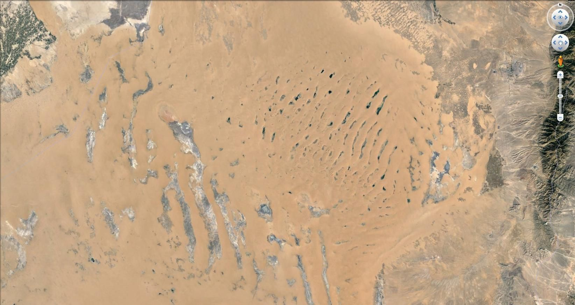
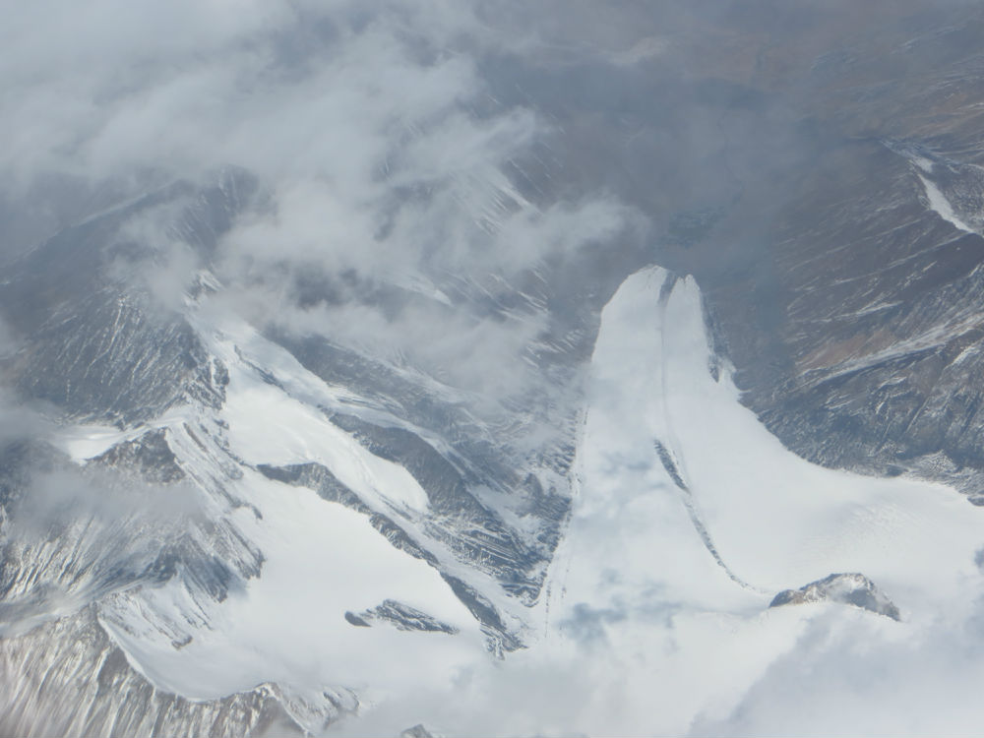
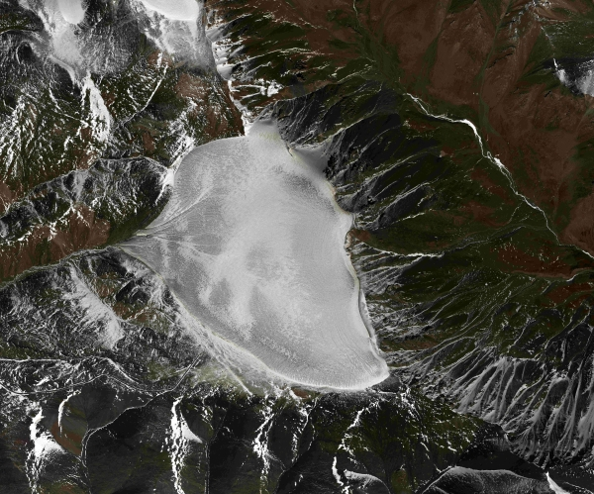
Pseudo-invariant calibration sites (PICS), which are selected for their spatial homogeneity and temporal stability and are usually located in deserts, glaciers, or other natural environments of the Earth.
Notes:
The selection of Pseudo-invariant calibration sites is the key of radiative calibration, which are selected for their spatial homogeneity and temporal stability. On Earth, we typically select stable natural areas such as deserts or glaciers as PICS. Due to the highly stable surface environment and the absence of atmospheric interference, the moon is well suited as the Pseudo-invariant calibration sites for radiometric calibration of geostationary and lunar satellites.

Slide 5
01
Lunar Brightness Temperature Model based on Multi-source Remote Sensing Data Considering Spatio-Temporal Characteristics
Notes:
In the following, I'm going to talk about our research in three parts, the first is our constructed Lunar Brightness Temperature Model based on Multi-source Remote Sensing Data Considering Spatio-Temporal Characteristics.

Slide 6
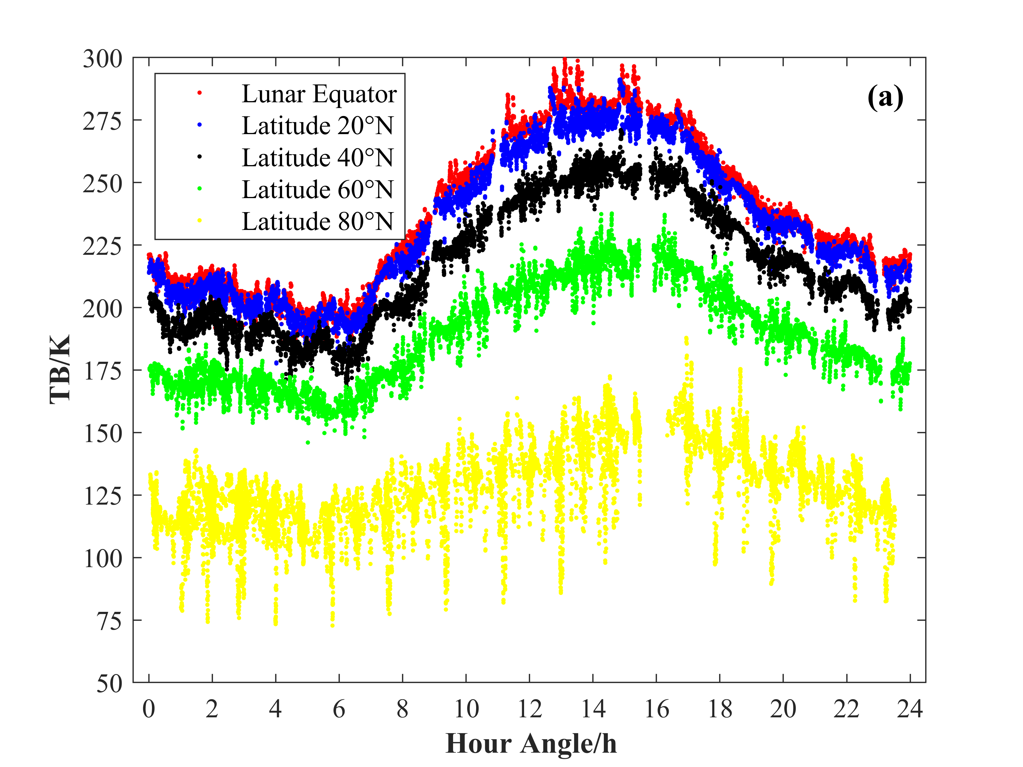
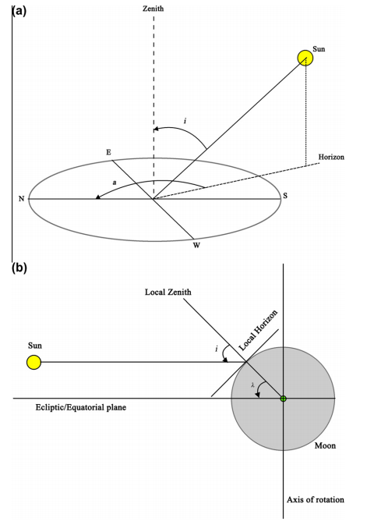
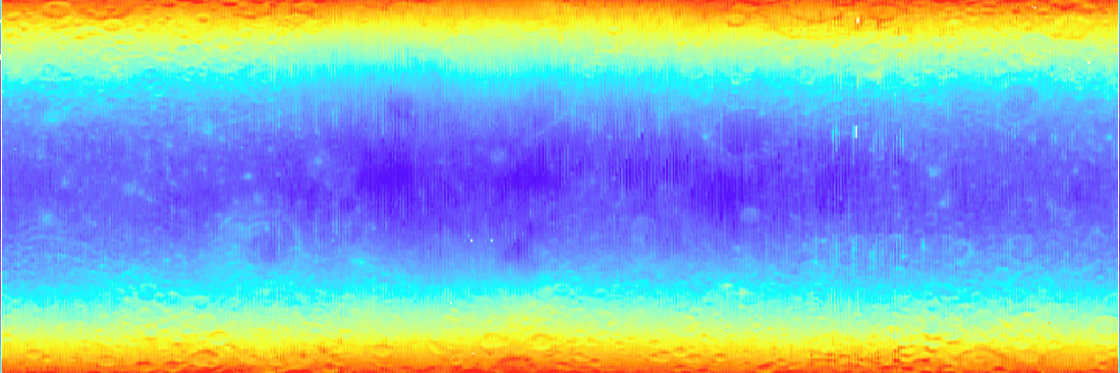
Lunar Brightness Temperature Model
Based on the Chang'e MRM data, time angle conversion, and simulation of diurnal changes in BT can generate a full lunar TB distribution image.
CE-2 37 GHz Microwave BT Data
238.301
The hour angle correction method
170.987
Notes:
Firstly, we carried out some necessary processing on the Chang'e BT data, including hour angle conversion and the construction of the daily variation model of BT, etc.

Slide 7
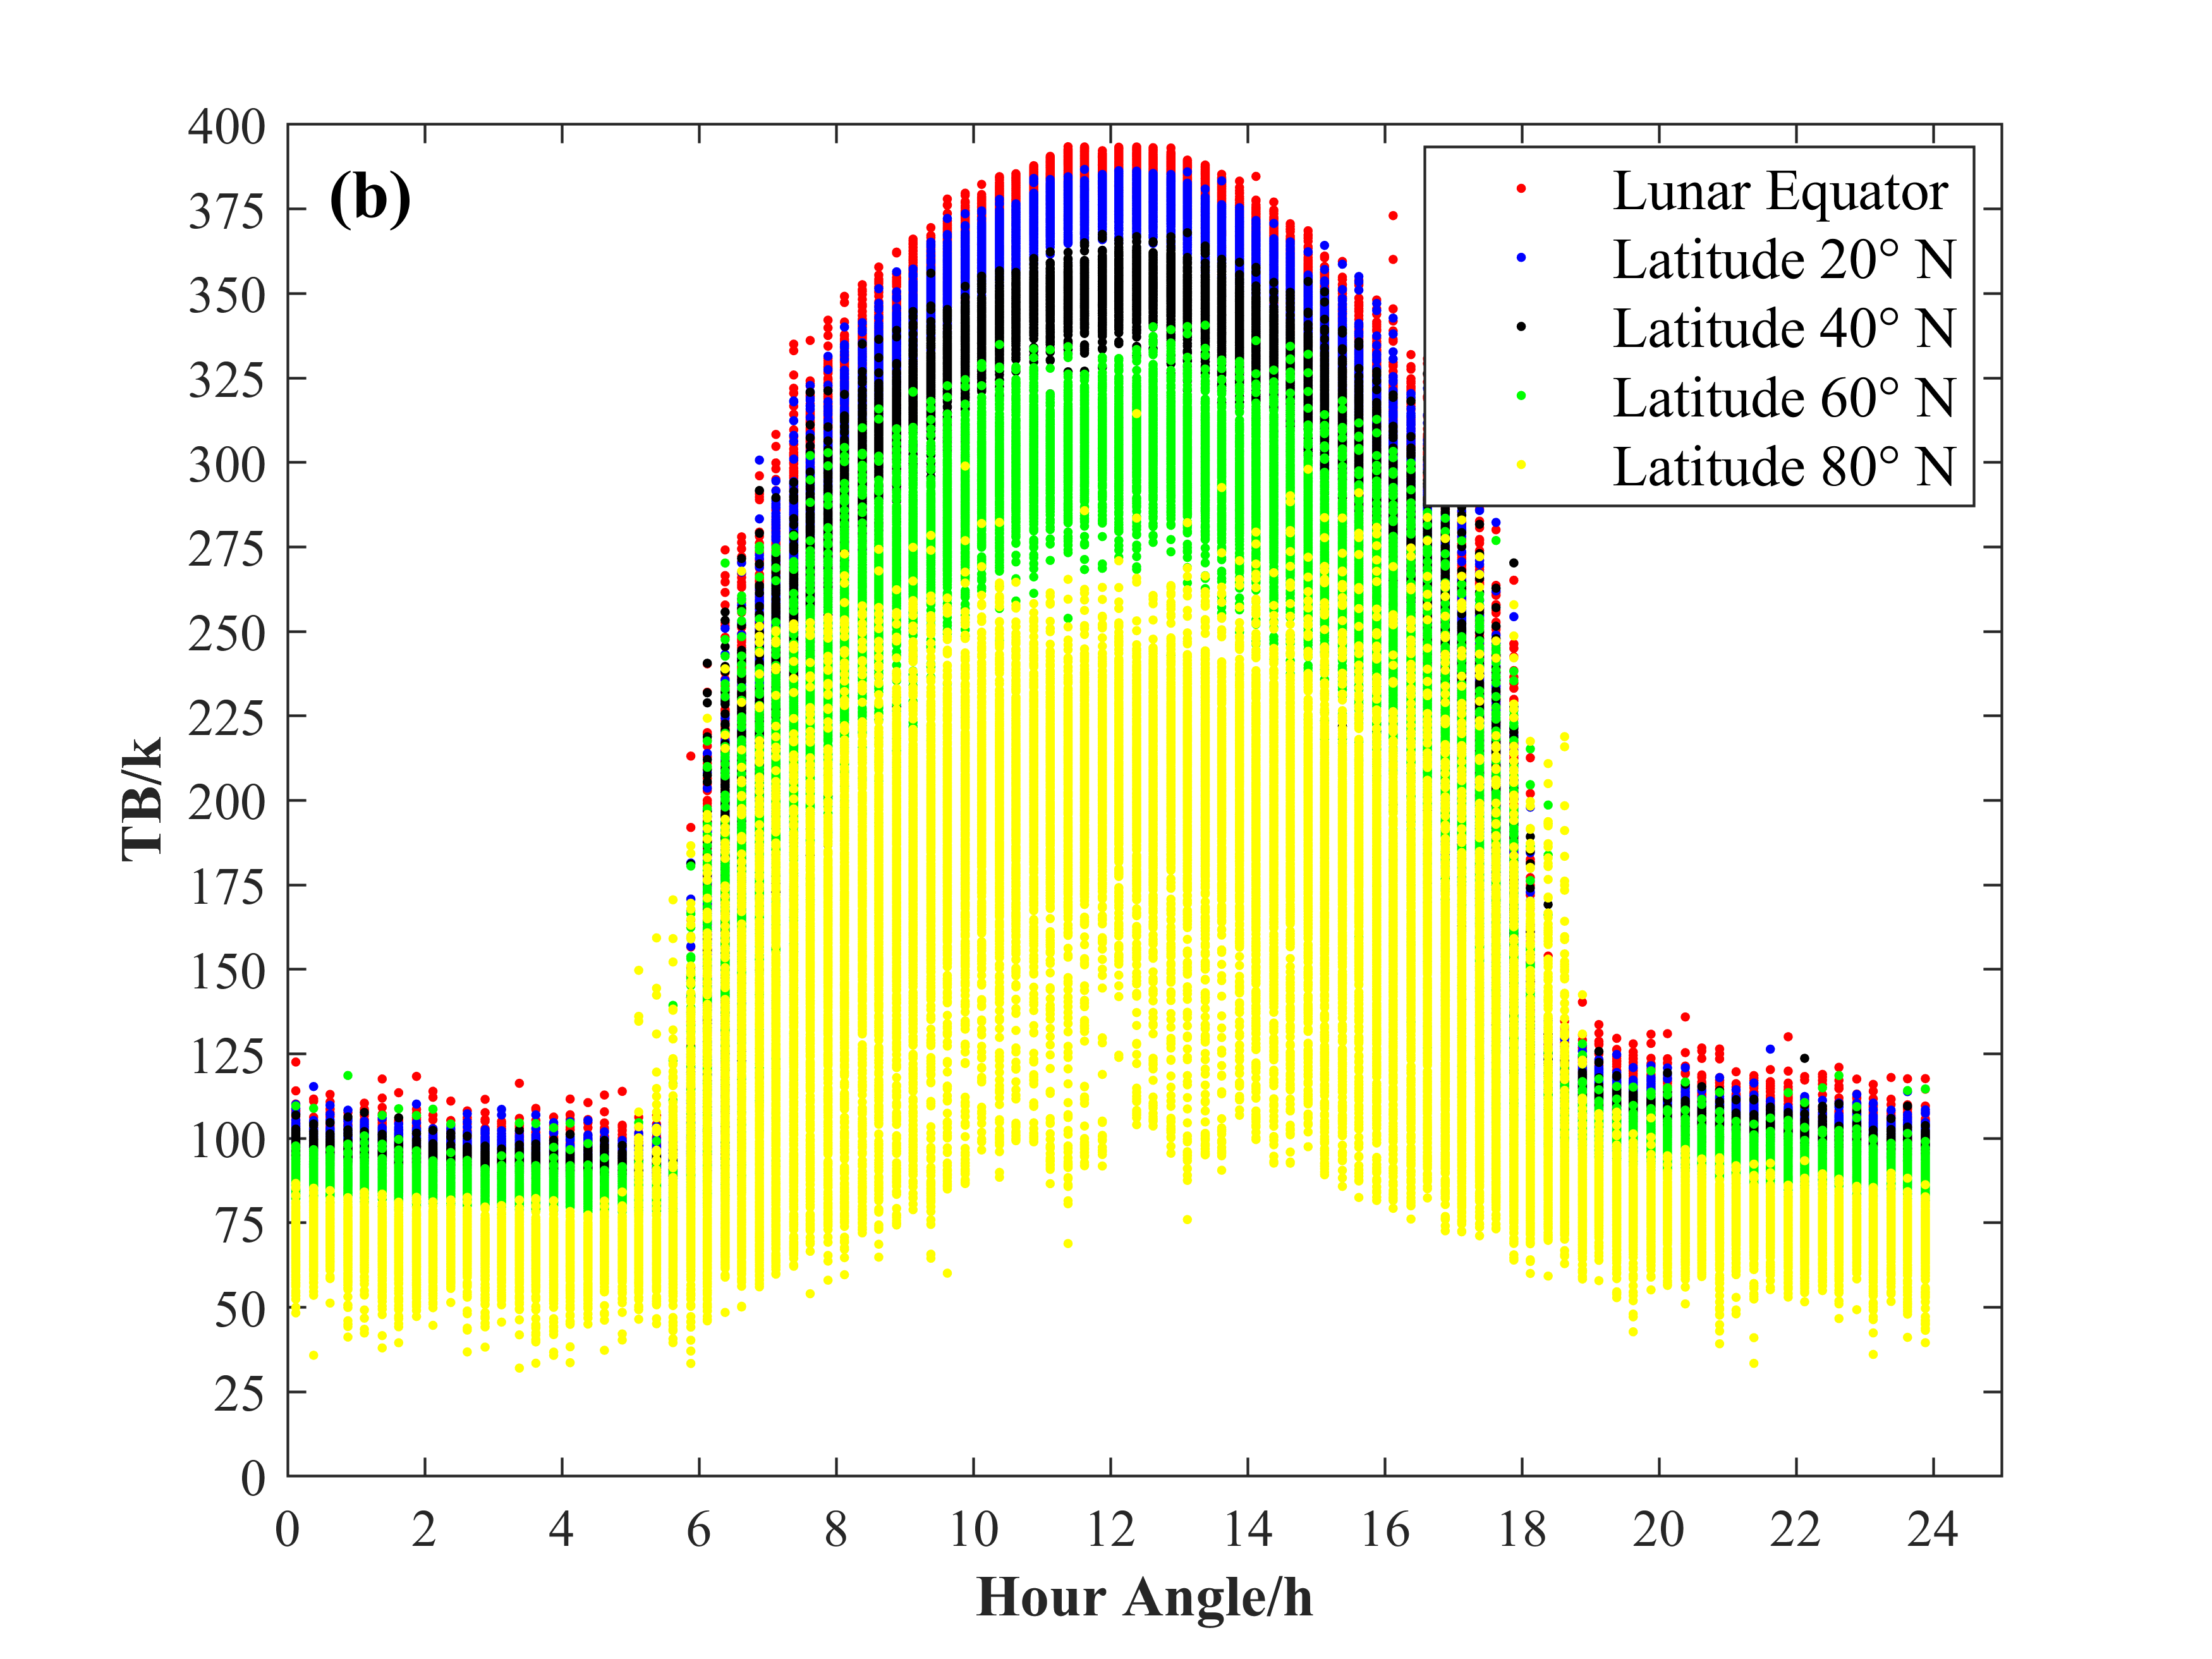
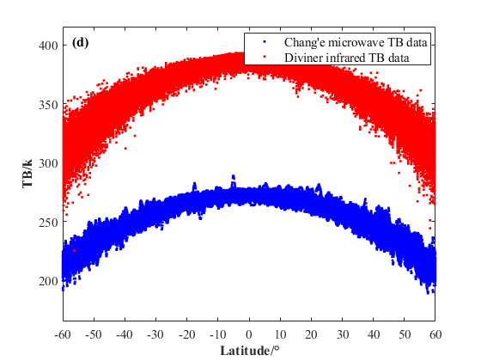
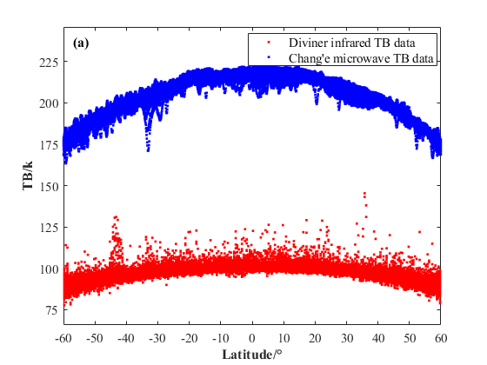
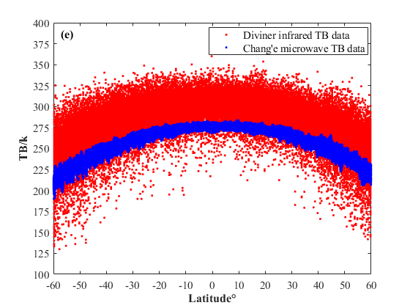
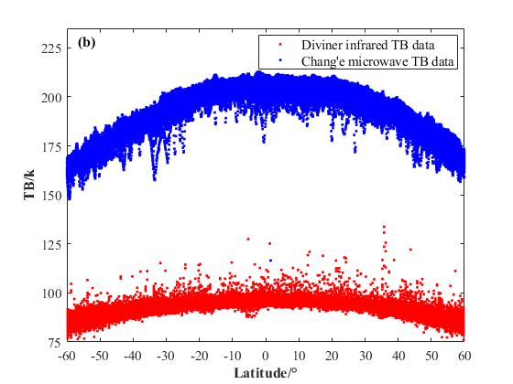
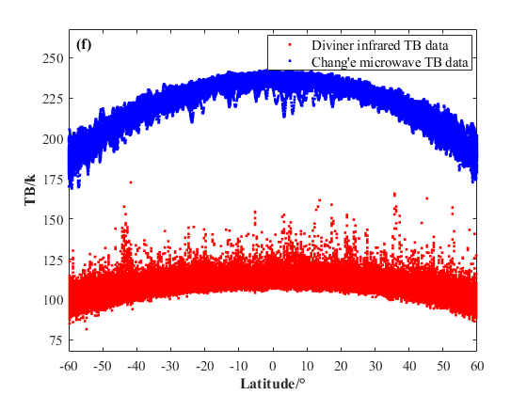
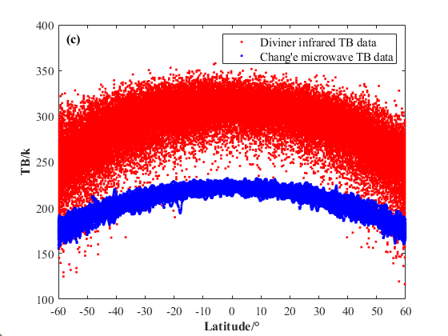
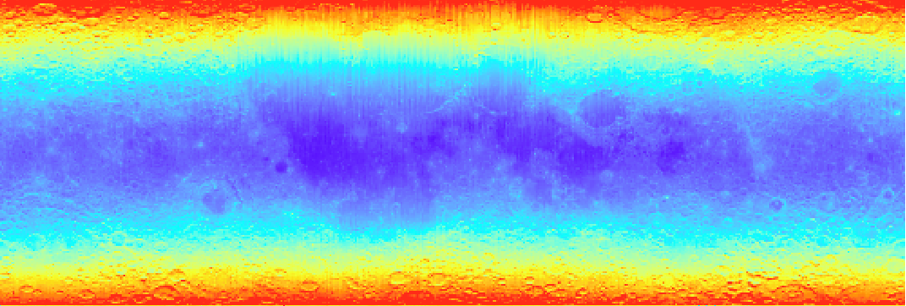
Lunar Brightness Temperature Model
Infrared BT
&
microwave BT
relationship?
Diviner Channel 7 Infrared BT Data
389.301
The changes of BT data from different sources in the latitudinal direction at different times.
108.987
Notes:
Further processing was conducted on the Diviner infrared BT data. By comparing the microwave and infrared BT data, it was found that there is a strong correlation between the two in terms of spatial and temporal distribution.

Slide 8
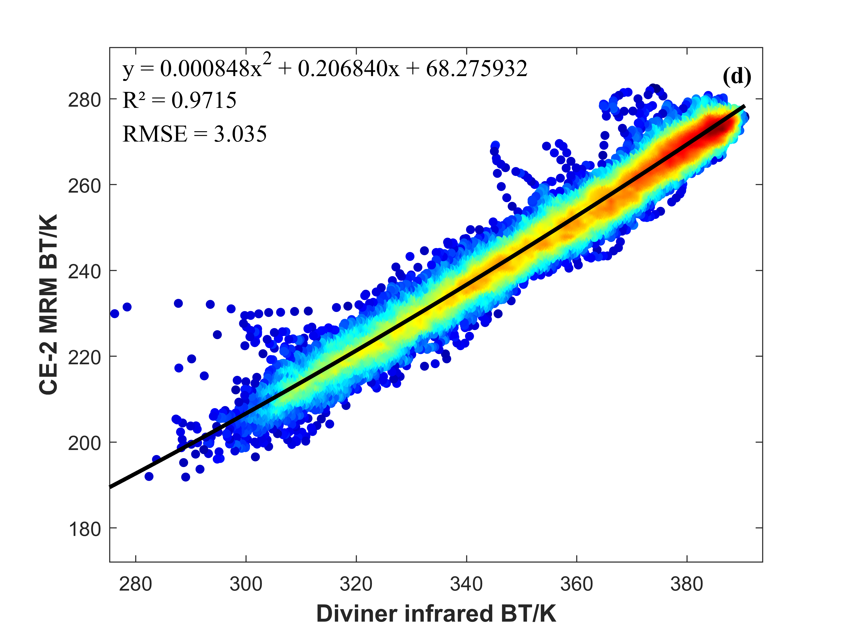
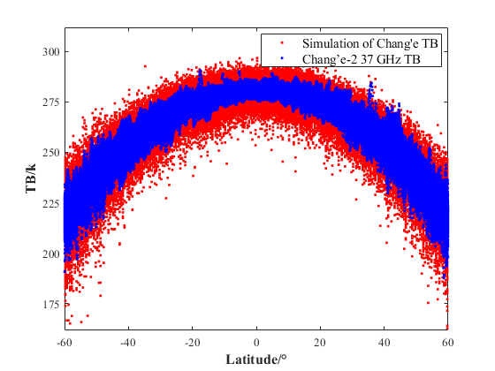

Lunar Brightness Temperature Model
Numerical Modeling Methods
Scatter fitting of multi-source BT data
Distribution of microwave and infrared brightness temperature at 12：00
Model effects considering only numerical relationship
Notes:
Therefore, based on the strong temporal and spatial correlation between the two types of data, we established a numerical model between them and attempted to re-simulate the microwave BT using the infrared BT data.

Slide 9
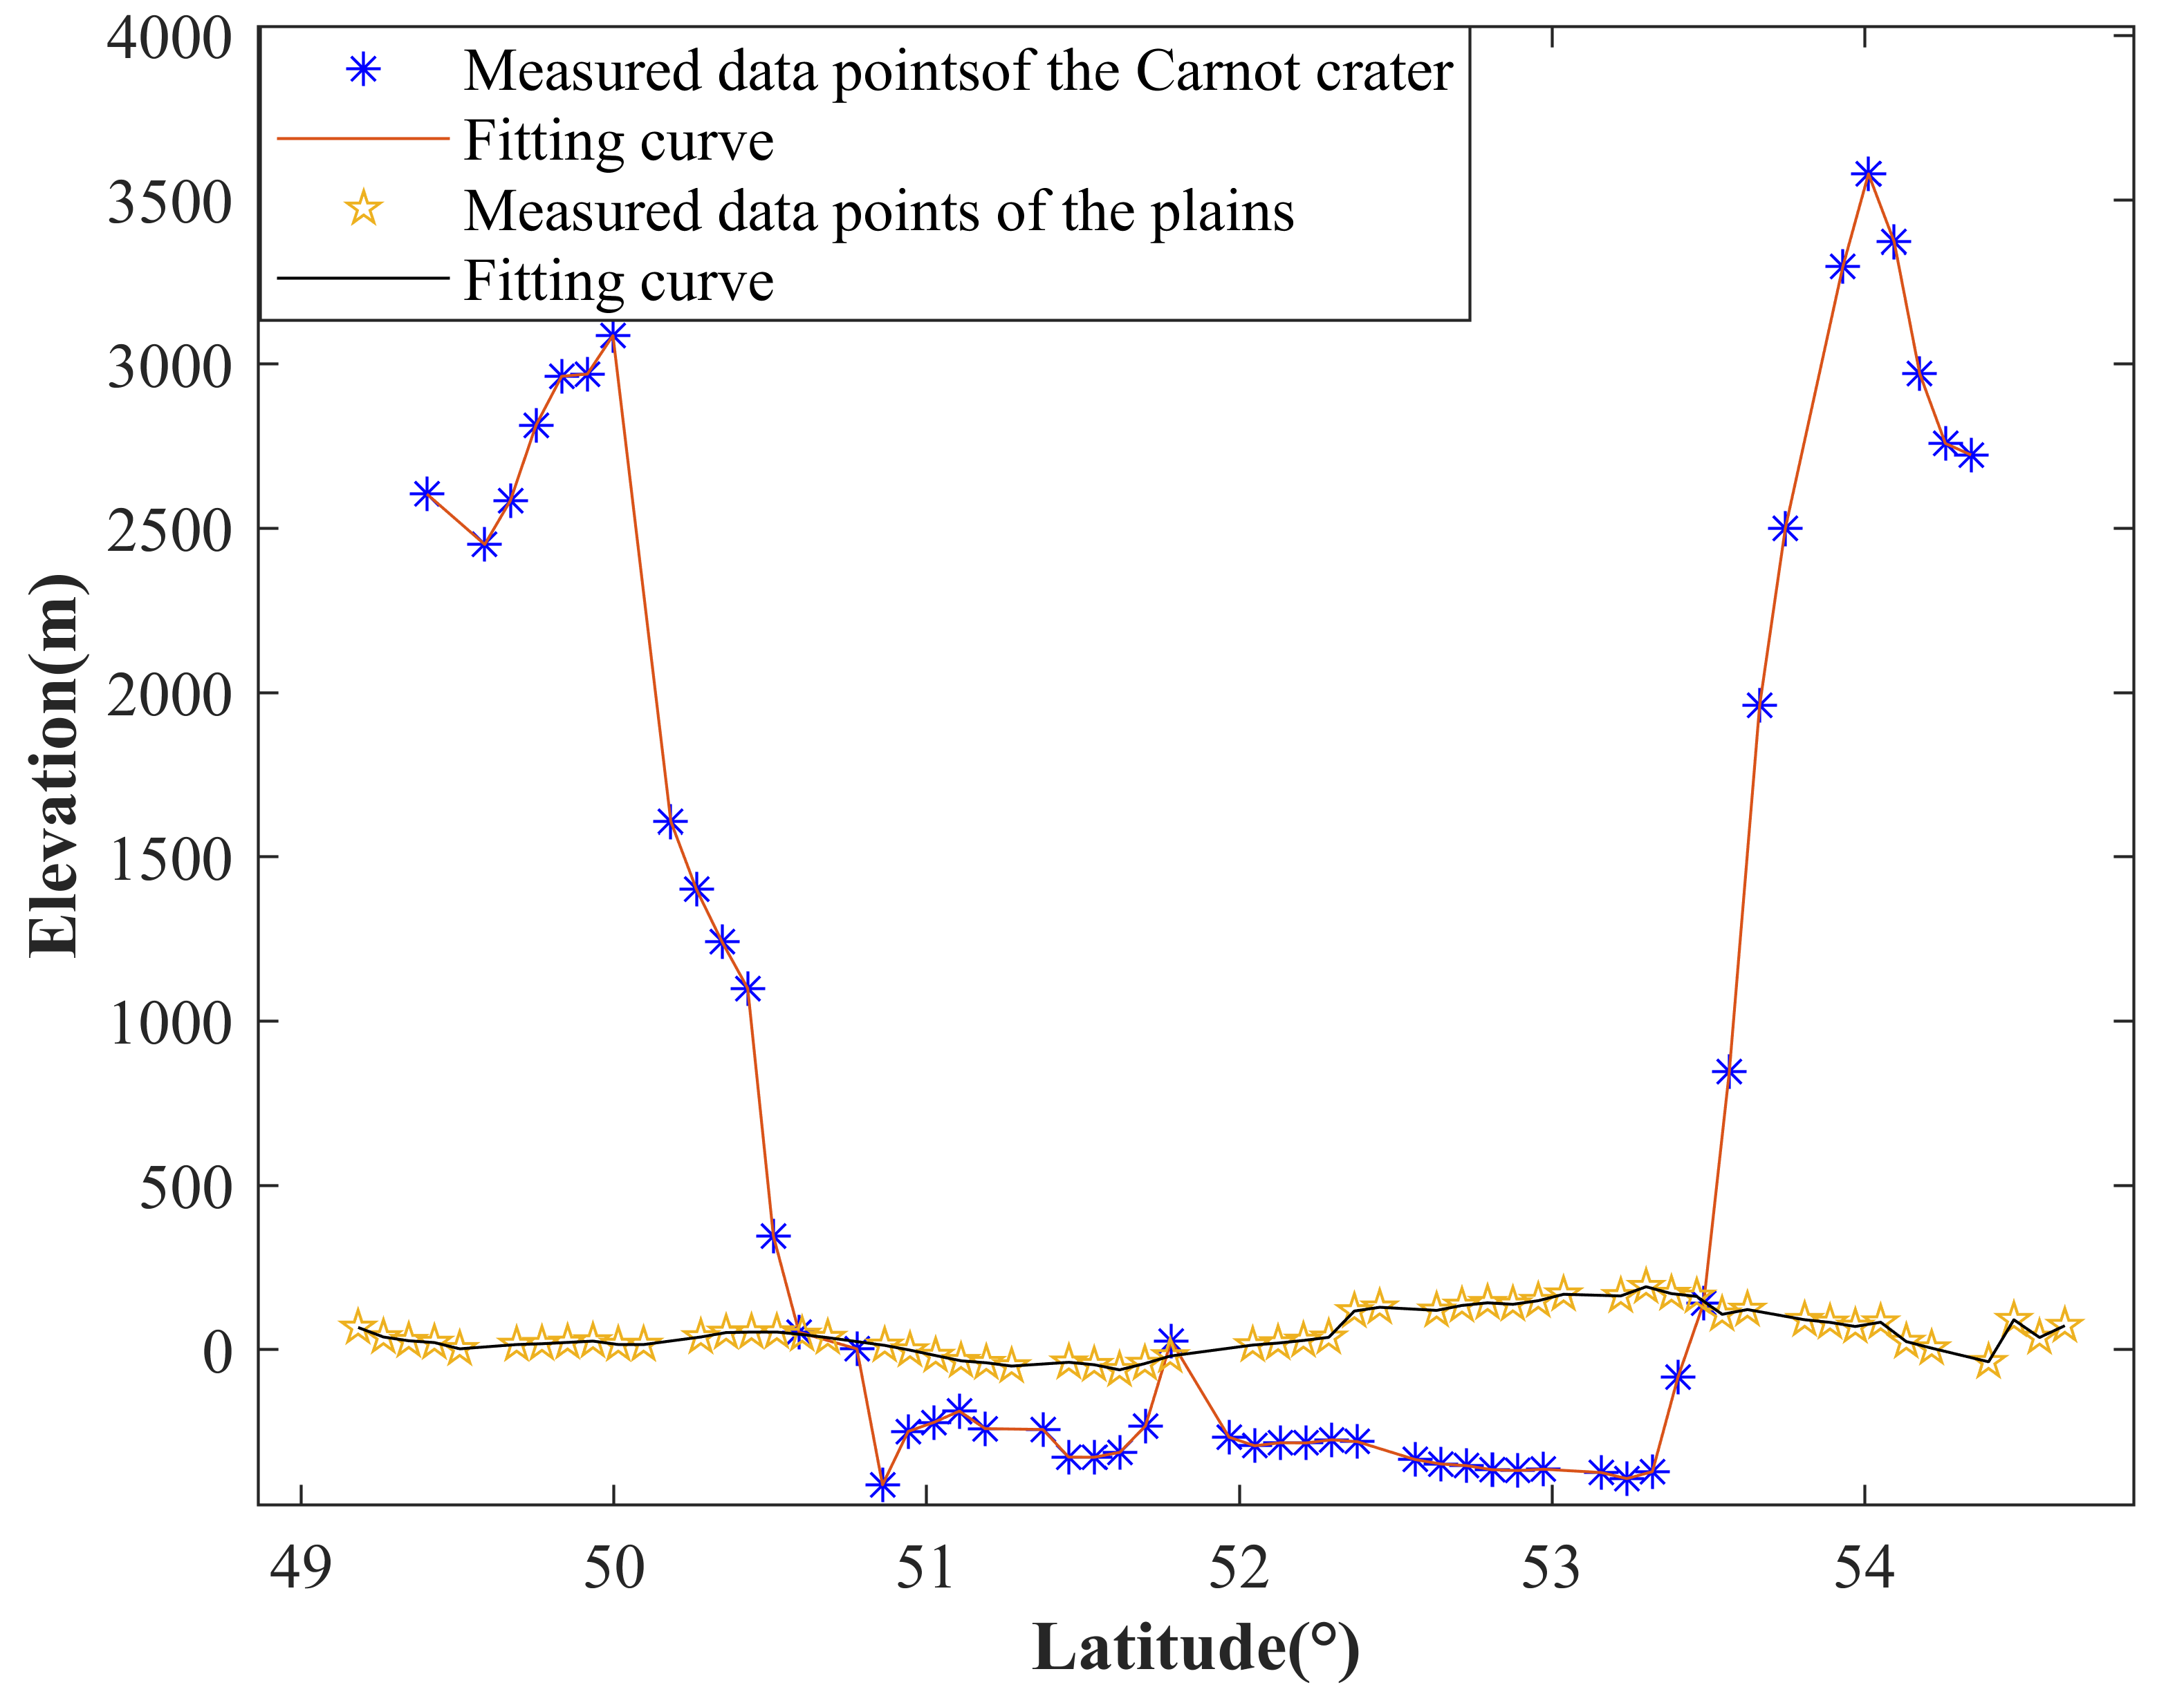
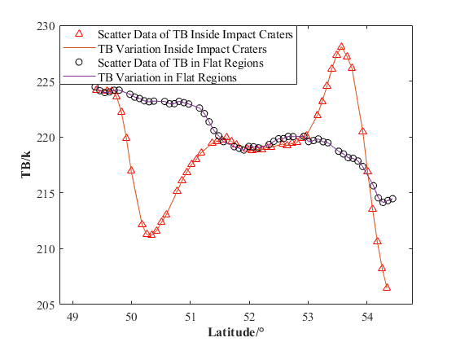
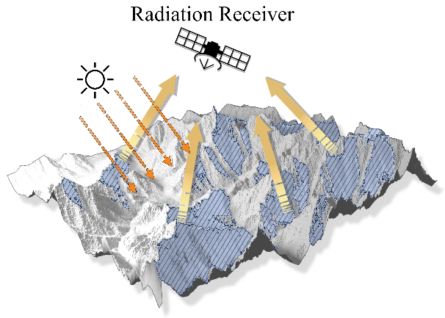
Lunar Brightness Temperature Model
Elevation
Slope
Aspect
Latitude
Notes:
In the model, we incorporated the spatio-temporal factors that affect solar radiation, such as slope, aspect, time, etc., to optimize the model.

Slide 10
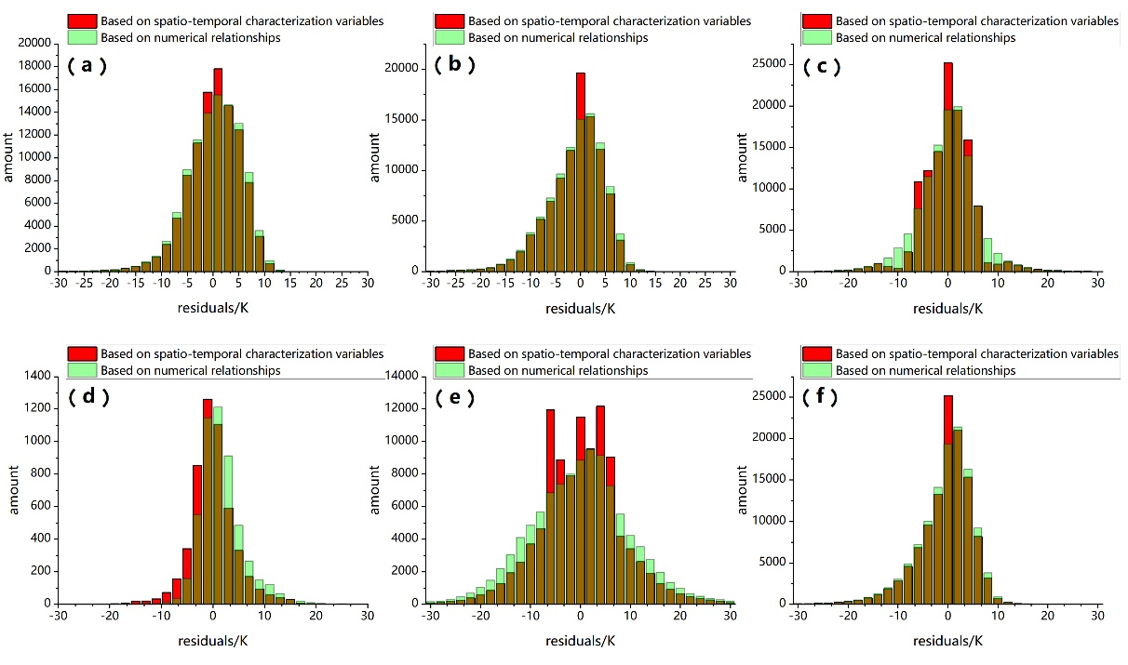
Lunar Brightness Temperature Model
Residual distribution of the multi-source TB relationship model before and after adding spatio-temporal characteristic variables.
(a）0:00 am.（b）4:00 am.（c）8:00 am.（d）12:00 am.（e）4:00 pm.（f）8:00 pm.
Notes:
As we can see, the model's performance has been improved to some extent after accounting for the influence of the spatio-temporal characteristic variables.

Slide 11
Lunar Brightness Temperature Model
Statistics of residuals generated by the multi-source BT relation model before and after adding spatio-temporal characteristic variables
Notes:
By conducting an accuracy test on the simulated microwave BT produced by the model, we can observe that the errors in the simulated microwave BT decrease significantly at different time periods.

Slide 12
02
Spatio-temporal Fusion Model to Reconstruct Brightness Temperature data
Notes:
The second part is the Spatio-temporal Fusion Model that we have established.

Slide 13
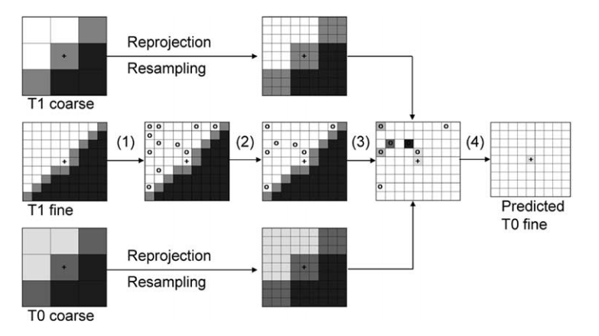
Spatio-temporal Fusion Model
In the fusion model, we chose the spatio-temporal adaptive reflectivity fusion model (STARFM) algorithm proposed by Gao ,et al to fuse microwave BT and simulated microwave BT. Using this method, we can mix the high-frequency temporal information from Chang'e microwave BT and the high-resolution spatial information from Diviner infrared BT.
Predicted time
acquisition date
Predicted time
acquisition date
[1] Gao F , Masek J G , Schwaller M R ,et al.On the Blending of the Landsat and MODIS Surface Reflectance: Predicting Daily Landsat Surface Reflectance[J].IEEE Transactions on Geoscience and Remote Sensing, 2006
Notes:
We choose the spatio-temporal adaptive reflectivity fusion model (STARFM) as the model foundation and adjust the model according to our data. .Using this method, we can mix the high-frequency temporal information from Chang'e microwave BT and the high-resolution spatial information from Diviner infrared BT.

Slide 14
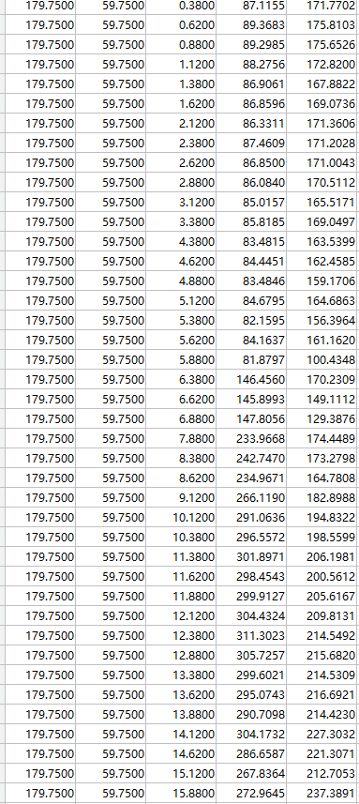
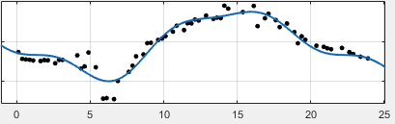
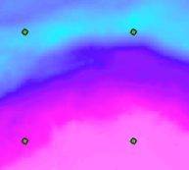
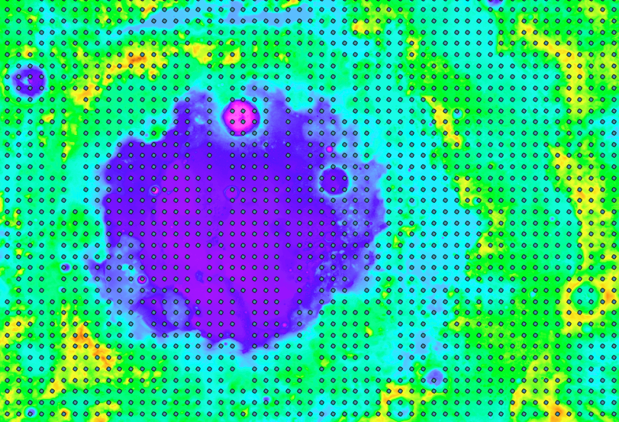
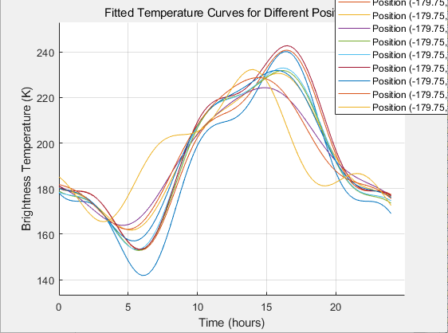
Spatio-temporal Fusion Model
Based on the time-space fusion (STARFM) algorithm, we simulate the complete time series information of microwave TB.
Notes:
The core of the model is that we can obtain the time series information of microwave BT changes in any region of the moon. Based on the spatio-temporal continuous "simulated microwave BT", the distribution of microwave BT at any time and any location can be reconstructed.

Slide 15
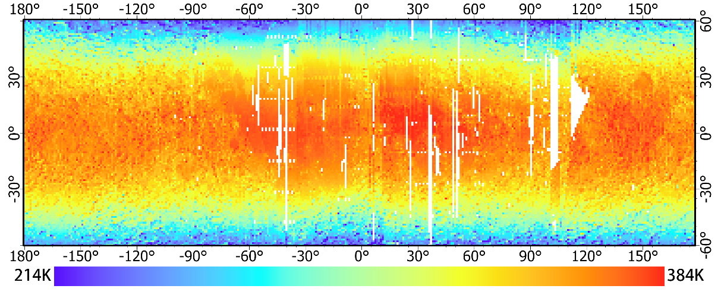
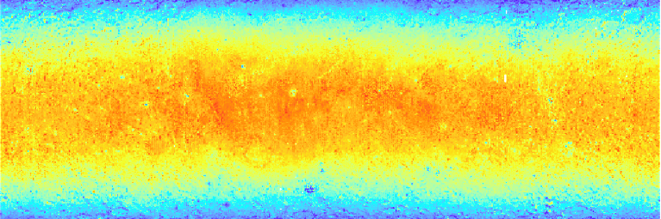
Spatio-temporal Fusion Model
Simulate microwave BT time series information
Chang'e microwave BT measured data
12：00 fusion microwave BT
Notes:
The figure shows the fusion lunar microwave BT distribution at 12 o'clock, we can see that the phenomena of spatial and temporal discontinuity and low spatial coverage of CE-2 microwave BT data have been significantly improved.

Slide 16

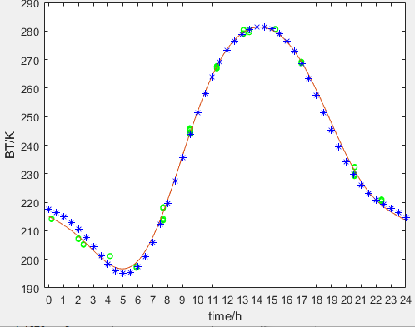
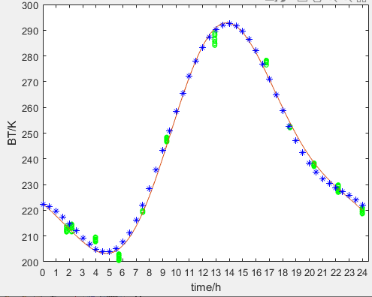
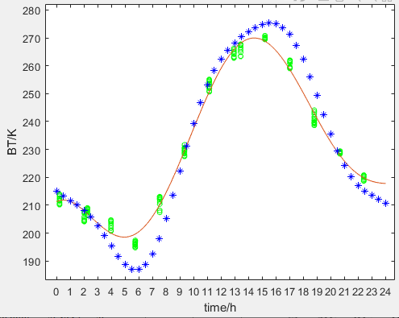
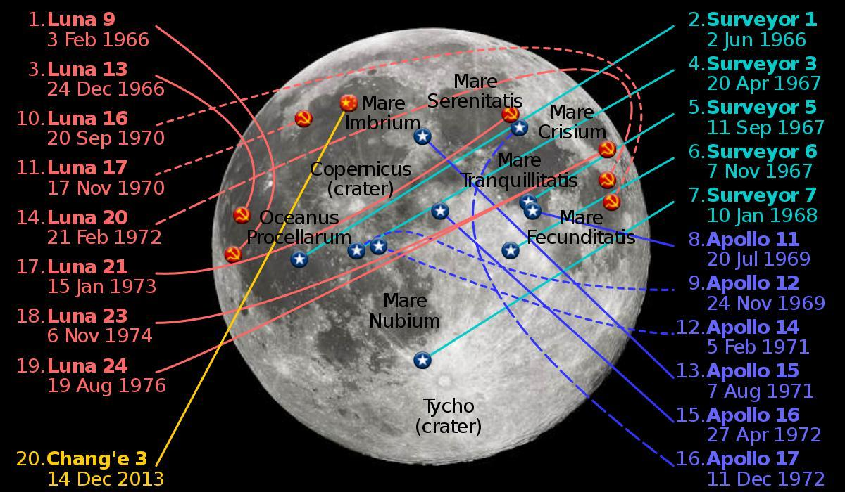
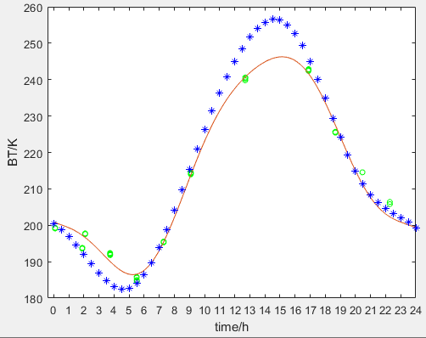
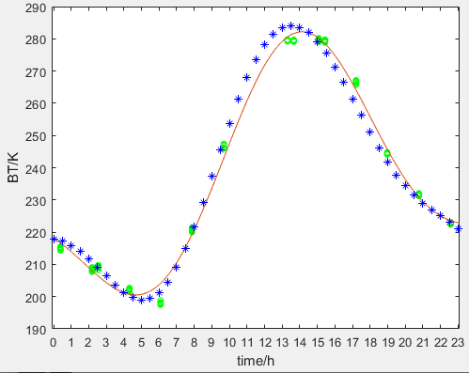
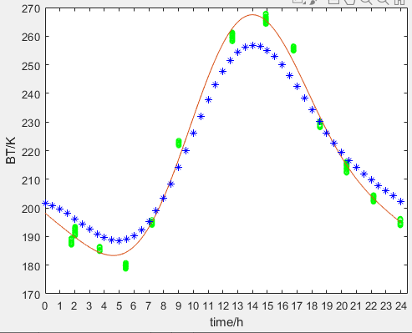
Spatio-temporal Fusion Model
Chang'e microwave BT
Diurnal variation of BT
Predicting microwave BT
Area | Lat | Lot
Mare Serenitatis | 31.5°W | 44.1°N
Apollo 12 | 23.2°W | 3.0°S
Apollo 15 | 3.4°E | 26.1°N
Apollo 16 | 15.3°E | 9.0°S
Lunar 20 | 56.4°E | 3.5°N
CE 5 | 51.5°W | 43.0°N
Mare Serenitatis
Apollo 12
Apollo 15
Apollo 16
Lunar 20
CE 5
Notes:
We selected some areas to verify the accuracy of the method, and we can see that in most areas the reconstructed fusion microwave BT and the measured microwave BT are in good agreement.

Slide 17
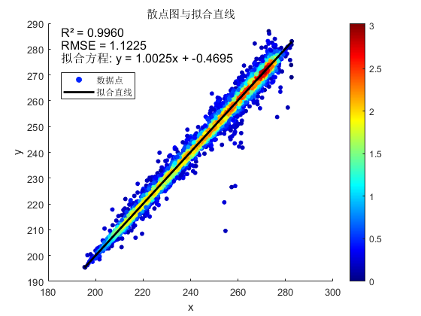
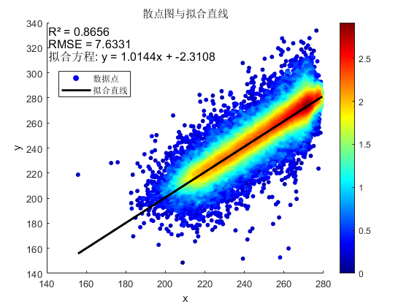
Spatio-temporal Fusion Model
The obtained 12:00 fused microwave BT dataset was verified with the measured microwave BT data (11.875-12.125) and the simulated microwave BT data (12.12) to prove the accuracy and reliability of the fused microwave BT dataset.
Predicting microwave BT & Chang'e microwave BT
Predicting microwave BT & Simulate microwave BT
Notes:
The Multi-correlation coefficient between the reconstructed fusion microwave BT, the measured microwave BT and the simulated microwave BT can reach 0.99 and 0.86, which are in good agreement. It can be said that the distribution of the lunar microwave BT has been reconstructed more accurately

Slide 18
03
Selection of pseudo-invariant calibration sites (PICS)
Notes:
Based on the above dataset, we have conducted some applications for satellite microwave radiation calibration. Using the method of evaluating coefficient of variation (CV), we have extracted the appropriate pseudo-invariant calibration sites (PICS) on the moon.

Slide 19
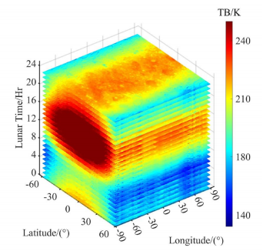
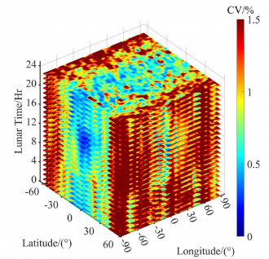
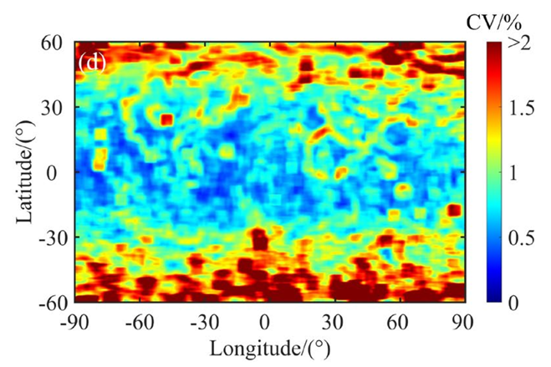

Selection of pseudo-invariant calibration sites (PICS)
The generated 24-hour Fusion
Microwave BT at 37GHz
The generated 24-hour CV at 37GHz
The CVs maps at 37GHz
Notes:
①We choose the frontal region of the moon as our study area, Used the generated 24-hour lunar 37 GHz microwave BT as the data base,
②Calculate the CV values and obtain the CV distribution for the entire day,
③Average the CV images at different times to characterize the spatial and temporal uniformity of the study area.

Slide 20



Selection of pseudo-invariant calibration sites (PICS)
Name | Area(km²)
P1 | 113,449
P2 | 22,092
P3 | 36,864
P4 | 51,974
P5 | 71,492
Total | 295,871
Notes:
①Taking 1.5% as the threshold, we initially extracted the regions on the lunar frontal surface suitable for PICS, and we observed that some regions with alternating high and low CV values still appeared.
②In order to identify PICS more accurately, the loss angle tangent is introduced in this study.
③Based on the preliminary extraction, five larger and more suitable areas for PICS were determined.

Slide 21



Selection of pseudo-invariant calibration sites (PICS)
The FTA map of study area
(The black line area is the selected PICS)
The RA map of study area
(The white line area is the selected PICS)
The slope map of study area
(The black line area is the selected PICS)
The FTA, RA and slope of the selected PICS
Notes:
We evaluated the extracted PICS based on the topography and geological information of the Moon. These areas are located in some regions with low iron and titanium contents, low rock abundance and flat terrain, which are suitable as calibration areas.

Slide 22
Conclusions and Discussions
1. Based on the Diviner infrared BT data, we applied the multi-source BT relation model considering spatio-temporal characteristics to establish high-quality simulated microwave BT data, thereby improving the coverage and spatio-temporal resolution of microwave BT data.
2.Based on the method concept of spatio-temporal fusion model, combined with the high spatial resolution of simulated microwave BT and the high temporal resolution of Chang'e microwave BT, the seamless BT distribution of the moon throughout the day at 0.5° spatial resolution was obtained.
3. Five pseudo-invariant calibration sites were finally identified in the lunar-land region by calculating the coefficient of variation to screen out regions with high spatial homogeneity. These areas have significant spatial homogeneity and are suitable as potential reference areas for microwave band calibration of geostationary orbit microwave satellites and satellites orbiting the Moon.
This work was supported by National Science Foundation of China (No.42275149 and No.42230109); National Key Research and Development Program of China (2023YFB3905304); Technical Pre-research Project of Civil Aerospace (No. D040401); Shanghai Aerospace Science and Technology Innovation Fund Project (No. SAST2019-044).
Notes:
Our research demonstrates that by adopting the spatio-temporal fusion method, utilizing the complementary advantages of multi-source lunar BT data and combining the influence of spatio-temporal factors on BT, the fused lunar BT data has been greatly improved in both spatiotemporal resolution and spatial coverage. The five pseudo-invariant calibration sites we have selected in frontal region of the moon are suitable for use as potential reference areas for microwave band calibrations of microwave satellites in geostationary orbit and satellites orbiting the Moon.

Slide 23
THE END
Thanks for your attention!
惟真求新
Reporter：Lide Zhu
Correspondence: zld0122@sdust.edu.cn
Notes:
Sorry, as a graduate student, my English listening and speaking skills are rather limited. If there are any questions I answered incorrectly or I have not explained the content on the slides clearly enough, please feel to communicate with me via email. That's all .Thanks for your attention!

