Slide 1
Update on Cal/Val Plans for MWS (Microwave Sounder on EPS-SG)
Tim Hewison, Imke Krizek, Jörg Ackermann (EUMETSAT)
19 March 2025, GSICS Annual Meeting

Slide 2
Agenda
Introduction to MWS
Cal/Val Objectives
Tasks
Phases
Process
Tests
Tool Box

Slide 3
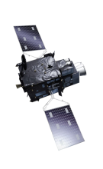
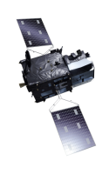

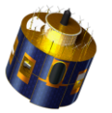

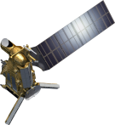
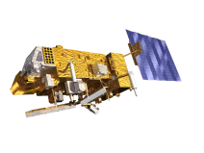
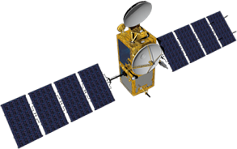
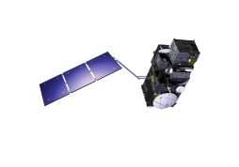
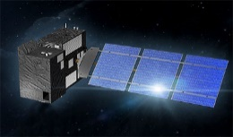

EUMETSAT missions – current and future
Geostationary
Programmes
MTG-I
Imagery
Dec. 2022
MTG-S
Sounding
2025
Meteosat-10
2013
MSG-4 / Meteosat-11
In-Orbit Storage 2016
Prime Satellite 2018
Mandatory
Programmes
Meteosat-9
2006
Polar
Programmes
Metop-B
2013
Metop-C
2018
Metop-SGA
Sounding & Imagery
2025
Metop-SGB
Microwave Imagery
2026
JASON-2
2009
Optional and
Third Party
Programmes
(incl. Copernicus)
Mandatory Polar Programmes:
EPS and EPS-SG
Sentinel-3A
2016
JASON-3
2016
Sentinel-5
on Metop-SG A
2025
Sentinel-4
on MTG-S
2025
Sentinel-3B
2018
JASON-CS/
SENTINEL-6
2021
CO2M
2026/27

Slide 4

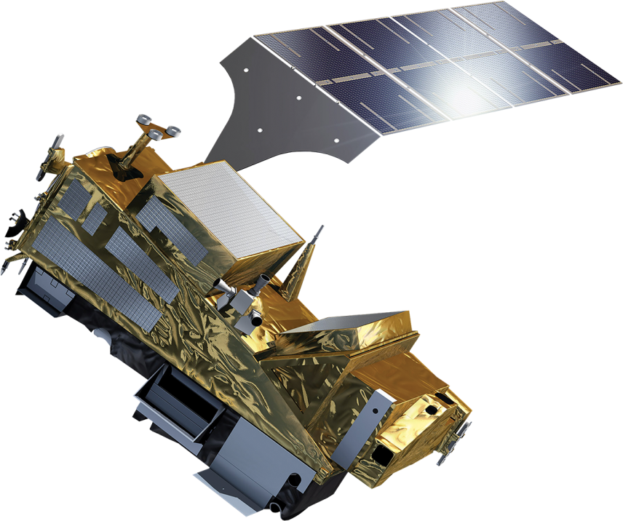
EPS-SGA Sounding and Imagery Mission
IASI-NG
Infrared Atmospheric Sounding
MWS
Microwave Sounding
METImage
Visible-Infrared Imaging
RO
Radio Occultation
3MI
Multi-viewing, -channel, -polarisation Imaging
Copernicus Sentinel-5
UN/VIS/NIR/SWIR Sounding
4
5
2
1
6
4
3
Launch window starting August 2025
https://www.eumetsat.int/metop-sg

Slide 5
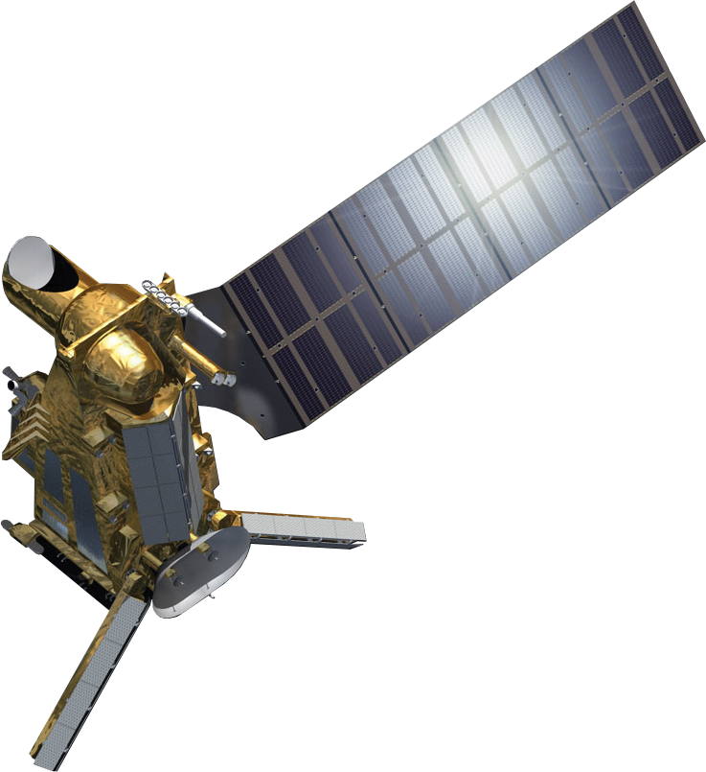
EPS-SGB Microwave Imagery Mission
SCA
Scatterometer
RO
Radio Occultation
MWI
Microwave Imaging for Precipitation
ICI
Ice Cloud Imager
ARGOS-4
Advanced Data Collection System
3
2
5
4
1
1
2
Launch window starting 2026Q2
https://www.eumetsat.int/metop-sg
1

Slide 6
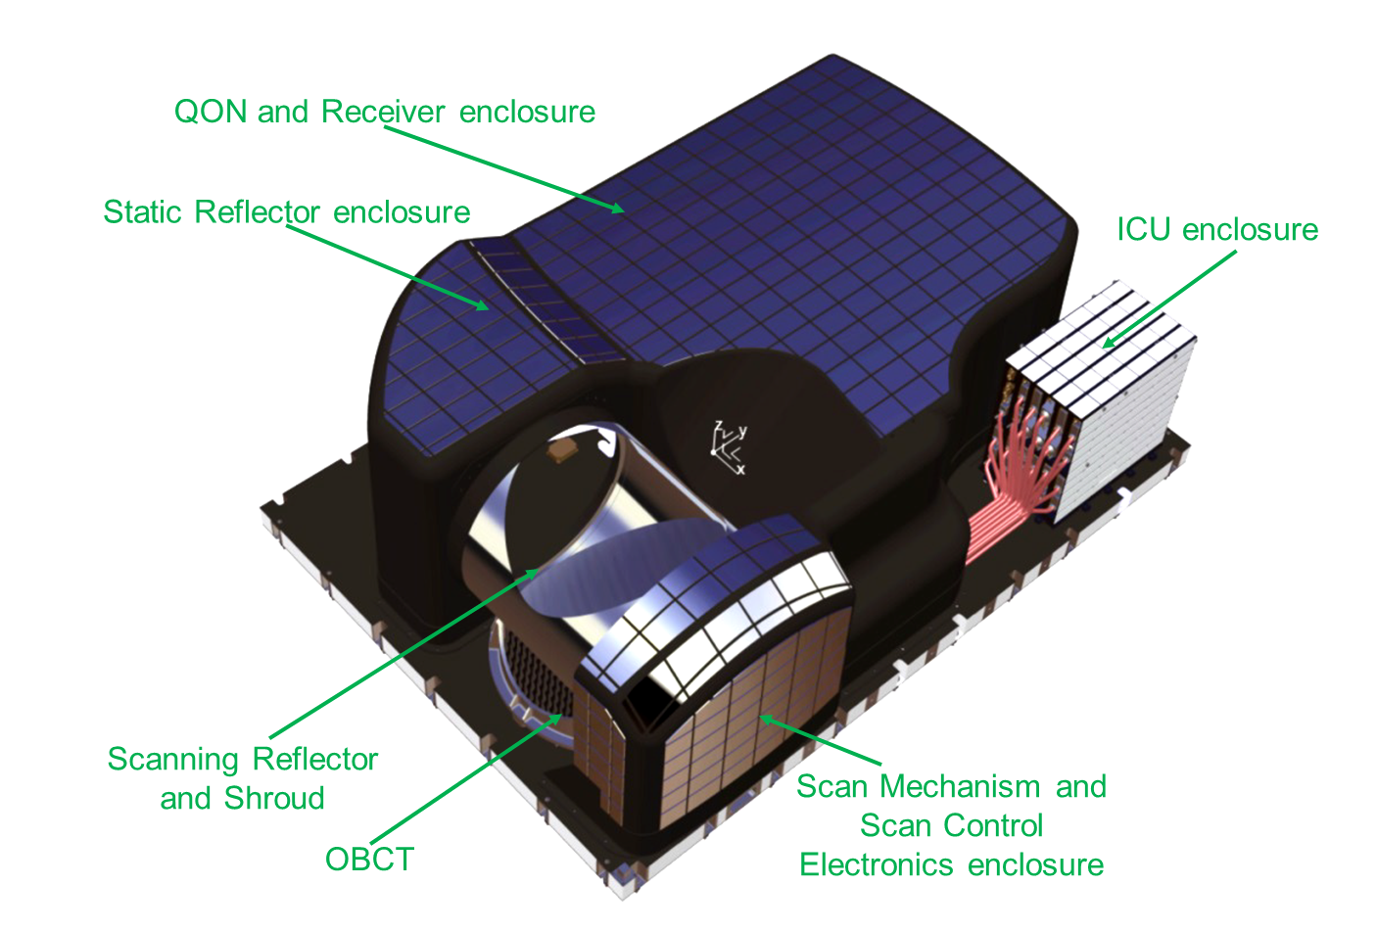
EPS-SG Microwave Sounder MWS
Primary role: Temperature and humidity sounding
Compact design: combines heritage to both AMSU-A and MHS on board NOAA and Metop satellites
Cross track scanner with 95 pixels per scan line and footprint diameter between 15 km and 40 km at nadir
Total of 24 channels: Bands in range 23-229 GHz:
  23-89 GHz: heritage AMSU-A
  89-183 GHZ: heritage MHS
  New channels:
    in AMSU-A range:
      53.246±0.080 GHz (CH 5)
      53.948±0.081 GHz (CH 7)
    → temperature sounding
    ATMS-like channels:
      183.311±4.5 GHz (CH20)
      183.311±1.8 GHz (CH22)
    → humidity sounding
    229 GHz (CH24): detection of cirrus clouds for improved humidity sounding
Fig. provided by ESA; in EPS-SG MicroWave Sounder (MWS) Science Plan
Location of MWS channels 4 – 16 relative to oxygen spectrum

Slide 7
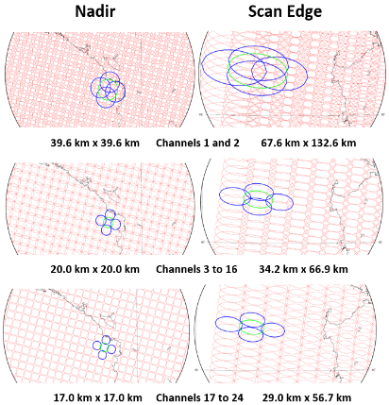
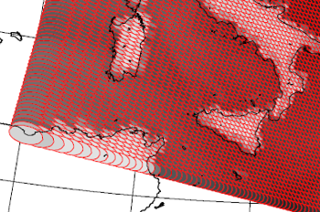
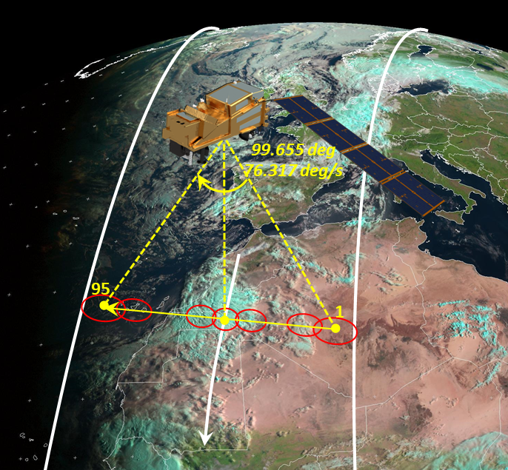
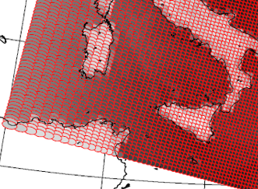
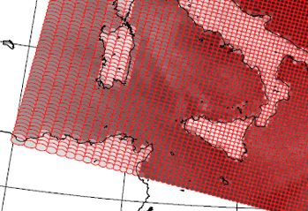
MWS Characteristics: geometry, resolution
24 channels
Cross-track scanner: 95 pixels, ~2200 km swath, 2.254 s scan duration
Resolution from 17 km to ~40 km at Nadir (channel dependent)

Slide 8
Characteristics: geometry, resolution
23.8 GHz
31.4 GHz
Comparing resolution to AMSU
AMSU brightness temperatures for Channel 1 and 2
(Metop-A, 12/08/2007)
23.8 GHz
31.4 GHz
corresponding simulated measurements from MWS-1 and MWS-2
MWS TBs have been simulated using the RTTOV radiative transfer model (MWS coefficients evaluated by E. Turner, UK MetOffice) with input ECMWF short-term forecasts relative to the observation date and time.

Slide 9
MWS Characteristics: spectral
Total of 24 channels
Bands in range 23-229 GHz:
  23-89 GHz: heritage AMSU-A
  89-183 GHZ: heritage MHS
  New channels:
    in AMSU-A range:
      53.246±0.080 GHz (CH 5)
      53.948±0.081 GHz (CH 7)
    → temperature sounding
    ATMS-like channels:
      183.311±4.5 GHz (CH20)
      183.311±1.8 GHz (CH22)
    → humidity sounding
    229 GHz (CH24): detection of cirrus clouds for improved humidity sounding
AMSU/MWS channels in blue, new MWS channels in red
Location of MWS channels 4 – 16 relative to oxygen spectrum

Slide 10
Characteristics: spectral
52.8 GHz
53.246 ± 0.08 GHz
53.596±0.115 GHz
53.948 ± 0.081 GHz
54.4 GHz
The new MWS channels 5 and 7 sense a portion of the atmosphere between the ‘classic’ AMSU channels

Slide 11
Processing: MWS Level 1B (global)
Input: MWS Level 0 / NAVATT data sets
Auxiliary input files
Geolocation
Calibration:
  Detection of possible pulsed interferences on oversampled CH1 and CH2
  Warm and cold target corrections
  Linear calibration + non-linear contribution
  Correction for non-unity scanning mirror reflectance
  Antenna pattern correction
Detailed processing quality flags
Output in NetCDF/BUFR format

Slide 12
Processing: MWS Level 2
Input: Level 1B data set
Auxiliary input
Product:
  Total precip. Water (TPW) from 23 GHz and 31 GHz channels, over sea, ±50º Latitude
    → support cloud detection for IR/ VIS radiometers
  Limb-corrected brightness temperatures
Output in NetCDF format

Slide 13
Definitions
Calibration:
The process of quantitatively defining the instrument response to known, controlled signal inputs
→ Instrument response: Measurement view counts
→ Known, controlled signal inputs:
      Deep space radiance
      Deep space reflectivity
      On-board calibration target radiance
      Vicarious calibration target radiance
      Vicarious calibration target reflectivity

Slide 14
Definitions
Validation:
The process of assessing by independent means the quality of the products derived from the instrument output
→ Products derived from the instrument output:
      L1: calibrated, geolocated Earth view radiances and reflectances, spectra, bending angles
      L2: surface properties and temperature, trace gases and aerosols, land use and forest fires, temperature and humidity profiles, cloud fraction and cloud properties, winds, stability indices

Slide 15
Objectives
Compare in orbit instrument performance with pre-launch calibration and characterisation
Validate L1 and L2 operational products to meet the end-user requirements or even exceed the specifications
Assure that the products are compliant with the end-user requirements or even exceed the specifications during the lifetime of the respective mission

Slide 16
Calibration and Validation
~6 months period after launch
~16 tests against requirements to review performance: e.g.
  Monitoring: radiometric sensitivity (NedT), count limits
  Spectral tests: frequency stability
  Geometrical tests: geolocation, co-registration
  Radiometric bias tests: Simultaneous Nadir Overpasses (SNO), collocation with other data
Structural planning for Software Toolbox in preparation

Slide 17
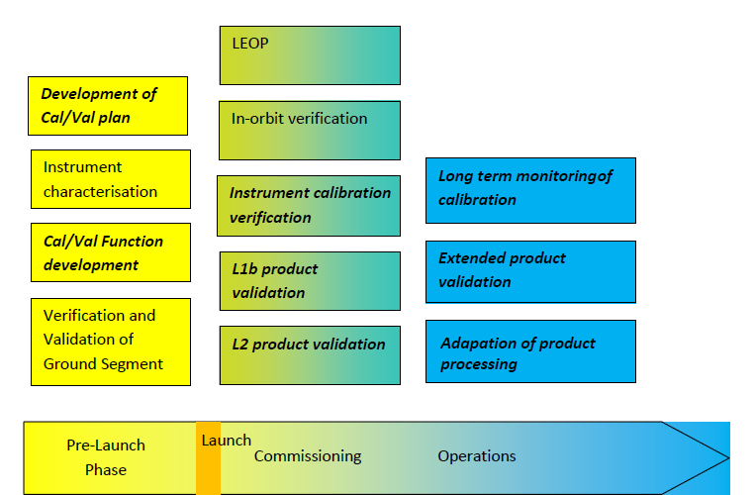
Phases
PL
CO
OP

Slide 18
Tasks
Draft Cal/Val Plans
Development of appropriate Cal/Val software
  (radiative transfer models, collocation tools, comparison statistics incl. random error and bias estimation)
In-depth analysis of consistency between operational processor outputs and reference datasets
  generated by e.g. a fully validated prototype
Collection of suitable independent validation data sets,
  i.e. measurements from ground based, airborne, and other satellites
Provision of environmental data to characterise a reference status of the Earth/Atmosphere system
  (e.g. ECMWF re-analysis)
Application/adaption of Cal/Val software to real data
Organise and collect early feedback from the user community
In case of need, iterative validation and re-processing to obtain products of improved quality
  (e.g. re-run of validation after processor update)
Maintenance and extension of operational product processing facilities
  through updated algorithms and auxiliary data sets
Continuous monitoring of product quality
PL
PL
PL, CO
PL, CO
CO
CO
CO
CO, OP
OP
OP

Slide 19
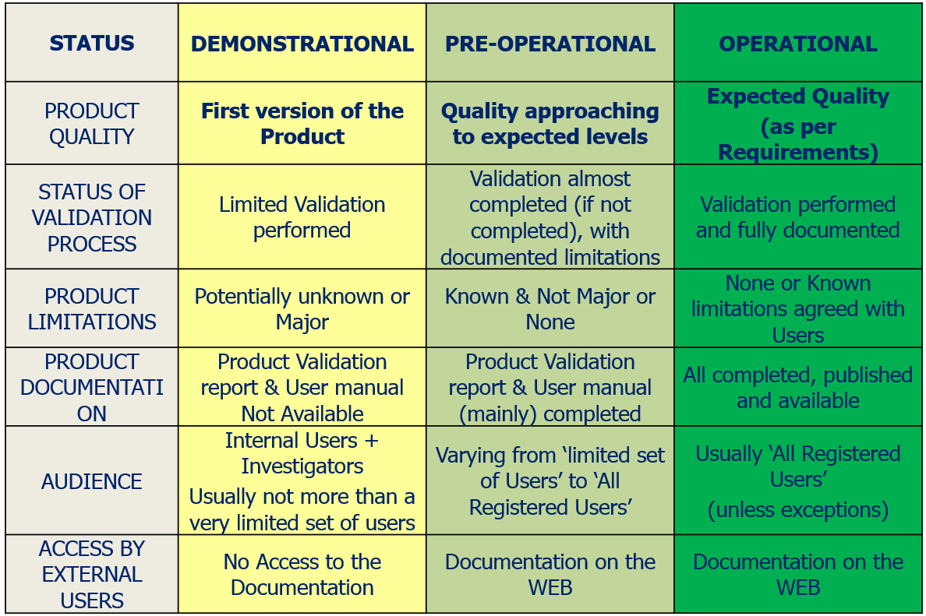
Process
A product validation review board gives a recommendation concerning the declaration of the product status:

Slide 20
Cal/Val Tests
Requirement |  |  | Test | Pre-Launch | Commissioning | Operations | Development of Test Tools | Mandatory/ Beneficial
Spectral | Frequency Stability | MWS-02040 | MWS_CVT_FREQ_STABIL | PL | CO |  | In-house with user feedback | Mandatory
 | Spectral Response Shape | MWS-02050 | MWS_CVT_SRF_SHAPE | PL | CO |  | In-house solely | Beneficial
Radiometric | Dynamic Range | MWS-02070 | MWS_CVT_DYN_RANGE | PL | CO | OP | In-house solely | Mandatory
 | Radiometric Sensitivity | MWS-02080 | MWS_CVT_NEDT | PL | CO | OP | In-house solely | Mandatory
 | Radiometric Bias | MWS-02090 MWS-02100 MWS-02110 | MWS_CVT_BIAS_SNO_METOP | PL | CO |  | In-house solely | Beneficial
 |  |  | MWS_CVT_BIAS_SNO_NOAA |  |  |  | In-house solely | Mandatory
 |  |  | MWS_CVT_BIAS_SNO_FY |  |  |  | In-house solely | Beneficial
 |  |  | MWS_CVT_BIAS_GPSRO |  |  |  | In-house solely | Mandatory
 |  |  | MWS_CVT_BIAS_RADIOSONDE |  |  |  | In-house solely | Beneficial
 |  |  | MWS_CVT_BIAS_AIRCRAFT |  |  |  | In-house solely | Beneficial
 |  |  | MWS_CVT_BIAS_NWP |  |  |  | In-house with user feedback | Beneficial
 | Interchannel and Interpixel radiometric bias | MWS-02120 MWS-02130 | MWS_CVT_BIAS_ROLLMAN | PL | CO |  | In-house solely | Mandatory
 | Polarisation | MWS-02140 | MWS_CVT_POL | PL | CO |  | In-house solely | Mandatory
Geometric | Viewing Angle | MWS-02150 MWS-02220 | MWS_CVT_VIEWANG |  | CO |  | In-house solely | Mandatory
 | Footprint | MWS-02155 MWS-02160 MWS-02165 | MWS_CVT_FOOTPRINT |  | CO |  | In-house solely | Mandatory
 | Geolocation | MWS-02170 MWS-02210 | MWS_CVT_GEOLOC | PL | CO |  | In-house solely | Mandatory
 |  |  | MWS_CVT_SUBPIXELACCURACY |  |  |  |  | Beneficial
 | Co registration | MWS-02200 | MWS_CVT_COREGISTRATION | PL | CO |  | In-house solely | Beneficial
L2 TPW product |  |  | MWS_CVT_TPW_SNO_METOP |  | CO |  | In-house solely | Mandatory
 |  |  | MWS_CVT_TPW_SNO_NOAA |  | CO |  | In-house solely | Mandatory
 |  |  | MWS_CVT_TPW_NWP |  | CO |  | In-house solely | Mandatory

Slide 21
Cal/Val Tests
Requirement |  |  | Test | Pre-Launch | Commissioning | Operations
Radiometric | Dynamic Range | MWS-02070 | MWS_CVT_DYN_RANGE | PL | CO | OP
 | Radiometric Sensitivity | MWS-02080 | MWS_CVT_NEDT | PL | CO | OP
 | Radiometric Bias | MWS-02090 MWS-02100 MWS-02110 | MWS_CVT_BIAS_SNO_METOP | PL | CO
 |  |  | MWS_CVT_BIAS_SNO_NOAA
 |  |  | MWS_CVT_BIAS_SNO_FY
 |  |  | MWS_CVT_BIAS_GPSRO
 |  |  | MWS_CVT_BIAS_RADIOSONDE
 |  |  | MWS_CVT_BIAS_AIRCRAFT
 |  |  | MWS_CVT_BIAS_NWP
 | Interchannel and Interpixel radiometric bias | MWS-02120 MWS-02130 | MWS_CVT_BIAS_ROLLMAN | PL | CO
 | Polarisation | MWS-02140 | MWS_CVT_POL | PL | CO

Slide 22
Cal/Val Tests
Requirement |  |  | Test | Pre-Launch | Commissioning | Operations
Spectral | Frequency Stability | MWS-02040 | MWS_CVT_FREQ_STABIL | PL | CO
 | Spectral Response Shape | MWS-02050 | MWS_CVT_SRF_SHAPE | PL | CO
Geometric | Viewing Angle | MWS-02150 MWS-02220 | MWS_CVT_VIEWANG |  | CO
 | Footprint | MWS-02155 MWS-02160 MWS-02165 | MWS_CVT_FOOTPRINT |  | CO
 | Geolocation | MWS-02170 MWS-02210 | MWS_CVT_GEOLOC | PL | CO
 |  |  | MWS_CVT_SUBPIXELACCURACY
 | Co registration | MWS-02200 | MWS_CVT_COREGISTRATION | PL | CO
L2 TPW product |  |  | MWS_CVT_TPW_SNO_METOP |  | CO
 |  |  | MWS_CVT_TPW_SNO_NOAA |  | CO
 |  |  | MWS_CVT_TPW_NWP |  | CO

Slide 23
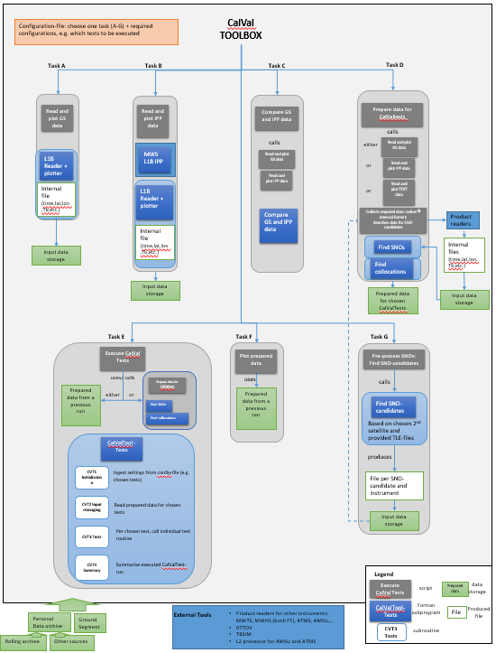
Cal/Val Tools Overview
Implemented software capable of running CalValTests for MWS
The user configures the CalValToolBox run via configuration file
Software calls the procedures, which run the required tools to be executed based on CalValTest chosen by user
Tools include:
  collocation/ SNO-tools
  computation of biases
  generation of plots,…
  External tools (i.e. compiled outside of CalValToolBox):
    Product readers for other instruments
    MWS IPP (L1,L2)
    RTTOV, and related tools for preparation
    TBSIM (collocating MWS and NWP fields, incl. RTTOV run)
Some tools are based on software implemented for EPS CalVal
  (e.g. SNO, subpixel accuracy)
  or EPS Metop-A EOL (mirror reflectivity from roll-manoeuvre)
Illustration of Tool Box structure

Slide 24
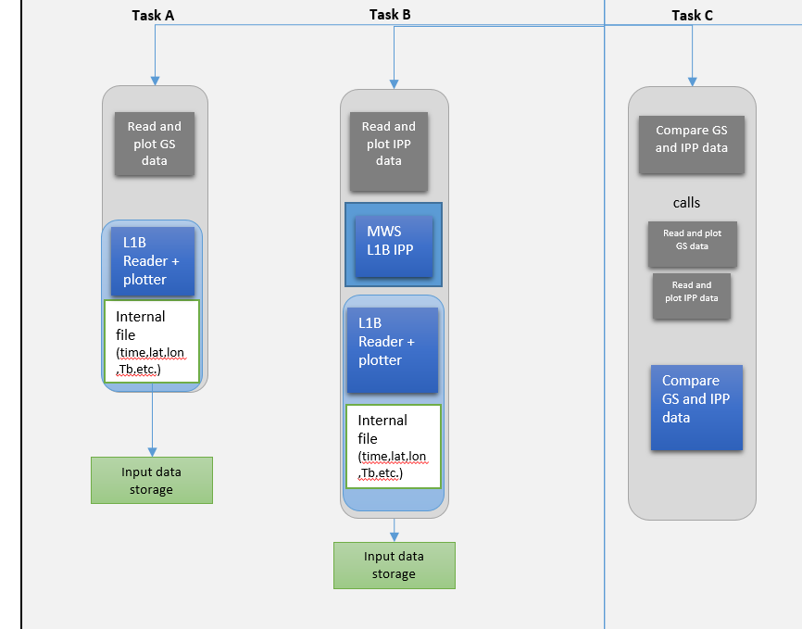
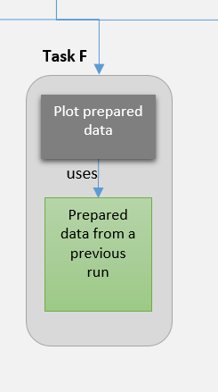
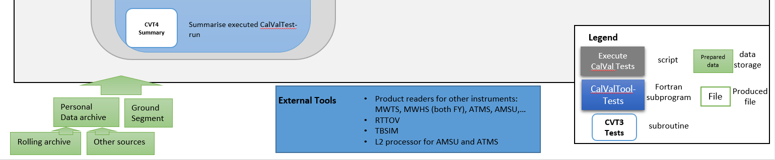
Tasks for accessing MWS data
Tasks for
  accessing MWS data from OP (from Ground Segment) or IPP (run ad-hoc)
  preparing internal file (for later use)
  plotting MWS swath on map
Comparing OP and IPP output via a “Delta”-file
INPUT

Slide 25
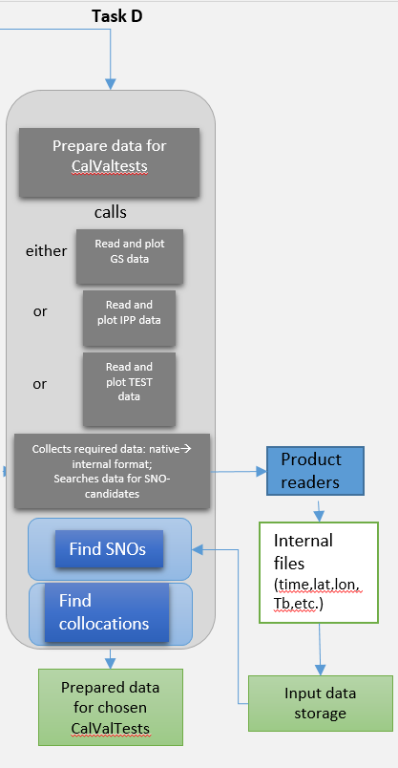
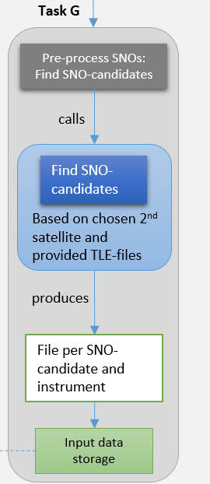
Tasks for Collecting, pre-processing MWS & other data
Pre-process Simultaneous Nadir Overpasses (SNOs): find candidates
Collect, prepare data for CalVal Tests selected by user
  Collecting MWS data (from OP, IPP), prepare internal files
  Collecting required data for comparison:
    from GPSRO, radiosondes
    found SNO-candidates with Metop/ NOAA/FY satellites
  Find SNOs, find collocations → store
External Tools (TBSIM, RTTOV, product readers are used)

Slide 26
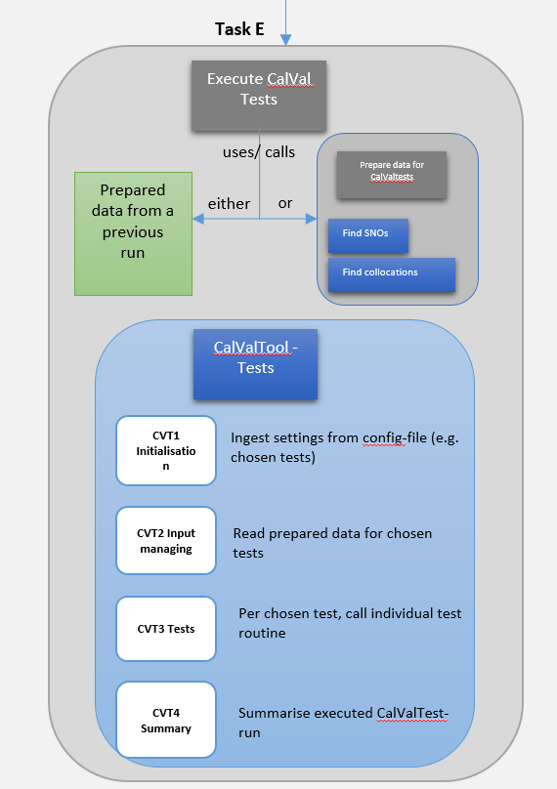
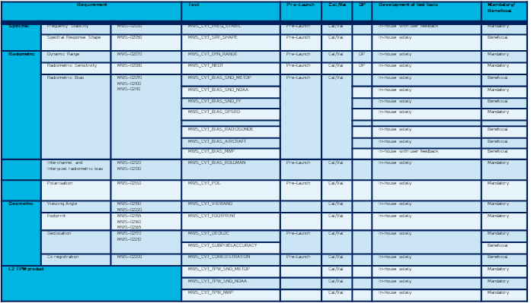
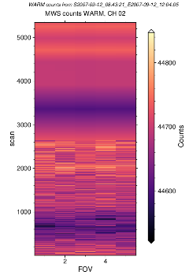
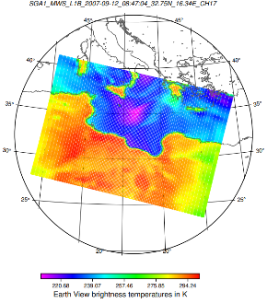
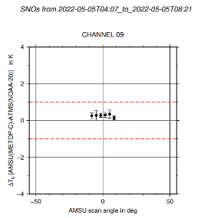
Task: Executing MWS CalVal-Tests
Use prepared data from a previous run (task D)
Or
Prepare data ad hoc
Cal/Val Tests:
Based on corresponding prepared data → execute computation of statistics, biases, according to individual tests
Dynamic range, NEdT,…
Geolocation tests…
Radiometric biases from SNO, …
Produce plots, store results

Slide 27
Thank you!

