Slide 1
[UVN Session, GSICS Annual Meeting 2025]
Current Status of Calibration and Validation for GEMS Level 1 Products
Yeeun Lee¹⁾, Myoung-Hwan Ahn¹⁾, Mina Kang^{2,3)}, Mijin Eo¹⁾, Jeonghyeon Seo⁴⁾, Kyounghwa Lee⁴⁾, Jaehoon Jeong⁴⁾, Dai Ho Ko⁵⁾, Jhoon Kim⁶⁾
¹⁾ Ewha Womans Unversity, Republic of Korea
²⁾ City College of New York, USA
³⁾ NOAA-Cooperative Science Center for Earth System Sciences and Remote Sensing Technologies, USA
⁴⁾ Environmental Satellite Center, National Institute of Environmental Research (NIER), Republic of Korea
⁵⁾ Korea Aerospace Research Institute (KARI), Republic of Korea
⁶⁾ Yonsei University, Republic of Korea
March 19, 2025

Slide 2
GEMS: Five Years of Operation
Air quality monitoring via UV-VIS hyperspectral instrument
SCIAMACHY (ESA, 2002)
Bovensmann et al. (1999)
TROPOMI (ESA, 2017)
Veefkind et al. (2012)
GOME-2 (EUMETSAT, 2006, 2012 & 2018)
Munro et al. (2016)
TEMPO (NASA, 2023)
Zoogman et al. (2017)
2000
2005
2010
2015
2020
2025
...
Since 2000,
OMPS (NOAA, 2011, 2017 & 2022)
Flynn et al. (2014)
UVN/Sentinel-4 (EUMETSAT, TBU)
Gulde et al. (2017)
OMI (NASA, 2004)
Levelt et al. (2006)
GEMS (NIER, 2020)
Kim et al. (2020)
SCIAMACHY: SCanning Imaging Absorption SpectroMeter for Atmospheric CHartographY
OMI: Ozone Monitoring Instrument
GOME-2: Global Ozone Monitoring Experiment-2
OMPS: Ozone Mapping and Profiler Suite
TROPOMI: TROPOspheric Monitoring Instrument
TEMPO: Tropospheric Emissions: Monitoring of POllution
Geostationary Earth Orbit (GEO)
Low Earth Orbit (LEO)

Slide 3
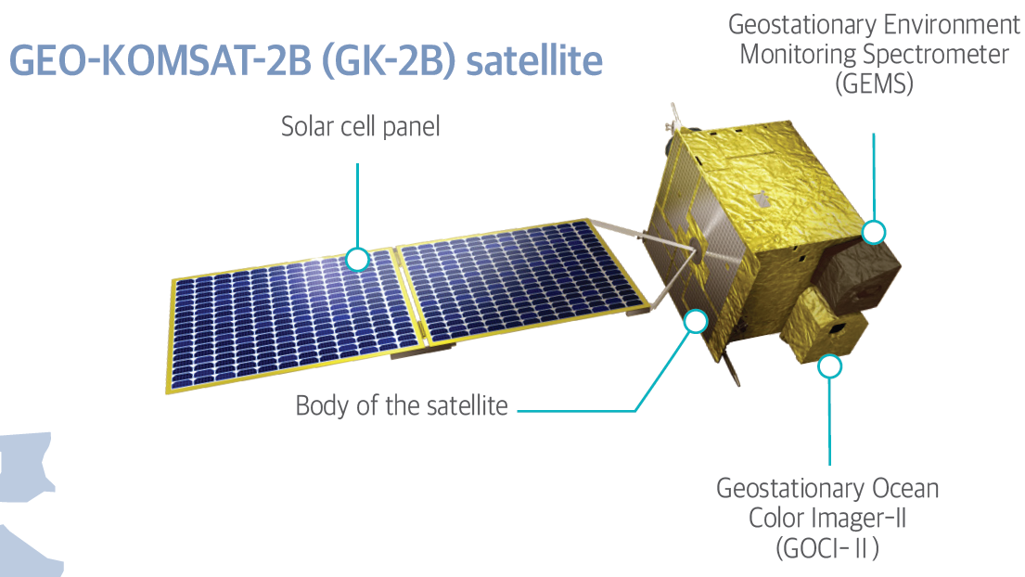
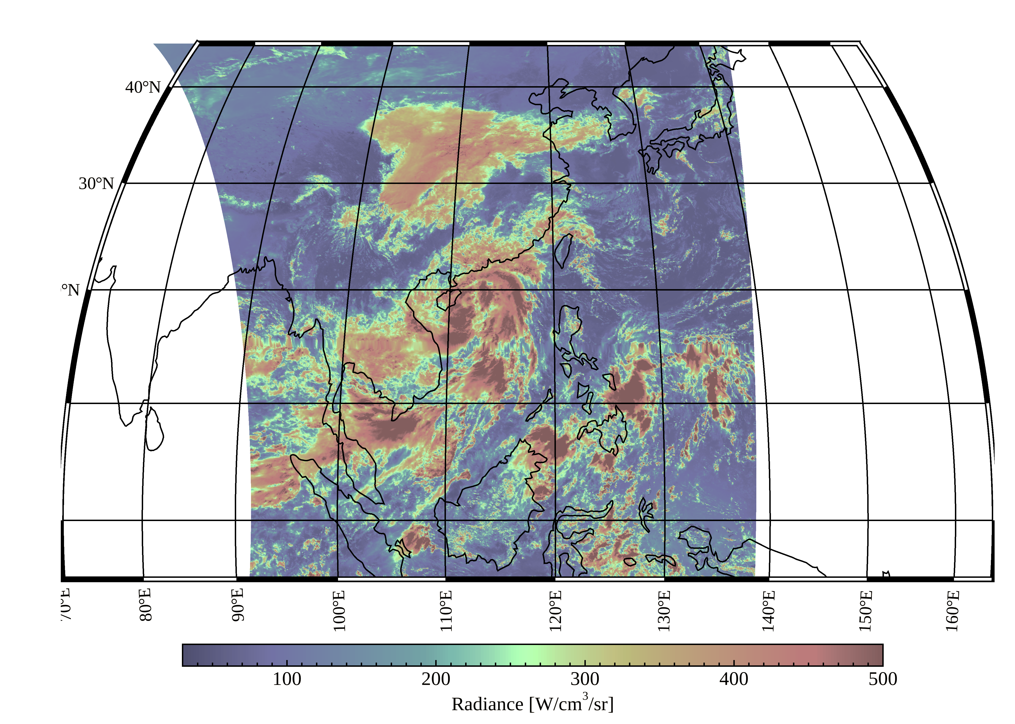
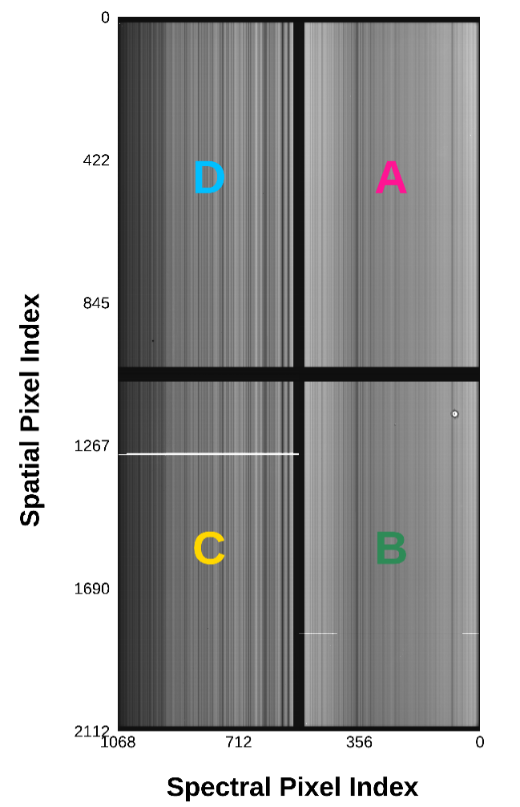
GEMS: Five Years of Operation
Geostationary Environment Monitoring Spectrometer (GEMS)
L2 | Fitting window [nm] | Retrieval
SFC | - | AC-BRDF-BSR
CLD | 460-486 (O2-O2) | DOAS
AEH
AOD | 354, 388, 412, 443, 477, 490 | OE
NO2 | 432-450 | DOAS + STS
SO2 | 312-335 | DOAS + PCA
O3P | 310-340 | OE
O3T | 312.34, 317.35, 331.02, 340, 354, 360, 380 | OE
VOC | 329.3-358.6 (HCHO) 433.0-461.5 (CHOCHO) | BOAS
UVI | 354 nm | LUT
East Asia & the Pacific (3.5 $×$ 7.7 km²)
Every hour during daytime (7~8 times)
300-500 nm (FWHM<0.6 nm)
W
E
@ 487 nm

Slide 4
GEMS: Five Years of Operation
Level 0-1B Process
Level 0
Stray Light Correction
Co-addition Correction
(Ir)radiance Calibration
Green Box: updates
Pixel Flagging
Diffuser BTDF
Crosstalk/
Nyquist Phase Correction
Spectral Shift Correction
Spectral Shift Correction
Offset/Linearity Correction
2-Pixel Binning
2-Pixel Binning
Smear Correction
Spatial Registration
Spatial Registration
Gain/
FPE Temperature Correction
L1B-Earth
L1B-Solar
Integration Time/PRNU
BTDF Correction
Dark Correction
Empirical correction
(On-going update)
Degradation Correction
Geometric Calibration

Slide 5
GEMS: Five Years of Operation
Level 0 & observation frequency
Level 0
Frequency
Dark
2 times a day
Earth
NOR (L0)
8 times a day during daytime (mostly 23, 00-07 UTC)
Solar Dark
Every day (right before solar observation)
Solar diffusers
WSD (L0)
Every day (mostly 13-14 UTC before local midnight)
RSD (L0)
2 time a year (near the Equinox)
Onboard
Calibration System
: To monitor sensor response changes and channel band centers.
LED Dark
Every week (right after LED observation)
LED
LED (L0)
Every week (17 UTC)
: To verify pixel aliveness and monitor non-linearity.
Long-term observation data have been accumulated - over 4.5 years

Slide 6
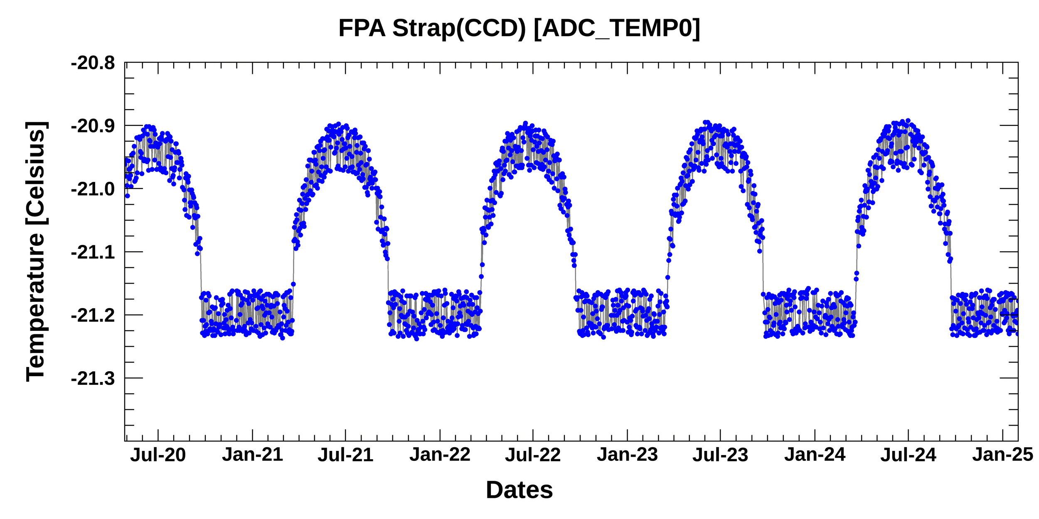
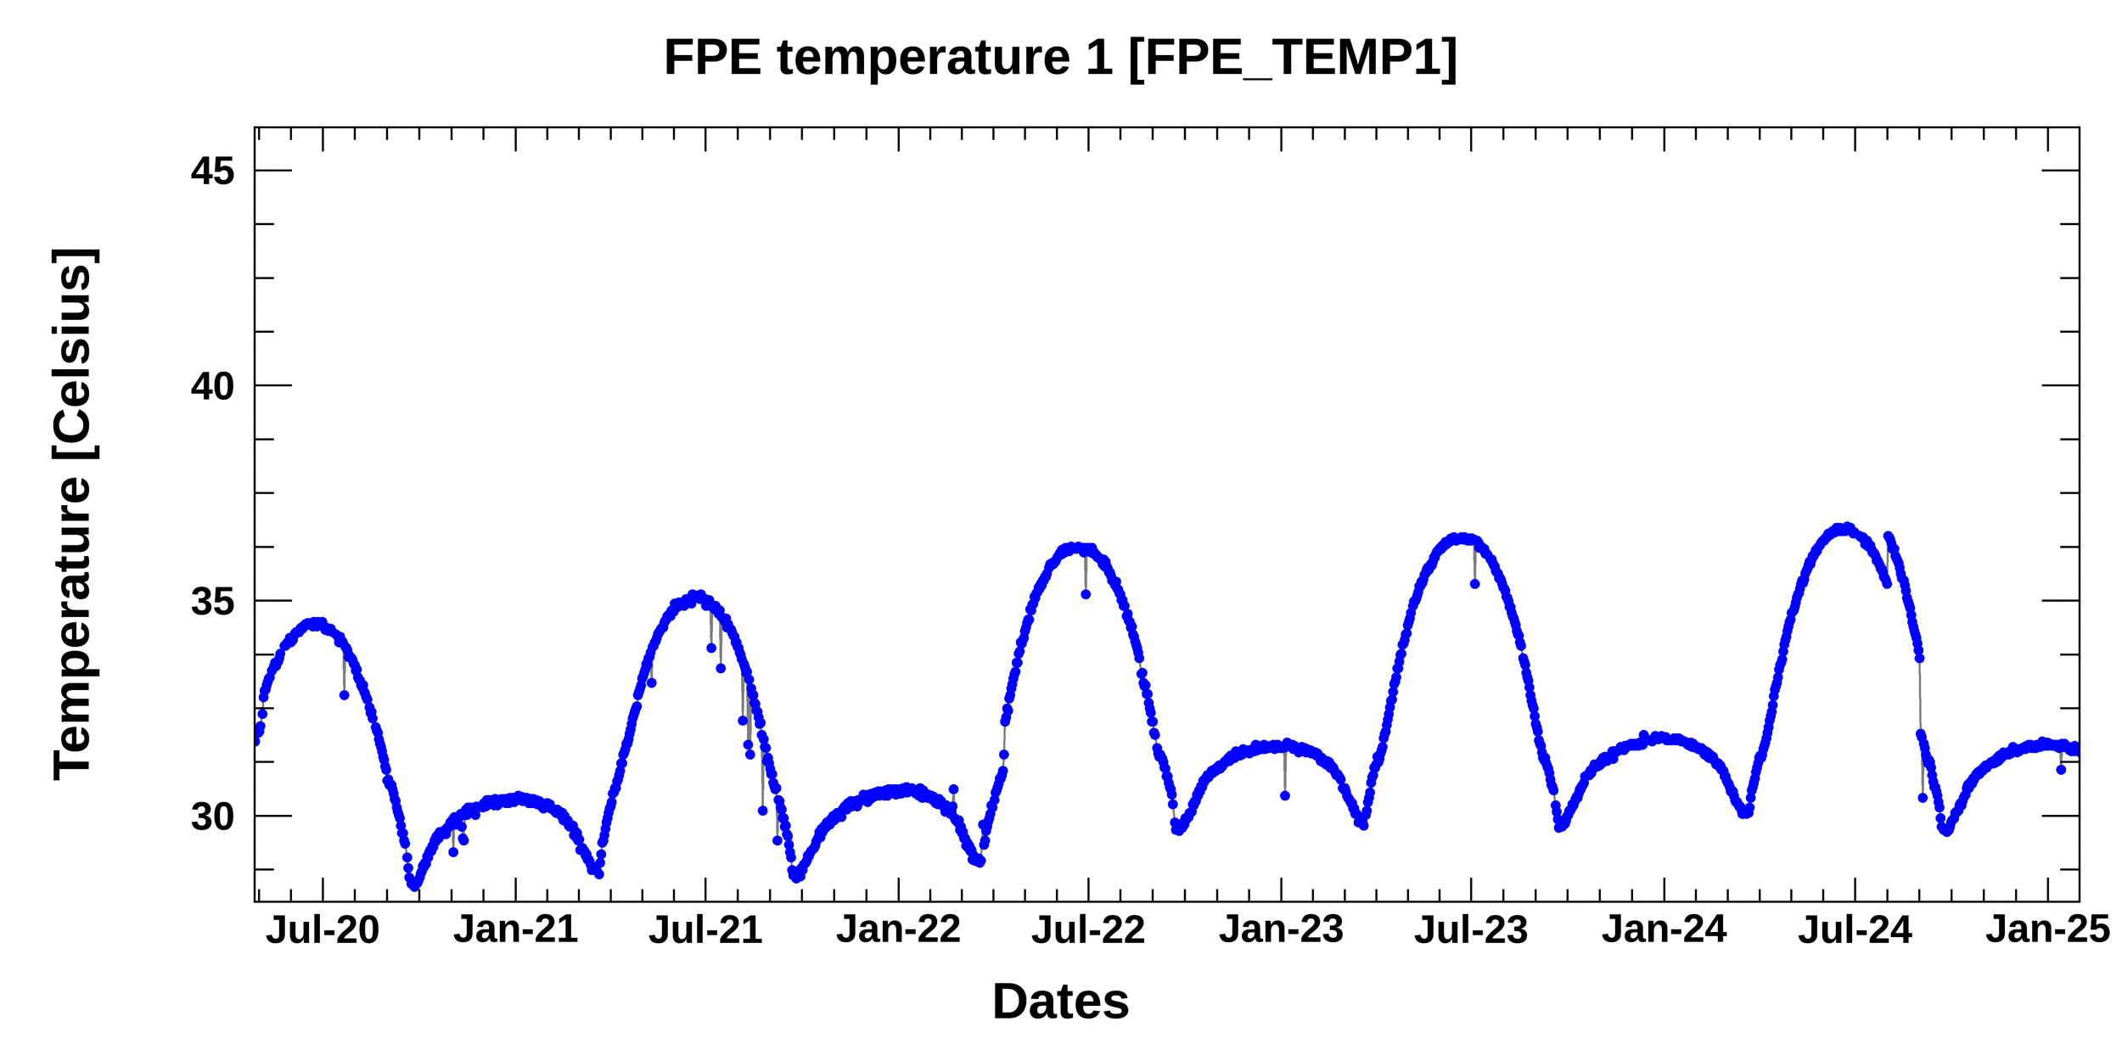
Long-term Monitoring: Telemetry (related to temperature)
Temperature variations - FPA & FPE (Close to CCD)
Focal Plane Array (FPA)
-20.906
-20.903
-20.896
-20.901
-21.248
-21.251
-21.251
-21.244
Requirement: 20.5 $±$ 1$°C$
Focal Plane Electronics (FPE)
Courtesy: J. Seo (NIER)

Slide 7
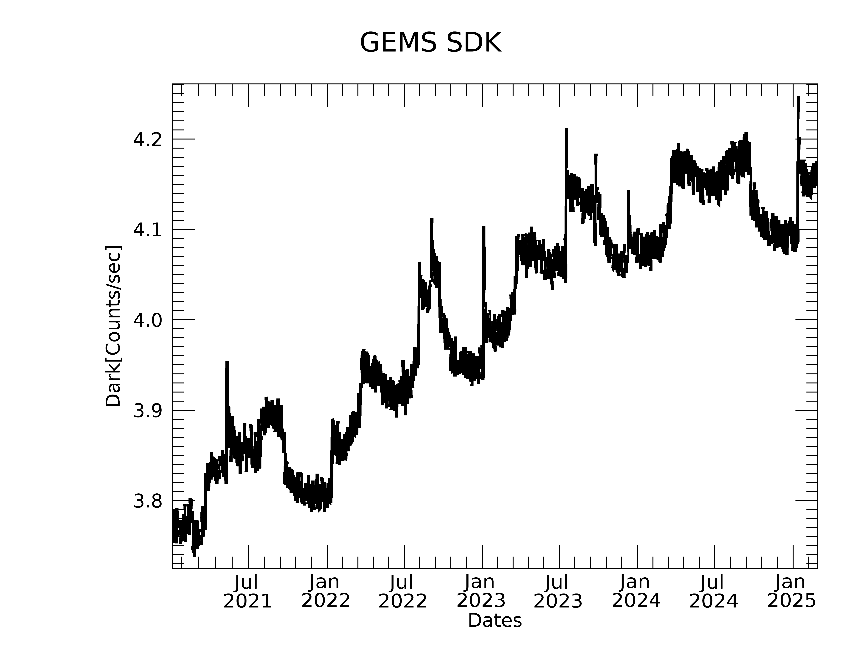
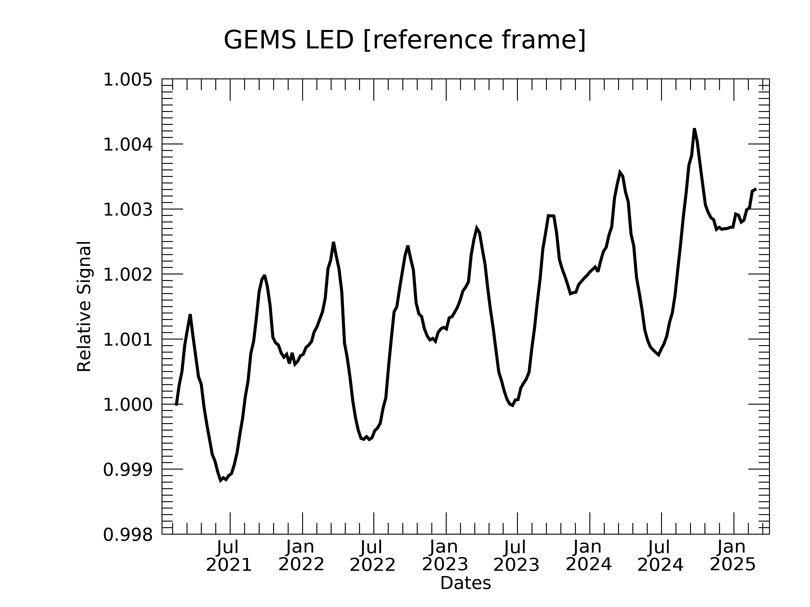
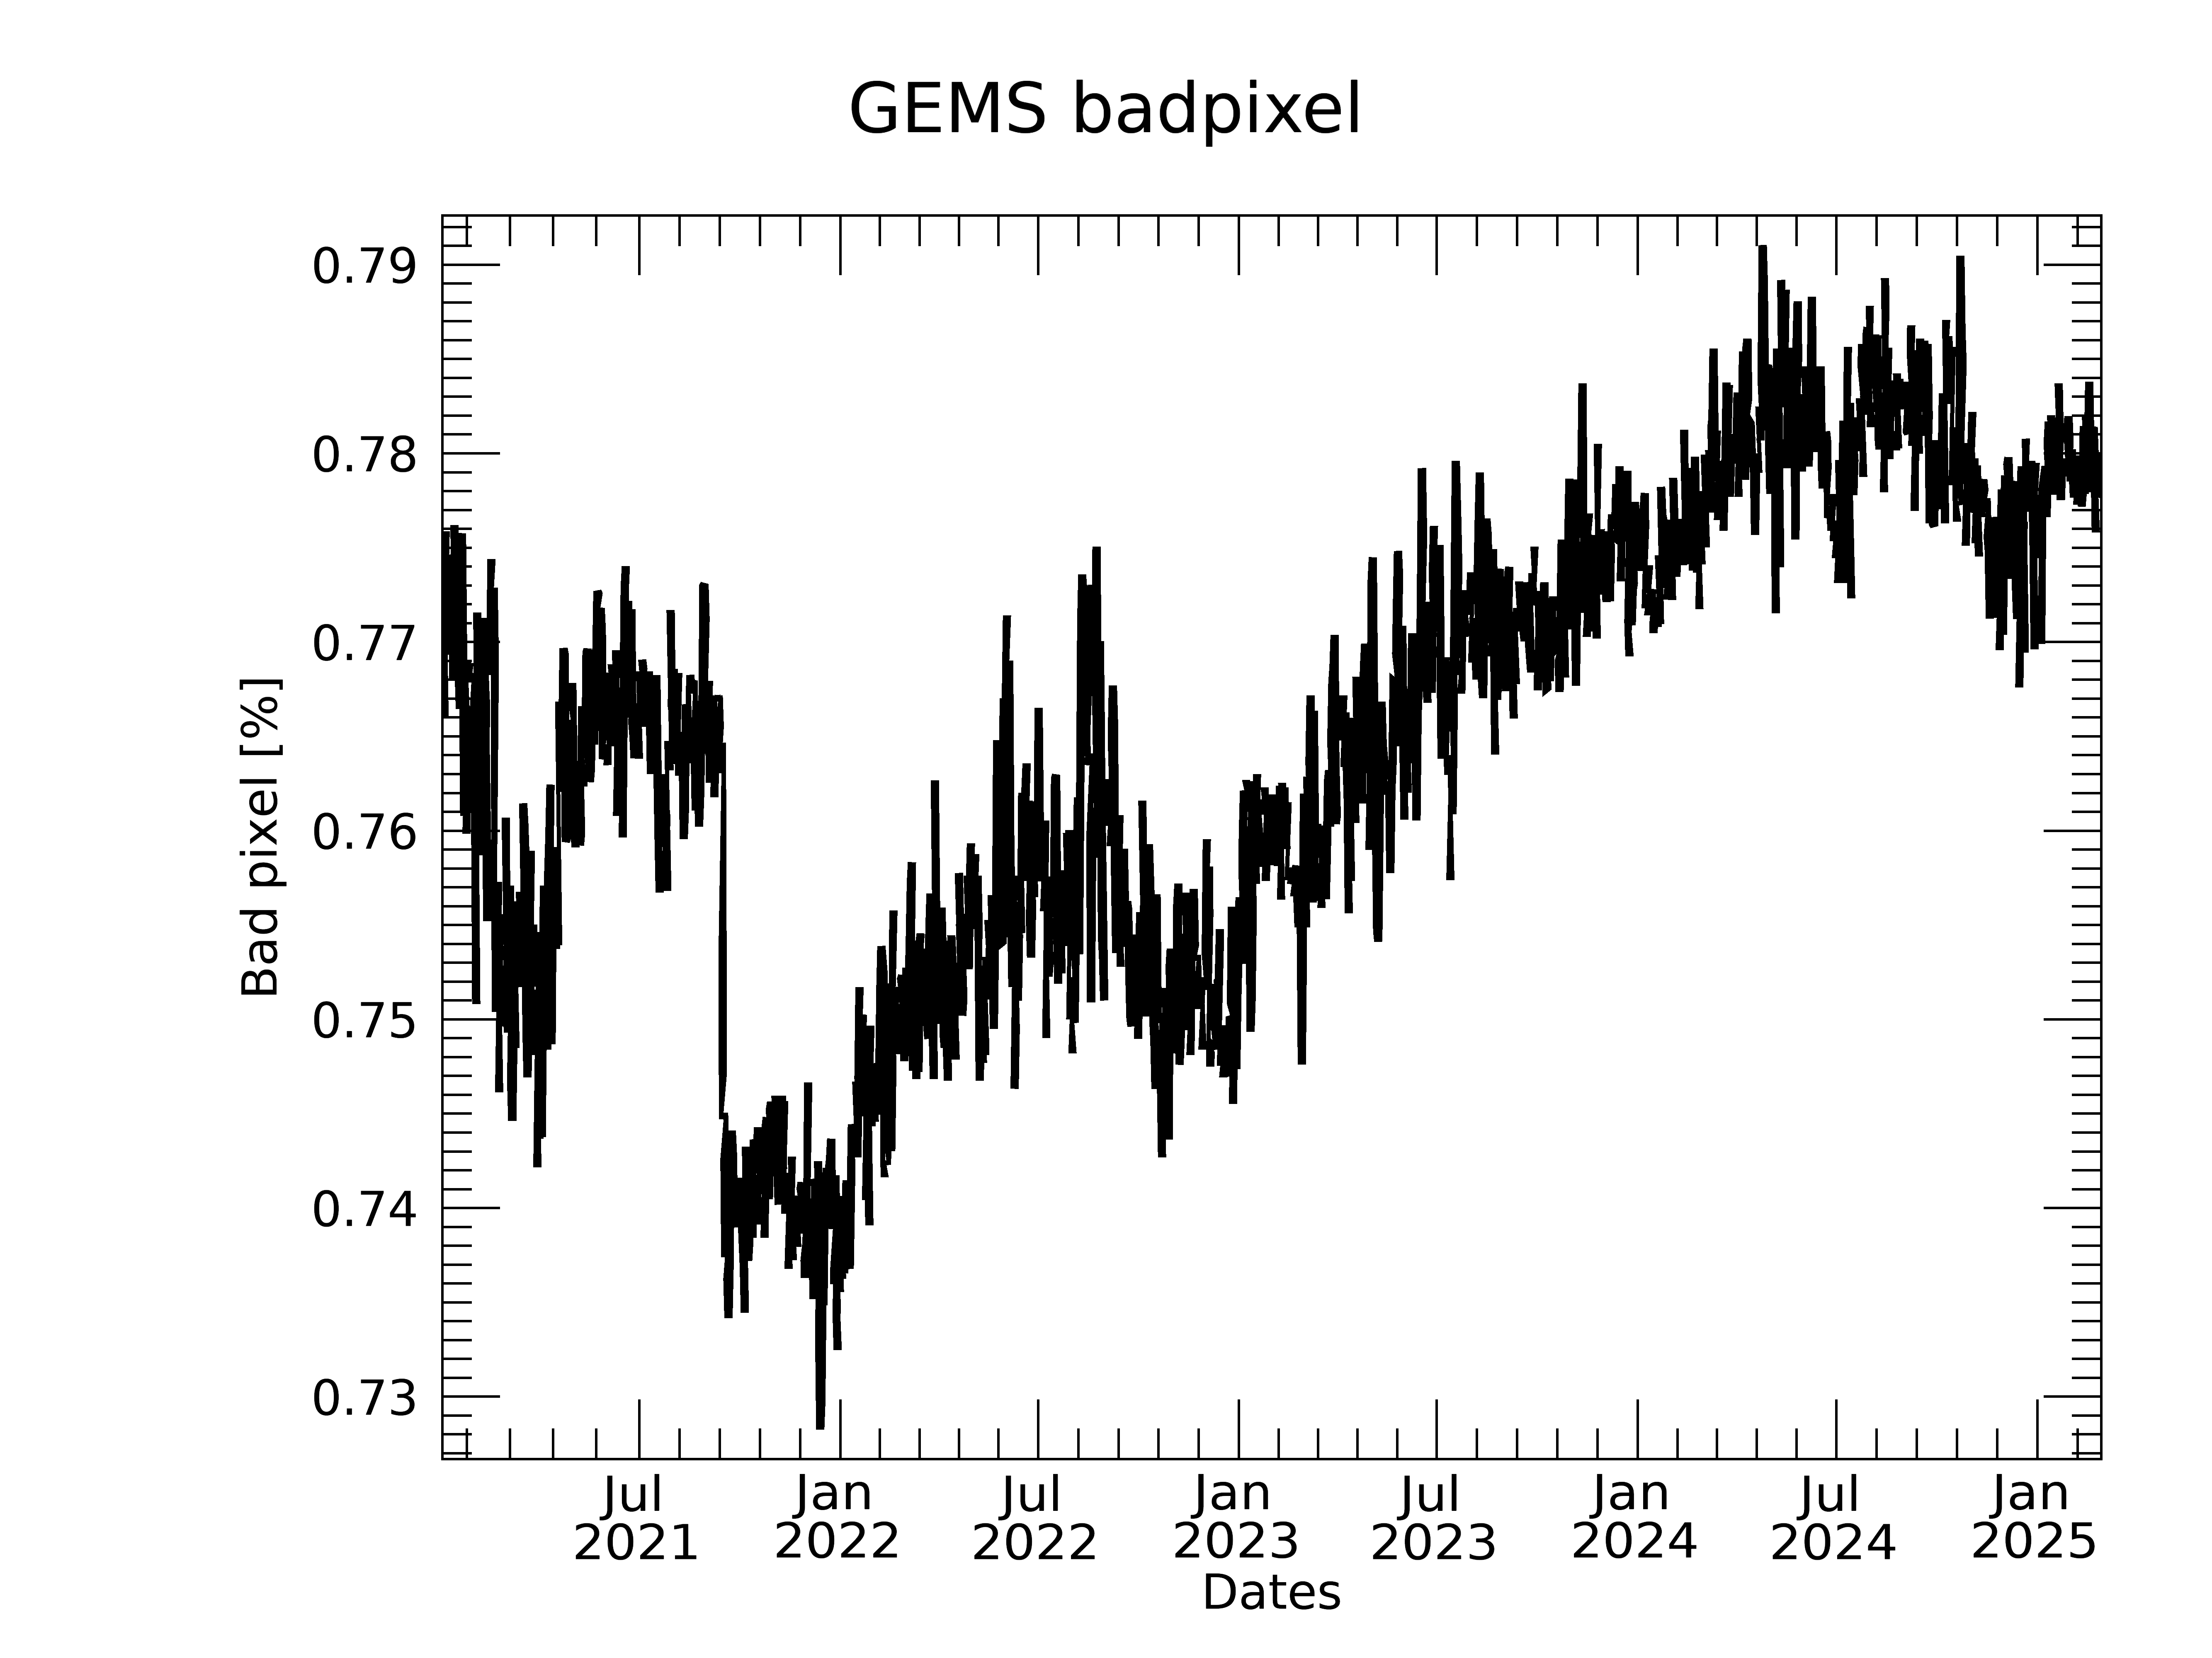
Long-term Monitoring: Level 0 calibration data
Dark currents & LED
Mean dark signals (SDK)
Mean LED relative signals
~0.3% increase
Fluctuations having similar patterns with the FPE Temp.
Increase by 9.3%

Slide 8
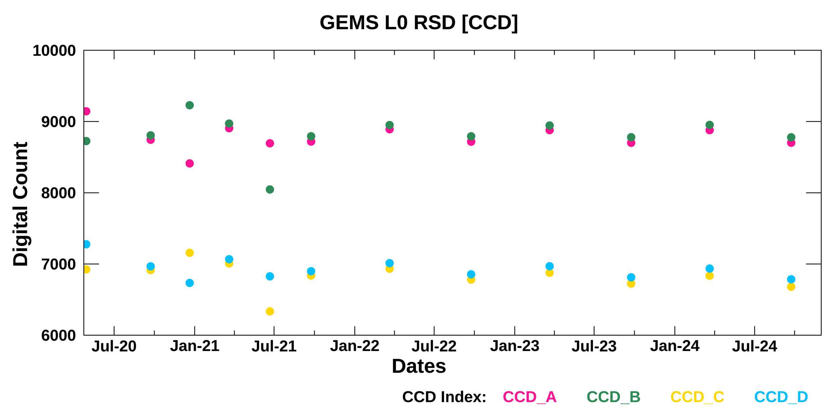
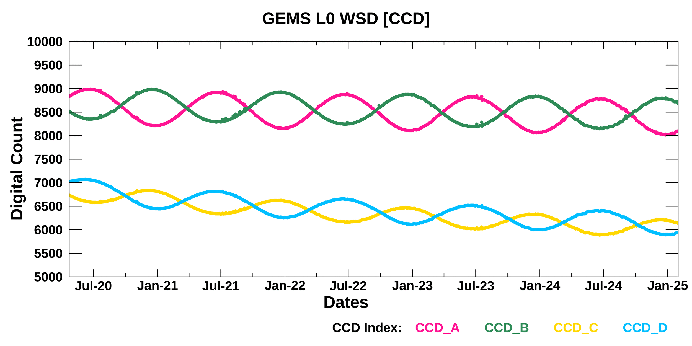
Long-term Monitoring: Level 0 (solar observations)
Digital counts of WSD & RSD
RSD (on Equinox)
North
~12 times of observations since 2020
WSD (every day)
500 nm (North)
500 nm (South)
300 nm (North)
300 nm (South)
South
300 nm
500 nm
Courtesy: J. Seo (NIER)

Slide 9
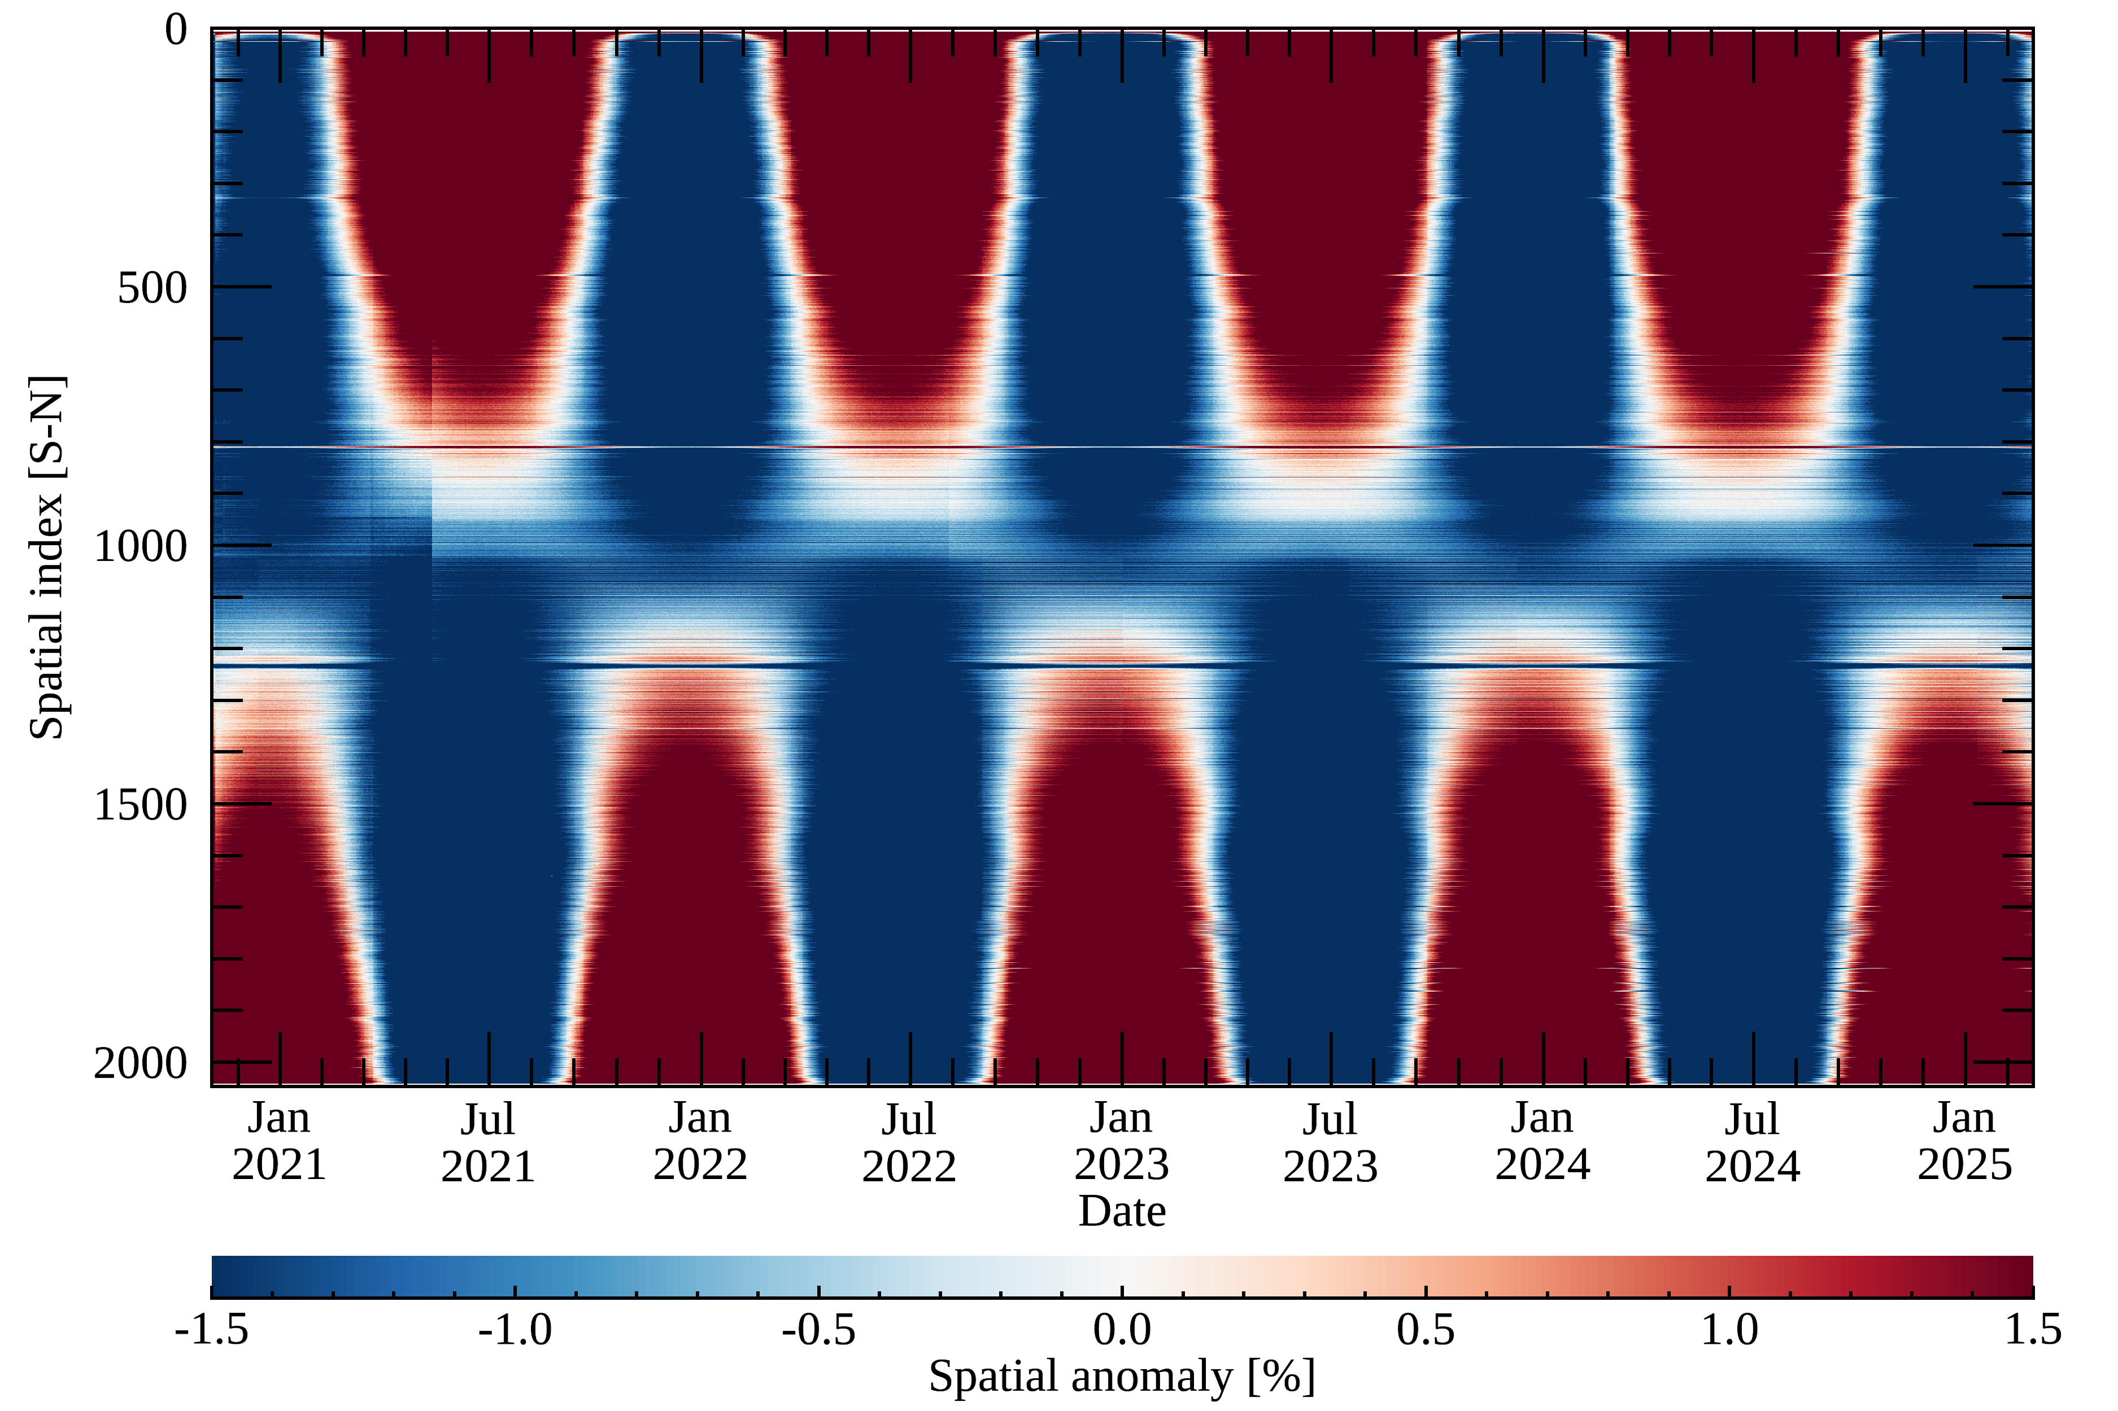
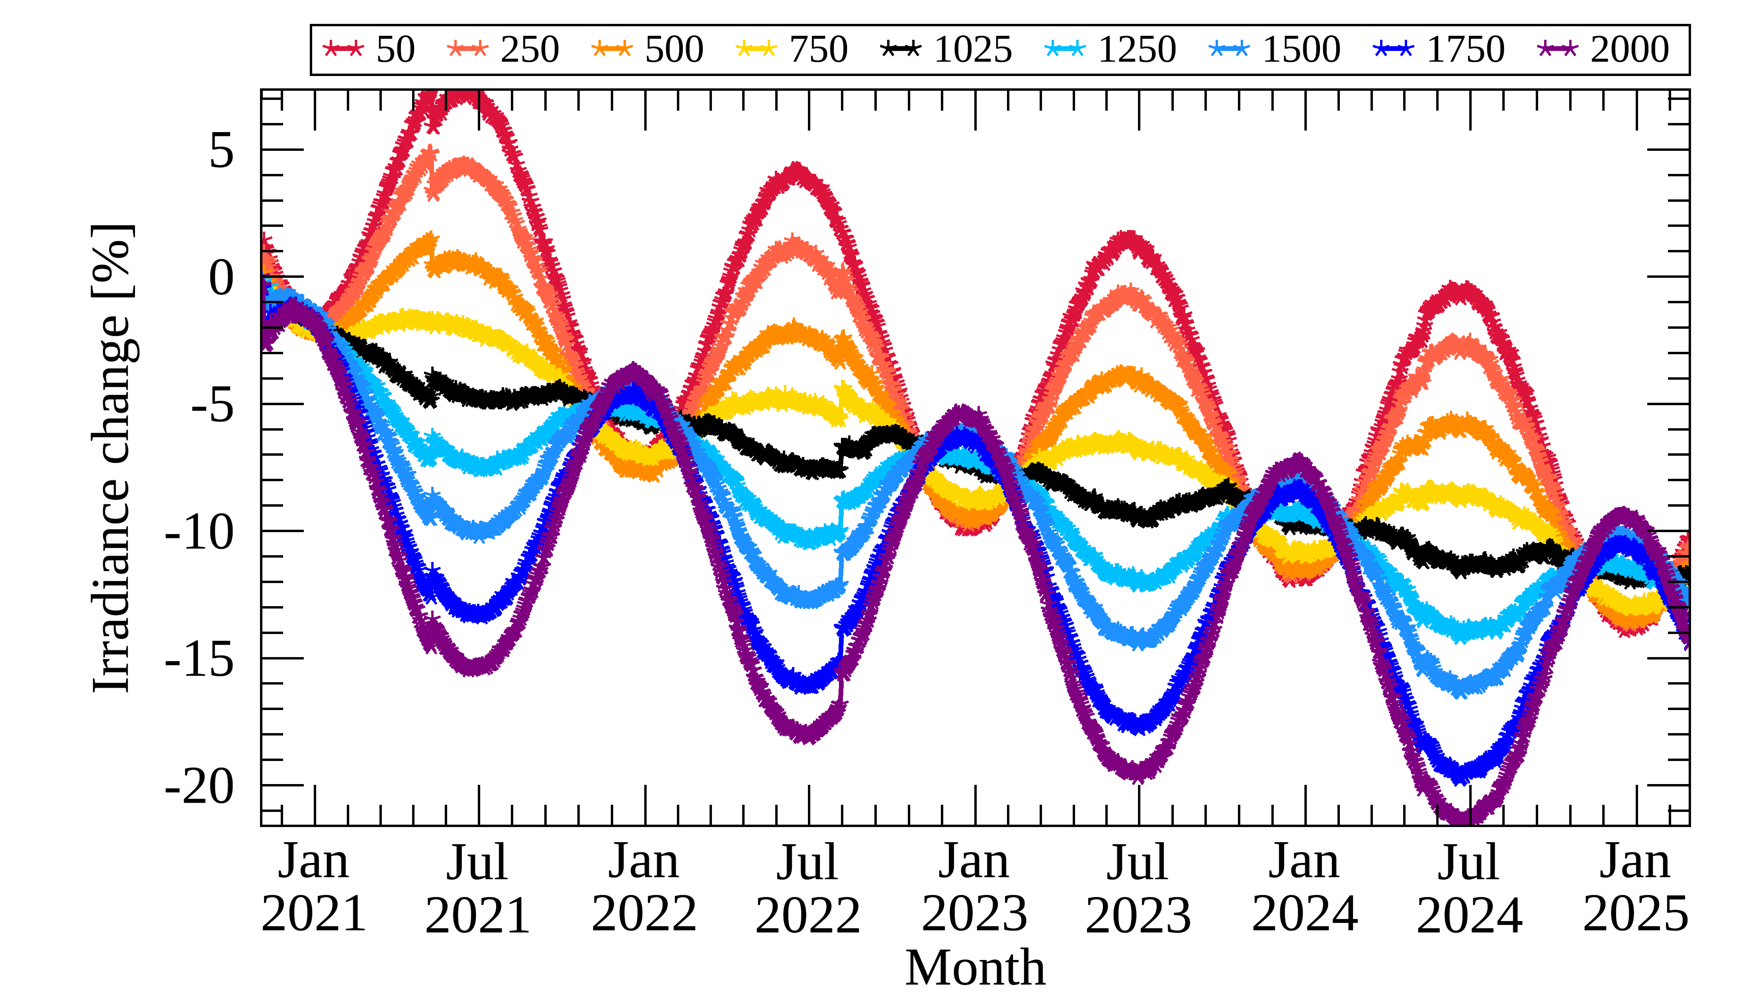
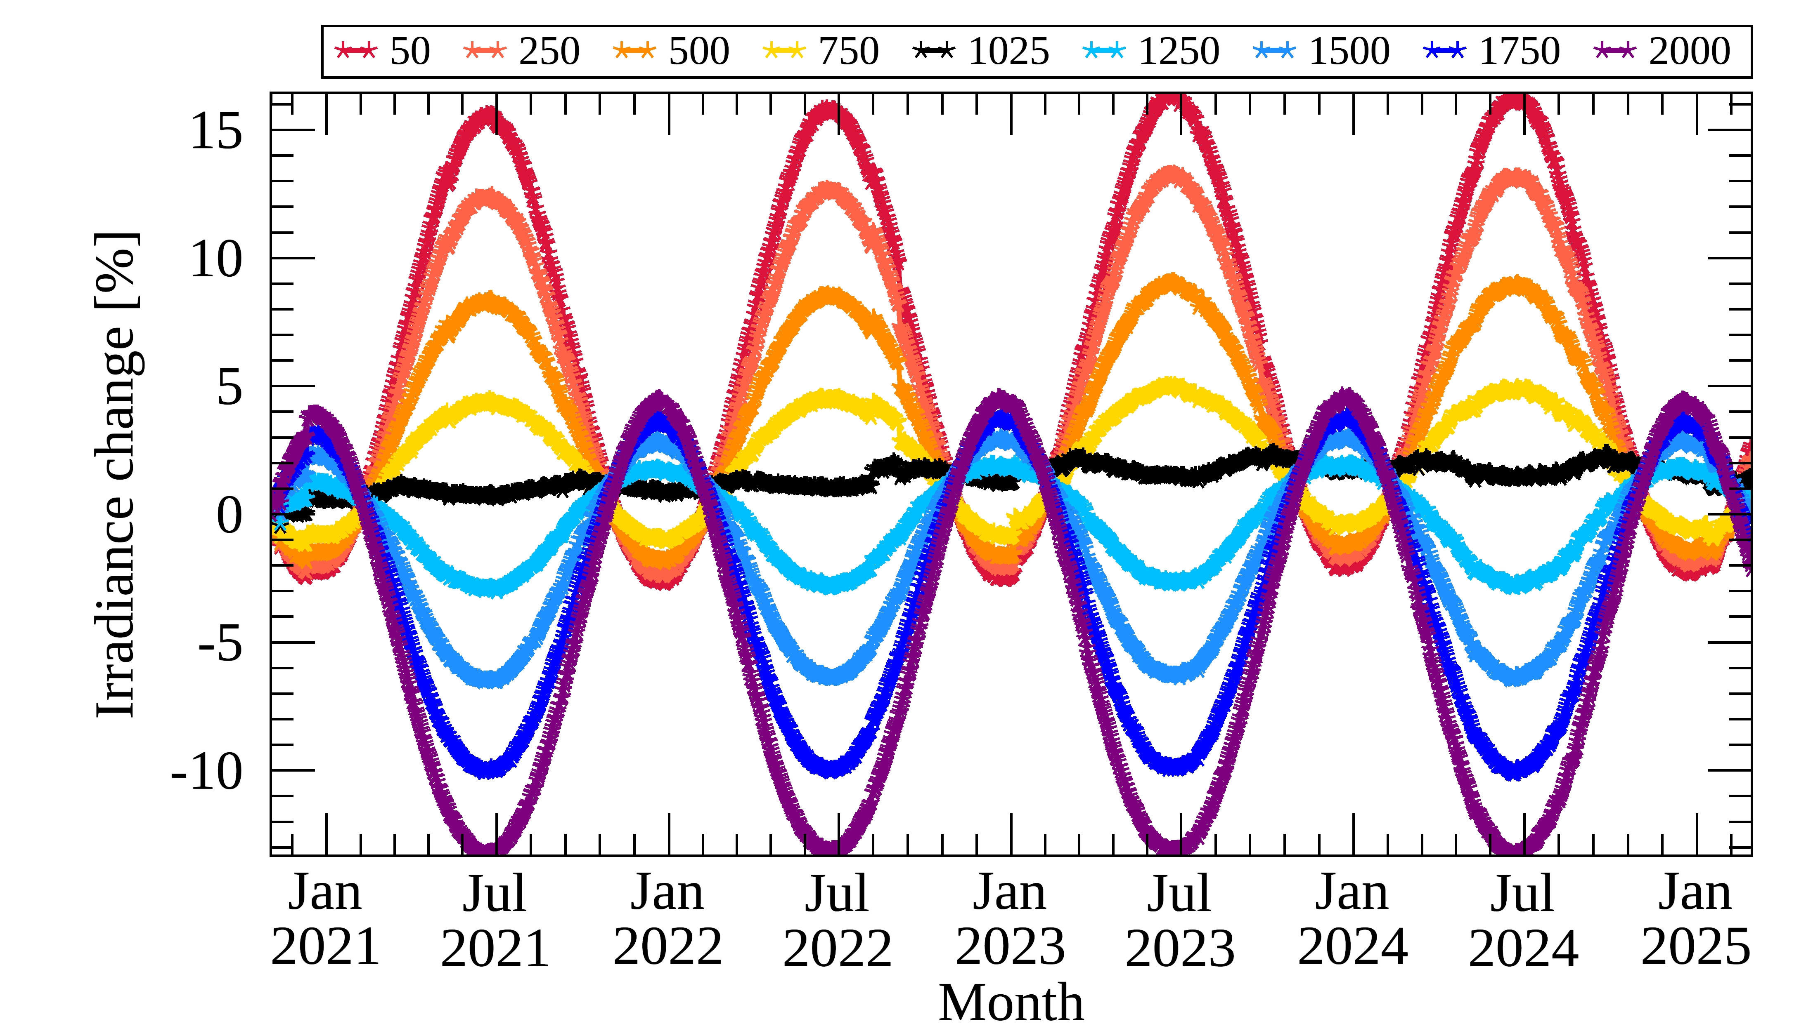
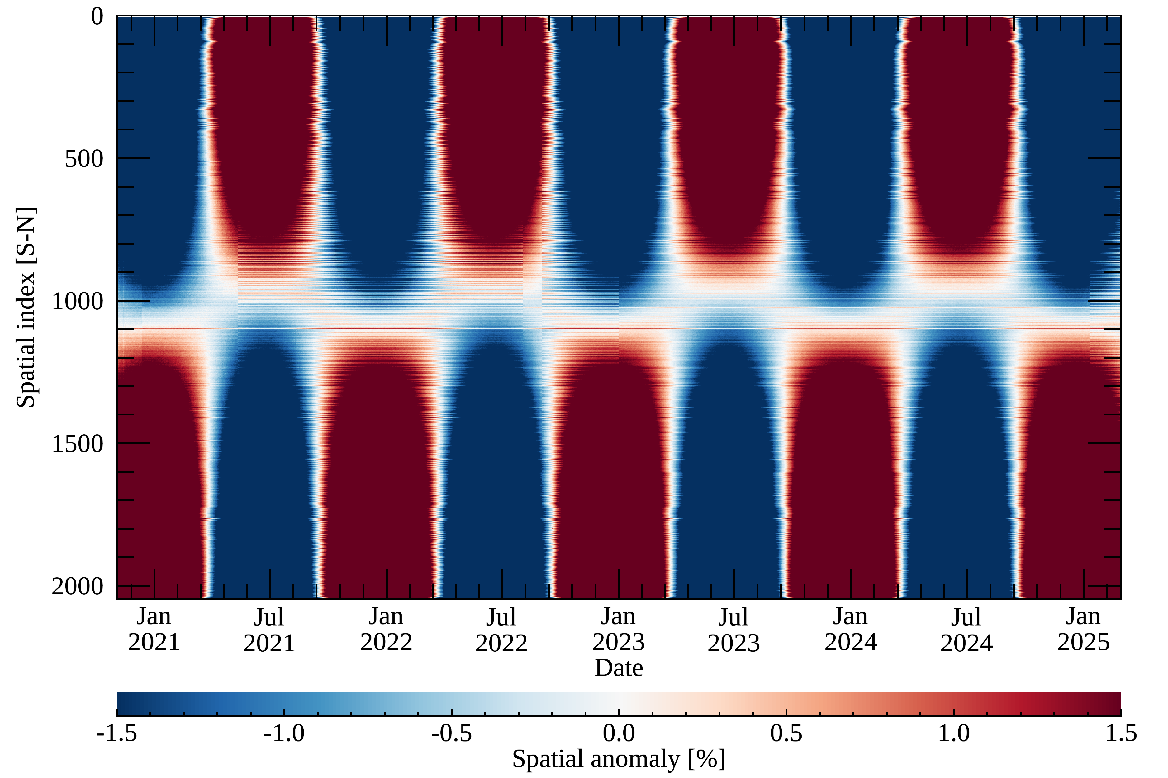
Long-term Monitoring: Level 1 (solar observations)
Solar irradiance (w/o BTDF update)
* BTDF: Bi-directional Transmittance Distribution Function
Spatial anomaly [%]
Temporal variations at each spatial index [%]
@ 305 nm
@ 480 nm

Slide 10
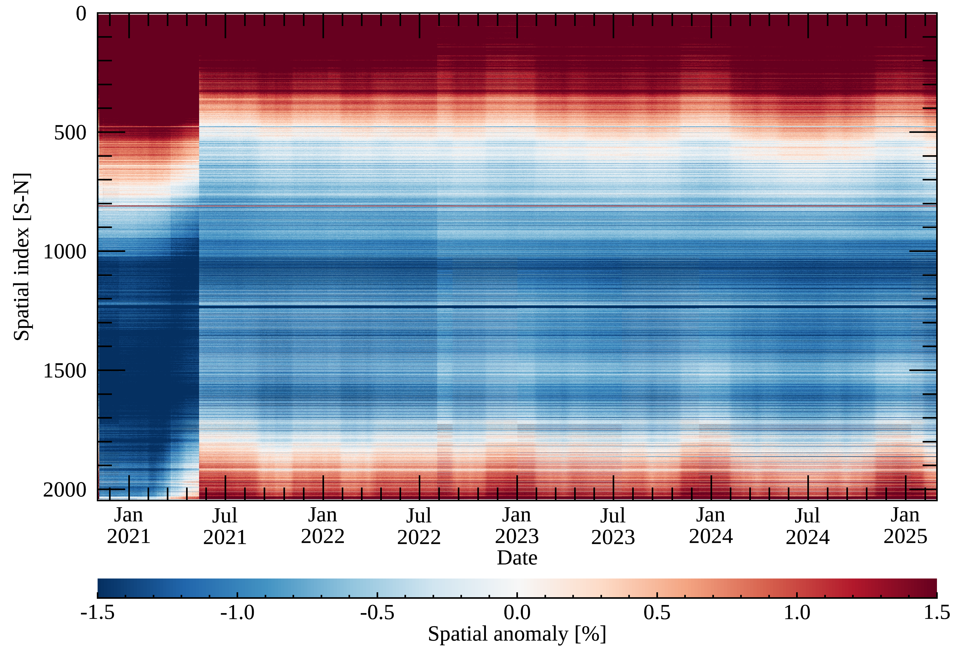
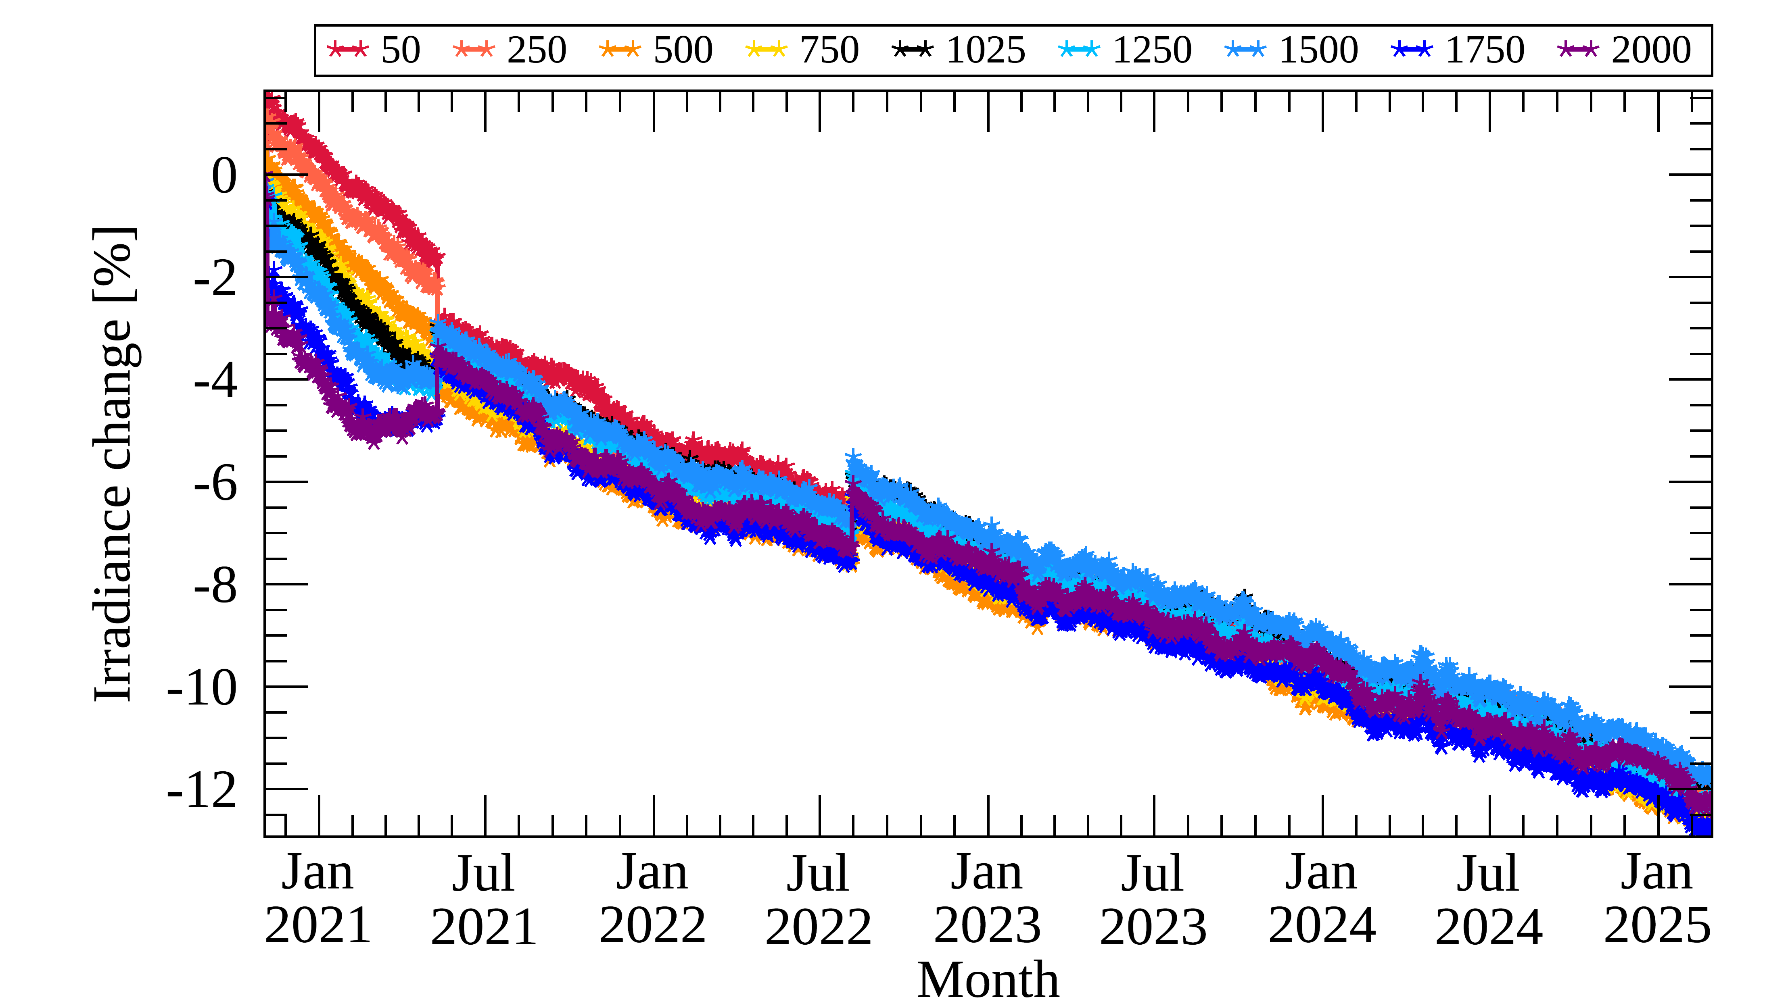
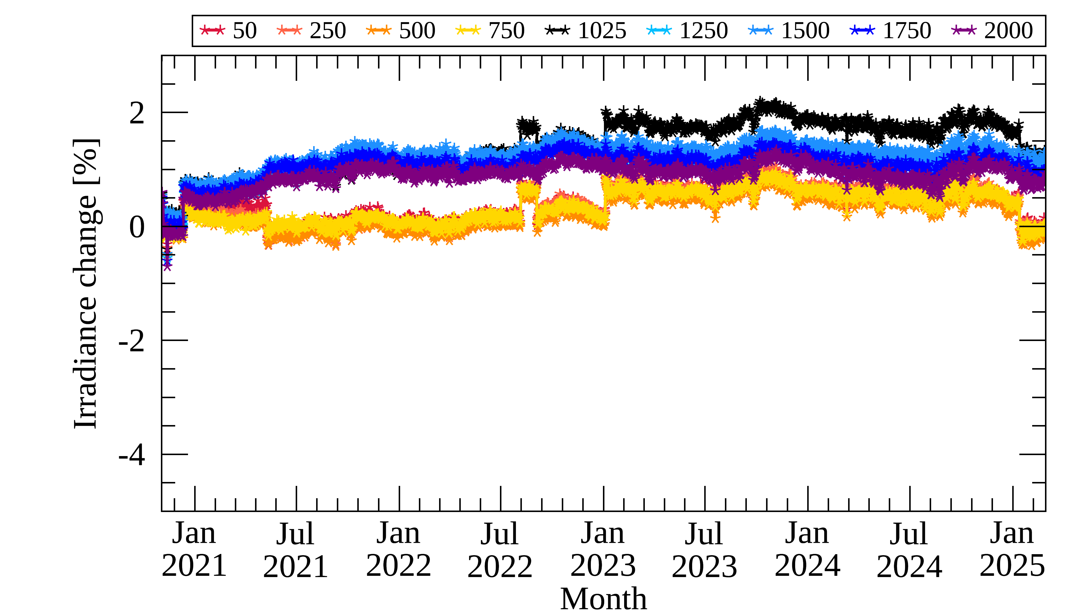
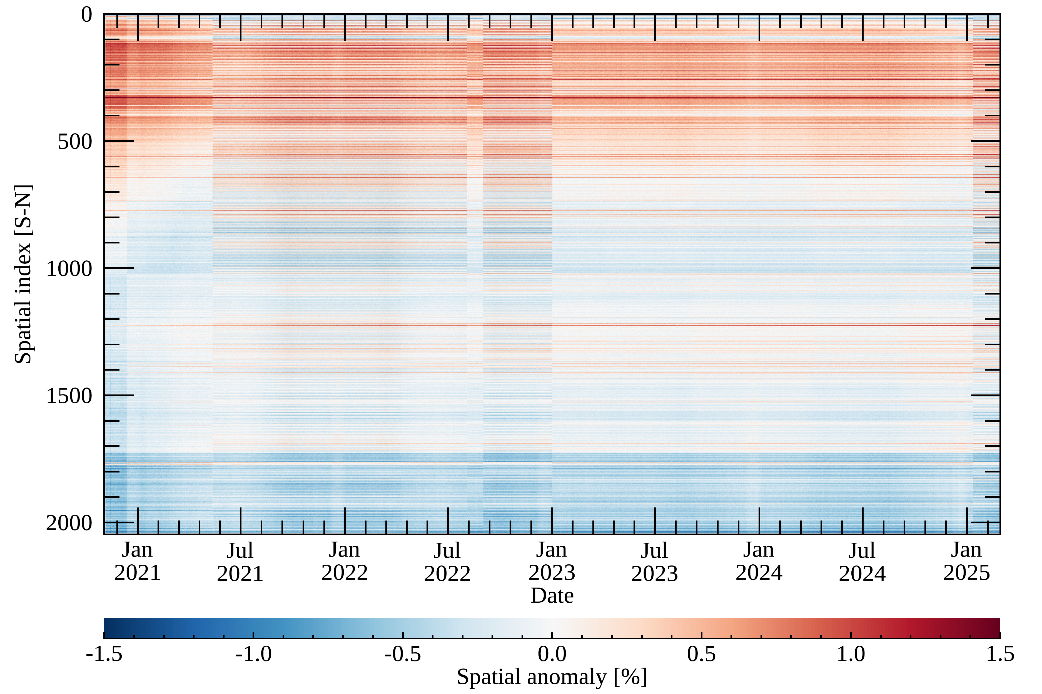
Long-term Monitoring: Level 1 (solar observations)
Solar irradiance (w/ BTDF update)
Kang et al. (IEEE TGRS 2024)
Spatial anomaly [%]
Temporal variations at each spatial index [%]
@ 305 nm
Degradation over 12% @ 305 nm
@ 480 nm
Major calibration issues:
Diffuser degradation
Stripe-like artifacts along N-S direction
Discontinuity with GEMS reboot

Slide 11
Current Level 1 Calibration Issues
1) GEMS diffuser degradation
Solar Irradiance
z
Solar diffuser
Scan mirror
Telescope
Spectrometer
Detector
…
Electronics
Earth Radiance
$$D_{tot,W}\left(t\right)=\frac{F_{W}\left(t\right)}{F_{W}\left(0\right)}=D_{SD}\left(n_{W}\left(t\right)\right)∙D_{com}\left(t\right)∙R_{t}$$
$$D_{tot,R}\left(t\right)=\frac{F_{R}\left(t\right)}{F_{R}\left(0\right)}=D_{SD}\left(n_{R}\left(t\right)\right)∙D_{com}\left(t\right)∙R_{t}∙P_{t}$$
$$\frac{D_{tot,W}\left(t\right)}{D_{tot,R}\left(t\right)}≈\frac{D_{SD}\left(n_{W}\left(t\right)\right)}{D_{SD}(n_{R}\left(t\right))}$$
WSD:
Fitting function
: $N\left(t\right)=N_{0}e^{N_{1}t}+(1−N_{0})$
Similar degradation approach
for TROPOMI using WSD & RSD
RSD :
$D_{tot}$ : Total degradation
$D_{q1, q2}$ : Diffuser contribution
$D_{com}$ : Degradation from common parts
$R_{k},P_{k}$ : Temporal variations
Ludewig et al. (AMT 2020) & Larry Flynn (NOAA)

Slide 12
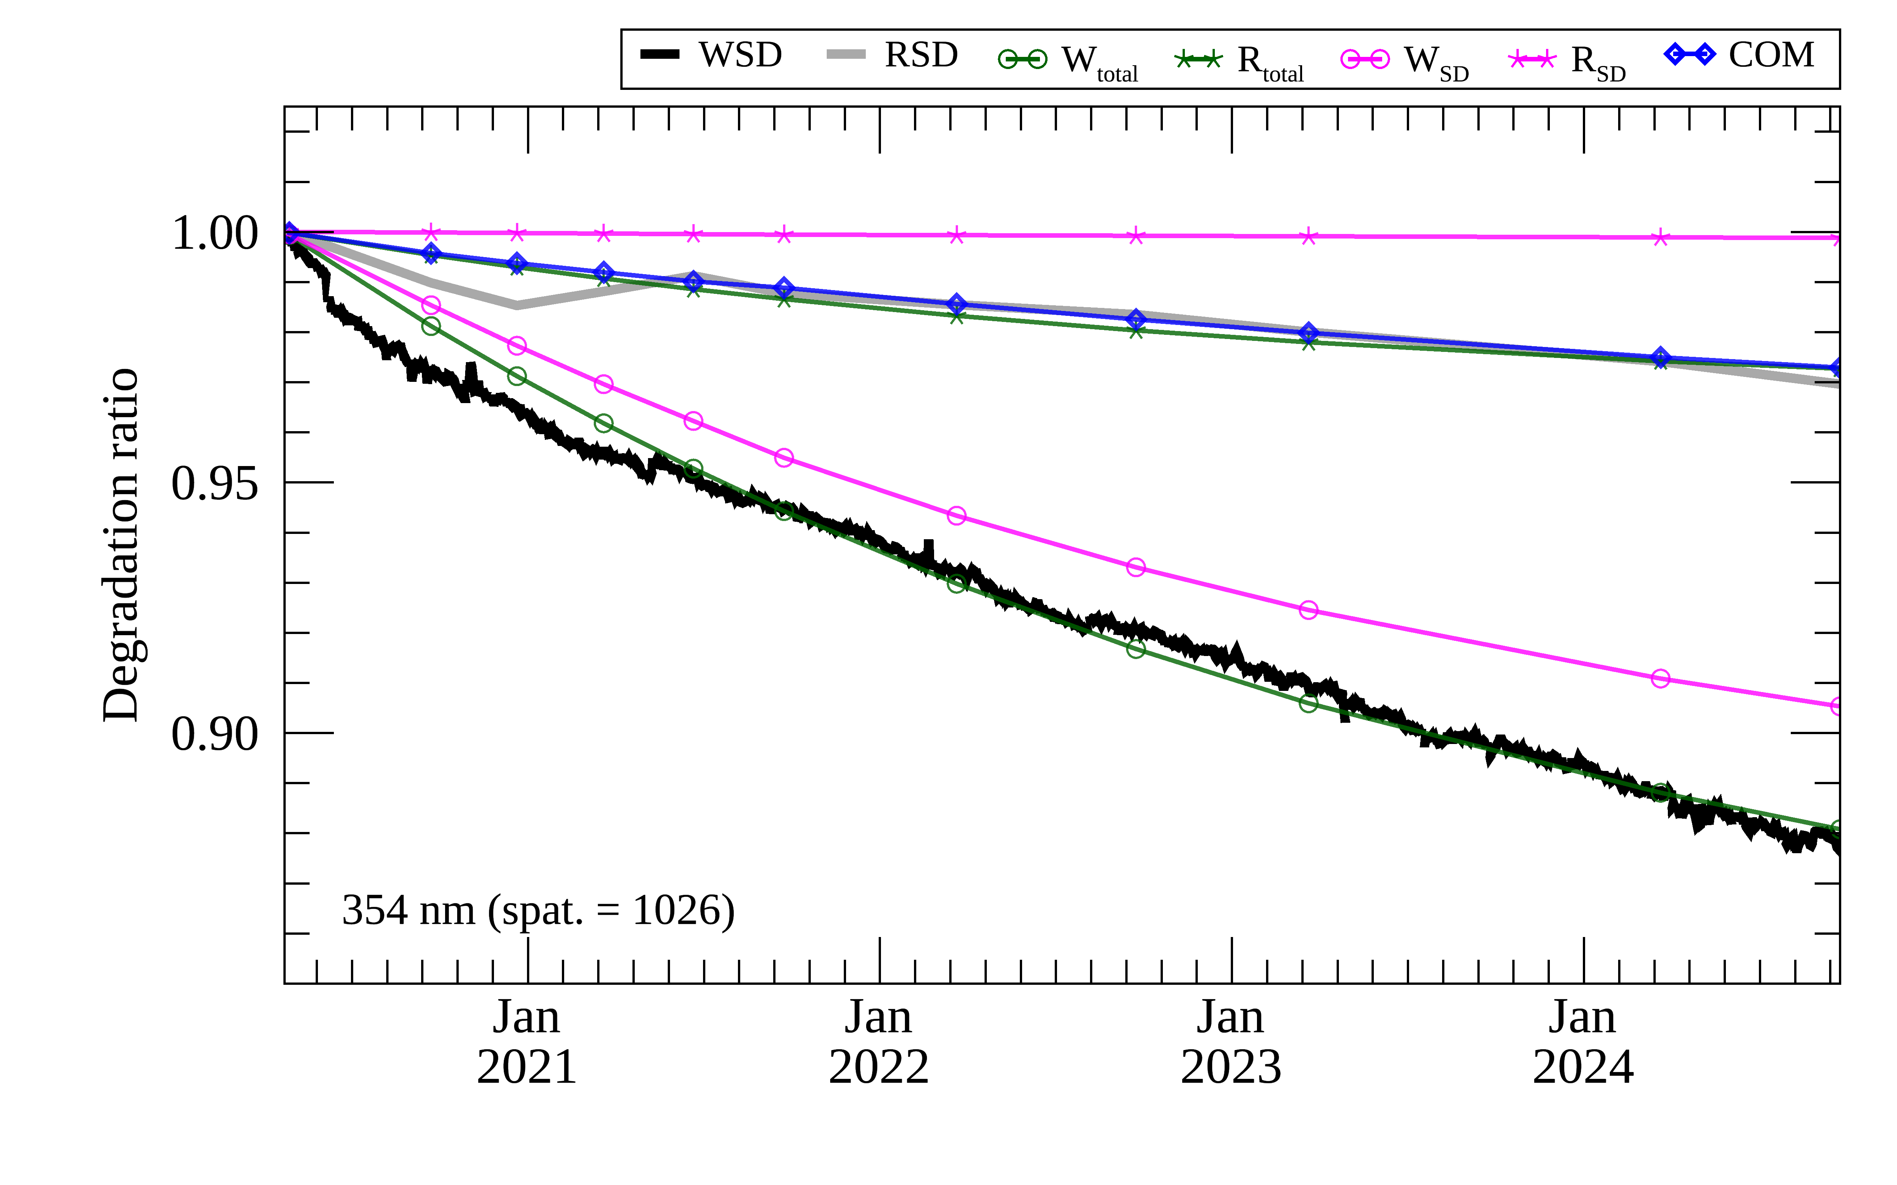
Current Level 1 Calibration Issues
1) GEMS diffuser degradation
$$D_{tot,W}\left(t\right)=D_{SD}\left(n_{W}\left(t\right)\right)∙D_{com}\left(t\right)∙R_{t}$$
$$D_{tot,R}\left(t\right)=D_{SD}\left(n_{R}\left(t\right)\right)∙D_{com}\left(t\right)∙R_{t}∙P_{t}$$
Diffuser degradation correction:
$$\frac{D_{tot,W}\left(t\right)}{D_{SD}(n_{W}\left(t\right))}=D_{com}\left(t\right)∙R_{t}$$
Ratio to the initial observation

Slide 13
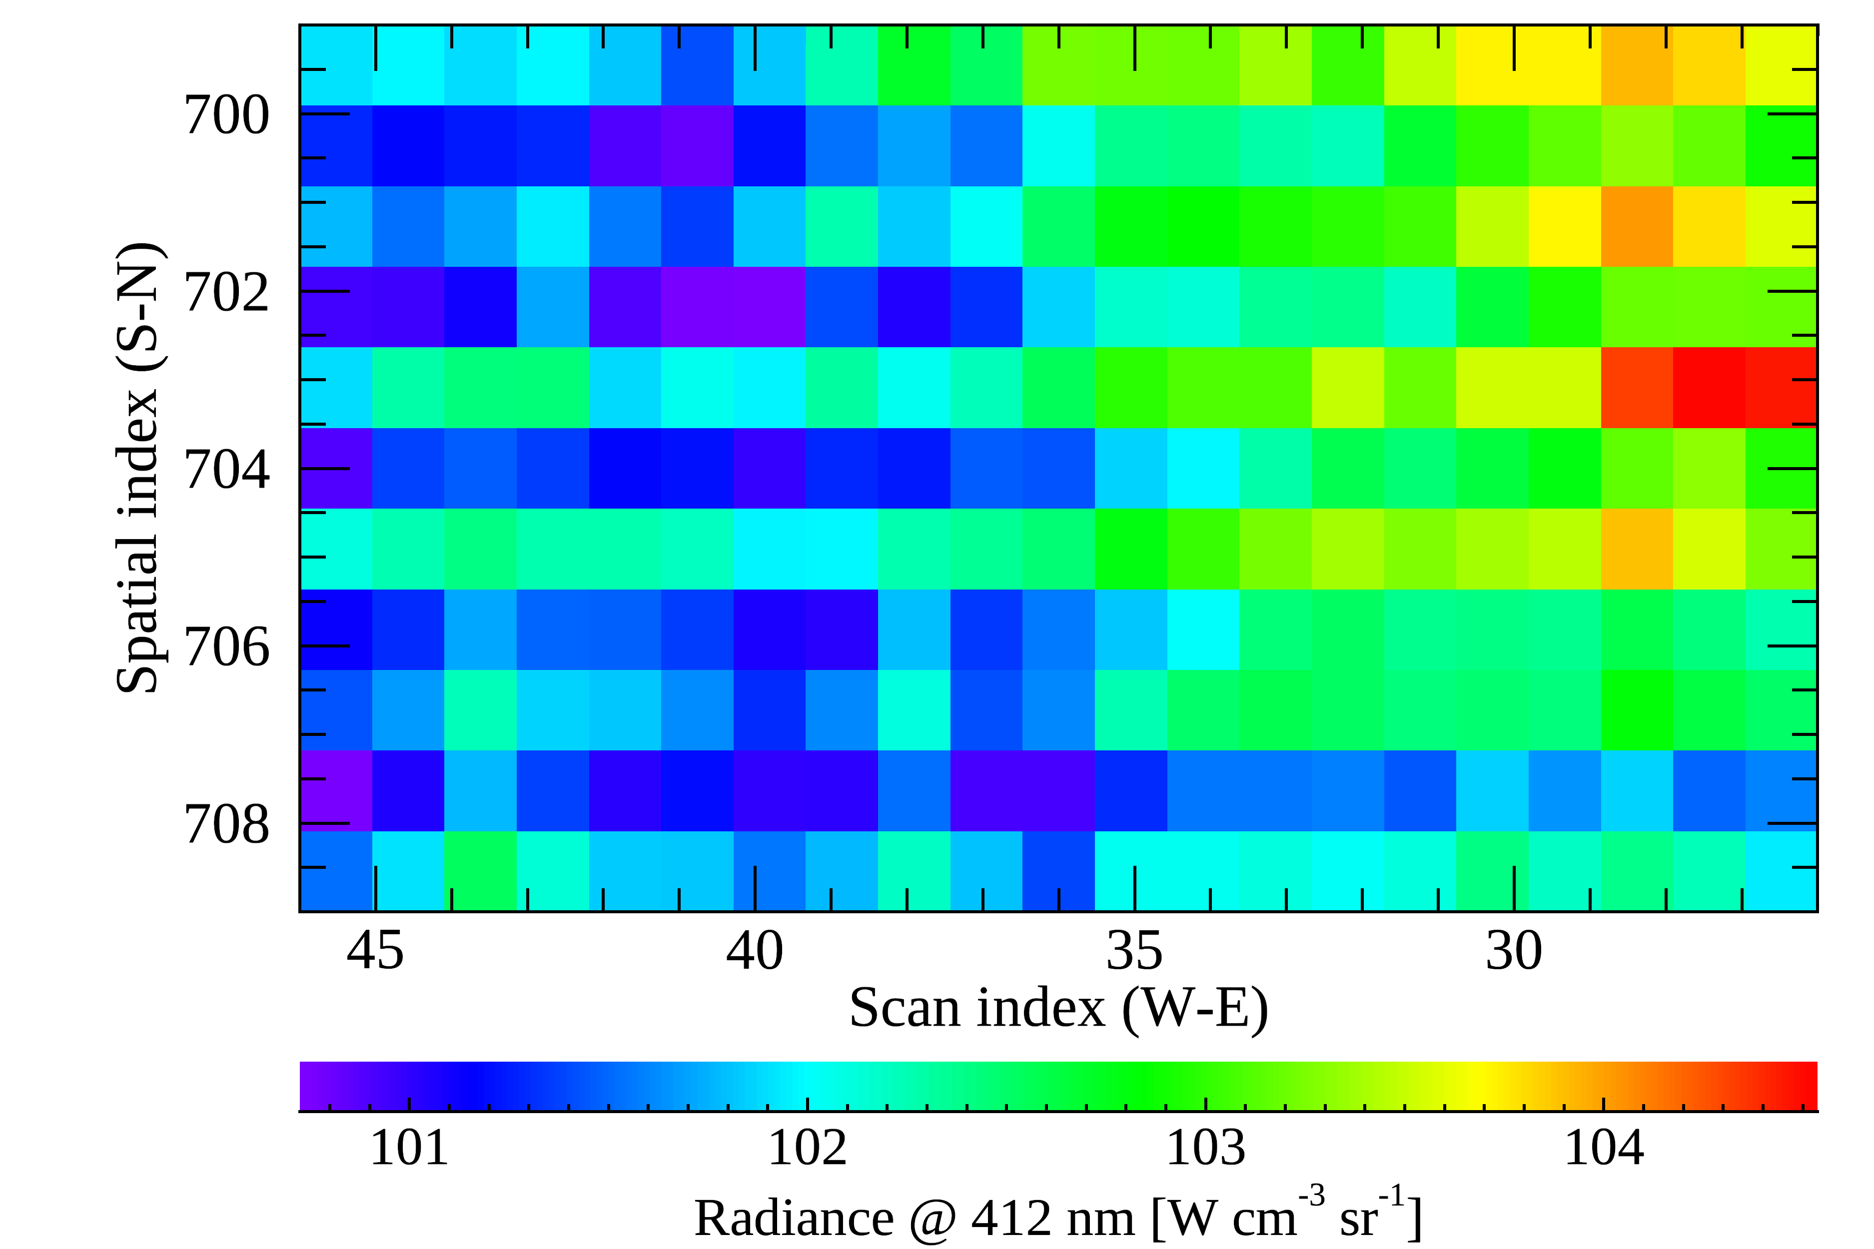
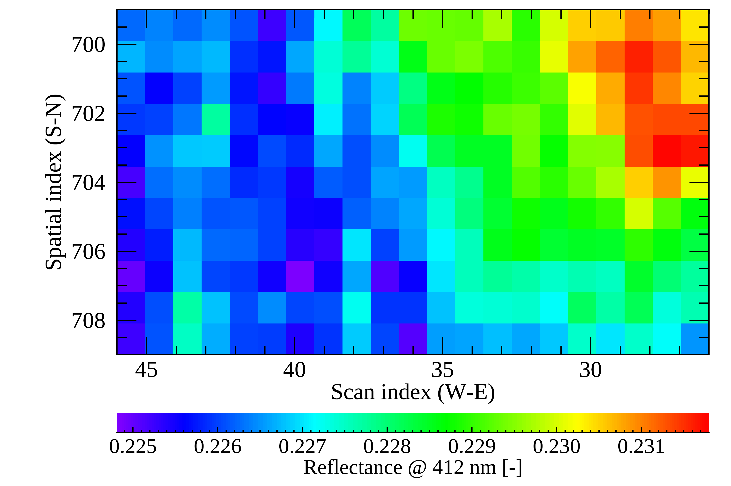
Current Level 1 Calibration Issues
2) Stripe-like artifacts along north-south direction on the CCD
Clearly appear in weak signals about 2% variations (i.e., dark ocean)
Radiance
March 20, 2022
Reflectance = $\frac{Earth Rad}{Solar irrad}$
* Potentially by non-linearity correction in the ADC process

Slide 14
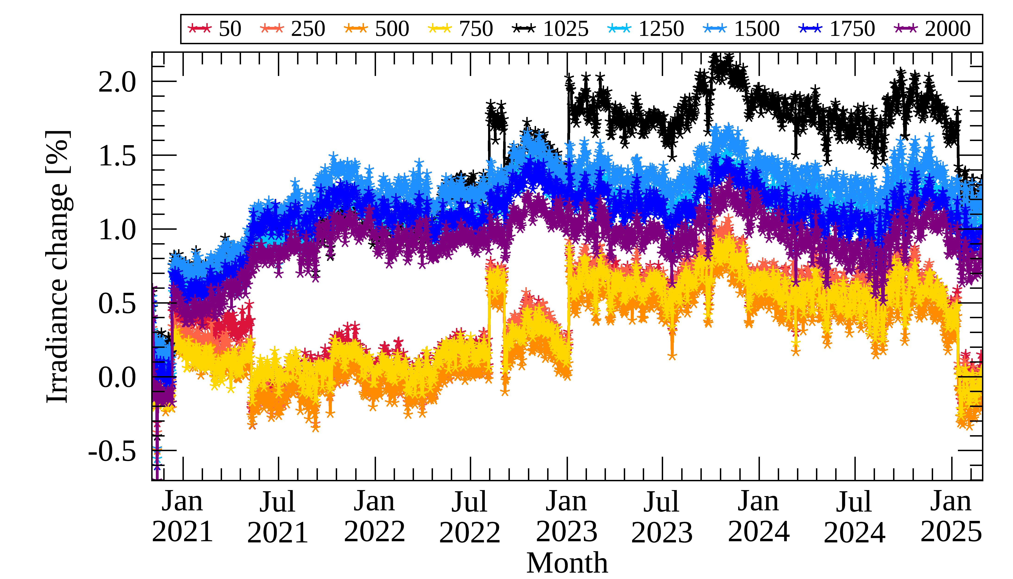
Current Level 1 Calibration Issues
3) Instrument reboot
Occurs when GEMS is rebooted after entering survival mode, potentially related to electronic chain
5/9, 2021
@ 480 nm (Nadir)
$±1$% depending on WV

Slide 15
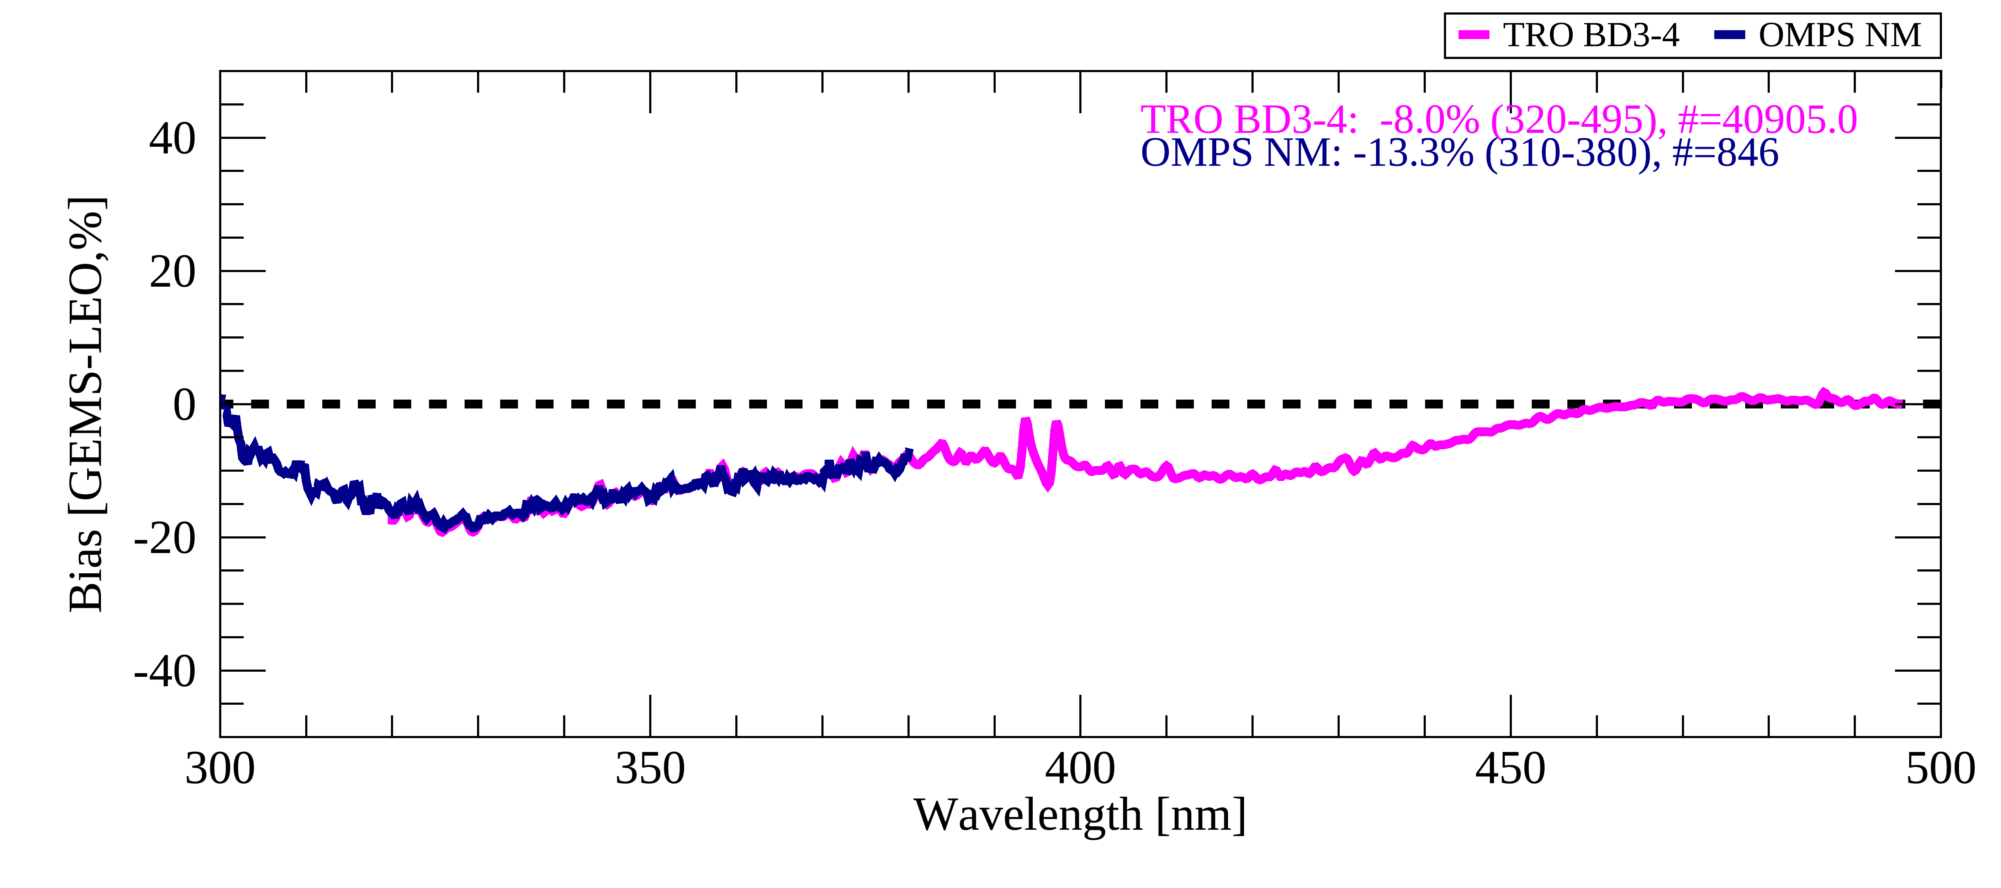
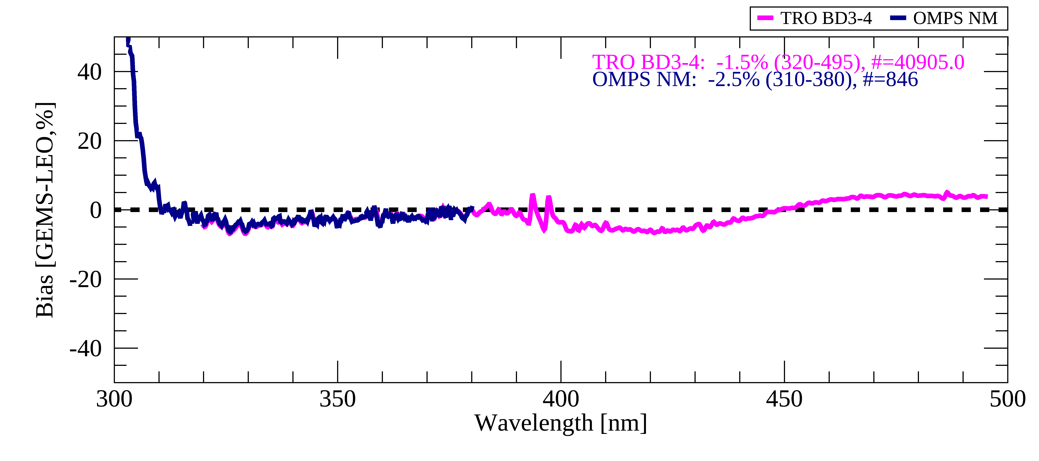
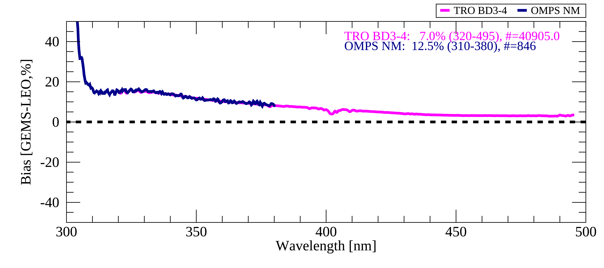
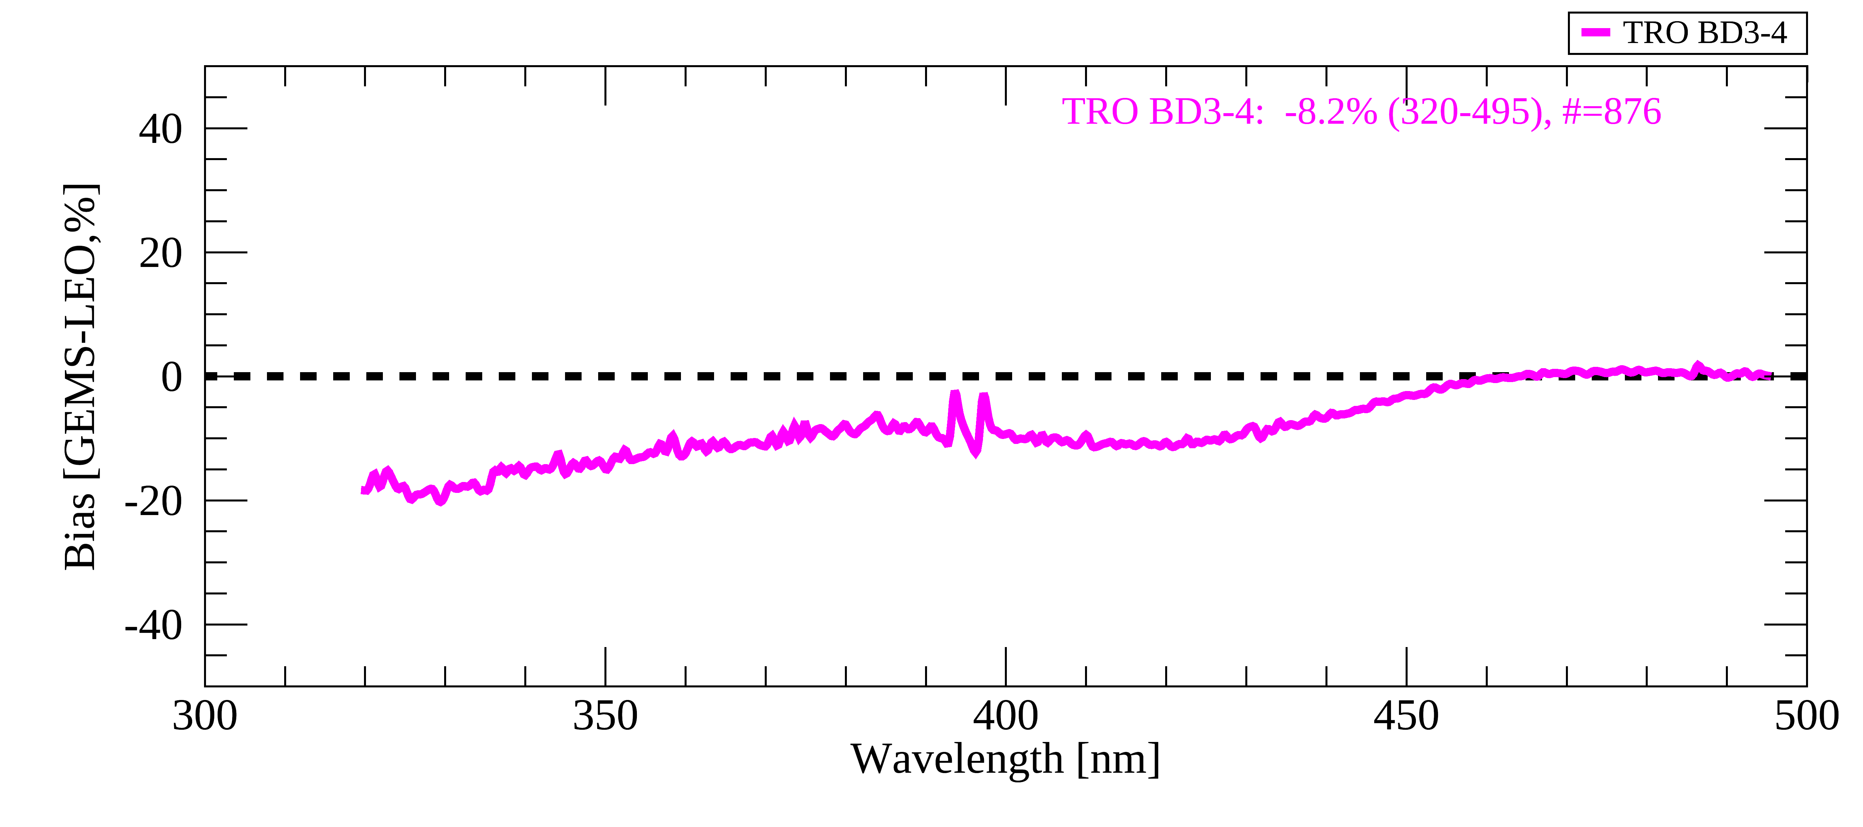
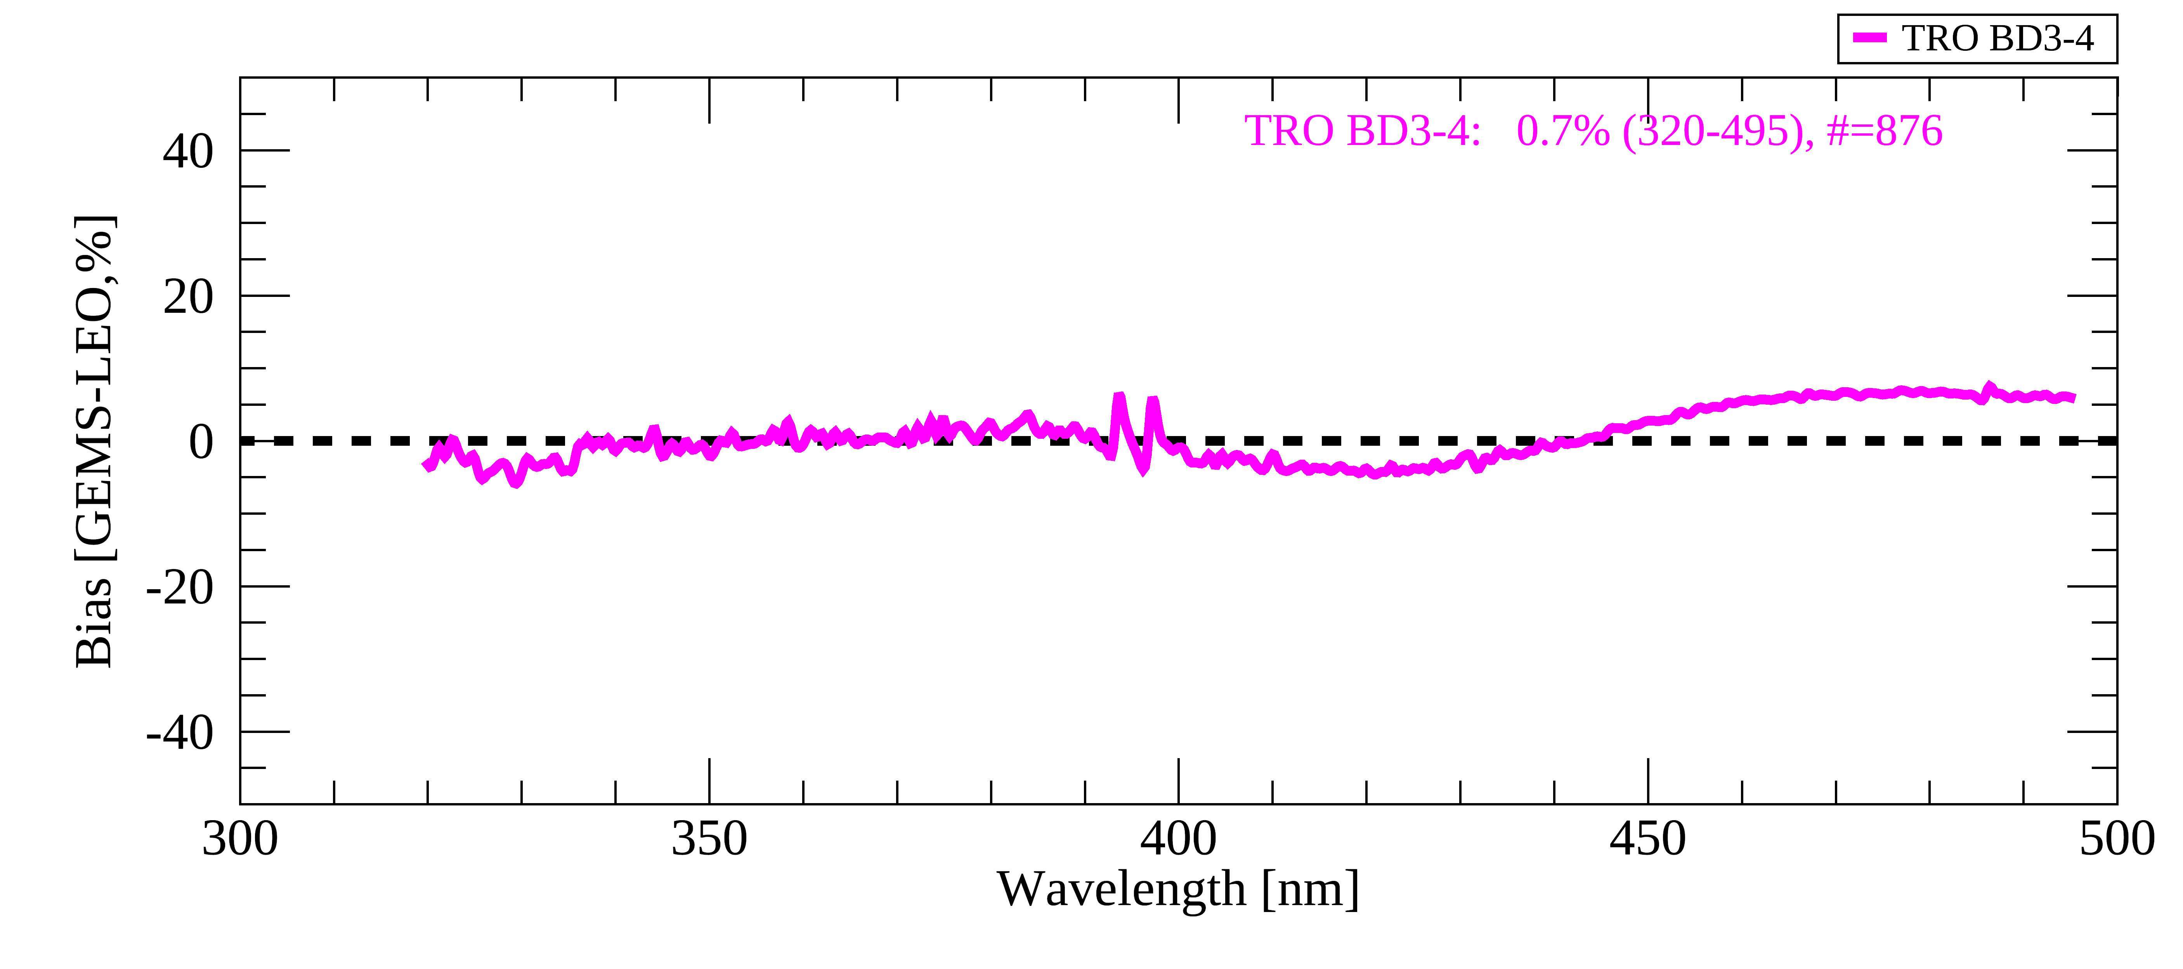
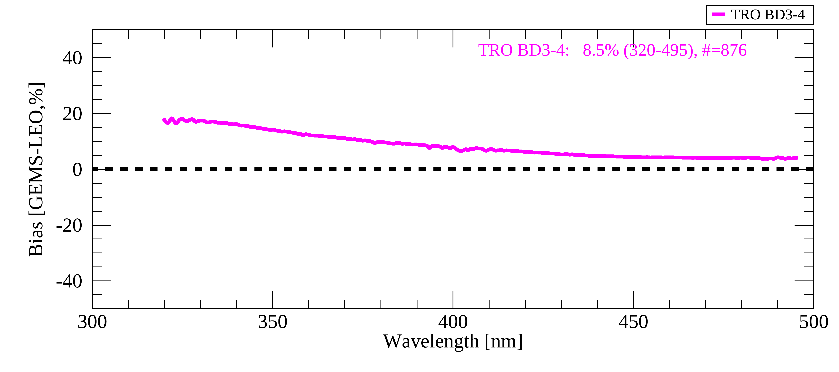
Validation Results – after BTDF update
Collocation w/ TROPOMI BD3-4 and OMPS/SNPP NM
January 2021 – February 2025, five-days interval
DCCs
Irradiance Radiance Reflectance
SSP
Irradiance Radiance Reflectance

Slide 16
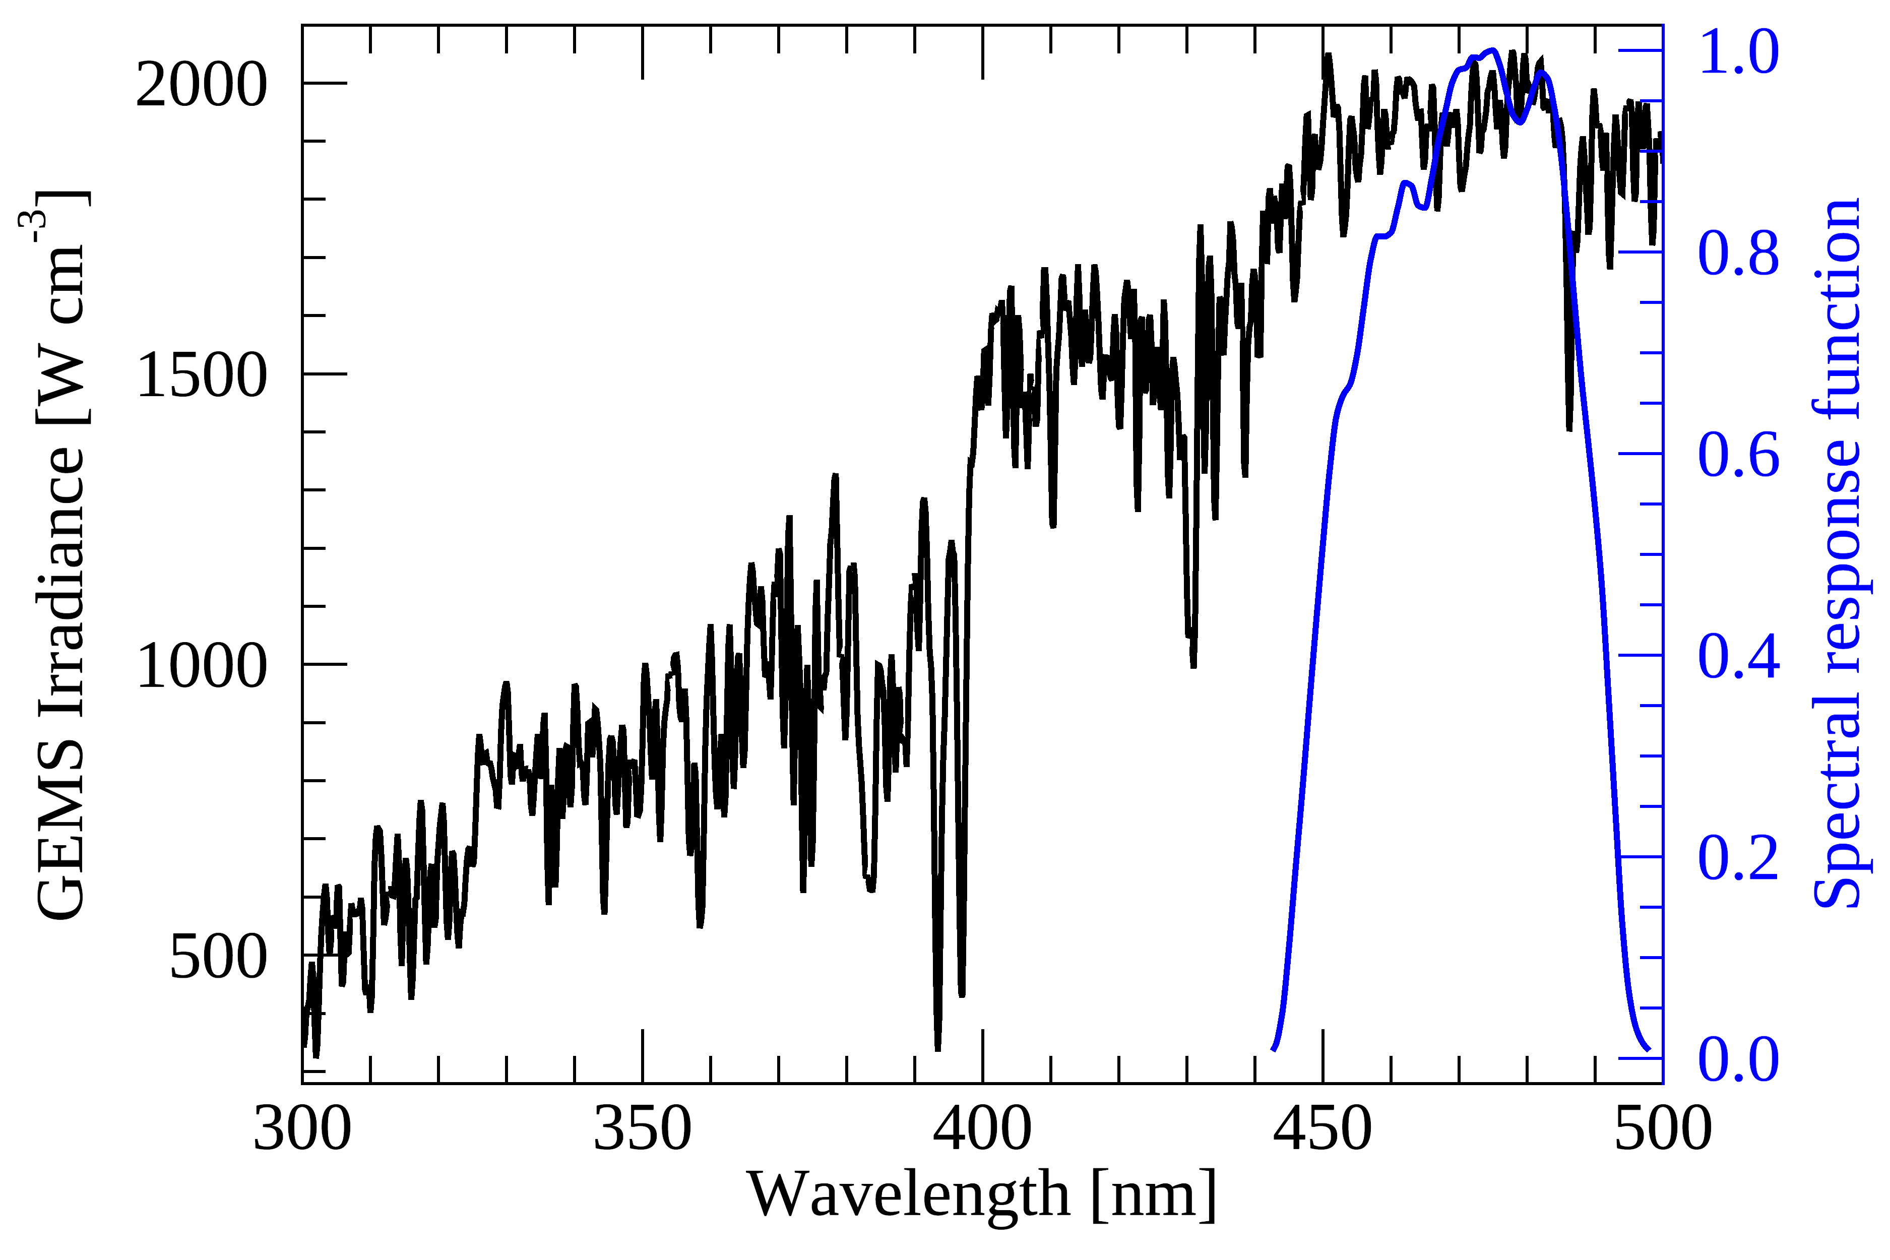
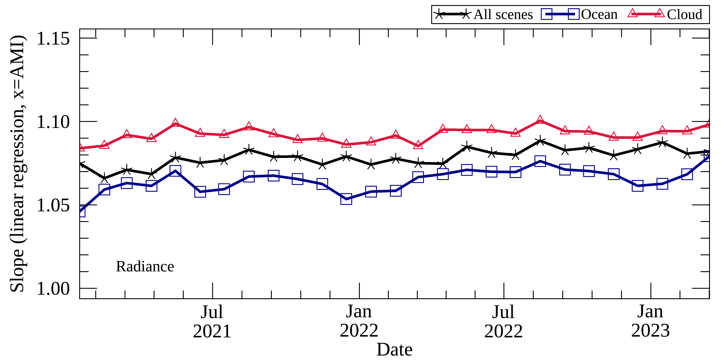
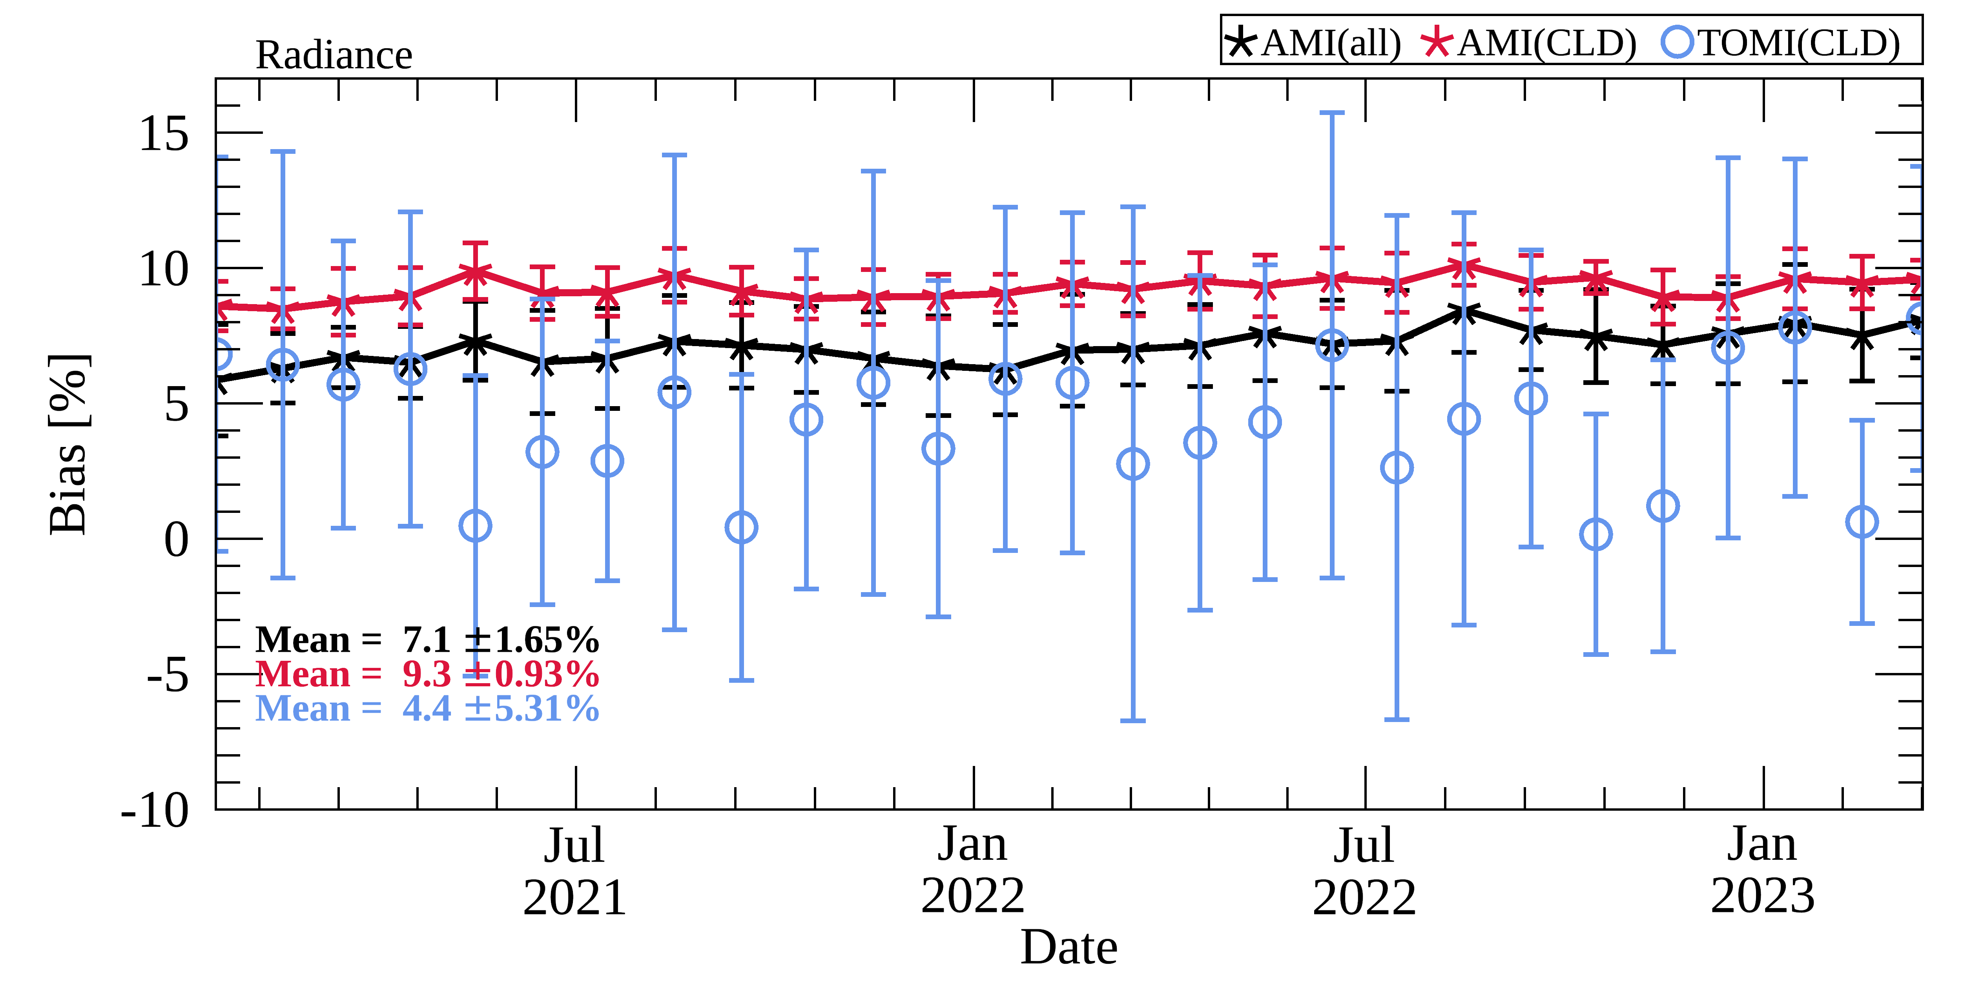
Validation Results – after BTDF update
Lee et al. (GRL 2024)
Collocation w/ AMI/GK-2A and TROPOMI
* Re-gridding (0.25$°$)
Condition | All scenes | Ocean | Cloud
General | Elimination of sun-glint, land, and bad pixels SZA & VZA < 40$°$ Longitude > 100$°$
Scene specific | $u\left(x\right), u\left(y\right)$ < 5% | $u\left(x\right), u\left(y\right)$ < 1% IR_{10.5} > 280 K R_{0.47} < 0.15 | $u\left(x\right), u\left(y\right)$ < 3% IR_{10.5} < 220 K R_{0.47} > 0.7
Linear regression (weighted) Bias [%]

Slide 17
Summary & Future Works
Remaining GEMS calibration issues
* Updated only for IRR
Issue (prominent) | Irradiance (IRR) | Radiance (RAD) | Reflectance (REF) | Effect | EOSRL 2024 (Research purposes)
North-South dependence | O | X | O (inverse) | Systematic bias along the N-S direction | Reduced (<1%, REF)
Diffuser degradation | O | X | O (inverse) | Higher degradation in ~300 nm | On-going
Sensor degradation (post diffuser) | O | O | X | Degradation | -
BTDF Negative bias | O | X | O | Systematic bias | Increase by 10% on IRR
Stripping | O | O | X | N-S spatial discontinuity | -
Reboot discontinuity | O | Potential | Potential | Temporal discontinuity | -
Radiometric calibration coefficient | O | O | X | Systematic bias | On-going

