Slide 1
OMI-TROPOMI Overview
Mission Status and outlook to future activities
Presented on behalf of TROPOMI and OMI Science teams
Deborah C Stein Zweers, KNMI
deborah.steinzweers@knmi.nl

Slide 2
Summary & Take Home messages
OMI and TROPOMI missions are operating well
Both OMI and TROPOMI are beyond mission lifetimes
OMI remains stable and functioning despite advanced mission “age”
TROPOMI is stable and providing high quality science data for Level 1 and more than 12 Level 2 operational data products, plus additional research products
Erwin Loots will give more details about the instrument & calibration, next presentation
Level 1 processing for OMI & TROPOMI harmonized to facilitate combined datasets
OMI: Nov 2004 to present – More than 20 years of data!
TROPOMI: May 2018 to present – Nearly 7 years, overlap with OMI
Time resolution OMI combined with improved spatial resolution TROPOMI allows for much deeper understanding seasonal and interannual effects for emissions etc.

Slide 3
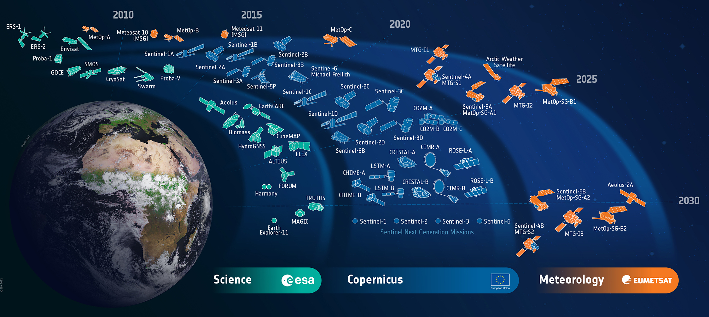
KNMI partners with ESA & EU missions across domains

Slide 4
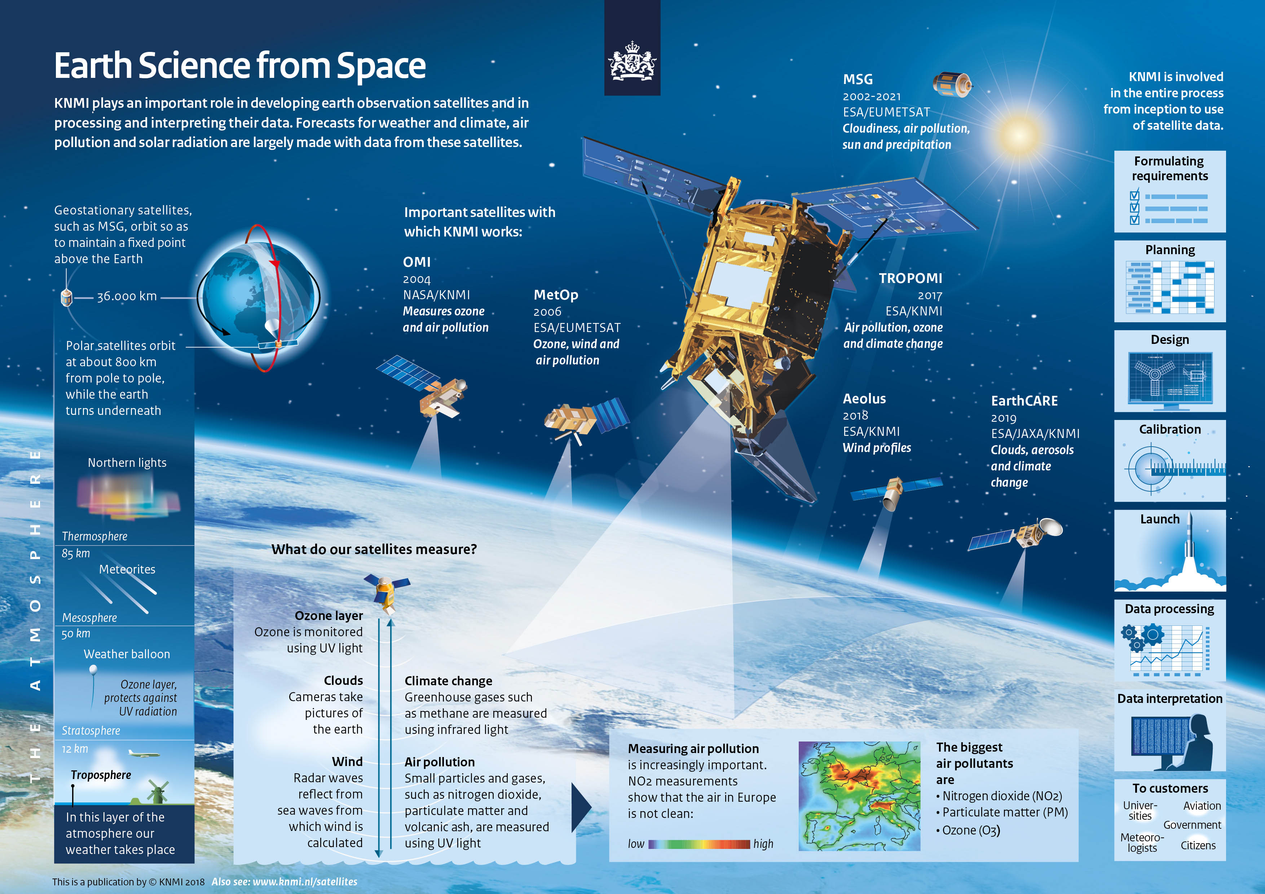
KNMI – Royal Netherlands Meteorological Institute: R&D Satellite Observations Department

Slide 5
Operating principles
Operational Scientific Data: Striking a balance between producing the highest quality data but releasing to the users as quickly as possible → Iterative Improvements
Visible and Open Data: Ensuring broad use of our data, with more users and increasingly diverse users, we always learn more & can improve our data
We actively approach user communities by offering TROPOMI training, workshops
One of the few benefits of COVID-crises was increased & broad usage of data
Interactions with data warehouses and non-scientific users (ex. NGOs and startups)
Standardized Comparison: Use of scientific community standards for the development of our quality monitoring (QA/QC) tools and visualizations
Open source tooling: several keys tools have been developed for monitoring quality, regridding the L2 → L3 for site-based routine validation and mapping
These tools and the visualization and reporting (L1, L2 & VAL) produced by them are all publicly available and accessible online
Notes:
Mention the reporting

Slide 6
OMI Mission Status Summary
Collection 4: mission reprocessing activity underway to ensure consistent datasets with improved irradiance, radiance inputs
Data products are available via https://disc.gsfc.nasa.gov/
All data to be released in by Q1 2026
OMI is still stable however as the instrument drifts in orbit solar power will be insufficient at some point in near-future
After a series of extensions, mission lifetime ending 2026?

Slide 7
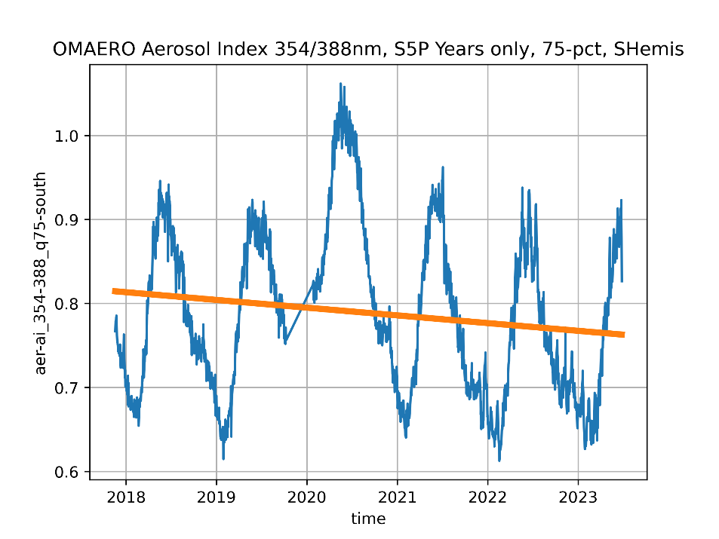
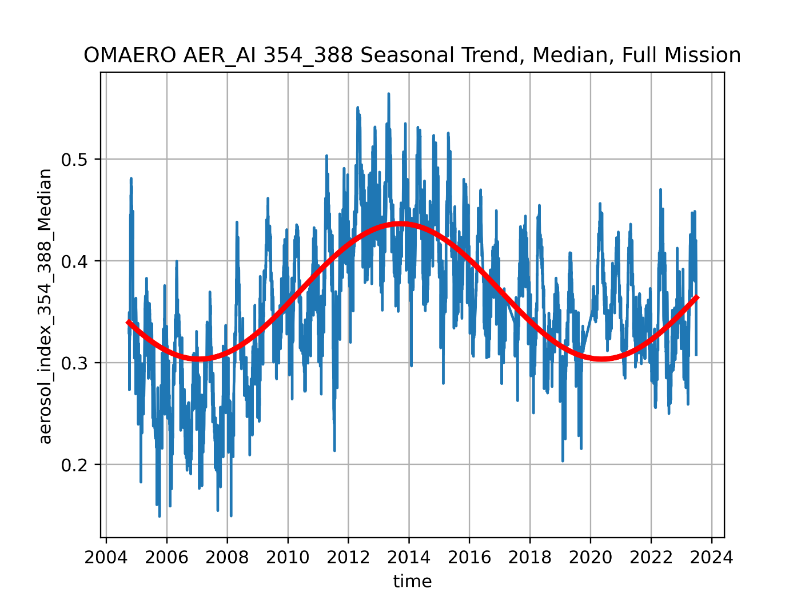
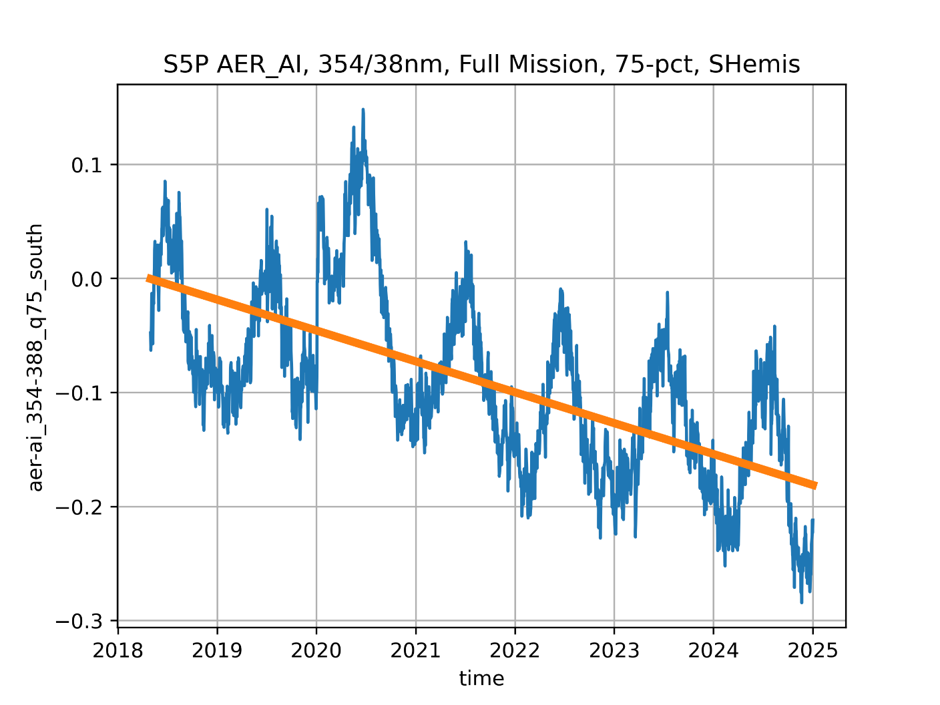
OMI Mission – Overlap with TROPOMI
Opportunity to study TROPOMI time-dependent features in more detail: example aerosol index

Slide 8
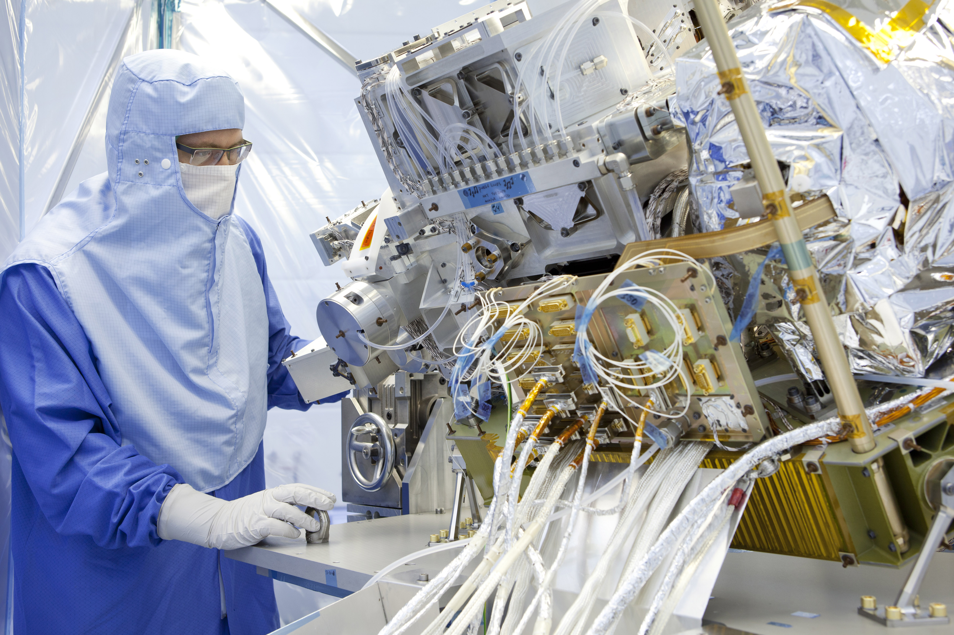
Focus on TROPOMI:
TROPOspheric Monitoring Instrument
Monitoring atmospheric composition, for:
Air quality
Climate change
Ozone layer
TROPOMI details:
Single instrument satellite onboard
Sentinel 5-Precursor platform (S5P)
Launched 13 October 2017
Polar-orbiting satellite
Overpass time ~13:30 LT
Data are free and open
https://www.tropomi.eu &
https://dataspace.copernicus.eu/
https://maps.s5p-pal.com/

Slide 9
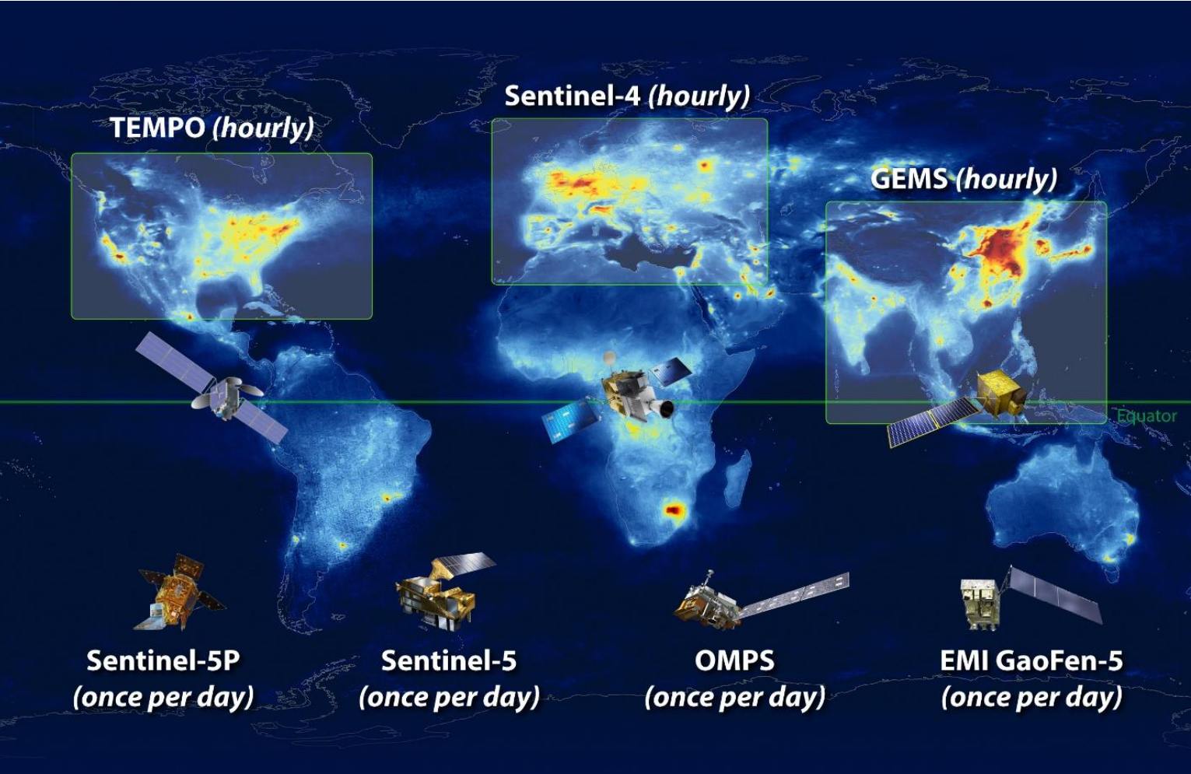
TROPOMI as a base map
The role of TROPOMI is ever-increasing to serve as an anchor point for comparison with:
Geostationary missions
Sentinel-5 morning
Ground-based sites
Field campaigns & mobile measurements
New! With higher spatial resolution small satellite footprints
Notes:
One of the few remaining afternoon orbit instruments -

Slide 10
TROPOMI: Mission Performance Center Core Elements
In-flight
Calibration
Quality Control
L1B and L2
Routine
Geophysical
Validation
Algorithm Evolution
L1B and L2
Processor Maintenance Tooling & Data Access
Communication
Notes:
Communication – backup response for complex queries of TROPOMI questions

Slide 11
TROPOMI Mission Performance
Atmospheric Mission Performance Center, a broad umbrella to facilitate expansion beyond TROPOMI borders including new Copernicus small sat missions
KNMI is the prime contractor for ATM-MPC Consortium working with ESA
Level 1 & Calibration activities: KNMI and SRON, DLR L1 validation
Level 2 Algorithm Evolution & Maintenance: DLR, KNMI, BIRA, SRON
Routine Validation and Tooling: BIRA, NILU, AUTH MPIC, IUP-Bremen, S&T
Outside the ATM-MPC we rely on interaction with the Ground Segment: DLR, ESA
Notes:
Consortium that has been working together since 2016; similar ESL structure for L1, L2, and VAL purposes
It is good to mention in the last bullet that we interact directly with CAMS, but that this is outside the scope of this presentation; to make it clear what we do focus

Slide 12
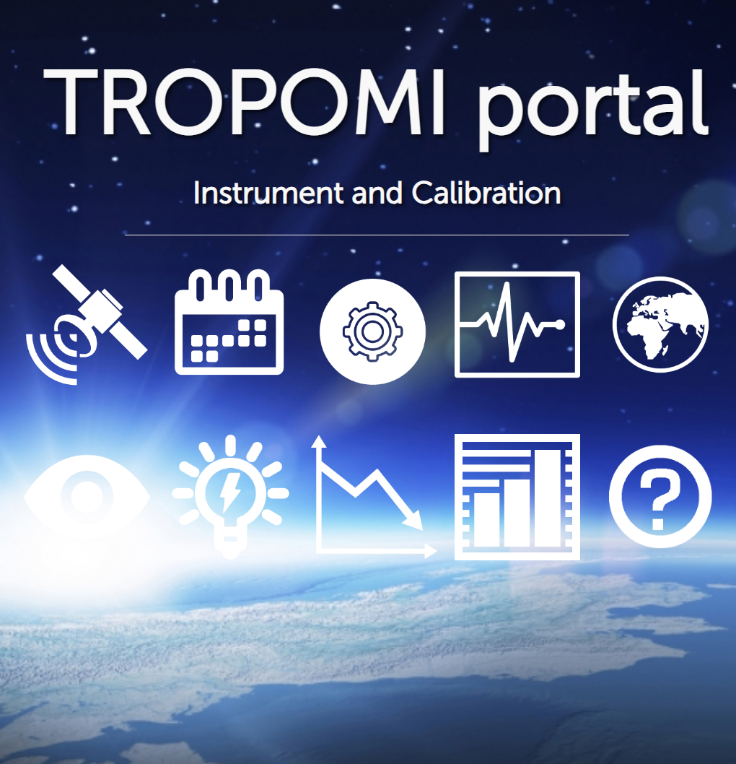
In-flight calibration and Level 0-1b
Pre-launch on-ground calibration.
Commissioning Phase testing.
Operational Monitoring tasks.
Instrument and Engineering
Characterization of instrument over time.
Delivery of Calibration Key Data to correct for time-dependent features.
Analyses of the irradiance and radiance degradation.
Support of the Level 2 teams.
https://mps.tropomi.eu/dashboard

Slide 13
Use of L01b for in-flight calibration
L01b processor
Data reduction
Quick look generation
ICAL processor
Multi-orbit (calibration) analysis
IDAF
Complex calibration algorithms
Off-line analysis
In-orbit calibration
Trending / monitoring data generation
Dynamic Calibration Key Data generation
Additional trending / monitoring data generation
Trending / monitoring / calibration database for entire mission
Website / Visualisation
Auxiliary Calibration Key Data updates
Calibration key data updates

Slide 14
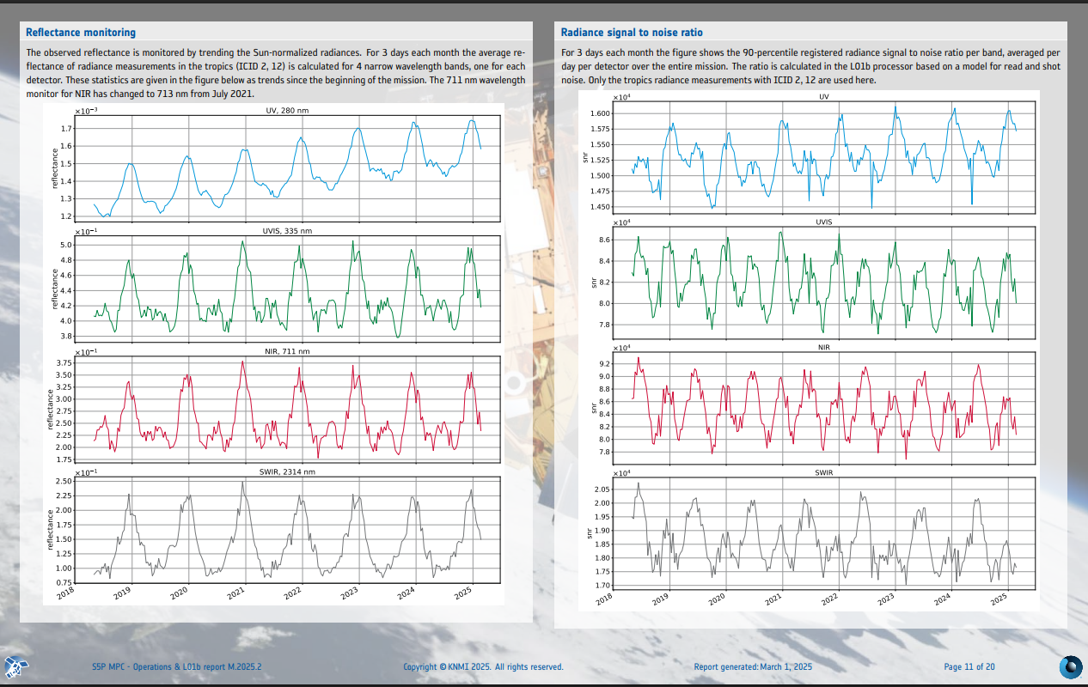
In-flight calibration reporting
Daily, weekly & monthly reporting: instrument performance, measurement quality, and trending

Slide 15
TROPOMI Data Timeliness
Near-real-time (NRTI) stream, in data granules (part of an orbit)
NRTI is available within 3 hours after data acquisition and intended for quick access & rapid use operational processing. However,
NRTI data may sometimes be incomplete and has a slightly lower data quality as compared to the other data streams.
Non-Time Critical or Offline (OFFL) stream, in orbits
Most data users should use the offline data, available within a few days after acquisition, which has the highest data quality and coverage.
Reprocessing stream (RPRO), in orbits
For time series / trend analysis, the latest version of the reprocessed data should be used to avoid shifts due to data version updates.
RPRO starts 30 April 2018 and can be combined with OFFL data starting July 2022 to the present date for a fully consistent data record
Except SO2, but that is being reprocessed right now (March 2025)
OFFL + RPRO

Slide 16
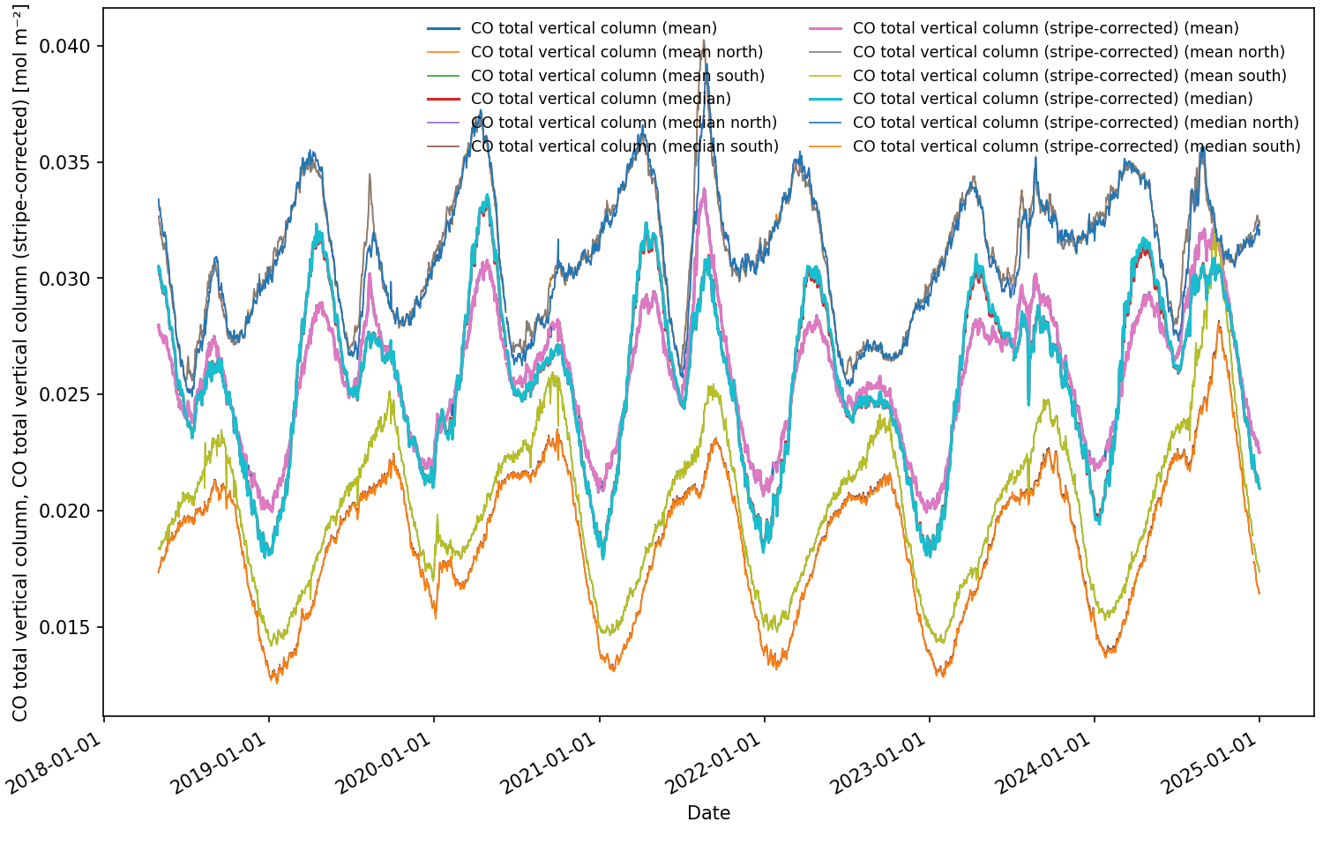
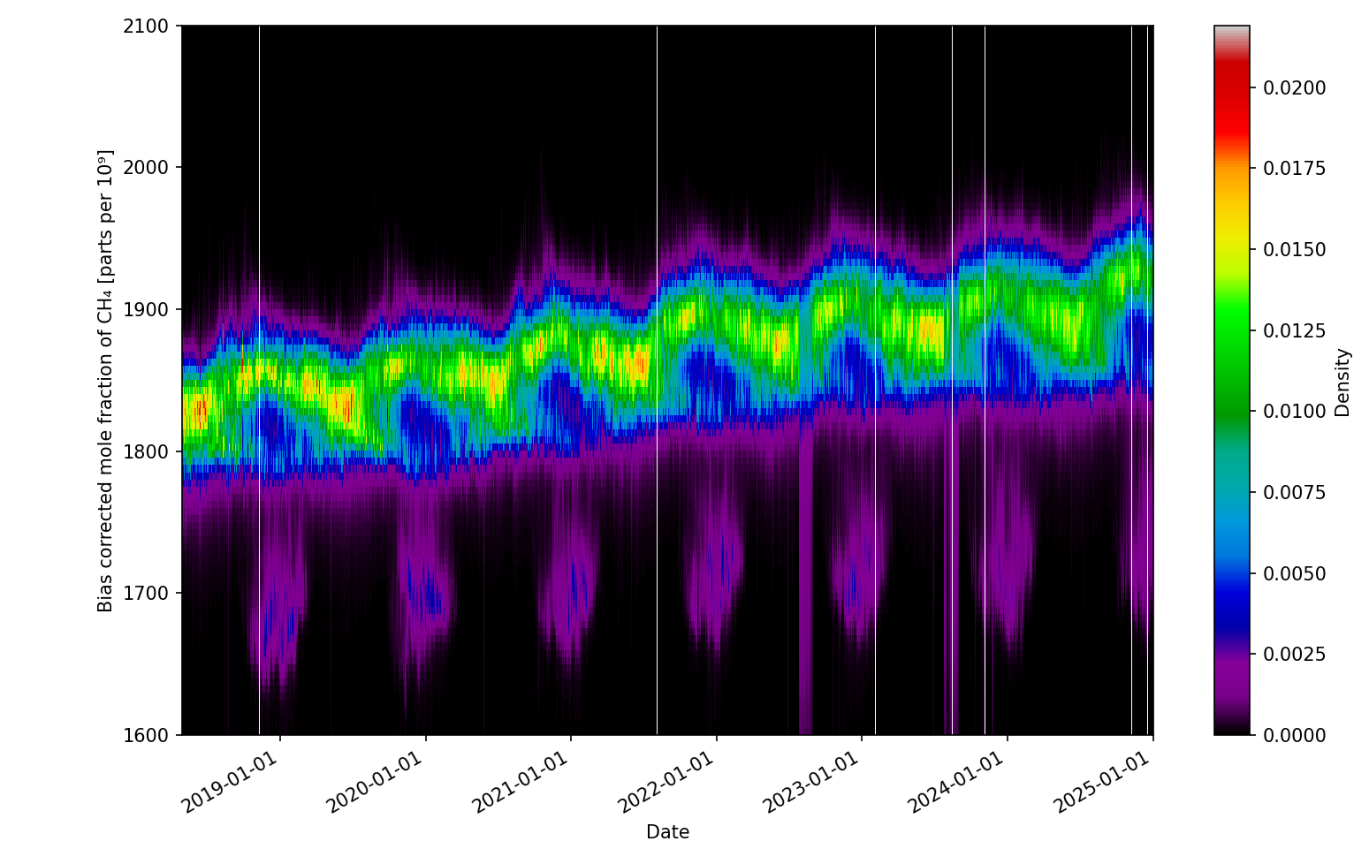
TROPOMI Reprocessing:
Completed full mission: All L2 data are produced based on a mission consistent L1 data set with correction for instrument features and time-dependent changes; Facilitates detailed time series analyses; Compatible with forward stream non-time critical data stream OFFL
Roughly 950K data files were produced for a total volume of 1.6 PB of data
CH4
CO – N. Hemis & S. Hemis

Slide 17
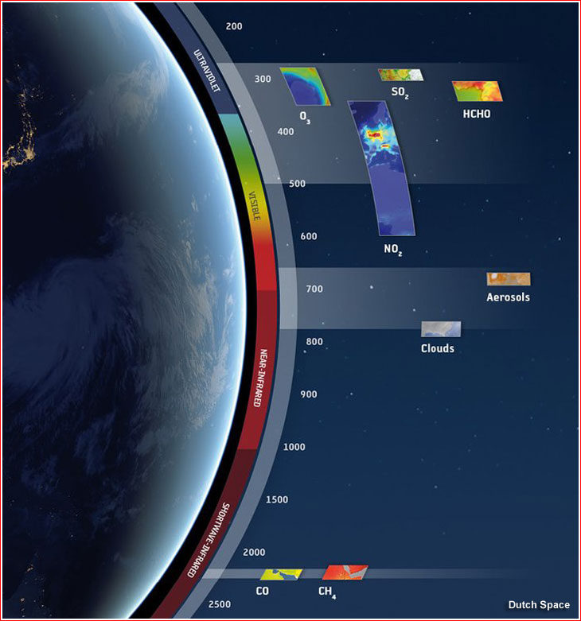
Measuring AQ & SLCPs Directly with TROPOMI
Index
Tropospheric Monitoring Instrument (TROPOMI) is an air quality mission that is also relevant for understanding our changing climate
Daily afternoon measurements (~13:30 LT)
What is being measured directly:
Tropospheric Ozone Column & profile
UV Surface Radiation / Dose
Aerosol Index, Ocean Color & properties*
NO₂, SO₂, HCHO, CHOCHO*
Clouds & Aerosol Layer Height
(SIF) Fluorescence*
CO, CH₄
SIF Fluores
*Research data products
Notes:
In many parts of the world ground monitoring stations are sparse, satellite data can help to fill in the gaps

Slide 18
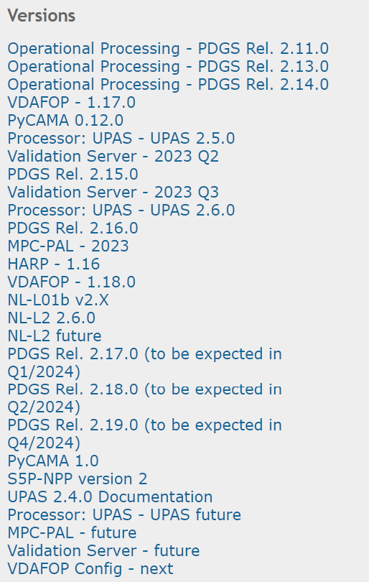
Level 1-2 Algorithm & Processors
Steady work of algorithm and processer improvements
Iteratively tied quality monitoring
11 Operational Data algorithms + 4 support data products
Created with 3 different processors
Progress of development is tracked & planned with roadmap approach
Diagnostic data sets are prepared and analyzed before new algorithms are put into production
Rigorous testing internally & with PDGS
Close interaction with validation team data product coordinators

Slide 19
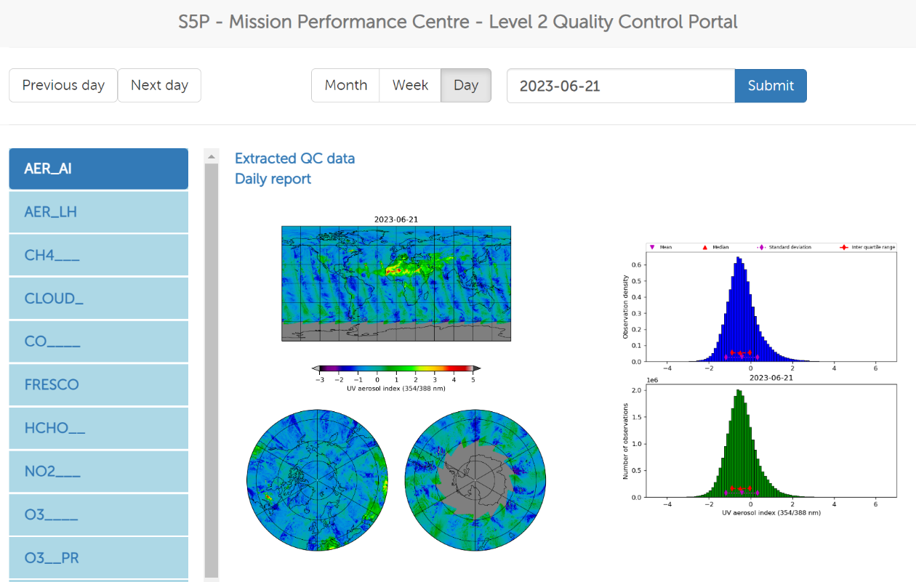
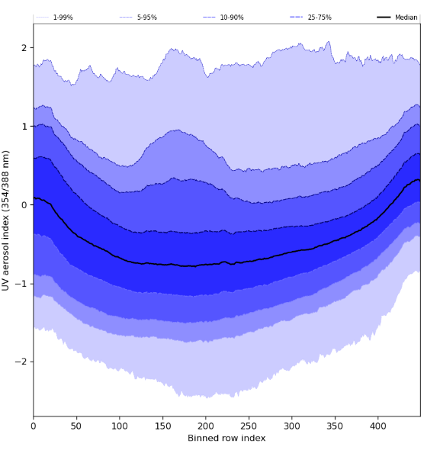
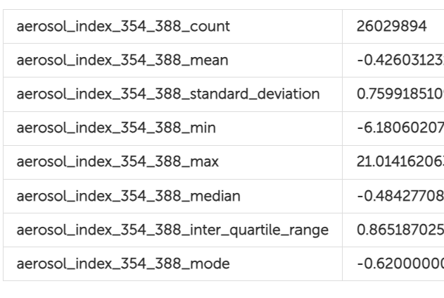
Level 2 Quality Control Monitoring
We monitor data quality of our products based on operationally produced daily extracts of detailed quality information
PyCAMA: detailed analysis software, publicly available used internally, externally and by operations ground segment
We report L2-QC both weekly & monthly; detailed automated daily reports are also available
https://mpc-l2.tropomi.eu/
https://mpc-l2.tropomi.eu/timeseries.html

Slide 20
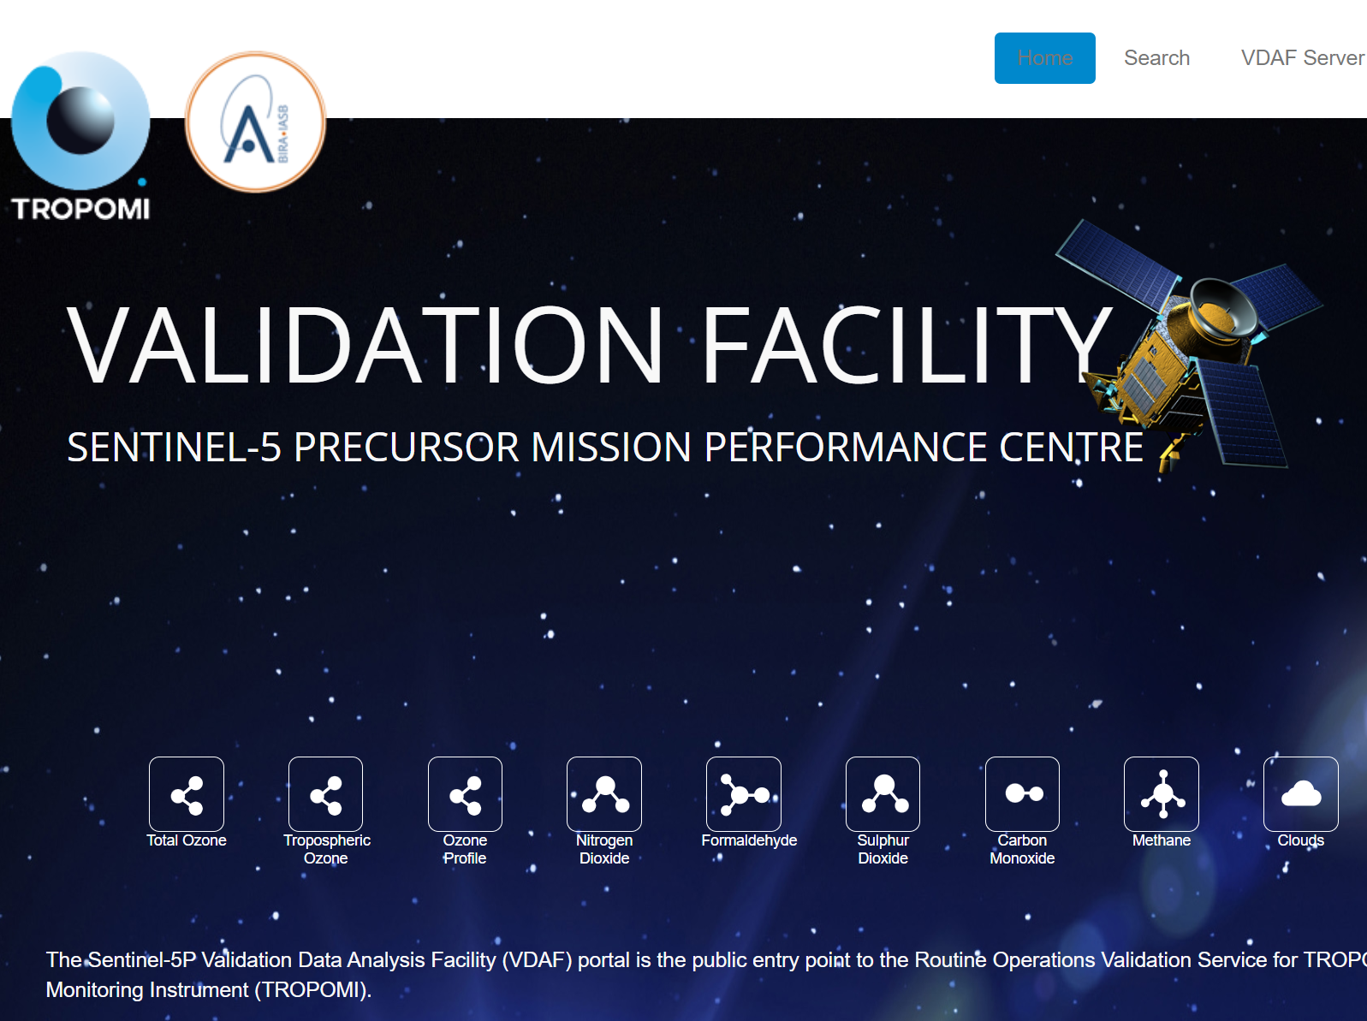
ATM-MPC Routine Validation
The routine validation performed by the Validation Teams using the ATM-MPC VDAF system set a new standard for future missions.
Standardized, rigorous validation techniques applied to an automated validation server
Ingests high-quality, ground-based and sonde data for most data products, around the globe with varying timeliness
Provides user-interactive visualization and analysis functionality
https://mpc-vdaf.tropomi.eu/

Slide 21
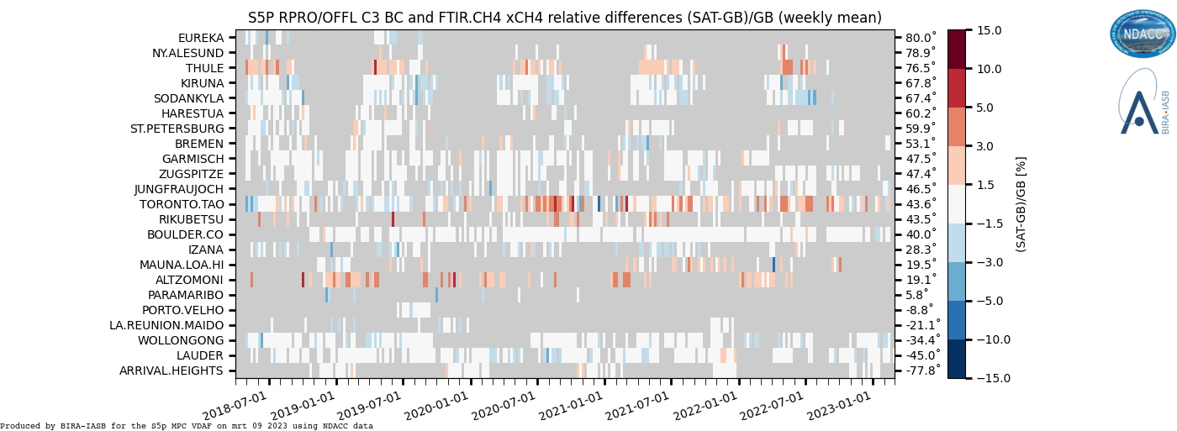
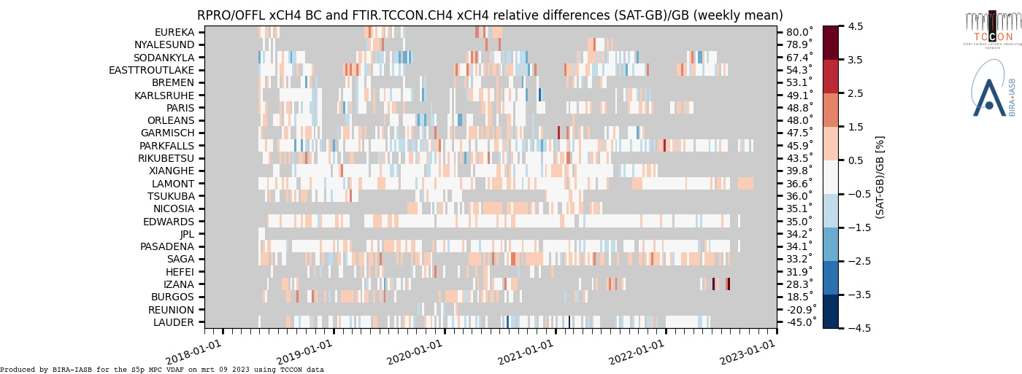
ATM-MPC Routine Validation
Comprehensive explanation of methods and data used
https://mpc-vdaf.tropomi.eu/index.php/methane

Slide 22
Motivation: How can TROPOMI be best used now?
Well suited to combine with many missions: past, current & future
Copernicus Data Ecosystem Space as common access point
TROPOMI satellite data can be starting point for identifying:
Which air pollutants are most prominent for my region/city?
What is the seasonal cycling of these species?
What is my city footprint? Urban vs. Background, trends, etc.
Is long-range transport occurring? Dust and smoke plumes
What if I look at relationships between gases and aerosols to identify types of sources?

Slide 23
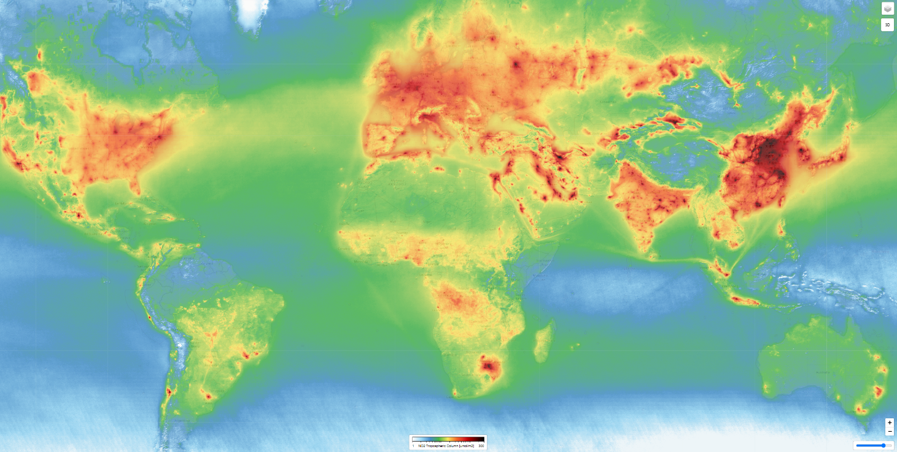
Thanks for your attention!

Slide 24
EXTRA SLIDES

Slide 25
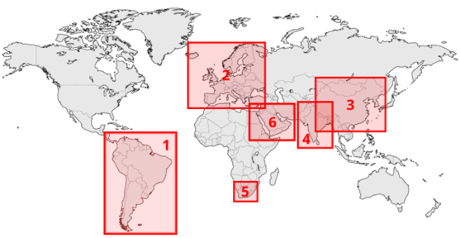
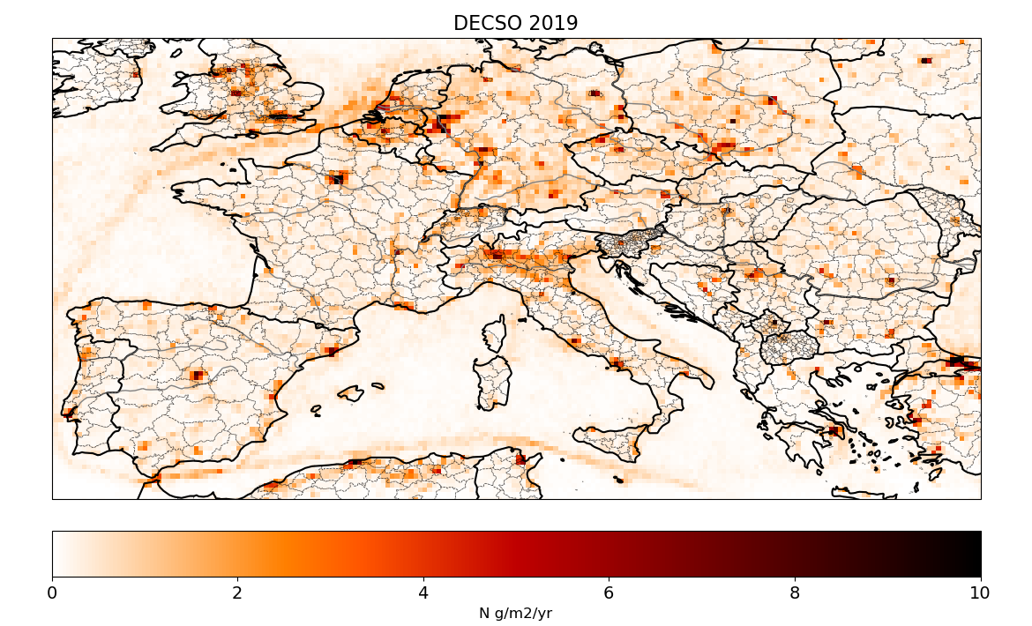
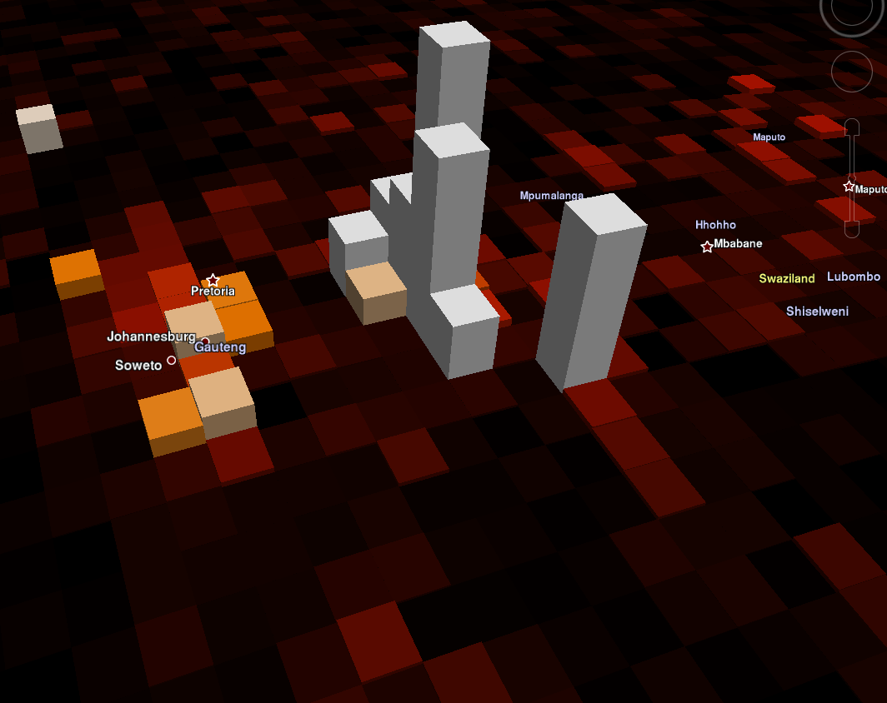
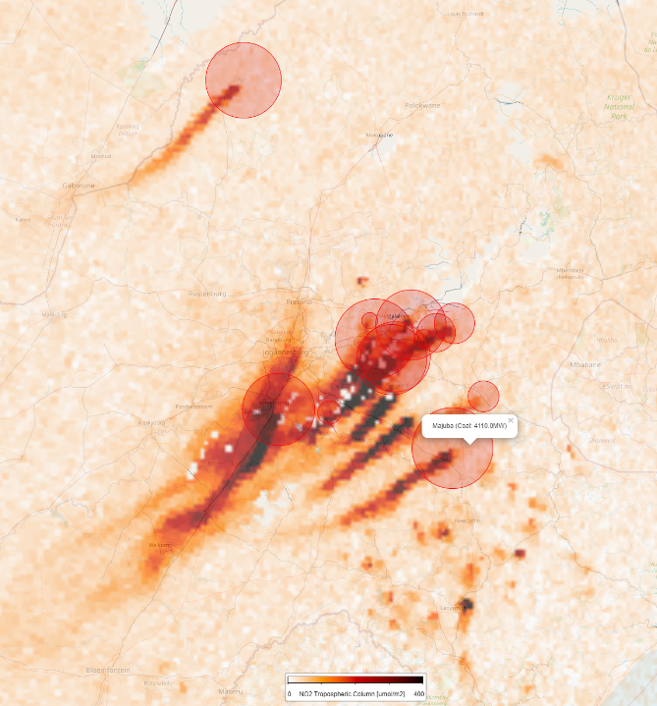
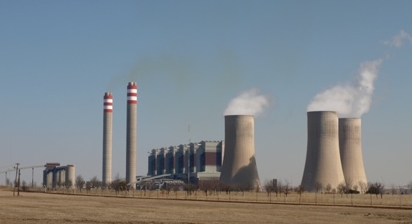
Monitoring Emissions
DECSO Daily Estimates Constrained by Satellite Observations
By Ronald van der A, Bas Mijling, Jieying Ding - KNMI
It is fast: one model run per assimilation step of 1 day
No a priori information needed: unknown sources will become visible.
Full error estimation of new emission inventory
Used for daily NO_{x}, NH₃, CH₄ emissions
This type of emissions calculation can be linked to CO₂ emissions for known point sources (ex. Power plants)
Tropospheric NO₂ 22 Sep 2021
Majuba power plant

Slide 26
Making Links: AQ-relevant Short-Lived Climate Pollutants (SLCP)
Some species have a large AQ and Climate Impact
Tropospheric Ozone
Black Carbon Aerosol (soot & smoke)
Methane (CH₄)
From: Climate & Clean Air Coalition

Slide 27
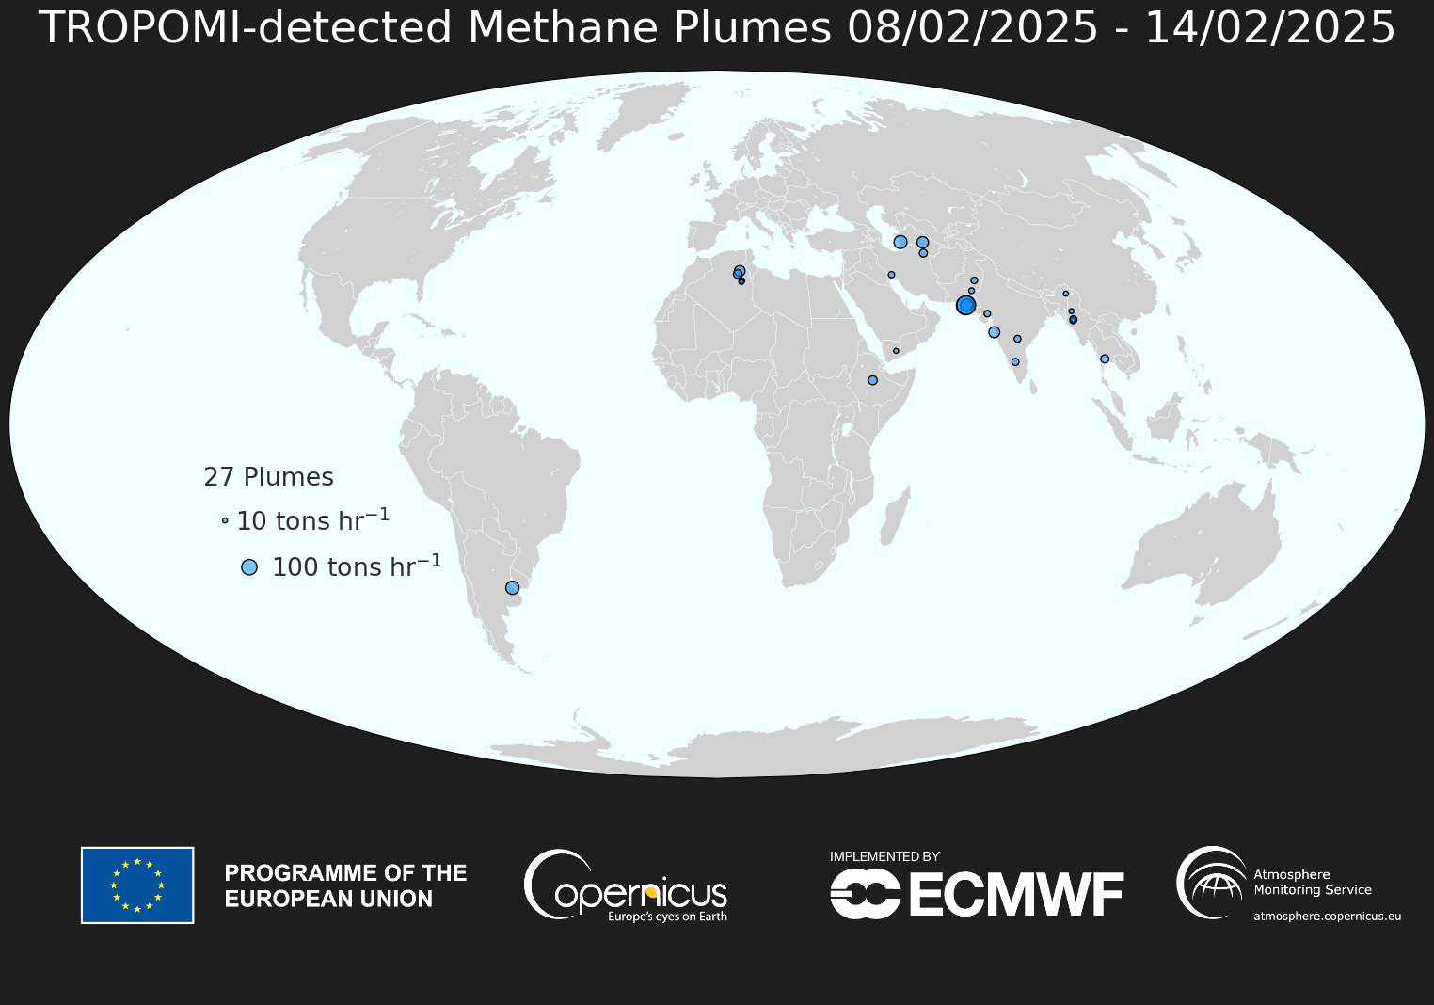
Global monitoring of TROPOMI detectable Methane sources

Slide 28
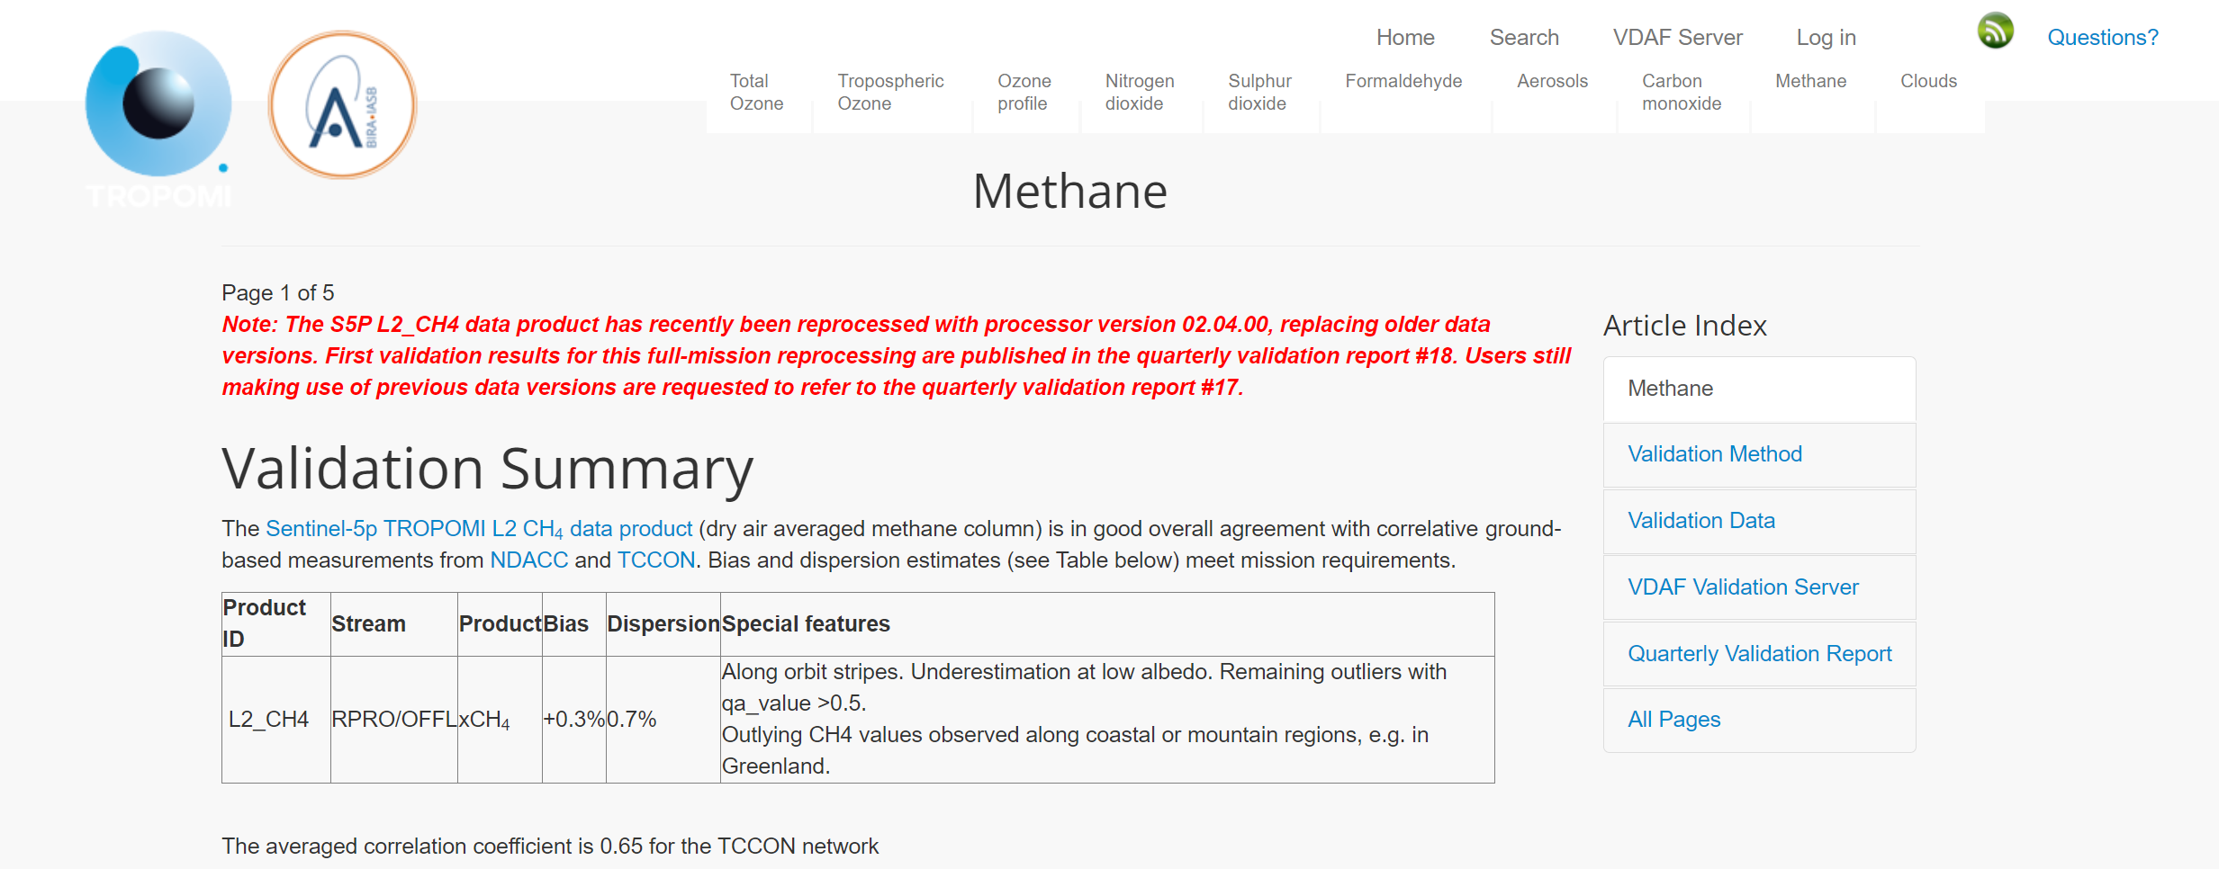
ATM-MPC Routine Validation
Comprehensive explanation of methods and data used
https://mpc-vdaf.tropomi.eu/index.php/methane

Slide 29
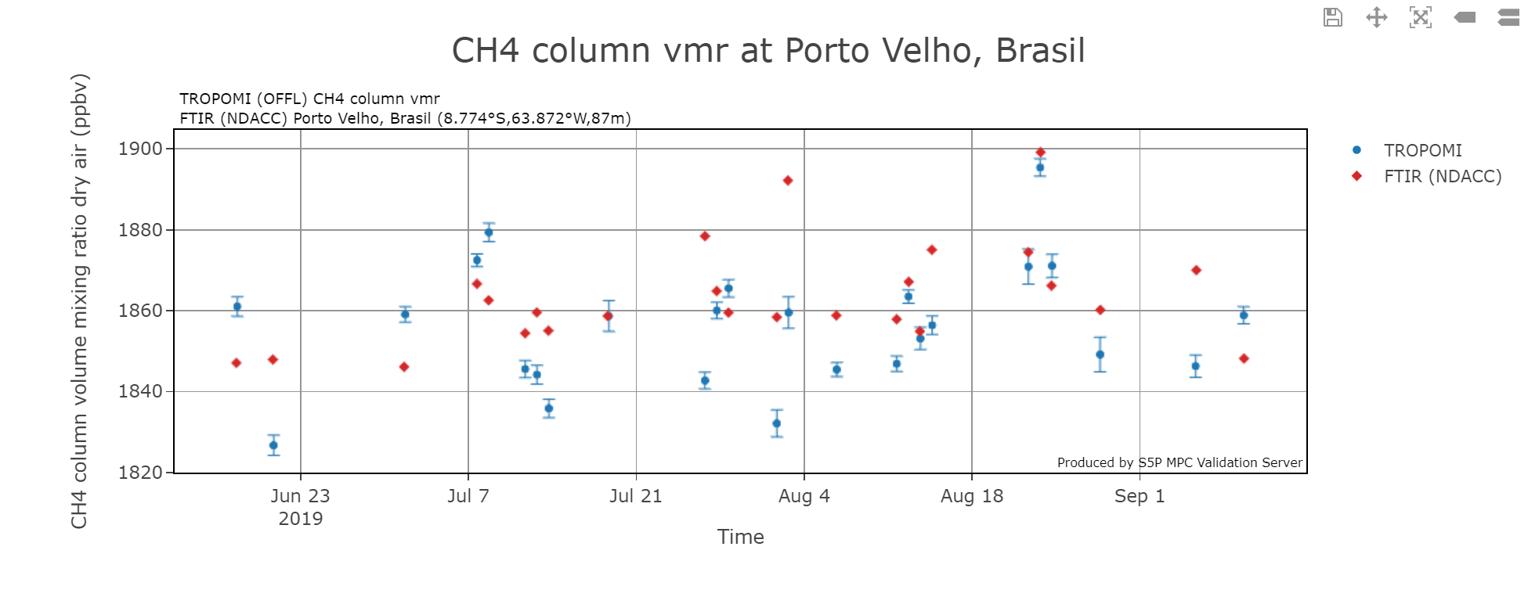
ATM-MPC Routine Validation
Interactive User Visualization capability with report generation options
https://mpc-vdaf-server.tropomi.eu/ch4

Slide 30
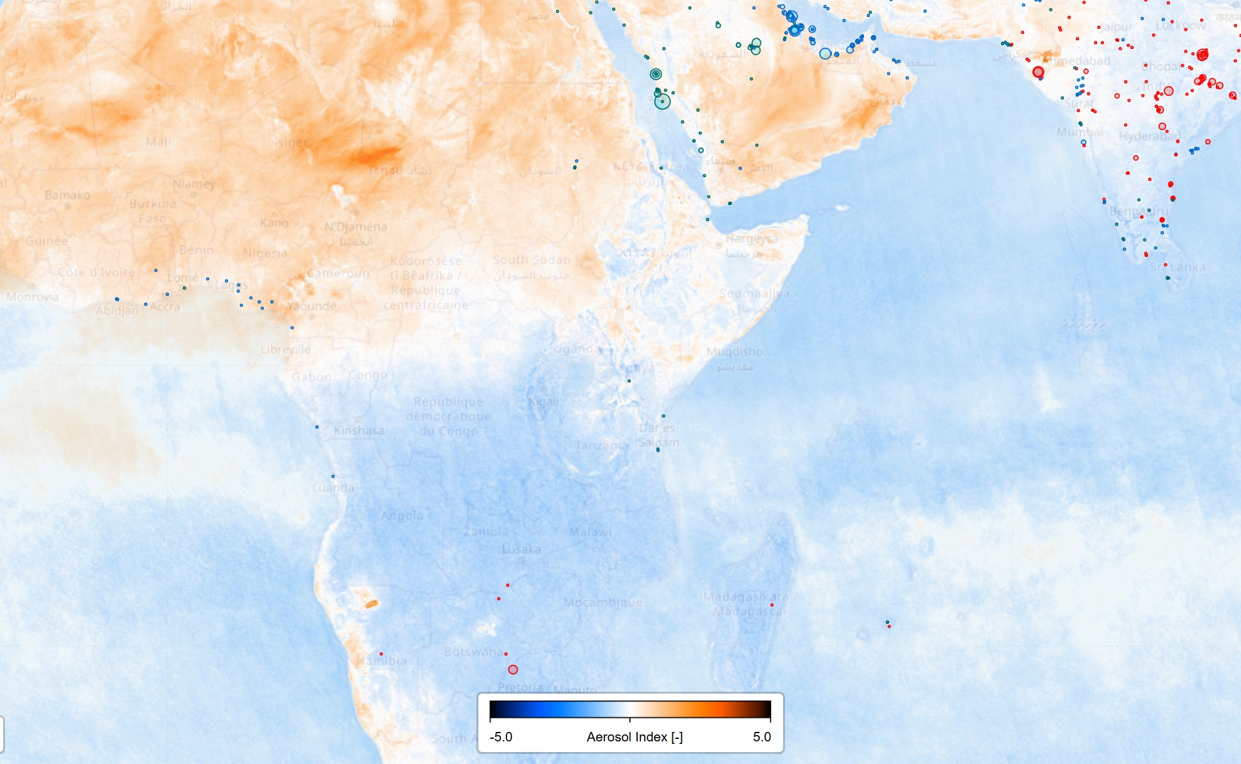
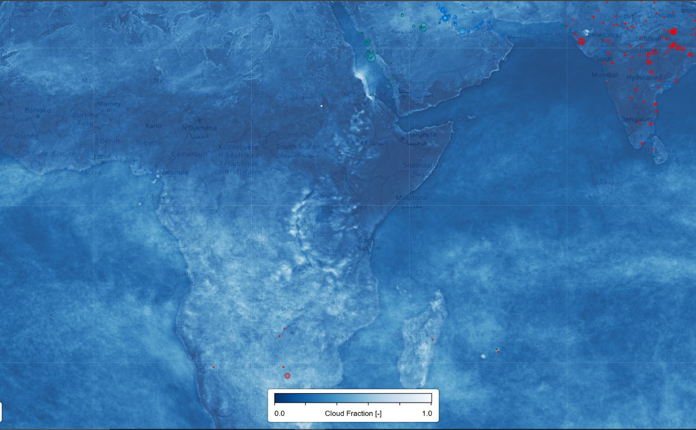
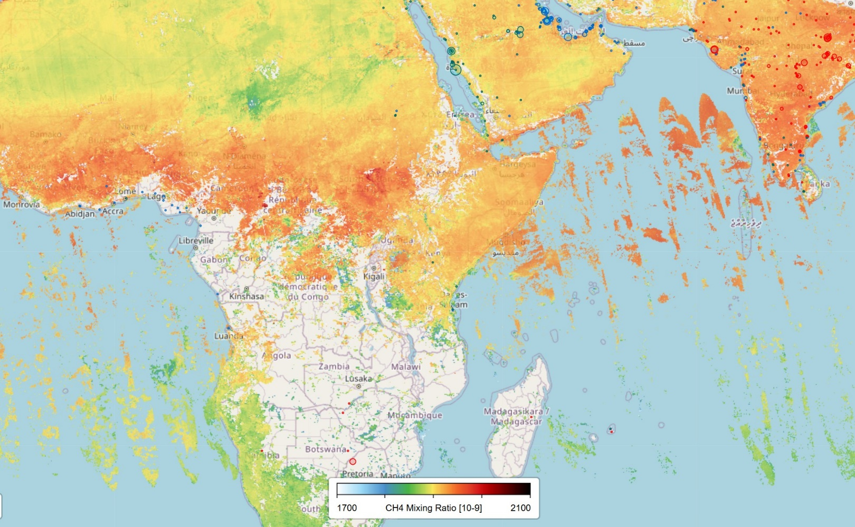
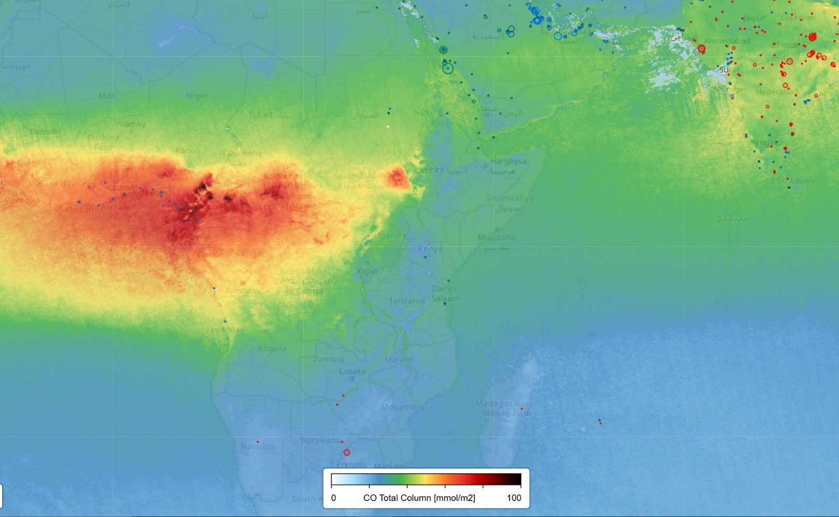
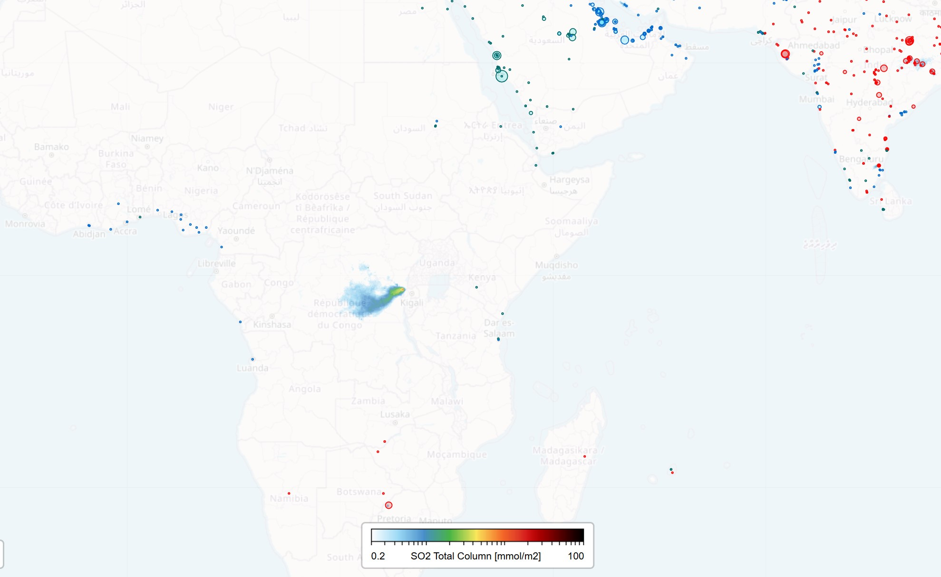
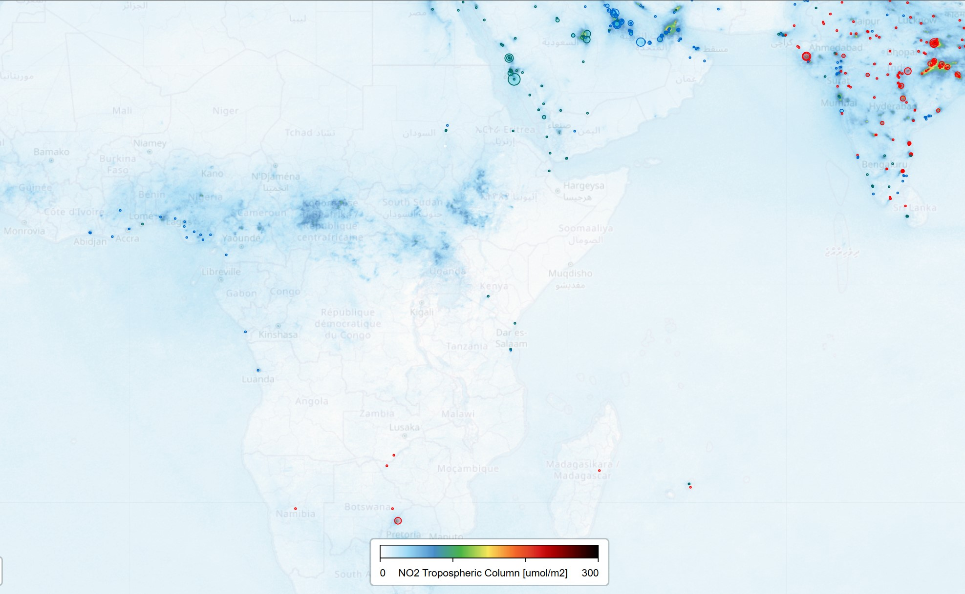
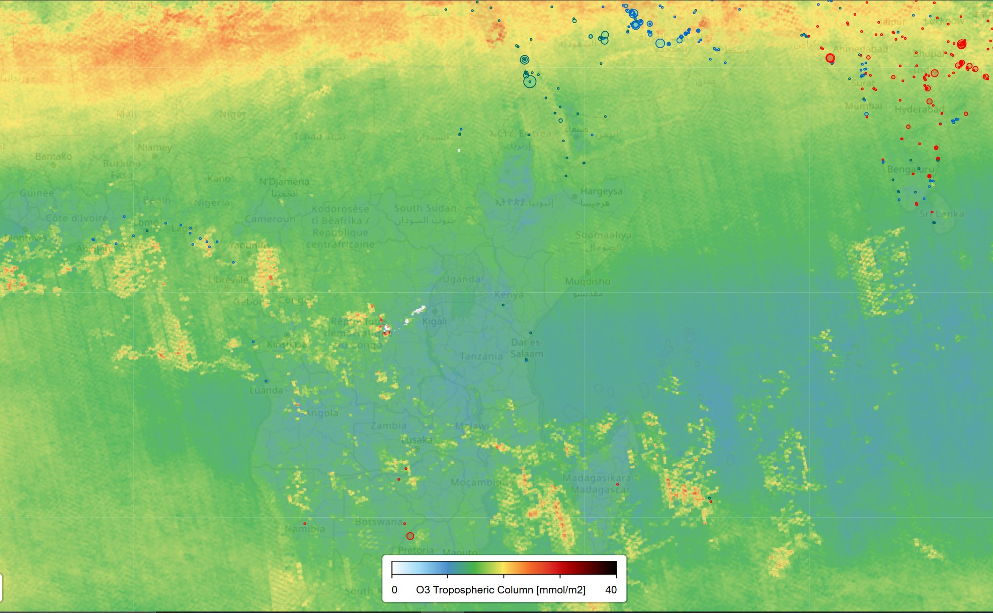
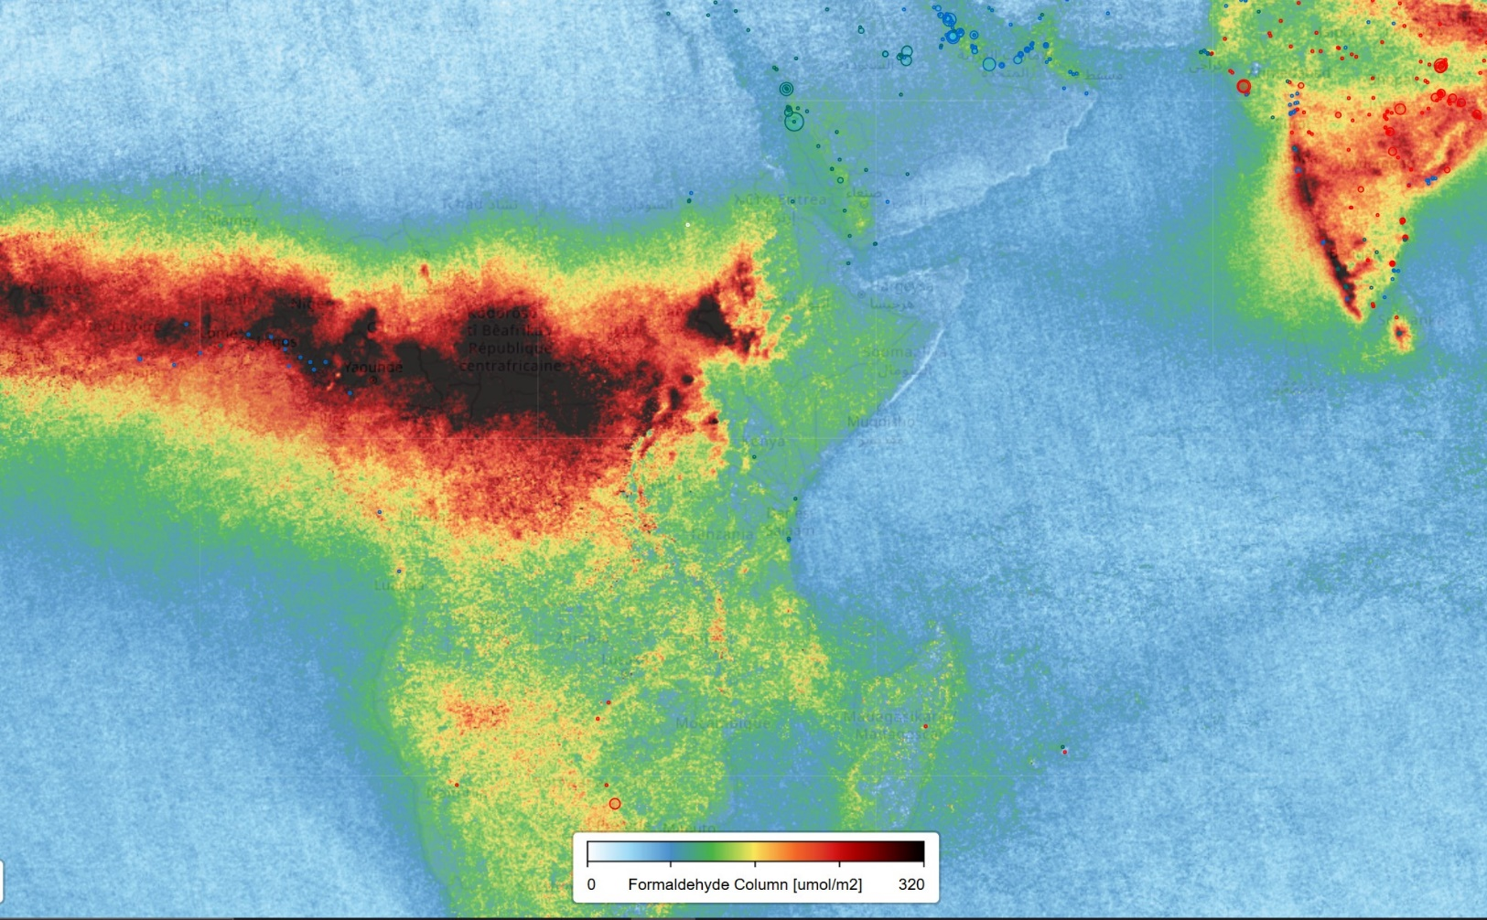
The many layers of TROPOMI

Slide 31
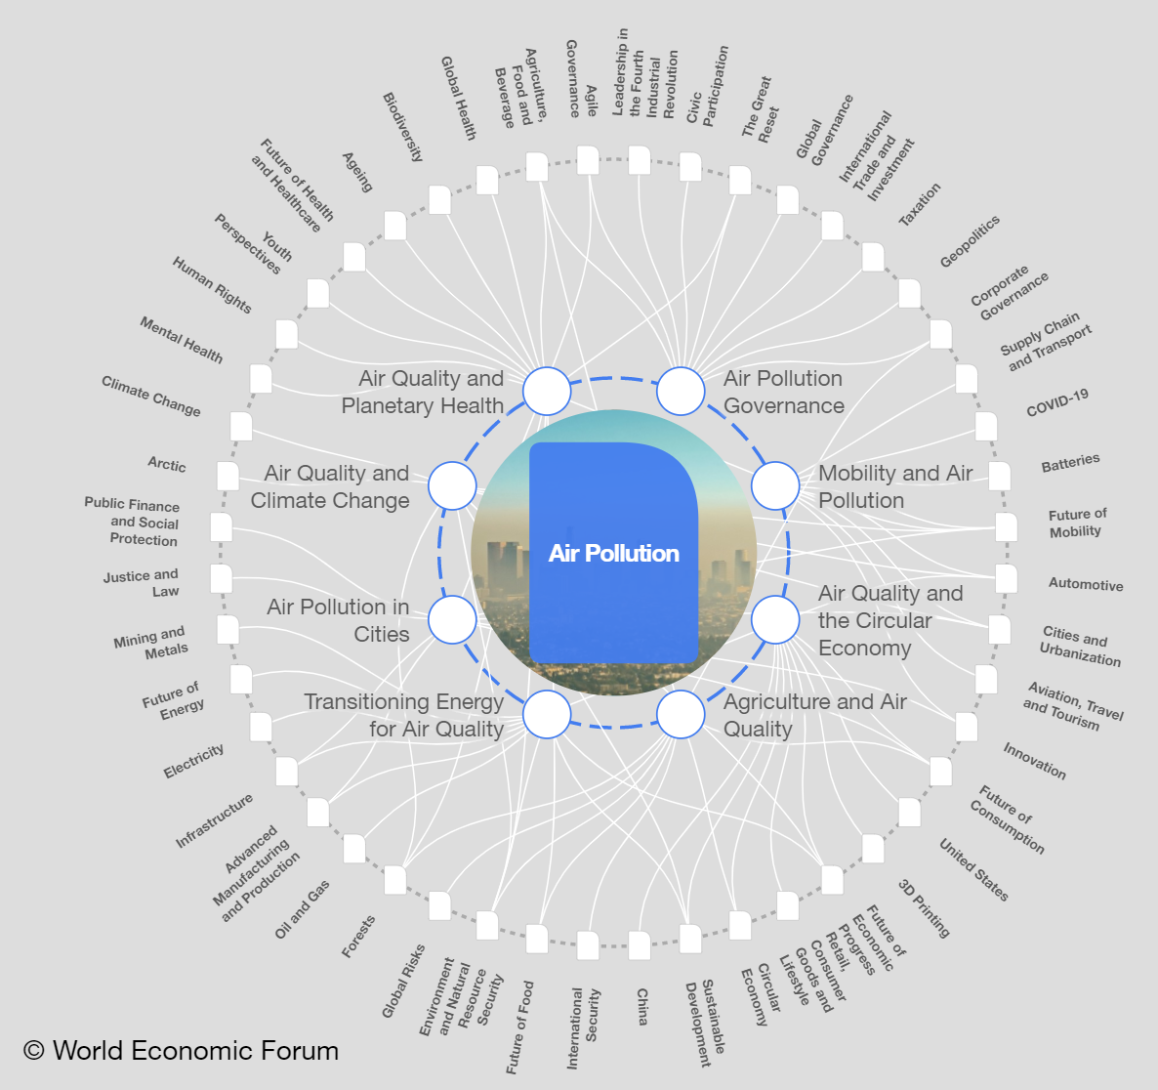
Air Quality is just the beginning…
What can TROPOMI + other satellites do?
Compelling visuals: Describe AQ changes over time and in space, from global to city-level for a variety of trace gas species relevant for understanding health impacts
Demonstrate policy-driven AQ improvements, ex. Before/after scrubber installation, effects of car-free days;
Pinpoint structural & incidental Hotspots, ex. CH4 gas leaks
Can be used to calculate satellite-based emissions with additional model and source information
Emissions help to better enter the realm of policy & AQ standards
Complement & Contextualize ground-based measurements including low-cost sensor networks
Climate Change pieces of the puzzle: Methane (CH₄), and NO₂ data can be use as a proxy for CO₂
Further insights about carbon cycling and link to the biosphere with measurements of Solar-Induced Fluorescence (SIF) indicative of vegetative productivity

Slide 32
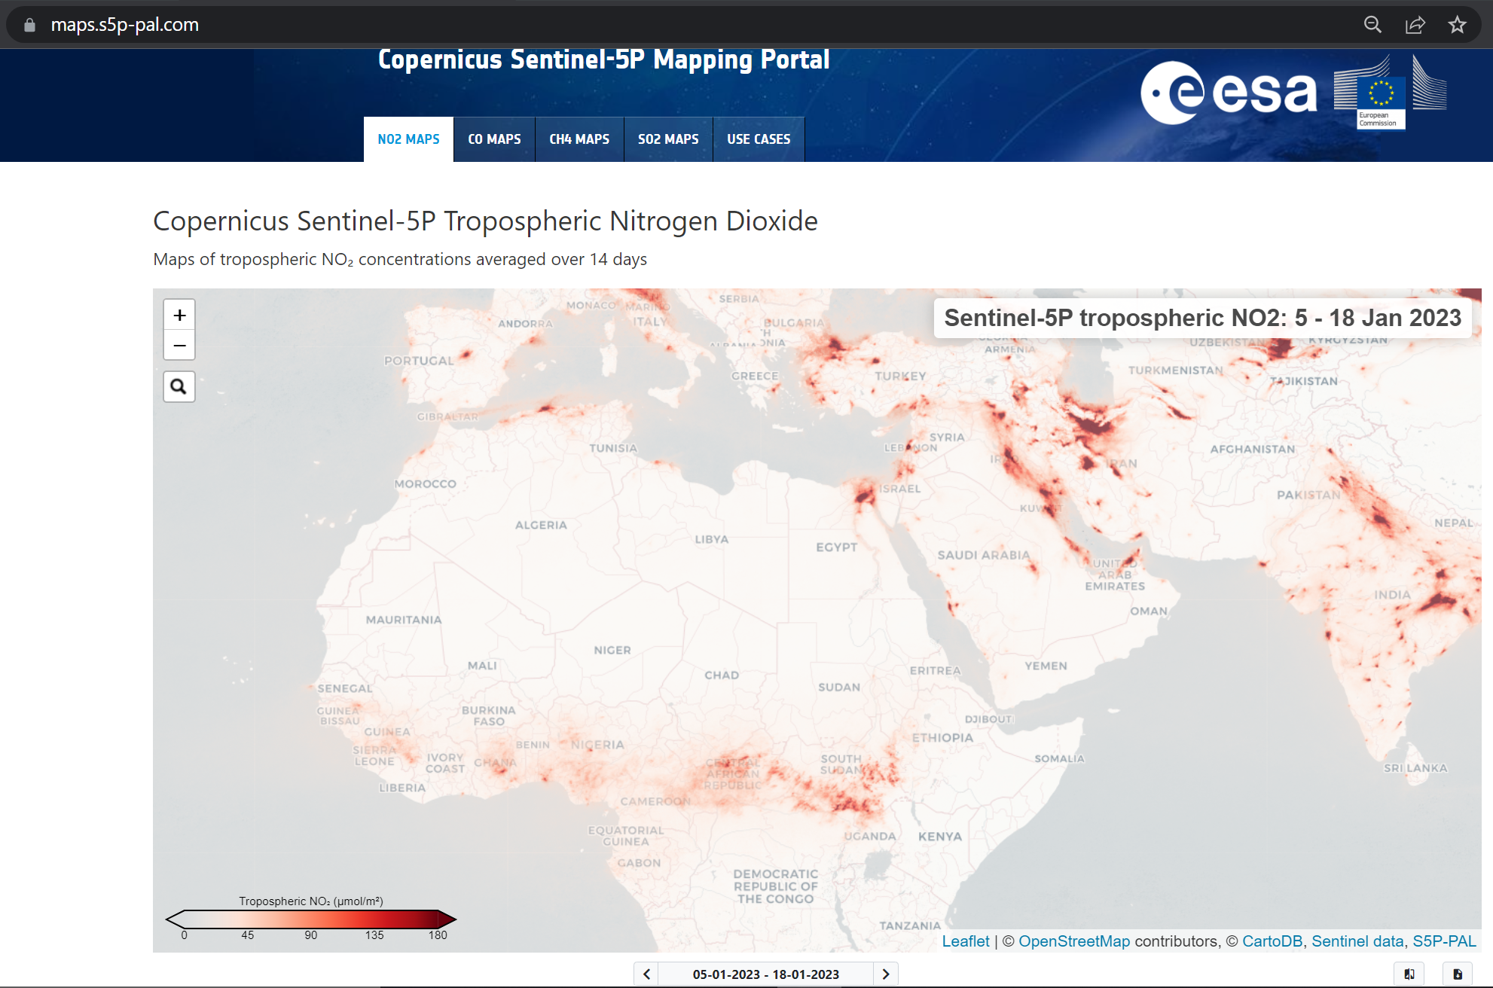
S5P-PAL system – TROPOMI mapping & data
maps.s5p-pal.com

Slide 33
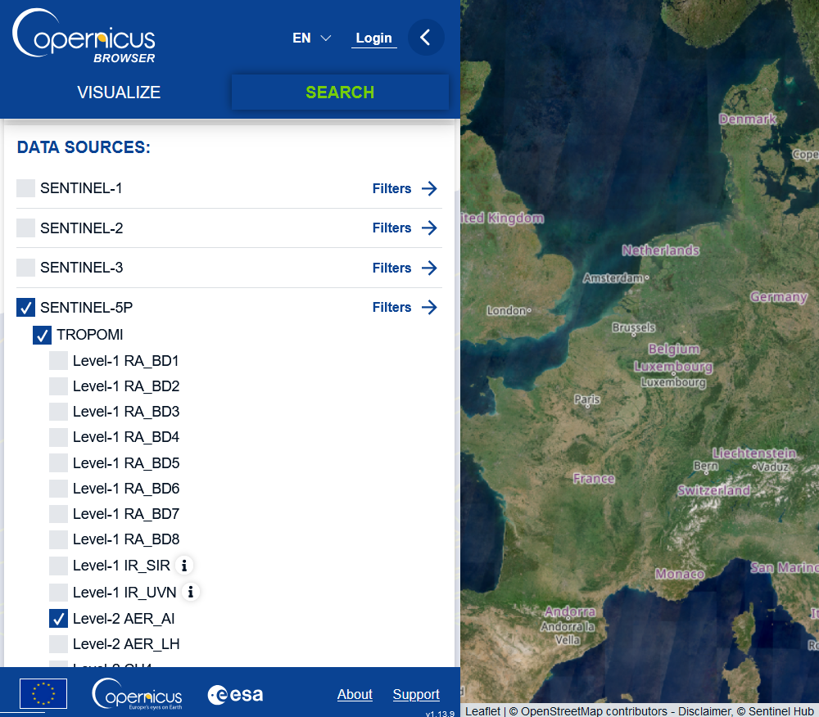
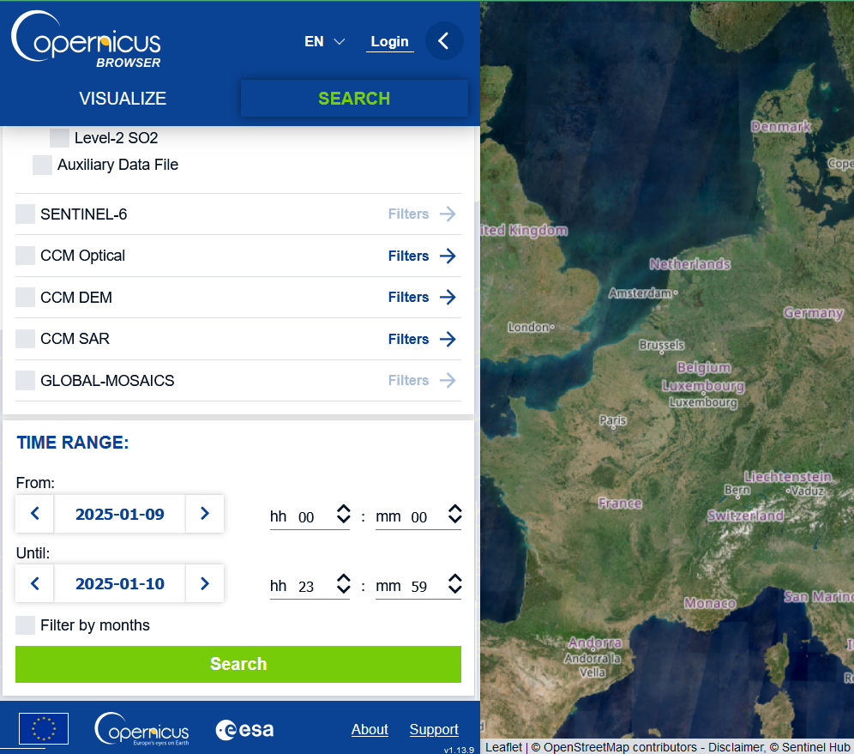
Download some files from the Copernicus Browser: https://browser.dataspace.copernicus.eu
Use the "search" tab to find data files by selecting the variable (here: aerosol index, AER_AI)
And set the time range
Click on "Search"

Slide 34
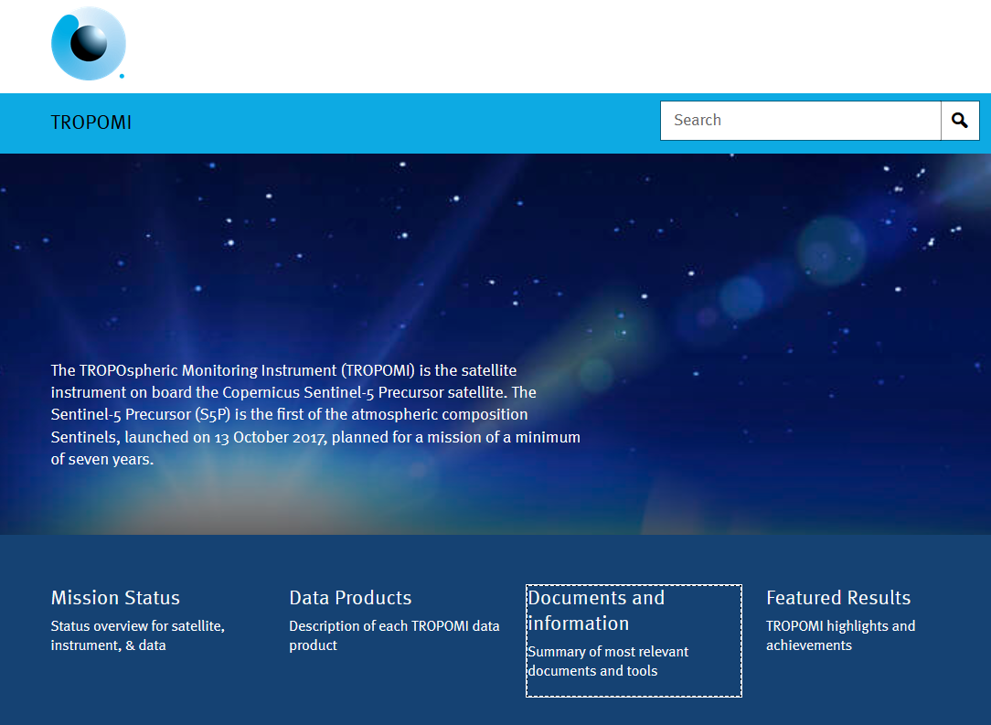
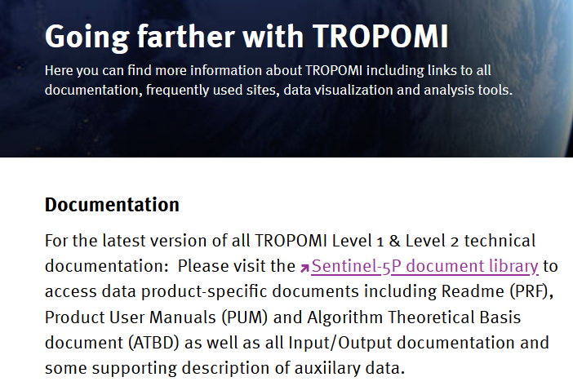
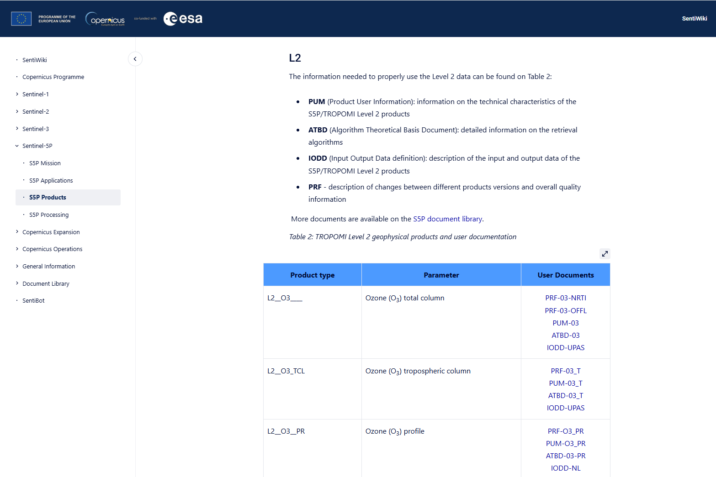
Links to Documentation? www.tropomi.eu

Slide 35
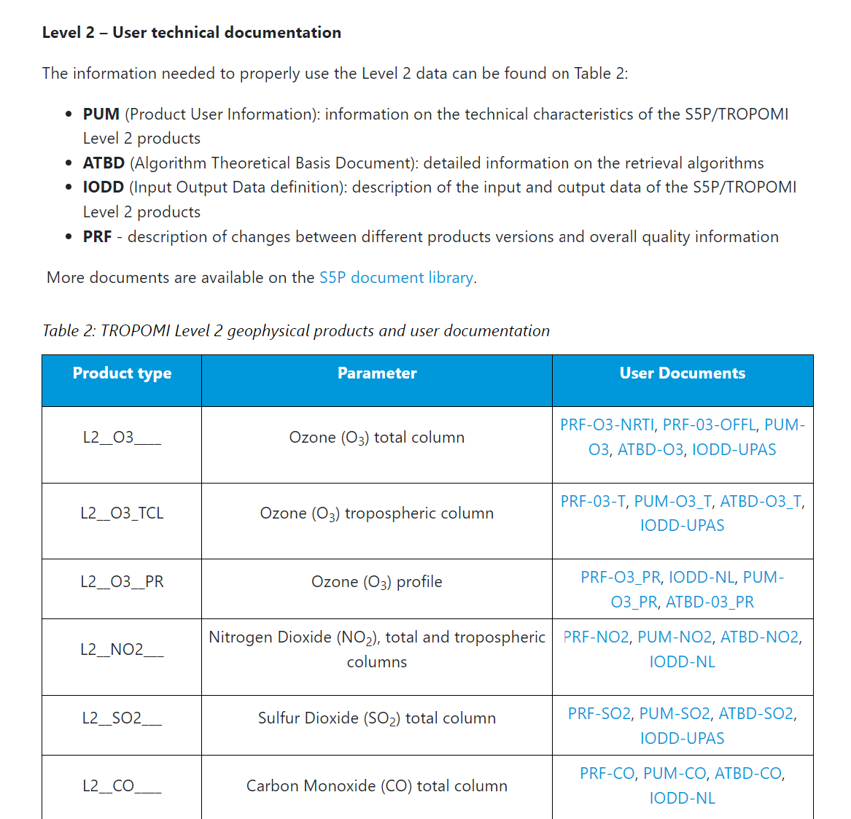
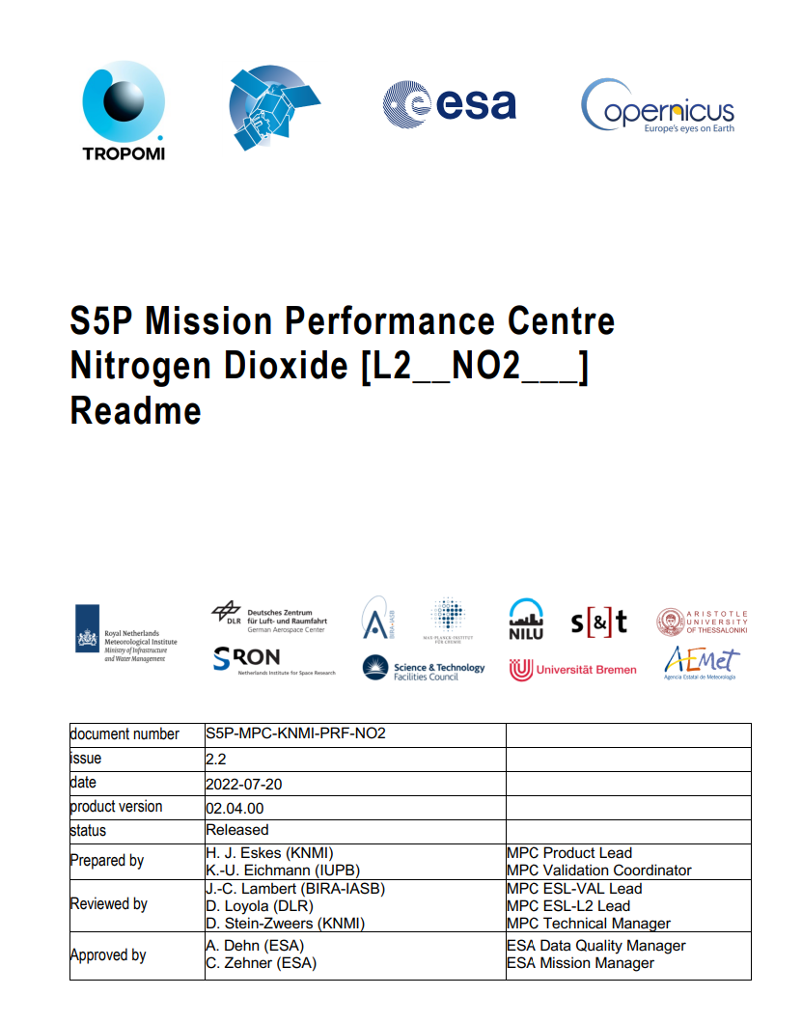
Sentinel 5P/TROPOMI Technical Library https://sentiwiki.copernicus.eu/web/s5p-products#S5PProducts-L2S5P-Products-L2
Documents needed to understand the data
README / PRF
File structure
Data Quality filtering
Known Features
Version History
ATBD: Technical Algorithm Explanation
PUM: Detailed file structure user manual

Slide 36
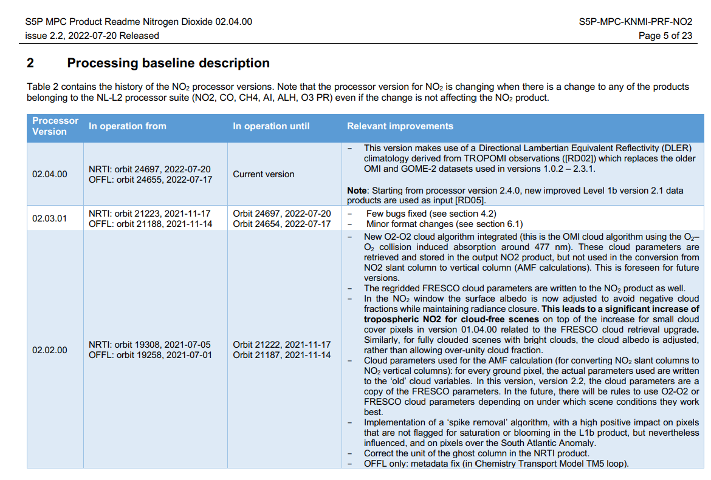
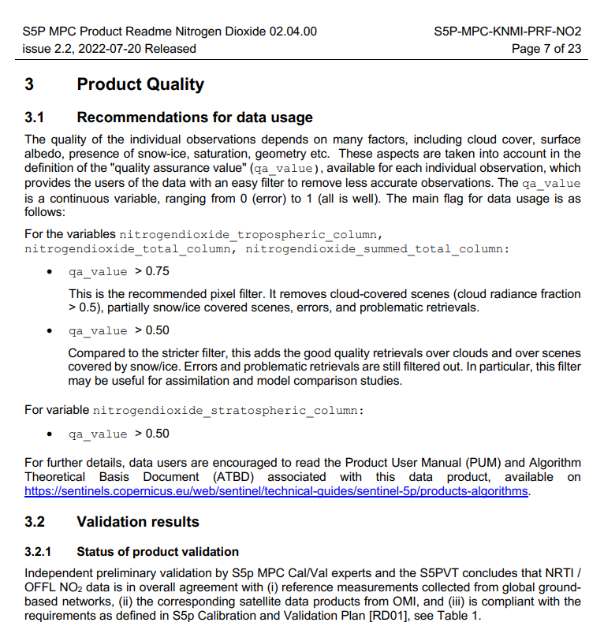
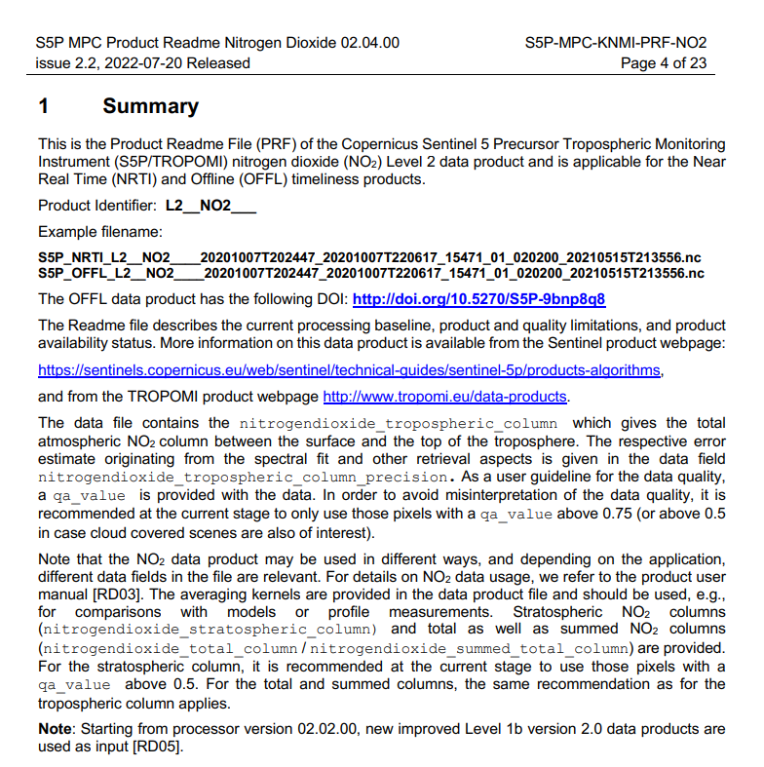
Sentinel 5P/TROPOMI Technical Library https://sentiwiki.copernicus.eu/web/s5p-products#S5PProducts-L2S5P-Products-L2
Recommendations for how to use the data

Slide 37
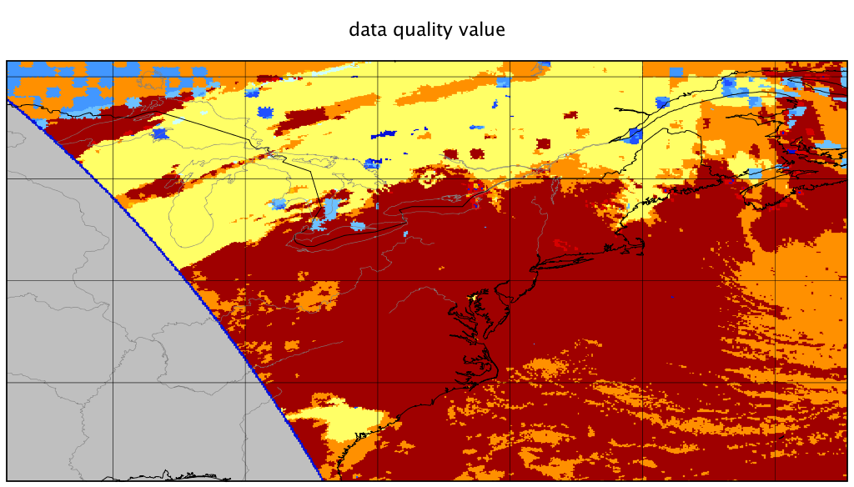
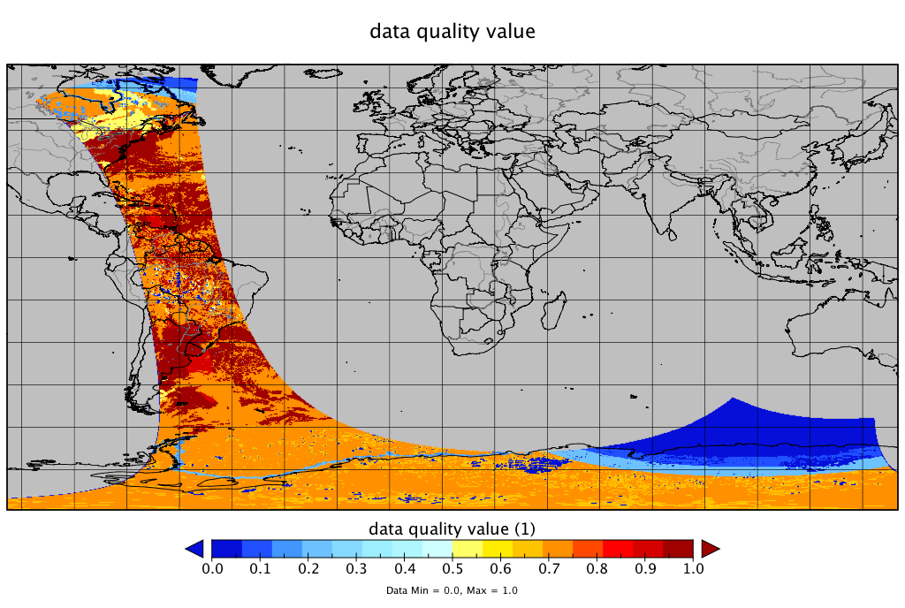
Data Quality Value
qa_value:
> 0.75 : cloud-free, good quality
> 0.50 : also cloudy, good quality

Slide 38
S5P-PAL system – TROPOMI mapping & data

