Slide 1
TROPOMI L1b: UV, VIS, NIR modules: status update
Erwin Loots ^{1 ,} Edward van Amelrooy ¹, Mirna van Hoek ¹, Emiel van der Plas ¹, Nico Rozemeijer ²
¹KNMI, Royal Netherlands Meteorological Institute, De Bilt, The Netherlands,
²TriOpSys B.V., Utrecht, The Netherlands

Slide 2
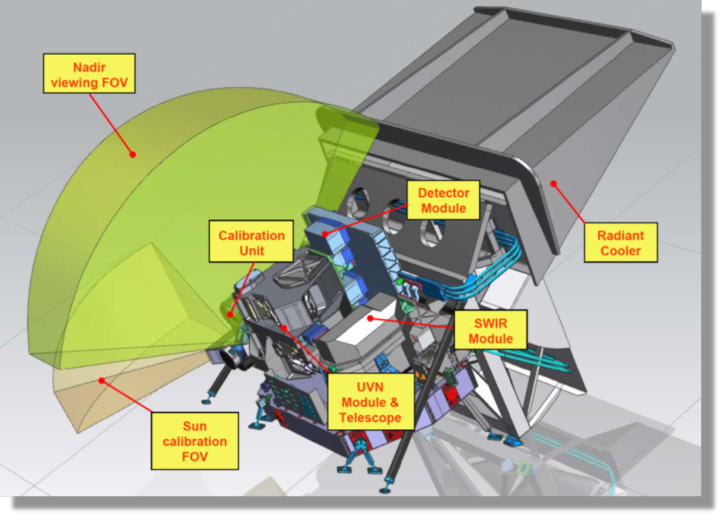
TROPOMI on-board Sentinel-5 Precursor
Single payload
Hyperspectral imager with 4 spectrometers
Sun synchronous orbit (MLTAN 13.30)
Pushbroom with ~ 2600 km swath
High spatial sampling (down to 5.5 km x 3.5 km)
Daily measurements of the Sun via Sun port
Launched 10/2017
Nominal operations since 30/4/2018
TROPOMI spectral bands – based on calibration data
Spectrometer | UV |  | UVIS |  | NIR |  | SWIR
Band ID | 1 | 2 | 3 | 4 | 5 | 6 | 7 | 8
Spectral range [nm] | 267-300 | 300-332 | 305-400 | 400-499 | 661-725 | 725-786 | 2300-2343 | 2343-2389
Spectral resolution [nm] | 0.45 - 0.5 |  | 0.45 - 0.65 |  | 0.34 - 0.35 |  | 0.227 | 0.225
Spectral sampling [nm] | 0.065 |  | 0.195 |  | 0.126 |  | 0.094
Spatial sampling [km²] | 5.5 x 28 | 5.5 x 3.5 | 5.5 x 3.5 |  | 5.5 x 3.5 |  | 5.5 x 7
Detector binning factor | 16 | 2 | 2 | 2 | 2 | 2 | 1 | 1

Slide 3
Current status
Nominal operations (E2) from 2018.04.30
From 2019.08.07: smaller ground pixels
From 2022.07.19: new L01b Processor 2.1
From 2022, autumn: all orbits have been reprocessed (‘collection-3’)
Regularly, CKDs are updated to cope with in-flight changes (degradation, electronic jumps)
This presentation:
Small inconsistencies in the observed degradation necessitated re-assessment of three correction algorithms in the L01b Processor.
Resulting adjustments in algorithms and calibration data lead to improved ozone profile analysis (UV detector)

Slide 4
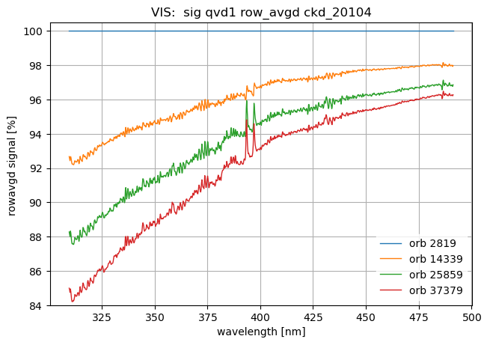
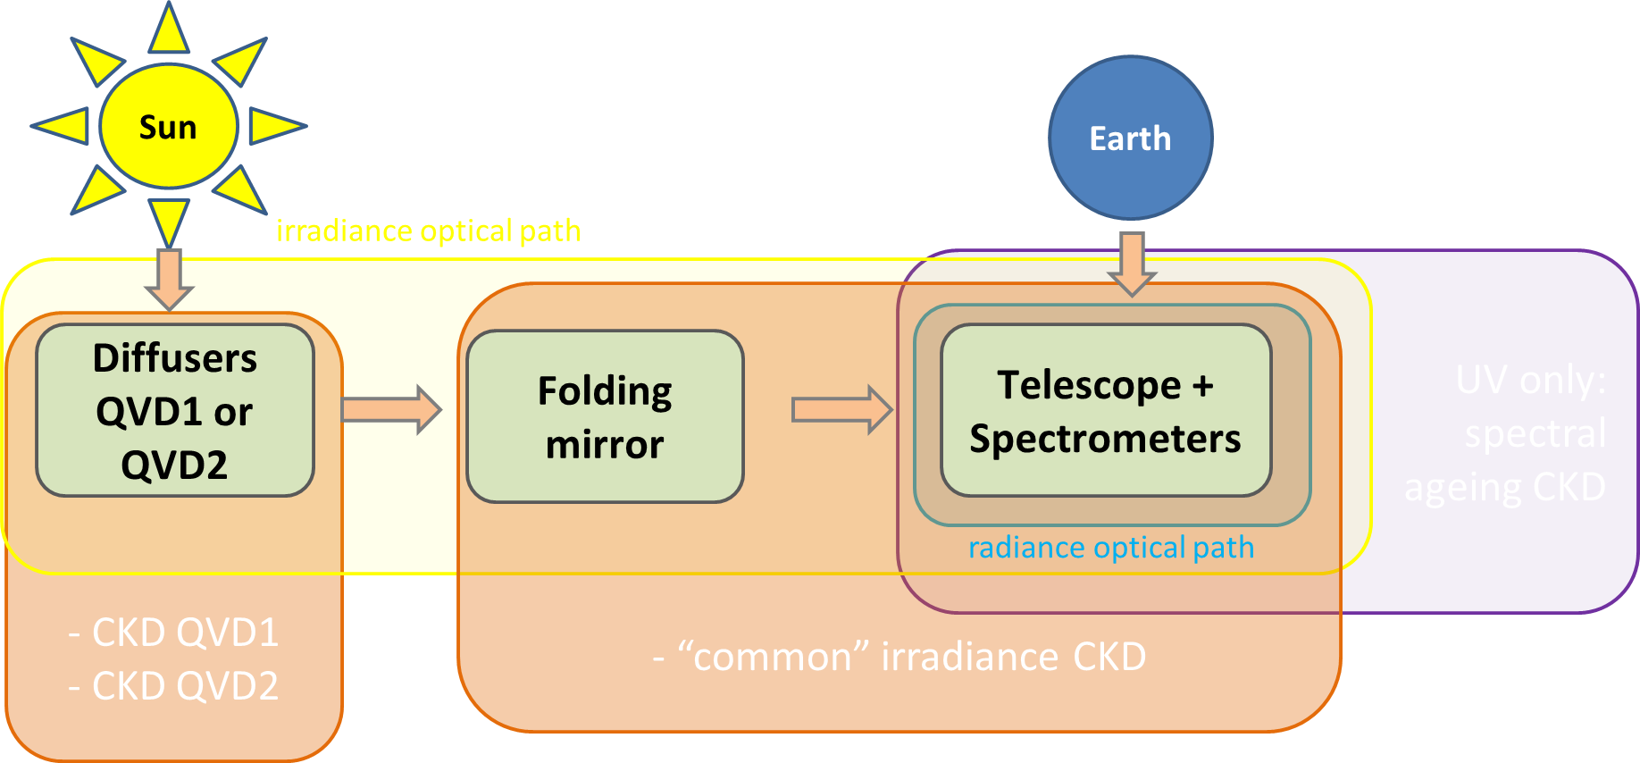
Instrument degradation
Method: In-flight calibration using solar measurements
Goal: Determine (and correct for) the instrument degradation
Degradation (long-term drift in signal)
  Multiplicative!
  Smoothness? spectrally/spatially. Pixel position vs pixel wavelength
  Monotonous?
  Cause. Leads to degradation components (flavours):
    Diffuser only (IRR)
    Instrument light path w/o diffuser (RAD, IRR)
    Detector bleaching (RAD,IRR, CU)
    Sharp detector features (RAD,IRR, CU)

Slide 5
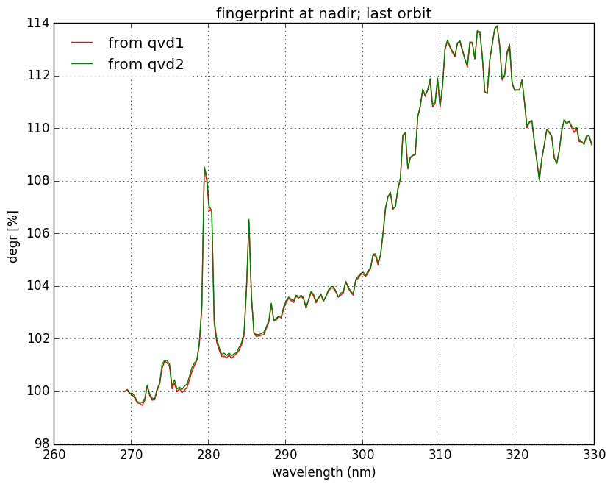
Instrument degradation (2/3): detector bleaching
(a)
UV detector measurements (a) show signal increase correlated with solar lines
In region 312-330 nm comparison with band 3 possible (b)
Suspect bleaching close to or on/within the detector
This gives an extra ‘spectral ageing’ degradation CKD for UV detector (c)
The temporal CKD shows a slowing increase in time ( d)
(c)
2018 2022
(b) ( d)

Slide 6
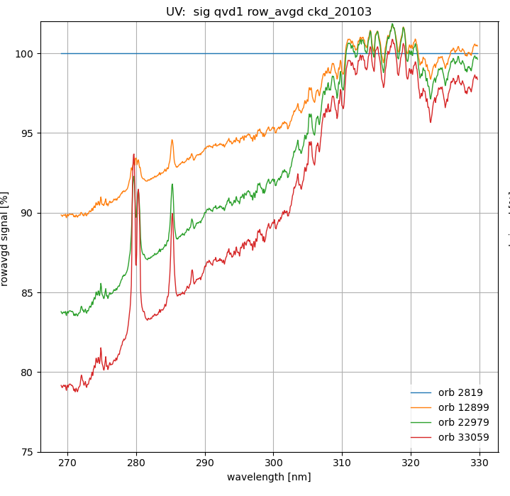

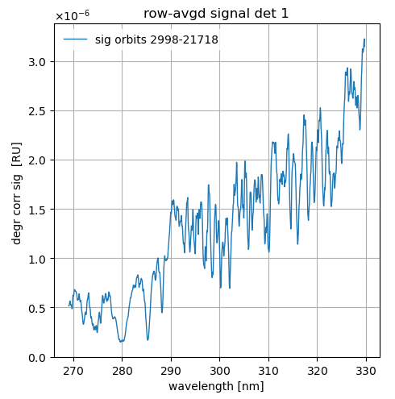
Instrument degradation (3/3): a false flavour?
In the UV detector, the degradation images show increasing positive peaks at 280 and 286 nm (where the absolute signal is minimal), suggesting an additive term, this is also an observation from O3-profile retrievals in UV.
This contradicts the detector bleaching hypothesis. Bleaching correlates with absolute signal → peaks caused by uncorrected-for offset?
→ main residual offset candidate is (far-field) straylight.
We first need a proper UV straylight correction before addressing degradation. With uncorrected straylight, we have a ‘false’ degradation flavour, not suitable as calibration key data.
Absolute signal

Slide 7
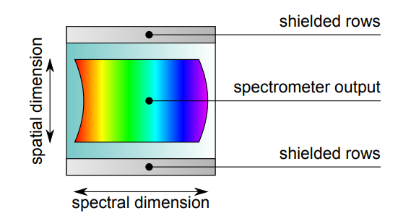
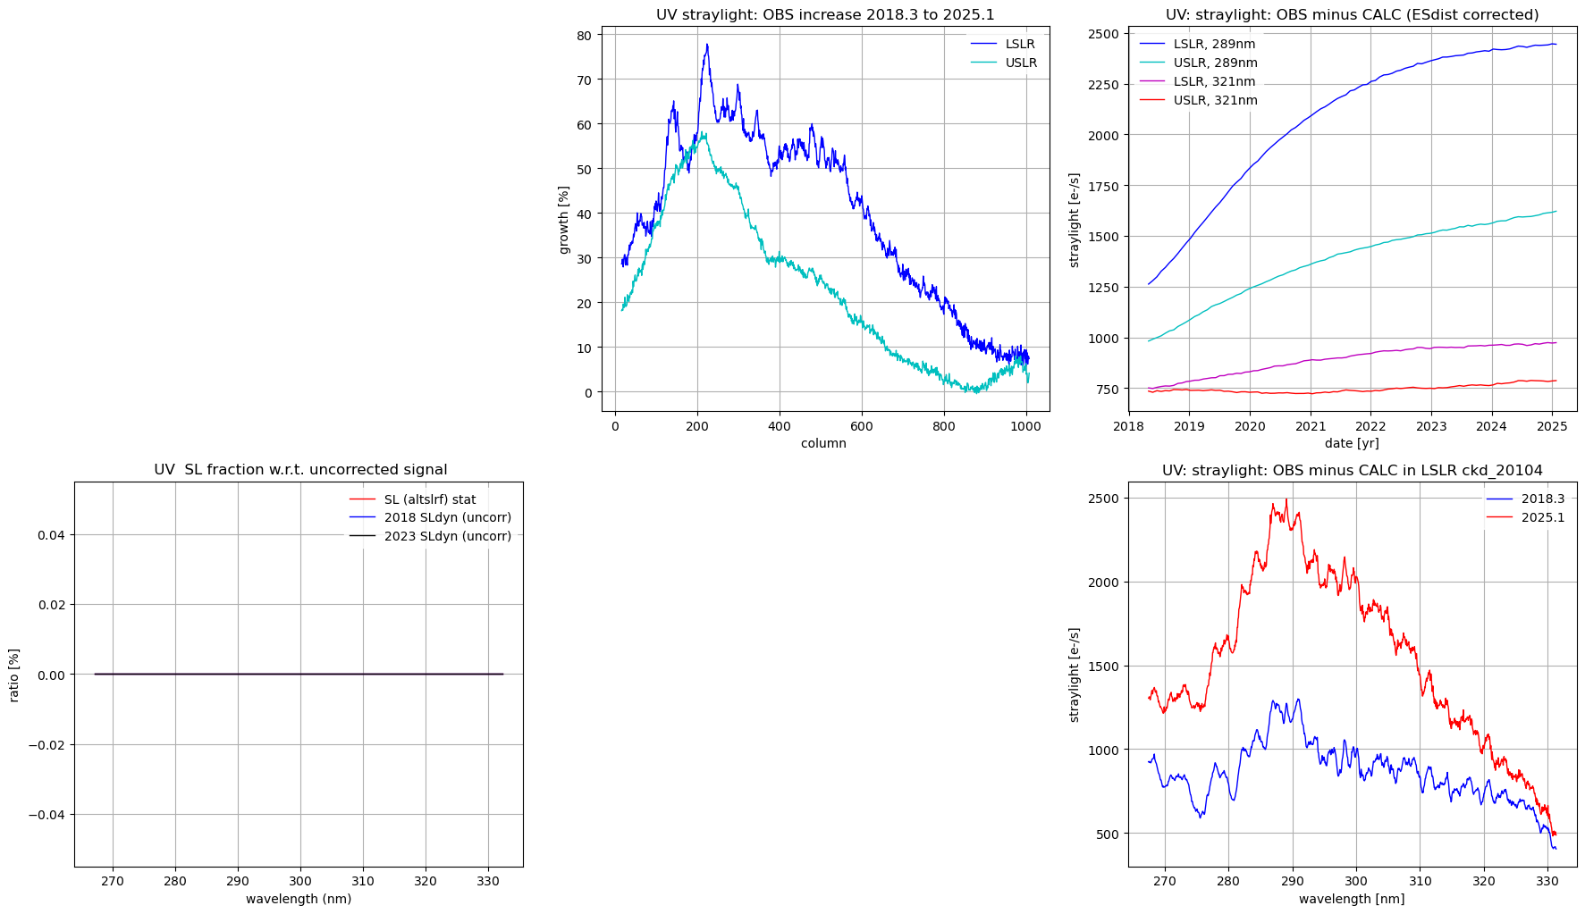
Monitoring straylight…
On each UVN detector there are masked rows (“upper and lower straylight regions”, USLR & LSLR); they do not receive direct light
Signals in these regions are monitored for all (ir-)radiance measurements, all scanlines
We monitor calculated (using the straylight convolution kernel CKD) and observed (measured signal before SL correction) signals.
If straylight calibration is perfect, then observed=calculated and signal after correction in these regions is zero. (in practice, we tolerate a slightly positive value: overcorrection is to be avoided)
→ Observed straylight is both too high (gap) AND smoothly increasing!
shielded
Masked USLR
Science region
Masked LSLR
shielded

Slide 8
Monitoring straylight… and how to use it
On each UVN detector there are masked rows (“upper and lower straylight regions”, USLR & LSLR); they do not receive direct light
Signals in these regions are monitored for all (ir-)radiance measurements, all scanlines
We monitor calculated (using the straylight convolution kernel CKD) and observed (measured signal before SL correction) signals.
If straylight calibration is perfect, then observed=calculated and signal after correction in these regions is zero. (in practice, we tolerate a slightly positive value: overcorrection is to be avoided)
→ Observed straylight is both too high AND smoothly increasing!
shielded
Masked USLR
Science region
Masked LSLR
shielded
Idea: We can, for each measurement, construct an extra straylight image based on this difference and linear interpolation toward the interior science rows
This extra straylight image signal can be dynamically subtracted from the signal in the L01b Processor:
“DYNAMIC STRAYLIGHT CORRECTION”
S_obs – S_calc
Detector row

Slide 9



Back to on-ground calibration of straylight…
rows
laser
Band-pass filter
Band-pass filter; large viewing angle
White light source; limited viewing angle
columns (spectral)
Calibration of straylight experimentally constrained
The straylight calibration key data is a convolution kernel, constructed by combining a near-field and a far-field part
Near-field part: calibrated using laser measurements (simply averaging 18 processed images)
Far-field part: calibrated using external white light source measurements and modeled using a 1D decay parametrization, and assuming axisymmetrial scattering
→ Question: Is the straylight calibration consistent with in-flight findings? (N0). What is to be done?

Slide 10
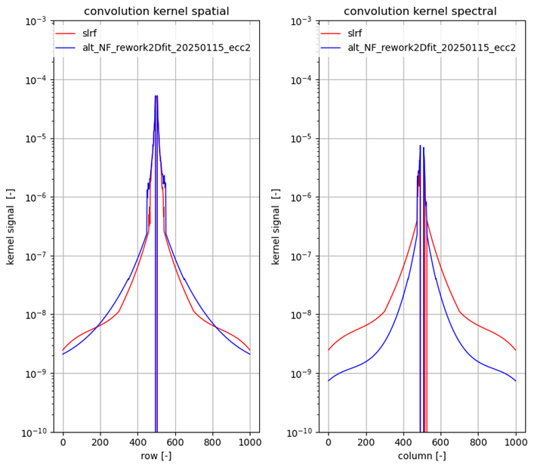
Straylight convolution kernel
Goal: to improve the straylight convolution kernel(s) derived in 2015 after on-ground calibration campaign
Why: understand, and close, the initial 2018 gap between observed and calculated straylight
Tools: all measurements and analysis software still available and running
For UV, a new kernel (red->blue) has been successfully derived.
Synergy:
  Improved CKD (kernel) for existing static straylight correction algorithm (partly closes the initial ‘straylight gap’ )
  New additional dynamic straylight correction algorithm using interpolation from masked rows removes straylight growth
gap

Slide 11
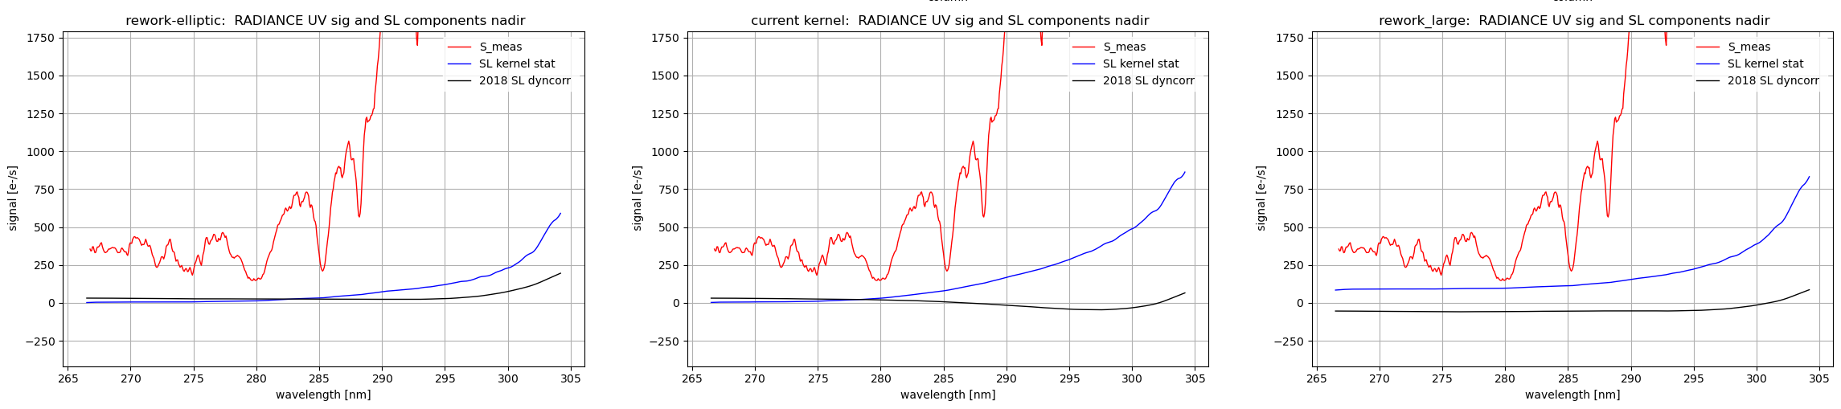
Straylight synergy: Improved static convolution kernel correction and dynamic straylight correction
Thus, the improved kernel aims to better correct for the straylight as measured on-ground, while the ‘delta’ dynamic correction serves a 2nd correction.
Note that the two straylight corrections are partly ‘communicating vessels’: a bad choice for the static kernel necessitates a larger ‘delta’ dynamic correction.
Does it matter? Yes, look at first-orbit radiance: measured, static kernel component, dynamic component
for three valid (w.r.t. on-grond data) choices of convolution kernel:
With the improved kernel original kernel large far-field-kernel

Slide 12
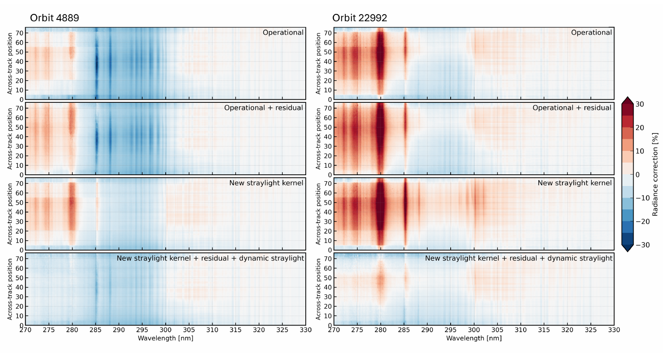
Is that all? – remaining additive terms?
Ozone profile analysis shows step-like artifacts that are related to the row binning regions
That implies that on the deepest electronic level, a small additive signal remains
This small artifact, outside the instrument model, typically emerges as a residual signal : the not-quite-zero remainder after processing dark measurements

Slide 13
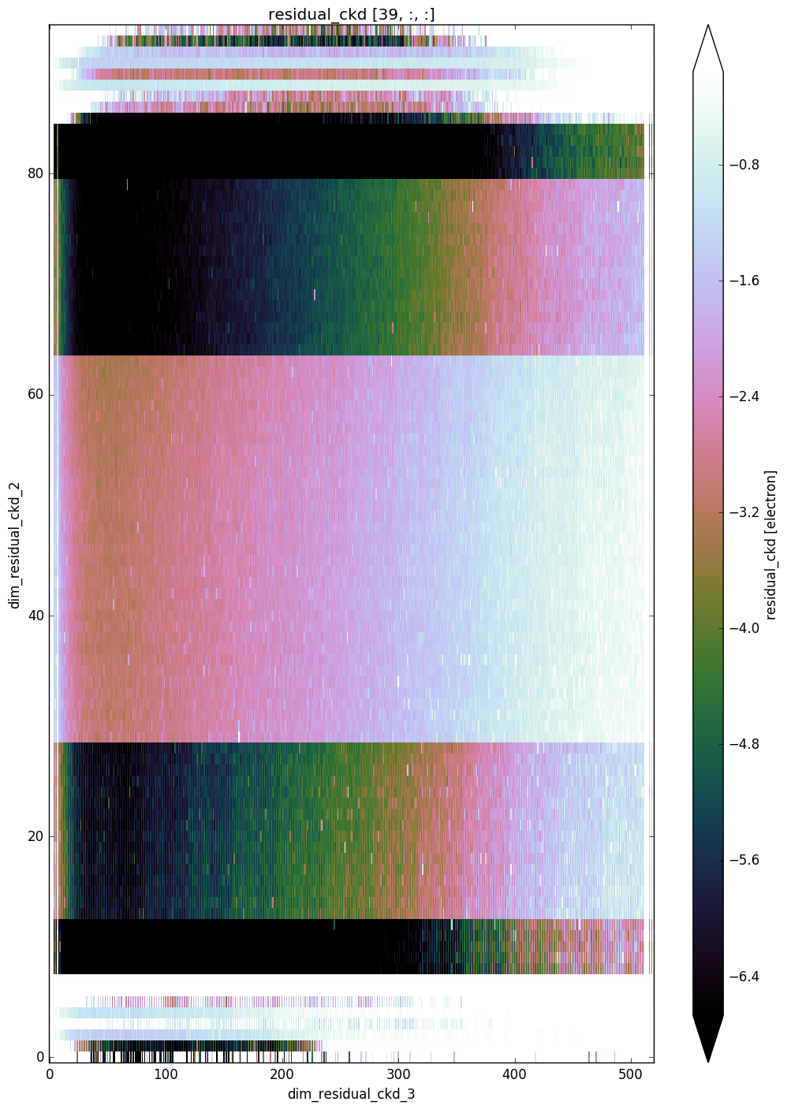
Besides straylight, a 2nd adjustment: Residual correction
From dark radiance measurements on the night side of orbit, aggregate background residual maps have been derived in off-line analysis
Literally ‘residual’: after correction for offset, dark current, … : unexplained (electronic/instrumental ) features outside model
Returning discussion: Pro’s/cons whether to perform a residual correction: noise-towards-error, robustness, performance, (orbital) stability
‘new’ pro’s: coping with RTS and improvement of the very low UV radiance signals
Residual aggregates converted to temporal CKDs and sleeping ‘residual correction algorithm’ switched on

Slide 14
Resume, before showing results
Analysis of instrument degradation led to suspicion of uncorrected-for additive signals (offsets)
Especially in UV, since absolute signal there is low
Three offset candidates, and three corresponding adjustments to the L1b Processor:
  Straylight convolution kernel (static). → Re-assessment of on-ground calibration: alternative convolution kernel that partly closes the ‘in-flight straylight gap’.
  (Temporally increasing) difference between calculated and observed straylight. → Use LSLR/USLR measurements to impose a dynamic (delta) straylight correction
  Residual out-of-model signal. → Use aggregate background measurements, converted to residual CKD for a residual correction
These changes are first to be tested on UV products, where problems were first observed (next slide)

Slide 15
Results: Soft calibration ozone profile retrieval algorithm
(“Characterization of the TROPOMI UV radiometric calibration for the operational Ozone Profile retrieval algorithm”, Di Pede et al, in prep. )
GSICS Annual Meeting 2025 - TROPOMI L1b UVN

Slide 16
Conclusions
Analysis of instrument degradation lead to suspicion of uncorrected-for additive signals (offsets)
Especially in UV, since absolute signal there is low
Three offset candidates, three corresponding adjustments to th1 L1b Processor:
  Straylight convolution kernel (static). → Re-assessment of on-ground calibration: alternative convolution kernel that partly closes the ‘in-flight straylight gap’.
  (Temporally increasing) Difference between calculated and observed straylight. → Use LSLR/USLR measurements to impose a dynamic (delta) straylight correction
  Residual out-of-model signal. → Use aggregate background measurements, converted to residual CKD for a residual correction
These improvements work well in the case of the UV detector, see ozone profile retrieval algorithm
Continuing research, together with L2 scientists, on feasibility of these potential improvements for UVIS and NIR detectors

Slide 17
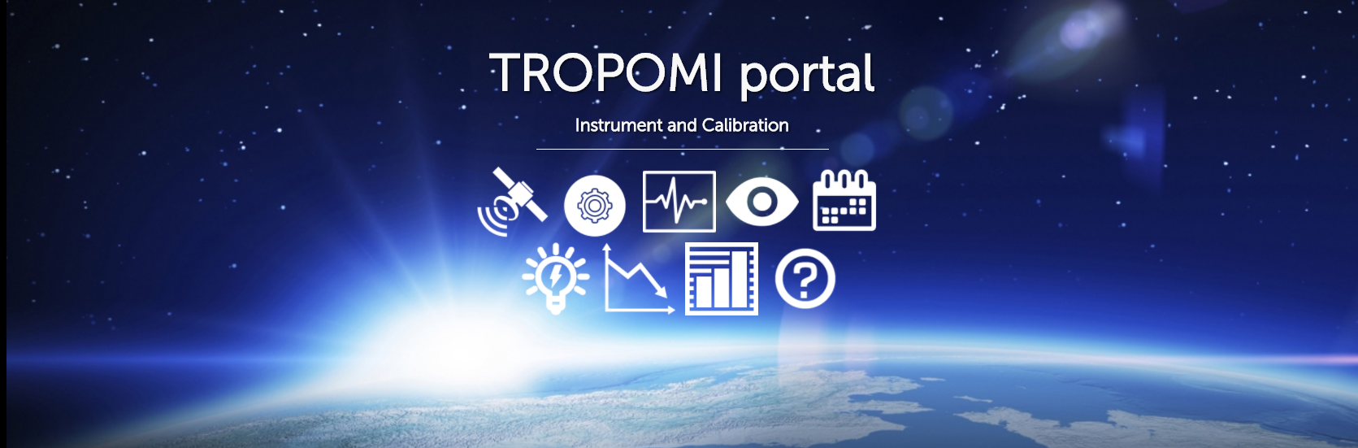
Thank you!
general information: http://www.tropomi.eu/
more on TROPOMI calibration: Kleipool et al. 2018 https://doi.org/10.5194/amt-11-6439-2018
Ludewig et al. 2020 https://doi.org/10.5194/amt-2019-488
Acknowledgement: Sentinel-5 Precursor is a European Space Agency (ESA) mission on behalf of the European Commission (EC). The TROPOMI payload is a joint development by ESA and the Netherlands Space Office (NSO). The Sentinel-5 Precursor ground-segment development has been funded by ESA and with national contributions from The Netherlands, Germany, and Belgium.
GSICS Annual Meeting 2025 - TROPOMI L1b UVN

