Slide 1
Future of the EUM VIS-NIR GSICS products
Mounir Lekouara
EUMETSAT
2025 annual GSICS meeting

Slide 2
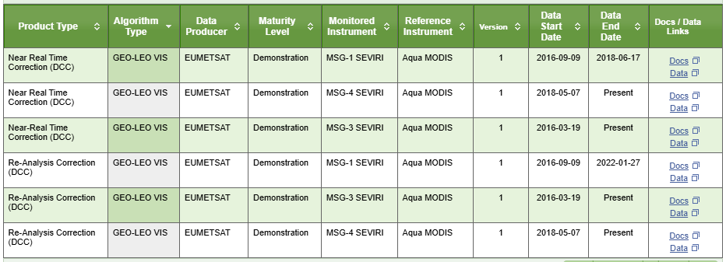
Current EUMETSAT VIS-NIR GSICS products

Slide 3
Inputs to the group discussion
EUMETSAT investigated the connections to our servers and could not identify any regular user.
MODIS DCC covering only one channel.
SEVIRI operational L1 VIS/NIR will be corrected (bias+drift) using MICMICS desert vicarious, lunar and DCC by end of 2025. Strong GSICS impact on the EUMETSAT L1 operational calibration is acknowledged.
Inter-calibration accuracy should be better than the calibration accuracy
For quality monitoring purposes, EUMETSAT is about to deploy MATRICS (equivalent to NOAA STAR ICVS and CMA L1 monitoring system). This will feature all radiometric (and geometric) user-relevant live monitoring information.
GEO-ring: EUMETSAT and NOAA are producing a FCDR from all historical measurements from imagers in geostationary orbit that form the Geostationary Ring. With cross-calibrated mapped radiances and spectral band adjustment factors. The GSICS methods will be employed.
EUMETSAT is considering discontinuing its GSICS VIS-NIR products.

Slide 4
Thank you!
Questions are welcome.

