Slide 1
IR Subgroup Report
Chengli Qi

Slide 2
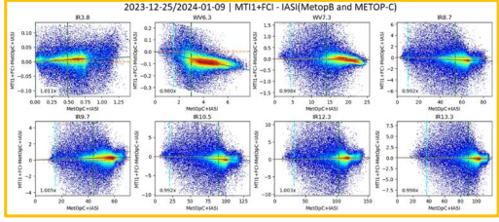
GRWG Subgroup Report - IR
IR group hosted 4 web meeting last year.
07/18: Inter-calibration of GEO-LEO IR instruments, and FY-3G/MERSI-RM Result of On-orbit Calibration.
10/24: FCI Commissioning update and Merging SSU with AIRS
12/19: IR lunar calibration
02/13: Uncertainy analysis of cross-calibration
The IR group is focused on the inter-calibration algorithms improvements for current GEO-LEO inter-calibration. Some issues are identified for further investigation.
Regression
Hot Land Bias issue
High viewing angles
Interpolation between GEO images
From Chengli Qi
From Ali Mousivand

Slide 3
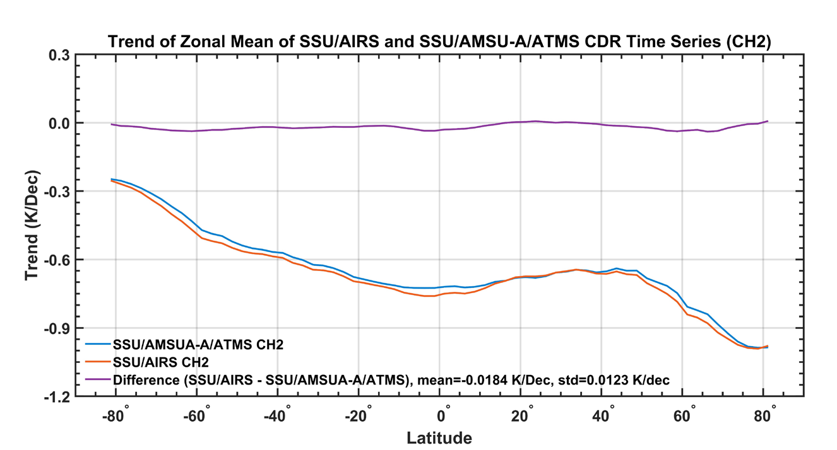
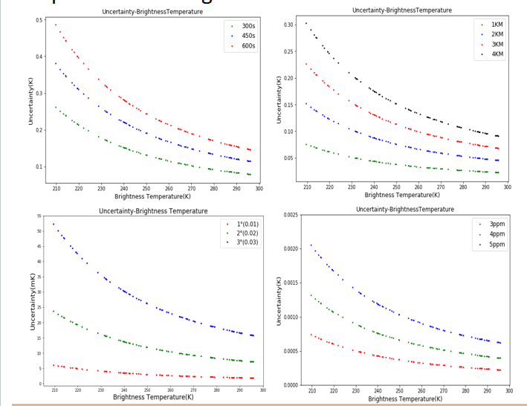
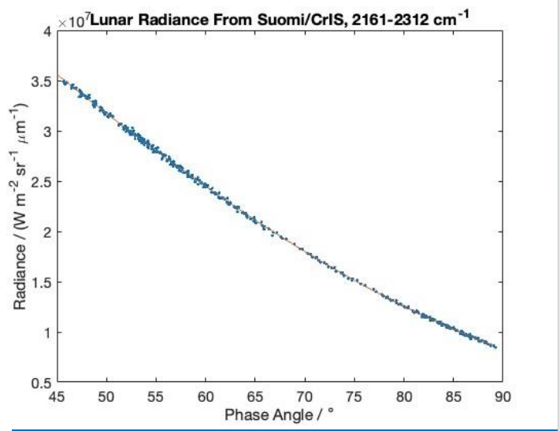
A generalized model for the uncertainty assessment of the SNO cross-calibration method for meteorological satellite infrared channels is constructed.
The IR group continue studying way to use Moon as a potential stable target to inter-calibrate IR sensors when the Moon was within their FOVs.
A method has been successfully developed to convert AIRS hyperspectral data into equivalent SSU observations.
From Likun Wang
From Martin Burgdorf
From Zhong Gu

Slide 4
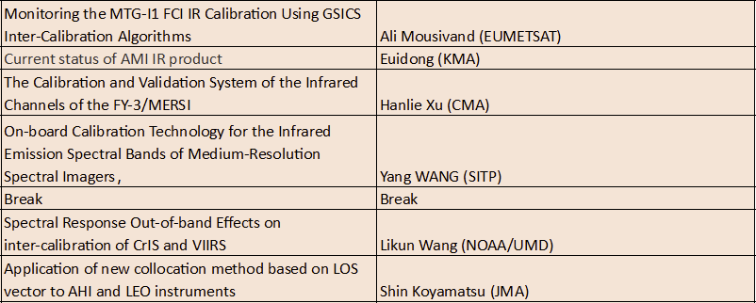
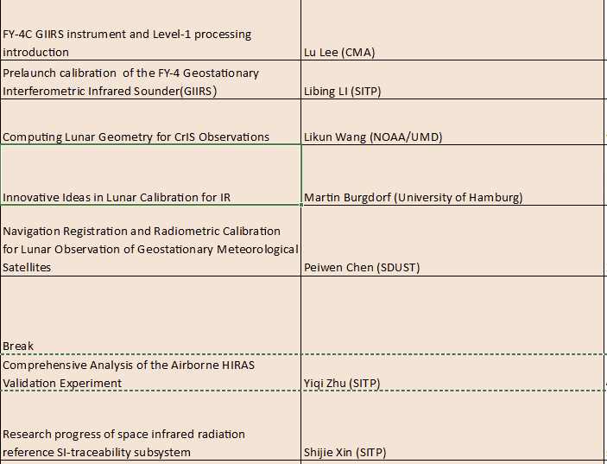
Talks at this year’s meeting
Monitoring of MTG-I1/FCI, AMI, FY-3/MERSI IR calibration.
Cross calibration method and factor influence analysis.
FY-4C GIIRS introduction.
IR Lunar calibration.
Airborne validation experiment.
Space infrared radiation reference SI-traceability subsystem.

