Slide 1
Challenges and Lessons Learned in Vicarious Desert Calibration: A Critical Review
Ali Mousivand
EUMETSAT/ RSP/INRC
GSICS Annual Meeting,
17 – 21 March 2025, Changchun, China

Slide 2
Agenda
Desert targets stability
Temporal and spatial stability
Atmospheric modelling
Atmospheric variables
Atmospheric correction (inter-calibration)
Assumptions and uncertainties
Postprocessing of results
Metrics to extract final calibrations
Insights and Discussions

Slide 3
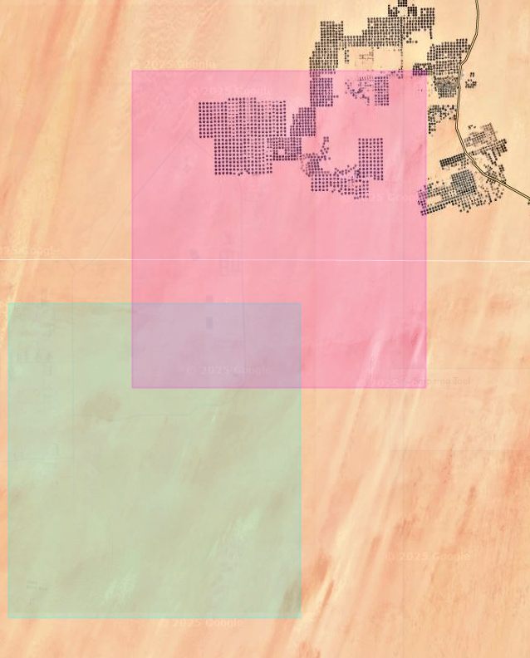
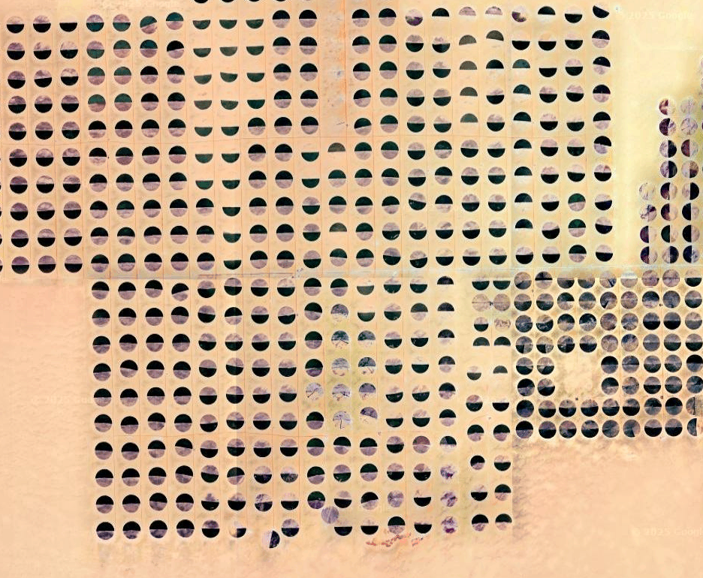
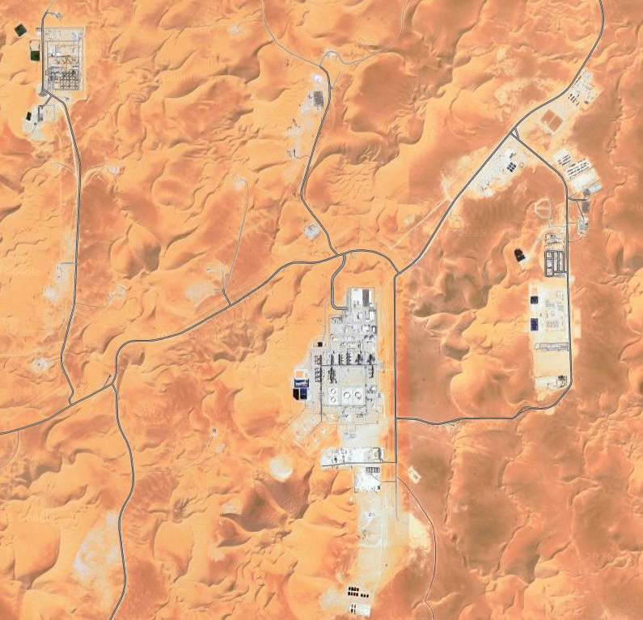
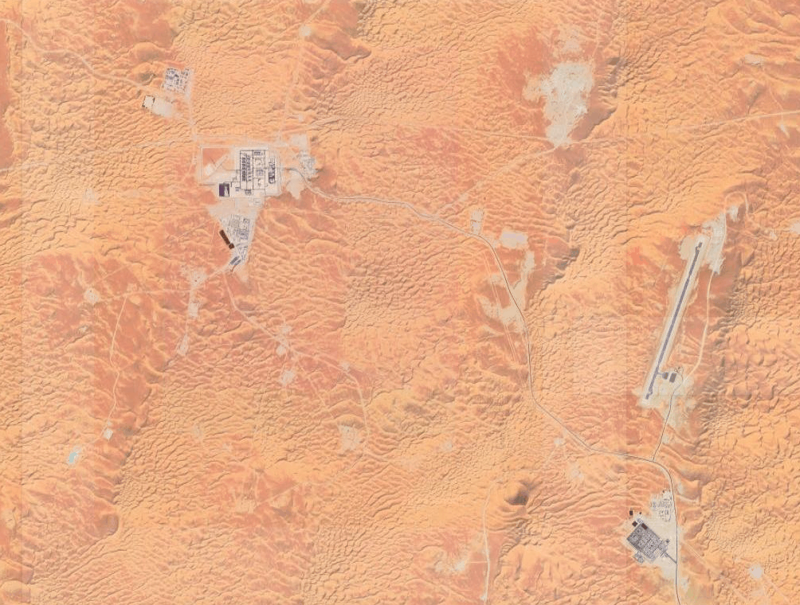
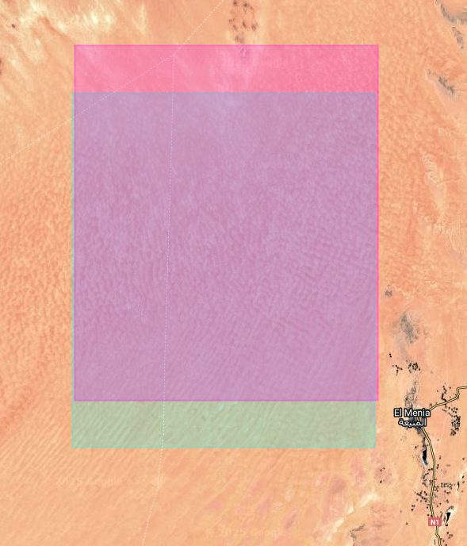
Desert target stability
Basic assumptions for desert vicarious calibration:
Radiometric Temporal Stability (Pseudo-Invariant Targets)
Spatial Uniformity
Sudan1
Algeria5
Algeria3
Notes:
CEOS endorsed targets: Libya1, Libya4, Mauritania1, Mauritania2, Algeria3, Algeria5

Slide 4
Desert target stability
Variations in practices among different groups regarding target size and Region of Interest (ROI)
Key Questions and Considerations:
What is the effective usable area of each target?
How do target size and ROI influence vicarious calibration results?
What is the optimal size for the ROI?
Does the surface characteristics (e.g., soil color, surface roughness) change over time?
How many targets should be used to achieve the best calibration results?
Notes:
CEOS endorsed targets: Libya1, Libya4, Mauritania1, Mauritania2, Algeria3, Algeria5

Slide 5
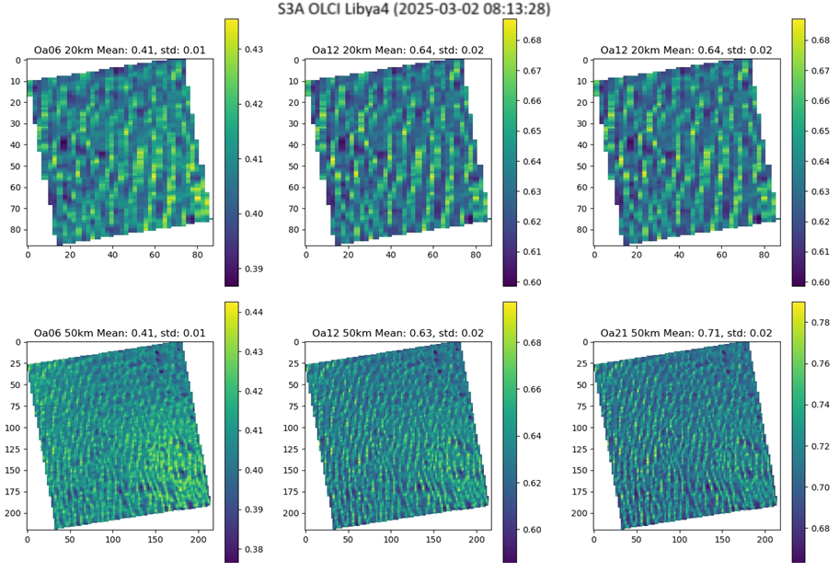
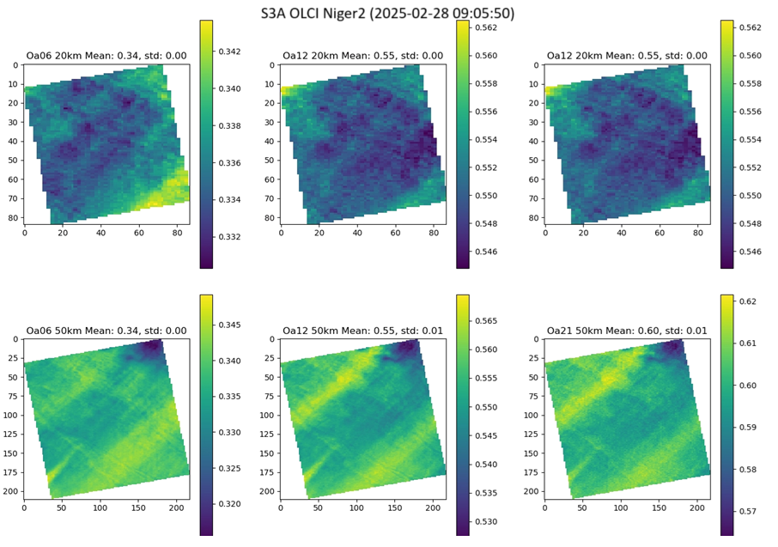
Desert target stability (quicklooks)
Examples of Sentinel-3A OLCI TOA reflectance over Libya4 and Niger2 (20km and 50km targets sizes)
Notes:
CEOS endorsed targets: Libya1, Libya4, Mauritania1, Mauritania2, Algeria3, Algeria5

Slide 6
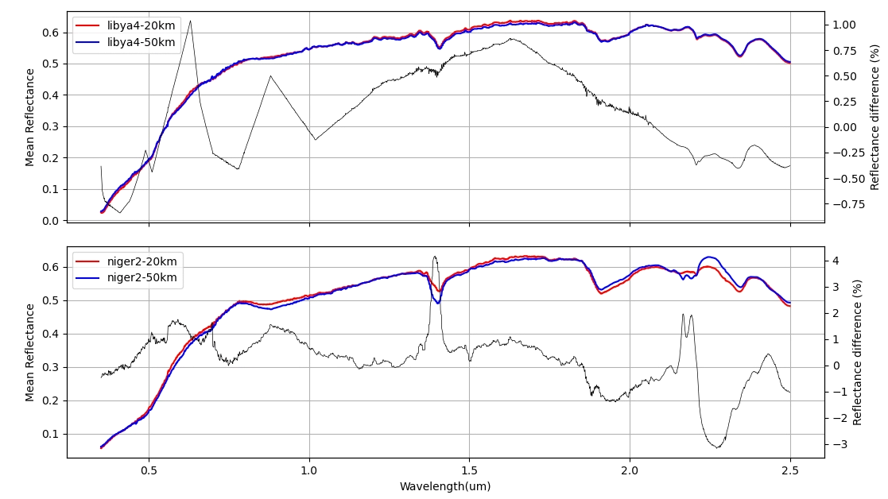
Desert target stability (surface mean reflectance)
Examples of surface mean reflectance over Libya4 and Niger2 (20km and 50km targets sizes)
Notes:
CEOS endorsed targets: Libya1, Libya4, Mauritania1, Mauritania2, Algeria3, Algeria5

Slide 7
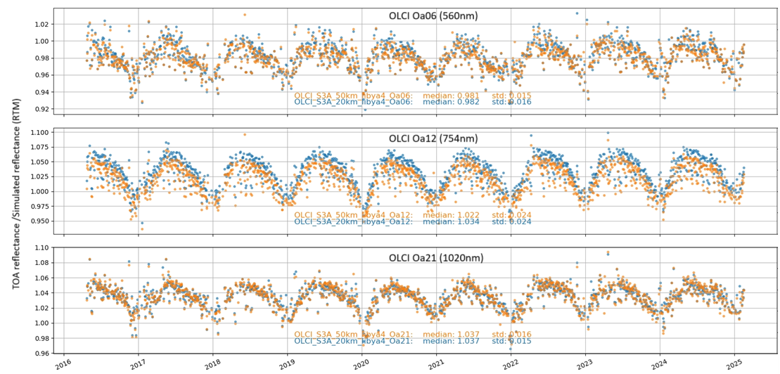
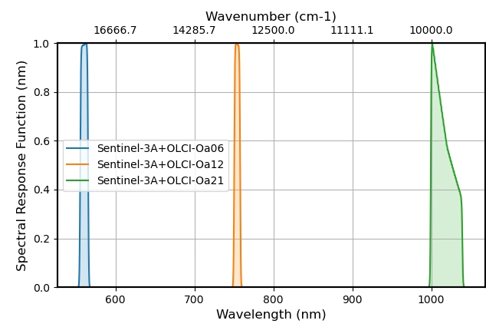
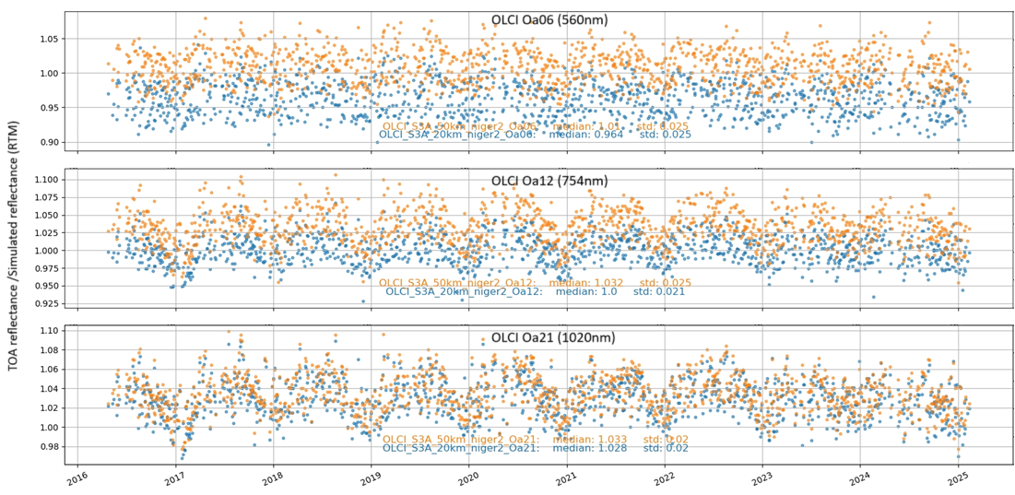
Target size influence vicarious calibration results
Sentinel-3A OLCI desert vicarious absolute calibration results over Libya4 and Niger2 (target sizes: 20 km and 50 km)
Results analysed across three different channels: Oa06, Oa12, and Oa21
The only variable is target size
Significant impact of target size on final calibration results, varying by target and channel
Notes:
CEOS endorsed targets: Libya1, Libya4, Mauritania1, Mauritania2, Algeria3, Algeria5

Slide 8
Atmospheric modelling over desert targets
Atmosphere is typically modelled using RTMs with key variables: total column water vapour (WV), total column ozone (O3), Aerosol Optical Depth (AOD), and surface pressure (P)
Key Questions and Considerations:
What is the atmospheric condition over desert targets?
What are the sources of atmospheric data? (e.g., ECMWF, Climatology, CAMS, other satellite products)
What is the uncertainty associated with atmospheric variables?
Is the default RTM aerosol model (e.g., background desert model in 6S) sufficient for accurate modelling?
How does aerosol type vary over time? (e.g., biomass burning, dust events)
Notes:
CEOS endorsed targets: Libya1, Libya4, Mauritania1, Mauritania2, Algeria3, Algeria5

Slide 9
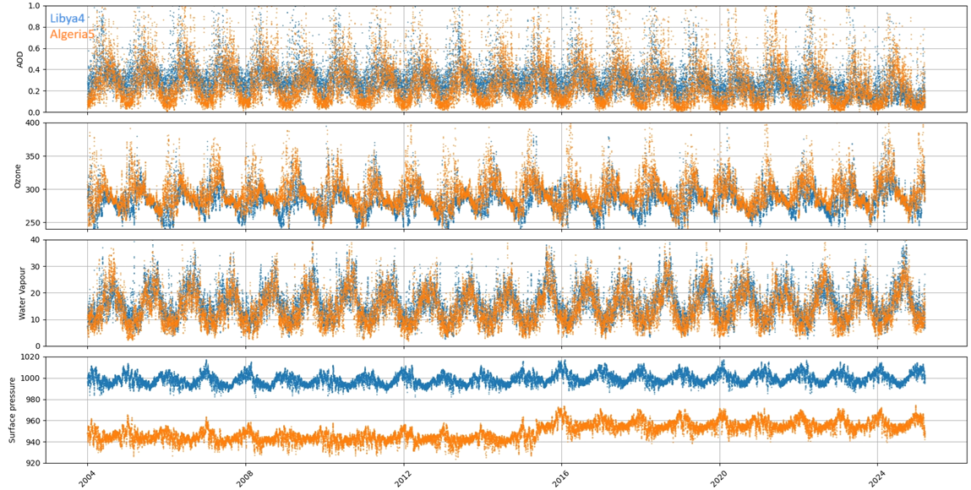
Atmospheric variables
Atmospheric variables over Libya4 and Algeria5

Slide 10
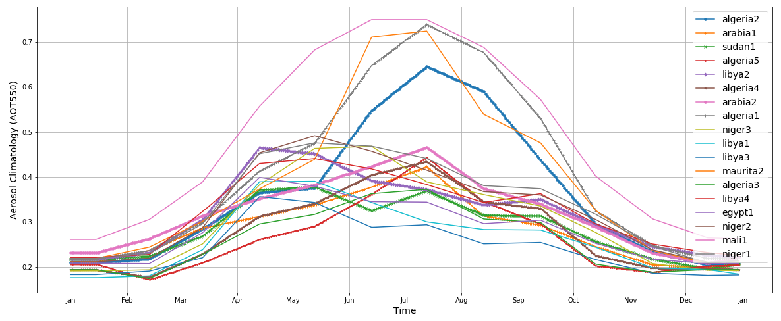
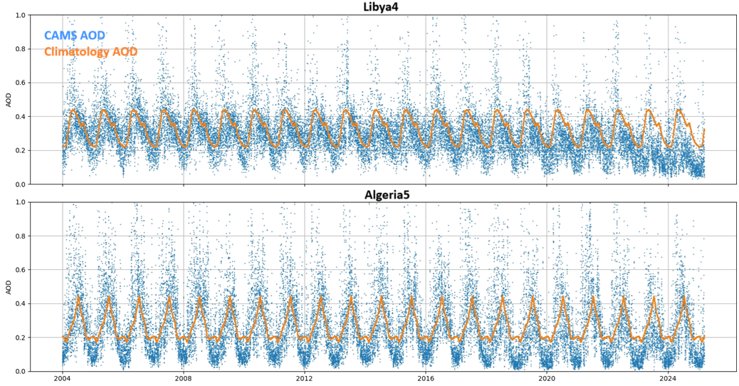
CAMS AOD vs Climatology

Slide 11
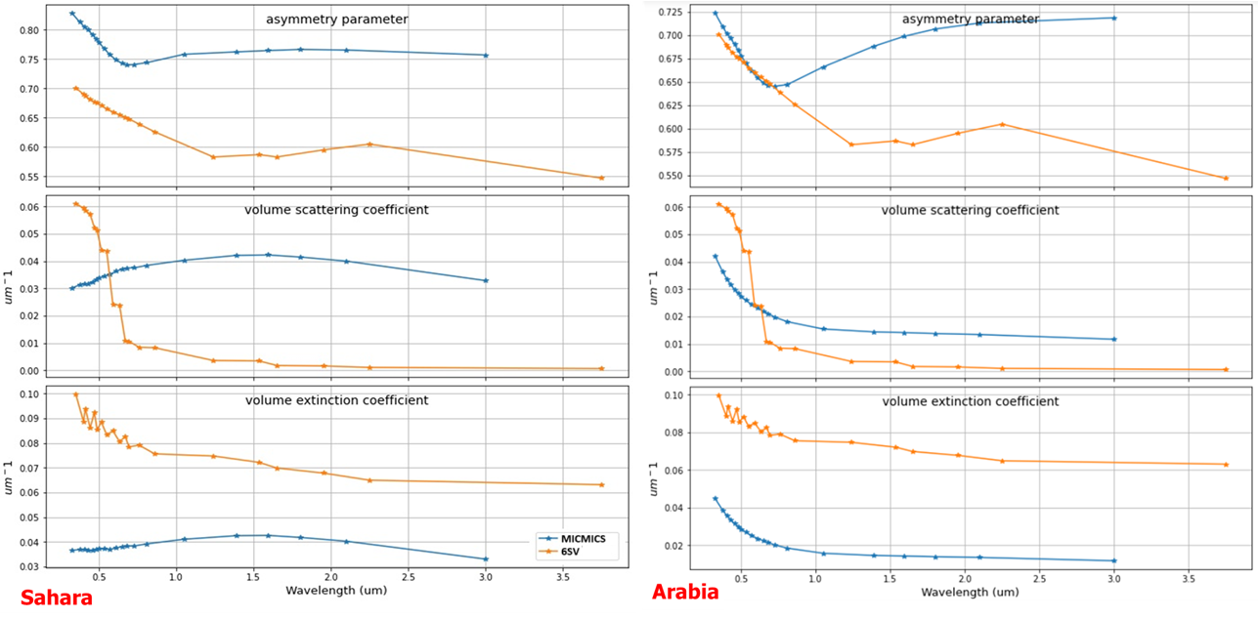
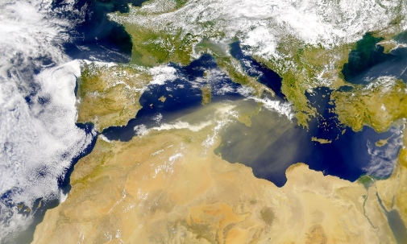
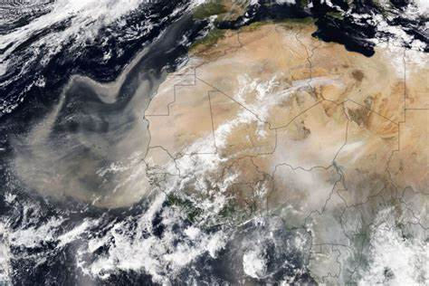
CAMS AOD vs Climatology
Aerosol type (dust, biomass burning, soot)
Seasonal aerosols
Default RTM aerosol model vs new aerosol model

Slide 12
Atmospheric modelling, other sources of uncertainty
Atmospheric correction considerations for desert inter-calibration:
Lambertian surface assumption (SMAC atmospheric correction model)
No topographic correction in most models
TOA Reflectance/Radiance Simulation Assumptions:
Spectral resolution
Per-pixel vs. super-pixel simulation approaches
Gaseous absorption effects (e.g., methane absorption in the SWIR channel)
Use of standard atmospheric profiles in models

Slide 13
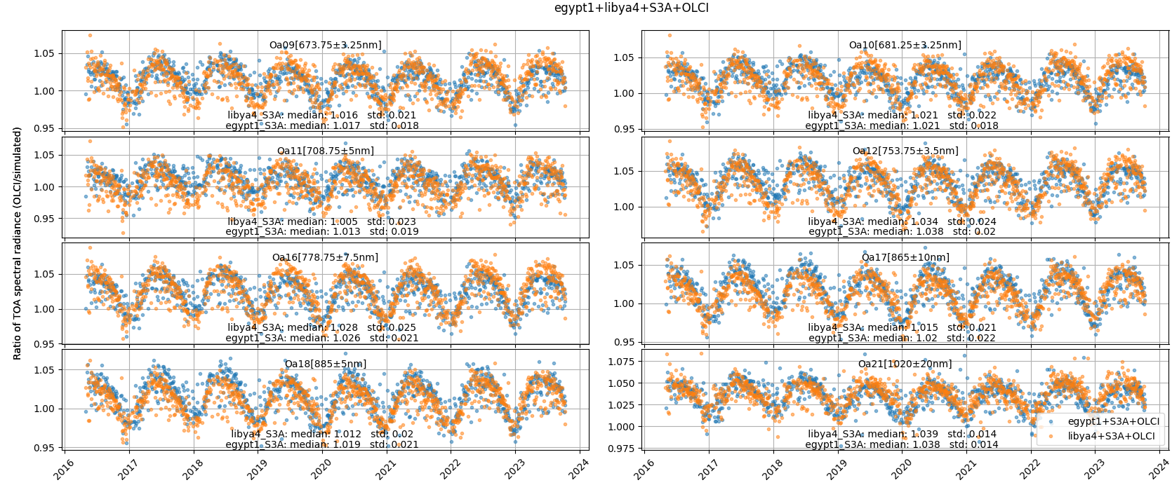
Seasonality
Desert targets often show strong seasonality that varies with spectral band and target.
How to address seasonality: Filtering? deseasonalisation?

Slide 14
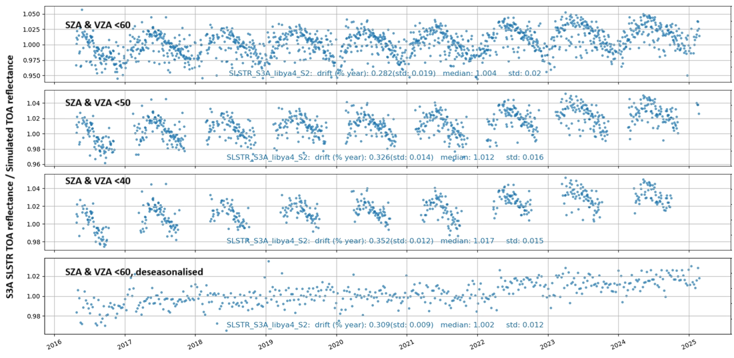
Seasonality and postprocessing
Sentinel 3A SLSTR S2 channel drift monitoring

Slide 15
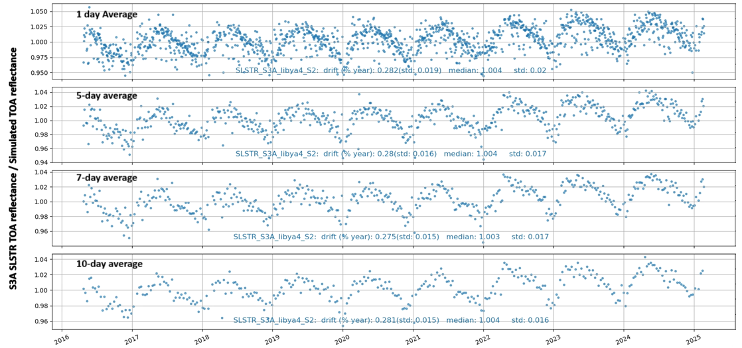
Time window to accumulate results
Time window size influence on the calibration results

Slide 16
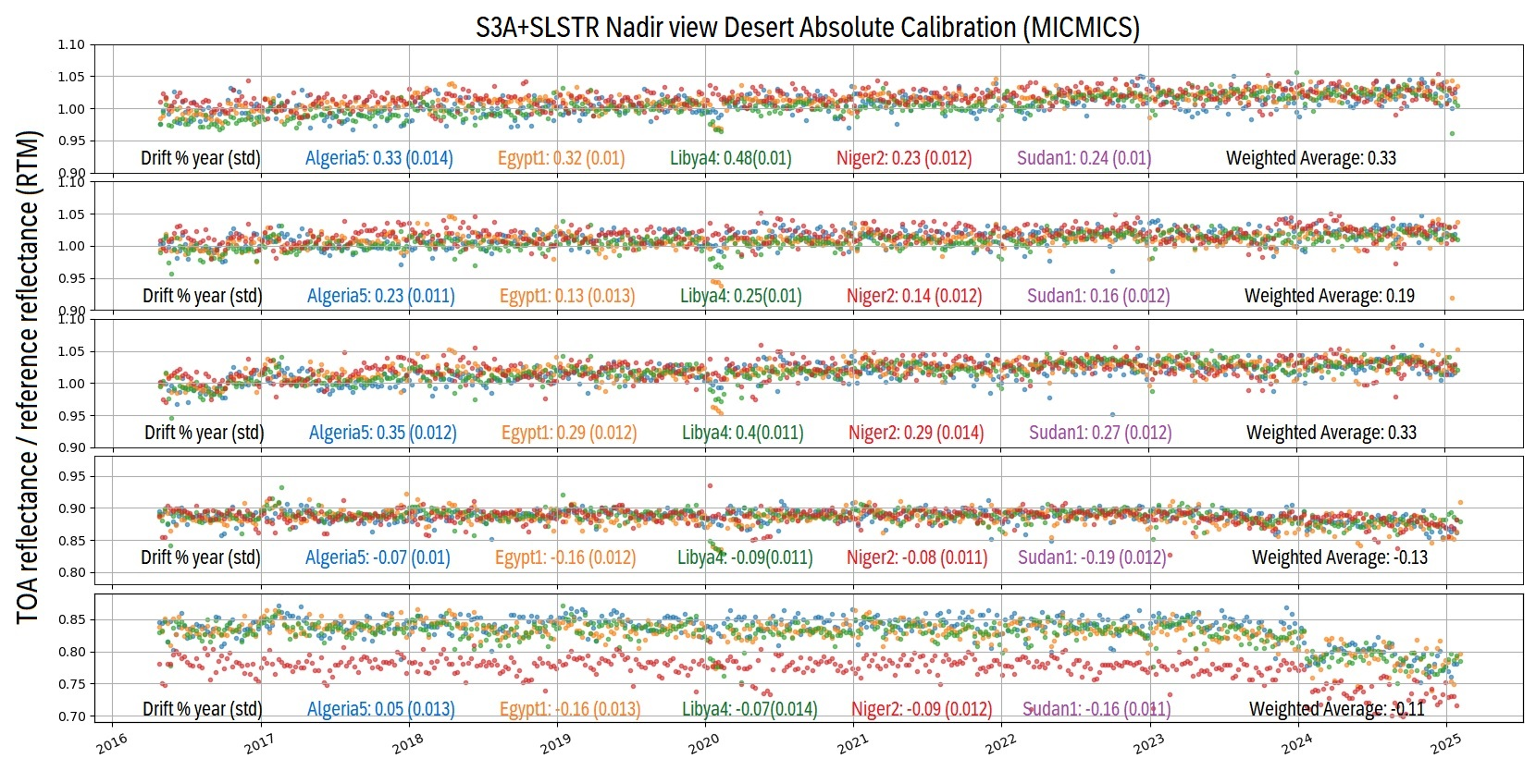
Blending the results
Which targets to use? How to weight the targets?

Slide 17
Metrics to get a comprehensive understanding
What metrics to use? What do we want to know?
Metric for overall error and magnitude
Mean Absolute Error (MAE), robust to outliers but doesn’t reveal the direction of errors.
Root Mean Squared Error (RMSE), Penalises larger errors more heavily, but sensitive to outliers.
Mean Bias Error (MBE), tells us about overestimates(positive MBE) and underestimates(negative MBE), but can be misleading if positive and negative errors cancel each other out.
Correlation and Relationship
Pearson Correlation Coefficient (r), captures the direction and strength of linear relationship, but sensitive to outliers.
Coefficient of Determination (R-squared), indicates how well the model fits the data, but it can be misleading if the relationship is not linear.
Spearman's Rank Correlation Coefficient (ρ), robust to outliers, captures non-linear relationships, but less sensitive to linear trend
Distribution and Variability
Standard Deviation of Errors, good to capture spread of errors, but Doesn't reveal the direction of errors
Percentiles of Errors, Provides a detailed view of the error distribution, but not easy to interpret
Relative Error Metrics
Mean Absolute Percentage Error (MAPE), easy to interpret as a percentage
Other metrics?

Slide 18
Uncertainties
Nothing is certain! ☺
Uncertainty premeats all aspects of vicarious calibration and intercalibration from inputs to models and presenting results
Accurately quantifying uncertainty is both challenging and essential
Yet, we often rely ourselves with simple statistical metrics (e.g. std, var), useful but insufficient!
Comparing results and integrating data/results without robust uncertainty estimation can lead to misleading conclusions

Slide 19
Conclusions
Desert targets are excellent calibration sources due to their stability and availability across multiple instruments.
Frequently used for calibration, providing reliable data across most of the spectrum, except in absorption-sensitive regions.
Several considerations and uncertainties must be addressed for better accuracy.
Focusing on the issues discussed in this presentation, along with other open challenges, will help further improve results over desert regions.

Slide 20
Thank you!
Questions are welcome.

