Slide 1
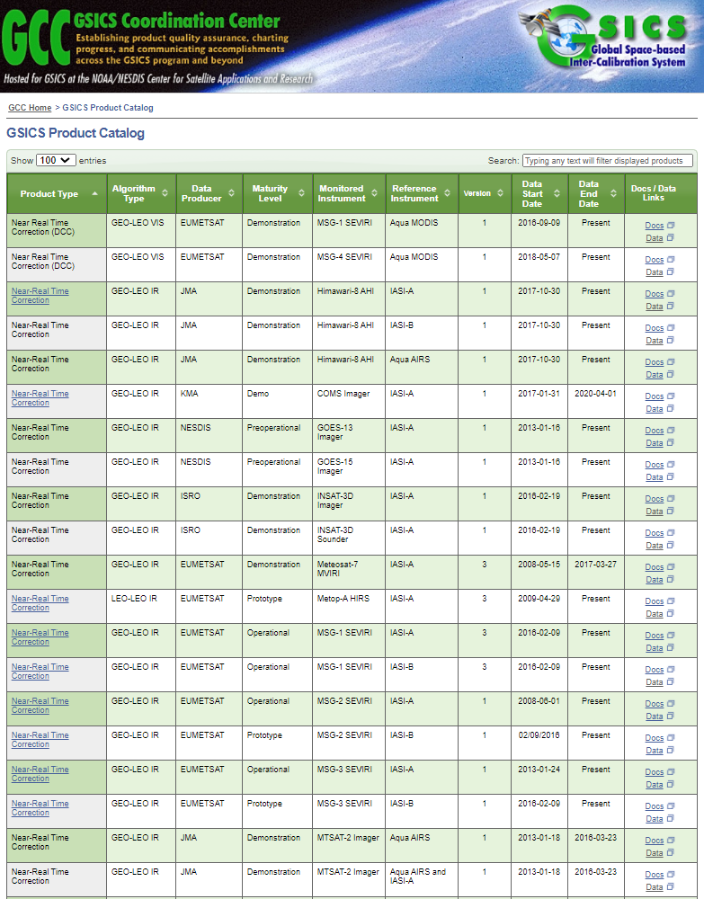
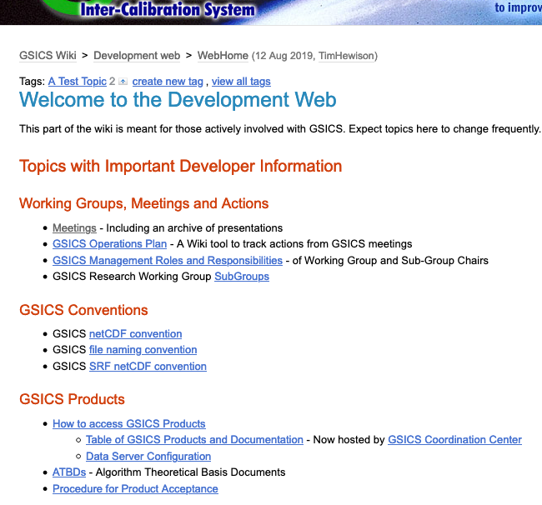
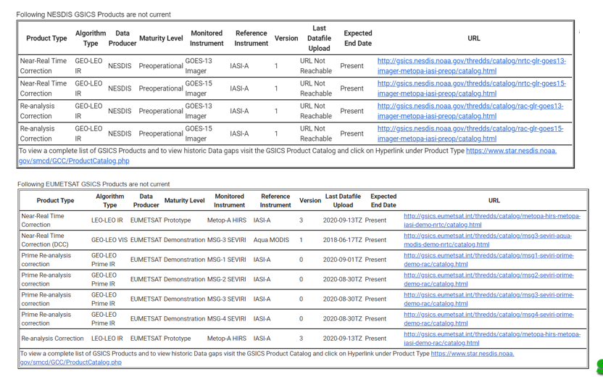
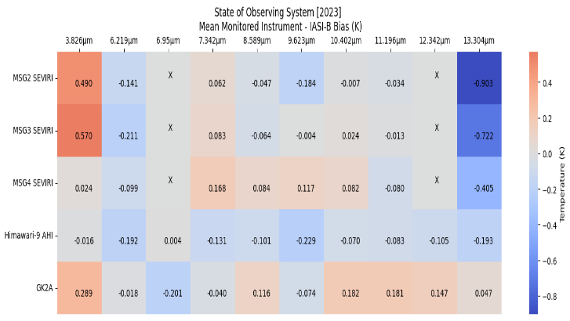
GSICS Product Catalog
GSICS Wiki
GSICS Notebooks
THREDDS Server
Track GSICS products
State of Observing System Heatmap

Slide 2
Summary GSICS tools
Bash script to download GSICS Data http://gsics.atmos.umd.edu/bin/view/Development/DownloadGSICSProducts
Series of notebooks to read, view and process GSICS Data and Deliverables from the browser in a collaborative ecosystem
DCC Product notebook
This notebook reads DCC products and plots and lists them
GIRO SRF notebook
GSICS Product RAC notebook and NRT notebook
3. Plotting Tool http://gsics.tools.eumetsat.int/plotter
4. GSICS Product Catalog: https://www.star.nesdis.noaa.gov/smcd/GCC/ProductCatalog.php
5. GSICS Product Status registration: Register here

